Slide 1
Air Quality Governance in the ENPI East Countries
Training on emission inventories
The EMEP/EEA Guidebook
Waste
21-22 January, 2014, Chișinău, Republic of Moldova

Slide 2
Outline
Introduction to the Waste chapters
Emission shares
Methodological tiers
Data requirements
Guidance for new sources of emissions
Update of existing methodologies and default emission factors

Slide 3
Introduction to the Waste chapters
The waste sector consists of the following sources:
  5.A Solid waste disposal on land
  5.B.1 Composting
  5.B.2 Anaerobic digestion at biogas facilities (no current guidance)
  5.C.1.a Municipal waste incineration
  5.C.1.b Industrial waste incineration including hazardous waste and sewage sludge
  5.C.1.b.iii Clinical waste Incineration
  5.C.1.b.v Cremation
  5.C.2 Open burning of waste
  5.D Wastewater handling
  5.E Other waste

Slide 4
Emission shares – waste sector (1)
The waste sector generally contributes little to the national emissions
Waste incineration with energy recovery are reported under energy → lower emissions in the waste sector
Waste
< 1 % | SO_{x}, NO_{x}, TSP, CO, As, Cr, Cu, Ni, Se, Zn
1- 5 % | NMVOC, NH₃, PM₁₀, PM_{2.5}, Cd, Hg, PAH
5-10 % | Pb, HCB
10-50 % | PCDD/F, PCB
> 50 %

Slide 5
Emission shares – waste sector (2)
Waste
< 1 % | SO_{x}, NO_{x}, TSP, CO, As, Cr, Cu, Ni, Se, Zn
1- 5 % | NMVOC, NH₃, PM₁₀, PM_{2.5}, Cd, Hg, PAH
5-10 % | Pb, HCB
10-50 % | PCDD/F, PCB
> 50 %
BY, 2011 | Waste
< 1 % | SO_{x}, NMVOC, CO, Hg, Pb, Zn, PAH
1- 5 % | NO_{x}
5-10 % | NH₃, PCB
10-50 % | PCDD/F, HCB
> 50 %
MD, 2011 | Waste
< 1 % | NO_{x}, TSP, CO, Pb
1- 5 % | SO_{x}, NMVOC, PAH, PCDD/F
5-10 %
10-50 % | NH₃
> 50 %
RU, 2010 | Waste
< 1 % | SO_{x}, NO_{x}, NMVOC, NH₃, TSP, PM₁₀, PM_{2.5}, CO
1- 5 %
5-10 %
10-50 %
> 50 %
UA, 2011 | Waste
< 1 % | SO_{x,} NO_{x}, TSP, CO, Pb, Cr, Cu, Ni, Zn, PAH
1- 5 % | NMVOC, NH₃, PM₁₀, PM_{2.5}, Cd, Hg
5-10 %
10-50 %
> 50 %

Slide 6
Methodological Tiers (1)
Tier 3 use of facility-specific data
  Where facility-level emission data of sufficient quality are available, it is good practice to use these data.
Tier 2 technology-specific approach
  To apply the Tier 2 approach, both the activity data and the emission factors need to be applied according to the used technologies
Tier 1 default approach
  The Tier 1 emission factors assume an average or typical technology and abatement implementation

Slide 7
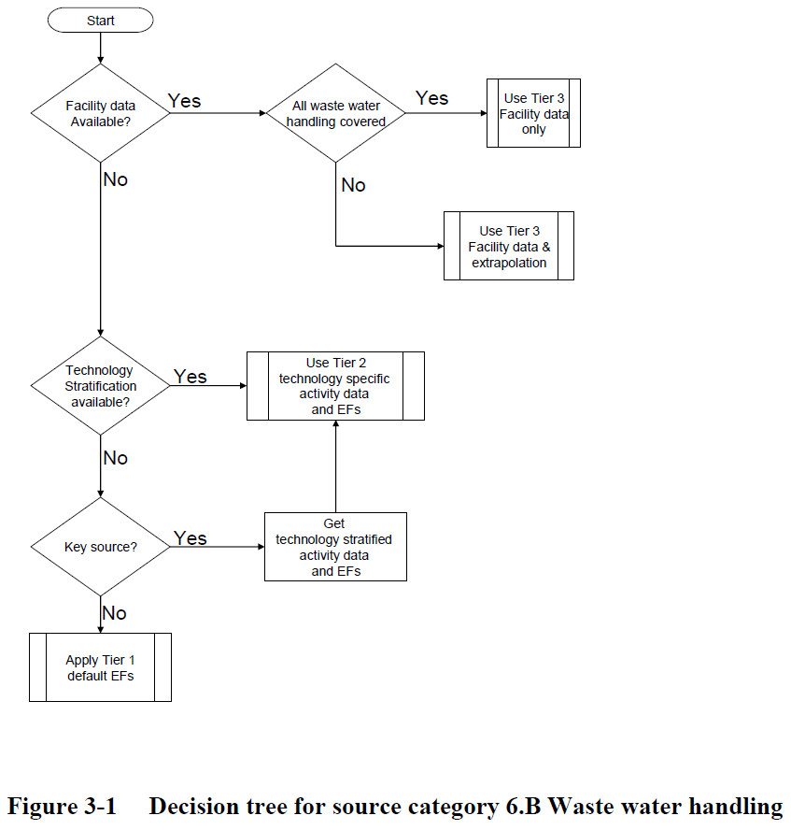
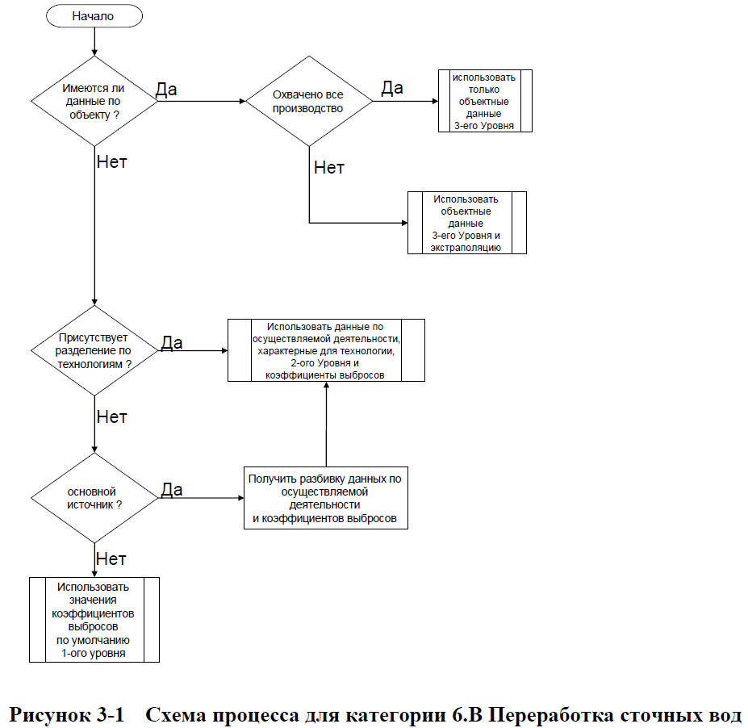
Methodological Tiers (2)
Example of decision tree from GB2013

Slide 8
Methodological tiers (3)
For the majority of waste sources there is a Tier 1 methodology
For waste incineration there is typically both a Tier 1 and Tier 2 methodology
Tier 2 in the waste sector requires knowledge of the technology, e.g. for incineration or wastewater handling

Slide 9
Data requirements (1)
Source | Tier 1 - Data requirement | Tier 2 - Additional data requirement
5.A Solid waste disposal on land | Amount of waste landfilled (mass) | Not available
5.B.1 Composting | Amount of waste composted (mass) | Abatement technologies/efficiencies
5.C.1.a Municipal waste incineration | Amount of municipal waste incinerated (mass) | Abatement technologies/efficiencies
5.C.1.b Industrial waste incineration including hazardous waste and sewage sludge | Amount of hazardous waste incinerated (mass) | Abatement technologies/efficiencies
5.C.1.b.iii Clinical waste Incineration | Amount of clinical waste incinerated (mass) | Abatement technologies/efficiencies

Slide 10
Data requirements (2)
Source | Tier 1 - Data requirement | Tier 2 - Additional data requirement
5.C.1.b.v Cremation | Number of persons cremated | Only tier 2 for incineration of animal carcasses
5.C.2 Open burning of waste | Amount of open burning of plant waste (mass) | Division between forest residues and orchard crops
5.D Wastewater handling | Amount of wastewater handled (volume) | Separate EFs for latrines and wastewater treatment plants
5.E Other waste | Not available | Sludge spreading Car fires Detached house fires Undetached house fires Apartment building fires Industrial building fires

Slide 11
Updates to the 2013 GB (1)
Landfills
  PM emission factors for landfilling
  Description of a Tier 3 methodology
Waste incineration
  New Tier 1 emission factors (EFs) for municipal waste
  Guidance on clinical waste simplified
  Correction of errors in PM EFs for industrial waste
  EFs for sludge incineration updated for most pollutants and EFs added for some pollutants
  Black carbon EFs added to all chapters

Slide 12
Updates to the 2013 GB (2)
Cremation
  EFs have been added for pollutants not previously covered
Small scale waste burning
  Tier 2 methodology streamlined and new Tier 1 EFs developed
Other waste
  A methodology and default EFs have been included for composting
  EFs for several pollutants for car and house fires have been updated to correct errors in the 2009 GB

Slide 13
Thank you for your attention

