Slide 1
Emission Inventory in Georgia
11-12 December, 2013 Tbilisi, Georgia
Ambient Air Protection Service MoENRP of Georgia

Slide 2
Reporting to CLRTAP
Each year
Last report was submitted in 19th of March 2013
NFR
No IIR submitted yet

Slide 3
Sectors
NFR category code | NFR category
1 A 1 a | Public electricity and heat production
1 A 1 c | Manufacture of solid fuels and other energy industries
1 A 3 b i | Road transport: Passenger cars
1 A 3 b ii | Road transport: Light duty vehicles
1 A 3 b iii | Road transport: Heavy duty vehicles
2 A 1 | Cement production
2 A 2 | Lime production
2 A 6 | Road paving with asphalt
2 B 5 a | Other chemical industry
2 C 2 | Ferroalloys production
2 D 1 | Pulp and paper
2 D 2 | Food and drink
2 D 3 | Wood processing
4 B 1 a | Cattle dairy
4 B 1 b | Cattle non-dairy
4 B 3 | Sheep
4 B 4 | Goats
4 B 8 | Swine
4 B 9 d | Other poultry

Slide 4
Pollutants
NOx
NMVOC
SOx
NH₃
TSP
CO
Benzo(a) pyrene

Slide 5
Reporting forms
Name of company
ID
Legal address, phone number
Actual address, Phone Number
GPS Coordinates
E-mail
Type of economic activity
Type and quantity of products
Type and quantity of used raw materials
Type and quantity of used fuel
Calorific value of used fuel
Work hours per year

Slide 7
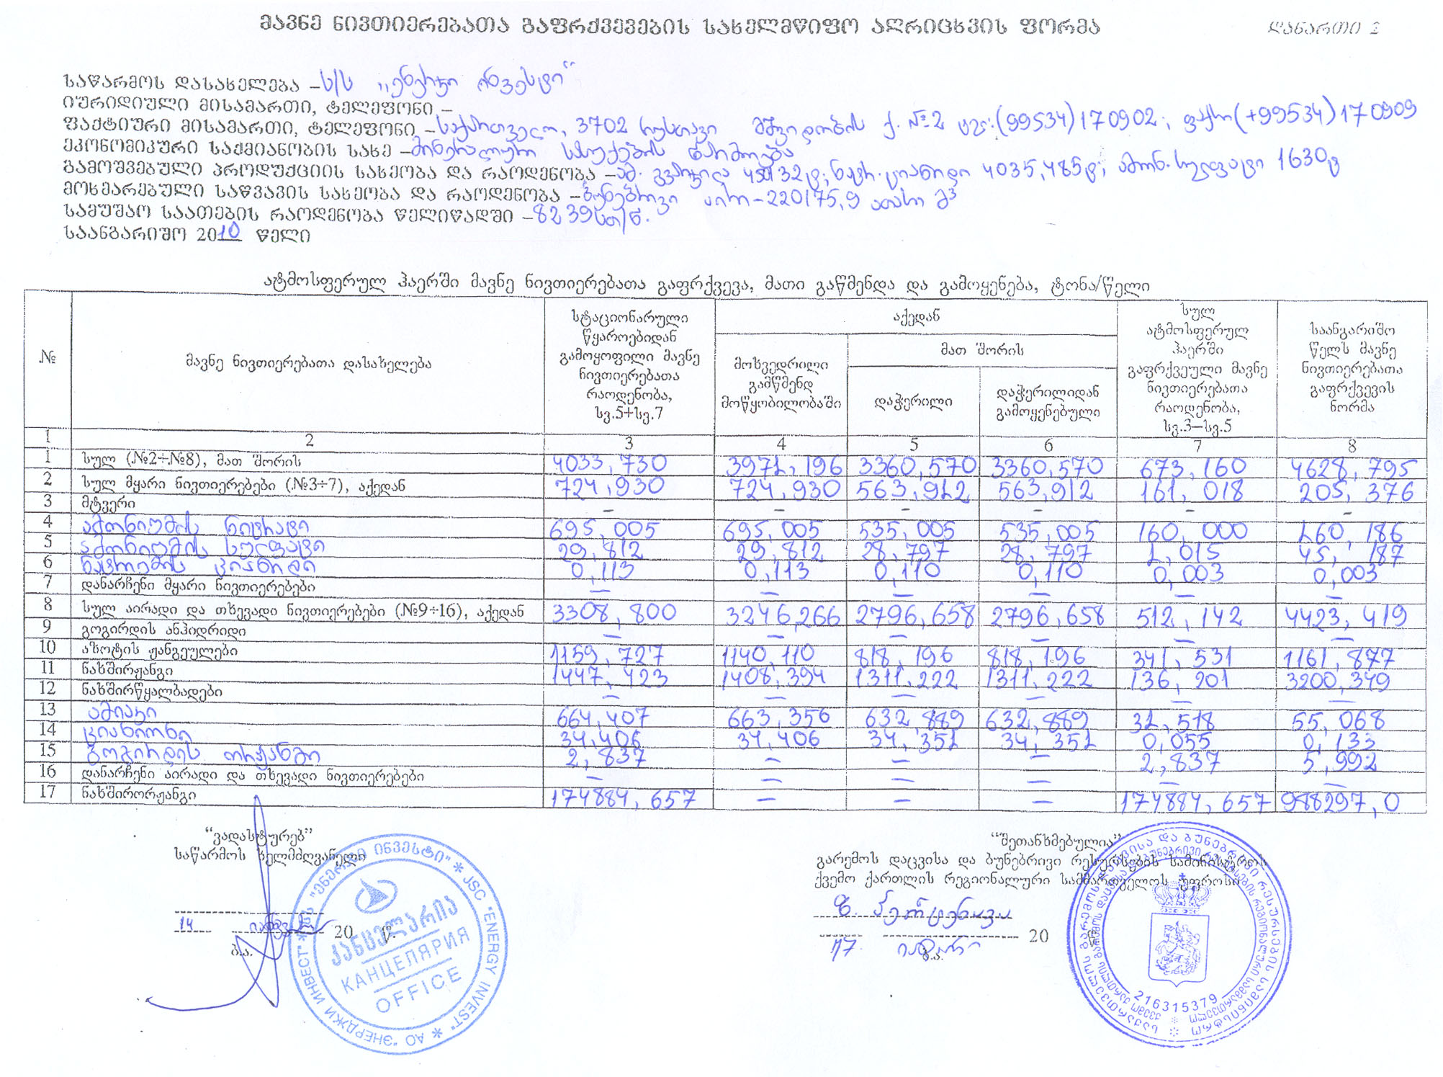

Slide 8
Approaches and Methodologies
EMEP/EEA Guidebook
National Methodology
Emission Data
Statistical Data

Slide 9
Calculation Method for Transport Sector
Statistical Data (Petrol and Diesel)
EF
Emission Data

Slide 10
Main Challenges
Lack of Resources
Lack of Statistical Data
Outdated National Methodology
No Electronic System for Submitting of Forms

Slide 11
Thank You for Your Attention
Noe Megrelishvili
Ambient Air Protection Service
MoENRP of Georgia
air@moe.gov.ge

