Slide 1
Air Quality Governance in the ENPI East Countries
Training on emission inventories
Spatial distribution of emissions
11-12 December, 2013, Tbilisi, Georgia

Slide 2
Outline
Reporting requirements
Best practise
Examples of simple approach to develop distribution keys

Slide 3
Reporting requirements
Guidelines for reporting emission data under the convention on long-range transboundary air pollution (ECE/EB.AIR/97)
Emissions should be spatially allocated in the EMEP grid using national datasets appropriate to each source category
Gridded emissions should be reported in the aggregated sectors (GNFR) for each EMEP grid cell that overlie the national territory.
Reported substances should include sulphur oxides, nitrogen oxides, ammonia, NMVOCs, carbon monoxide (CO), PM_{2.5}, PM₁₀, lead, cadmium, mercury, polycyclic aromatic hydrocarbons (PAHs), hexachlorobenzene (HCB) and dioxins and furans (PCDD/F).
Deadline for submission of gridded emissions is 1st March.
Gridded emissions should be reported for every fifth year from 2005.
  Parties are encouraged to update their gridded data more frequently where changes in spatial patterns have occurred, so that the models can represent the most up-to-date information.

Slide 4
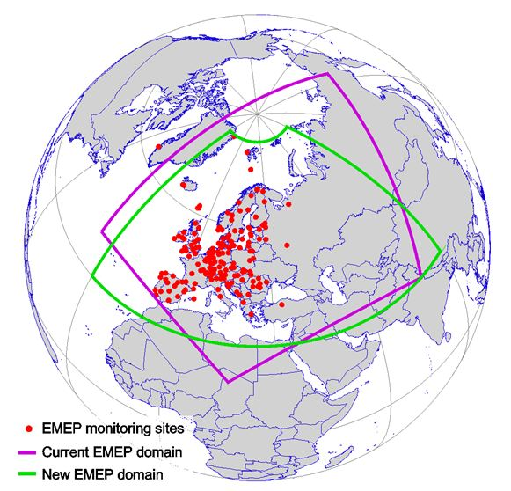
Reporting guidance (1)
The new EMEP grid:
  0.1° × 0.1° longitude-latitude
  WGS84 geographic coordinate system

Slide 5
Reporting guidance (2)
GNFR categories:
  A_PublicPower L_OtherWasteDisp
  B_IndustrialComb M_WasteWater
  C_SmallComb N_WasteIncin
  D_IndProcess O_AgriLivestock
  E_Fugitive P_AgriOther
  F_Solvents Q_AgriWastes
  G_RoadRail R_Other
  H_Shipping S_Natural
  I_OffRoadMob T_IntAviCruise
  J_AviLTO z_memo
  K_CivilAviCruise

Slide 6
Reporting guidance (3)
Point sources
  emission source at a known location (geographical coordinates (X,Y), e.g. derived from address, for the main point of emission).
    Examples: power stations, industrial plants
Area sources
  emission source are too numerous or small to be individually identified as point sources or from which emissions arise over a large area. Area sources is spatially associated with an area (a polygon).
    Examples: residential heating, non-road mobile sources.
Line sources
  emission source that exhibits a line type of geography
    Examples: road, railway, pipeline or shipping lane
Grids
  point, line and polygon features can be converted to grids and then several different layers of information (emission sources) can be aggregated

Slide 7
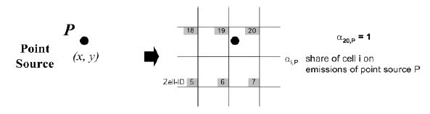
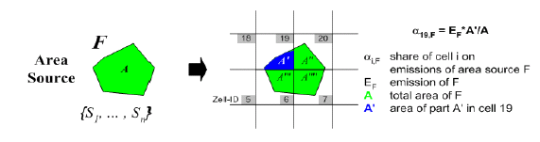
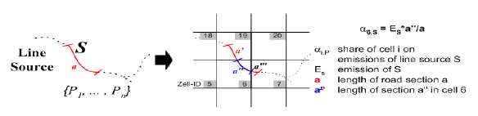
Combining different spatial features

Slide 8
Reporting guidance (4)
Use key category analysis to identify the most important sources and give the most resources to these.
Select proxy data that represent the spatial emission pattern and intensity best. Spatial data that cover the entire national territory are preferred.
Use of GIS tools and skills can improve the usefulness of available data.
Make use of existing spatial datasets.
It is not possible to update all the spatial datasets every year (both due to resources and data availability).
Consider costs and benefits before deriving new spatial data sets from new surveying or data processing.

Slide 9
Reporting guidance (5)
For consistency purpose, use the same spatial proxy data for all years if possible and if more accurate data has not become available.
Gridded emissions are reported on an aggregated level, which in many cases should ensure anonymity.
Problems with use of confidential data might be solved by getting aggregated data from the data supplier or by (signing of) confidentiality agreements.
It is advisable to consider the resolution (spatial detail) required in order to meet any wider national or international uses, e.g. air quality modelling on national, regional or local level.

Slide 10
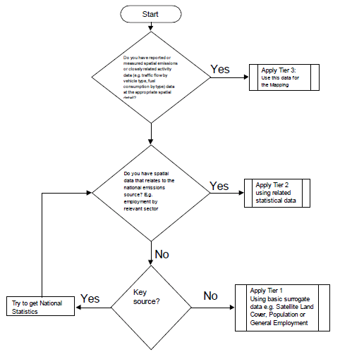
General decision tree for emissions mapping
Tier 3
  include estimates that are based on closely related spatial activity statistics
    e.g. road traffic flows by vehicle type, spatial fuel consumption data by sector
Tier 2
  use of surrogate statistics that relate to the sector
    detailed sector specific employment, population or household size and number
Tier 1
  use of loosely related surrogate statistics
    E.g. urban-rural land cover data and population density

Slide 11
Spatial data sets, national
Population and employment
Gas distribution networks
Agricultural data
Road network information
Rail
Airport activity data
Aviation
National shipping
Point source information
Local inventory data

Slide 12
Spatial data sets, international
CORINE
  land cover
  population
Eurostat
  Animal census
FAO
INSPIRE
Open Street Maps
ESRI data
Lloyds Register (shipping)
ICAO and EUROCONTROL
MapCruzin
COPERNICUS
ESA GlobCover
SEDAC population

Slide 13
Approach used by Denmark (1)
Gridding of emissions from area sources in stationary combustion are based on proxy distribution keys
* Regional energy consumption inventory for oil boilers, natural gas boilers and solid fuel installations for coal, wood, agricultural waste, gas oil, and natural gas
Source | Snap | Fuel | Proxy distribution key
Energy industries | 0101, 0102 | All | (Large) point sources
Small combustion | 0201, 0202, 0203 | Brown coal briquettes | Like coal *
 |  | Biogas | Like agricultural waste *
 |  | LPG | Like wood *
 |  | Residual oil | Industrial areas

Slide 14
Approach used by Denmark (2)
Road transport
  Annual average daily traffic per vehicle type for the entire Danish road network, based on traffic census and fleet data.
  Gridding made for 9 categories:
Non-road mobile sources
  National land use maps
    Industrial area
    Agricultural area
    Forrest area
    One-storage housing
Road type | Vehicle type
Roads in urban areas, U | Passenger cars and two-wheelers, P
Roads in rural areas, R | Vans, V
Highway, H | Heavy duty (trucks and busses), T

Slide 15
Approach used by Denmark (3)
Industry and Solvent and other product use
  Gridding based on population density and national land use maps including
    Industrial areas
    Areas with single storage buildings (residential area with one/two family houses)
Agriculture
  Spatial data from Statistics Denmark and a number of agricultural registers, e.g. the Central Husbandry Register (animals on farm level), the General Agriculture Register (crops on field and farm level) and the Land Parcel Identification System (agricultural soils on field level)
  Gridding is made separately for each source

Slide 16
Approach used by JRC, EDGAR (1)
Split the national emission to smaller administrative units, e.g. regions, provinces or communities
Emissions are distributed spatially in each area based on spatial data different from the data used to split the national emissions on administrative units
  combination of different proxy data, e.g. population and road network for road transport (PC, LC, MC) to increase the gradient between city and intercity transport

Slide 17
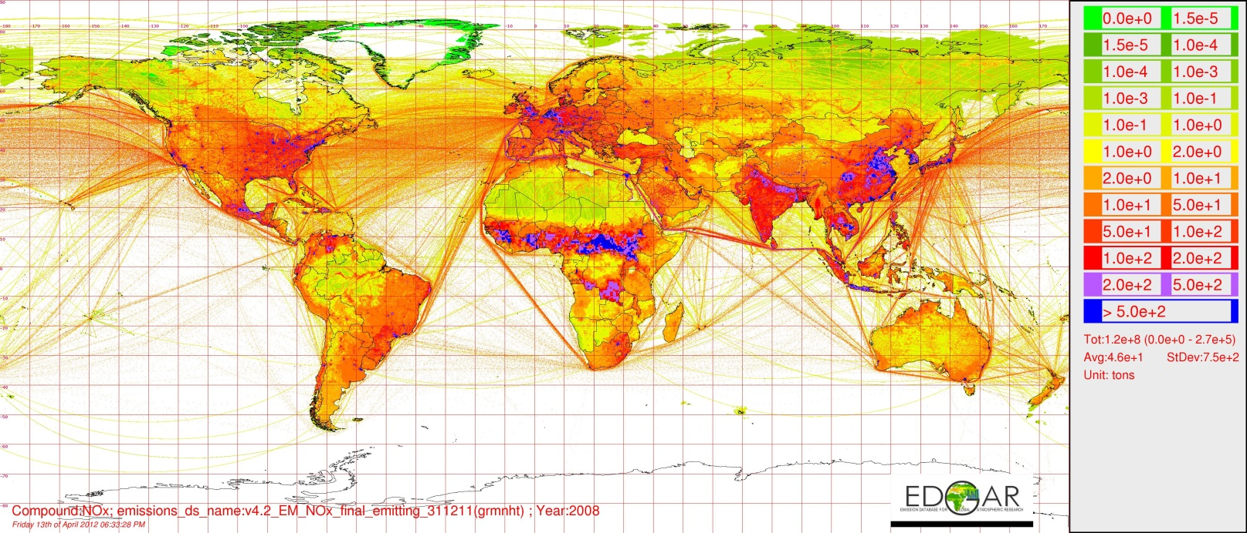

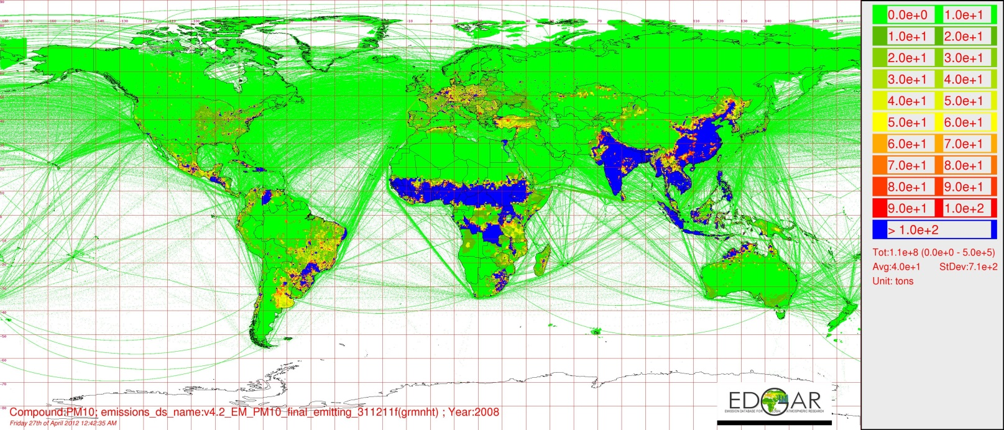

Approach used by JRC, EDGAR (2)
Indsæt kort, hvis muligt

Slide 18
Approach used by United Kingdom
Road transport
  Traffic flow for roads are based on ordnance survey, road network, and traffic census count points.
  Emissions are calculated by vehicle type and then aggregated to the appropriate grid resolution.
Domestic emissions
  High resolution gas and electricity statistics
  Survey and census
  Estimated energy consumption

Slide 19
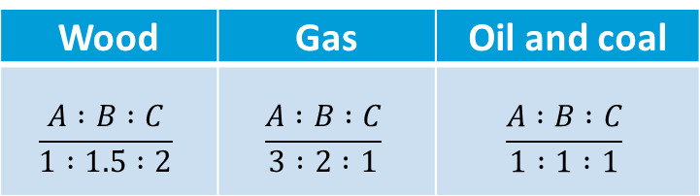
Approach used by the Netherlands
Degree of urbanisation
  A: densely populated
  B: intermediate populated
  C: thinly populated
Energy consumption weighting

Slide 20
Examples of simple approach to develop distribution keys (1)
Spatial data
  Geographical coordinates for (large) point sources, e.g. power plants, industrial plants and farms
  Population density
  Road network
    Annual average daily traffic per road segment if available for different vehicle types
    Travel speed if available
  Land use maps, e.g. agricultural areas, industrial areas and housing areas
  EMEP grid

Slide 21
Examples of simple approach to develop distribution keys (2)
Prioritise major sources
Figure out an appropriate methodology
  which spatial proxy data are needed?
  and
  which spatial proxy data are available?
Improve gridding methodologies when new spatial data become available
Source | 1st level | 2nd level | 3rd level | 4th level
Stationary combustion | Population density | Heating districts | Heating demand per building | …
Transport | Road network | Road types | Average daily traffic per vehicle category | …
Agriculture | Agricultural areas | Fields and farms | Animals and crops | …

Slide 22
The SPREAD Model
- Spatial High Resolution Emission to Air Distribution Model
National
emissions
LPS
Stationary
combustion,
PS
Stationary
combustion,
AS
Road traffic
Other
mobile
sources
Fugitive
emissions
Industrial
processes
Solvents
and other
product use
Agriculture
Waste
SPREAD includes:
  ● 10 sub-models
  ● > 15 databases
  ● > 30 distribution keys
  ● > 50 distribution
  ● a module for extraction of results
    ● all or selected pollutants
    ● all or selected sources
    ● customised aggregation level, e.g. sectoral total or source level

Slide 23
Examples of SPREAD sub-models (1)
Mobile sources
Mobile
sources
Road
Railway
Aviation,
LTO
Aviation,
cruise
Ferries
Fishing
Other
navigation
Mobile in
agriculture
Mobile in
forestry
Mobile in
industry
Mobile in
household
Military

Slide 24
Examples of SPREAD sub-models (2)
Agriculture
Agriculture
Enteric
fermentation
Manure
management
Agricultural
soils
Crop
residue
N-fixing
crops
Manure
application
Fertilizer
application
Leaching
and
run-off
Atmospheric
deposition
Sludge
PRP
Histosols
Field
burning

Slide 25
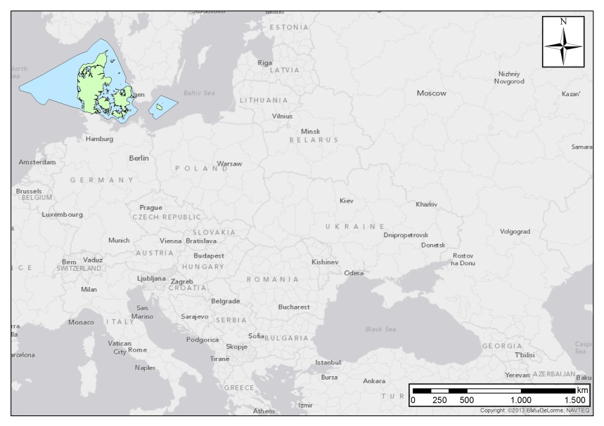
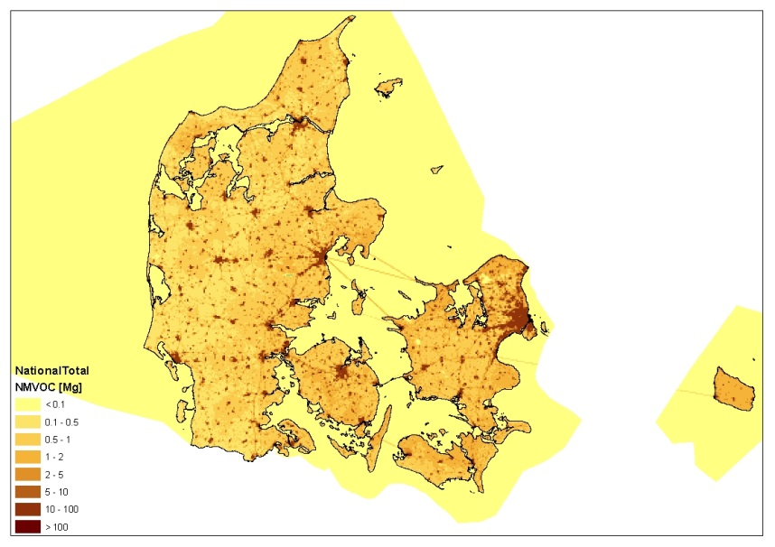
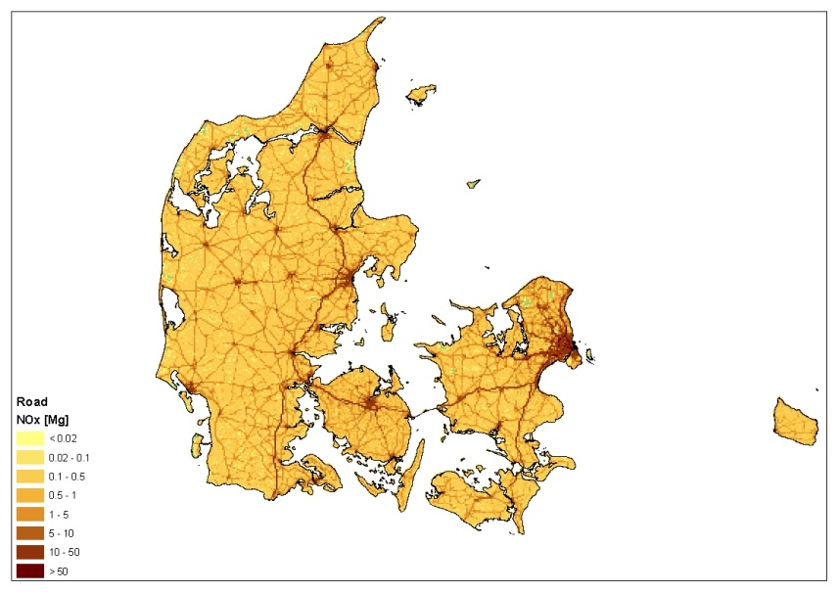
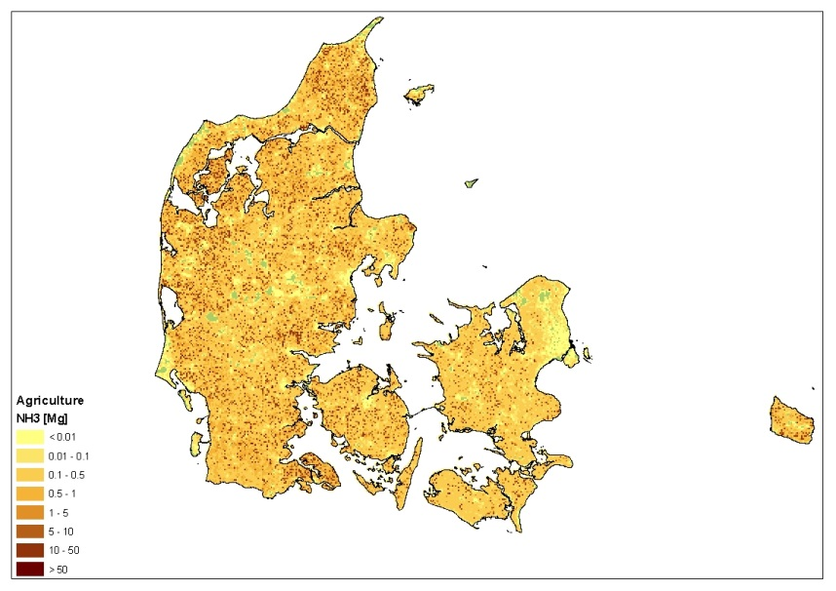
Danish gridded emissions from the SPREAD model

Slide 26
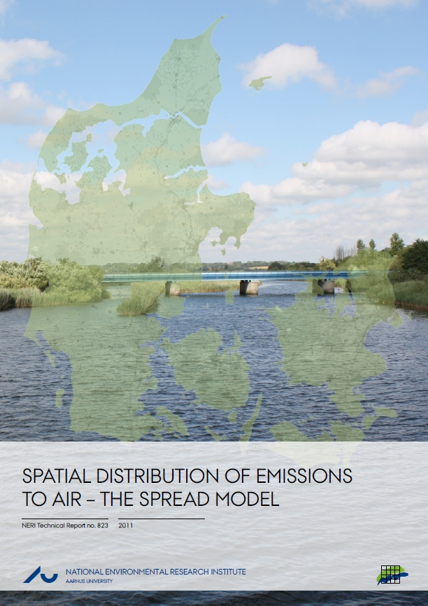
Plejdrup, M.S. & Gyldenkærne, S., 2011: Spatial distribution of emissions to air
– the SPREAD model.
National Environmental Research Institute, Aarhus University, Denmark. http://www.dmu.dk/Pub/FR823.pdf

Slide 27
Thank you for your attention

