Slide 1
Air Quality Governance in the ENPI East Countries
Training on emission inventories
The Danish example
11-12 December, 2013, Tbilisi, Georgia

Slide 2
Outline
The Danish inventory system
  Reporting obligations
  Institutional arrangements
  Software
  Projections
  SPREAD
  QA/QC
  Uncertainties
  International cooperation
Lessons learned

Slide 3
Reporting obligations
DCE is responsible for the reporting of the Danish inventories to international conventions:
  The Convention on Long-Range Transboundary Air Pollution under the UNECE
  The UN Framework Convention on Climate Change
The Convention was the first international legally binding instrument to deal with problems of air pollution on a broad regional basis. Besides laying down general principles of international cooperation for air pollution abatement, the Convention sets up an institutional framework bringing together research and policy

Slide 4
Reporting obligations
It has been extended by eight protocols including obligations to inventory and/or reduce emissions
  Reporting of emission inventories for 21 pollutants, including particles (PM), heavy metals (HM) and persistent organic pollutants (POP)
Parties to CLRTAP should annually submit emissions and an informative inventory report (IIR)
Guidelines for reporting emission data under the Convention on Long-Range Transboundary Air Pollution (ECE/EB.AIR/97)

Slide 5
Institutional arrangements
DCE (Danish Centre for Environment and Energy), Aarhus University is contracted by the Ministry of the Environment and the Ministry of Climate, Energy and Building to complete emission inventories for Denmark.
Department of Environmental Science, Aarhus University is responsible for calculation and reporting of the Danish national emission inventory to UNECE CLRTAP (Convention on Long Range Transboundary Air Pollution) and to EU and the UNFCCC (United Nations Framework Convention on Climate Change).

Slide 6
Institutional arrangements
The inventory work in Denmark is carried out in cooperation with Danish ministries, research institutes, organisations and companies
A large number of data suppliers is contributing within all sectors
Formal agreements about delivery of data are in place for the vital data suppliers → very important with a formalised cooperation

Slide 7

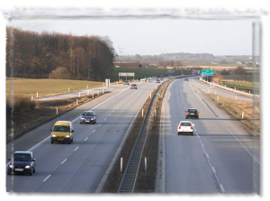
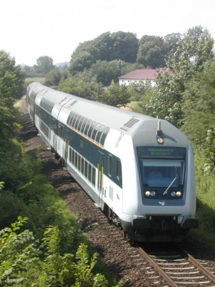
External data
Energy
Danish Energy Agency, The Ministry of Climate and Energy:
Annual energy statistics in a format suitable for the emission inventory work and fuel consumption data for large combustion plants.
The Road Directorate, The Ministry of Transport: Number of vehicles grouped in categories corresponding to the EU classification, mileage (urban, rural, highway), trip speed (urban, rural, highway).
Civil Aviation Agency of Denmark, The Ministry of Transport: City-pair flight data (aircraft type and origin and destination airports) for all flights leaving major Danish airports.
Danish Railways, The Ministry of Transport: Fuel related emission factors for diesel locomotives.

Slide 8


Industrial processes
Statistics Denmark, The Ministry of Economic and Business Affairs:
Statistical yearbook, Sales Statistics for manufacturing industries.
Danish companies: Audited Green accounts and direct information gathered from producers and agency enterprises
Solvents
Statistics Denmark, The Ministry of Economic and Business Affairs:
Statistical yearbook, Production, import and export of NMVOC

Slide 9


Agriculture
Statistics Denmark, The Ministry of Economic and Business Affairs:
Statistical yearbook, agricultural statistics.
Faculty of Agricultural Sciences, Aarhus University: Data on feeding stuff consumption and nitrogen turnover in animals.
The AgriFish Agency, Ministry of Food, Agriculture and Fisheries: Data on animal housing, synthetic fertiliser use and manure statistics at farm level
Waste
Danish Environmental Protection Agency, The Ministry of the Environment:
Database on waste

Slide 10
Institutional arrangements
Emission inventory team structured with sectoral experts who are responsible for maintaining and updating the inventories
12 experts participating in the work though not on full time
Average experience with emission inventory work: 10+ years

Slide 11
Software
External data are usually received as MS Excel files
Prior to import in the central databases there is a pre-processing usually carried out in MS Excel or MS Access
The pre-processing comprises aggregating data and preliminary calculations in order for the data to be compatible with the level of aggregation in the central databases

Slide 12
Software
The inventory is based on MS Access databases
  For energy, IPPU and waste, the CollectER II database structure is used modified to Danish conditions
  For agriculture, DCE has developed an integrated database system for calculating all emissions form agriculture
Furthermore, DCE (Danish Centre for Environment and Energy, Aarhus University) has developed MS Access and MS Excel applications to transfer data from the central emission databases to the reporting formats

Slide 13
Projections
DCE is also responsible for preparing the official projections of emissions
The sectoral models developed are based on the same methodologies and coverage as the emission inventory
The projections use official projections of energy consumption, waste, etc.
Technological development taken into account
The latest projection is just carried out covering the years 2012-2035

Slide 14
SPREAD
- spatial high resolution distribution model for emissions to air
Parties to the convention are obligated to report gridded emissions.
  Previously 50 km x 50 km EMEP grid
  Prospectively 0.1° x 0.1° EMEP grid
SPREAD is the Danish model for gridding of national emission
  All sources
  All pollutants

Slide 15
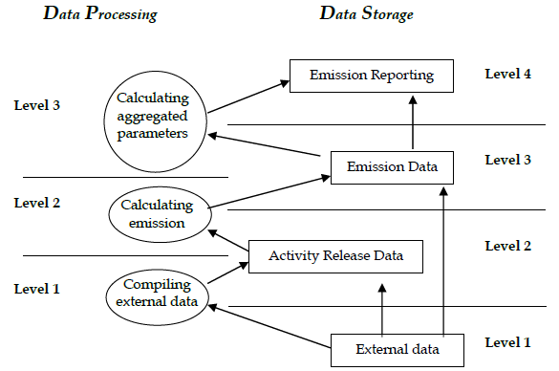
Quality Assurance/Quality Control
- data structure

Slide 16
QA/QC
- Critical Control Points (CCP)
Accuracy
  exactness of an emission or removal estimate
Comparability
  comparable among Parties
Completeness
  covers all sources as well as all pollutants
Consistency
  internally consistent in all its elements with inventories of other years
Transparency
  assumptions and methodologies used for an inventory should be clearly explained
Robustness
  arrangement of inventory work as regards e.g. inventory experts and data sources in order to minimise the consequences of any unexpected disturbance due to external and internal conditions
Correctness
  avoid uncontrollable occurrence of uncertainty directly due to errors in the calculations

Slide 17
QA/QC
- point of measurements (PM)
PMs identified for the all CCPs for each part of the data structure

Slide 18

QA/QC
Quality manual for Danish greenhouse gas inventory
Describes in detail the overall system of QA/QC
Available online: http://www.dmu.dk/Pub/SR47.pdf

Slide 19
Uncertainties
Tier 1
The uncertainty estimates for air pollutants are based on the simple Tier 1 approach in the EMEP/CorinAir Good Practice Guidance for LRTAP Emission Inventories (Pulles & Aardenne, 2004)
Estimates include uncertainty of the total emission as well as uncertainty of the trend
Uncertainty estimates are based on emission data for the base year and the latest reporting year, and on uncertainties for activity rates and emission factors for each of the main SNAP sectors

Slide 20

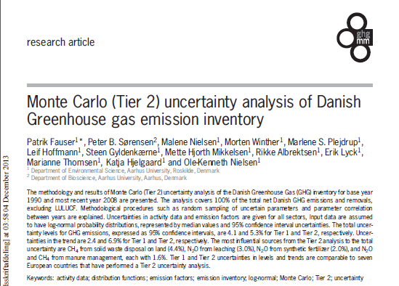
Uncertainties
Tier 2
Tier 2 uncertainty analysis prepared for Danish greenhouse gas emissions using Monte Carlo simulations
Research article on methodology: http://www.tandfonline.com/doi/pdf/10.1080/20430779.2011.621949

Slide 21
International cooperation
Task Force on Emission Inventories and Projections (TFEIP) http://tfeip-secretariat.org/
  Annual TFEIP/EIONET meeting (2 days)
    Reporting review and UNECE developments
    Discussion of selected topics, e.g. inventory compiling, emission reporting, and revision of guidelines and directives
  Annual workshop (1 day)
    Discussions with inventory users and modellers
    Spatial distribution
    Emissions of POPs
  Expert panels
    Combustion and Industry
    Transport
    Agriculture and Nature
    Projections

Slide 22
Lessons learned
- through 20 years of compiling emission inventories (1)
The work on air emissions started at DCE (then NERI) in 1994
The first complete emission inventory for 1972-1995 published in 1997
Start simple
  The first inventory was based on tier 1 methodologies and only covered major sectors
Improvements first – then documentation
  First report ≈ 50 pages → the latest report ≈ 700 pages

Slide 23
Lessons learned
- through 20 years of compiling emission inventories (2)
Develop an institutional framework
  Dedicated emission inventory team with high continuity
  Support from Ministries very important
  Identify important data suppliers and make them interested
  Involve industrial associations and large companies → it is also their interest to have the best possible inventory
  Emphasise the importance of a good emission inventory in a policy context – impossible to track the effects of policies and measures without good monitoring, reporting and verification

Slide 24
Lessons learned
- through 20 years of compiling emission inventories (3)
Confidential input data
  Important to have good dialogue with the data supplier
    explaining the intended use of the data
    identifying the increased accuracy that can be gained through its use in inventories
    It is of interest also for the data supplier to get the best emission estimates (regulations, taxes, environmental improvements)
    Emissions calculated from the data are aggregated before reporting and other publication
    Reported emissions cannot be linked to a single point source (make sure that it is the case if only one or few point sources in a NFR category)
    giving credit/acknowledgement in the inventory to the data providers
  Formal agreement of data handling and use
    agreeing, in writing, to the level at which it will be made public
    Data only used by the inventory team, and will no be passed on to others inside or outside the organisation
  Data provided in an aggregated but still useful form

Slide 25
Lessons learned
- through 20 years of compiling emission inventories (4)
Continuous improvements
  New sources
  Additional pollutants
  More details
    Higher level of disaggregation
    Higher tier methodology → more precise emission estimates
Very useful to participate in international meetings and reviews
Patience - it takes time to develop an emission inventory system!
Any number is better than no number

Slide 26
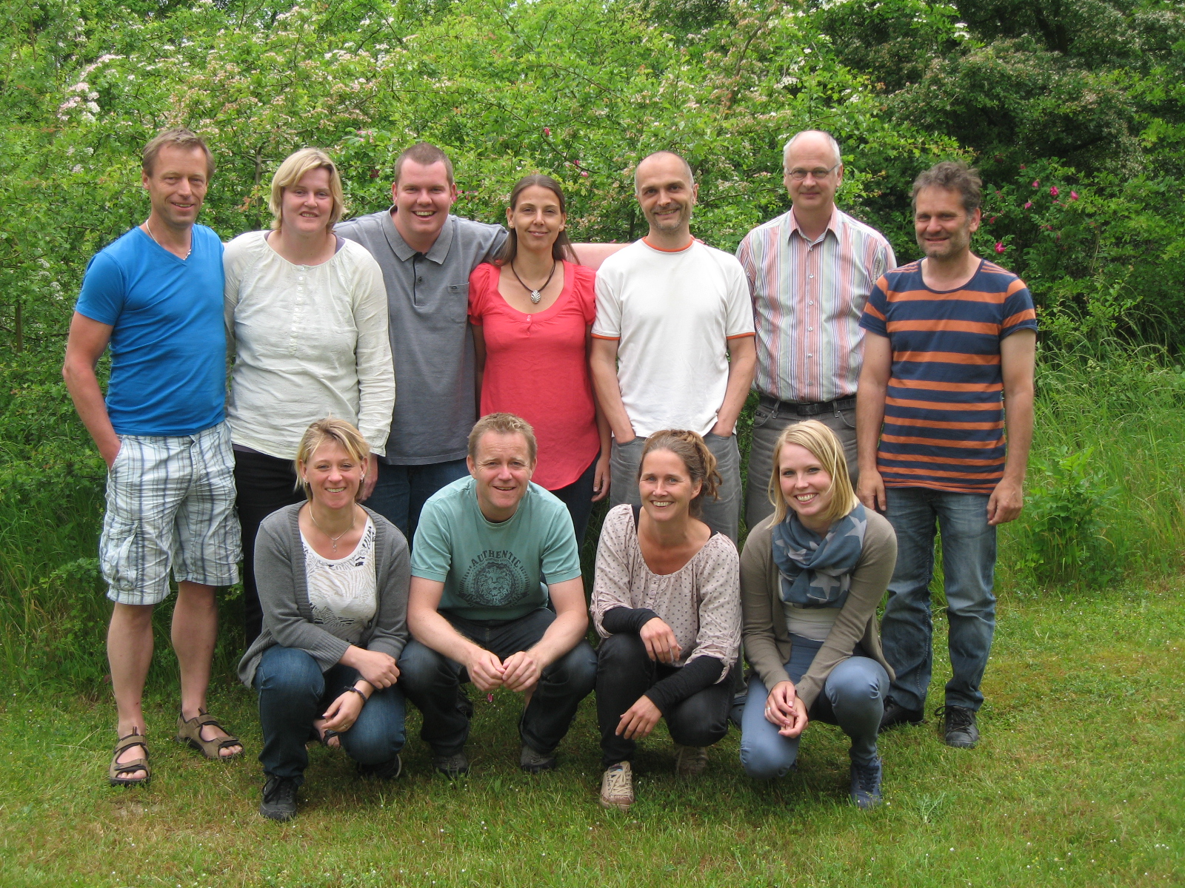
The Danish inventory team

Slide 27
Thank you for your attention

