Slide 1
Air Quality Governance in the ENPI East Countries
Training on emission inventories
The EMEP/EEA Guidebook
General chapters
21-22 January, 2014, Chișinău, Republic of Moldova

Slide 2
Outline
General introduction to the EMEP/EEA Guidebook
Data Collection – general guidance
Time Series Consistency
Inventory Management
QA/QC
Improvements

Slide 3
General introduction to the EMEP/EEA Guidebook (1)
GB 2013 - the latest version of the guidebook
  will be formally endorsed by the EMEP Executive Body in December 2013
  http://www.eea.europa.eu/publications/emep-eea-guidebook-2013
GB 2013 will be translated to Russian hopefully before May 2014
GB 2009 – the previous version - is available in Russian
  http://www.eea.europa.eu/ru/publications/emep-eea

Slide 4
General introduction to the EMEP/EEA Guidebook (2)
General guidance chapters
  Key category analysis and methodological choice
  Data Collection
  Time Series Consistency
  Uncertainties
  Inventory Management, Improvement and QA/QC
  Spatial mapping of emissions
  Projections

Slide 5
Data Collection – general guidance
Focus on the largest sources
Collect data at a level of detail appropriate to the method used (increasing level of detail from Tier 1 to Tier 3)
Introduce agreements with data suppliers to support consistent and continuing information flows
Aim to do data collection activities that lead to a continuous improvement of the data sets used in the inventory
  resource prioritisation, planning, implementation, documentation, etc.
Review data collection activities and methodological needs on a regular basis, to guide inventory improvement
Prefer data that are available for all years in the time-series and that cover all or the majority of the sources in a category

Slide 6
Data Collection – data sources
National Statistics Agencies
Sectoral experts, stakeholder organisations
Other country national experts / inventory reports from other parties
Emission Factor collections
  EMEP/EEA GB, http://www.eea.europa.eu//publications/emep-eea-guidebook-2013
  TNO’s CEPMEIP Database, http://www.air.sk/tno/cepmeip/
  USA EPA’s AP42, www.epa.gov/ttn/chief/ap42/
International organisations publishing statistics
  e.g. UN, Eurostat, the International Energy Agency, OECD, and IMF
Scientific and technical articles in environmental books, journals and reports
Web search for organisations and specialists

Slide 7
Time Series Consistency (1)
All emissions estimates in a time series should be estimated consistently
  the time series should be calculated using the same method and data sources in all years, as far as possible
Adding new categories (sources and/or pollutants) requires calculation for the entire time-series
Emission factors might change for the time-series due to e.g. technological improvements and abatement equipment

Slide 8
Time Series Consistency (2)
Data gaps:
  If data are updated less frequently than annually
  If data doesn’t cover all sources in a category
  If changes in data availability
Solutions to data gaps
  gap-filling
    interpolation
    extrapolation
    surrogate data
  expert judgement if no other way out !

Slide 9
Time Series Consistency (3)
Approach | Applicability | Comments
Interpolation | Data needed for recalculation using the new method are available for intermittent years during the time series. | Estimates can be linearly interpolated for the periods when the new method cannot be applied. The method is not applicable in the case of large annual fluctuations.
Trend extrapolation | Data for the new method are not collected annually and are not available at the beginning or the end of the time series. | Most reliable if the trend over time is constant. Should not be used if the trend is changing (in this case, the surrogate method may be more appropriate). Should not be done for long periods.
Overlap | Data necessary to apply both the previously used and the new method must be available for at least one year, preferably more. | Most reliable when the overlap between two or more sets of annual estimates can be assessed. If the trends observed using the previously used and new methods are inconsistent, this approach is not good practice.
Surrogate data | Emission factors, activity data or other estimation parameters used in the new method are strongly correlated with other well-known and more readily available indicative data. | Multiple indicative data sets (singly or in combination) should be tested in order to determine the most strongly correlated. Should not be done for long periods.

Slide 10
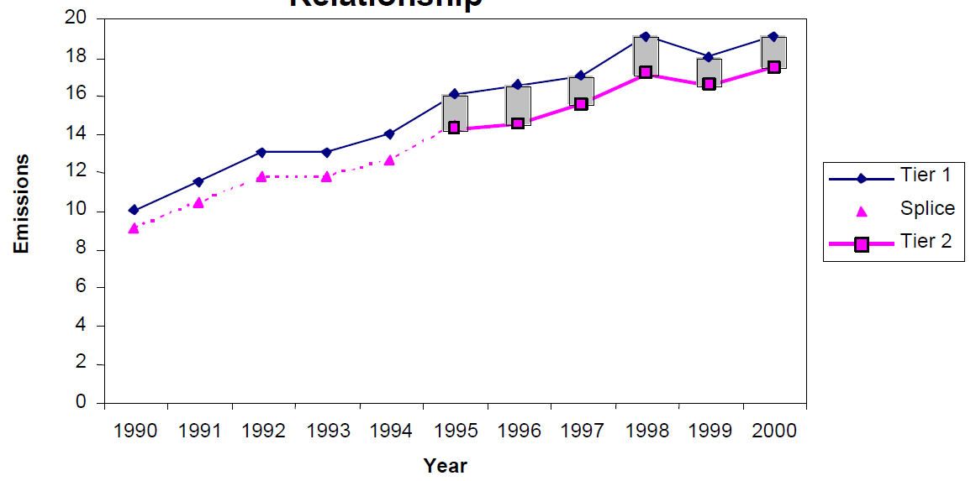
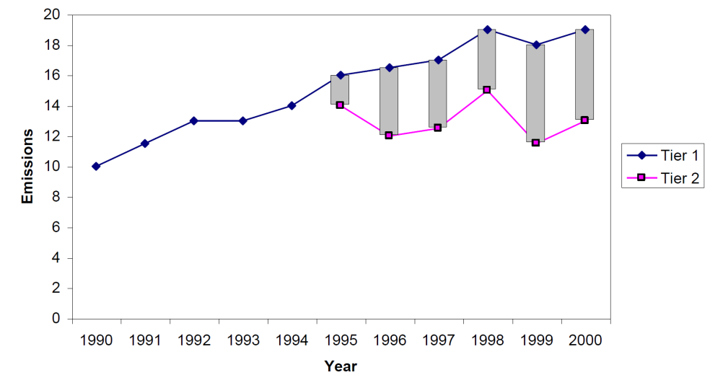
Time Series Consistency (4)
Approach | Applicability | Comments
Interpolation | Data needed for recalculation using the new method are available for intermittent years during the time series. | Estimates can be linearly interpolated for the periods when the new method cannot be applied. The method is not applicable in the case of large annual fluctuations.
Trend extrapolation | Data for the new method are not collected annually and are not available at the beginning or the end of the time series. | Most reliable if the trend over time is constant. Should not be used if the trend is changing (in this case, the surrogate method may be more appropriate). Should not be done for long periods.
Overlap | Data necessary to apply both the previously used and the new method must be available for at least one year, preferably more. | Most reliable when the overlap between two or more sets of annual estimates can be assessed. If the trends observed using the previously used and new methods are inconsistent, this approach is not good practice.
Surrogate data | Emission factors, activity data or other estimation parameters used in the new method are strongly correlated with other well-known and more readily available indicative data. | Multiple indicative data sets (singly or in combination) should be tested in order to determine the most strongly correlated. Should not be done for long periods.
Consistent overlap
Inconsistent overlap

Slide 11
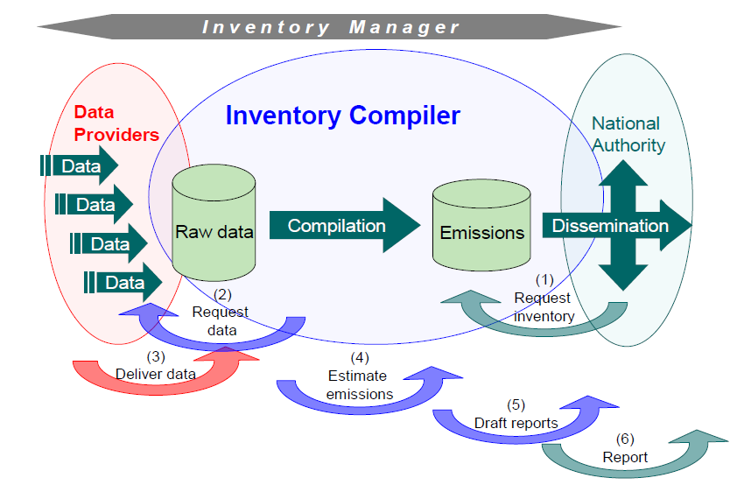
Inventory Management
Clear inventory process
  Dataflow; strong and continuous
  Timeliness; data agreements
Institutional arrangements
  Formal agreements
    deadlines
    data formats
    contact persons

Slide 12
QA/QC
Element | Data quality objectives (general)
Transparency | Sufficient documentation and referencing to be able to trace any inventory estimates back through the calculations to the source data, data providers and assumptions.
Consistency | Ensuring that methods are consistent with good practice as defined in the EMEP/EEA guidebook
Comparability | Using agreed good practice methodologies and formats for estimating and reporting emissions. Allocating emissions to source categories in accordance with the split given by the in Reporting Guidelines.
Completeness | Providing all NFR tables including notation keys where appropriate and complete sectoral background data. Providing information in the inventory documentation on the completeness of the emissions inventory.
Accuracy | Using of appropriate or better tiered methodology that is consistent with the guidebook and other guidelines.

Slide 13
Improvements
Key category analysis and methodological choice
  A good tool to prioritise the effort for different sources
Uncertainties, Spatial mapping of emissions, and Projections
  Tools to make the inventory more useful to policy makers, air quality modellers, health scientists etc.
Uncertainty estimates
  Combination of key category analysis and uncertainty to identify sources that need improvements

Slide 14
Thank you for your attention

