Slide 1
Air Quality Governance in the ENPI East Countries
Training on emission inventories
The UNECE reporting guidelines
21-22 January, 2014, Chișinău, Republic of Moldova

Slide 2
Outline
The Convention on Long-Range Transboundary Air Pollution
The UNECE reporting guidelines
  Objectives
  Scope
  Methods
    Emission estimation methods and principles
    Key categories and uncertainties
    Quality assurance/quality control
    Recalculations and time-series consistency
    Reporting of adjusted national inventories
  Reporting
    General reporting
    Annual reporting
    Two-yearly reporting

Slide 3
UNECE - CLRTAP
The Geneva Convention on Long-range Transboundary Air Pollution was agreed in 1979 and the Convention entered into force in 1983
The Convention was the first international legally binding instrument to deal with problems of air pollution on a broad regional basis
Besides laying down the general principles of international cooperation for air pollution abatement, the Convention sets up an institutional framework bringing together research and policy

Slide 4
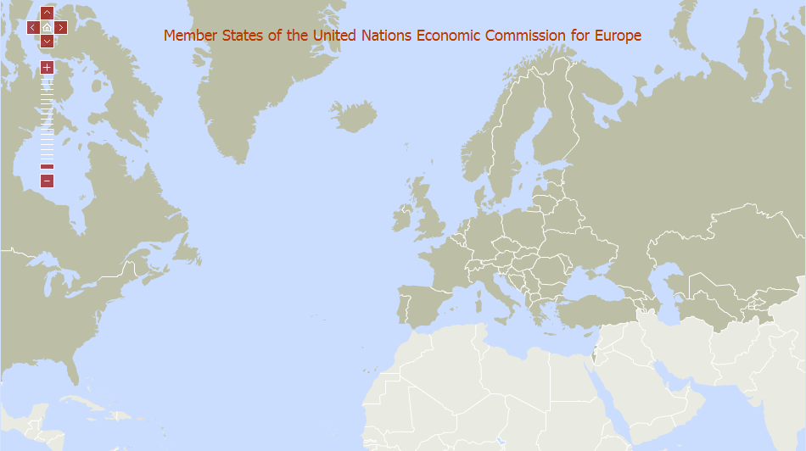
UNECE - CLRTAP

Slide 5
UNECE - CLRTAP
Parties to the Convention develop policies and strategies to combat the discharge of air pollutants through exchanges of information, consultation, research and monitoring
The Convention aims to reduce and prevent air pollution including long-range transboundary air pollution
A number of Protocols have been agreed covering specific issues, pollutants or group of pollutants

Slide 6
CLRTAP Protocols (1)
The Convention has been extended by 8 protocols:
  The 1984 Protocol on Long-term Financing of the Cooperative Programme for Monitoring and Evaluation of the Long-range Transmission of Air Pollutants in Europe (EMEP); 44 Parties. Entered into force 28 January 1988.
  The 1985 Protocol on the Reduction of Sulphur Emissions or their Transboundary Fluxes by at least 30 per cent; 25 Parties. Entered into force 2 September 1987
  The 1988 Protocol concerning the Control of Nitrogen Oxides or their Transboundary Fluxes; 34 Parties. Entered into force 14 February 1991
  The 1991 Protocol concerning the Control of Emissions of Volatile Organic Compounds or their Transboundary Fluxes; 24 Parties. Entered into force 29 September 1997

Slide 7
CLRTAP Protocols (2)
The Convention has been extended by 8 protocols:
  The 1994 Protocol on Further Reduction of Sulphur Emissions; 28 Parties. Entered into force 5 August 1998
  The 1998 Protocol on Heavy Metals; 33 Parties. Entered into force on 29 December 2003
  The 1998 Protocol on Persistent Organic Pollutants (POPs); 33 Parties. Entered into force on 23 October 2003
  The 1999 Protocol to Abate Acidification, Eutrophication and Ground-level Ozone; 25 Parties. Entered into force on 17 May 2005

Slide 8
The UNECE reporting guidelines
The current version was approved by the EMEP Executive Body (EB) in December 2008
A new version is on the agenda on this years EMEP EB meeting this week
This presentation will be based on the proposed new version indicating where changes have been made

Slide 9
Objectives
To assist Parties, through a common approach, in meeting their obligations
To support the evaluation of emission reduction strategies
To facilitate the technical review of air pollutant emission inventories
To allow for the effective assessment of compliance with emission obligations
To facilitate the harmonization of emission reporting

Slide 10
Scope
The Guidelines (GL) provide guidance for reporting primary emissions data related to SO₂, NO_{x}, NH₃, NMVOC, CO, particulate matter, Cd, Pb, Hg, PAH, PCDD/F, PCBs and HCB
The GL define the scope of reporting of emission related information by Parties
Varying reporting requirements depending on status of ratification
All Parties to the Convention shall exchange available information on emissions of agreed air pollutants
Notes:
A

Slide 11
Emission estimation methods and principles (1)
National emission inventories and projected emissions should be transparent, consistent, comparable, complete and accurate
Parties shall as a minimum use the methodologies in the latest version of the EMEP/EEA Guidebook
Parties can use, as an alternative to the EMEP/EEA Guidebook, national or international methodologies that they consider better able to reflect their national situation

Slide 12
Emission estimation methods and principles (2)
Parties should make every effort to develop and/or select data in accordance with the Guidebook
For sources that are determined to be key categories, Parties should make every effort to use a Tier 2 or higher methodology
For emissions from transport, all Parties shall calculate emissions consistent with national energy balances. Therefore emissions from road vehicle transport shall be calculated on the basis of the fuel sold in the Party concerned

Slide 13
Emission estimation methods and principles (3)
Emissions from aviation (national and international) during the landing and take-off cycle shall be included in the national totals – cruise emissions shall not be included in national totals
Emissions from fuels used for international maritime shipping shall not be included in the national totals,
Natural emissions from forest fires, volcanoes, etc., shall not be included in national totals

Slide 14
Key categories and uncertainties
Parties shall identify in their IIR national key categories in accordance with the EMEP/EEA Guidebook for the latest inventory year.
Parties shall quantify uncertainties in their emission estimates using the most appropriate methodologies available, taking into account guidance provided in the EMEP/EEA Guidebook

Slide 15
Quality assurance/quality control
Procedures for quality assurance and quality control (QA/QC) shall be implemented during the planning, preparation and management of the national inventories and shall be documented in the IIR
Examples of adequate QA/QC procedures are those set out in the EMEP/EEA Guidebook and those accepted by the IPCC for greenhouse gas inventories

Slide 16
Recalculations and time-series consistency (1)
The aim of recalculations is to ensure consistency of the time series
A complete time series should be calculated using the same methodologies to ensure that the inventory reflects real changes in emissions
Recalculations should be made if:
  there are changes in methodologies
  there are changes in the manner in which emission factors and activity data are obtained or used
  estimates are provided for sources which have existed but which were not accounted for in previous submissions

Slide 17
Recalculations and time-series consistency (2)
In cases where activity data or other data cannot be obtained for certain years, emissions should be estimated using alternative methodologies or appropriate techniques for estimating activity levels or emissions for these years, taking into account guidance provided in the EMEP/EEA Guidebook

Slide 18
Reporting of adjusted national inventories
Inventories shall be calculated without corrections or normalization relating, for example, to climate variations or trade patterns of electricity
Parties may apply to adjust their emission reduction commitments or inventory data in extraordinary circumstances
A Party applying an adjustment to its inventory for the purpose of comparing total national emissions with emission reduction commitments shall include supporting documentation in its IIR or in an alternative report

Slide 19
General reporting (1)
Emission and activity data should be reported up until the latest inventory year, which shall be calculated as X-2, e.g. for reporting in 2015, emission and activity data for the years 1990–2013 shall be reported
Emission inventory reporting shall cover all years from 1990 onwards
Particle emissions shall be reported from 2000 onward

Slide 20
General reporting (2)
Where Parties do not have sufficiently detailed data to allow estimation of individual source categories in their inventory, they may report aggregated emissions
The deadline for submitting annual emission inventory is 15 February
The deadline for submitting the IIR is 15 March
The deadline for submitting gridded data and LPS data is 1 May
Parties shall use the reporting templates defined

Slide 21
Annual reporting
Each Party shall annually report emission inventories of SO₂, NO_{x}, NH₃, NMVOC, CO, particulate matter, Cd, Pb, Hg, PAH, PCDD/F, PCBs and HCB
In addition, Parties are encouraged to voluntarily report emissions of black carbon, TSP, As, Cr, Cu, Ni, Se and Zn
The IIR shall be submitted annually. However, certain elements of the report need only be updated every five years

Slide 22
Two-yearly reporting
For Parties to the Gothenburg Protocol, projections of SO₂, NO_{x}, NH₃, PM_{2.5} and NMVOC for the years 2020, 2025 and 2030 and, where available, also for 2040 and 2050
Gridded data and point source data in the format specified in the reporting GL
Currently this is five-yearly reporting – There are still discussions on the frequency of reporting, so the frequency might end up being somewhere between every two and five years

Slide 23
Thank you for your attention

