Slide 1



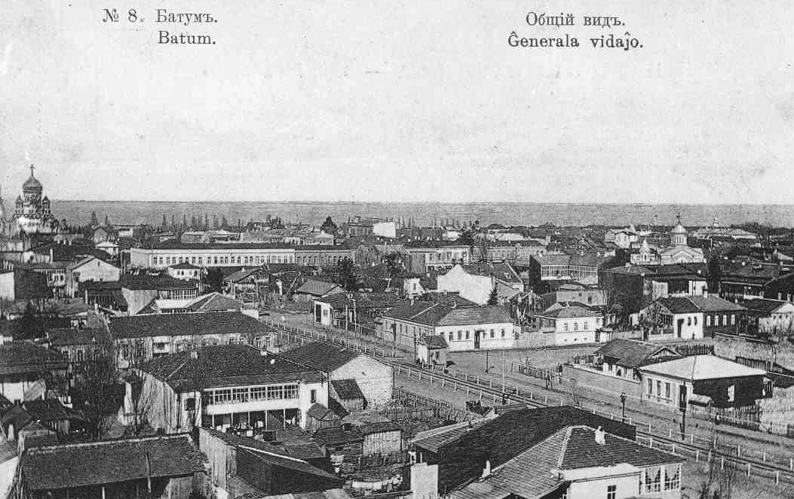
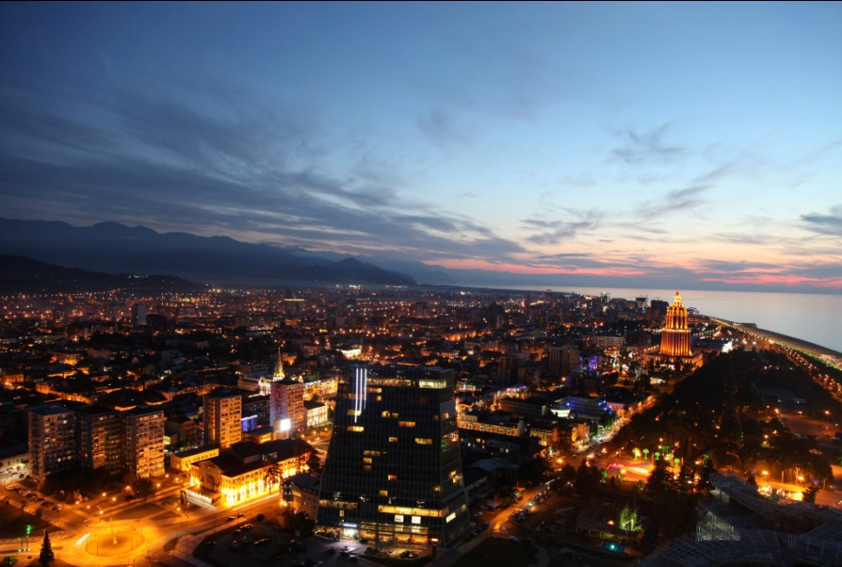
CITY OF BATUMI
Georgia
Economic Instruments in Transport Sector for Sustainable Development of the City of Batumi

Slide 2



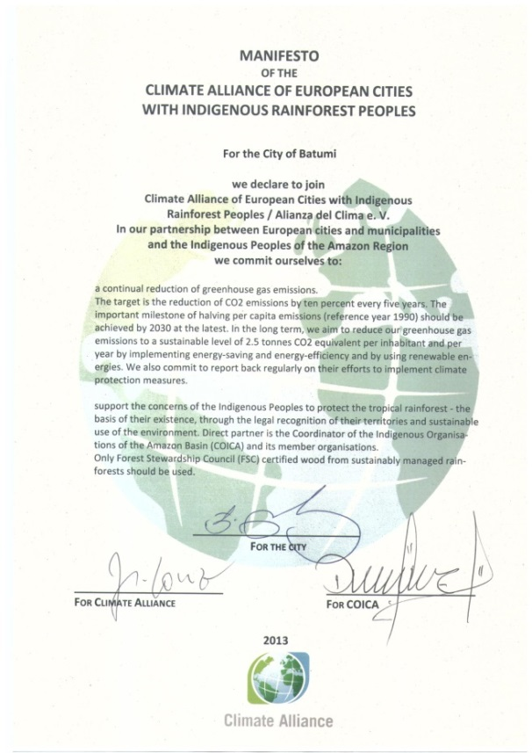
Commitments of the European Union
2011
In 2011 the City of Batumi joined the European Union’s Initiative “Covenant of Mayors” having taken a commitment to elaborate the action plan on energy sustainable development; such plan foresees reduction of green-house gas emissions by at least 20%.
Additionally the City of Batumi in 2013 became the member of “Climate Alliance” Association
2013

Slide 3
Reduction of Green-house Gas Emissions until 2020 - Scenario
waste
external lighting
buildings
transport

Slide 4
Reduction of Emissions by 2020
22,1%

Slide 5
Priorities for Reduction of Green-house Gas Emissions
External lighting
Buildings
Transport
Solid
Waste
Waste
water
City landscaping

Slide 6
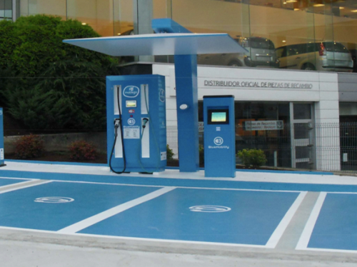
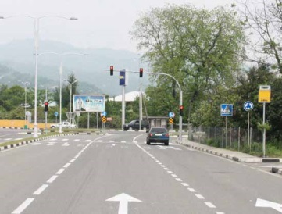
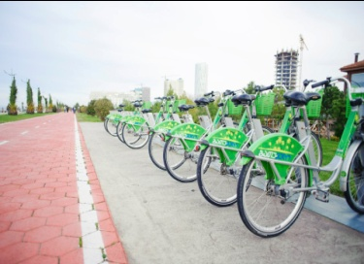
Strategic Vision - Transport
Transport
Transport:
Short-term Strategy: restoration and development of transport infrastrucrure, including repair and improvement of pavement, construction of bypass roads, bridges, efficient traffic regulation on intersections;
Mid-term Strategy: improvement of public transport system, introduction of energy saving technologies (modernization of public buses, public transport, optimization of public transport services, promotion of alternatives, electric transport etc.);
Long-term Strategy: Decrease of traffic of private vehicles, restrictions and incentives to encourage motor vehicles with low level of emissions (green islands, parking management, tariffs etc.).

Slide 7
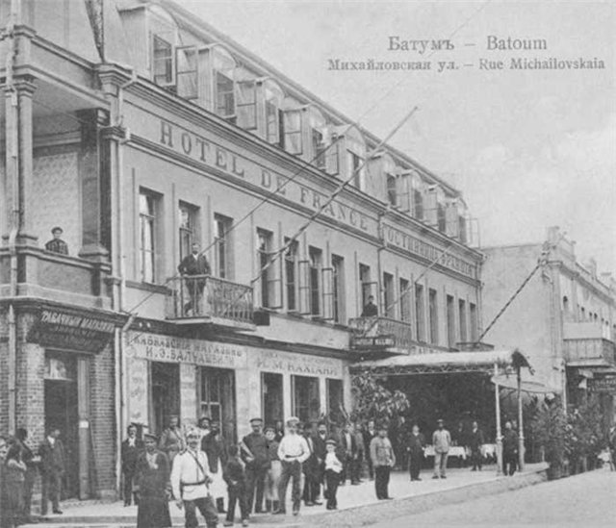

Slide 8

Problems in Transport Sector
Shortage of a number of city buses;
Depreciation of fleets that, in its turn, increases impact on environment;
Availability of non-standard passenger minivans;
Old private motor vehicles;

Slide 9
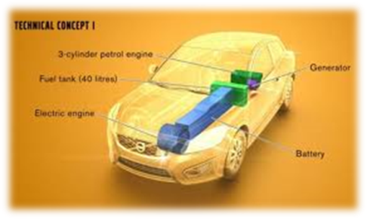
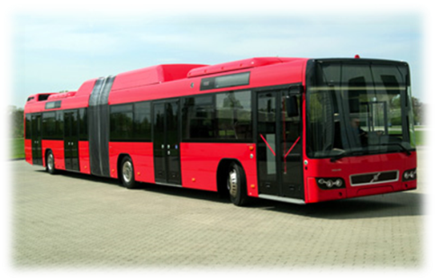

Planned Activities
Transport
Introduction of municipal electric taxi;
Replacement of old buses into the modern ones;
Improvement of cycling systems – increase a number of bikes, expand cycle lane networks, add a number of terminals;
Comprehensive regulation of system for public bus stops.

Slide 10
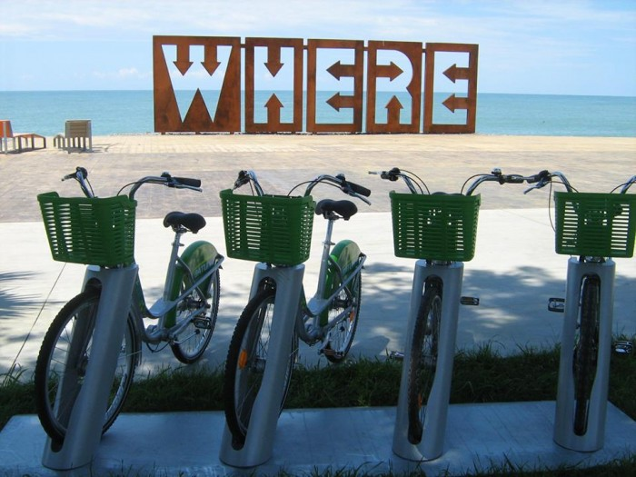
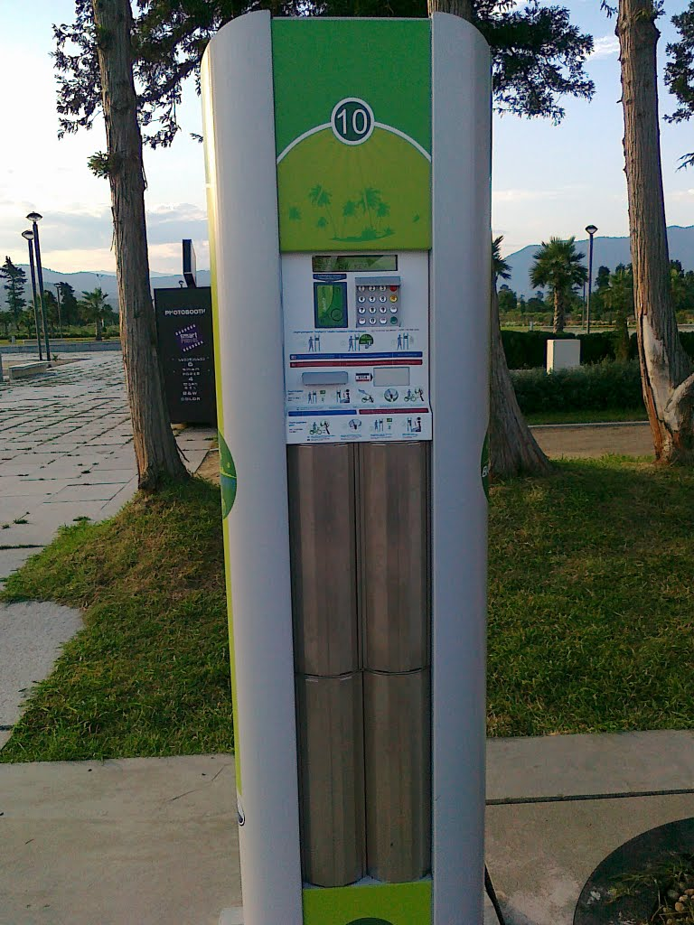
“BATUMIVELO” Project
370 bikes;
22 terminals – they are located in central zone and in seaside areas;
Terminal where one can rent a bike

Slide 11
Comparison of Different Cities from the Point of View of Green-house Gas Emissions from Motor Vehicles
Carbon oxide (СО)
Kutaisi
Batumi
Zugdidi

Slide 12

Comparison of Different Cities from the Point of View of Green-house Gas Emissions from Motor Vehicles
Carbon dioxide (CO2)
Kutaisi
Batumi

Slide 13
Thanks for your attention

