Slide 1
About The CIVITAS Initiative
Air Quality Governance in the ENPI East Countries AIR-Q-GOV
Workshop “Use of economic instruments for supporting sustainable development”
October 21-22, 2014
Chisinau, Moldova
Teije Gorris, CIVITAS & TNO

Slide 2


TNO connects people and knowledge to create innovations that boost the sustainable competitive strength of industry and well-being of society.
Notes:
From idea to innovation:
Fundamental knowledge development (together with universities)
Knowledge development (together with partners)
Knowledge application (contract research and consultancy)
Knowledge exploitation (TNO companies)

Slide 3



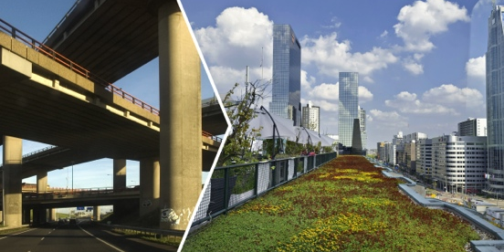

VisION
THEMES IN TRANSITION
INDUSTRY
HEALTHY LIVING
DEFENCE, SAFETY & SECURITY
URBANISATION
ENERGY

Slide 4
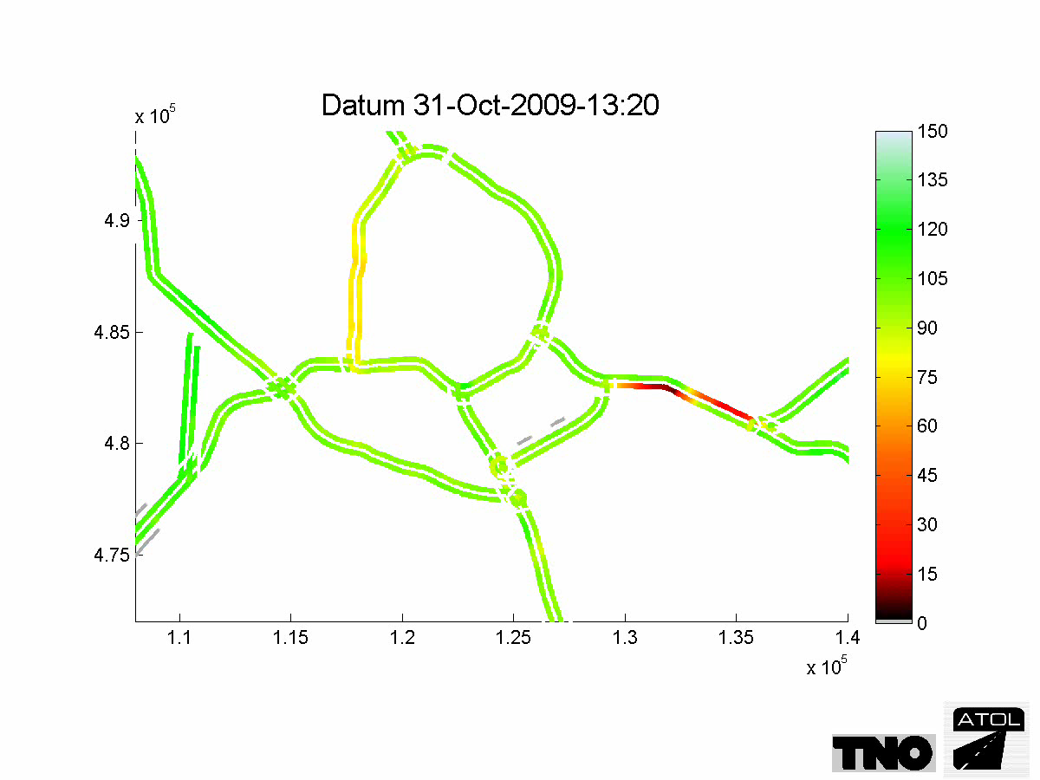


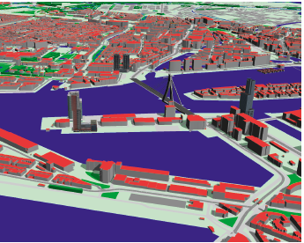
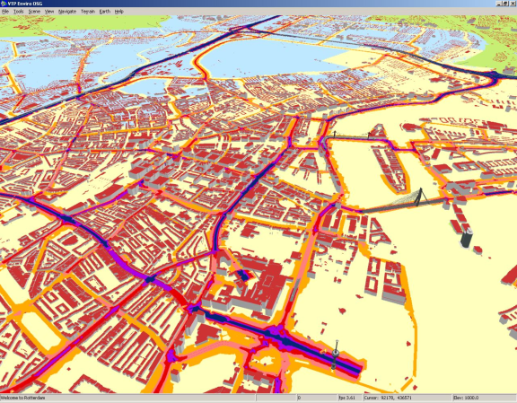

urbanisation
From urban bottlenecks to dynamic urban regions
Notes:
Urbanisation is a theme dedicated to helping create innovations for dynamic urban regions by working with partners on today’s solutions and tomorrow’s opportunities to improve the quality of life, accessibility and competitiveness of these urban regions.
ROADMAPS
Mobility & Logistics
Environment & Sustainability
Buildings & Infrastructures
Smart Cities

Slide 5
Content
CIVITAS – The Initiative
Organisation
Results
Reflection

Slide 6
CIVITAS – The Initiative

Slide 7
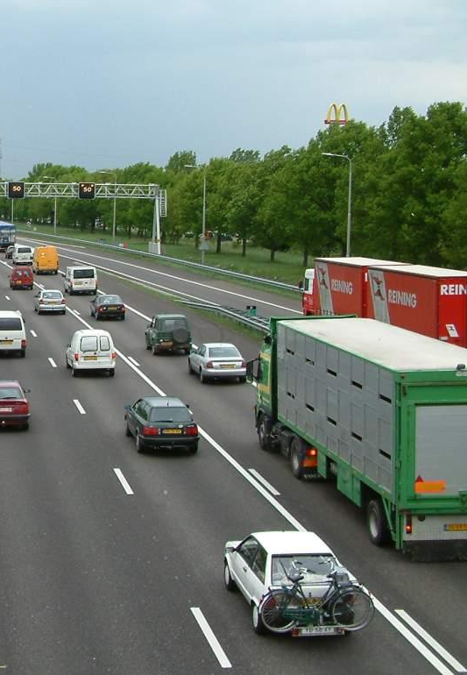
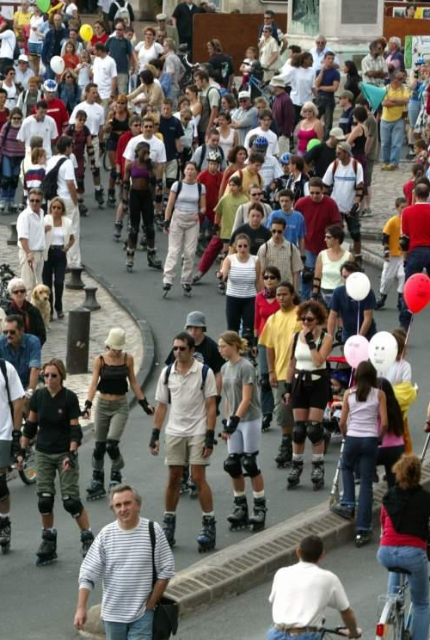
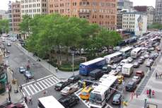
72% of Europe’s citizens live in cities
40% of CO₂ from road transport
70% of other pollutants from urban traffic
Millions of hours are spent in urban and regional congestion

Slide 8

EC Policy Dimension
Mobility: Urban Mobility Package (COM)
Air quality: New Air Quality Directive
Climate / Energy: Strategy for competitive, sustainable and secure energy (COM)
Noise: Sound levels motor vehicles Directive

Slide 9
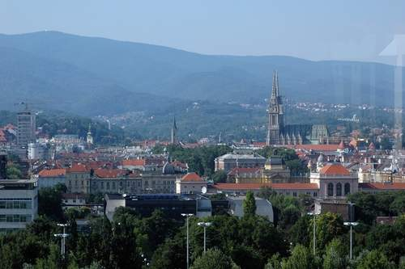
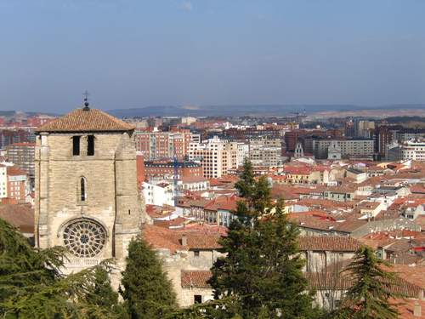
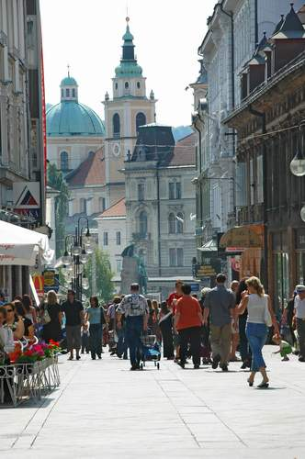
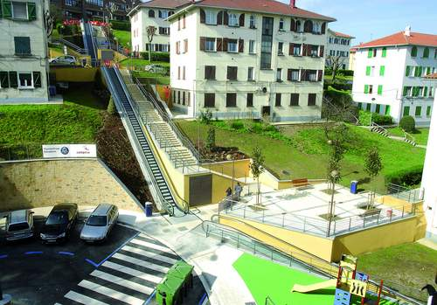
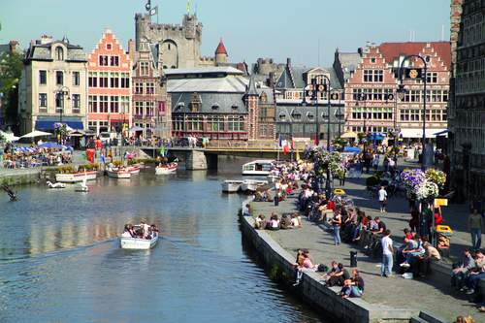
CIVITAS: A network of cities for cities to achieve sustainable urban mobility

Slide 10
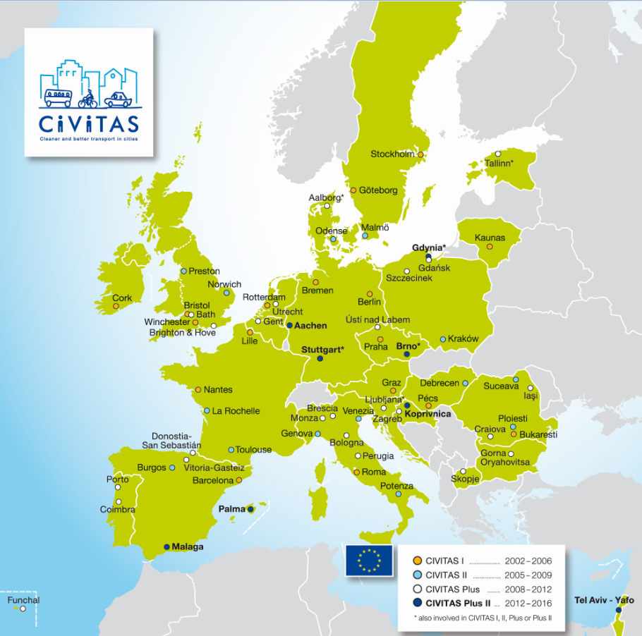
CIVITAS Demonstration cities

Slide 11
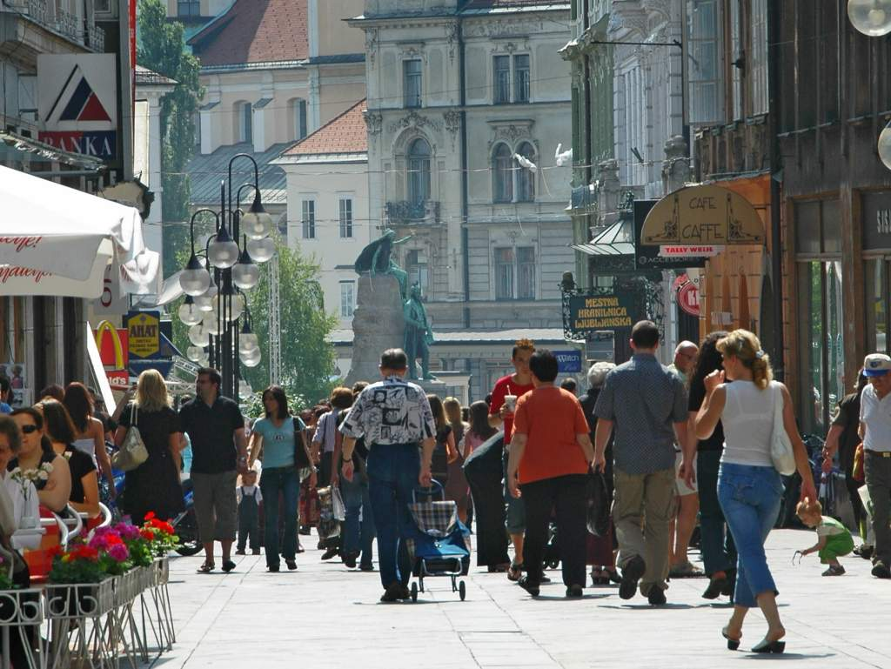
10 years CIVITAS:
69 demonstration cities
700 measures tested
220 cities member of the Forum Network
> 200 M€ EC investment

Slide 12

Key domains of intervention
Car
Independent
Lifestyles
Safety and
Security
Integrated
Planning
Demand
Management
Strategies
Collective
Passenger
Transport
Mobility
Management
Transport
Telematics
Public
Involvement
Clean Fuels
and Vehicles
Urban Freight
Logistics

Slide 13
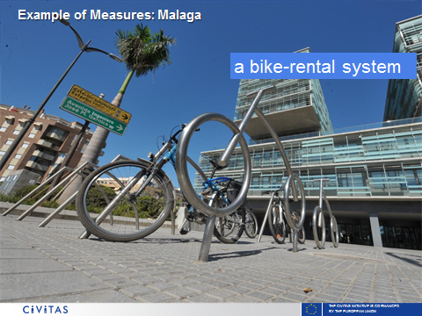
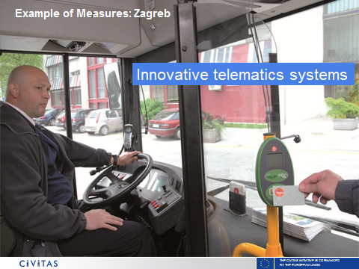
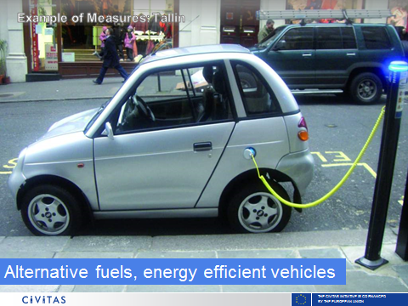
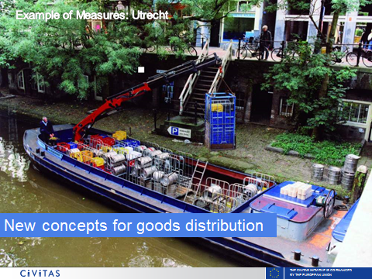
Examples of measures

Slide 14
Organisation

Slide 15
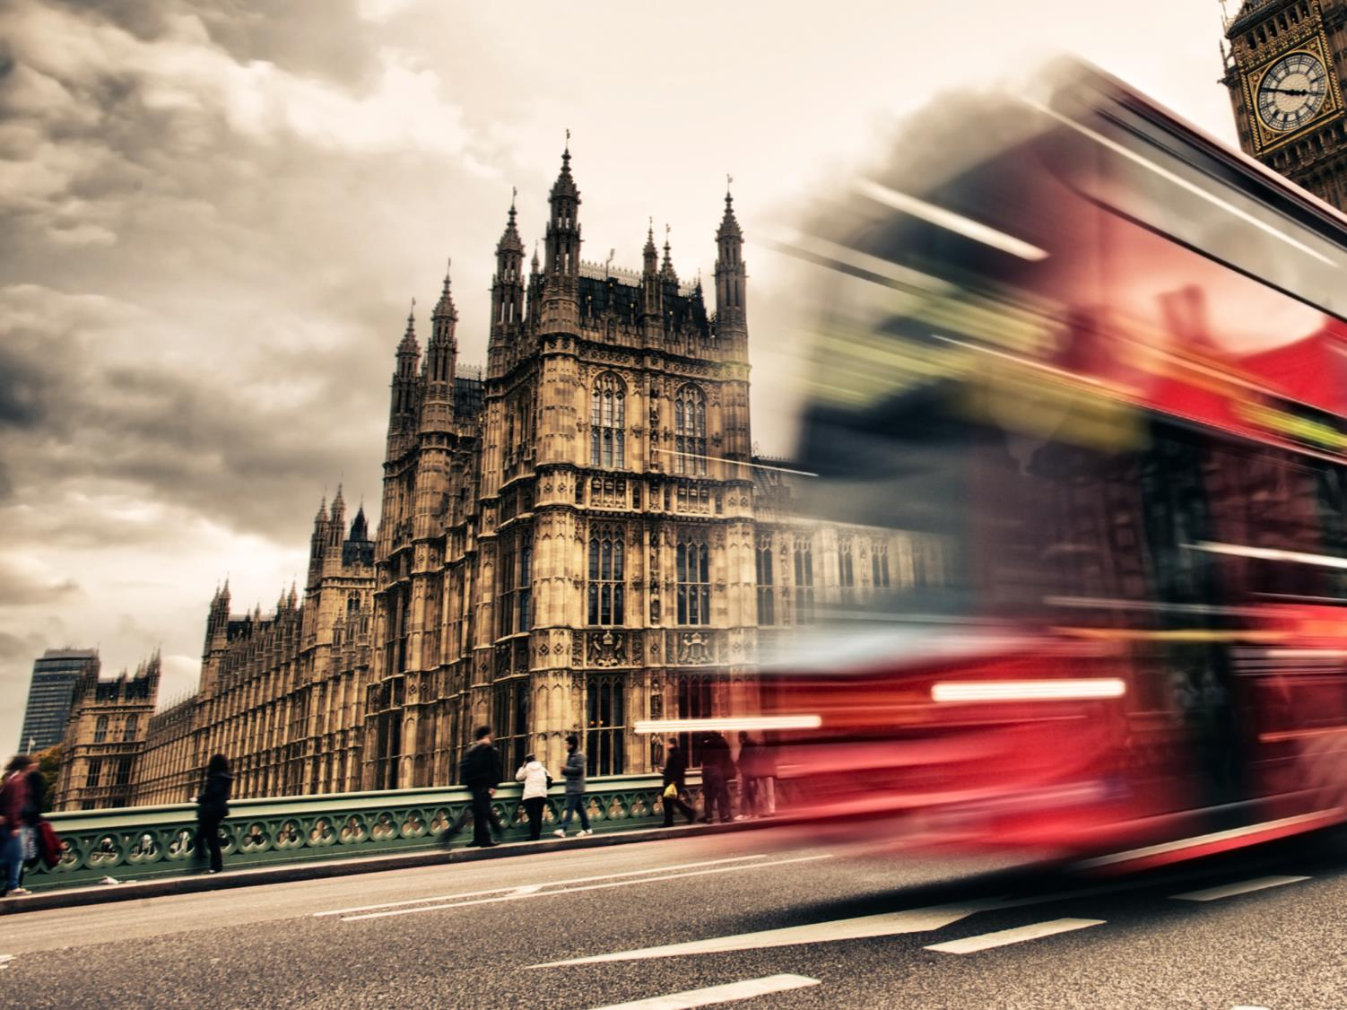

CIVITAS in action
Test New Solutions
1
Living labs
Knowledge Base on Clean Urban Transport
Exchange Good Practices
2
How did you do it?
Convince Politicians
3
How did you dare it?

Slide 16
Activities
Implementation ➔ demonstration of measures
Research ➔ gaining insights in impact and process
  Evaluation
  Facts ‘n figures
  Policy notes
Exchange ➔ bringing professionals together
  Webinars, workshops, trainings, seminars, placements, etc.
  Online thematic groups (www.civitas.eu and LinkedIn)
  Annual conference
Dissemination ➔ spreading the word
  Website, knowledge base > www.civitas.eu
  3rd party events
  Brochures, leaflets, etc

Slide 17
Implementation via projects
EC programs for innovation (FP5-7, Horizon2020)
  Consortia comprising cities, industry, research, service providers
  Co-financing
  Phases
Demonstration projects
  Implementation of measures
  Cities in the lead
Support actions
  Support for dissemination, evaluation and monitoring
  Facilitate the network

Slide 18
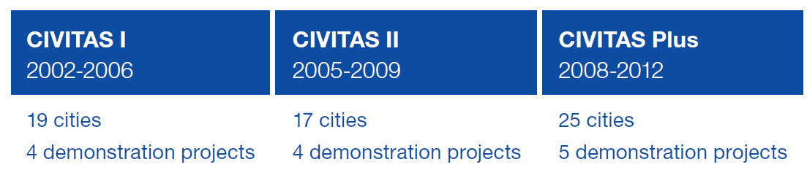
Previous CIVITAS phases

Slide 19

CIVITAS PLUS II (2012-2016)
Stuttgart, Malaga, Brno & Tel Aviv Yafo
2 projects
2MOVE2
8 cities
DYN@MO
  Aachen, Gdynia, Koprivnica & Palma
2 support actions:
WIKI
CAPITAL

Slide 20

How to get involved?
Participate in project
CIVITAS 2020
Apply for
Activity Fund
Join
Thematic Groups
  Participate in
TRAININGS
  Submit questions in
CIVITAS interactive
  Become a
Forum member

Slide 21
New projects CIVITAS 2020
Call for new projects under H2020 (MG 5.5a and 5.5b)
Budget estimate: 4-5 projects @ 12-18 M€
Funding rate: 70%
Deadlines
  Stage 1: 23 April 2015
  Stage 2 15 October 2015
Focus on implementation of innovations (instead of development)
Who can apply: EU member states, associated countries and third countries
Notes:
Associate
Iceland
Norway
Albania
Bosina and Herzegovina
Macedonia
Montenegro
Serbia
Turkey
Israel
Moldova
3rd Countries (automatic Eligable)
Azerbaijan
Albania
Belarus
Georgia
Macedonia
Moldova
Ukraine
Uzbekistan
Tajikistan

Slide 22
Results

Slide 23
Types of results
Outputs
Impacts
Process
Verifiable results
Economy
Energy
Environment
Transport
Society
Drivers
Barriers
Level
Measure
Cluster
City
Initiative

Slide 24
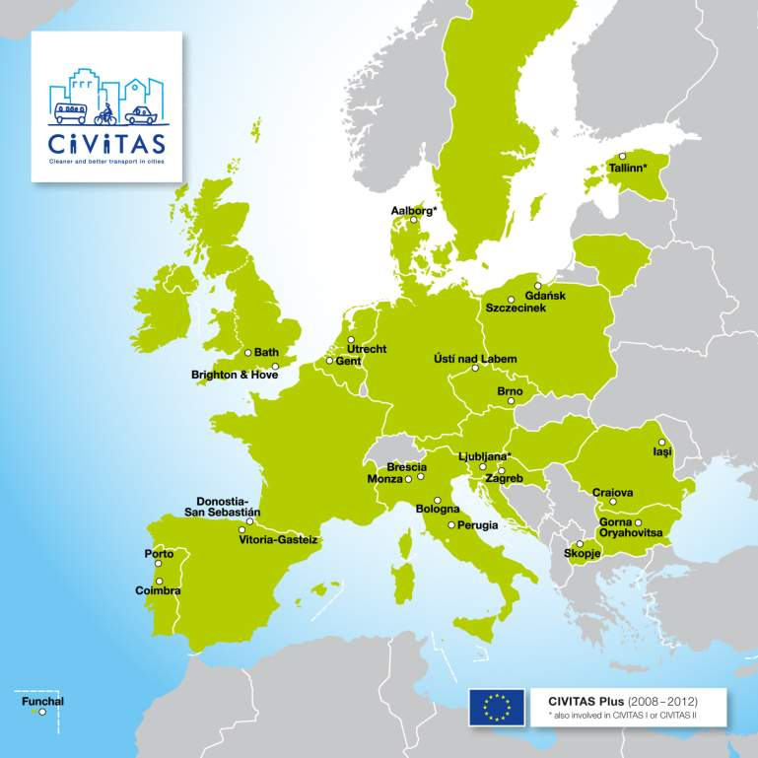
CIVITAS Plus in Numbers
2008-2012
5 projects
25 cities
€115m (€80m EC)

Slide 25
CIVITAS Plus in Numbers
The Measures
  40 clean fuel and vehicle measures in 22 cities
  45 collective passenger transport measures in 21 cities
  48 demand management measures in 18 cities
  59 mobility management measures in 23 cities
  32 safety and security measures in 17 cities
  25 car-independent lifestyle measures 16 cities
  14 urban freight measures in 12 cities
  46 transport telematics measures in 21 cities
}
20 cities and 26 (of the most successful) measures
Σ = >300 measures
Notes:
In total over 300 measures, almost as many as CIVITAS I and II combined.
First a question: How does one judge the most successful? Benefits in terms of the Env/Econ/Social issues? Do we consider aspects of mobility and accessibility/Safer Streets and Livable Cities/Social Inclusion/Integrated Measures/The Most Innovative/the best cost-benefit ratio etc.? Perceptions are continually changing which makes it difficult to present a ‘top ten.’
In the following slides I will give attention to as many of these issues as possible, and will focus on the tangible benefits that have been derived by 20 cities from the implementation of 26 measures.

Slide 26
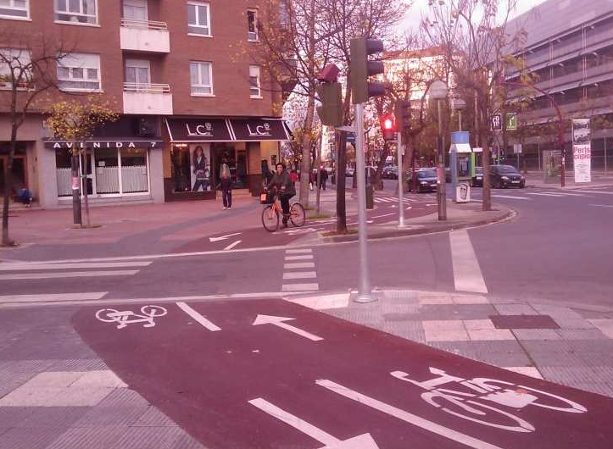
Vitoria-Gasteiz (CIVITAS MODERN) -
Pedestrian & Bicycle Lanes Network
  Build new bikeways extending the current network
  Construct pedestrian ways to improve pedestrian mobility
  Cycle lanes extended by 40 km and pedestrian network by 17.6km
  Increase in number of cyclists by 18.4%; decrease in modal split of cars by 6%;and pedestrian accidents lowered by 18% in 2 years
  increase the percentage of pedestrianised
  urban streets from 24% to 69%
  After survey showed that awareness
  level of the measure was 83% and
  acceptance level was 6 (0 to 10).
Notes:
The major benefits considered included journey time savings, reductions in environmental emissions, and reductions in fuel consumption
This measure has then achieved better results thanks to the implementation of the measure about the building of the Superblocks Model
To implement a functional and integrated network for each of the mobility modes
The innovative aspects of the measure are:
• New conceptual approach, nationally – New pedestrian and bicycle lanes network
design coherent with the super-block model proposed by the Sustainable Mobility Plan of
Vitoria-Gasteiz. Such measures together should provide important advantages:
guaranteeing a free public space for activities of living, shopping and pedestrian relations
avoiding the disturbances due to goods distributions in the pedestrians’ priority areas,
improving the acoustical quality of the area or reducing emissions of polluting gasses

Slide 27
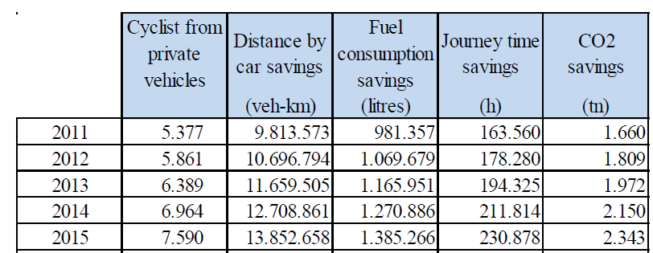
Vitoria-Gasteiz (CIVITAS MODERN) –
Pedestrian & Bicycle Lanes Network
  Investment costs (Y1-4) approx 9M€
  Maintenance costs: 160k€/Y
  NPV of €197,087,000 over 20 years
Notes:
In Vitoria-Gasteiz, an infrastructure measure was implemented to increase bikeway mileage from 75 to 115 km and increase the percentage of pedestrianised urban streets from 24% to 69%. The NPV of the measure was estimated to be 197,087,000 € over the 20 year evaluation period(2011 price). The major benefits considered included journey time savings, reductions in environmental emissions, and reductions in fuel consumption
This measure has then achieved better results thanks to the implementation of the measure about the building of the Superblocks Model
To implement a functional and integrated network for each of the mobility modes
The innovative aspects of the measure are:
• New conceptual approach, nationally – New pedestrian and bicycle lanes network
design coherent with the super-block model proposed by the Sustainable Mobility Plan of
Vitoria-Gasteiz. Such measures together should provide important advantages:
guaranteeing a free public space for activities of living, shopping and pedestrian relations
avoiding the disturbances due to goods distributions in the pedestrians’ priority areas,
improving the acoustical quality of the area or reducing emissions of polluting gasses

Slide 28
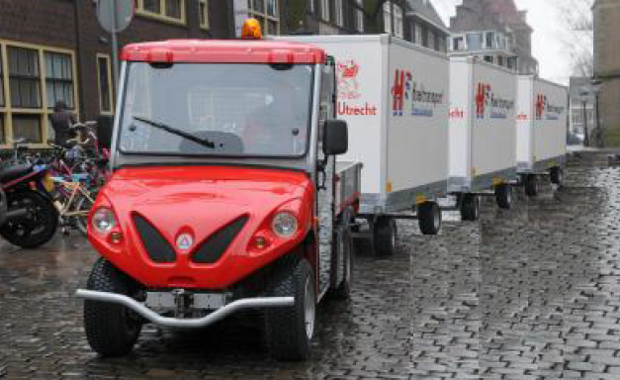
Utrecht (CIVITAS MIMOSA) –
Cargohopper (flexible access for cleaner freight traffic)
  Low emission zone city centre (min EURO V/EEV/EEV+)
  Use a electric mini-train called the Cargohopper (mini train, capacity of 5-8 vans)
  From a City Distribution Centre to the city center
  Saving 4,080 freight trips and over 80,000 km driven by vans or
  light trucks for the duration of the project
  €65,000 investment
  €120,000/y operational costs
  NPV of €65,000 for its lifespan (5y)
Notes:
This Cargohopper is an electric mini-train which delivers goods from a hub near
the city centre to different delivery addresses within the city centre. 1,25m wide replaces 5-8 vans
A low-emission zone was implemented already, but the low-emission zone alone provides only a
base level in decreased emissions. The city of Utrecht wanted to produce an effect above and
beyond this and encourage the usage of vehicles even cleaner than those meeting the low
emission zone regulations. This CIVITAS measure is about stimulating cleaner freight traffic by
giving these cleaner vehicles exemptions on existing prohibitions for access of freight vehicles to
the Utrecht city centre.
The deployment of cleaner vehicles was stimulated by offering companies using vehicles
cleaner than the low emission zone norm, something extra, a benefit that the 'normal' vehicles
do not get. Various measures are possible in this respect. Therefore the city of Utrecht
determined, in co-operation with private companies, for this measure different actions, which
would improve air quality in the low-emission zone. First an implementation plan was developed
in which ‘cleaner’ vehicles were distinguished with possible exemptions and adequate
measures. The next step was implementation of these adequate measures.
• Exemption from the legally allowed time window for deliveries (possibly in combination with a
minimum amount of packages to be delivered in the city centre);
• Allowing freight deliveries during the night (in this case the vehicle must be both ‘super clean'
and 'quiet');
• Exemption from the prohibition on the use of bus lanes;
• Subsidies when purchasing a new ‘super clean’ vehicle (possibly in combination with national
subsidy schemes);
• Financially supporting or facilitating the purchase of a new ‘super clean’ vehicle;
• Offering parking benefits (e.g. a special (un)loading dock for companies that have an
exemption);
This Cargohopper is an electric mini-train which delivers goods from a hub near
the city centre to different delivery addresses within the city centre. The Cargohopper replaces
the transport of goods to the city centre by vans. As it is a clean, small (1.25m wide) and quiet
vehicle which doesn't disturb public shopping in the city centre, it is now allowed to deliver
outside delivery time windows. In addition to the Cargohopper several other measures to
stimulate cleaner freight traffic were considered and implemented. This resulted in the following
activities for this CIVITAS measure: night deliveries for clean and quiet vehicles, a pilot with the
usage of bus lanes by cleaner vehicles

Slide 29
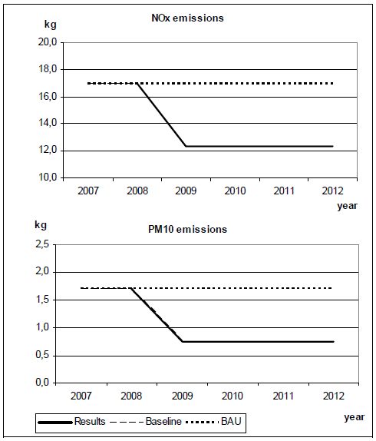
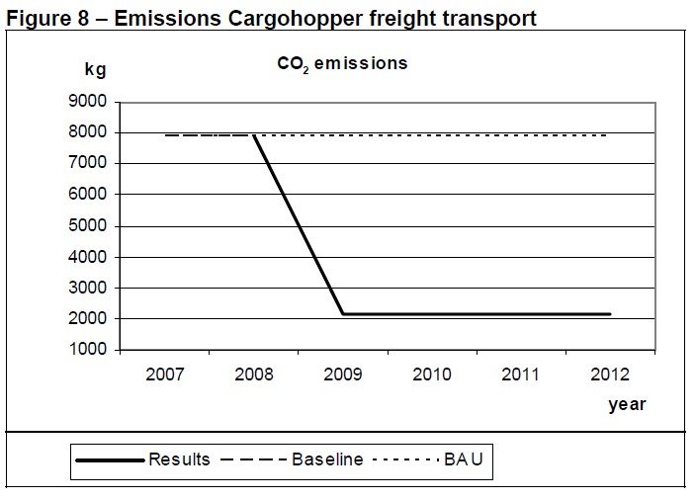
Utrecht (CIVITAS MIMOSA) ) –
Cargohopper (flexible access for cleaner freight traffic)
  73% CO2 emission,
  27% NOx emission and
  56% PM10 emissions
Notes:
Reference is regular Mercedes Sprinter van (2008)

Slide 30
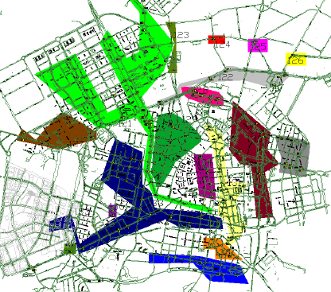
Vitoria-Gasteiz (CIVITAS Modern) –
Traffic Light Regulation for the New PT Network
  Automatic traffic lights to regulate priority
  Establish a hierarchy of streets according to their traffic volumes
  Focus traffic on the main streets and disincentive the traffic in the rest of the network using priority on intersections
  Make sure public transport uses this main streets
Notes:
Traffic lights phases were long and not adapted to the dominant
flows changing over the time of the day, producing an under-capacity road network.
For these reasons, the Sustainable Mobility Plan of Vitoria-Gasteiz establishes a network of basic
roads along which all the motorized ways of transport, either public (bus, tram and taxis) or private
run. The aim is to disincentive the traffic in the rest of the network. The Sustainable Mobility Plan
describes the parameters to adjust the traffic light regulation.

Slide 31
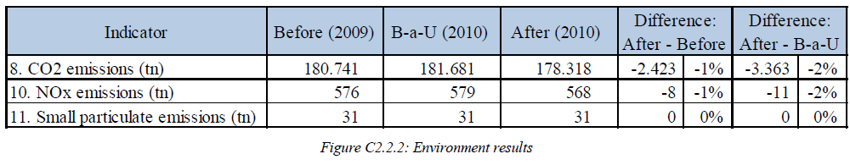
Vitoria-Gasteiz (CIVITAS Modern) –
Traffic Light Regulation for the New PT Network
  Installed on 230 intersection regulations
  High level of acceptance (70%), awareness (89%) and quality (6,7 out of 10)
  €12,180,000 saved in journey time reduction
  2.423 tonnes of CO2 and 8 tonnes of NOx are saved each year (representing €438.000 in 10 years)
  €331.000 investment costs
  NPV €140,721,000 (10y, 3,5%)
Notes:
Traffic lights phases were long and not adapted to the dominant
flows changing over the time of the day, producing an under-capacity road network.
For these reasons, the Sustainable Mobility Plan of Vitoria-Gasteiz establishes a network of basic
roads along which all the motorized ways of transport, either public (bus, tram and taxis) or private
run. The aim is to disincentive the traffic in the rest of the network. The Sustainable Mobility Plan
describes the parameters to adjust the traffic light regulation.

Slide 32
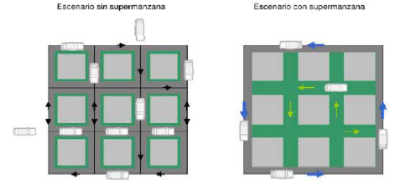
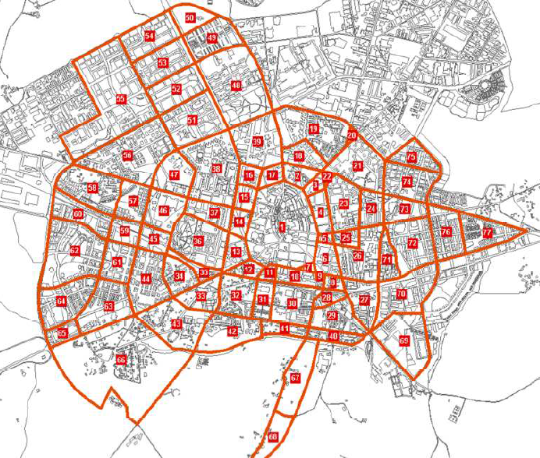
Vitoria-Gasteiz (CIVITAS Modern) –
Super blocks contributed to success of measures
Notes:
A superblock is a geographical space delimited by
main streets covering several city blocks. Superblocks concept establishes a hierarchy of streets,
according to their volumes of traffic, by separating the crossing roads from the ones just covered by
local traffic.
The main objective of the measure is redistributing traffic flows from local streets (inner streets in
superblocks) to main roads (streets separating superblocks). Thus, the air and public space quality can
be improved thanks to a better private vehicles demand management in the city.

Slide 33
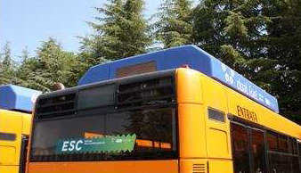
Perugia (CIVITAS RENAISSANCE) –
Clean Fuel technology for the public transport
  20 Euro 2 diesel powered buses (16% of the fleet) retrofitted with the dual-fuel kit (methane and diesel)
  CO2 reduction of 12-17%
  NOx reduction of 0-8%
  CO reduction of 95-96%
  Investment costs of €21,575 per bus
  (€16,000 kit, €5,600 installation)
  NPV (5y, 3%): €9,709
Notes:
The aim of the conversion is not to extend
the life of the vehicles, but to increase their functionality and reduce operating costs.
Emissions from the vehicles are lower than those of diesel buses, and the converted fleet
can, therefore, be deployed on routes that enter the city centre low emissions zone. Euro 2
buses are currently excluded from the Low Emission Zone due to the high level of particulate
emissions.

Slide 34
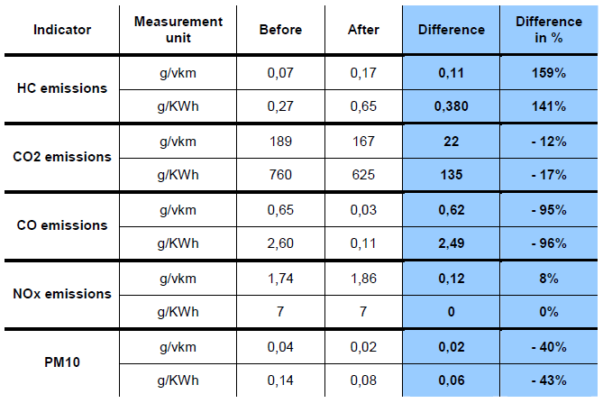
Perugia (CIVITAS RENAISSANCE) –
Retrofitting the service car fleet of the Municipality

Slide 35
Iasi (CIVITAS ARCHIMEDES) –
Access Control to a Historic Centre in Iasi
  Aimed to reduce the number of motorized vehicles in the historic city center
  Speed restricted to 30 km/h and a maximum weight of 1.5 ton/axle
  Supplying activities restricted to two 2-hour intervals (7-9 am and 3-5 pm)
Notes:
From the perspective of the impact on the city, the conservation of the historic centre of Iasi means preserving the cultural identity of the city, attracting tourists, and improving the quality of life, as the area is less polluted, and more appropriate for leisure activities.

Slide 36
Iasi (CIVITAS ARCHIMEDES) –
Access Control to a Historic Centre in Iasi
  Marginal investment costs, some regulation costs
  Reduction of number of cars 92% at peak hours and 91% at off peak hours
  Reduction of 84% for goods vehicles in the city center (from 43 to 7 per day)
  Decrease in CO2 level: 7.7% during daytime and 8.4% during night time
  Decrease in NO2 level: 7.5% during daytime and 9.5% during night time
  Decrease in noise level: 7.9% during daytime and 3.7% during night time

Slide 37
CIVITAS 5 years later: Long term evaluation
Reasons to participate (drivers):
  Integration of measures in a local transport plan (or SUMP)
  Financial contribution from the EC
  Learning and sharing of experiences → network function of CIVITAS
  ‘out of the box’, try something new
Lessons learned
  Organise your local stakeholders (select the right partners)
  Learn from other (experienced) cities
  Political commitment: willingness to invest and learn
  Low cost ‘smart measures’ can be quite effective
  Plan gradual change
  ➔ Would you do it again? (93% yes)
Notes:
CIVITAS II > projects completed in 2009
But cities move on
Has CIVITAS led to change
Qualitative approach
Survey
Interview
Would you do it again? (93% yes)
Continue to innovate, experiment with new measures
Showcase results and strengthen image of the city
To take a next step in sustainable urban mobility
To receive additional funding

Slide 38
Reflection

Slide 39
Learnings (1)
There is no silver bullit
  No single solution
  Packaging of measures
  Link to SUMP
Depends on local characteristics
  Modal split
  Legacy systems

Slide 40
Learnings (2)
There is a huge knowledge base
  Explicit and tacit (within document and within people)
  Needs to be used. People tend to reinvent the wheel
  Translate research output to decision making information
Process is as important as impact
  Process of implementation needs to be managed carefully
  ‘External’ influences affect the result: political support, citizens involvement etc.
The paradox of evaluation
  Decision makers needs fact ‘n figures, but evaluation is often being neglected

Slide 41
The way forward CIVITAS 2020
Continue greening (urban) mobility
Explore new ways of using the mobility system
Increase insight in mobility behaviour
Continue improving SUMPs
Continue to build partnerships
Notes:
1. Continue greening (urban) mobility
Hybrid & electric vehicles
Sustainable biofuels (biogas, diesels, algae, ..)
Public transport modes
Non-motorised modes
Reduce the need to travel (landuse)
2. Explore new ways of using the mobility system
Shared mobility opportunities
New mobility service providers entering the market
Integrated information/payment systems
Move from selling tickets to offering a mobility service
3. Increase insight in mobility behaviour
“Data Tsunami” provides great opportunities to understand and influence (urban) mobility
E.g. Insight in cycling behaviour
E.g. Insight in multimodal trips in urban environment
Societal trends influence decision making
E.g. dropping car ownership rates in urban areas among young people
E.g. mode-choice becomes more flexible and adapted to specific needs
4. Continue improving SUMPs
CIVITAS as ‘champions league for SUMPs
Integration of measures is key
Not only focus on technology, simple measures can be as effective
SUMP leads to SUM!
5. Continue to build partnerships
Between public and private organisations
Focus on exploitation beyond the lifetime of the experiment itself
Rethink leading / learning concepts towards mutual development of knowledge
Level of innovation should fit the environment

Slide 42
For the Air Quality Governance Project
Useful CIVITAS output
  Cluster reports
  Measure reports
  Policy notes
Join our thematic groups, and support activities
  Connect with peers in Europe
  Gain insights in knowledge and experience
Participate in CIVITAS2020 proposal
  Opportunity for the implementation of measures

Slide 43

Thank you!
Teije Gorris
Contact Details
CIVITAS
Teije.Gorris@CIVITAS.eu
http://www.civitas.eu

