Slide 1

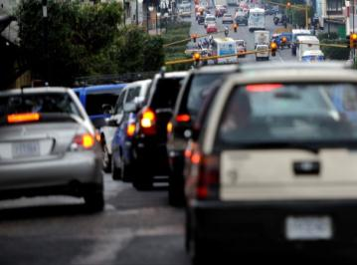
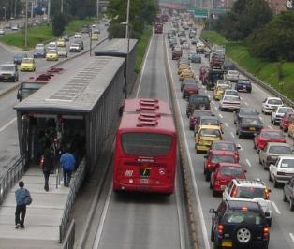
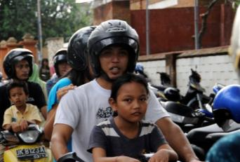

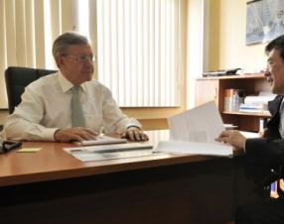

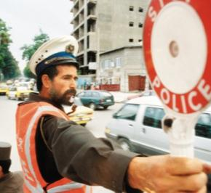
German International Cooperation in the field of Transport and Mobility
Focus Air Quality
Дипл. екон. транспорту Матіас Мерфорт
Консультативные услуги в области транспортной политики, GIZ

Slide 2
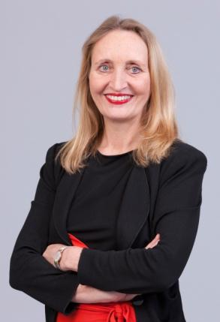
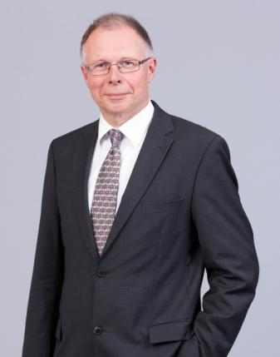
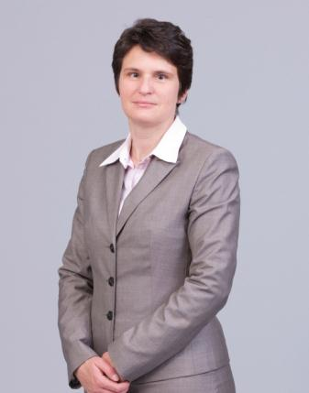
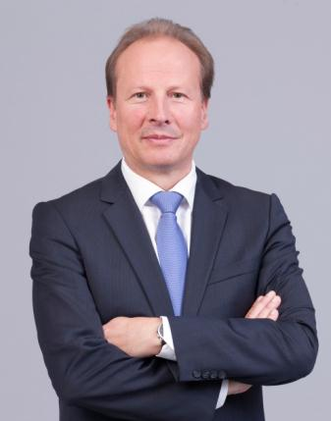
GIZ at a Glance
GIZ’s purpose is to promote international cooperation for sustainable development and education work.
As a 100% federally owned, public-benefit enterprise, we support the German Government in achieving its objectives in the field of international cooperation for sustainable development.
Our annual turnover is about 2 billion Euro.

Slide 3
We are a partner of extensive size and stability and outstanding personnel management aiming at international cooperation for sustainable development
We implement projects and programs on behalf of governments, international institutions and companies in 130 countries. In 85 of these countries we have country offices with experienced GIZ permanent staff members as country directors. Approximately 7.500 employees have contracts from headquarters and approximately 11.000 employees have local contracts. Our turnover in 2012 exceeded 2 (two) billion Euros.
Our project and program staff recruited internationally to overcome local skills gaps, transfer management and professional skills and technology and to introduce and adapt processes to the local environment. Our extensive local staff ensures continuity and intimacy with local societies, customs, laws, rules and regulations.
International cooperation for sustainable development is our corporate objective. We work closely with private companies when benefits for sustainable development meet the interest of companies – companies reduce risks and support development.
Size and Stability
Personnel management
Our interest

Slide 4








Transport & Mobility:
Priority Areas
Infrastructure Management
Poverty and Transport
Sustainable Urban Transport
Energy Efficiency, Fuels and Vehicle Technology
Road Safety
Climate and Transport
Freight Transport and Logistics

Slide 5
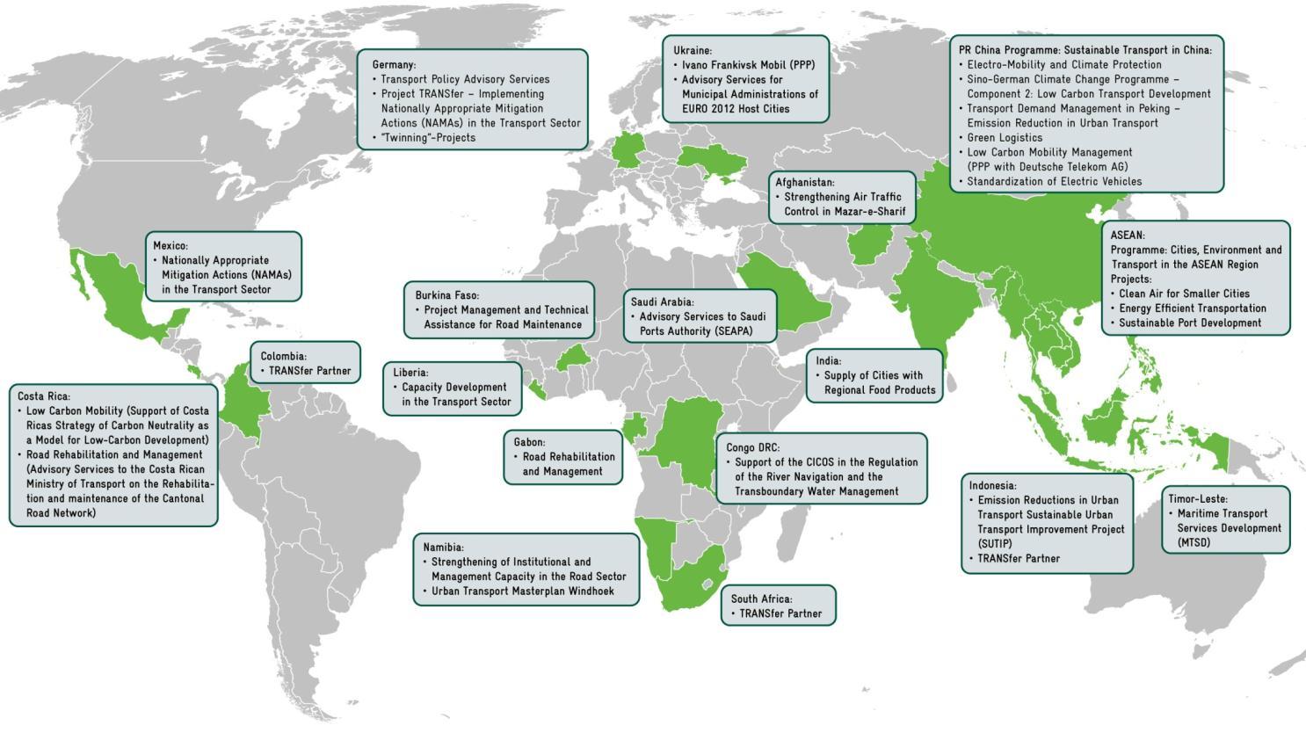
Ongoing GIZ Transport and Mobility Projects

Slide 6
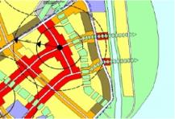
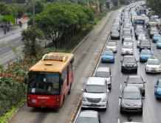
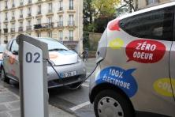
Our Approach
As an advocate of sustainable urban mobility, GIZ supports improving of mobility conditions in cities by providing knowledge, trainings, peer-to-peer exchanges, assessments and targeted project implementation. The activities in urban mobility are implemented under the umbrella of the Sustainable Urban Transport Project (SUTP, www.sutp.org).
Our Guiding Principles: The ASI Approach:
AVOID or reduce the need to travel through smart planning
SHIFT to more environmentally friendly modes of transport
IMPROVE the efficiency of transport modes and vehicle technologies

Slide 7
Путь вперёд
УЛУЧШЕНИЕ
ИЗБЕГАНИЕ/
СНИЖЕНИЕ
Энергоэффективность
– больше, с меньшими затратами –
ПЕРЕХОД/ПОДДЕРЖКА
Эффективность
системы
Эффективность
поездок
Эффективность
транспортного
средства
Меры в области транспорта
Организовать землепользование, социальную и экономическую деятельность таким образом, чтобы сократились потребность в транспорте и использование ископаемого топлива.
Использовать энергоэффективные способы перемещения, такие как общественный и немоторный транспорт для снижения энергопотребления на 1 поездку.
Потреблять минимум энергии в расчёте на транспортное средство-километр путём использования современных технологий и видов топлива и оптимизации эксплуатации транспортных средств.
Снизить или избегать поездок или потребность в поездках
Перейти к более энергоэффективным видам транспорта
Повысить эффективность с помощью технологий в области транспортных средств

Slide 8
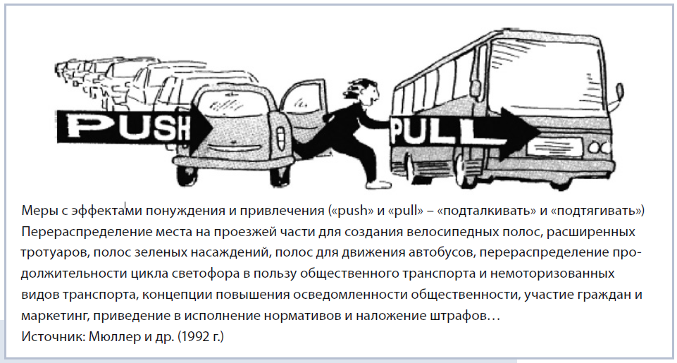

Slide 9






Мероприятие: Сокращение расстояний путём рационального планирования
Второе решение:
Какой вид транспорта вы (вынуждены) будете использовать?
Третье решение:
Какой тип транспортного средства использовать?
Пример: Покупки
?
Первое решение:
Как далеко вам идти/ехать?
?
2 km
Отправная точка:
В домашнем хозяйстве требуются различные товары с различной частотой.
10 km
Рациональное
планирование
инфраструктуры:
Снижает
потребность в
поездках!
ИЗБЕГАНИЕ/
СНИЖЕНИЕ
Поощрение использования безмоторного и общественного транспорта!
ПЕРЕХОД
Уменьшение размера автомобиля и использование альтернативных видов топлива!
УЛУЧШЕНИЕ

Slide 10
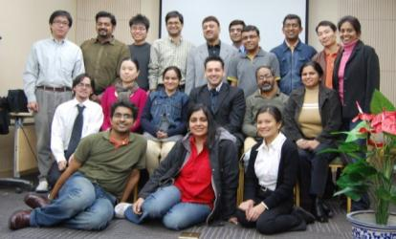
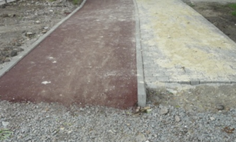
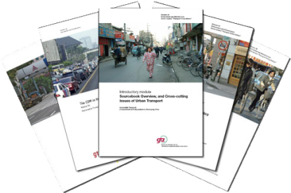
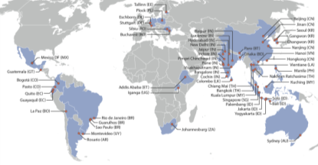
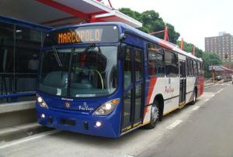
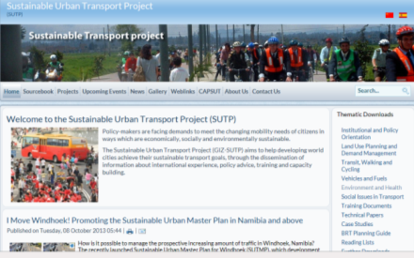
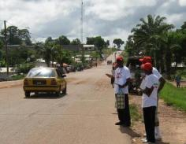
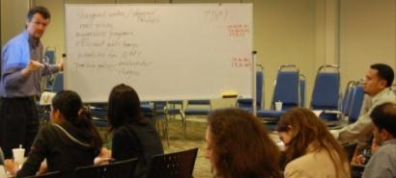
GIZ Transport & Mobility
Developing and Disseminating Resources
Sharing Experiences and Best Practices
Supporting Project Implementation

Slide 11
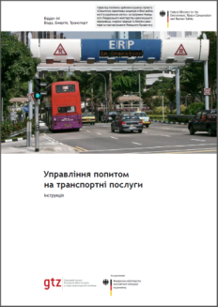
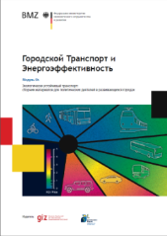
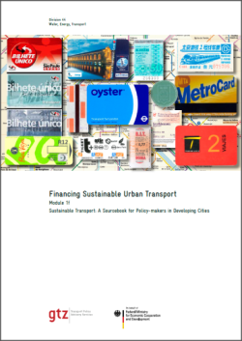
Посібник GIZ з питань сталого міського транспорту
Вирішення основних питань політичної основи сталого транспорту
Складається з більш ніж 30 модулів та пакетів для навчання
Призначений для розробників політики та їхніх радників
Ознайомтеся з нашою роботою на www.sutp.org
Публікації з питань фінансування транспорту та управління попитом на транспортні послуги:
Управлiння попитом на транспортнi послуги (укр. мовою)
Городской транспорт и энергоэффективность (рос. мовою)
Financing Sustainable Urban Transport (англ. мовою)
Accessing climate Finance for Sustainable Transport (англ. мовою)
Notes:
Auf unseren Internetseiten sutp.org und mobilnist.org.ua/home finden Sie eine umfangreiche Sammlung von Publikationen zu städtischer Mobilität. Diese richtet sich konkret an Planer und Entscheidungsträger auf verschiedenen Ebenen. Mit Relevanz für Verkehrsfinanzierung möchte ich an dieser Stelle einige Publikationen hervorheben, die Sie kostenlos herunterladen können und die zum Teil im Foyer ausliegen.
Управлiння попитом на транспортнi послуги in ukrainischer Sprache
Городской Транспорт и энергоэффективность , kürzlich auf Russische erschienen
Financing Sustainable Urban Transport (EN)
Accessing climate Finance for Sustainable Transport (EN)

Slide 12
GIZ Transport & Mobility
Developing and Disseminating Resources
Sharing Experiences and Best Practices
Supporting Project Implementation

Slide 13

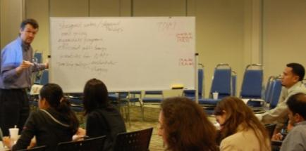
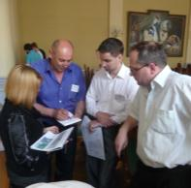

Training Courses: Topics & Participants
Sustainable Urban Transport
The target groups for training courses are:
Policymakers: high level officials who are given key information about particular aspects of an SUT policy in order to provide them with basic insights about how to improve their urban transport policies and projects
Planners: middle-level municipal staff who have the task to guide and oversee implementation of urban transport policies and projects
Engineers: municipal staff who work “on the ground” of specific urban transport projects
Bus Rapid Transit
Bus Regulation and Planning
Non-motorized Transport
Transport Demand Management
Development of Parking Strategies
Development of Bike Sharing Systems
Raising Public Awareness
Financing Urban Transport
Transport and Climate Change

Slide 14
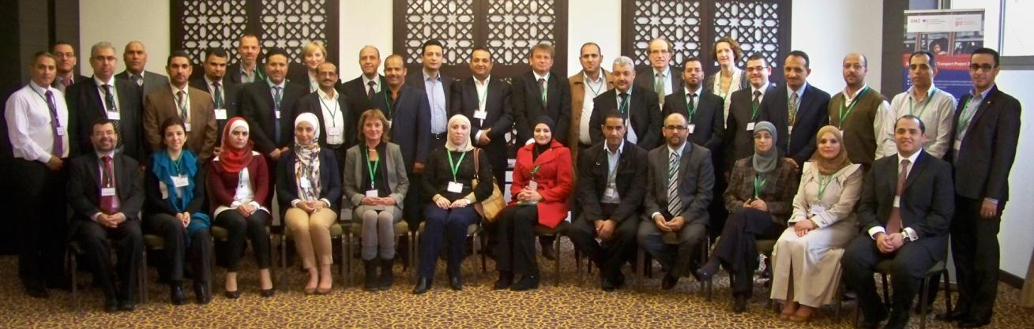
Example: Training on Sustainable Transport, Bus Improvement and Bus Rapid Transit (implemented in cooperation with IsDB)
Amman / Jordan
30 participants from 9 countries from MENA region
Topics:
  Principles of Sustainable Urban Transport
  Public Transport Planning and Management
  Overview on International Trends in Bus Improvement and BRT planning
  Comparison of Modes
  BRT Components
  Vehicles, Fare Collection, ITS
Country presentations: Egypt, Morocco and Lebanon, Palestine and Saudi Arabia
Group work:
  Identification of Challenges in Cities in the MENA Region
  Identification of basic BRT concept

Slide 15



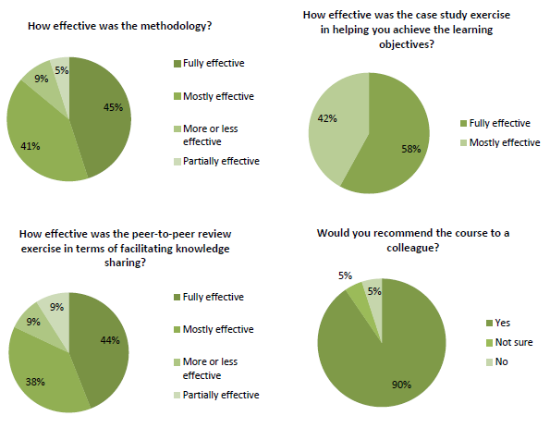
Training Courses: Online
e‐Learning course ‘Sustainable Urban Mobility in Developing Countries’ jointly developed by UNITAR and GIZ
Available in English and Spanish language
Quotes from Course Participants:
“I enjoyed the course, and the perspective it offered on the necessity of improving transportation as a prerequisite for creating cities that are more just.”
“Thank you for all the resources and information you have collected and shared ‐ I will come back to them time and time again to improve my knowledge, and to develop my tools to do good work.”
“The materials provided (in terms of class materials and additional/supporting resources) are an amazing compilation of information and resources related to this topic ‐ I feel like I now have access to the best library of resources for future learning.”
*Figures and user feedback based on evaluation of second course conducted from November 2011 to March 2012
More on: http://www.unitar.org/event/urbanmobility

Slide 16
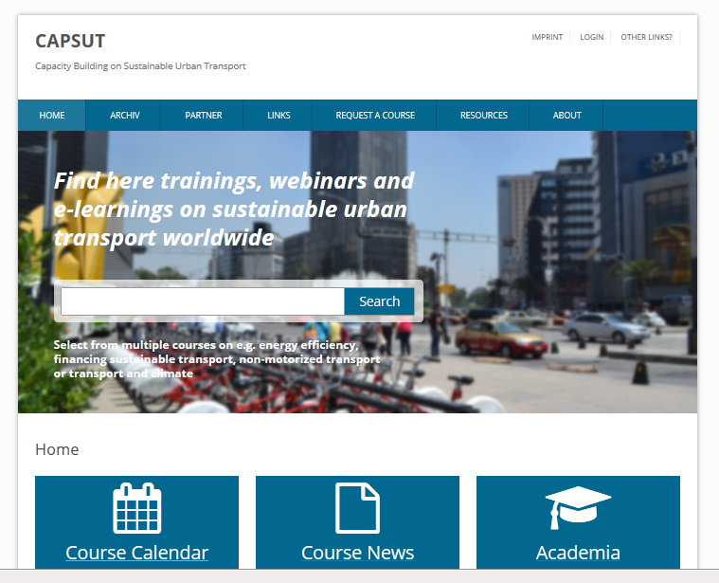
CAPSUT – Capacity Building for Sustainable Urban Transport
International platform, dedicated to capacity building in sustainable urban transport.
Created and is maintained by GIZ-SUTP on behalf of German Federal Ministry for Economic Cooperation and Development (BMZ)
Contributions from various partners worldwide that range from bilateral and multilateral organizations to academia, NGOs and other relevant stakeholders.
Open platform to announce non–commercial trainings and training related documents in the area of sustainable urban transport.
www.capsut.org

Slide 17
GIZ Transport & Mobility
Developing and Disseminating Resources
Sharing Experiences and Best Practices
Supporting Project Implementation

Slide 18

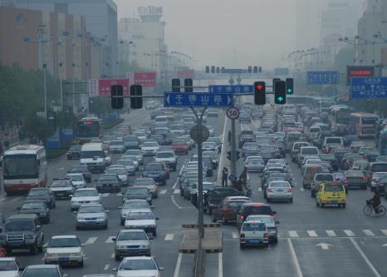

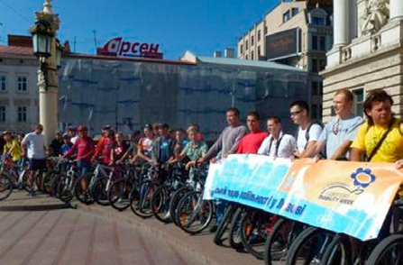
Priority Area:
Sustainable Urban Transport
Challenges:
By 2050 almost 70% of world’s population will be living in cities
Rapid urbanisation is putting more pressure on an already over burdened existing transport system in developing countries
Inadequate supply of public transport and non-motorised transport facilities in developing cities is pushing people towards use of private modes of transport
Exponential growth in rate of motorisation is increasing levels of congestion and air pollution within the cities
Shortage of skilled people within the government organisations which are responsible for handling urban transport activities
Source: blog.udn.org

Slide 19
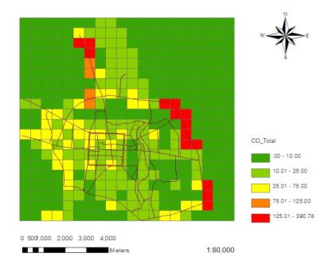
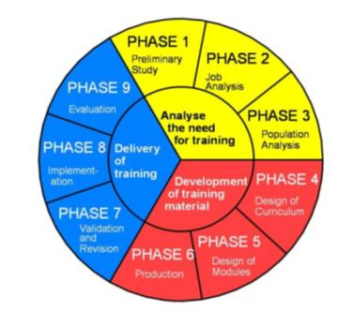
ASEAN: Clean Air for Smaller Cities (I)
Countries
Cambodia, Indonesia, Lao PDR, Malaysia, Myanmar, Philippines, Thailand and Vietnam; 12 cities
Overall Project Objective
To develop clean air plans for smaller cities and support implementation
Client
German Federal Ministry for Economic Cooperation and Development (BMZ)
Indicators
At least 11 smaller and medium sized cities (0.2 - 1.5 m inhabitants) have developed CAPs
In at least 7 cities, CAPs are under implementation
At least three cities that were not beneficiary cities of the project implement clean air measures
Two national environmental agencies developed a concept to strengthen the legal basis to improve air quality
Four regional institutions have included one or more training modules of “Train-for-Clean-Air” in their training programme and market it professionally
The project results are anchored in the ASEAN region through a regional NGO.

Slide 20
ASEAN: Clean Air for Smaller Cities (II)
Key impacts:
Multiplication of emission inventory development on local level: 13 Indonesian cities
Budget for AQMt and institutional development on local level (in Palembang, Bac Ninh, Korat and Chiang Mai)
Emission inventory guidelines on national level (Indonesia)
Inspection & Maintenance programme on national level enhanced (Thailand)
Harmonisation of approaches and standardisation (regional level)
South-south cooperation (among universities and cities)
Mainstreaming of environment and climate issues in ASEAN bodies and “trickle-down” to member state authorities

Slide 21
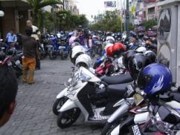
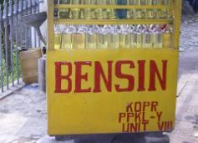
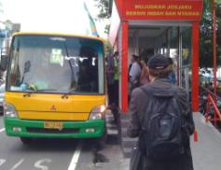
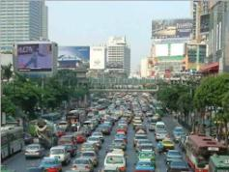
Indonesia: Emission Reduction in Urban Transport
Objectives
Implement environmentally friendly and energy efficient transport systems in selected medium sized and large sized Indonesian cities
Provide direct support to selected city governments in specific areas
Strengthen institutional capacities in the field of transport planning and governance
Client
German Federal Ministry for Economic Cooperation and Development (BMZ)
Measures on National Level (Indonesian Ministry of Planning)
Capacity building for technical staff in the Ministry
Assist in developing a National Urban Transport Policy and regulatory framework
Support on national standards, guidelines and manuals
Climate related national policies (e.g. CO2 Transport Roadmap)
Measures on Local Level (pilot projects in four cities)
Capacity building on transport planning
Support for integrated public transport planning
Support for introduction of high quality public transport schemes
Development of concepts for non-motorized transportation
Promotion of Transportation Demand Management (TDM)
More on www.sutip.org

Slide 22
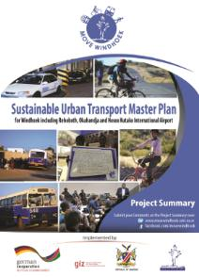

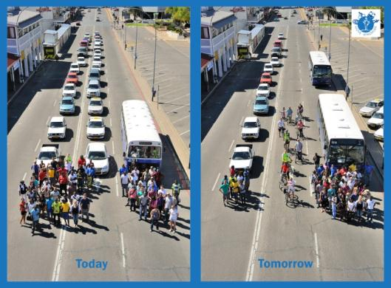
Namibia: Sustainable Urban Transport Master Plan Windhoek
The Sustainable Urban Transport Master Plan Windhoek
aims at improving the Public Transport System & Non-Motorised Transport provisions in Windhoek, including traffic to and from Rehoboth, Okahandja and Hosea Kutako International Airport in a 20 years horizon.
The development of the plan is supported by the German Federal Ministry for Economic Cooperation and Development (BMZ) through its implementing agency “Deutsche Gesellschaft für Internationale Zusammenarbeit” (GIZ).
Cedric Limbo, Deputy Director Transportation Policy in the Ministry of Works and Transport: “This Master Plan enables us to make decisions and to have a clear guidance for an improved public transport system.”
Download: http://www.movewindhoek.com.na/

Slide 23
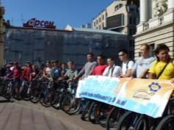
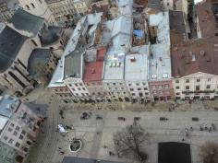


Ukraine: Climate-friendly Mobility
in Ukrainian Cities
Objective
Support preparation of mobility concepts for EURO2012 football championship
Develop cycling as modern, clean, sustainable and truly European mode of transport in the City of Lviv/Ukraine
Disseminate knowledge on sustainable urban mobility in Ukrainian cities
Client
Federal Ministry for the Environment, Nature Conservation, Building and Nuclear Safety (BMUB)
Measures
Based on a comprehensive cycling development program, Lviv has started in 2011 to built the first new cycling routes. According to the approved plans, the city will feature about 270 km of cycling infrastructure in 2019.
Jointly with representatives of the City of Lviv we:
  supported the development of technical recommendations
  developed recommendations for design of cycling infrastructure
  assisted in supervision of works
  celebrated cycling during the European Mobility Week
  and promoted cycling in various other cities and on national level
Implementation of cycling program saves 20% of the transport related CO2-emissions.
Support in selected public transport issues and ad-hoc advisory services on sustainable mobility questions.
More on www.mobilnist.org.ua/home

Slide 24
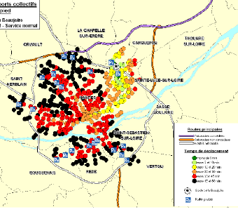
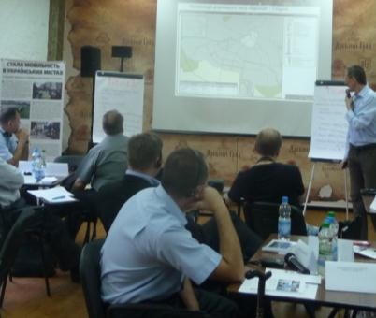

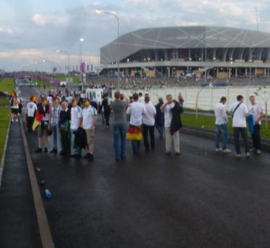
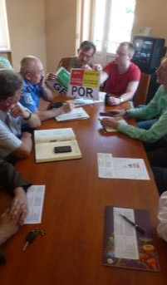
Ukraine: Support to EURO 2012 preparation
Example Large Scale Events
Source: CERTUMultimodal transport provision
for large sports facilities
Award
Event
Pre-Bid Concepts
Concept Development
Preparation / Implementation
Operation
Post-event use
Avoid
Shift
Improve

Slide 25
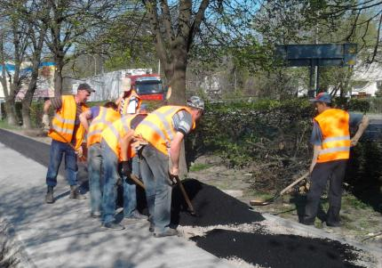
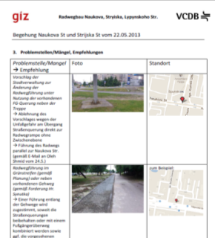
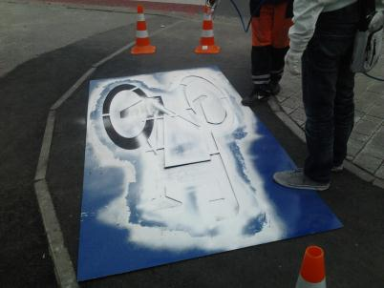
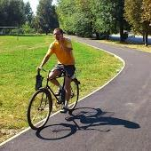








Ukraine: Advisory services to EURO2012 host cities
Focus: Cycling Development in Lviv
In cooperation with the city of Lviv, GIZ on behalf of BMZ, has supported the construction of about 15 km of state-of-the-art cycling infrastructure. Based on a comprehensive cycling development plan, the city of Lviv plans to build about 270 km of cycling infrastructure in the next years.

Slide 26


Slide 27




Priority Area:
Energy Efficiency, Fuels and Vehicle Technology
Challenges:
Transport sector is heavily reliant on oil (90% of the total energy consumed by transport sector is derived from oil)
Reduction of energy consumption in the transport sector requires comprehensive approach, including better integration of land use and transport, use of more efficient modes and improvement of operations
Fuel subsidies hamper deployment of efficient technologies and concepts (In 2011, subsidies given to fossil fuels accounts to approximately USD 523 billion. Source: IEA)

Slide 28


Climate-friendly road freight transport in Mexico
Scrapping Program and Eco driving + Technology Program for small transportation companies
Objective
The road freight transportation “Nationally Appropriate Mitigation Actions” (NAMA) aims to lower GHG emission generation and other pollutants from small transportation companies and owner-operated trucks.
Client
Federal Ministry for the Environment, Nature Conservation, Building and Nuclear Safety (BMUB) via the International Climate Initiative (ICI)
Measures
Capacity building for technical staff in the Mexican Environmental Ministry (SEMARNAT) and Transport Ministry (SCT)
Technical support to improve the scrapping program operated by SCT and Mexican Development Bank (NAFIN)
Technical support to improve the Eco driving/ Technology Program operated by SEMARNAT
Development of a MRV-System for both programs
Development of a financial concept
Development and evaluation of pilot projects

Slide 29



PR China: Climate Protection and Electric Mobility
Objective
Assist ministries, research institutes and think tanks in the development of strategies and technical guidelines to implement electric mobility in China
Reduction of the greenhouse gases
Field testing of 10 x 1.000 Vehicles
Client
Federal Ministry for the Environment, Nature Conservation, Building and Nuclear Safety (BMUB)
Measures
Development of scenarios for electricity demand in transport and impacts on
GHG emissions
Analyzing standards for battery and charging technology
Policy recommendations for harmonizing standards
Optimize battery recycling
Evaluate the eco-balance of electric vehicles
  More on: www.electro-mobility.cn

Slide 30

International Fuel Prices
Since 1991 GIZ carries out regular worldwide Fuel Price Surveys. One of its goals is to provide a worldwide comparison of retail prices to track / to highlight energy price policies in developing countries.
Currently, data are available for 170 countries for Diesel and Gasoline based on survey in Mid-November 2012
Part of World Bank Indicator Set (World Development Indicators, World Road Statistics, …)
2012 Survey available on: www.giz.de/fuelprices
Factsheets for more than 130 countries on: https://energypedia.info/index.php/International_Fuel_Prices

Slide 31


Slide 33






Ціни на паливо, якість палива та енергоефективність у транспортній галузі
Низькі, чи навіть субсидовані ціни на паливо заохочують до...
...безконтрольного зростання забудови з великими відстанями
...надмірного користування автомобілями
...неефективності транспортних засобів
Низькі, чи навіть субсидовані ціни на паливо заохочують до...
...неефективної роботи НПЗ та дефіциту палива
...низької якості палива
...відсутності інновацій в автомобільній промисловості

Slide 34

Национальные правительства
Национальные правительства должны создавать благоприятные условия и поддерживать местные инициативы
Акцент на возможных действиях на национальном уровне:
  Создание национальной правовой базы
  Оказание влияния на транспортную подвижность с помощью налогов и финансовых стимулов
  Поддержка местных бюджетов в целях устойчивого транспорта
  Поддержка исследований и пилотных проектов

Slide 35
Excourse: як фінансувати чисту, безпечну та доступну мобільність?
податок на пальне + x за літр
Фонд міського транспорту
Капітальні інвестиції: Інфраструктура та технологія
Інші транспортні податки/збори
Державні джерела?
Приватні джерела?
Позики та гранти?
Notes:
Mit diesen zusätzlichen Einnahmen könnte ein Nationaler Anti-Stau Fond eingerichtet werden, der ausschließlich für die Förderung von ÖPNV, Radfahrern und Fußgängern verwendet wird.
Im Kontext zunehmender Belastungen des Straßennetzes und steigender Ölpreise kann die Stärkung dieser Verkehrsträger einen wichtigen Beitrag zur langfristigen Erhaltung von Mobilität in ukrainischen Städten leisten.

Slide 36
Інфраструктура громадського транспорту
Трамвайні коліх, тролейбусна контактна мережа тощо.
“Розумне” управління транспортом
Центри управління дорожнім рухом
Інтеграція громадського транспорту
Безмоторні види транспорту
Велосипедна інфраструктура
Зменшення інтенсивності та підвищення безпеки руху (покращення тротуарax, перехрестяx тощо (для пішоходів))
Смуги/коридори для гром. транспорту
Модернізація рухомого складу (купівля нового та відновлення старог)
Плани сталого розвитку міського транспорту (стратег. планування, розвиток потенціалу)
Управління парковками
Модернізація депо та технічних споруд
Модернізація зупинок громадського транспорту

Slide 37

Джерела фінансування загальнодержавного рівня
Федеральний закон про фінансування місцевого транспорту (GVFG)
Запроваджений 1971 року як складова масштабного оновлення транспортної інфраструктури
Націлений на інвестиції
Співфінансування проектів у транспортній сфері до 75% (для Східної Німеччини - до 90%)
Співфінансування масштабних місцевих проектів розвитку залізничної інфраструктури (> 50 млн. євро) до 60%
Федеральний закон про регіоналізацію транспорту (RG)
Запроваджений 1993 року разом з докорінною реформою системи залізничних сполучень
Націлений на виділення експлуатаційних субсидій переважно для регіональних залізниць
6,5 млрд. євро (на сьогодні)
Усі кошти направляються провінціям/землям (у пропорції, що відповідає кількості мешканців)

Slide 38
Національний фонд міського транспорту
Кошти, виділені з підвищення податку на паливо (напр., x €/л)
Національні кошти з інших джерел
Міжнародні позики, гранти та кошти
Позики (ЄБРР, СБ, ЄІБ)
Кліматичні кошти (ЗКФ, ГЕФ, t-NAMA*)
Гранти (від ЄС, інших партнерів)
Державний бюджет,
Транспортний податок,
Кошти регіонального розвитку
Керівний орган
Співфінансування з місцевого/ регіонального бюджетів
Комплексне інвестування та управління інвестиціями у громадський транспорт
t-NAMA – “Національно прийнятні заходи мінімізації впливу від транспортного забруднення”, ініціатива GIZ в рамках його Проекту TRANSfer (прим. перекл.)

Slide 39
Завдання Керівного органу
Визначення проектів
Взаємодія з основними зацікавленими сторонами
Сприяння проведенню конкурсних закупівель
Супроводження контрактів
Нагляд за будівельними роботами
Дорадча діяльність з питань транспортної політики
Комунікації та “паблік рілейшнз”

Slide 40






БРАЗИЛІЯ: державна політика міської мобільності (2012)
Значні інвестиції у міський транспорт (50 млрд. євро до 2020 р.)
Плани розвитку міської мобільності – умова отримання коштів державного бюджету
Основні рекомендації для міської влади та стратегія комлексного розвитку потенціалу від Мінбуду
Notes:
So viel zu den Herausforderung, vielen von den sie sich gegenübersehen.
Überletiung diskussion
Brasilien sehr viel Bewegung im Thema, das kann man sehen und das haben wir bei Erarbeitung neuer Publikation festgestellt.

Slide 41
Висновки з міжнародного досвіду
Для сприяння сталому розвитку міського транспорту необхідні надійне державне фінансування
Державна політика щодо міського транспорту та його фінансування відіграли основну роль у створенні комплексних систем громадського транспорту в багатьох країнах
“Універсальних” схем фінансування, які б задовольняли зростаючі можливості, немає
Пастка ремонту та утримання
Для забезпечення сталого розвитку міського транспорту окрім державних схем фінансування шукайте також додаткових надходжень від управління транспортним попитом до вартості земельних ділянок та скорочення субсидій на паливо
Для сприяння державній політиці розвитку міського транспорту та механізмів його фінансування вивчайте можливості NAMAs, кліматичних фондів та міжнародного співробітництва
Notes:
Developed countries: high cost shares for operation and maintenance
Developing countries: major infrastructure investment needs, but Beijing already around 500 million USD subsidies for metro system

Slide 42
The German Partnership for
Sustainable Mobility (GPSM)
…is your guide for sustainable mobility and green logistics solutions and knowledge from Germany.
…supports global capacity development and raises awareness on sustainable mobility and green logistics.
…is a reliable and inspiring network which offers access to knowledge, experts, networking events.
Notes:
Dear ladies and gentlemen,
The International Transport Forum has always been a venue, where big ideas started and initiatives gained pace. Today we gathered here to launch an initiative with great perspectives and high ambitions. An initiative which brings the right people and the right ideas together, no matter if like today in Germany or in any other corner of the world where there is a high need for sustainable mobility and logistics solutions. Transport is shaping our world – positively by supporting economic activities and providing access to education, health and social participation. And negatively by increasing emissions and road accidents which seriously threaten our livelihoods.
The initiave we will be introducing today, wants to make a contribution for tackling urgent development challenges. The German Partnership for Sustainable Mobility wants to become a reliable and inspiring partner for supporting the international dialogue and international cooperation in the fields of mobility and logistics.

Slide 43
The German Partnership for
Sustainable Mobility (GPSM)
Current activities:
Supporting international delegations to Germany
Publications and thematic exploration:
  Transport & Clean Air – Made in Germany
  Cycling Made in Germany
Roundtable discussions on Smart Mobility
Notes:
Dear ladies and gentlemen,
The International Transport Forum has always been a venue, where big ideas started and initiatives gained pace. Today we gathered here to launch an initiative with great perspectives and high ambitions. An initiative which brings the right people and the right ideas together, no matter if like today in Germany or in any other corner of the world where there is a high need for sustainable mobility and logistics solutions. Transport is shaping our world – positively by supporting economic activities and providing access to education, health and social participation. And negatively by increasing emissions and road accidents which seriously threaten our livelihoods.
The initiave we will be introducing today, wants to make a contribution for tackling urgent development challenges. The German Partnership for Sustainable Mobility wants to become a reliable and inspiring partner for supporting the international dialogue and international cooperation in the fields of mobility and logistics.

Slide 44

Explore sustainable mobility and logistics made in Germany: www.german-sustainable-mobility.de
And connect with us: contact@german-sustainable-mobility.de
The German Partnership for
Sustainable Mobility (GPSM)

Slide 45
Transport and Mobility in German Development Cooperation
The new brochure offers an overview on current activities of GIZ and KfW Banking Group carried out on behalf of the Federal Ministry for Economic Cooperation and Development (BMZ) in the transport sector. The publication outlines the importance of the transport sector in development cooperation and presents projects in the current six fields of work in the transport sector (sustainable urban mobility, transport and climate, green logistics, infrastructure management and rural transport, energy efficiency, technologies and fuels and road safety).
Download: http://www.giz.de/Themen/de/dokumente/giz2013-en-transport-mobility-development-cooperation.pdf

Slide 46






































Websites:
www.giz.de/transport
www.giz.de/fuelprices
www.sutp.org
www.transport2020.org
www.transferproject.org
www.sutip.org
www.tdm-beijing.org
www.citiesenvironmenttransport.org
www.citiesforcleanair.org
www.sustainableport.org
www.transportandclimatechange.org
www.electro-mobility.cn
www.movewindhoek.com.na
www.sustainabletransport.org
More information and contact
Transport Team
Deutsche Gesellschaft für Internationale Zusammenarbeit (GIZ) GmbH
T + 49 6196/79-2650 / E transport@giz.de

Slide 47

Thanks for your attention!
Контакт:
mathias.merforth@giz.de
contact@german-sustainable-mobility.de (GPSM)
Notes:
Ich bin mir sicher, dass Sie nicht nur heute insbesondere auch von den Erfahrungen Ihrer Kollegen profitieren können, sondern bald gemeinsam mit den Entscheidungsträgern auf nationaler Ebene eine erfolgreiche Debatte zur Zukunft der Verkehrsfinanzierung in ukrainischen Städten führen werden.
Душе дякую за Вашу увагу!

