Slide 1
Successive EU program support:
Clima East activity in the field of urban transport
Mr Mikhail Kozeltsev Regional coordinator & Mr Zsolt Lengyel, Team Leader & Key Expert
22 October 2014, Chisinau

Slide 2

Content of presentation
Clima East activities – historic & future with focus on transport
Economic instruments in transport (AQG overview and recommendations of first day)
Road transport emissions – vehicle oriented & fuel quality – fuel oriented
Outlook & discussion

Slide 3
Clima East Activity Matrix – 2014 Regional
Shared interest core (C)
Cross-cutting (X)
Potential Expert Facility activity (EF)
RA 3,5
C4-MRV-Large Industrial Sectors and Emitters
BY, UA, RUS, GE, AZ, AM
Mitigation
RA = Result Area number
RA 3,5
C5 -GHG Reduction Economic Instruments
(industrial)
BY, UA, RUS
EF1-LULUCF Inventory Review and Improvement
AZ, UA
EF3-Climate policy fundamentals
UA
RA 2,3,6
C1- Intended national contributions & 2020/2050 targets
AM, AZ, BY, GE, MD
EF2-Accreditation of PMU for CC (adaptation) finance disbursement
AM
EF4- Economic GHG regulation / efficiency of GHG measures
RUS
Blue background indicates potential transport relevance
RA 1-6
C3
Climate Action Mainstreaming -Supporting National Bodies
AM, AZ, GE,
EF6-Vulnerability Modelling
and Software training
AM , AZ, BY, GE, MD
EF7-EU Dialogue ( ETS, Fuel quality)
MD
RA 1-6
C2-COP Negotiator Consultations & Workshops
AM, AZ, BY, GE,
MD, UA
Workplan
EF5National Adaptation Planning for agriculture sector
BY,
Expert Facility
X1-Programme Development & Planning
X2-3 Website
&
Helpdesk
X9-Clima East Review Conferences
(2015-16 only)
X11-Donor Co-ordination & signposting
Other Expert Facility Applications submitted and under preparations
AM, AZ, BY, GE,
MD, UA
, RUS
Total number of applications in Oct. 2014: 28
Adaptation
X4-Expert Facility Management
X5-Partner Country Beneficiary & Stakeholder Engagement
X6-Lessons learned & Results Dissemination
X7-Monitoring & Evaluation
X8-Reporting to EC & Steering Committee

Slide 4
2015 planning – open for
transport related suggestions
Steadily growing GHG emissions coupled with air quality issues
Limited attention up to date – CE NFPs acknowldge the transport problem, but have not requested interventions
A balance between municipal level and country level interventions & policies
Expert facility – transport focused, collaborative proposals awaited

Slide 5
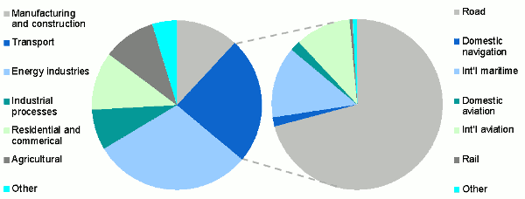
Transport – form an EU perspective
The transport sector has the second biggest greenhouse gas emissions in the EU.
More than two thirds of transport-related greenhouse gas emissions are from road transport

Slide 6
Transport: Overview of EU Legislative Framework
CO₂ from road transport
Regulation (EC) No 443/2009: Emission performance standards from new passenger cars (amended by Regulation (EU) No 333/2014 <= CO2 target)
Regulation (EC) No 510/2011: Emission performance standards for vans (amended by Regulation (EU) NO 253/2014 <= CO2 target)
Communication: Strategy for reducing Heavy-Duty Vehicles' fuel consumption and CO2 emissions (COM (2014) 285)
Directive 1999/94/EC on consumer information on fuel economy and CO2 emissions in respect of the marketing of new passenger cars
Fuel quality
Directive 1998/70/EC Fuel quality Directive
Directive 2009/30/EC on fuel quality (amending number of elements of Directive 1998/70/EC)
Transport roadmap 2050
White Paper Roadmap towards a competitive and resource efficient transport system (28 March 2011)

Slide 7
White Paper - Roadmap to a Single European Transport Area - Towards a competitive and resource efficient transport system
The European Commission adopted a roadmap of 40 concrete initiatives for the next decade to build a competitive transport system that will increase mobility, remove major barriers in key areas and fuel growth and employment.
At the same time, the proposals will dramatically reduce Europe's dependence on imported oil and cut carbon emissions in transport by 60% by 2050

Slide 8
White Paper - Roadmap to a Single European Transport Area - Towards a competitive and resource efficient transport system
By 2050, key goals will include:
No more conventionally-fuelled cars in cities.
40% use of sustainable low carbon fuels in aviation; at least 40% cut in shipping emissions.
A 50% shift of medium distance intercity passenger and freight journeys from road to rail and waterborne transport.
All of which will contribute to a 60% cut in transport emissions by the middle of the century

Slide 9
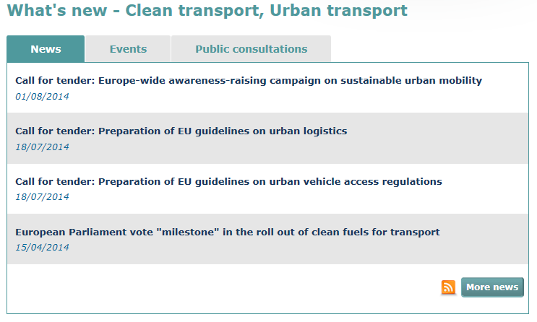
Dynamic context for Clima East
http://ec.europa.eu/transport/themes/urban/index_en.htm

Slide 10
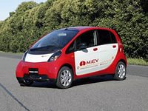
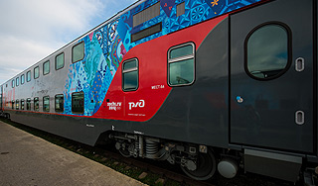
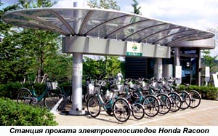
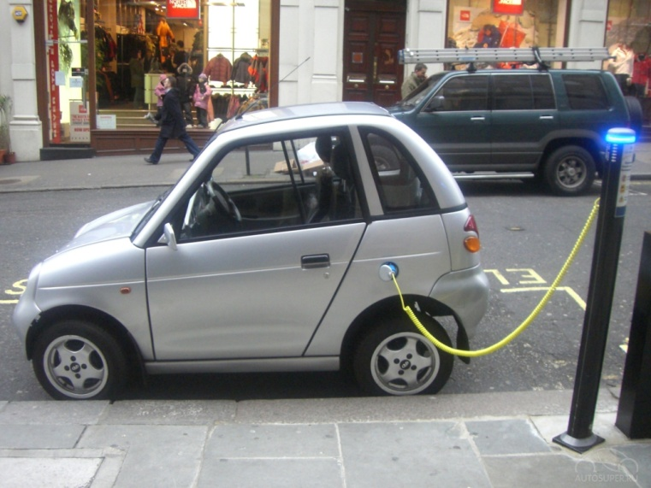

Slide 11
Republic of Belarus
State motor transport development programme for 2011-2015.
Implies among others decrease in the volume of GHG and ozone depleting substances emissions

Slide 12
State policy and measures in the field of transport vehicles in Russia
Transport strategy of the RF up to 2030
Railway transport development strategy of the RF till 2030.
State programme “Development of transport system in Russia” for 2010 – 2015»

Slide 13
Transport Strategy in Russia till 2030
It is supposed to develop and implement state regulation mechanisms to motivate switching of transport vehicles to the use of ecologically clean types of fuel, decrease in energy intensity of transport vehicles to the level of advanced countries.

Slide 14
Railway transport development strategy of Russia till 2030
Depending on development scenarios implementation of planned activities will make it possible to achieve 50-70% reduction of the pollutants discharged by the railway transport by 2030

Slide 15
State Programme «Development of transport system in Russia (2010 – 2015)»
Protection of environment is ensured by means of implementing technical and technological solutions designed in investment projects, which comply with the modern standards and high ecological requirements

Slide 16
Motor transport. Russia
Starting January 1st 2013 all the transport vehicles produced and used in the RF should comply with the requirements of Euro-4 emission standard.
Kazan Regional Experience: public transport use gas

Slide 17
Aviation transport. Russia
National action plan on restriction of GHG emissions in civil aviation in Russia developed
Target indicators of the National plan:
  Volume of CO2 emissions resulted from the combustion of aviation fuel during air transportations will achieve 56 mln. tons including 35 mln. tons – on international transportations. Decrease of specific CO2 emissions indicator per a transport vehicle operation unit in 2011 – 2030 should be in the average 2% a year

Slide 18
Corporate programme of JSC “RZhD” (Russian railways). Russia
It is planned to reduce the aggregate emissions of GHG in 2013 - 2015 by 2,6 mln. of СО2 equivalent.

Slide 19
Ukraine
State programme for transport system of Ukraine

Slide 20
GHG emissions «Transport», Republic of Belarus
In 1990:
  Total – 12 985,75 Gj, including:
    Civil aviation – С
    Road transport – 12927,68
    Railway transport – 58,07
    inland water and marine transport – no data
    Other types of transport – no data
In 2012:
  In total – 7 178,58 Gj, including:
    Civil aviation – 34,32
    Road transport – 5 460
    Railway transport – 942,42
    Inland water and marine transport – 12,78
    Other types of transport – 728б,94 (pipe lines)

Slide 21
GHG emissions “Transport Russia”
In 1990:
  Total – 346 776,31 Gg
    Civil aviation – 19 567,68
    Road transport– 181 748,82
    Railway transport – 18 417,72
    inland water and marine transport – 16 615,62
    Other types of transport– 110 426,46
In 2012:
  Total – 236 487,07Gg, including:
    Civil aviation – 9 272, 56
    Road transport – 148 140,53
    Railway transport – 4 922,37
    inland water and marine transport– 2 647,99
    Other types of transport – 71 503,61

Slide 22
GHG emissions «Transport Ukraine»
In 1990 :
  Total – 70 299,64 Gg
    Civil aviation – 781,30
    Road transport – 146 342,57
    Inland water and marine transport – 2 563,69
    Pipe lines – 9 427,78
    Railway transport – 3 826,93
    Other types of transport – 7357,37
In 2012:
  Total– 33 046,51 Gg, including:
    Civil aviation– 222,05
    Road transport– 29 059,11
    Railway transport – 333,89
    Inland water and marine transport–67,07
    Pipe lines – 3 364,39
    Other types of transport– 3 364,39

Slide 23
Thank you for your attention!
How to contact us
The project team can be contacted at personal e-mail addresses and:
info@climaeast.eu
Clima East Office
c/o Milieu Ltd
Rue Blanche n 15
1050 Brussels, Belgium
Website:
www.climaeast.eu

