Slide 1
Air Quality in the ENPI East Countries
Results from RPP3:
(Effective use of Urban modelling tools on Air Quality policy development)
&
The Danish experience on urban transport policy
21-22 October, 2014, Chișinău, Moldova

Slide 2
Content
1: Overview of the THOR-system
  DEHM, UBM & OSPM.
2: Application of the THOR-system in
RPP3.
3: Use of the THOR-system on urban
transport policy.
18
Notes:
Give a short presentation of THOR. The system installed on the computers in front of you.
THOR consists of three models ……
Many groups have Rigional ACTM, not so many UBM of street models.
Why three model???????????

Slide 3
Integrated air pollution modelling
from hemispheric to local scale
The THOR system

Slide 4
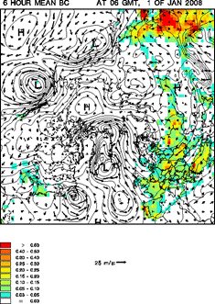
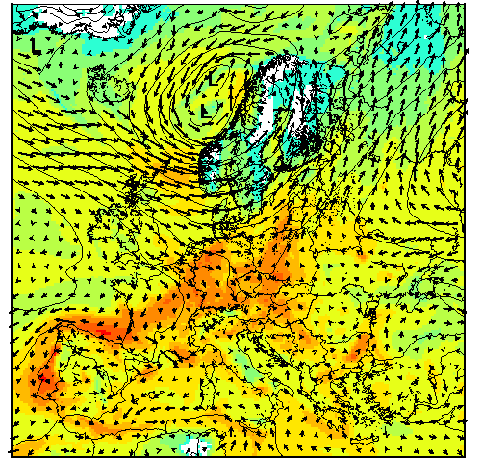
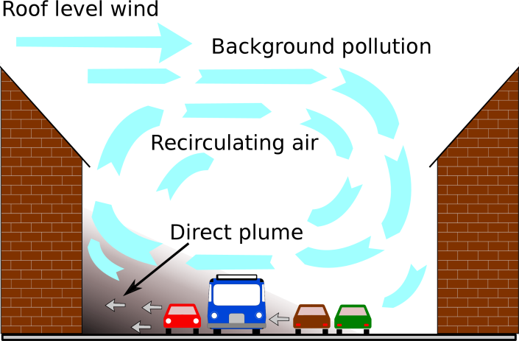
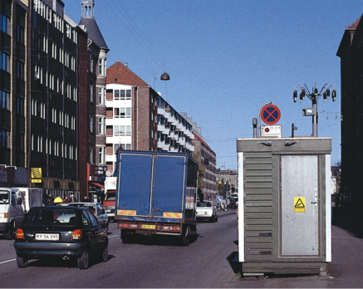
Scales
The range of atmospheric motion covers, roughly speaking, 13 orders of magnitude (10⁻⁶ m to 10⁷ m) from molecular diffusion to large-scale weather systems and with a non-linear continuous interaction between all these scales of motion.
DEHM
UBM
50%
OSPM
20%
10%
20%

Slide 5
The THOR system – main purpose
Main purpose is to carry out research, development and applications with respect to air pollution modelling, e.g.:
  to carry out operational air quality forecasting and management from regional to local scale for information and warning of the public,
  to quantify human exposure, impacts on human health from air pollution and the subsequent costs,
  to use models in combination with measurements (both surface and satellite data) to carry out “integrated monitoring” of the environment,
  AQ and impact assessments
  to support policy development of the above.
2

Slide 6
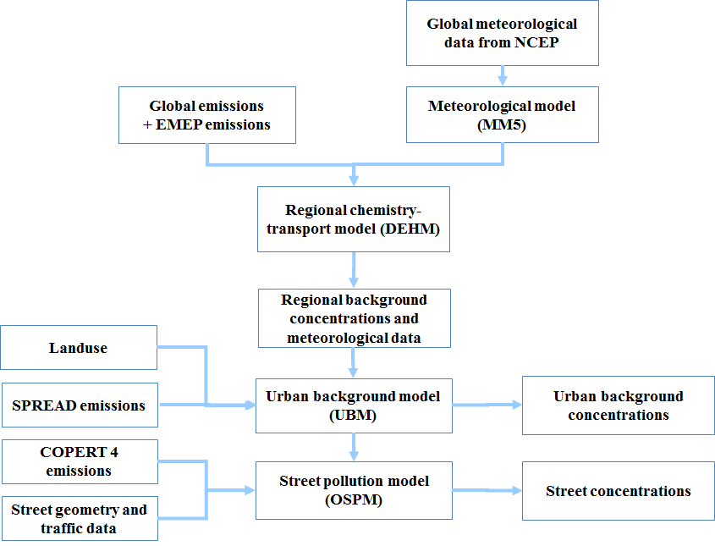
The THOR Integrated Model System Applied to in the RPP3-Project
d4
Notes:
How these are coupled together can you see here.

Slide 7
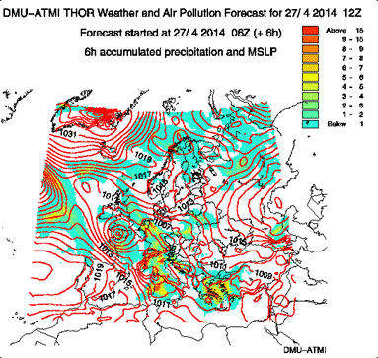
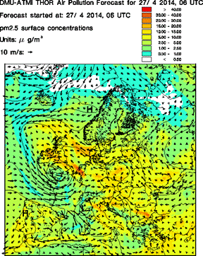
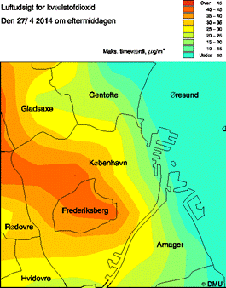
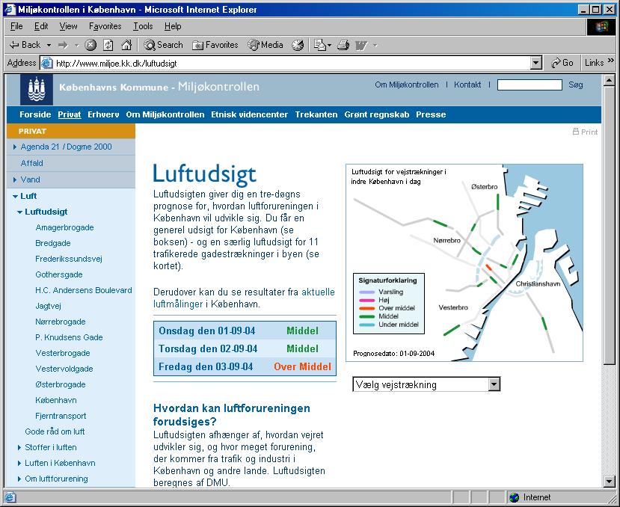
Model Scales Within the THOR system from Regional to Local Scale

Slide 8
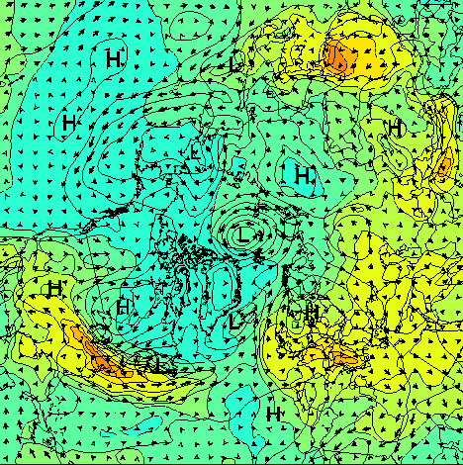
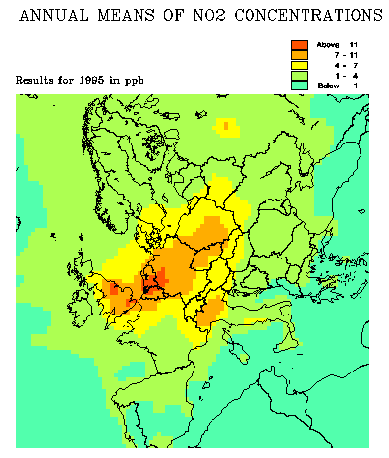
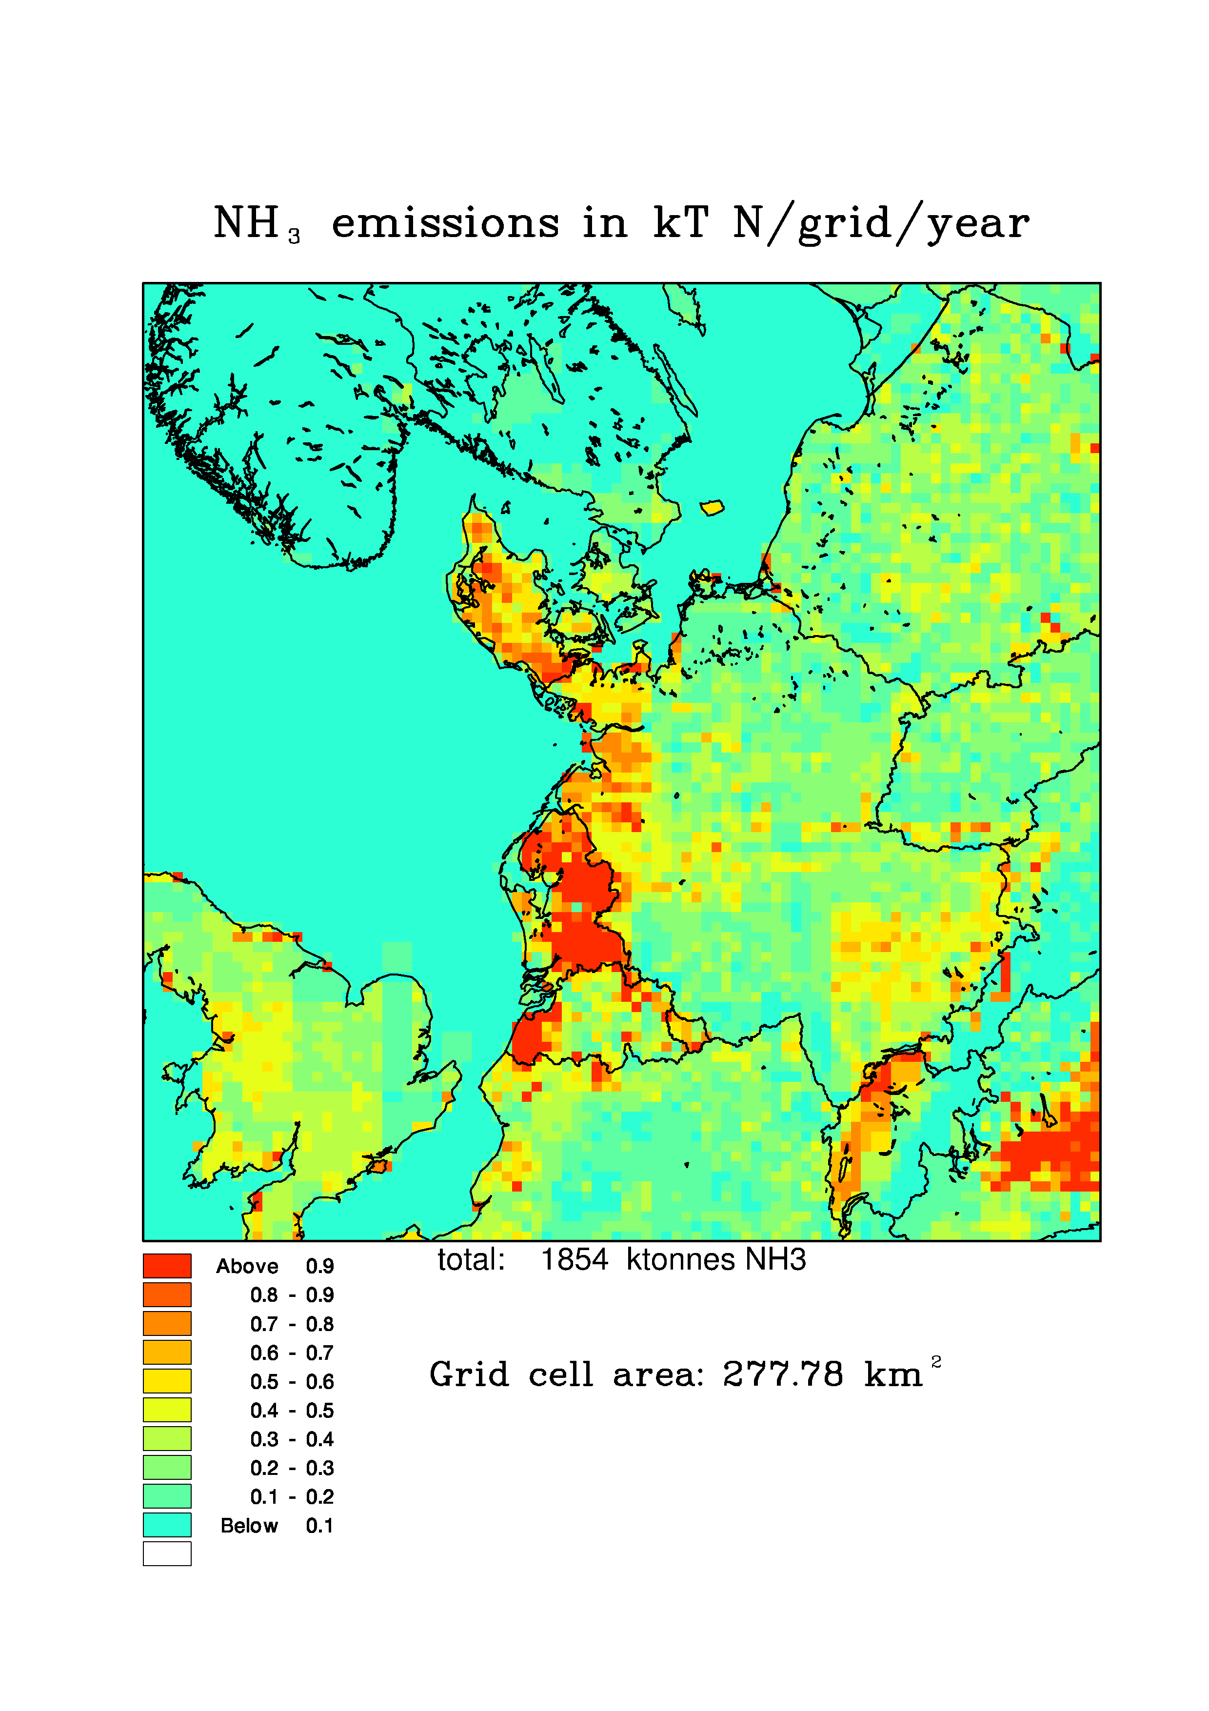
Regional ACTM
  Danish Eulerian Hemispheric Model (DEHM)
    a nested transport-chemistry model for the Northern Hemisphere
    150x150 km² resolution over NH, 50x50 km² resolution over Europe and 16.67x16.67 km² resolution over Denmark
    emissions: global to Denmark (next slide)
    meteorological data from MM5 by THOR system (150, 50 and 16.67 km² from MM5)
    hourly time-series of e.g. NO_{x}, NO₂, nitrate, N-deposition, SO2, sulphate, S-deposition, O₃, CO and secondary particles incl. PM2.5, PM10
    model runs on work station cluster
Northern Hemisphere
Europe
Denmark
14
Notes:
Kva_celler_ligg.ppt

Slide 9
Emissions for DEHM
  Global
    GEIA, EDGAR, RETRO (wildfire), Corbet (ship))
  Europe
    EMEP (50x50 km²)
  Denmark
    AIS (ship) and high resolutions from
    ENVS
Northern Hemisphere
All sectors without road traffic:
All the emission categories are
added together in SNAP codes
for DEHM run
Road traffic, split:
different vehicle types
exhaustion and non-exhaustion
All these data are added together
into one SNAP category.
Europe
Denmark
13
Notes:
Danish data work at ENVS/AU
Kva_celler_ligg.ppt

Slide 10
The Danish Eulerian Hemispheric Model, DEHM
12
Notes:
Typical anual concentrations of O3 and PM2,5 from Northern Hemispheric DEHM.
E.g. NOX eat O3, high PM2.5 over cities

Slide 11
The Danish Eulerian Hemispheric Model, DEHM
11
Notes:
Same pictures but on European scale

Slide 12
The Danish Eulerian Hemispheric Model, DEHM
NO₂
O₃
SO₂
SO₄²⁻
10

Slide 13
Urban Background Model, UBM
Gaussian multiple plume model (horizontal) and linear dispersion to Hmix (vertical)
Input data:
  Meteorological forecast from the Eta/MM5 model
  Regional air pollution forecast from DEHM
  Emissions of NO_{x}, CO, benzene, PM, etc.
Output:
  Hourly values of O₃, NO, NO₂, NO_{x}, CO, benzene, PM, etc.
Resolution ~ 1 km
Validated for several cities in Denmark
NO_{x} emissions
[kg/km²/day]
NO₂ conc. [ppb]
9
Notes:
Need the regional contribution (DEHM og rural station)
Has to cross the water therefore bery high AP over few bridges

Slide 14
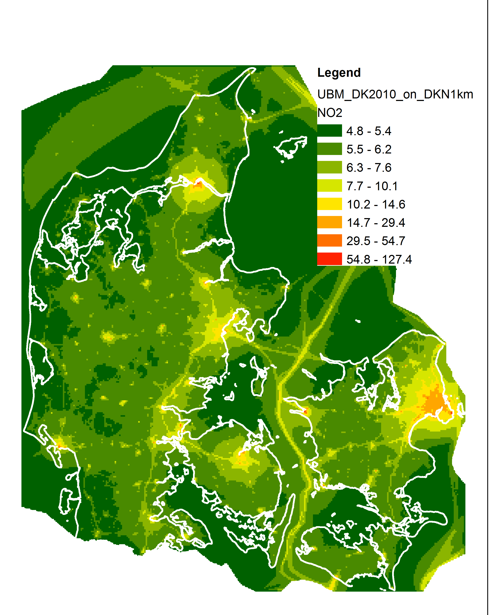
UBM NO₂ simulation
1X1 km²
7
Notes:
Signal from major cities, street, ships

Slide 18
Operational Street Pollution Model, OSPM
Street canyon model
Combined plume model (leeward side of the street) and box model (windward side)
Input:
  Meteorological forecast from the Eta model
  Air pollution forecast from DEHM and UBM
  Street configurations
  Traffic data
Output:
  O₃, NO, NO₂, NO_{x}, CO, benzene and PM
Forecasting at both sides of the street
Applied and validated for many cities
NO + O₃ NO₂
NO₂ + hv O₃ + NO
6
Notes:
Input from DEHM and UBM, or URBAN background and meterological station
AP captured -> very different AP on the different sides on the street

Slide 19
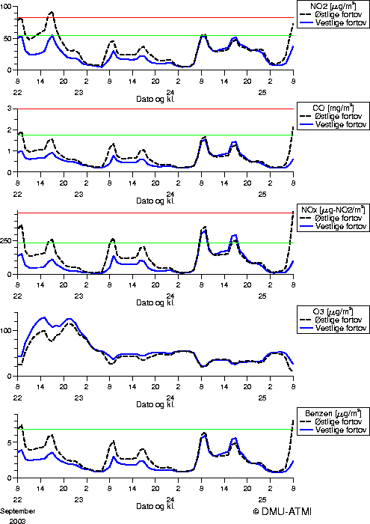
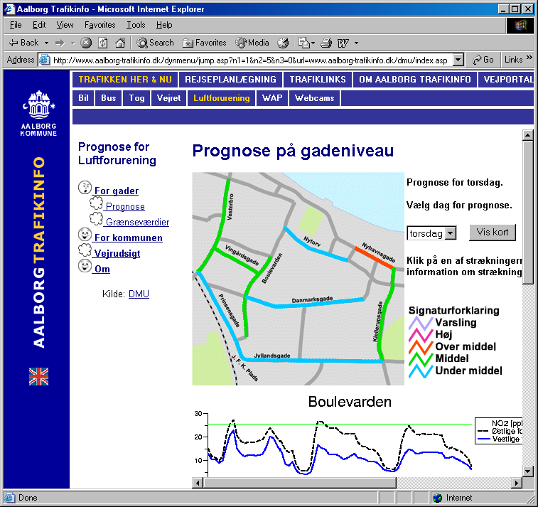
Air quality forecasts in Danish cities
Copenhagen
Aalborg
5

Slide 20
Time series of meteorology at Aalborg roof level (left) and concentrations (right) at Aalborg street level
4
Notes:
Some misses
In general good

Slide 21
RPP-3 project, Objective:
In close collaboration with local authorities, experts and civil servants to build/implement the integrated monitoring system THOR in the ENPI east countries which can be used for:
    high resolution urban air quality modelling,
    urban assessment,
    urban planning / traffic planning,
    etc.
After the end of the project:
    the system can be operated by local civil servants,
    the local civil servants can setup the system in other cities in their countries.

Slide 22
RPP3 Pilot Cities
Country | Pilot City | Area | Population | Urban Background Stations | Street Level Stations
Armenia | Yerevan | 223 km² | 1.060.138 (2011) | 2 AQ | 7 AQ
Azerbaijan | Sumgait | 83 km² | 312.000 (2010) |  | 3 AQ
Belarus | Novopolotsk | 48,49 km² | 98.138 (2009) |  | 1 AQ
Georgia | Batumi | 64,9 km² | 190.405 (2012) | 2 Met | 1 AQ
Moldova | Chisinau | 123 km² | 674.500 (2014) | 1 Met, 1 AQ | 5 AQ
Ukraine | Kiev | 839 km² | 2.847.200 (2013) |  | 16 AQ

Slide 23
Yerevan, Armenia
1: UBM simulation for the Armenian EMEP station from 2009 - 2012
2: UBM simulation for the hole grid for Yerevan 2012
3: UBM simulation for 2 background stations in Yerevan 2011 - 2013
2: OSPM simulation of Komitas street in Yerevan 2009

Slide 24
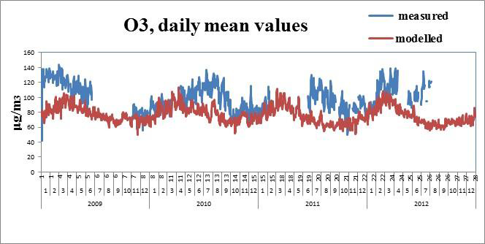
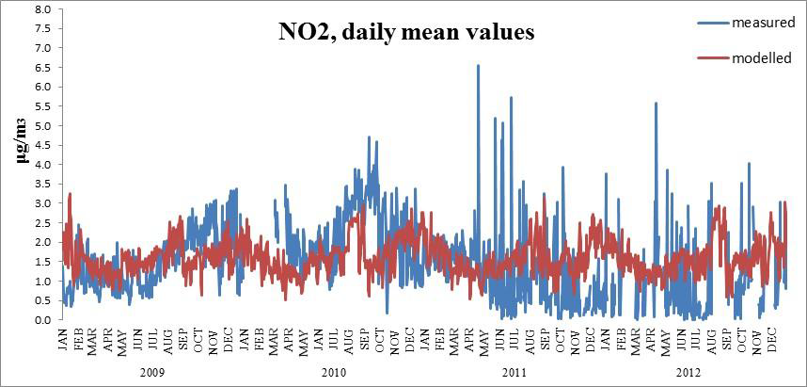
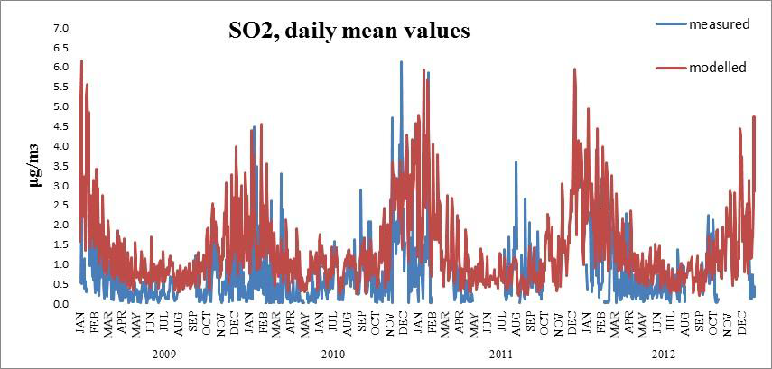
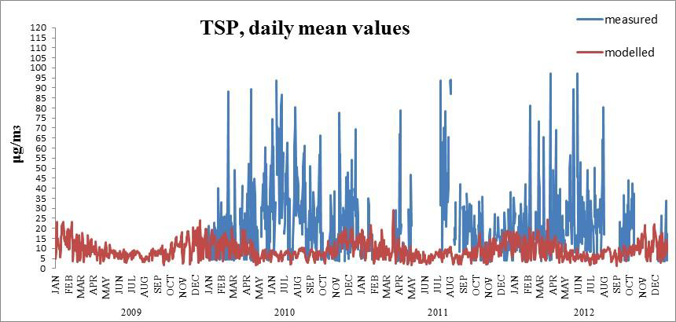
UBM simulation for the Armenian EMEP station

Slide 25
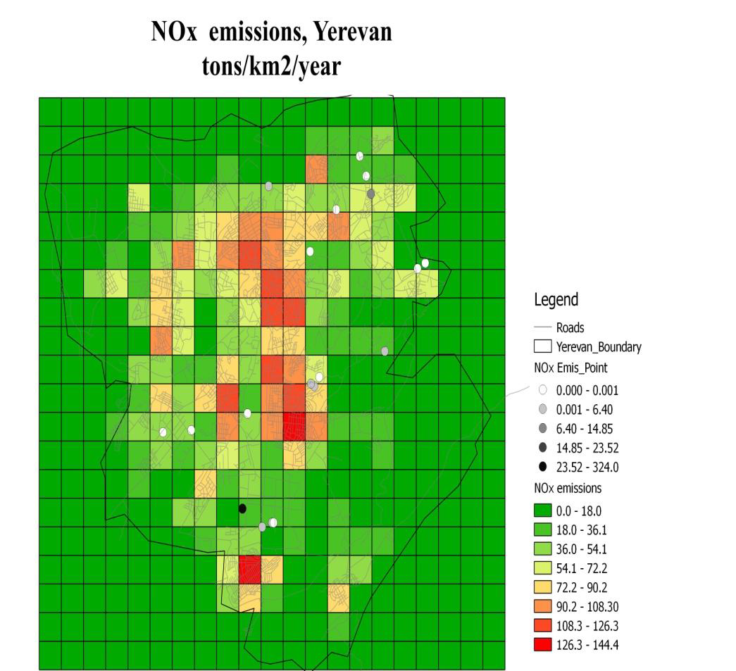
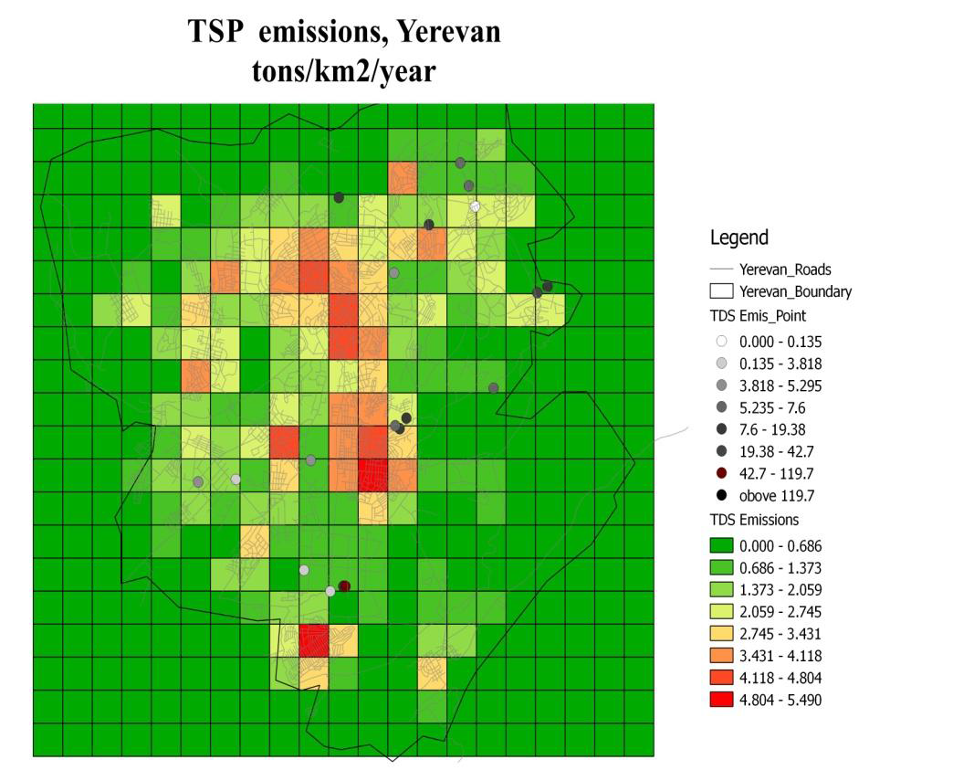
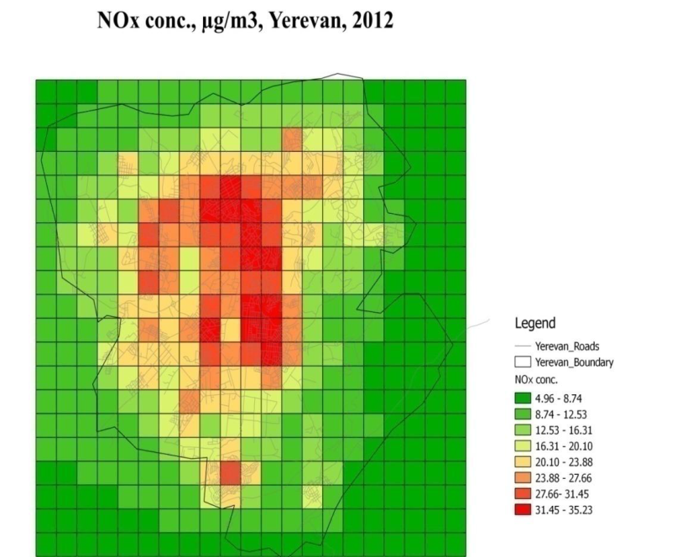
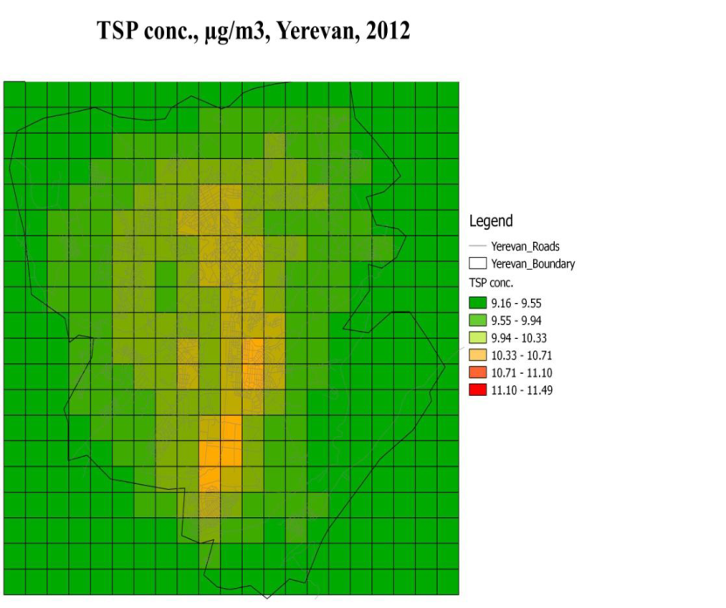
UBM simulation for the hole grid for Yerevan 2012

Slide 26
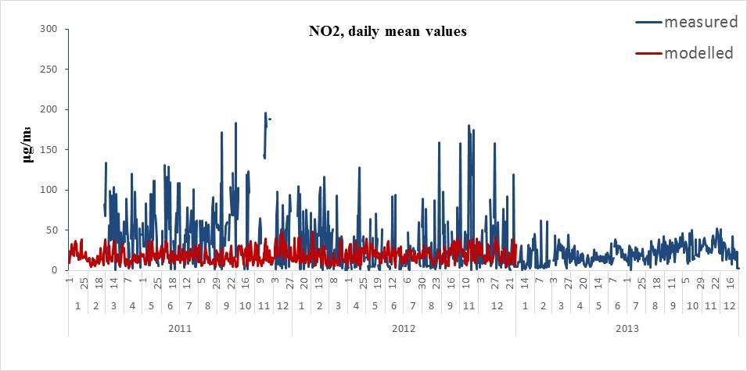
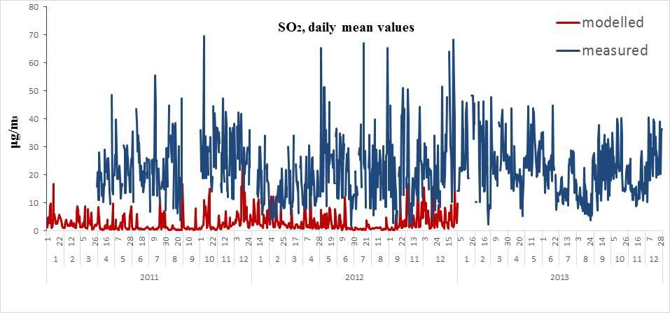
UBM simulation for 2 background stations in Yerevan 2011 - 2013

Slide 27
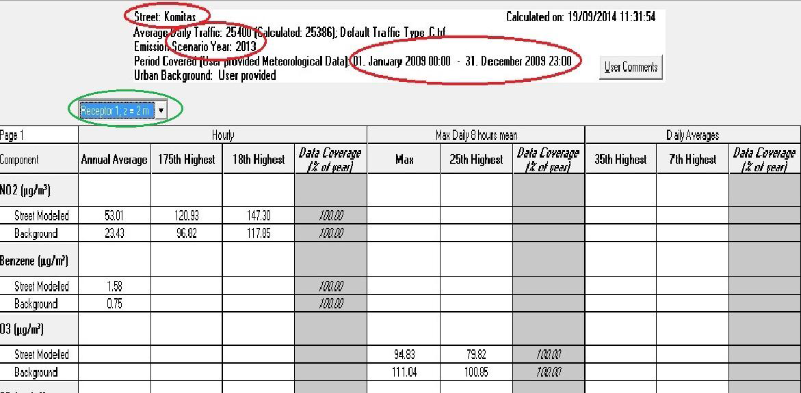
OSPM simulation of Komitas street in Yerevan 2009

Slide 28
Sumgait, Azerbaijan
1: UBM simulation for the entire grid 6 years (2000-
2005)
2: UBM simulation for 2 years and 5 receptors
3: OSPM simulation for Sulh and Samed Vurgun street

Slide 29
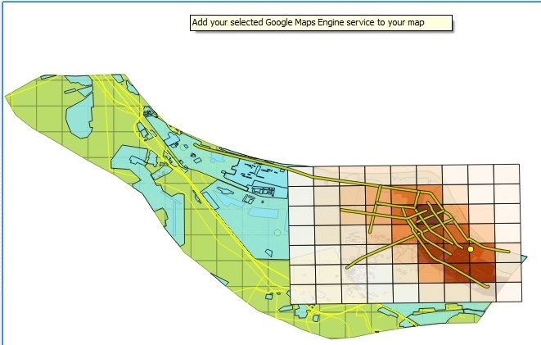
Showing results in QGIS
Average of Nox for whole grid

Slide 30
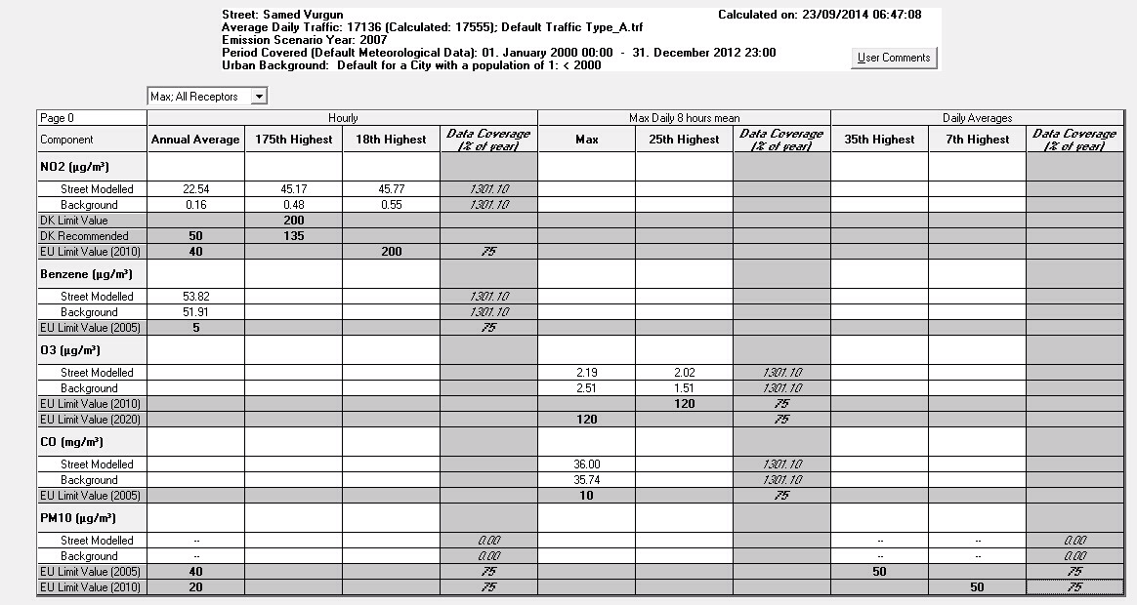
OSPM modeling for Samed Vurgun street

Slide 31
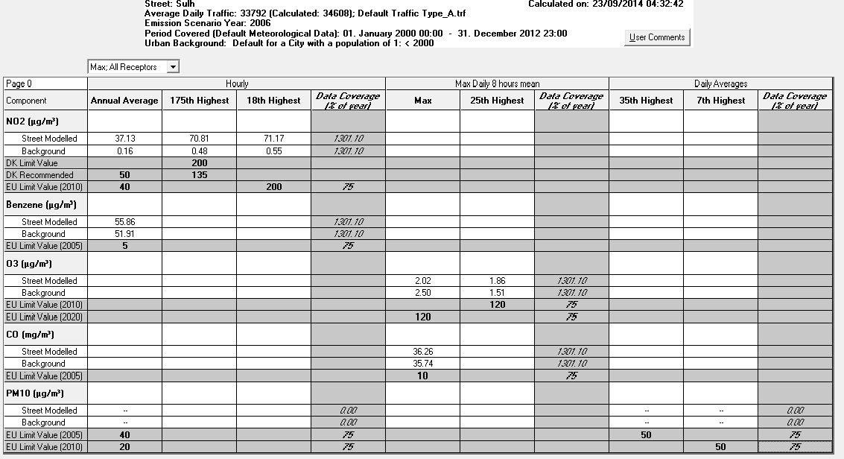
OSPM modeling for Sulh street

Slide 32
Chisinau, Moldova
1: UBM simulation, entire grid, year 2009
2: OSPM simulation for Calea Iesilor str.
For 2009

Slide 33
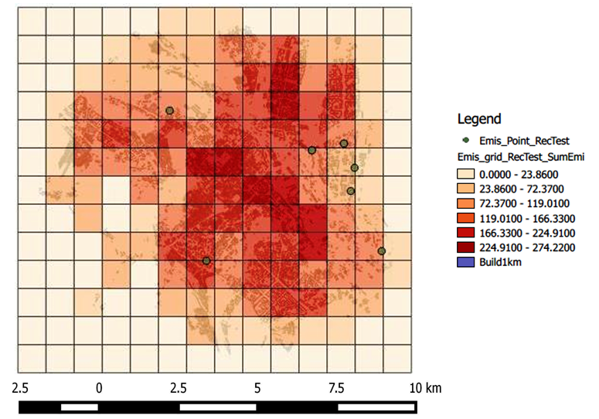
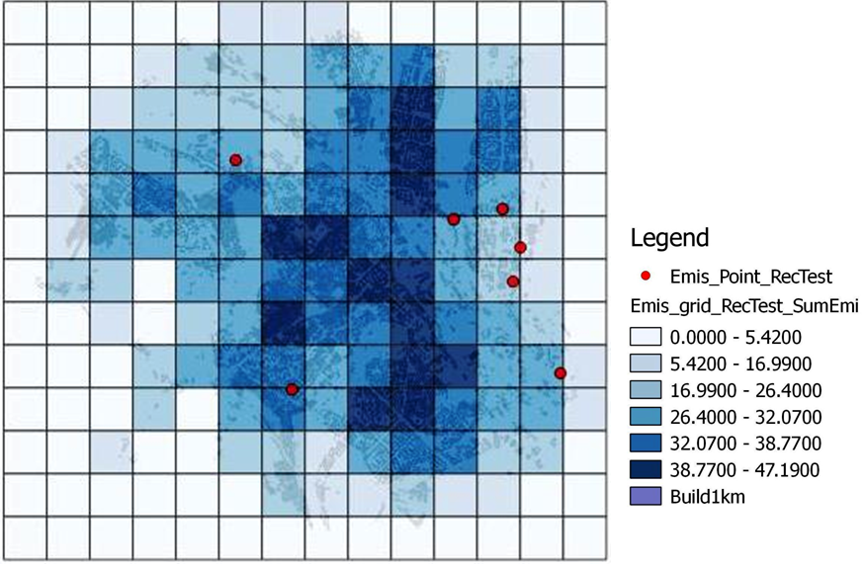
NOx Emissions SOx Emissions in Tons

Slide 34
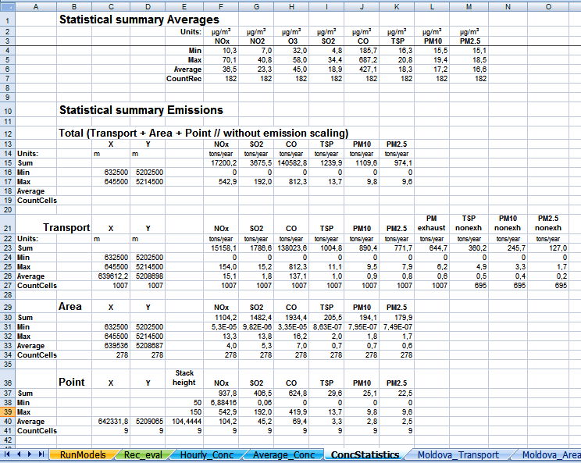
UBM output data as presented in THORAirPas:
Concentration of pollutants in Chisinau mun. in 2009

Slide 35
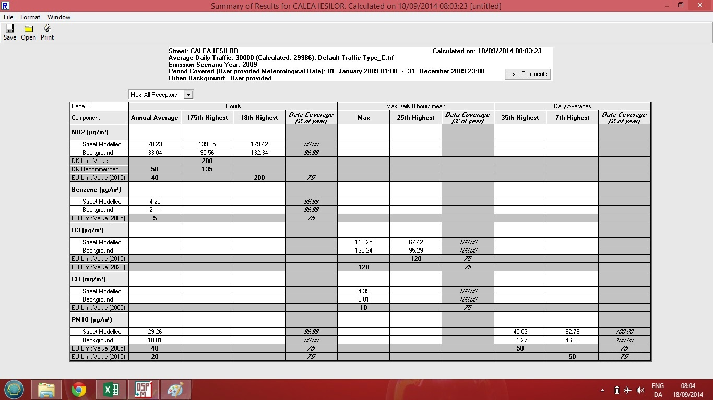
OSMP output data as presented in THORAirPas
for the Calea Iesilor str.

Slide 36
Batumi, Georgia
UBM Simulation for the entire grid

Slide 37
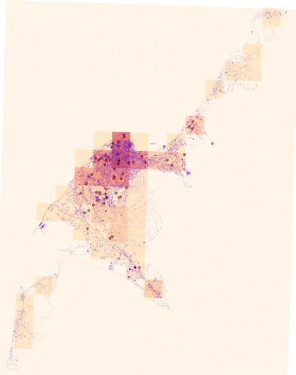
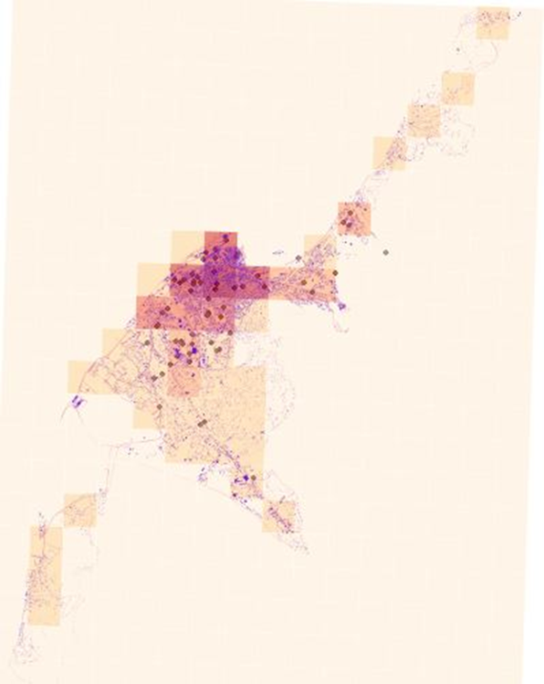
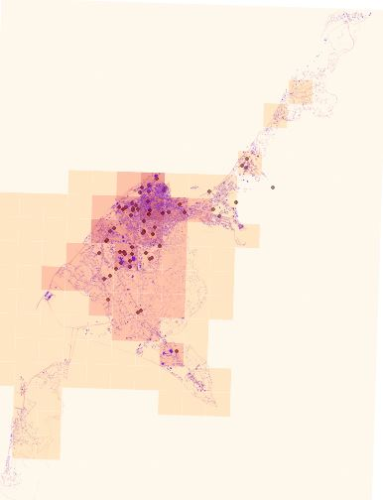
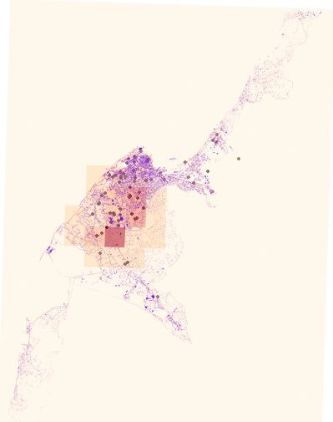
SO₂ TSP
Emissions 07.2012
Conc. 07.2012
Emissions 07.2012
Conc. 07.2012

Slide 38
Kiev, Ukraine
UBM simulation, entire grid

Slide 39
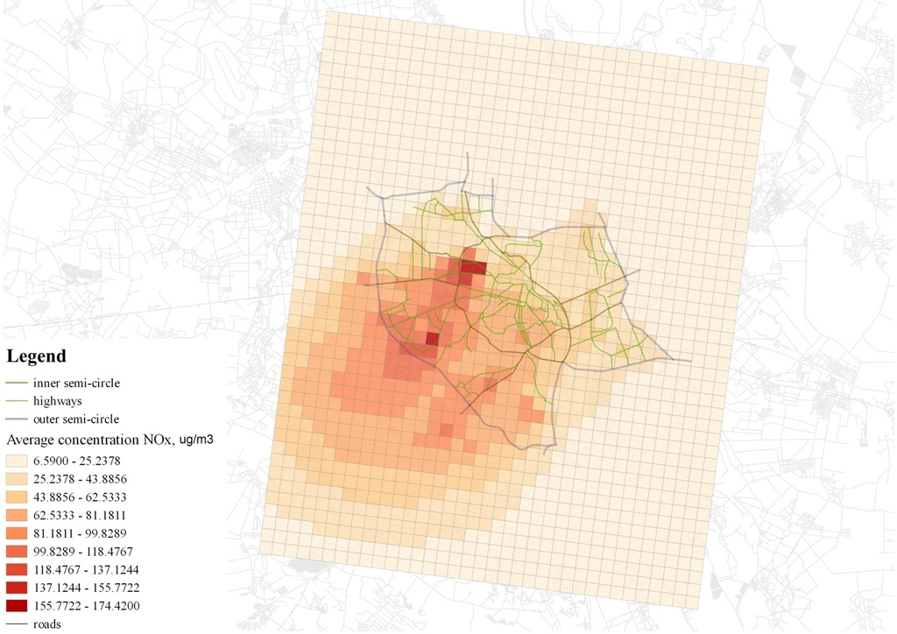
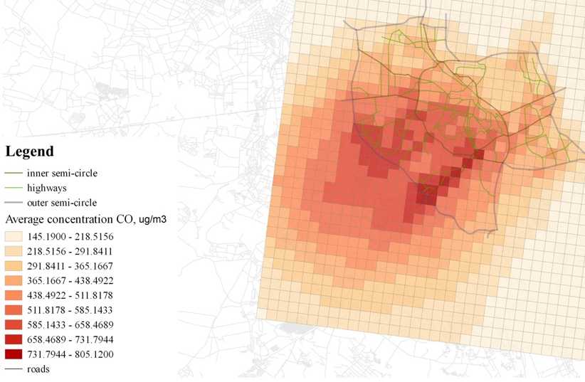
NOx Conc.
CO Conc.

Slide 40
Danish experience on urban transport policy
(Using THOR for AQ and Impact Assessment)
Air quality assessment
Health impact assessment and external costs of air pollution
Impact assessment of policy measures

Slide 41
Air quality and health impact assessment
AQ information at the regional scale, urban background scale and street scale
past, present and future air quality levels
visualize spatial distribution of air quality levels
validated models can provide comparisons air quality limit values or guidelines can be carried out and an assessment of exceedances of limit values
impact assessment on health effects and related social costs of air pollution

Slide 42
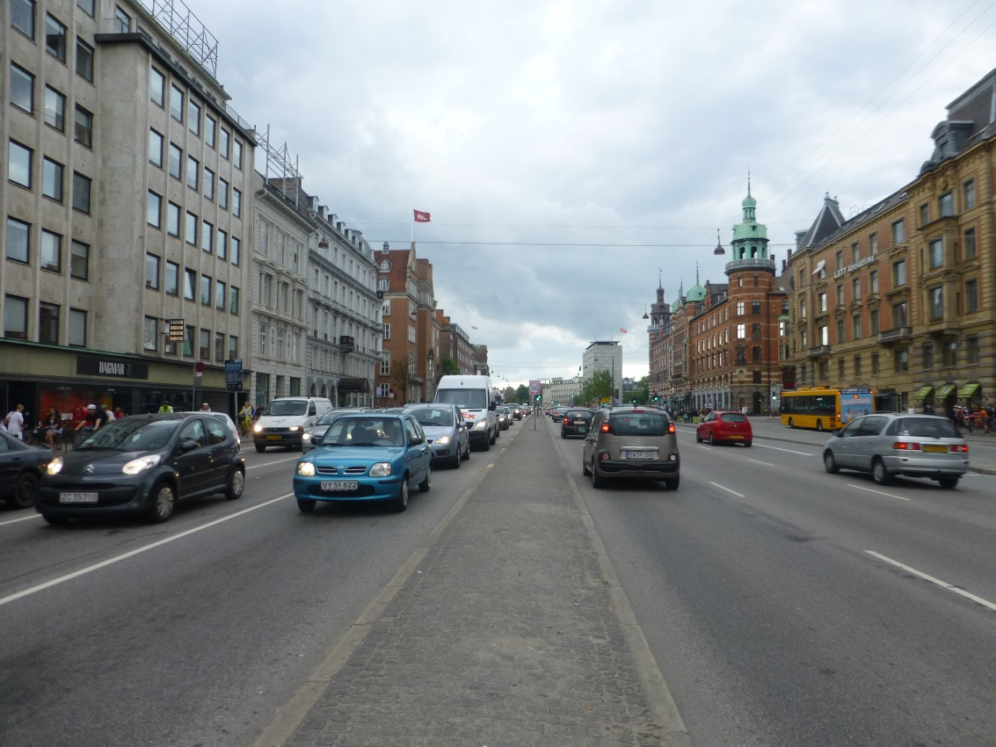
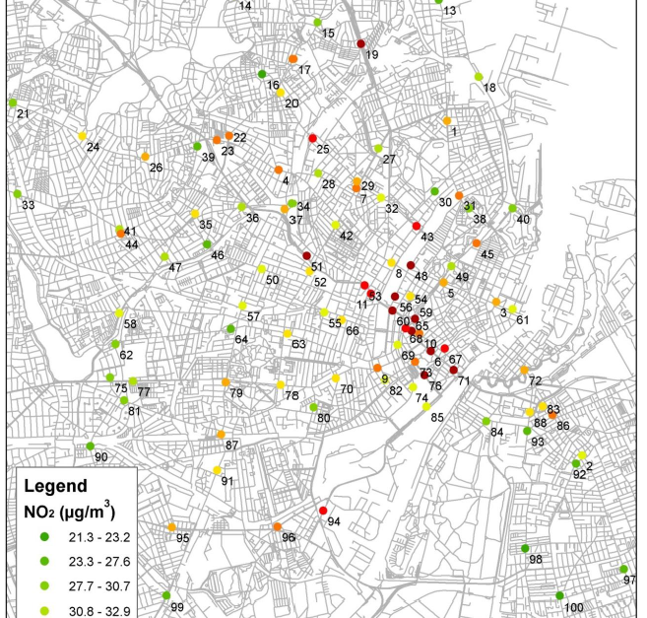
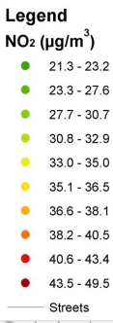
Annual average NO2 conc. at 100 streets in Copenhagen Red and Dark Red: NO2 exceednces in Copenhagen 2012
6
Notes:
How OSMP used in Copenhagen (Work by MK)
Show where is HCA
Above EU limit -> mainly at HCA

Slide 43
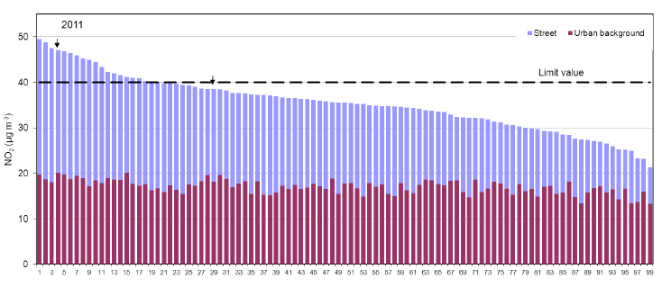
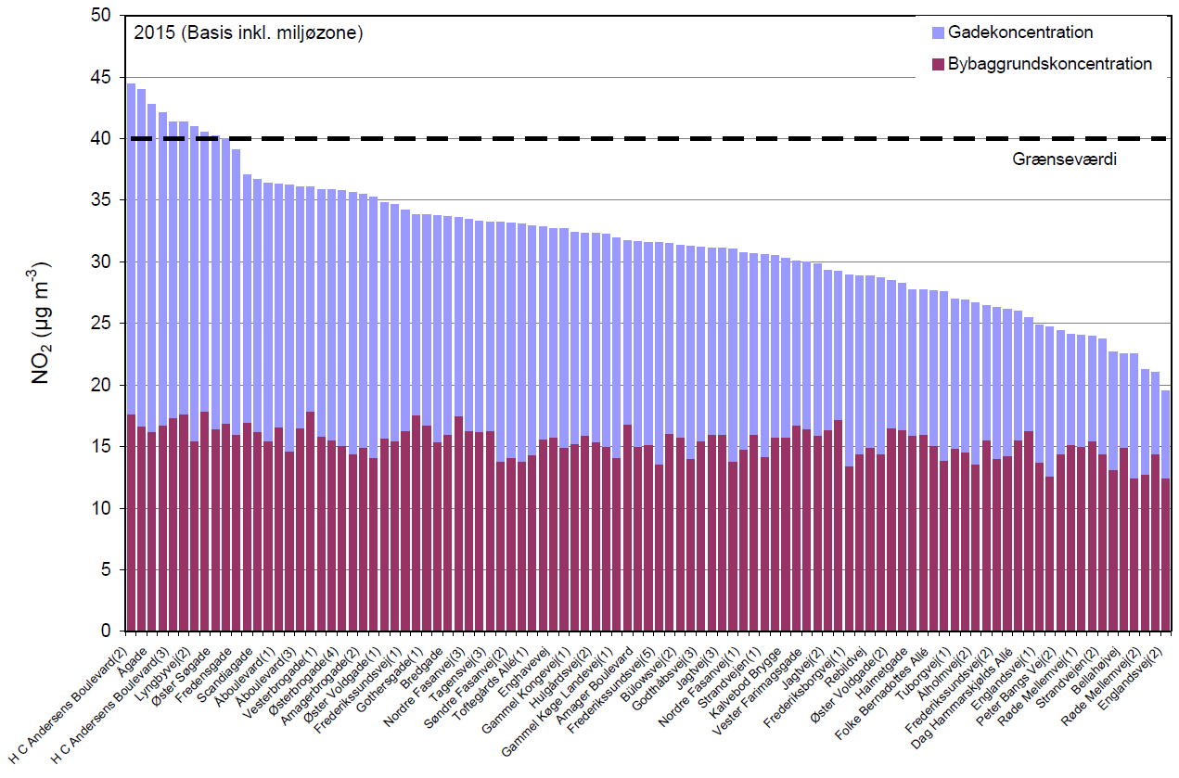
Predicted NO2 (μg/m3) exceedances in 2011 and 2015
5

Slide 44
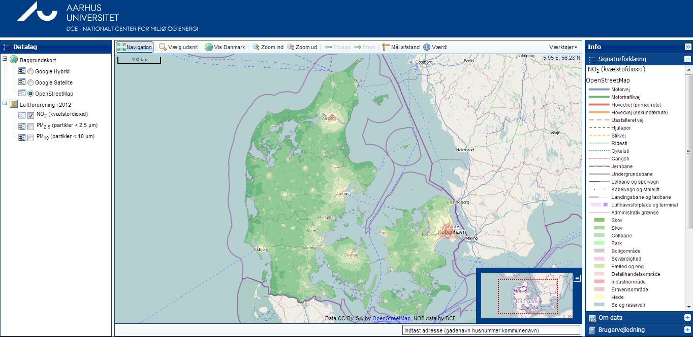
Website for Air Quality at Your Street

Slide 45
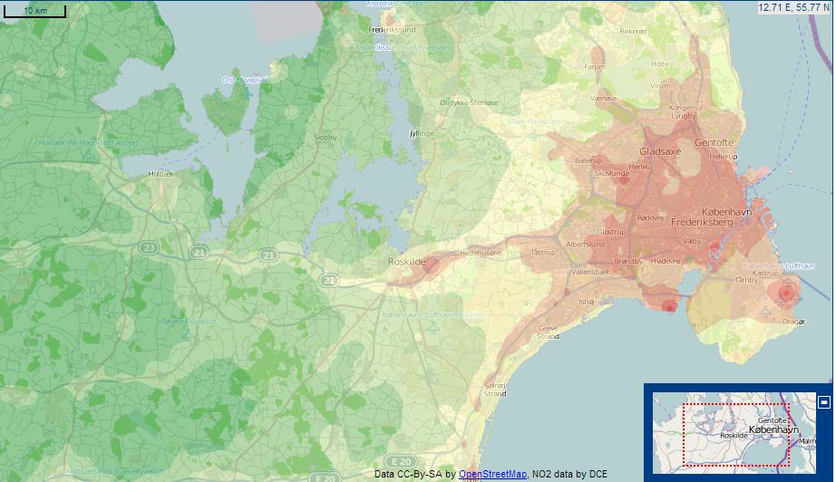
Urban background concentrations of NO2
DEHM + UBM

Slide 46
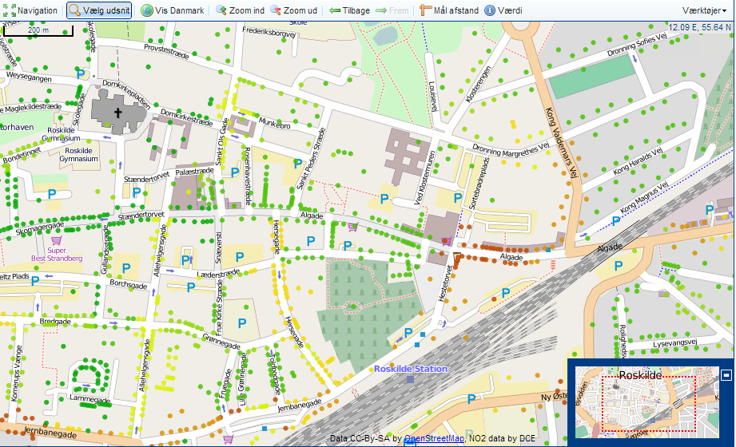
Street concentrations of NO2
DEHM+UBM+OSPM

Slide 47
External costs of air pollution
External costs for air pollution (excl. CO2) are related to health effects and estimated based on the ”impact pathway” method (EVA-system)

Slide 48
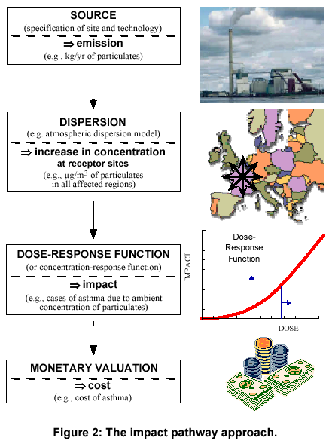
EVA – Economic Valuation of Air pollution
Emissions sources
Concentration (DEHM) and
(UBM) and population
exposure Health effects
based on exposure–response
relations
External costs based on pricing
of health effects
Output:
  Health effects
  External costs
  Unit costs
Applications:
  Assessments, cost-benefit

Slide 49
Calculated using EVA (THOR System + Health and Economic Valuation Module) for the year 2000 for the total air pollution levels
A total of 680000 cases decreasing to 450000 in the year 2020
For Denmark:
Year 2000: 4000,
Year 2011: 3200
Year 2020: 2200
Total number of cases of premature deaths in Europe
Notes:
to quantify human exposure, impacts on human health from air pollution and the subsequent costs,

Slide 50
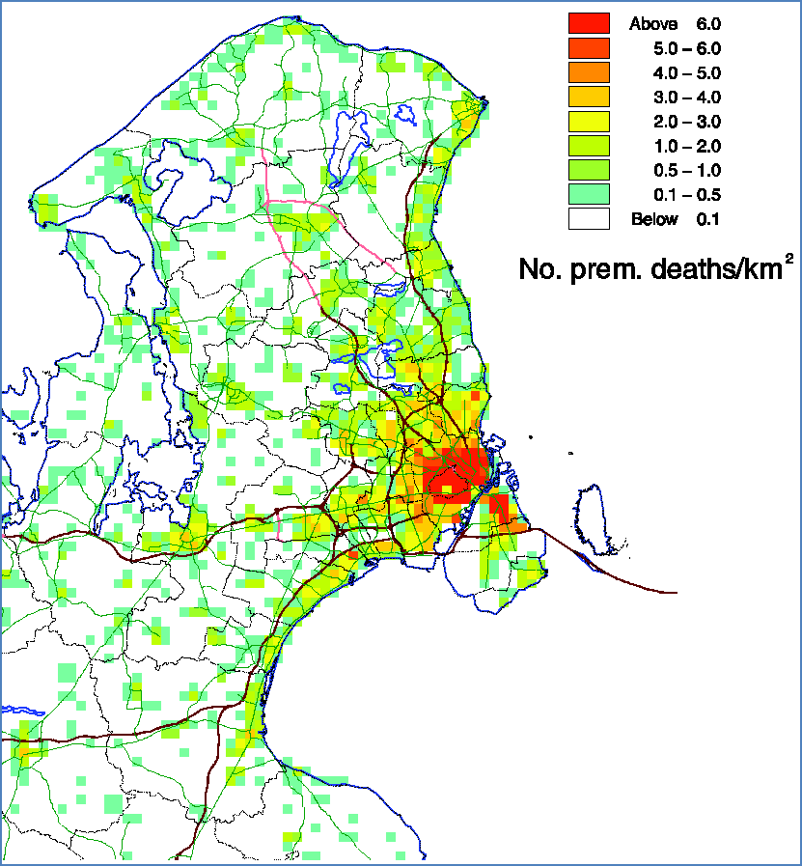
Premature deaths in Copenhagen region 2010
1: total of ~1500 premature deaths for the whole area due to all domestic and foreign emissions or about DDK 12 billion per year
2: ~540 in inner city
(Municipalities of
Copenhagen and
Frederiksberg or about DDK
4 billion per year
3: local emissions in
Copenhagen and
Frederiksberg contribute only about 11%

Slide 51
Impact assessment of transportation schemes
Road network and associated traffic (e.g. based on traffic modelling)
Traffic (total flow, vehicle distribution, travel speed) in an existing road network
Traffic due to policy measures such as toll ring, road pricing or other traffic management schemes
Vehicle emissions due to:
  dieselisation of the vehicle fleet
  Low Emission Zone (LEZ) that ban older vehicles (older emission classes) to enter a zone
  scenarios for introduction of electric vehicles
  etc.

Slide 52
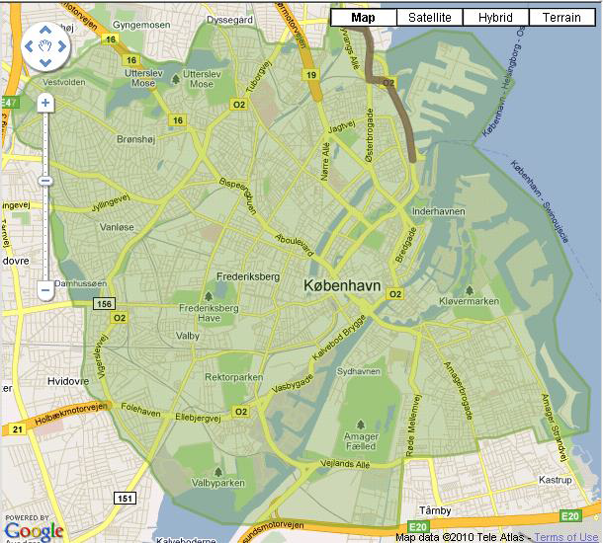
Existing Low Emission Zone
Particle filters on diesel-
powered heavy-duty vehicles
> 3½ ton
Euro II & older by Sept. 1, 2008
(vehicles<=2001)
Euro III & older by July 1, 2010 (vehicles<=2006)
Etablished in Copenhagen in
Sept. 2008)
Particle filters in average
assumed to reduce exhaust
PM by 80%
Impacted assessed with
UBM-OSPM and regional
measurements
Low emission zone in Copenhagen,
equal to municipal border
Other cities:
  Aalborg (Feb, 2009)
  Odense (Jul, 2010)
  Aarhus (Sep, 2010)

Slide 53
Impacts of LEZ in Copenhagen:
1: PM exhaust emission from HDT is reduced by 60% in
2010 corresponding to 16% for all traffic (HCAB) (due to shift to EEV/Euro5 and re-profit of DPF on <=Euro
3)
2: LEZ reduces PM10 street concentrations with 0.2 μg/m3 (1%) and PM2.5 also by 0.2 μg/m3 (1.5%) modest change due to significant non-exhaust and regional contribution
3: NOx reduction of about 25% due to a partly shift towards Euro 5 vehicles instead of equipping all heavy-duty vehicles with particle filters (Euro 3 or older)
4: Total NOx emission reduced 8% in 2010
5: No. of exceedances of the NO2 limit value in 2010 47 to 29 (out of 138 streets)

Slide 54


Impacts of proposed LEZ to EC concentrations in CPH
Reference in 2015 Proposed Berlin scenario in 2015
Berlin scenario: Diesel-dreven passenger cars and vans <= Euro 3 and petrol-dreven passenger cars and vans <= Euro 0 are banned in LEZ

Slide 55

Proposed toll ring in Copenhagen
Congestion charging
impact assessment showed reduction in traffic by 19% and in NOx emissions by 10%
reduction in No. of NO2 exceedances from 11 to 6 in 2016 (out of 138 streets)
proposal turned down due to opposition

Slide 56
Thank you for Attention!

