Slide 1
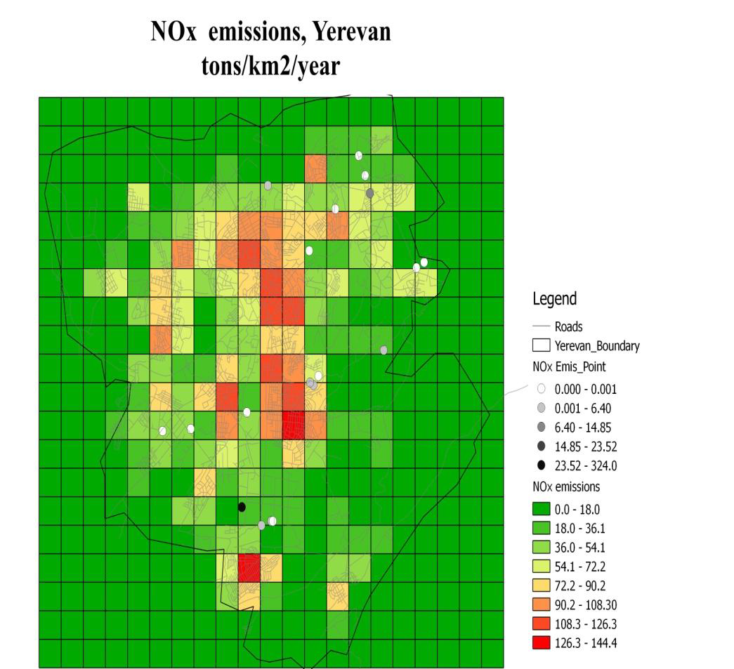
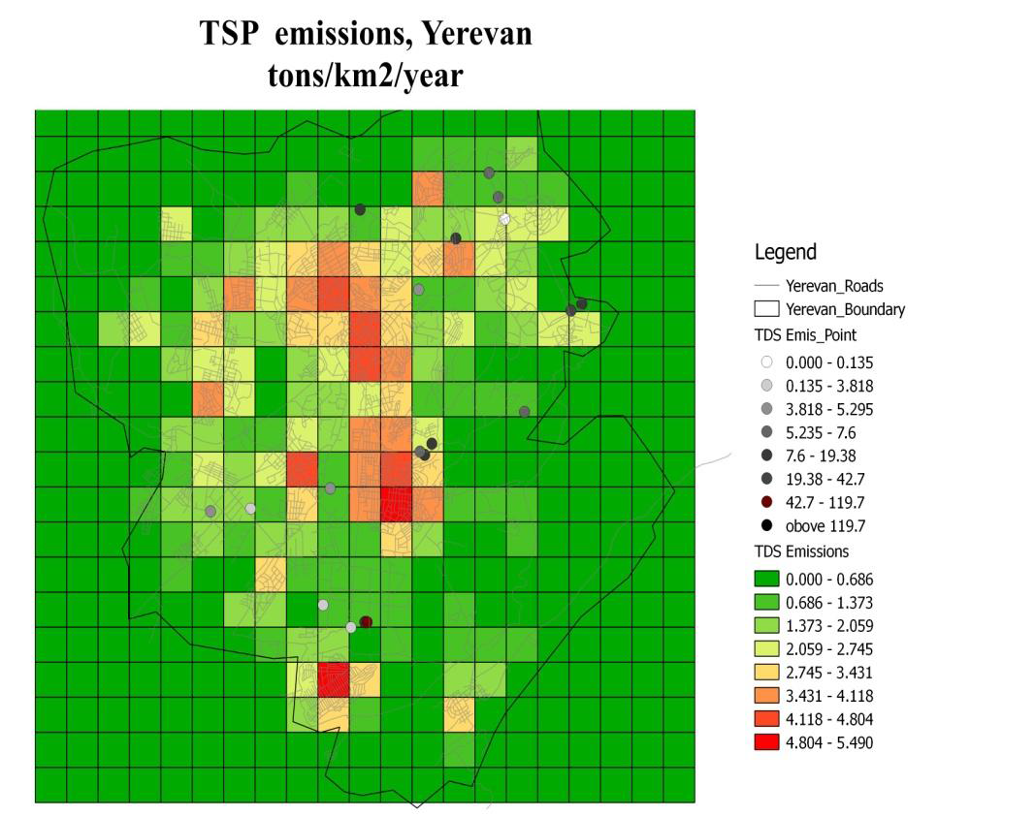
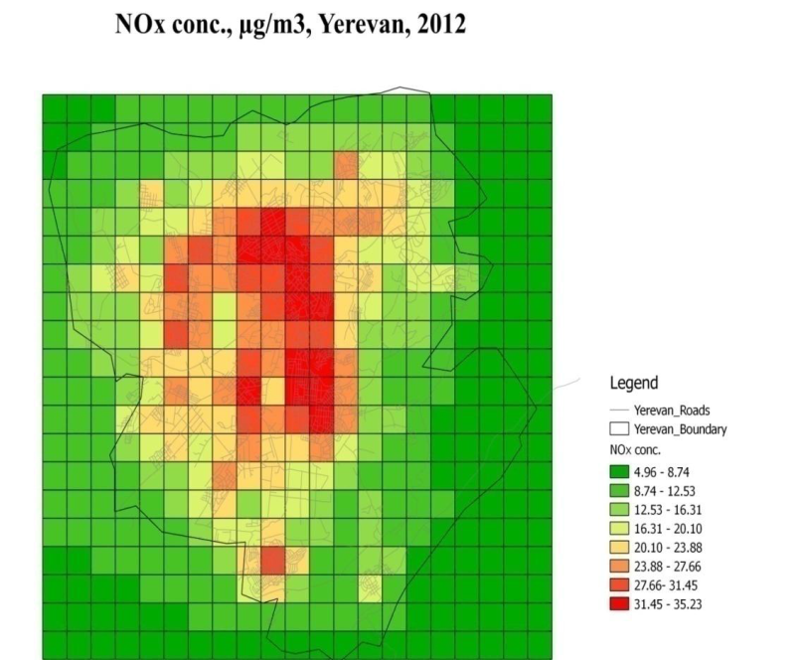
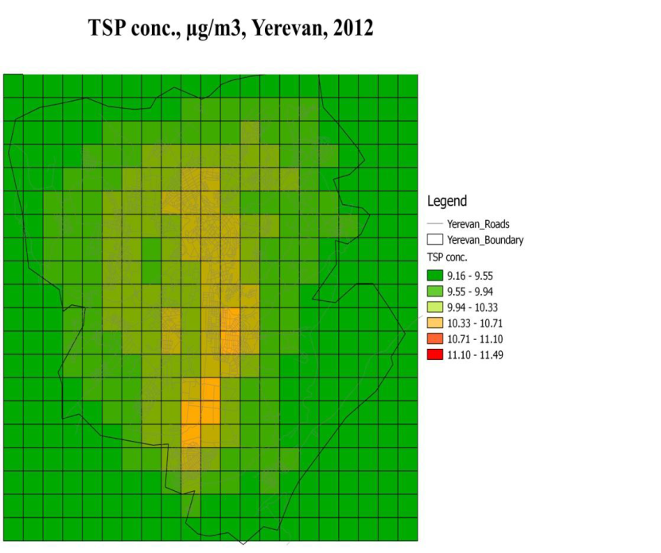
UBM simulation for the hole grid for Yerevan 2012

Slide 2
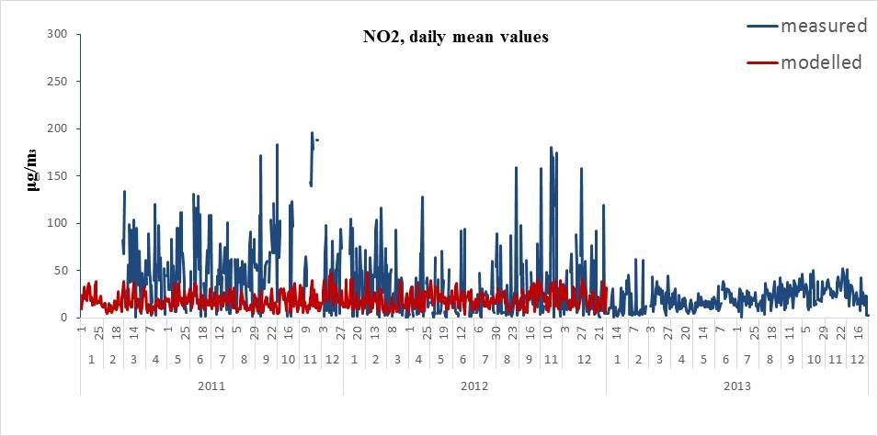
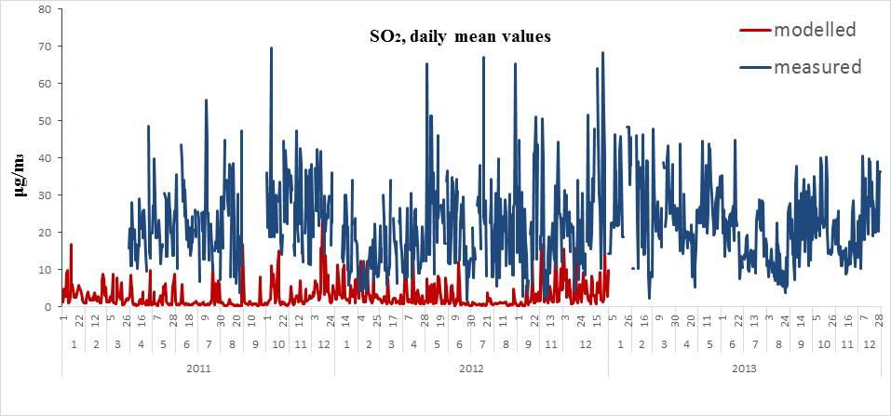
UBM simulation for 2 background stations in Yerevan 2011 - 2013

Slide 3
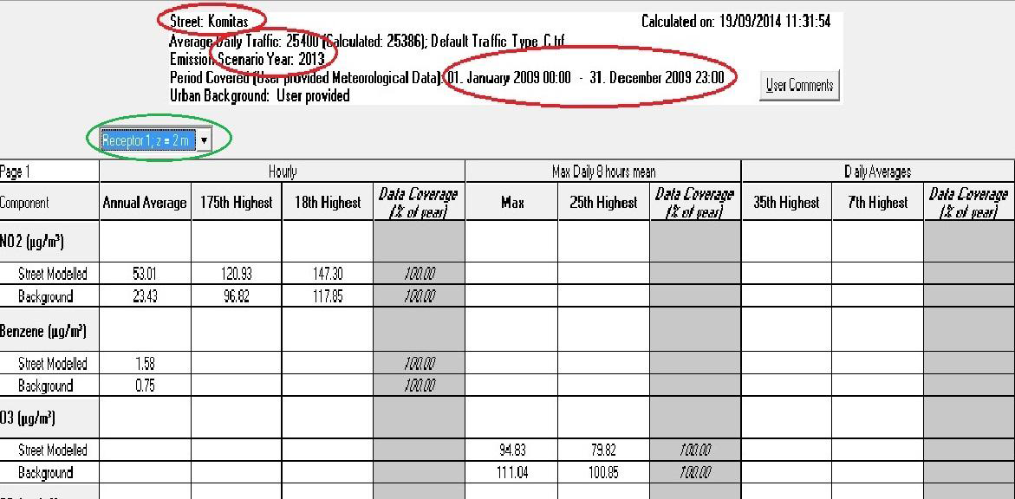
OSPM simulation of Komitas street in Yerevan 2009

Slide 4
Sumgait, Azerbaijan
1: UBM simulation for the entire grid 6 years (2000-
2005)
2: UBM simulation for 2 years and 5 receptors
3: OSPM simulation for Sulh and Samed Vurgun street

Slide 5
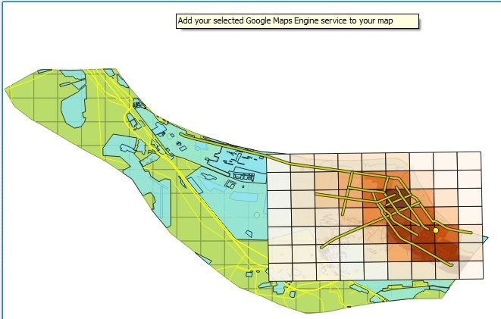
Showing results in QGIS
Average of Nox for whole grid

Slide 6
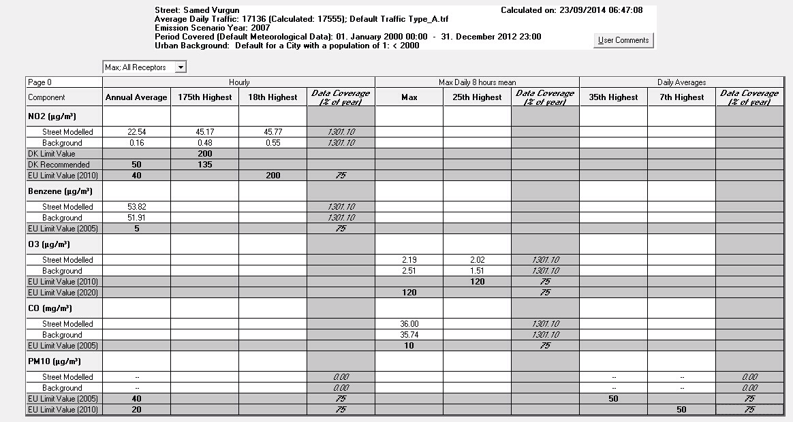
OSPM modeling for Samed Vurgun street

Slide 7
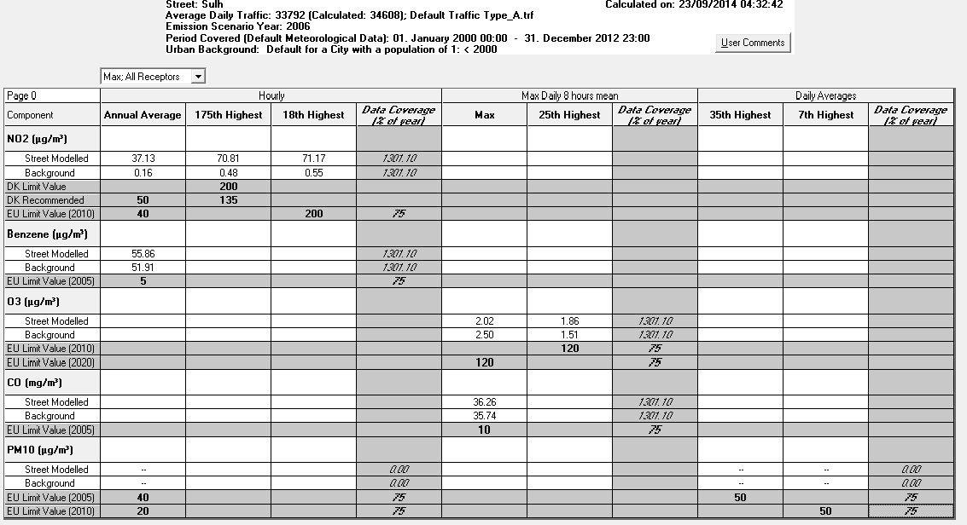
OSPM modeling for Sulh street

Slide 8
Chisinau, Moldova
1: UBM simulation, entire grid, year 2009
2: OSPM simulation for Calea Iesilor str.
For 2009

Slide 9
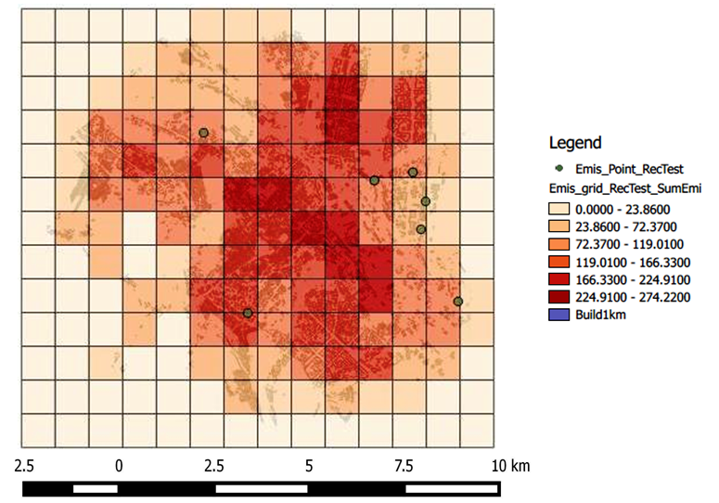
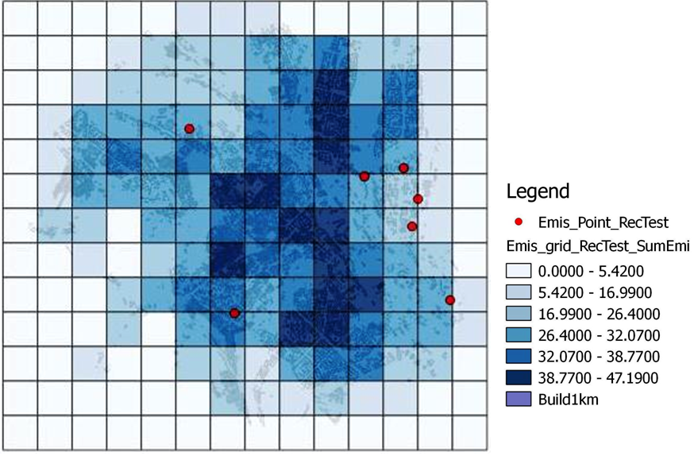
NOx Emissions SOx Emissions in Tons

Slide 10
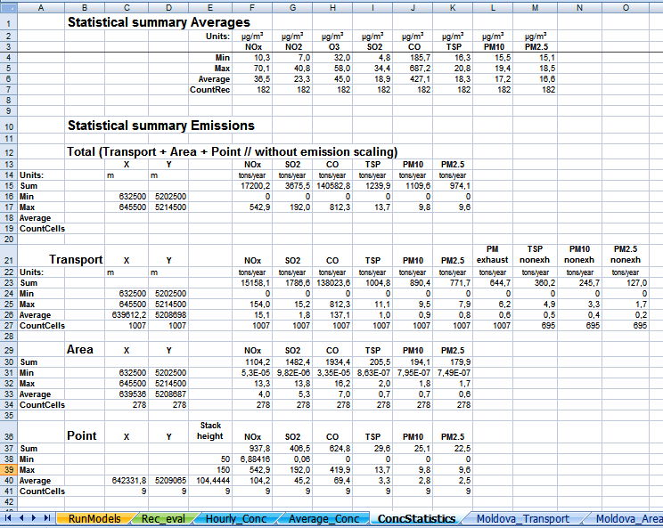
UBM output data as presented in THORAirPas:
Concentration of pollutants in Chisinau mun. in 2009

Slide 11
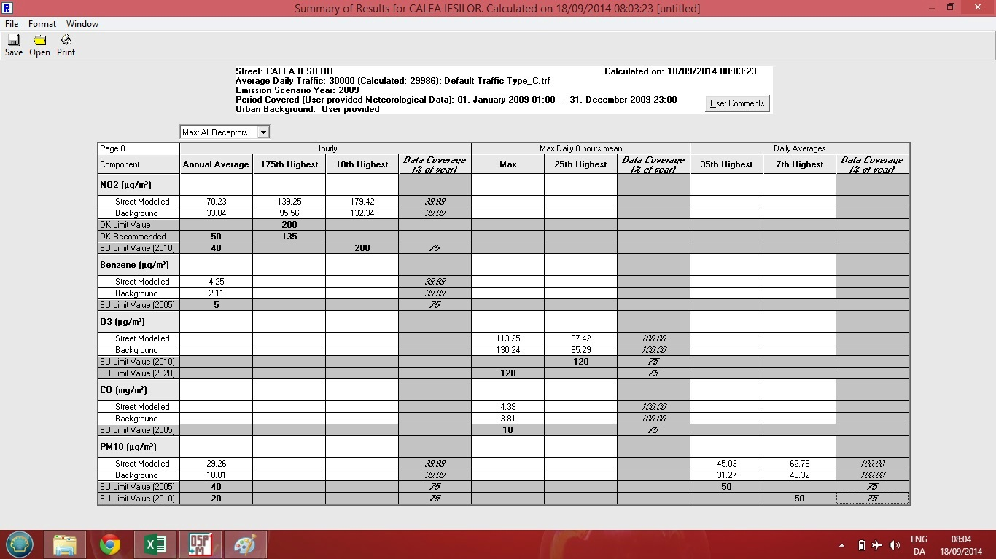
OSMP output data as presented in THORAirPas
for the Calea Iesilor str.

Slide 12
Batumi, Georgia
UBM Simulation for the entire grid

Slide 13
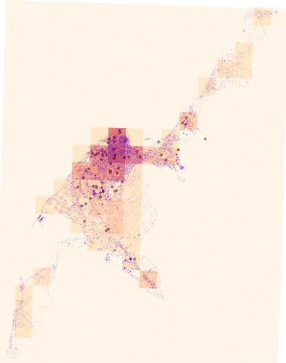
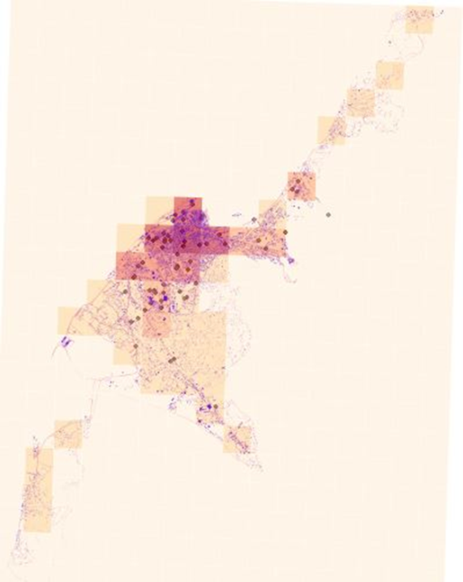
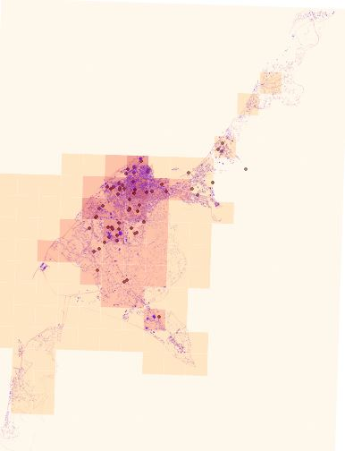
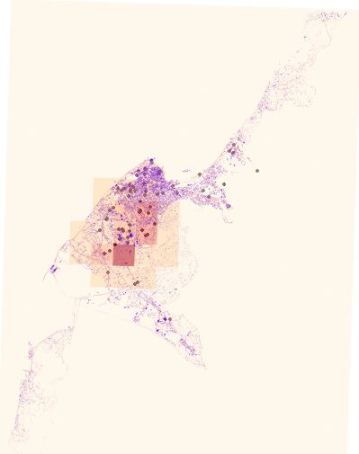
SO₂ TSP
Emissions 07.2012
Conc. 07.2012
Emissions 07.2012
Conc. 07.2012

Slide 14
Kiev, Ukraine
UBM simulation, entire grid

Slide 15
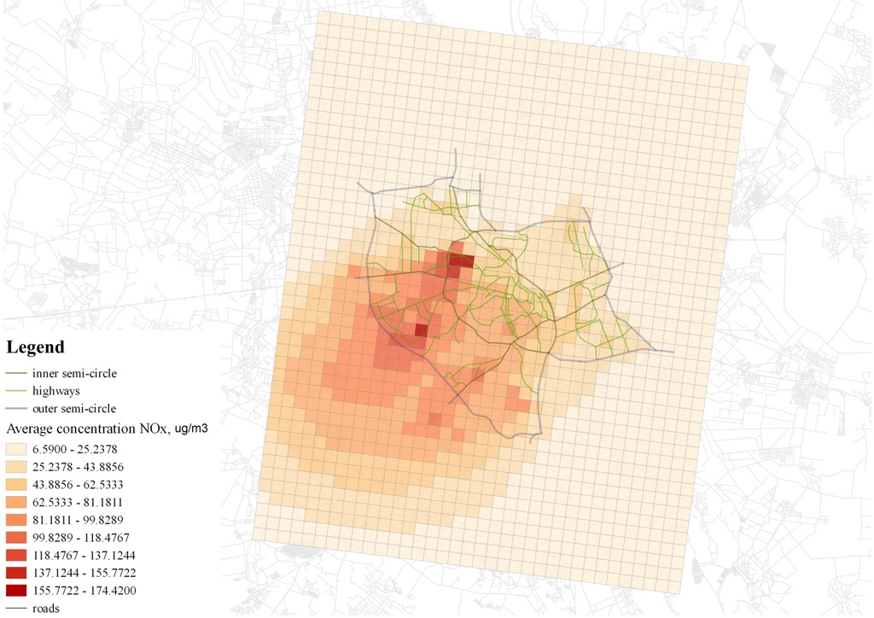
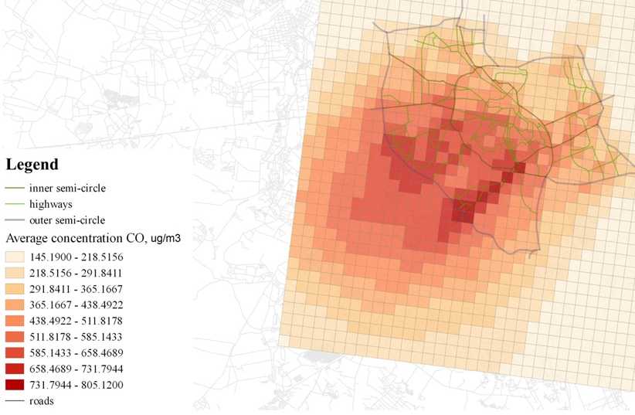
NOx Conc.
CO Conc.

Slide 16
Danish experience on urban transport policy
(Using THOR for AQ and Impact Assessment)
Air quality assessment
Health impact assessment and external costs of air pollution
Impact assessment of policy measures

