Slide 1
Air quality and health impact assessment
AQ information at the regional scale, urban background scale and street scale
past, present and future air quality levels
visualize spatial distribution of air quality levels
validated models can provide comparisons air quality limit values or guidelines can be carried out and an assessment of exceedances of limit values
impact assessment on health effects and related social costs of air pollution

Slide 2
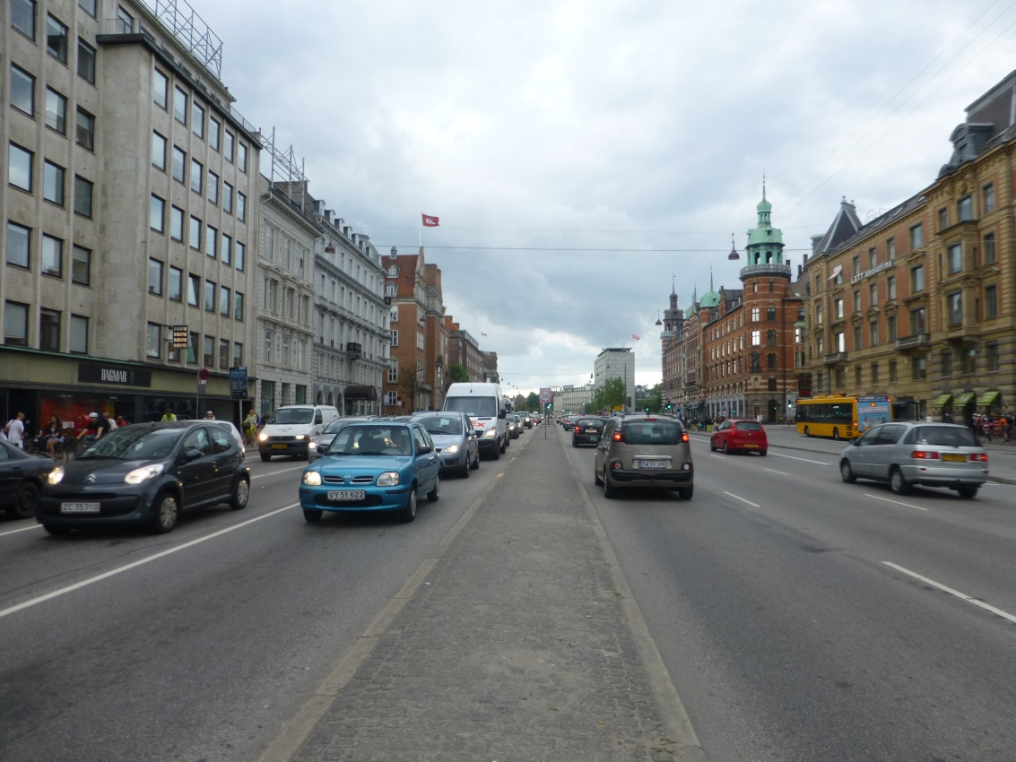
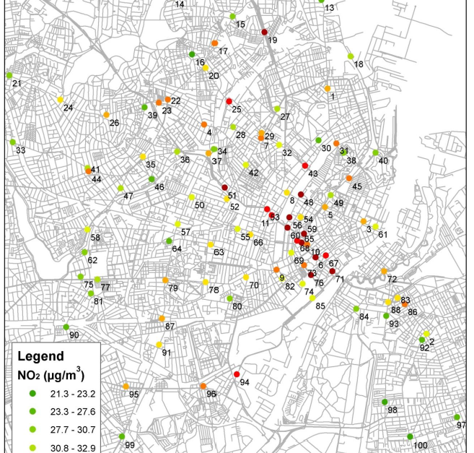
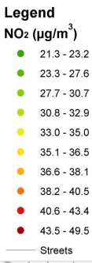
Annual average NO2 conc. at 100 streets in Copenhagen Red and Dark Red: NO2 exceednces in Copenhagen 2012
6
Notes:
How OSMP used in Copenhagen (Work by MK)
Show where is HCA
Above EU limit -> mainly at HCA

Slide 3
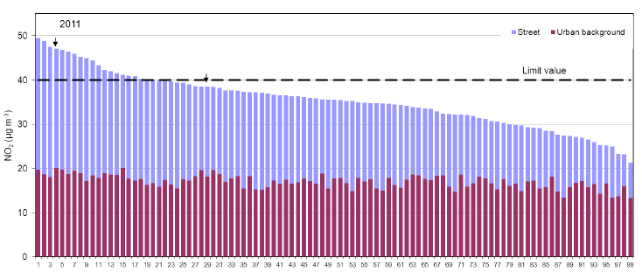
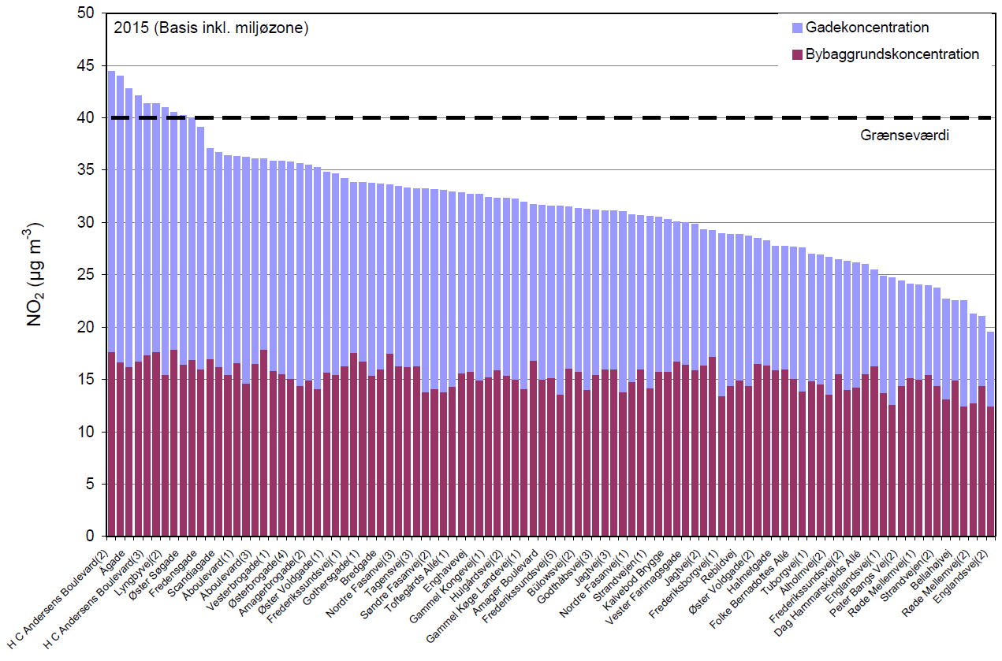
Predicted NO2 (μg/m3) exceedances in 2011 and 2015
5

Slide 4
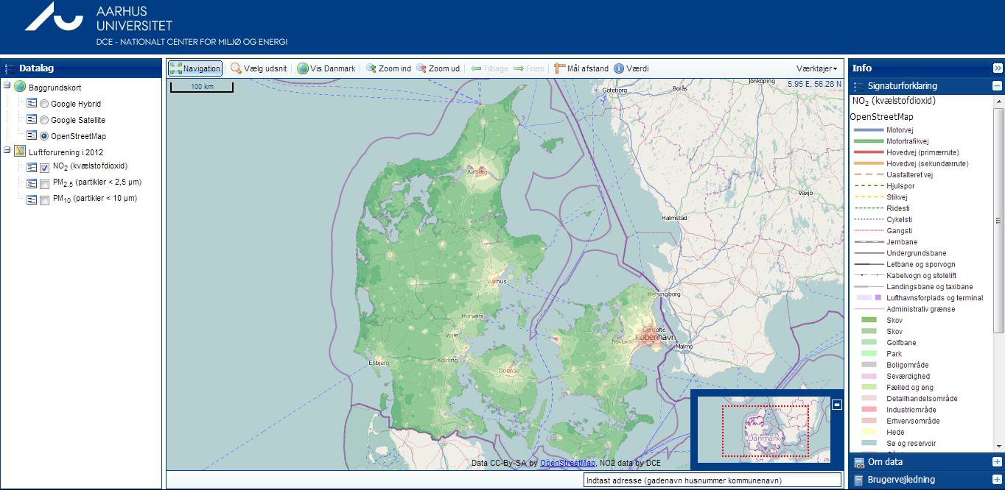
Website for Air Quality at Your Street

Slide 5
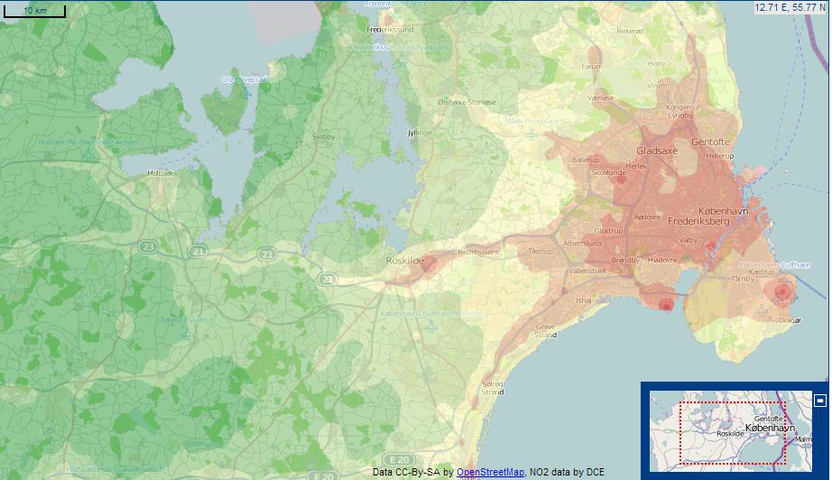
Urban background concentrations of NO2
DEHM + UBM

Slide 6
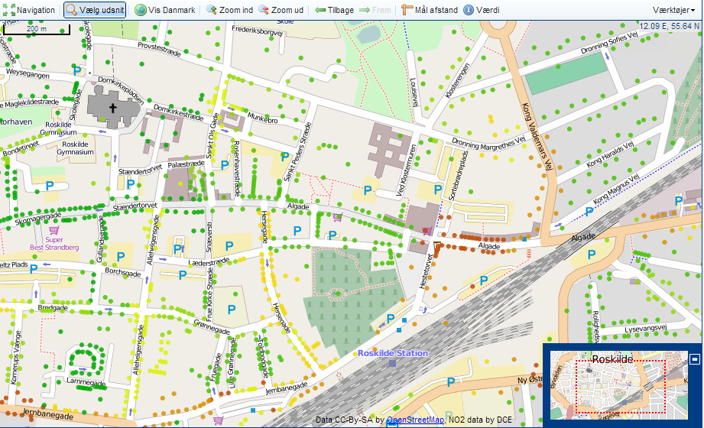
Street concentrations of NO2
DEHM+UBM+OSPM

Slide 7
External costs of air pollution
External costs for air pollution (excl. CO2) are related to health effects and estimated based on the ”impact pathway” method (EVA-system)

Slide 8
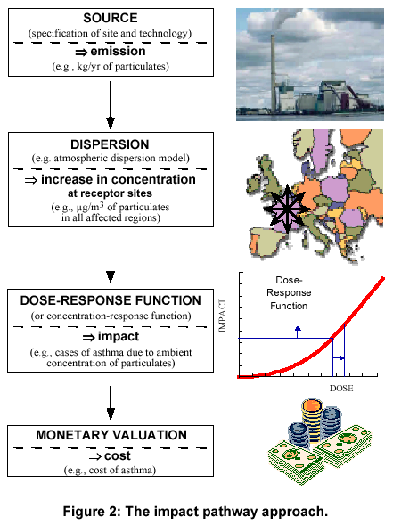
EVA – Economic Valuation of Air pollution
Emissions sources
Concentration (DEHM) and
(UBM) and population
exposure Health effects
based on exposure–response
relations
External costs based on pricing
of health effects
Output:
  Health effects
  External costs
  Unit costs
Applications:
  Assessments, cost-benefit

Slide 9
Calculated using EVA (THOR System + Health and Economic Valuation Module) for the year 2000 for the total air pollution levels
A total of 680000 cases decreasing to 450000 in the year 2020
For Denmark:
Year 2000: 4000,
Year 2011: 3200
Year 2020: 2200
Total number of cases of premature deaths in Europe
Notes:
to quantify human exposure, impacts on human health from air pollution and the subsequent costs,

Slide 10
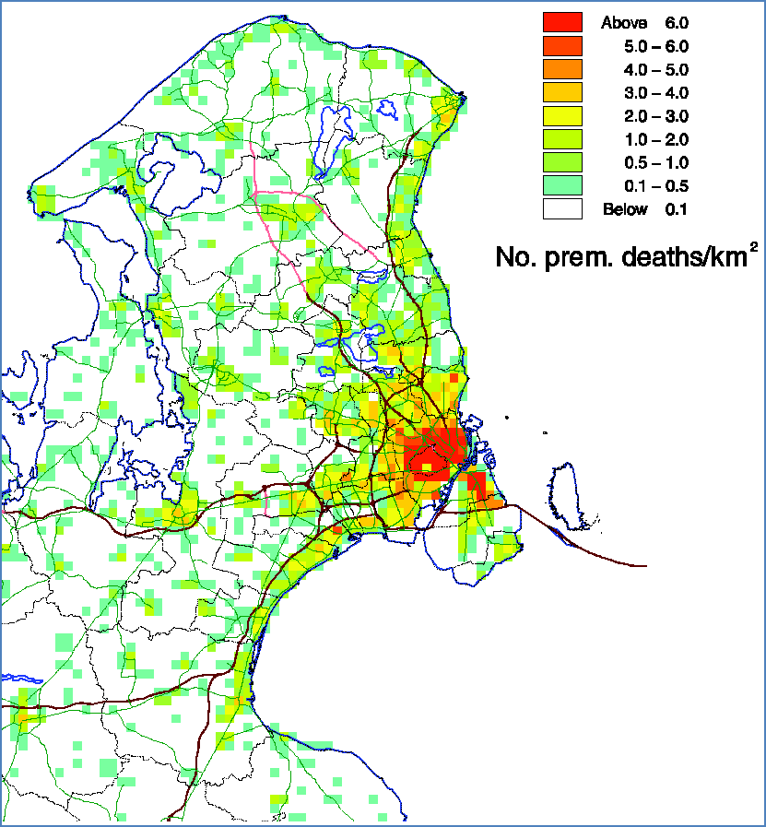
Premature deaths in Copenhagen region 2010
1: total of ~1500 premature deaths for the whole area due to all domestic and foreign emissions or about DDK 12 billion per year
2: ~540 in inner city
(Municipalities of
Copenhagen and
Frederiksberg or about DDK
4 billion per year
3: local emissions in
Copenhagen and
Frederiksberg contribute only about 11%

Slide 11
Impact assessment of transportation schemes
Road network and associated traffic (e.g. based on traffic modelling)
Traffic (total flow, vehicle distribution, travel speed) in an existing road network
Traffic due to policy measures such as toll ring, road pricing or other traffic management schemes
Vehicle emissions due to:
  dieselisation of the vehicle fleet
  Low Emission Zone (LEZ) that ban older vehicles (older emission classes) to enter a zone
  scenarios for introduction of electric vehicles
  etc.

Slide 12
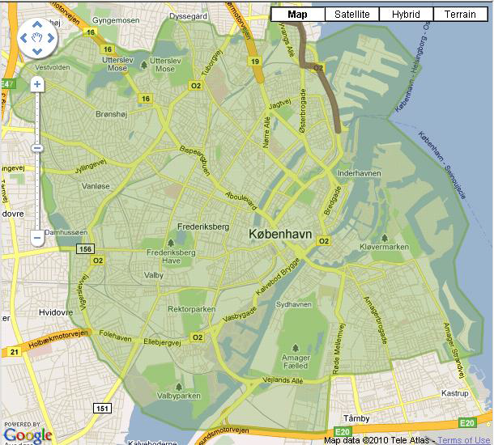
Existing Low Emission Zone
Particle filters on diesel-
powered heavy-duty vehicles
> 3½ ton
Euro II & older by Sept. 1, 2008
(vehicles<=2001)
Euro III & older by July 1, 2010 (vehicles<=2006)
Etablished in Copenhagen in
Sept. 2008)
Particle filters in average
assumed to reduce exhaust
PM by 80%
Impacted assessed with
UBM-OSPM and regional
measurements
Low emission zone in Copenhagen,
equal to municipal border
Other cities:
  Aalborg (Feb, 2009)
  Odense (Jul, 2010)
  Aarhus (Sep, 2010)

Slide 13
Impacts of LEZ in Copenhagen:
1: PM exhaust emission from HDT is reduced by 60% in
2010 corresponding to 16% for all traffic (HCAB) (due to shift to EEV/Euro5 and re-profit of DPF on <=Euro
3)
2: LEZ reduces PM10 street concentrations with 0.2 μg/m3 (1%) and PM2.5 also by 0.2 μg/m3 (1.5%) modest change due to significant non-exhaust and regional contribution
3: NOx reduction of about 25% due to a partly shift towards Euro 5 vehicles instead of equipping all heavy-duty vehicles with particle filters (Euro 3 or older)
4: Total NOx emission reduced 8% in 2010
5: No. of exceedances of the NO2 limit value in 2010 47 to 29 (out of 138 streets)

Slide 14
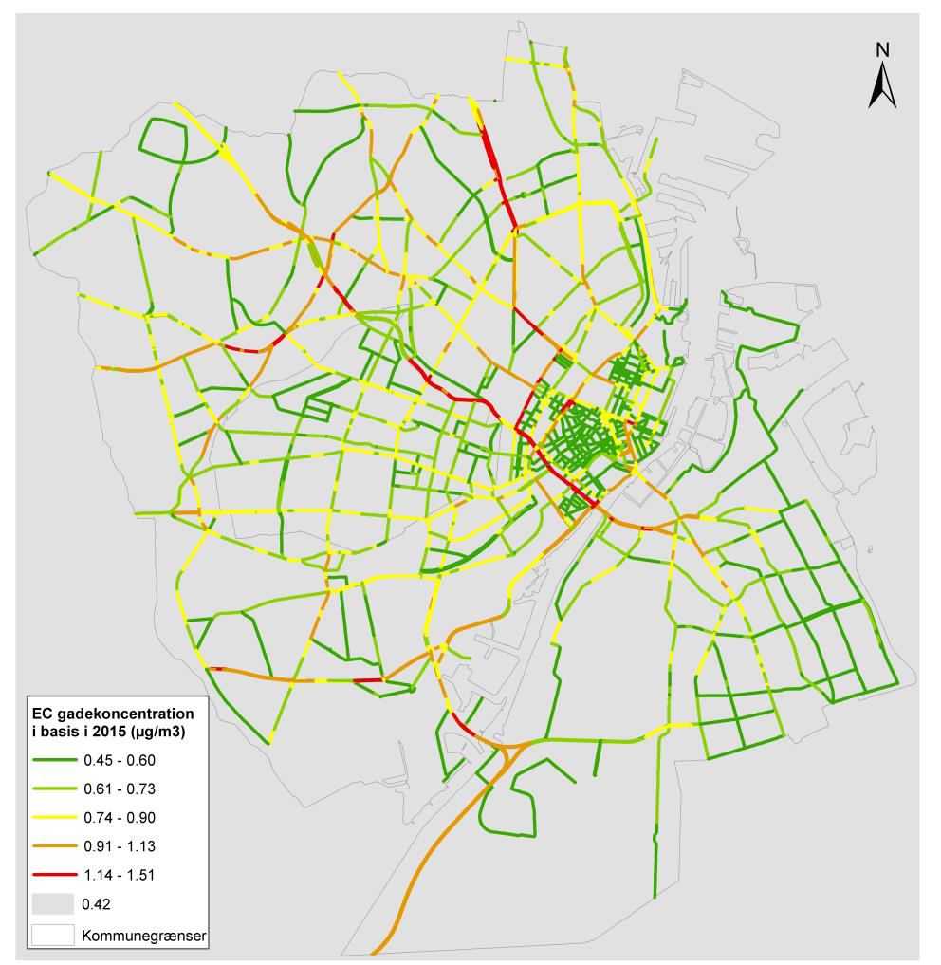
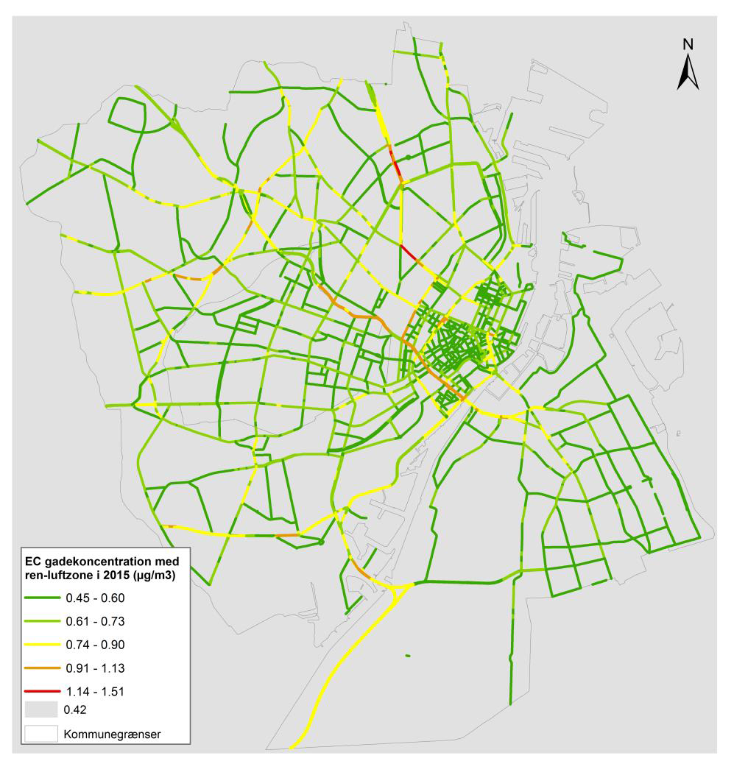
Impacts of proposed LEZ to EC concentrations in CPH
Reference in 2015 Proposed Berlin scenario in 2015
Berlin scenario: Diesel-dreven passenger cars and vans <= Euro 3 and petrol-dreven passenger cars and vans <= Euro 0 are banned in LEZ

Slide 15
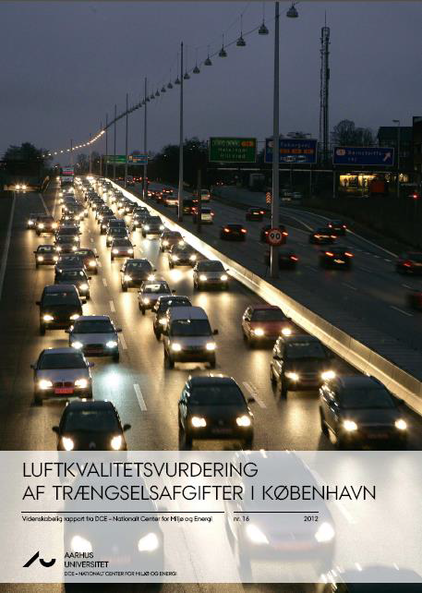
Proposed toll ring in Copenhagen
Congestion charging
impact assessment showed reduction in traffic by 19% and in NOx emissions by 10%
reduction in No. of NO2 exceedances from 11 to 6 in 2016 (out of 138 streets)
proposal turned down due to opposition

Slide 16
Спасибо За Внимание!

