Slide 1
Air QuAlity governance in the enpi east countries air-q-gov
Copenhagen, Denmark 23-26 September 2014
Simulation Thor modeling system in Sumgait, Azerbaijan
Faig Mutallimov
faig.mutallimov@gmail.com

Slide 2
Thor air system modeling in Sumgait
Running Thor system for 6 years whole grid (2000-2005)
Running Thor system for 2 years as well as for 5 receptors
Ospm modeling for Sulh and Samed Vurgun street

Slide 3
Running Thor system for whole grid
Transport emission data have gotten from 10 streets of Sumgait considering all vehicle types in one snap code (07)
Area emission data
Point sources emission from 8 point

Slide 4
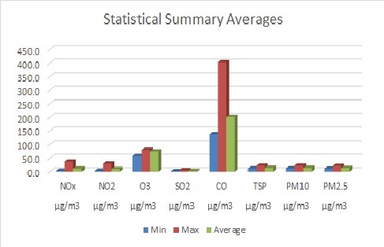
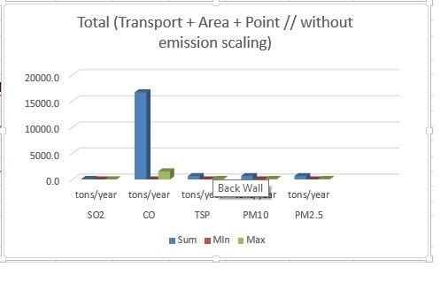
Running Thor system for whole grid

Slide 5
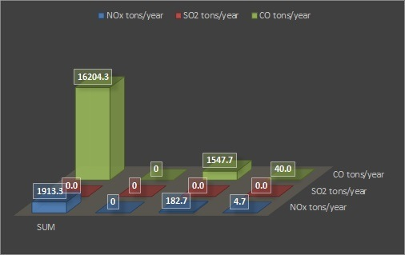
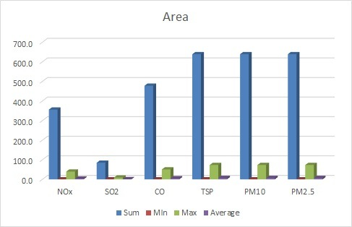
Running Thor system for whole grid

Slide 6
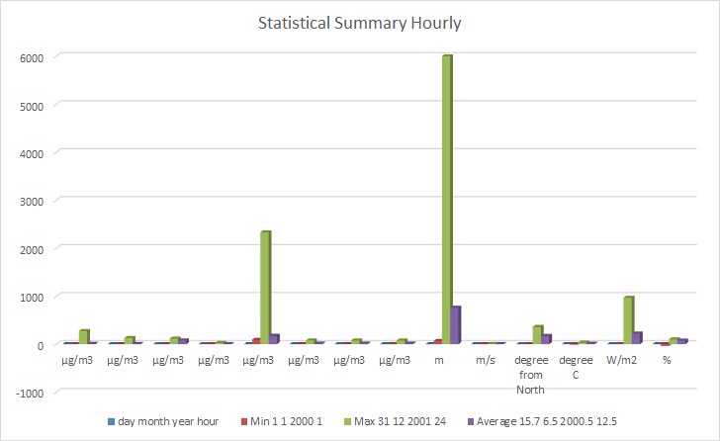
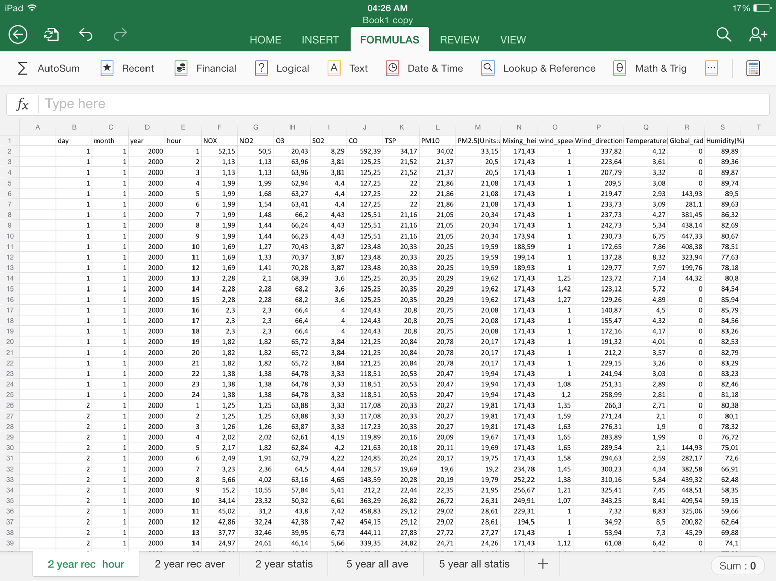
Running Thor system for 5 receptors

Slide 7
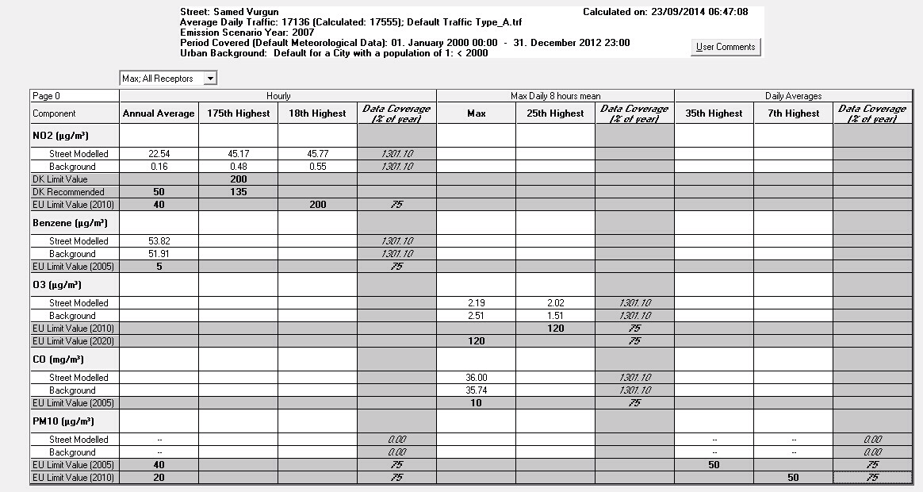
Ospm modeling for Samed Vurgun street

Slide 8
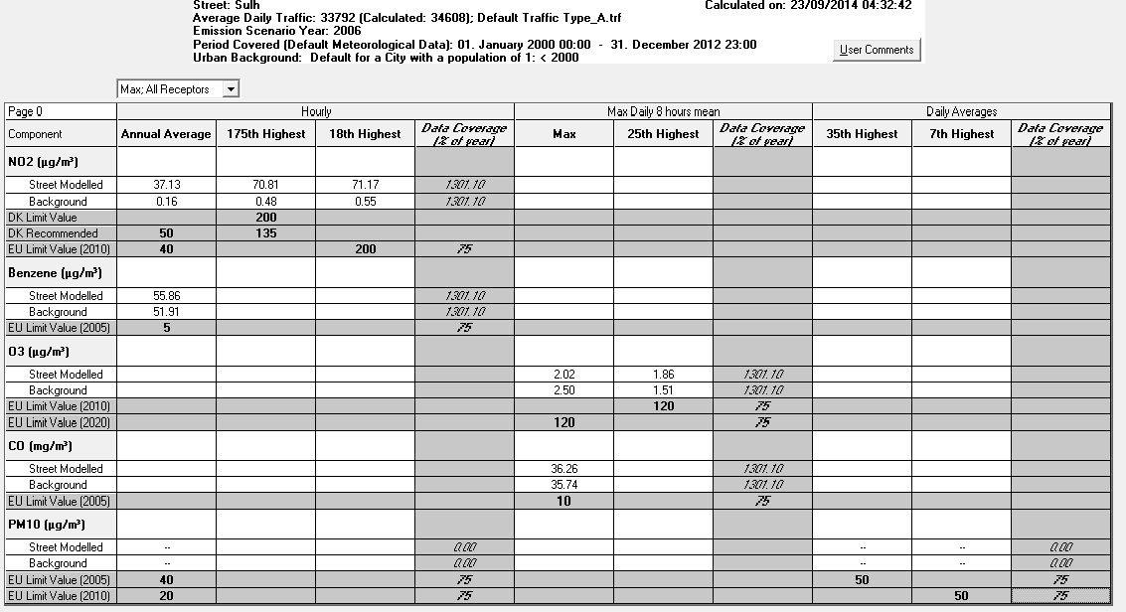
Ospm modeling for Sulh street

Slide 9
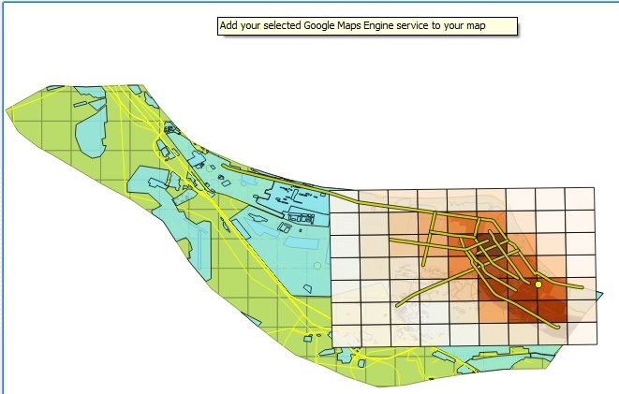
Showing results in qgis
Average of Nox for whole grid

Slide 10
Thank you for your attention

