Slide 1





What we learned during the EU FP7 project
“Joint Learning in Innovation Systems in African Agriculture” (JOLISAA)
Ann Waters-Bayer, Prolinnova International Secretariat, ETC Foundation, Netherlands
for the JOLISAA & Prolinnova partners
Workshop on Operationalizing an EU Approach to Research &
Innovation for Sustainable Agriculture and Food & Nutrition Security:
Drawing on Lessons Learned, 7 November 2014, Brussels

Slide 2
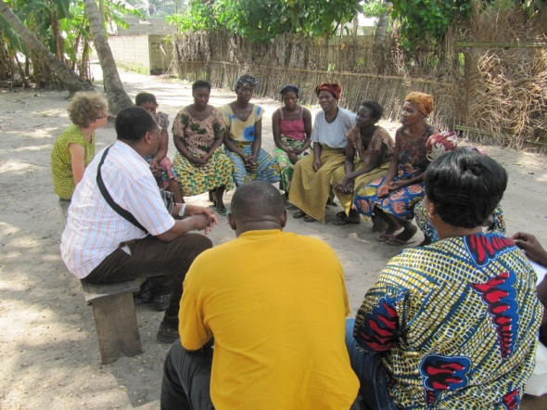
The partners
in JOLISAA project (2010–13)
CIRAD, France – project leader
Bernard Triomphe
ETC Foundation/Prolinnova Secretariat,
Netherlands
International Centre for development-
oriented Research in Agriculture (ICRA)
Kenya Agricultural Research Institute
University of Abomey-Calavi, Benin
University of Pretoria, South Africa
Wageningen University and Research
Centre (WUR), Netherlands
and many smallholders and their
partners in innovation in Africa
in Prolinnova network (2004 – )
Secretariat: ETC Foundation, NL
International Institute of Rural
Reconstruction (IIRR), Philippines
Innovations, Environnement,
Développement (IED) Afrique, Senegal
21 multistakeholder platforms in
Africa, Asia and Latin America
and many other smallholders and
their partners in innovation worldwide
Learning from local innovation in Benin (Photo: Bernard Triomphe)
Notes:
U Abomey-Calavi, Faculté des Sciences Agronomiques, Bénin

Slide 3

Objective of JOLISAA project:
To learn jointly about how innovation processes in African smallholder farming happened, so as to draw lessons for research, policy and practice to support continuing innovation processes that address the needs & demands of smallholders.
Objective of Prolinnova network:
To mainstream farmer-led participatory research & innovation processes so as to create a world where women and men smallholders play decisive roles in agricultural development
for sustainable livelihoods.

Slide 4

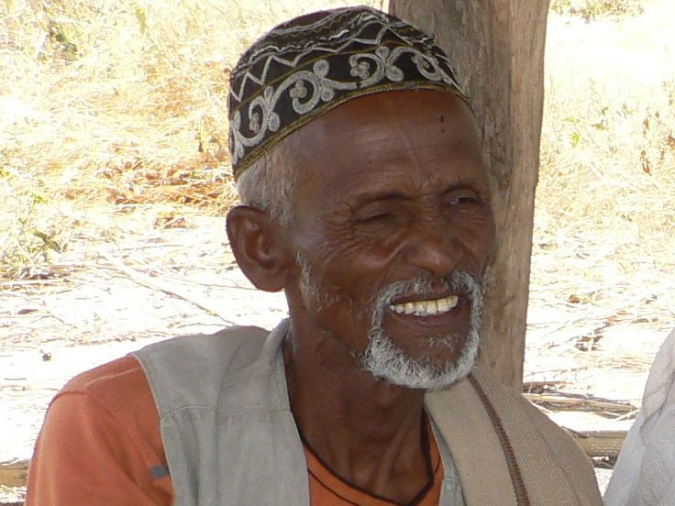
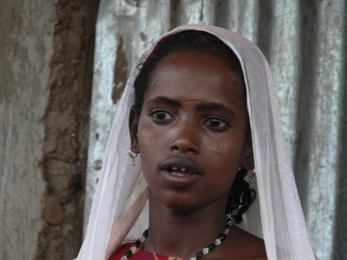
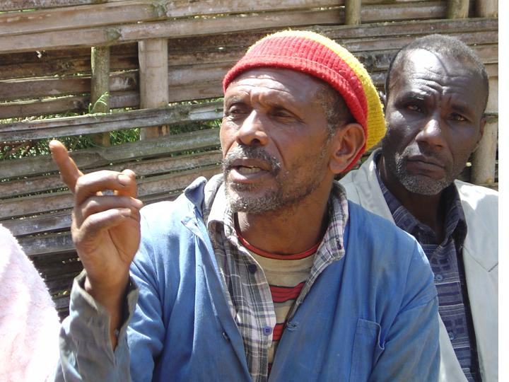
EU FP7 research & networking project JOL ISAA was designed to:
Show pathways toward food & nutrition security in smallholder farming
Identify the partnerships & interactions needed to achieve this
Inform agricultural research & development (ARD) policy
Stimulate interest & learning among European & African ARD actors about participatory innovation in smallholder farming

Slide 5
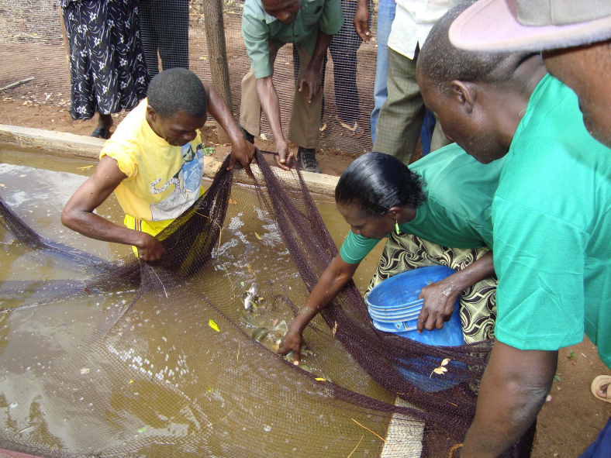

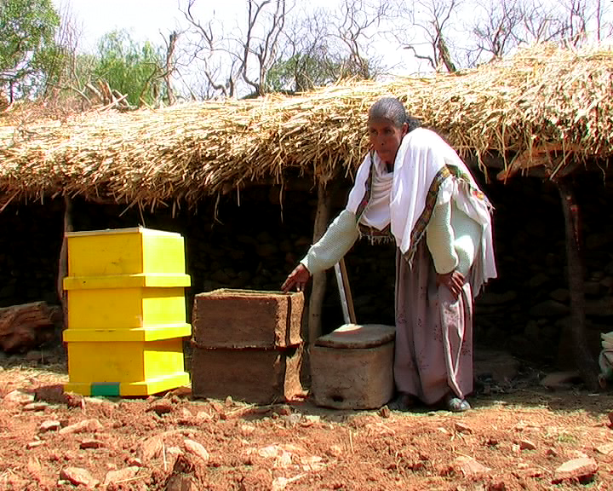
This fits into ongoing Prolinnova efforts to:
Build national and international multi-stakeholder communities of practice focused on smallholder farming
Foster a culture of mutual learning
in local innovation processes
Link local creativity with other sources of knowledge & ideas in order to enhance resilience to change
Make farmer-led participatory innovation processes an everyday part of ARD (“institutionalisation”)
Farmer-led research in fish farming in Tanzania (Photo: L. van Veldhuizen)
Ethiopian woman compares her local “modern” beehive with introduced
one (Photo: Tesfahun Fenta)

Slide 6

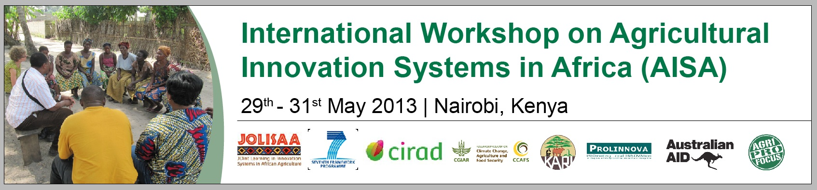
Processes of action research & joint learning
by farmers & other stakeholders jointly
analysing innovation cases in Benin, Kenya
& South Africa
through cross-analysis of cases from different countries
in exchange with other groups studying
innovation processes in African agriculture,
culminating in a jointly organised
JOLISAA–Prolinnova international workshop:

Slide 7

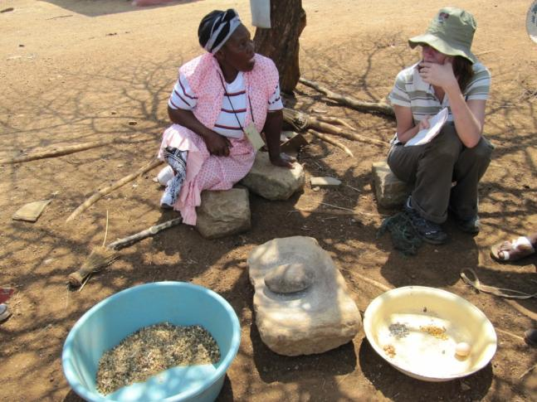
Main questions
How can we better understand innovation processes in smallholder farming & the role of formal research in these processes?
How can we generate a collective understanding of an innovation process in the innovation system,
as a 1st step for collective action?
What lessons can we learn from this understanding for more effective support to multistakeholder innovation processes in smallholder farming?
Trying to understand innovation process in South Africa
(Photo: Laurens van Veldhuizen)

Slide 8
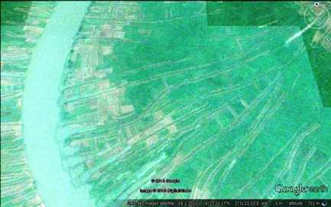
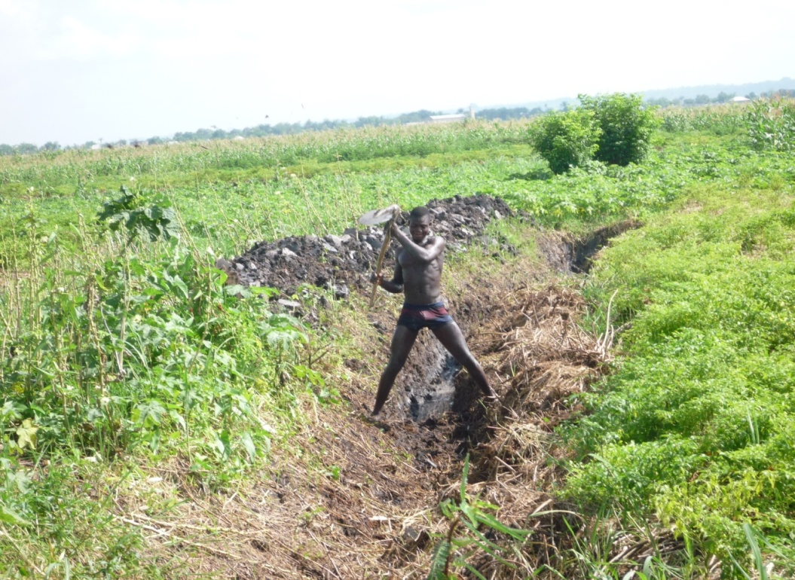
Range of cases: from endogenous innovation in aquaculture …
Farmers in southern Benin
dug hwedos in floodplains
to trap fish as water recedes
Intensified system through
better drainage & irrigation
to grow off-season vegetables
on raised hwedo banks to sell
to coastal city markets
Rely on both fish & vegetables to
secure income while adjusting to
environmental & market fluctuations
Introduced “modern” aquaculture
projects ignored this locally developed
low-external-input system
Maintaining canal to keep hwedo productive (Photo: Anne Floquet)

Slide 9
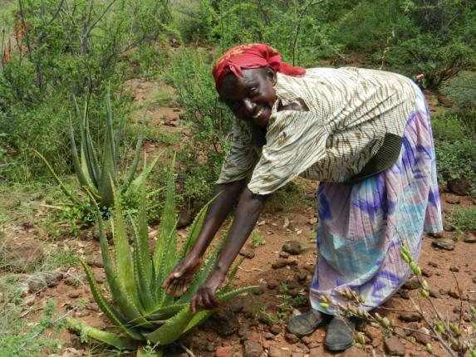
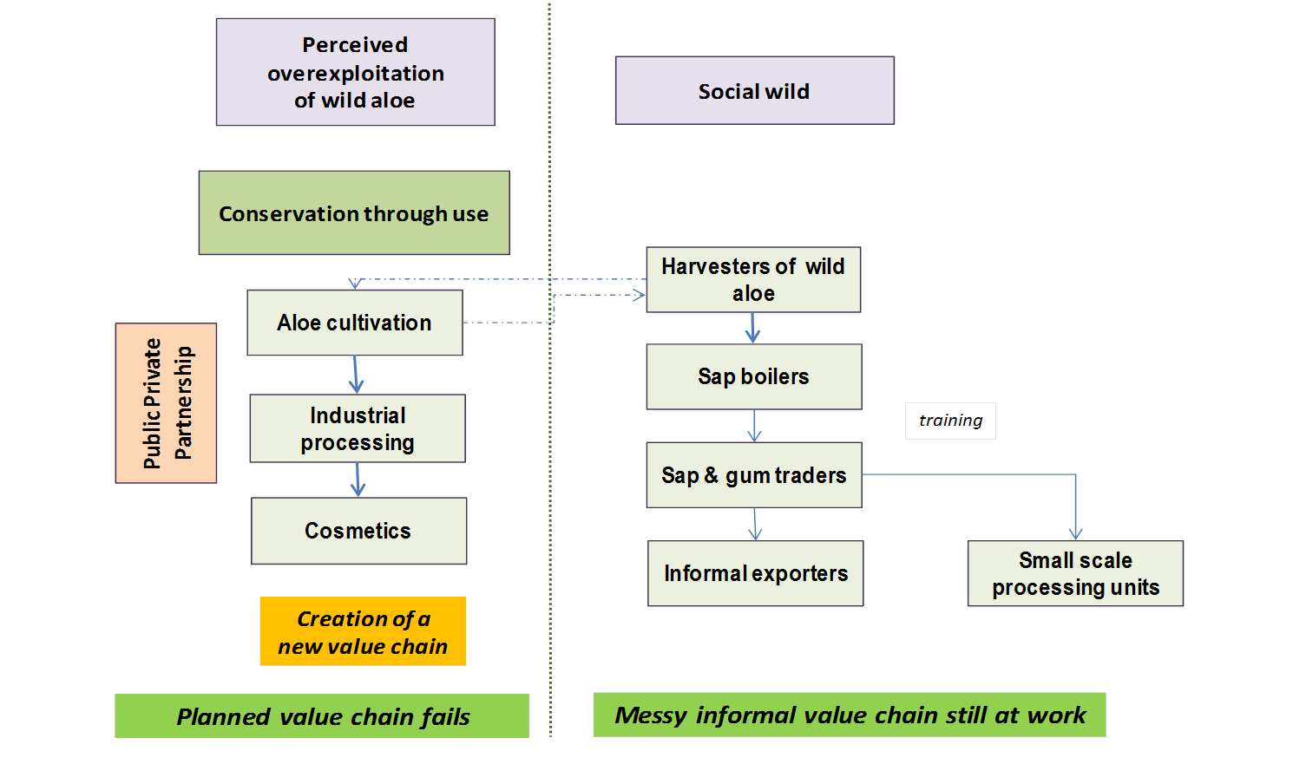
… to orchestrated innovation
that took on its own “life”,
e.g. aloe value chain
Harvesting aloe in Kenya (Photo: Bernard Triomphe)

Slide 10
Five lessons for enhancing innovation by smallholder farmers
Build on local dynamics: innovation “in the social wild”
Combine local & external knowledge & ideas
to enhance innovative capacity (1+1=3)
Encourage access to diverse value chains
to lower the innovation risks
Support unpredictable innovation processes
Address the multiple dimensions of innovation

Slide 11
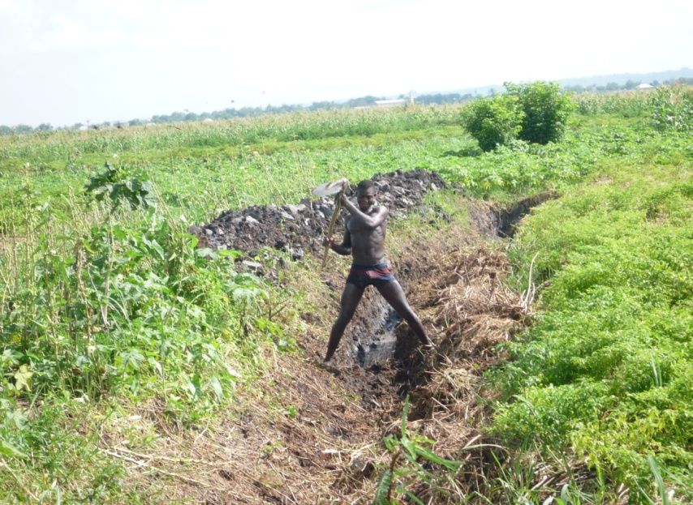
Build on innovation
“in the social wild”
With little or no support from public research & development (R&D) institutions, many smallholders are innovating individually and collectively to:
solve problems
improve their farming & income
grasp new opportunities.
Endogenous aquaculture development in Benin (Photo: Anne Floquet)
Harvesting aloe for informal market chain in Kenya (Photo: B. Triomphe)

Slide 12
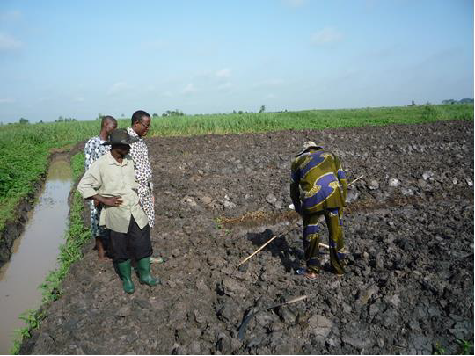
Combine local & external knowledge and
ideas to enhance innovative capacity (1+1=3)
Linking multiple sources of knowledge enhances the capacity of all stakeholders to innovate: to adapt to changing conditions &
to grasp opportunities. These synergies benefit all involved.
Innovation “in the social wild”
can be enhanced and become
more sustainable through appropriate
inputs of knowledge from different
sources responding to farmers’
demands, needs & actual possibilities.
Farmers & scientists in Benin explore
ways to improve the local innovation (Photo: Anne Floquet)
Notes:
Scientific knowledge can help improve local systems e.g. by introducing new fingerlings, advising about vegetable diseases & helping farmers develop labour-saving technologies to maintain the fishponds & raised vegetable beds

Slide 13
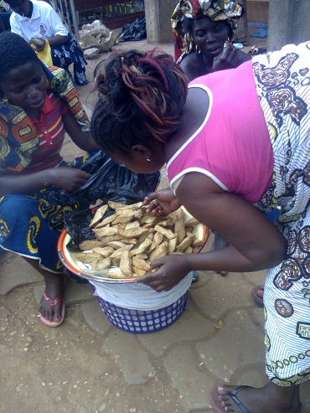
Encourage access to diverse value chains to lower the innovation risks
Markets and value chains, whether local or distant, can trigger & sustain dynamic innovation processes that benefit smallholders & consumers
… but imply significant risks for resource-poor farmers and small-scale processors.
Having access to diverse value chains is critical to increase local resilience to erratic & dysfunctional markets.
Soy cheese in fried pieces on
market in Benin (Photo: Anne Floquet)
Notes:
Promoting diverse formal and informal value chains linking efficiently farmers & small-scale processors to local, national & international demand allows them to access the different markets in a flexible & gradual way, avoid dependency on one market and respond to demand from a range of users.

Slide 14
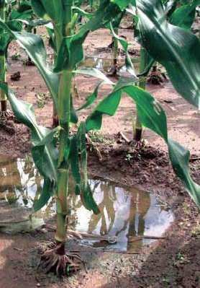
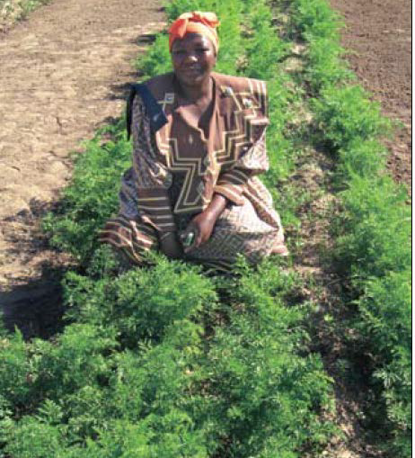
Support unpredictable
innovation processes
Innovation cannot be planned from the onset.
It evolves in unpredictable
& often unexpected ways over a long time – specific
to a changing context.
In supporting innovation, formal R&D actors
should make use of highly flexible, open-ended & iterative approaches adapted to local conditions.
In-field water-harvesting technique introduced for large-scale cropping
Farmers adapted technique to grow vegetables
(Photos: Water Wheel)
Notes:
Benin: Soy for baby food; local women integrated it into local cuisine. Kenya: Gadam sorghum for commerical brewery to replace imported barley; smallholders used it in local cuisine to replace maize.

Slide 15
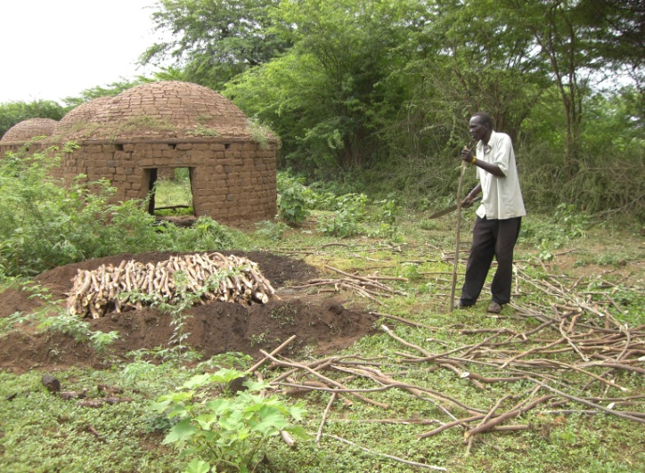
Address multiple dimensions of innovation
Innovation has major social & organisational dimensions that cannot be addressed in isolation from technologies,
if innovation is to be successful.
e.g. to deal with invasive weed
Prosopis juliflora in Kenya,
technological innovation
(charcoal-making) had to be
intertwined with institutional
innovation (change in law) &
organisational innovation (self-
formed charcoal-maker groups)
Making charcoal from prosopis in Baringo, Kenya
(Photo: Ann Waters-Bayer)

Slide 16
Promising paths to promote innovation
Providing longer-term, flexible funding for research to support existing development dynamics in smallholder farming – enhancing the capacity to innovate
Encouraging innovation platforms & other multistakeholder alliances at different levels – and not only for value chains
Strengthening innovation brokerage capacities, especially in rural advisory services
Integrating innovation system approaches into agricultural education and on-the-job training

Slide 17

Some follow-on activities by Prolinnova
with CGIAR Research Programs AAS & CCAFS
Desk study of impact of farmer-led research supported by CSOs
– completed and lessons drawn for stakeholder groups
(www.prolinnova.net/content/farmer-led-research-featured-tropentag-prague)
On-the-ground “realist impact evaluation” of selected farmer-led research cases from this study – upcoming AAS design workshop
Contributing to clarifying CGIAR intermediate development outcome “Capacity to innovate”
(http://aas.cgiar.org/publications/capacity-innovate-system-cgiar-research-program-perspective#.VFYevIfmrzI)
Action research on scaling up farmer-led ARD in three countries in Africa – joint concept note, seeking funding

Slide 18
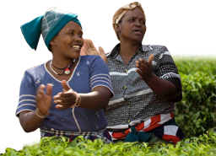

Thus:
Some CGIAR Research Programs and
ARD actors in Prolinnova are jointly
following up on lessons learned from the
JOLISAA project and similar initiatives
to promote appropriate support to dynamic, innovative and productive smallholder farming.
www.jolisaa.net
www.prolinnova.net
The project “Joint Learning in Innovation Systems in African Agriculture” (JOLISAA) received funding from the European Union’s 7th Framework Programme.
The views expressed here are the sole responsibility of the author.
Thanks to all JOLISAA and Prolinnova partners for their collaboration
and providing data, insights and comments.

