Slide 1
Fostering innovation in EU agriculture: the European Innovation Partnership
Brussels
7 November 2014
Rob Peters
AGRI H-5
DG Agriculture and Rural Development
European Commission

Slide 2
Context of the preparation of the CAP towards 2014
  CAP started to pay attention to advisory services only since reform of 2004
  Measures meant to foster knowledge in the Rural Development Pillar of the CAP needed to be reinforced
  Consensus that renewed impetus for research in agriculture was necessary and that this implied improving the interface between research and the potential users
  Europe 2020 Agenda and Innovation Union
  Increased budget for research / European Innovation Partnership (EIP Agri)

Slide 3
Origin of the European Innovation Partnership (EIP)
  The concept of the EIP was established by the Flagship Initiative "Innovation Union" of the “Europe 2020 Strategy” to:
  enhance interaction between science and practice
  facilitate communication and networking among stakeholders
  achieve synergies between different innovation-related measures and initiatives,
  No funding, joining up of existing policies and funding streams
Notes:
3
3

Slide 4
The European Innovation Partnership "Agricultural productivity and sustainability" (EIP-Agri) in short
  Agricultural Productivity and Sustainability (COM (2012)79)
  Overarching concept – funding in the CAP (Rural Development) and interaction with Horizon 2020
  Based on interactive innovation model:
    linking up multiple actors for creation and diffusion of knowledge.
  Key entities: Operational Groups
  EU wide EIP network: communication, partnering, dissemination, knowledge flows and collecting practice needs

Slide 5
"I not only use all the brains that I have,
but all that I can borrow"
Woodrow Wilson –
President of the USA, 1913-1921

Slide 6
How to use all brains?
The Interactive Innovation model
The EIP adheres to the "interactive innovation model" which focuses on forming demand-driven partnerships - using bottom-up approaches and linking farmers, advisors, researchers, businesses, and other actors to implement concrete innovation projects in Operational Groups.
Knowledge “exchange” between partners generates new insights and ideas and integrates existing tacit knowledge. The more focused solutions are put into practice more quickly thanks to the co-ownership generated during projects.
This stimulates innovation from all sides and helps to target the research agenda (or part of it) towards practice needs.

Slide 7
European Innovation Partnership
CAP Rural Development
Horizon 2020
  Funding for setting up of an “Operational Group“: farmers, advisors, agribusiness, researchers, NGOs, etc) planning an innovation project (Art 35)
  Project funding for the Operational Group’s project (Art 35). This co-operation could be combined with other measures (investment, knowledge transfer, advice)
  Supporting innovation support services
  Research projects, including on-farm experiments to provide the knowledge base for innovative actions
  Interactive innovation formats such as multi-actor projects and thematic networks genuinely involving farmers, advisors, entreprises,…."all along the project"
eip-agri

Slide 8
Key Acting Entities Within the EIP
- Operational Groups -
Farmers
NGOs
Advisors
Operational
Group
Agri-
business
Researchers
"Operational Groups" are no stakeholder networks, no stakeholder boards, no thematic coordination groups, nor discussion groups
An OG = actors working together in a project targeted at innovation and producing concrete results
OG=

Slide 9

Network Function of the EIP
EIP
Network
  Collect information (research and innovation projects etc.) and innovation practices
  Provide an effective flow of information (website, databases, publications)
  Give information on opportunities within policies (helpdesk function)
  Share knowledge on concrete projects and connect actors
  Provide feedback to the scientific community on practice needs (Art.12 H2020)

Slide 10
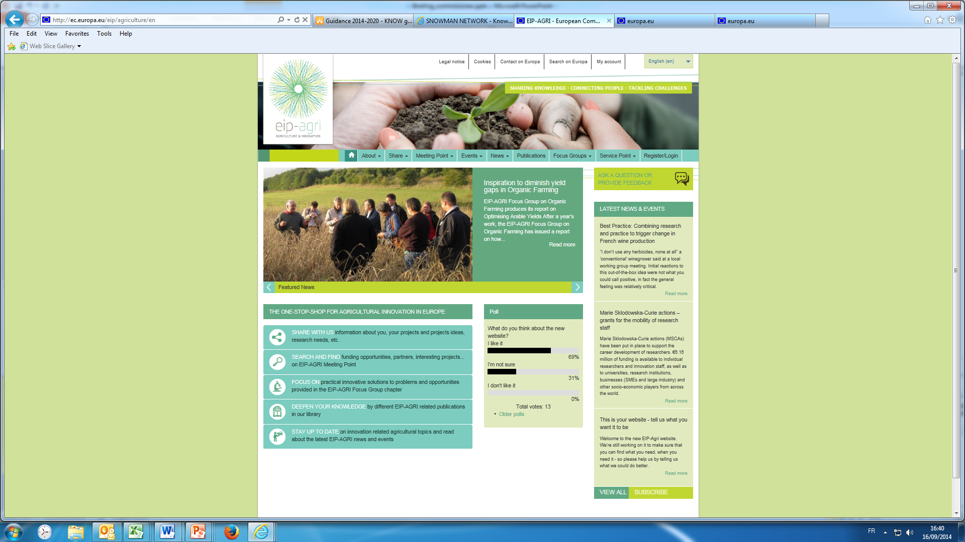
The EIP website is live!

Slide 11
How will Horizon 2020 foster interactive innovation ?
  Fostering co-creation of knowledge in research and innovation projects through the so-called "Multi-actor approach" which implies the involvement of concerned actors all along the projects
  Fostering knowledge exchange through Thematic Networks producing end-user oriented material
  Participation of the EIP in the establishment of Horizon 2020 research and innovation priorities (Art. 12 H2020 Regulation)

Slide 12
Concluding comments
  Active involvement of farmers and other economic operators seen as crucial for innovation in the agro-food sector and its capacity to face the current challenges of food security and sustainability
  To this end, the whole Agricultural Knowledge and Innovation System (AKIS) is mobilised. Hence an effort of both the EU CAP and the Research Policy to support the different segments of the AKIS

Slide 13
Many thanks for you attention
http://ec.europa.eu/eip/agriculture/

