Slide 1
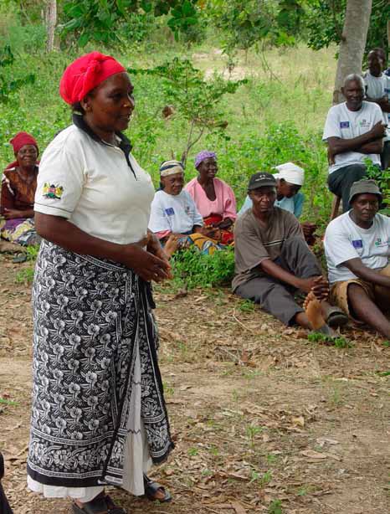
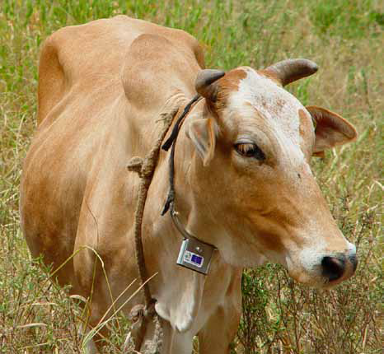
DEVCO Approach Paper
Research & Innovation for
Food and Nutrition
Security / Sustainable
Agriculture

Slide 2
Why a new approach is needed
New policy Communications:
    Agenda for Change
    Food Security
    Nutrition, focusing on children and women
    Resilience to food security crises
New budget cycle/ financial instruments
    Global public goods and challenges
    EDF and DCI geographical
    Locate DEVCO's research support in context of RTD programmes, Horizon 2020
Update existing guidance from 2008
Builds on lessons from our programmes to date

Slide 3
Which research themes?
Towards a portfolio balanced between research themes that reflect DEVCO development priorities
Need to build pipeline of research directed to nutrition outcomes, while seeking to capture and enhance synergies with sustainable agriculture and resilience and cross-sectorial links with health and social sciences
Current portfolio of CGIAR supported research

Slide 4
Which research and supporting activities?
Balance between strategic, adaptive and policy research should be coherent and based on an understanding of impact pathways
Researchable questions formulated based on foresight and stakeholder participation.
Proportionate investment in complementary activities such as knowledge management, extension and capacity building, to maximise potential research impact
2010-2013 funding

Slide 5
Where should research be carried out?
  Food Security a global, but geographically differentiated challenge, AR4D can contribute at 3 levels:
    Global,
    regional, with Africa as priority,
    sub-regional and country, noting Sahel and Horn of Africa
  Priorities are not exclusive of other regions and countries with food security challenges.
  Linkages, synergies to be sought between ‘levels’.
DEVCO Support to AR4D 2010-2013

Slide 6
Rationale for selecting partners
  European leadership in major international AR4D initiatives such as GFAR, CGIAR, African AR4D institution building (governance and support programme).
  flexibility to select implementing partners based on comparative advantage
  Identify and promote opportunities to engage more with European researchers and research stakeholders
2010-2013

Slide 7
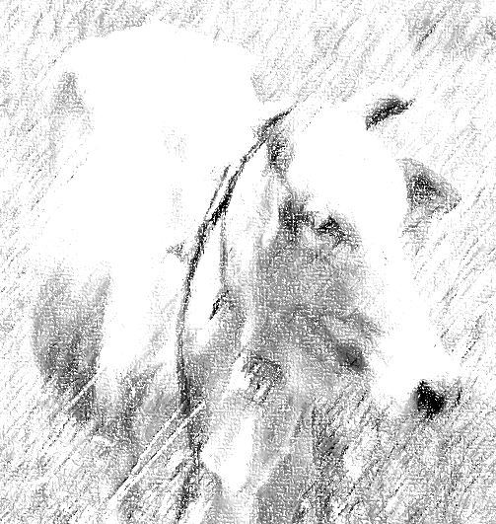
TAKING THE APPROACH FORWARD
  Ensuring the success of global and regional AR4D initiatives:
  Improving European leadership, coordination and influence:
  Exploring new strategic directions to put research into use and achieve impact
  Ensuring that AR4D delivers impact at country and local level

Slide 8
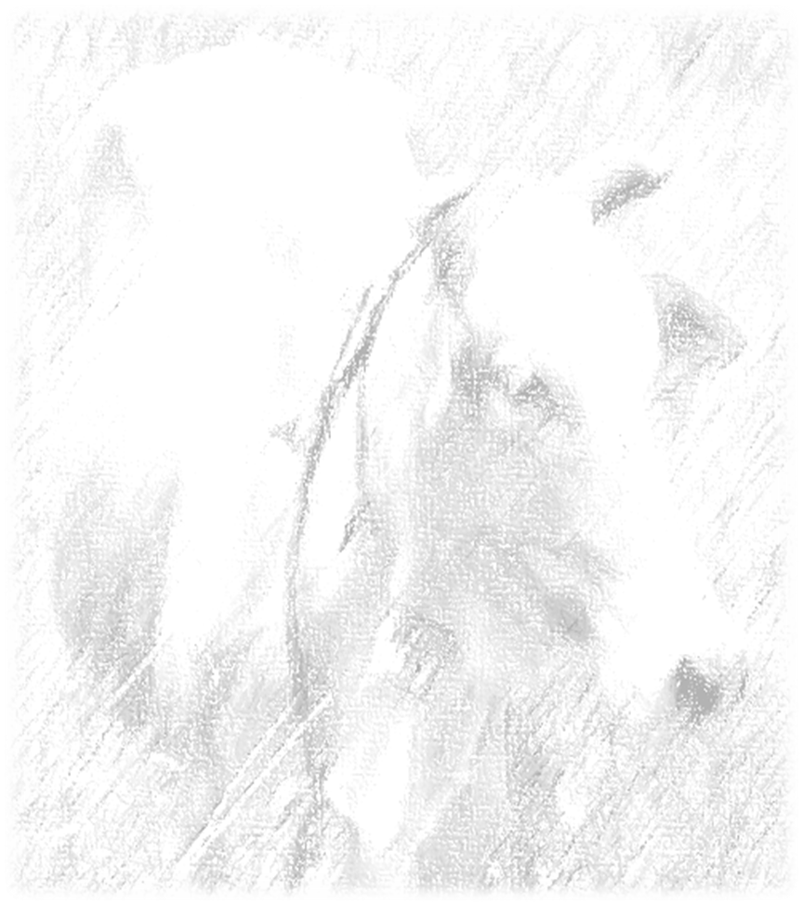
GLOBAL AND REGIONAL AR4D INITIATIVES
Funding and influencing governance
CGIAR
  Reforms align priorities to development goals (beyond international public goods)
  EU in top 10 donors and member Fund Council/ Governance Working Group
GFAR (Global Forum on Agricultural Research)
  Mobilises stakeholder and regional constituencies in setting the research agenda
  EU is lead donor and has place on Steering Committee
FARA (Forum for Agricultural Research in Africa) & Sub-regional organisations
  EU lead donor, supporting medium term plans linked to performance management frameworks
  Science Agenda for African Agriculture
G8 New Alliance and Technology Platform

Slide 9
EUROPEAN LEADERSHIP, COORDINATION AND INFLUENCE
Working with other DGs – RTD, AGRI, JRC
  Horizon 2020
  High Level Policy Dialogue of Science and Technology
  JRC foresight and policy initiatives
Coordination across Europe
  EIARD (European Initiative on Agricultural Research for Development) - donors
  EFARD (European Forum on Agricultural Research for Development) – multi-stakeholder
Creating opportunities for European researchers/ stakeholders
  Intense Africa, PAEPARD – European – African research initiatives
  Agrinatura (pan-European research institutes/ Universities)
  Linkages to CGIAR Programmes

Slide 10
EXPLORING NEW STRATEGIC DIRECTIONS
Innovation and value chains, engaging with new partners
Examples from current programmes
Model | Actors | Programme/ project | Comment
Uptake by private sector | NOVELLA Partnership: UNILEVER, ICRAF, IUCN, TechnoServe, Novel Development Ltd. , | Allanblackia Development | Development of value chains and creating markets.
Partnerships that are internal to the research programme | FARA, CORAF, CGIAR centres, farmers organisations, private sector | Sub-Saharan Africa Challenge Programme | Innovation platforms identify opportunities to build value chains and link farmers to markets.
 | ICIPE, KARI, Heifer International | Push-pull mechanism (control of Striga and insect pests of maize) | Both government and NGO partners, media (radio), farmer to farmer exchange
Dissemination through extension service | FARA, CORAF, national extension systems | Sub-Saharan Africa Challenge programme | Sierra Leone, Burkina Faso adopted innovation platform model of SSA-CP in extension services

Slide 11

DELIVERING IMPACT AT COUNTRY AND LOCAL LEVEL
Supporting EU Delegations through
  Technical support to management of regional AR4D projects
  Identifying priority needs for strengthening the NARS and or extension system.
  Identifying opportunities for taking up or up-scaling successful research products
  Obtaining feedback on national priorities
  Advising on innovation, particularly in relation to the supporting platforms and value chains promoting the uptake of tried and tested research products.

