Slide 1


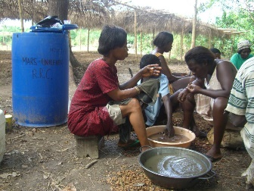




Engaging with the Private Sector
Tony Simons, ICRAF, Kenya
DEVCO Event, Brussels, November 2014

Slide 2




Engaging with the Private Sector
Why the Private Sector?
Allanblackia Case Study
Cocoa Case Study
New Nutrition PPP
Closing thoughts

Slide 3
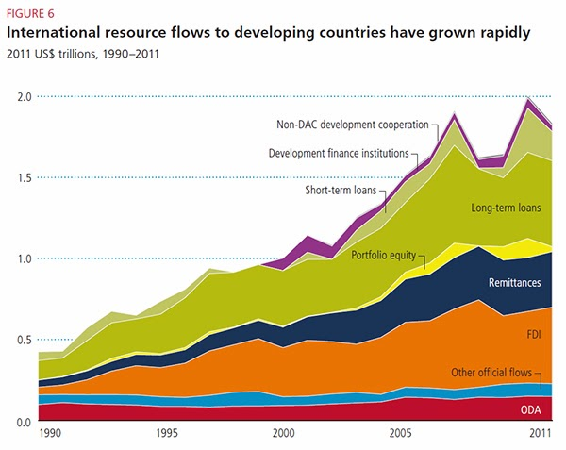
1. Why the Private Sector?

Slide 4
Public Goods
Private Bads
Private Goods
Public Bads

Slide 5
Five stage framework for small holder agriculture livelihoods
Subsistence agriculture
Subsistence agriculture + safety nets
Use of AF
Interventions:
Pre-commercial agriculture
Profitable small-holder agriculture
Sustainable small-holder agriculture

Slide 6
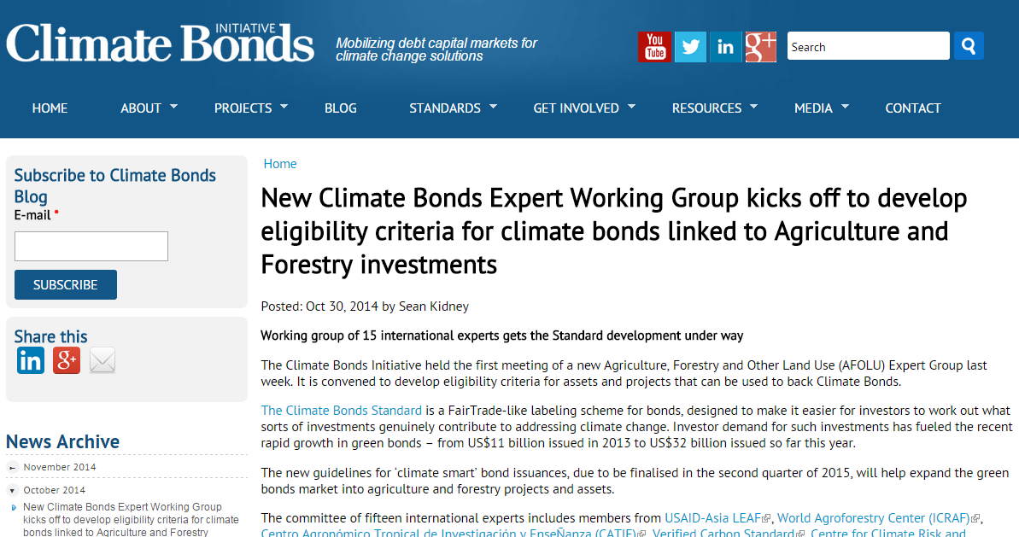

Slide 7
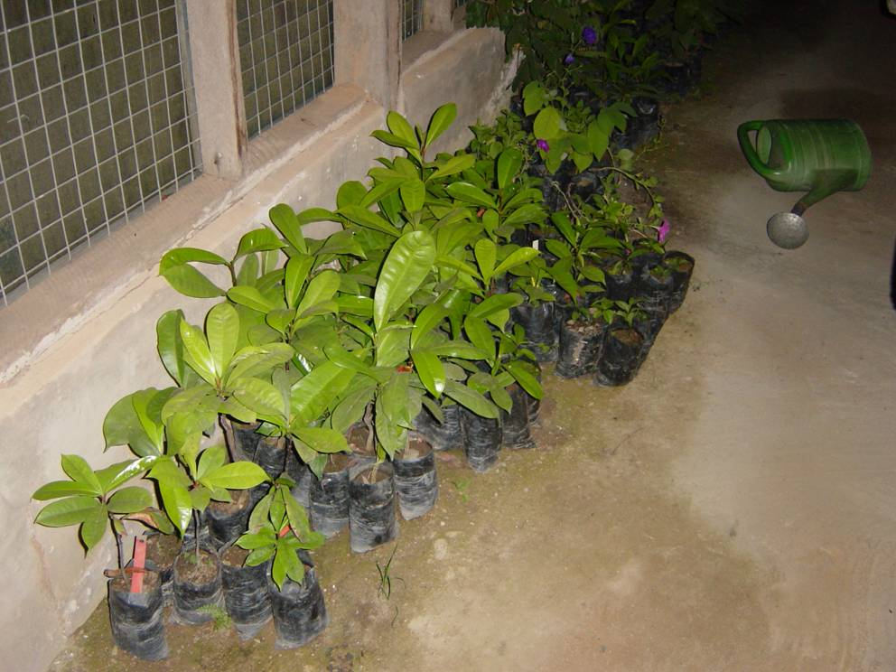
2. Allanblackia Case Study
State of world’s research
December 2003

Slide 8
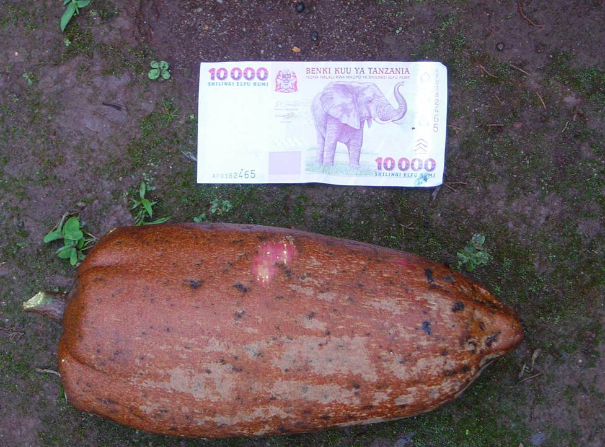
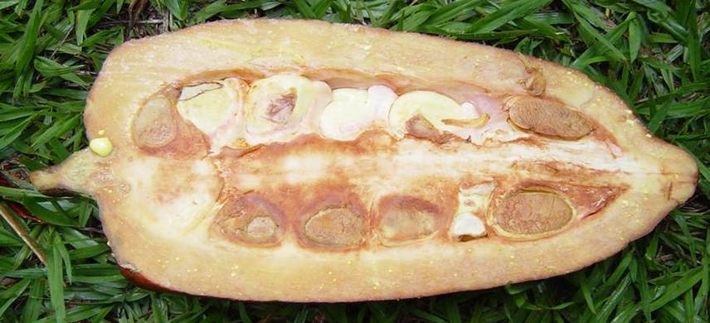
Allanblackia stuhlmanii

Slide 9
Problems with AB cultivation
1. Low seed germination – <1%, take up to 24 months.
Uncertain sexuality of the species – male and female trees
Long time to fruiting – first fruiting takes 12-15 years
Dwindling natural populations – wild fruit collection threatens the species
5. Uncertainty on tree management practices - uncultivated

Slide 10
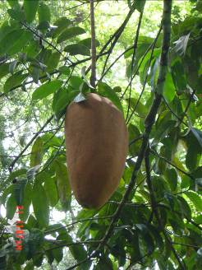
Germplasm collections
Plus trees
150 trees Ghana
117 trees in Cameroon
120 trees in Tanzania
500 fruit on one tree in Amani
Up to 4.5 kg per fruit

Slide 11
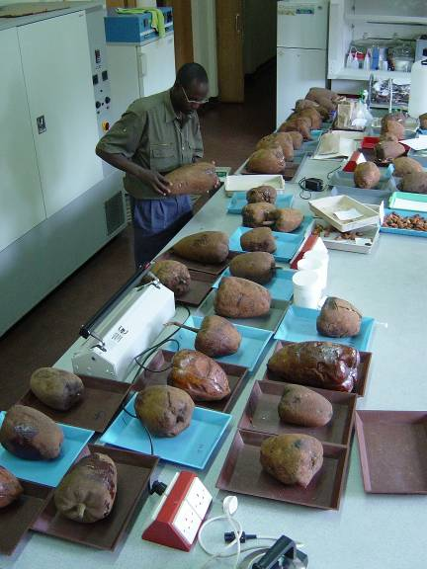
Fruit characterization
and germination
experiments

Slide 12
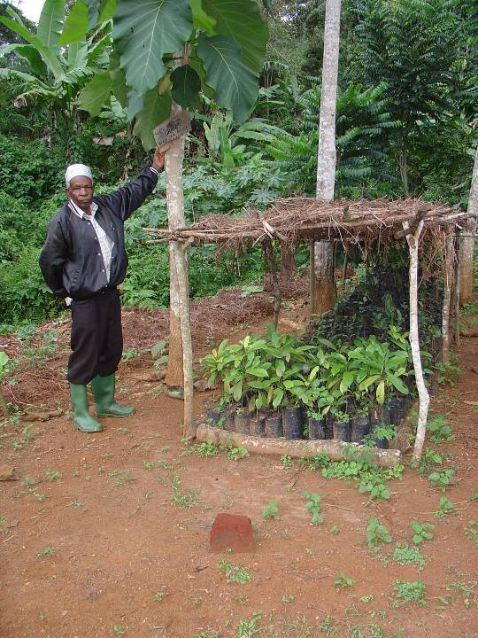
Village nurseries

Slide 13
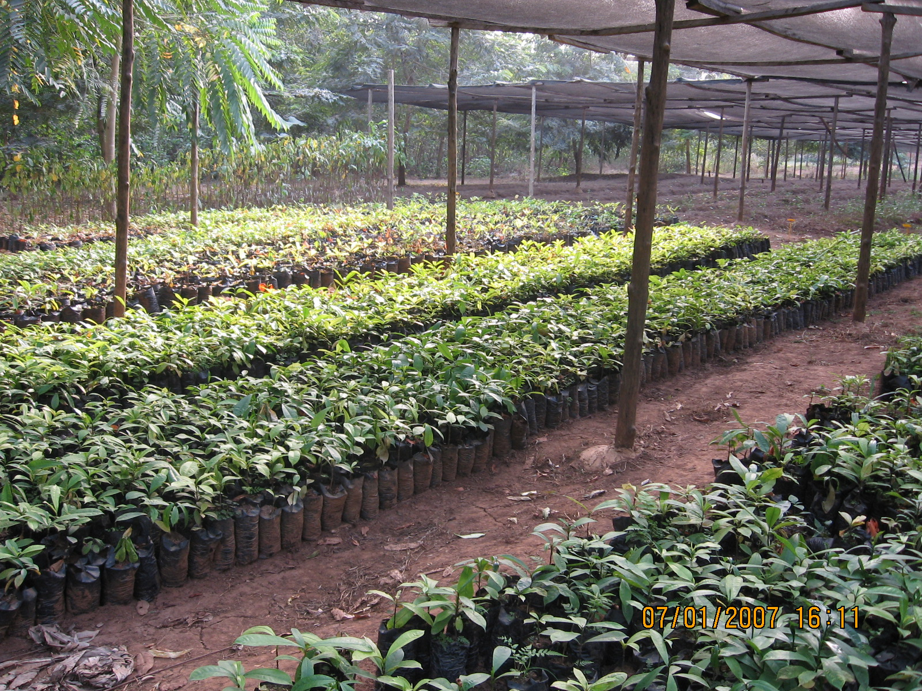

Slide 14
Rural Resource Centres
Mother block area
Fruit reception,
Processing, drying area
propagators
Seed storage pits
seedling beds
seed germination beds
Water storage
Storage
sheds
Covered
Meeting
Area
Storage
sheds
Satellite nursery model
(banana leaves shade, etc)
Trials and field demonstration area

Slide 15
Rural Resource Centres
Source of Knowledge
Skills training
Demonstrations (nursery, field, mother block)
Registration of collectors, buyers, nurseries, producers
Germplasm source
Materials (bags, chemicals, equipment)
Venue for partners to come together

Slide 16
satellite
nursery
satellite
nursery
satellite
nursery
satellite
nursery
satellite
nursery
satellite
nursery
satellite
nursery
satellite
nursery
satellite
nursery
Rural
Resource
Centre
satellite
nursery
satellite
nursery
satellite
nursery
satellite
nursery
satellite
nursery
satellite
nursery
farmer’s
fields
satellite
nursery
1 Rural Resource Centre serves 10-30 satellite nurseries
1 Satellite nursery serves 20-50 farmers
1 farmer growing 10-100 trees
1 Rural Resource Centre for each 200-1500 farmers (av. 800)
1 RRC leads to 2000 – 150,000 (av. 40,000)

Slide 17
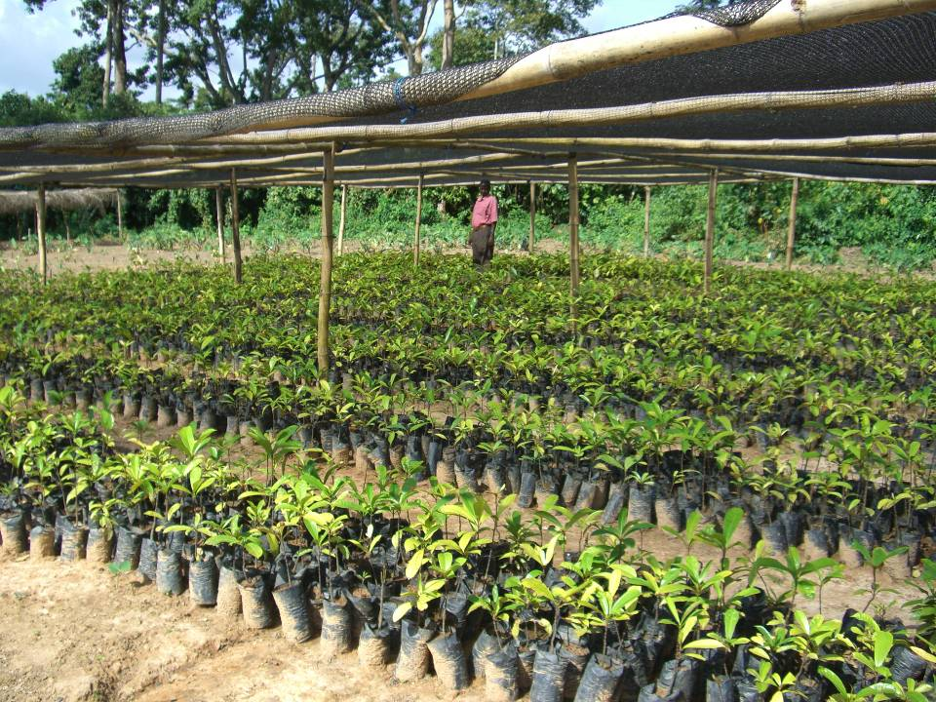
Rural Resource Centre – New Edubiase)

Slide 18

RRC, New Edubiase, Ghana

Slide 19
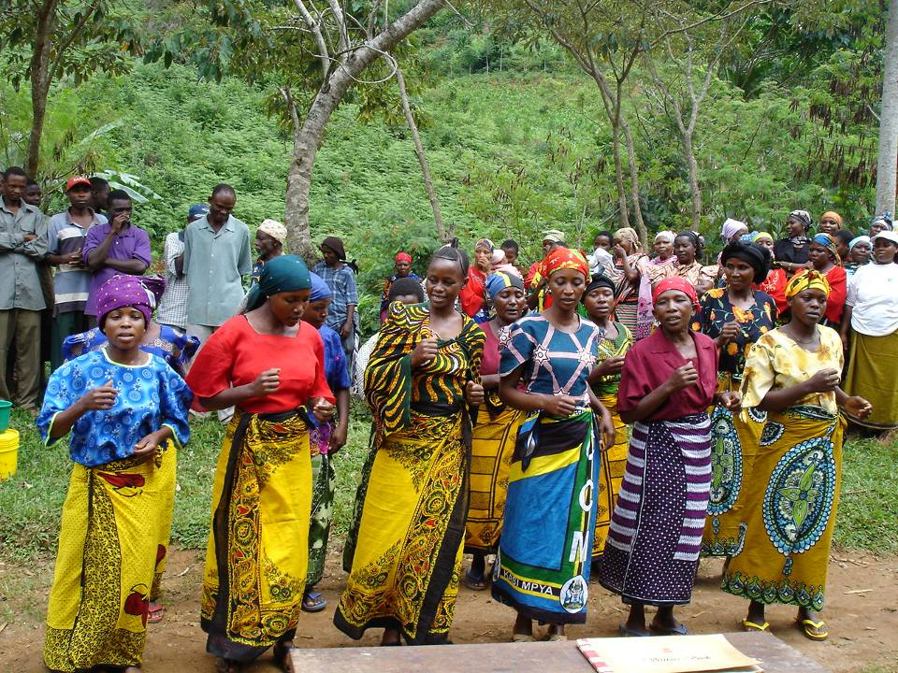
Village tree planting launch May 2006, Tanzania

Slide 20
Proportion of A. parviflora trees that fruited per accession at 7 year
Notes:
At 7 years all seedlings planted per accession that fruited ranged from about 14% to 100%. This provides justification for selection for early fruiting genotypes

Slide 21
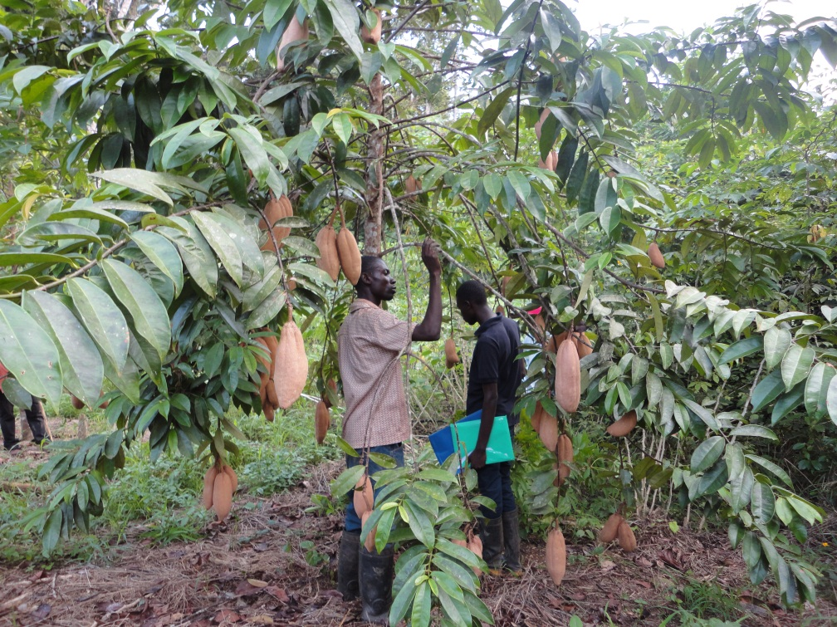
First time fruiting of a 6-year old tree, producing 79 fruits

Slide 22
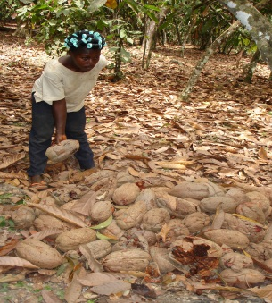
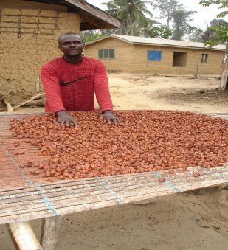
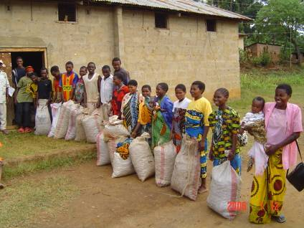
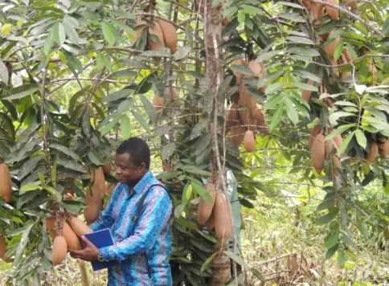
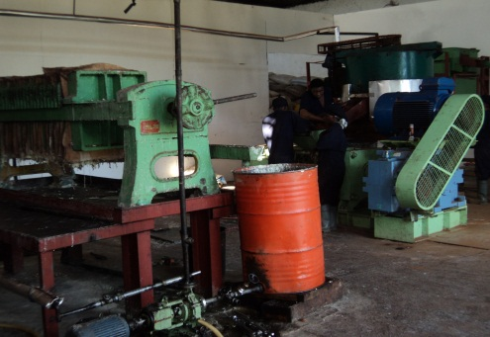
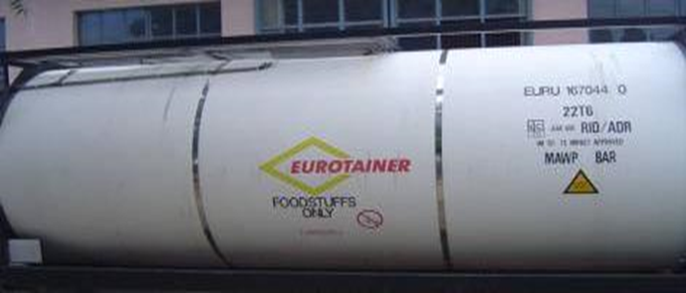
Supply chain and market development for Allanblackia nuts in Tanzania
4000 men and women involved in wild collection, processing & sale of nuts
37 buying centres in
operation
300 tons of nuts sold in
2013
4000 men & women involved in wild collection
Oil export to International market
Oil mill at Tanga for oil extraction

Slide 23
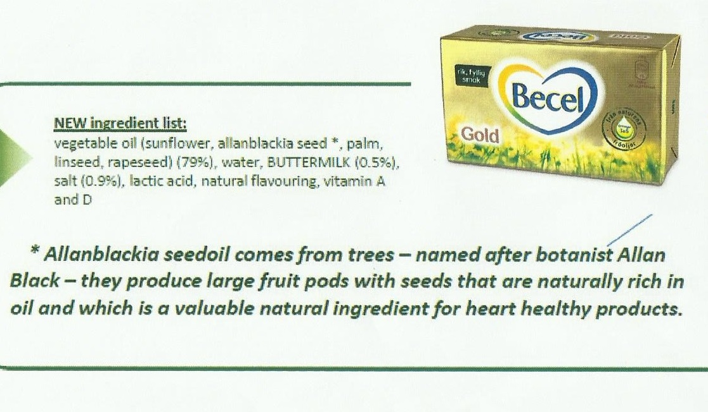
Allanblackia margarine launched in Sept 2014

Slide 24
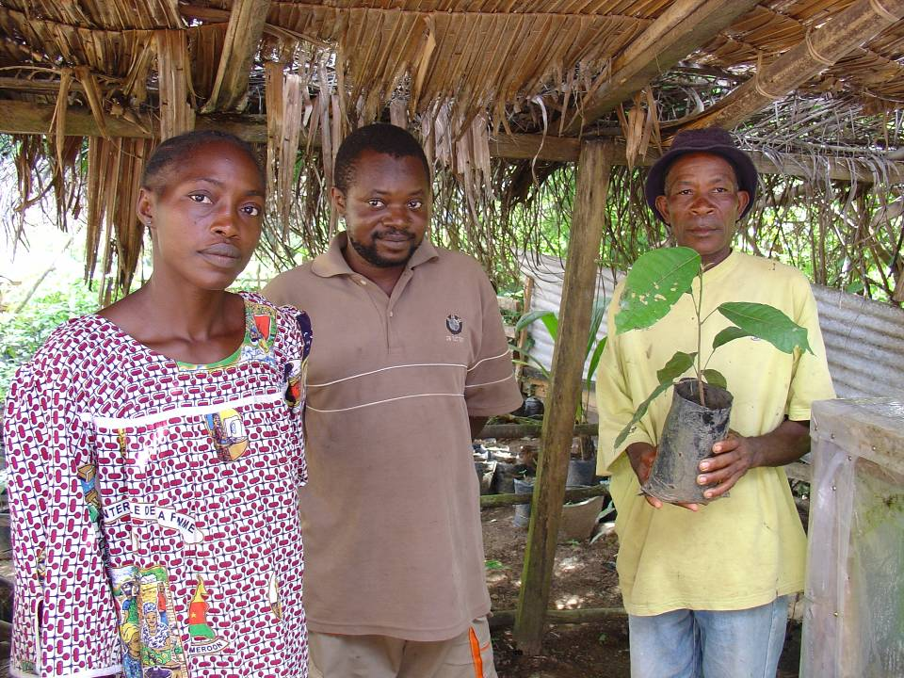
3. Cocoa Case Study

Slide 25
Cocoa Yields are too low
Researcher
Managed
On farm
1500kgs
New farmer
threshold
On station
2500kgs
0.5 MT/ha
70
60
50
Number of plots surveyed
40
30
20
10
0
0-100
100-200
200-300
300-400
400-500
500-600
600-700
700-800
800-900
900-1000
1000-1100
1100-1200
1200-1300
1300-1400
1400-1500
1500-1600
1600-1700
1700-1800
1800-1900
1900-2000
Yield classification (kg/ha)
Source: Etude sur les revenus et les investissements des producteurs de café et de cacao en Côte d’Ivoire, Agrisystems Consortium, 2008

Slide 26
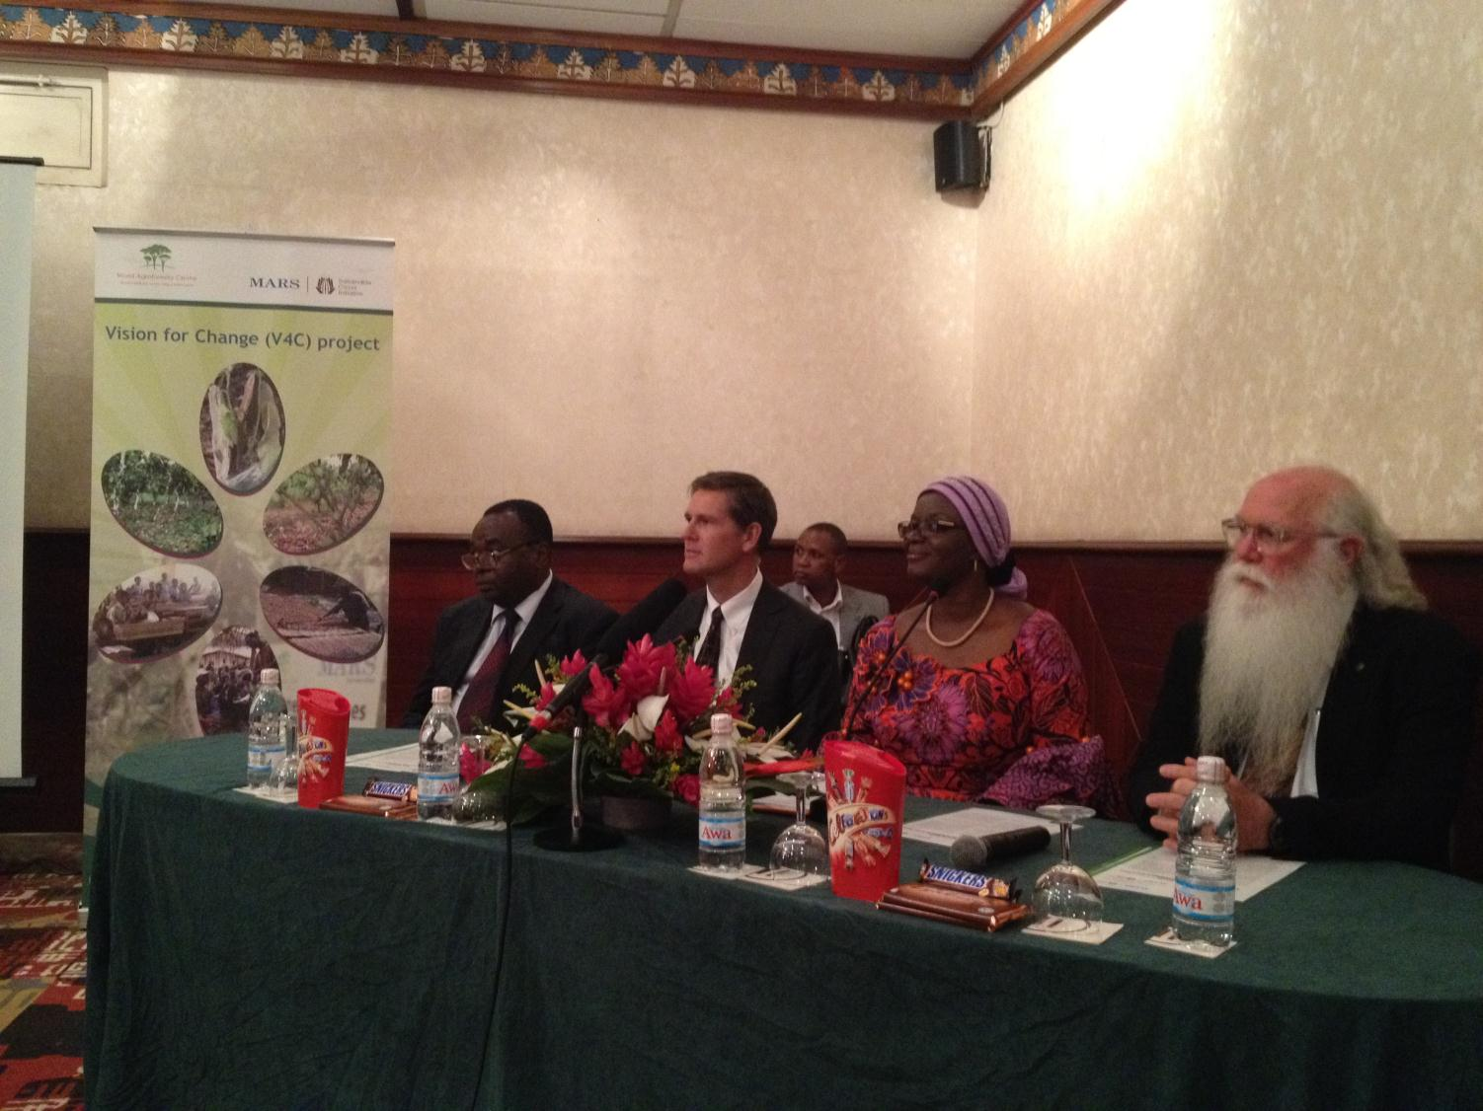
MARS-ICRAF-CDI Government
Public Private Partnership

Slide 27
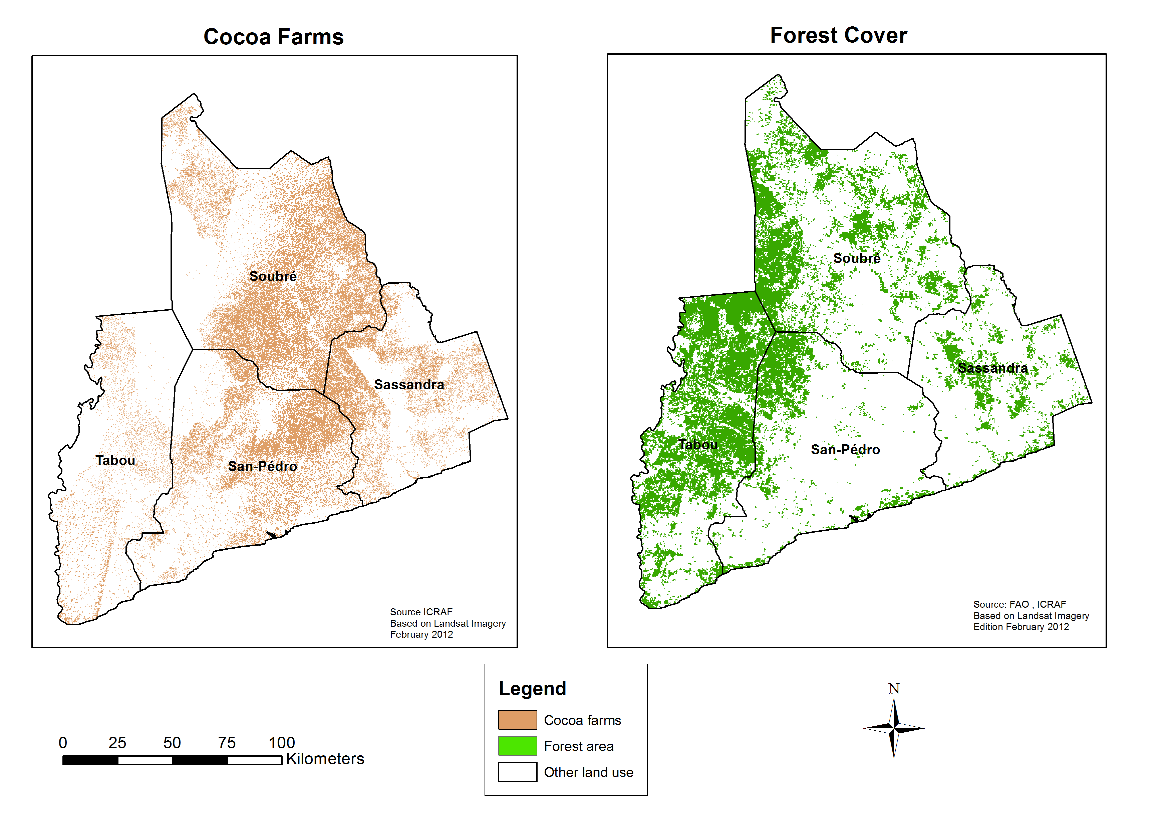
Robust Evidence for decision-making for investments and policies

Slide 28
~40 identified QTLs
in cacao
1
2
0.0
3
cir120
4
5
0.0
cir184
0.0
cir252
cir150
0.0
cir242
0.0
WRKY-10
2.1
cir153
1.5
cir234
0.3
cir111
5.1
cir19
3.8
cir198
3.8
cir241
1.3
cir232
9.2
cir240
5.4
TIR2
5.1
cir233
2.1
cir119
11.6
cir161
9.6
cir146
9.4
Tce195
5.2
shrs37
cir118
16.0
cir3
10.7
cir21
11.2
cir117
7.4
shrs12
15.7
cf974239
20.9
Tce089
10.9
cir192
14.5
cir33
7.6
shrs11
23.4
cir129
11.6
cir62
14.8
cir237
13.5
cir148
23.8
shrs21
12.3
cir40
20.6
cir95
18.2
shrs22
shrs6
13.9
cir247
23.3
shrs33
21.5
cir10
Witches’ Broom
Resistance
28.9
cir143
32.3
ca797995
17.0
cir204
26.2
cir32
26.1
Tce030
cir159
37.4
cir268
19.5
Tce380A
32.0
cir43
26.8
cir196
cir152
21.6
cir180
34.2
cir12
27.7
cir123
39.4
cir102
38.5
shrs13
31.4
cir175
31.5
cir42
Frosty Pod
Resistance
45.0
WRKY-14
39.6
cir280
cir169
46.5
cir29
48.5
cir60
40.6
cir289
39.8
cir149
51.0
50.1
cir139
42.0
cir78
cir256
53.3
cf972885
cir165
45.4
cir263
48.6
cir213
40.7
cir170
54.7
cir249
51.3
shrs2
48.0
cir219
cir206
47.7
shrs19
60.4
shrs3
57.7
cir162
63.6
cir254
48.8
cir245
Pod Weight
61.1
cir244
63.9
cir135
49.1
cir69
62.7
shrs23
64.1
cir128
59.4
Tce380
WRKY-11
65.8
cir246
66.4
cir140
52.3
TIR4
68.4
cir273
70.5
cir48
70.1
shrs7
52.6
TIR3
Pod Number
69.0
cir286
shrs5
63.7
shrs4
shrs34
70.4
cir226
67.6
cir87
70.8
cir131
75.3
cir115
73.0
cir80
Trunk Circumference
80.1
Tce574
85.4
cir230
71.4
cir202
84.9
cir109
86.1
cir228
72.1
cir144
cir101
87.7
cir275
88.0
WRKY-03
73.0
ca798018
9
85.3
cir274
89.9
cir264
93.5
cir68
79.5
cir81
Jorquette Height
93.5
cir22
cir261
91.6
ca795469
100.5
cir73
0.0
cir79
10
97.0
RGH11
cir269
3.4
cir85
cir194
0.0
cir37
Bean Length
4.7
cir223
6
7
8
24.0
cir64
11.2
RGH7
Pod Number & Wet
Bean Weight
0.0
ca972846
24.8
cir98
13.4
RGH8
0.0
cir6
1.7
cir186
0.0
cir103
cir283
23.3
cir61
1.5
cir136
3.0
cir134
32.8
cir212
5.4
3.2
cir277
5.4
cir189
36.4
RGH2
Frosty Pod Resistance
& Wet Bean Weight
10.5
cir53
4.4
cir116
cir58
5.7
cir179
13.5
Tce487
40.6
cir104
cir177
16.8
cir26
45.0
cir8
41.3
cir155
8.0
cir147
47.5
cir178
32.2
cir71
10.2
cir55
23.0
cir200
34.3
cir276
12.4
cir56
55.2
cir160
57.8
cir229
Black Pod
34.7
16.6
cir46
cir211
58.0
cir157
37.4
cir25
cir181
33.3
shrs20
60.5
cir35
22.8
RGH4
35.2
cir225
67.0
cf972909
26.1
RGH5
68.5
cir24
Bean Weight, Bean Thickness,
Pod Weight & Pod Length
54.3
cir209
33.1
cir13
73.3
cir251
57.9
cir9
37.4
RGH1
45.1
cir282
74.1
cir30
43.7
cir190
79.5
cir166
59.9
cir291
51.1
cir1
83.2
cir250
44.1
cir141
86.0
cir126
88.1
cir108
Bean Length, Seed Weight,Ovule
Number, & Trunk Circumference
88.6
cir266
94.6
cir72
95.4
cir287
cir243

Slide 29
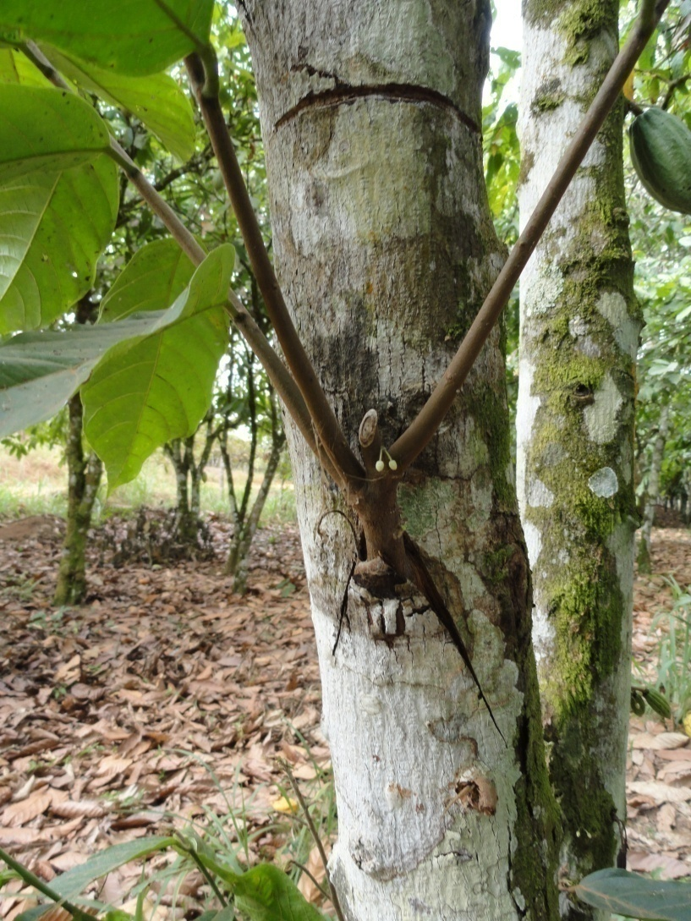
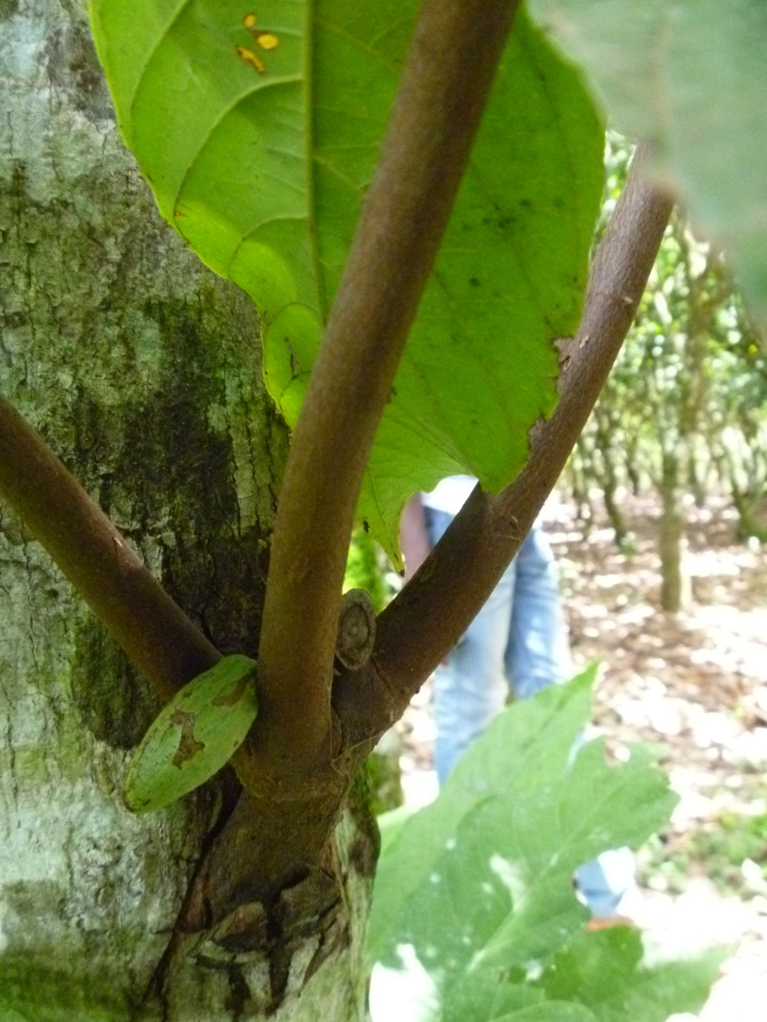
Project Vision for Change (V4C)
First flowers after 5 months
First pod at 9 months

Slide 30
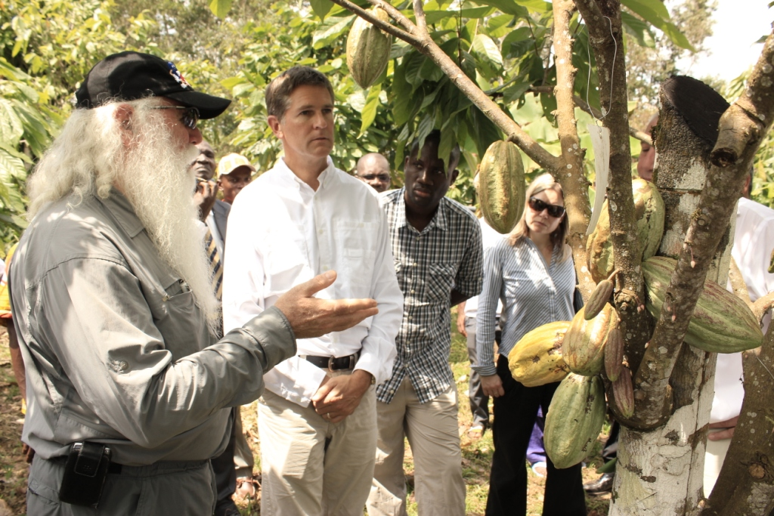
22 months after side grafting, from 4-5 pods to 20-30 pods per tree

Slide 31
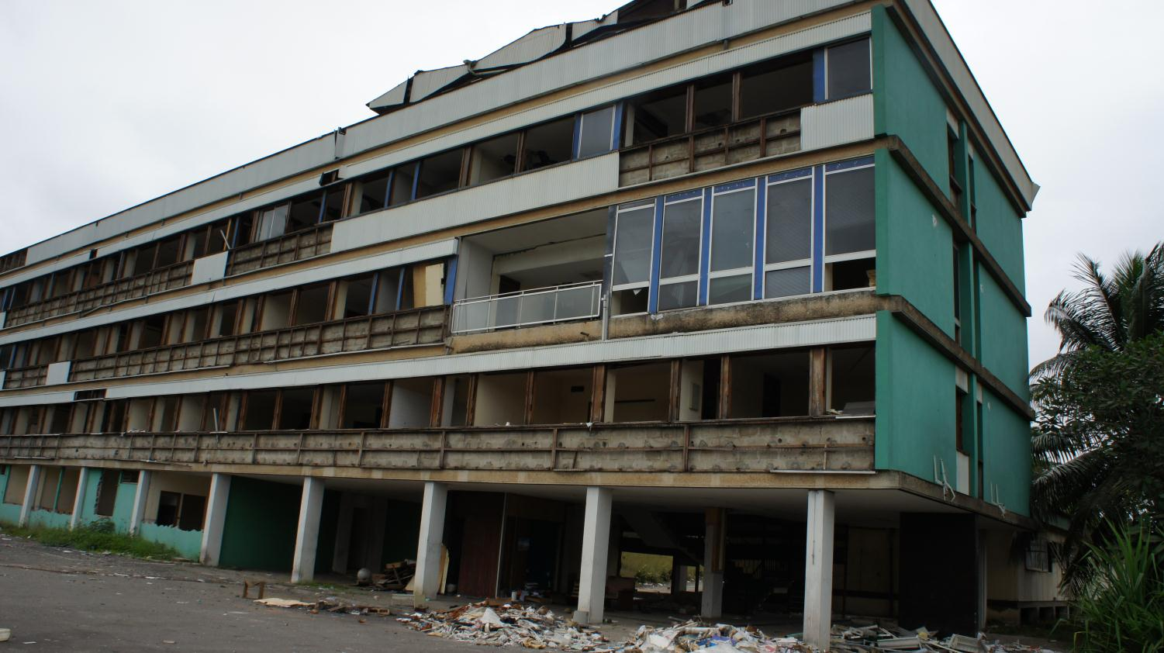
National Partner Offices, August 2011

Slide 32
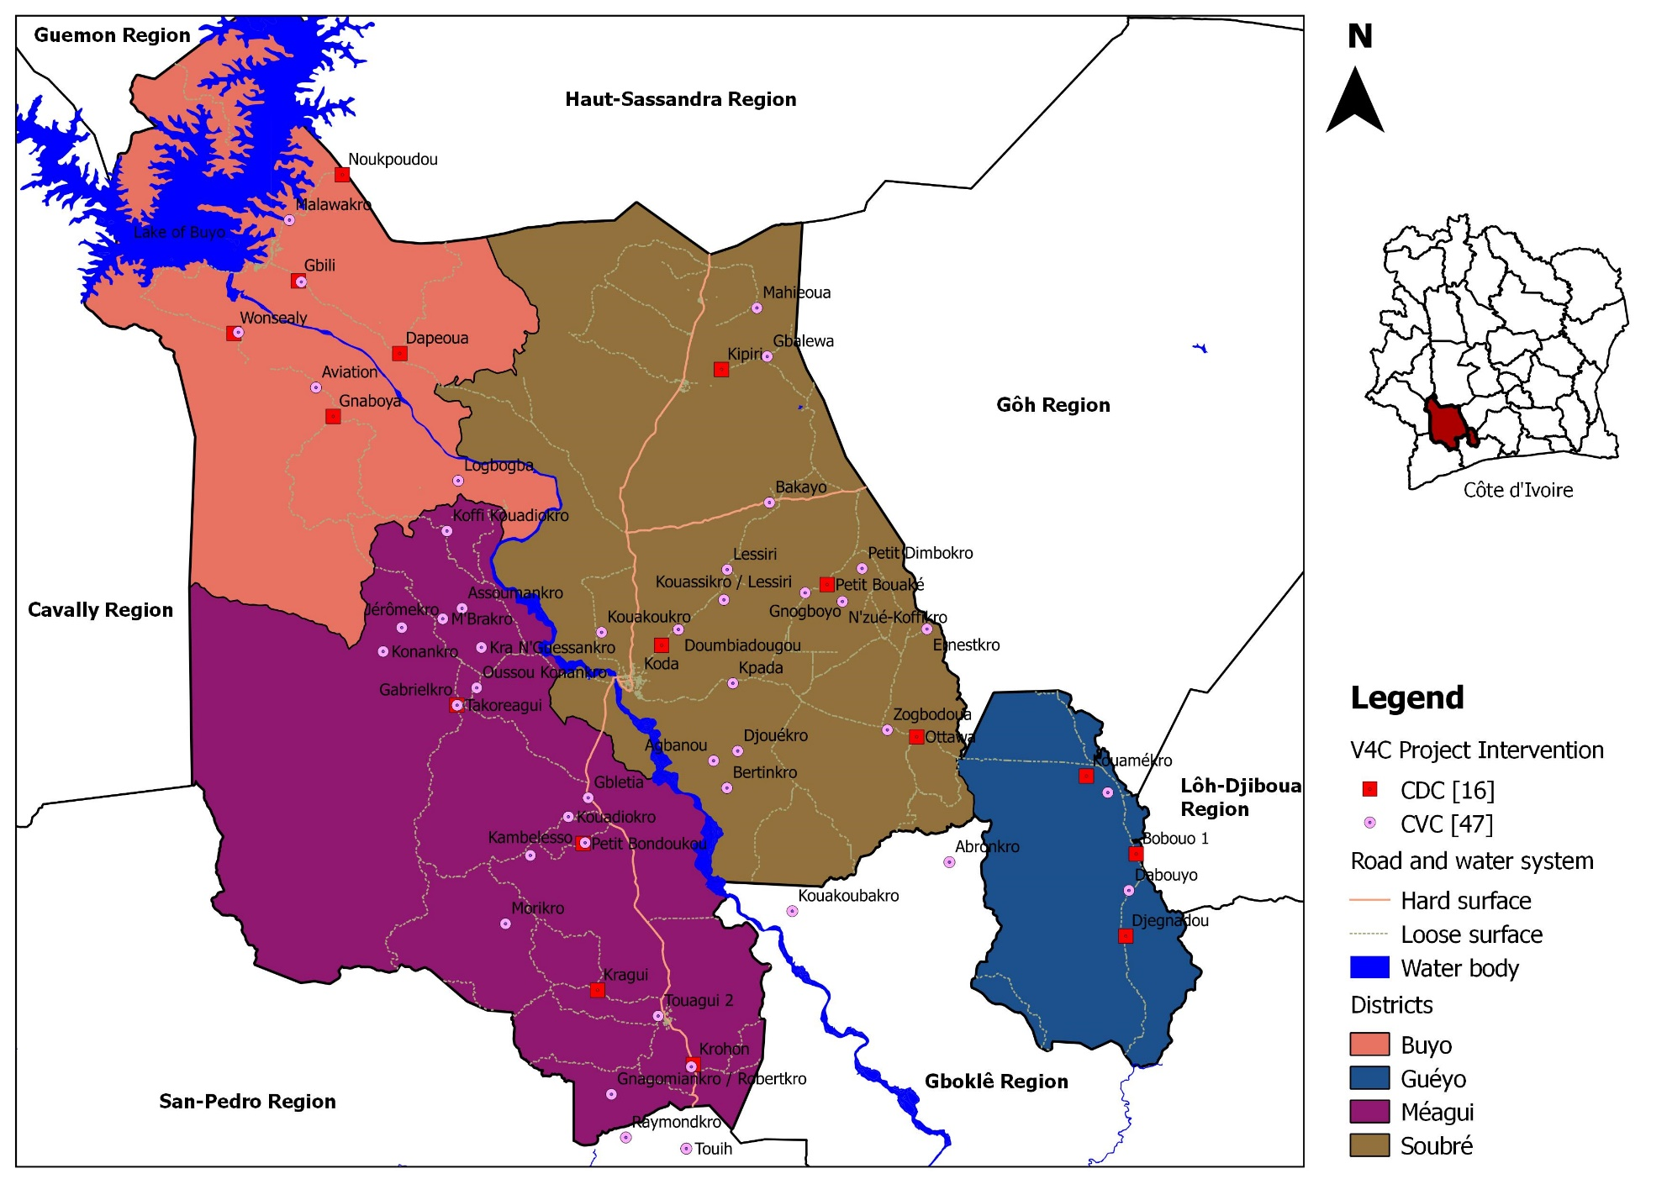
V4C project implementation area with the 16 Cocoa Development Centre (CDC) and 47 Cocoa Village Centre (CVC)

Slide 33
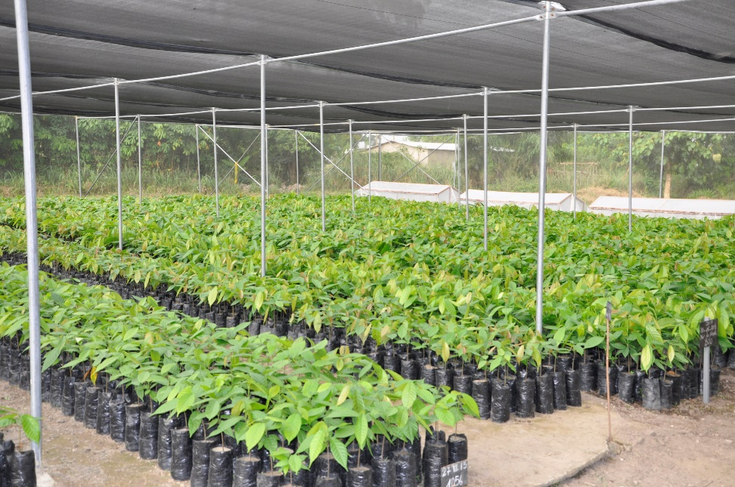
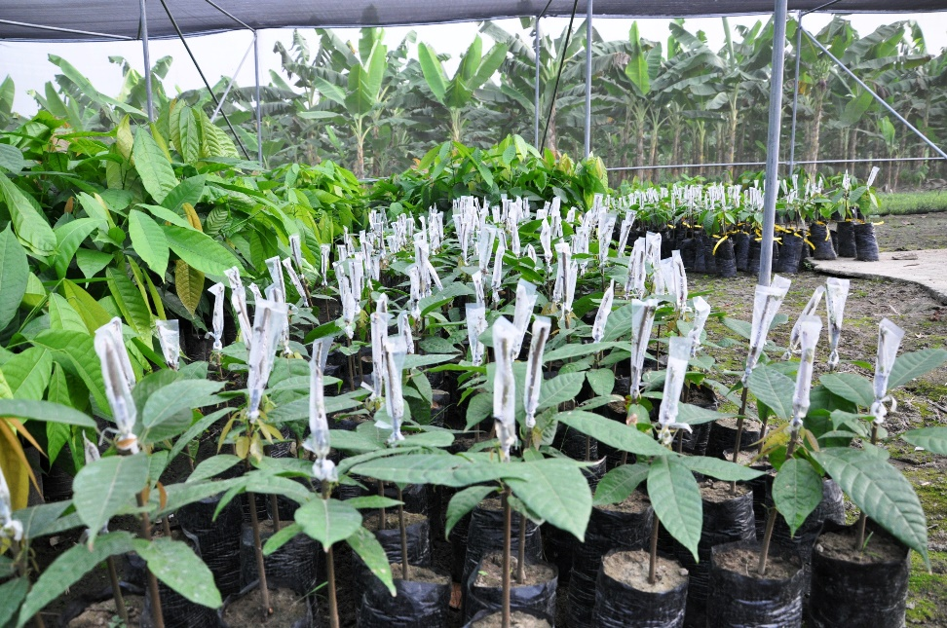
Use of clones and hybrid seeds
Seedlings of improved cocoa varieties produced in V4C nursery at Soubre
Newly grafted seedlings for the establishment of clonal gardens

Slide 34
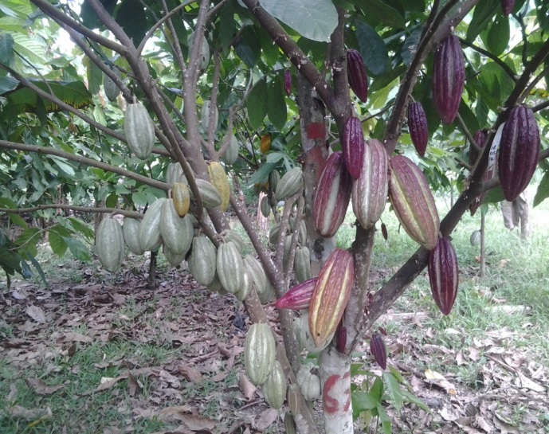
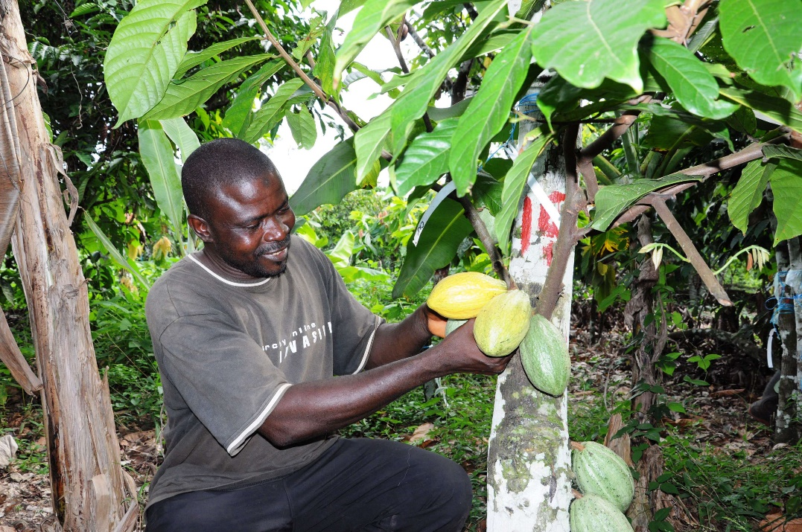
A farmer delighted at the sight of the pods on one yr old grafted cocoa tree
A 2 yr old grafted cocoa tree with 2 high yielding clones

Slide 35
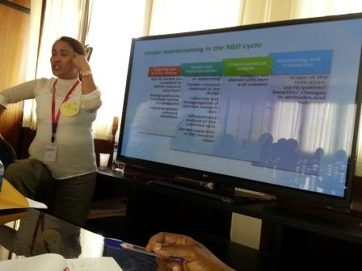
Integrating women empowerment and gender equality into the program
18-19 Sept 2014: Gender awareness Training.
Gender concept is more a social value that biological aspect… is the process to attend equity … gender assessment:
How men and women be affected in the project?
Will there be gender issues in the project will encounter?
Can my project address gender concerns?
Research question for gender investigation
A model package of gender-focused interventions proposed

Slide 36

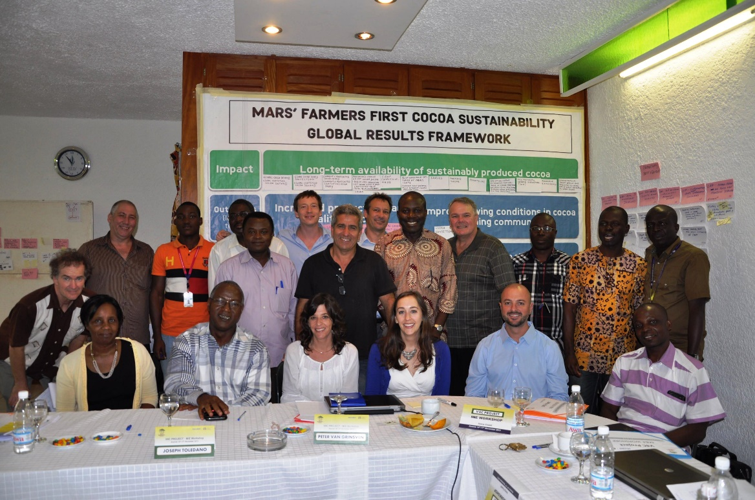
A winning public-private partnership (PPP) to empower smallholders cocoa farmers in Cote d’Ivoire!
A planning workshop for the second phase (2014-2017) was organized in Assinie, Cote d’Ivoire from 14 to 17 November 2013. Highlights of the activities for this second phase include:
Scale up of the project intervention through partners
Increase access and development of improved planting materials
Develop rural entrepreneurship to deliver the productivity package
Provide smallholders with sustainable agroforestry options to enhance human diets, health and income
Involve women in decision-making and increase their income
Promote best practices for education, child protection, and nutrition

Slide 37
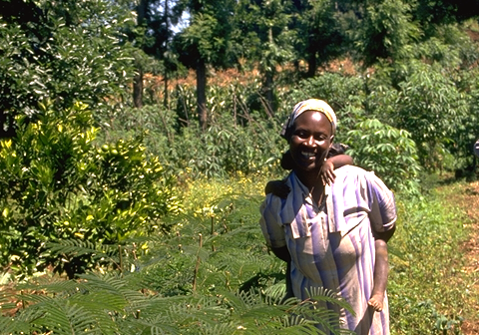
4. The African Orphan Crop Consortium
Growing Africa out of poverty, stunting, hunger and malnutrition

Slide 38
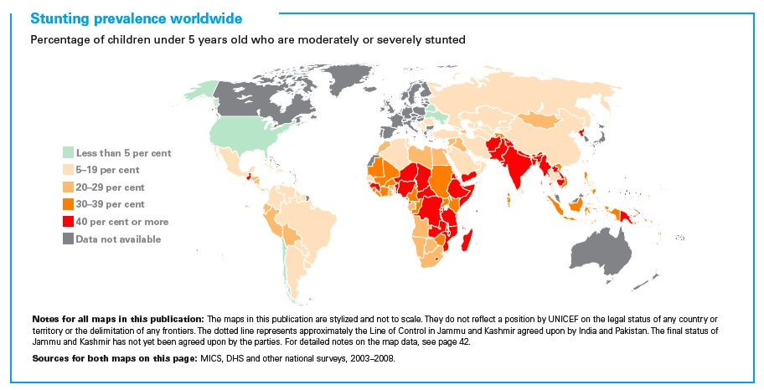

Slide 39
Options available for more nutritious food
1. Transgenic plants – possible but several barriers
2. Chemically add to foods – rural? nutritional complexity?
3. Dietary diversity – homogeneous supply chains, under-investment
4. Physiologically fortify food plants- AOCC

Slide 40














African Orphan Crops Consortium
Dr. Ibrahim Mayaki presented AOCC to African heads of state at an African Union Assembly, and they voted to endorse the initiative.
Investment so far:
$32million
$23 million
is still needed
Key Partners

Slide 41
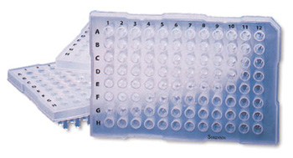
96 well sequencing plate

Slide 42

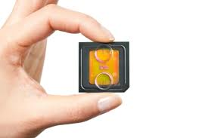
Changing Technology

Slide 43



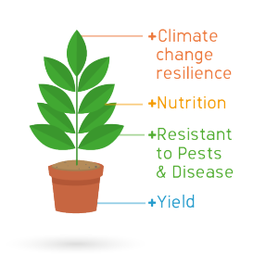

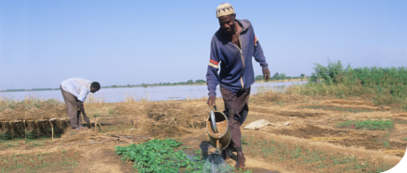
Our Process
1
BGI sequence, assemble and annotate the reference genomes.
2
The Academy then re-sequences 100s of varieties of each plant.
3
The breeding program uses this information to produce superior crop varieties.
4
The IP is made available unrestricted to scientists, plant breeders and seed companies to translate their work to the smallholders fields

Slide 44
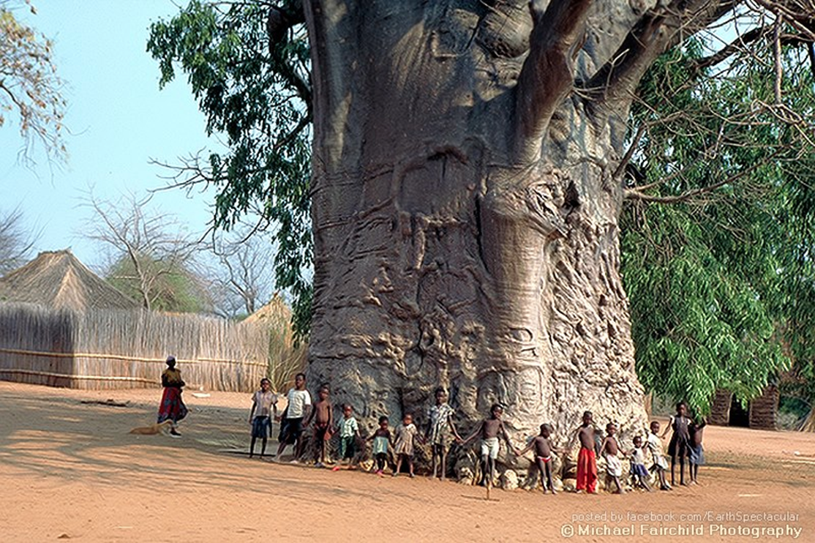

Slide 45





Meet the Crops
The 101 targeted crops are the ‘home garden’ crops
of rural Africa, home to more than 600 million people.
The Baobab Tree
The first crop to be sequenced – it is used as a dried fruit powder in a range of products.
Known as the ‘Wonder Tree’ it is the iconic tree of Africa.
4x
the potassium of bananas
10x
the antioxidants of oranges
2x
the calcium of spinach

Slide 46
2050 - two billion people
- for 1 billion rural people AOC make up 20% diet
- for 1 billion urban people AOC make up 10% of diet
- 75% utilization of what is grown (50% wastage)
28 million tonnes cereals
22 million tonnes vegetables
22 million tonnes fruit
8.2 million tonnes protein (25 million tonnes soy equiv)
7.7 million tonnes fat (25 million tonnes oilpalm equiv)
120 million tonnes = US$60 billion per year

Slide 47
Responsibilities (from Dec 2013)
ELEMENT | LEAD | Highly Involved
Governance | NEPAD | MARS, UCD, ICRAF
Materials, Facilities | ICRAF | BGI, NARS, BecA, NEPAD
APB Academy | UCD | MARS, NEPAD, BecA, ICRAF
Sequencing, Bioinform | MARS/BGI | NEPAD, UCD, iPlant, BecA, ICRAF, Google, LGC
Application, Networks | ICRAF | BecA, MARS, UCD, GCP/IBP, NEPAD

Slide 48
Scientific name | Common name
Adansonia digitata | Baobab
Adansonia kilima | Baobab
Carica papaya | Papaya
Citrullus lanatus | Watermelon
Phaseolus vulgaris | Green bean
Amaranthus tricolor | Vegetable amaranth
Solanum nigrum | African nightshade
Lens culinaris | Lentil
Brassica carinata | Ethiopia mustard
Ipomoea batatas | Sweet potato
Eleusine coracana | Finger millet
Sclerocarya birrea | Marula
Psidium guajava | Guava
Mangifera indica | Mango
Cucurbita maxima | Pumpkin
Vigna radiata | Mung bean
Morus alba | Mulberry
Persea americana | Avocado
Syzygium guineense | Water berry
Momordica charantia | Bitter gourd
Passiflora edulis | Passion fruit
Colocasia esculenta | Taro
Xanthosoma sagittifolium | Arrow root
Lablab purpureus | Lab lab bean
Diospyros mespiliformis | African persimmon
First 25 of 101 orphan crops
for Africa being
sequenced in 2014

Slide 49
5. Closing Thoughts
Development
(application of knowledge)
Research
(building of knowledge)
Impact Pathway Paradigm
Time (years)

Slide 50
Production/validation
of knowledge
Pilot Project
Proof of Concept
studies
Development
Programme
RESEARCH
DEVELOPMENT

Slide 51
Development
(proof of application &
application of knowledge)
Research
(building of knowledge)
New Impact Pathway Paradigm
Time (years)

Slide 52
Development
(proof of application &
application of knowledge)
Research
(building of knowledge &
Development discovery)
New Impact Pathway Paradigm
Time (years)

Slide 53
(y = x)
Benefit
per
contact
farmer
2. Development
1. Research
Cost per contact farmer

Slide 54
4. Enhanced
Development
(y = x)
Benefit
per
contact
farmer
3. Proof of Application
2. Development
1. Research
Cost per contact farmer

Slide 55
Proof of Application Projects underway at ICRAF
Donor Project | Countries | Grant Total (USD) | Number of beneficiaries | Cost per beneficiary
DGIS – Food and Water Security | Burkina, Ethiopia, Kenya, Mali, Niger | $49,000,000 | 500,000 | $99
Cocoa – Vision for Change | Cote d’Ivoire | $50,000,000 | 300,000 | $167
Finland – Biocarbon and Rural Development | East Africa, Guinea, Mali, Sierra Leone | $13,000,000 | 100,000 | $130
CIDA – Sulawesi integrated agroforestry | Indonesia | $9,300,000 | 100,000 | $93
Irish Aid – Agroforestry FS | Malawi | $5,200,000 | 200,000 | $26
ACIAR – Evergreen Agriculture in East Africa | Burundi, Ethiopia, Rwanda, Uganda | $5,200,000 | 80,000 | $65

Slide 56
Criteria for Assessing Effectiveness of Extension Approaches
The degree to which they:
facilitate the flow of information, innovation and materials (e.g., seed) among farmers leading to improved livelihoods
benefit women and the poor
are cost-effective; high benefits relative to costs
are sustainable
strengthen local capacities
are accountable to their clients

Slide 57
Analytical framework: Benefits and costs of a Farmer Trainer Programme
from the perspective of different stakeholders
 | Stakeholders
Item | 1. Project | 2. Farmer Trainers | 3. Trainees
Bene-fits | 1. Benefits to farmers acquiring dairy goats or improving management | 1. Empowerment, knowledge, which helps them increase economic benefits from their own enterprises. | 1. Increased benefits from dairy goat enterprise in terms of increased herd size and value, goat sales, milk and manure.
 | 2. Benefits to economy of increased income and employment | 2. Higher social status | 2. Empowerment, knowledge that farmers use in improving other enterprises.
 | 3. Lessons learned, knowledge generated international public goods | 3. Economic benefits from extension activities (e.g., Sale of seed) | 3. Enhanced social capital provides benefits to group members in other enterprises
 | 4. Enhanced food and nutritional security and health of beneficiaries | 4. Economic benefits to members of their groups(from sale of group-owned seed)
 |  | 5. New contacts with other institutions
* denotes the benefits and costs that were measured in monetary terms in this study.
** denotes the non-monetary aspects assessed in the study

Slide 58
 |  | Research Institution Needs
 |  | A. Awareness of business orientation/effic (seek to replicate) | B. Funds through Public Private Partnership | C. Funds direct from private sector | D. Understand market demand side priorities/ opportunities | E. Greater impact and scaling up | F. Increased visibility/communication of our work
Private Sector Needs | 1. Identify/manage supply chain risks
 | 2. Technical inputs to initiatives, and instrumentation
 | 3. Ease of operation in countries, set up business hubs/incubators
 | 4. Investment validation, pulling in other finance (e.g. leasing)
 | 5. Policy change, advocacy
 | 6. Credibility by associating with us
 | 7. Internal review/audit of ventures
 | 8. Contract research for delievrables
 | 9. Retained advisers for rapid response
 | 10. Justify to their staff need for changes
 | 11. Germplasm access, multiplication
 | 12. Interfacing/convening and aligning role
 | 13. Training Programmes

Slide 59

Engaging with the Private Sector

Slide 60
