Slide 1
GENERATION CHALLENGE PROGRAMME (GCP)
EXTERNAL REVIEW
INDEPENDENT EVALUATION ARRANGEMENT (IEA) OF THE CGIAR

Slide 2
RELEVANCE
EFFECTIVENESS
EFFICIENCY
IMPACT
SUSTAINABILITY
QUALITY OF SCIENCE
Two surveys - (1) programme (2) governance and management

Slide 3
GCP PURPOSE
To use genetic diversity and advanced plant science to improve crops for greater food security in the developing world

Slide 4
BACKGROUND
August 2003
CIMMYT
10 years (two phases – close in 2014)
Annual budget USD15-17 million pa
Drought-prone areas
18 CGIAR mandate crops in Phase I
9 CGIAR mandate crops in Phase II
>180 organizations in the global network

Slide 5
EC provided largest share of funding – USD57 million from a total of USD168 million

Slide 6
OUTPUTS
Genetic resources
Genomic resources
Informative markers
Genes
Germplasm
Tools
Capacities
Knowledge – the Integrated Breeding Platform (IBP)

Slide 7
Conclusion of the review team
“… GCP has performed well, has met the majority of its genetic enhancement goals and surpassed others, and will leave a formidable legacy of useful and accessible products and information”

Slide 8
Assessment of GCP’s overall performance from stakeholder survey
Possible choices: Strongly agree; agree; disagree; strongly disagree;
don’t know/not applicable
% Agree
93.6%
92.8%
95.1%
96.3%
92.2%
91.4%
91.5%
90.0%

Slide 9
Key learning areas
Governance
Science management
Monitoring and evaluation
Selecting research projects
Linking upstream research with applied science
Partnership
Adoption and behaviour change
Research leadership
Product delivery
Programme closure and transition

Slide 10
KEY AREAS OF SUCCESS
Partnership and collaboration – the GCP spirit
Research management
Capacity building
Leveraging the GCP legacy

Slide 11
Partnerships
Be strategic in partnership development
The importance of people
  People are first, and institutions are second
  Building on existing partnerships, maximizing on personal relations
Be selective, and also cautious
  Can easily get out of hand, can be a distraction
Plan for it, and do not underestimate effort needed
  Managing true partnerships takes time and resources!!!
But, if managed well…
  One of the most efficient and effective ways to do business
  One of the most rewarding components of the work
  Creates a special group dynamic and brings in new ideas
  Cultivates public trust, with the resultant positive public image
  Not every project is most efficiently implemented through partnership

Slide 12
Research activities: integration into CRPs
GCP Research Initiative | CRP in which embedded (Director)
1. Cassava | RTB (Graham Thiele)
2. Rice | GRisP (Bouman Bas)
3. Sorghum | Dryland Cereals (Shoba Sivasankar)
4. Legumes | Grain Legumes (Noel Ellis)
5. Maize | Maize (Dave Watson)
6. Wheat | Wheat (Victor Kommerell)
7. Comparative genomics (sorghum, rice, maize) | Sorghum: Al tolerance in sorghum embedded in Dryland Cereals CRP
 | Rice: Al tolerance in rice embedded in Global Rice Science Partnership (GRiSP) CRP
 | Maize: Al tolerance in maize embedded in Maize CRP
All extended projects now embedded into respective CRP
Highlight of finished projects with valuable intermediate products
CRP Directors deeply involved in the transition process

Slide 13
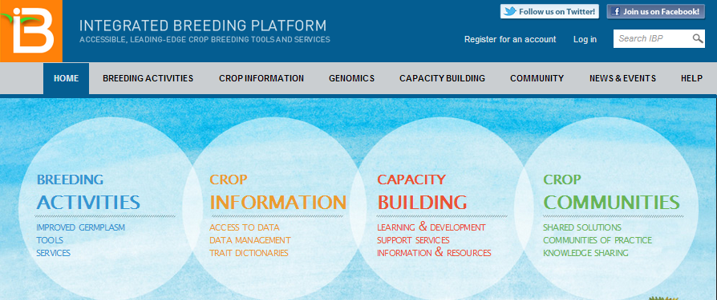
Integrated Breeding Platform www.integratedbreeding.net
Providing resources and building professional networks for plant breeding
Breeding
Data mgt tools
Trial Mgt Tools
Data analysis tools
Molecular analysis tools
Breeding decision tools
Protocols
Breeding support services
Crop Information
Crop databases
Trait Dictionaries
Marker information
Capacity building
IBMYC & other training courses
Learning resources
Infrastructure support
Support Services
Communities
Blogs & Forums
News
Publications
Live chat

Slide 14
The Integrated Breeding Platform:
moving into the future
IBP will survive the GCP
A proposal currently under development to be submitted to the Bill & Melinda Gates Foundation in a couple of months
Proposed project duration: 5 years (2014‒2019), US$12m
Overarching objective:
    To improve the efficiency of plant-breeding programmes in developing countries by enabling plant breeders to access modern breeding technologies, breeding materials and related information in a centralised, integrated and practical manner

Slide 15
Major achievement: the GCP community
EPMR panel (2008) noted that the GCP community is one of the Programme’s most crucial assets. In their words:
    “Perhaps the most important value of GCP thus far, is the opportunities it has provided for people of diverse backgrounds to think collectively about solutions to complex problems, and, in the process, to learn from one another.”
Linking upstream research with applied science
True partnership
  Shared resources
  In-kind contribution from most of our partners
  Work as a team to find funds
Evolution of roles and responsibilities
  Leaders became mentors
  Trainees become doers and leaders
  In 2013/14, about half of the PIs are from developing countries
  There is no doubt a unique and tangible ‘GCP spirit’ observable in the camaraderie at GCP meetings

