Slide 1

GFAR: the Global Forum - Shaping the future of agriculture together
Mark Holderness, GFAR

Slide 2
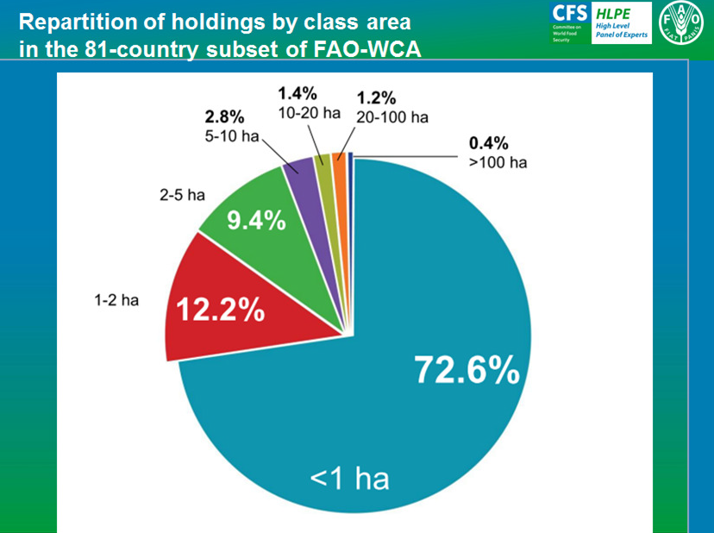
From national to global
Source: Pierre-Marie Bosc for HLPE, 2013

Slide 3
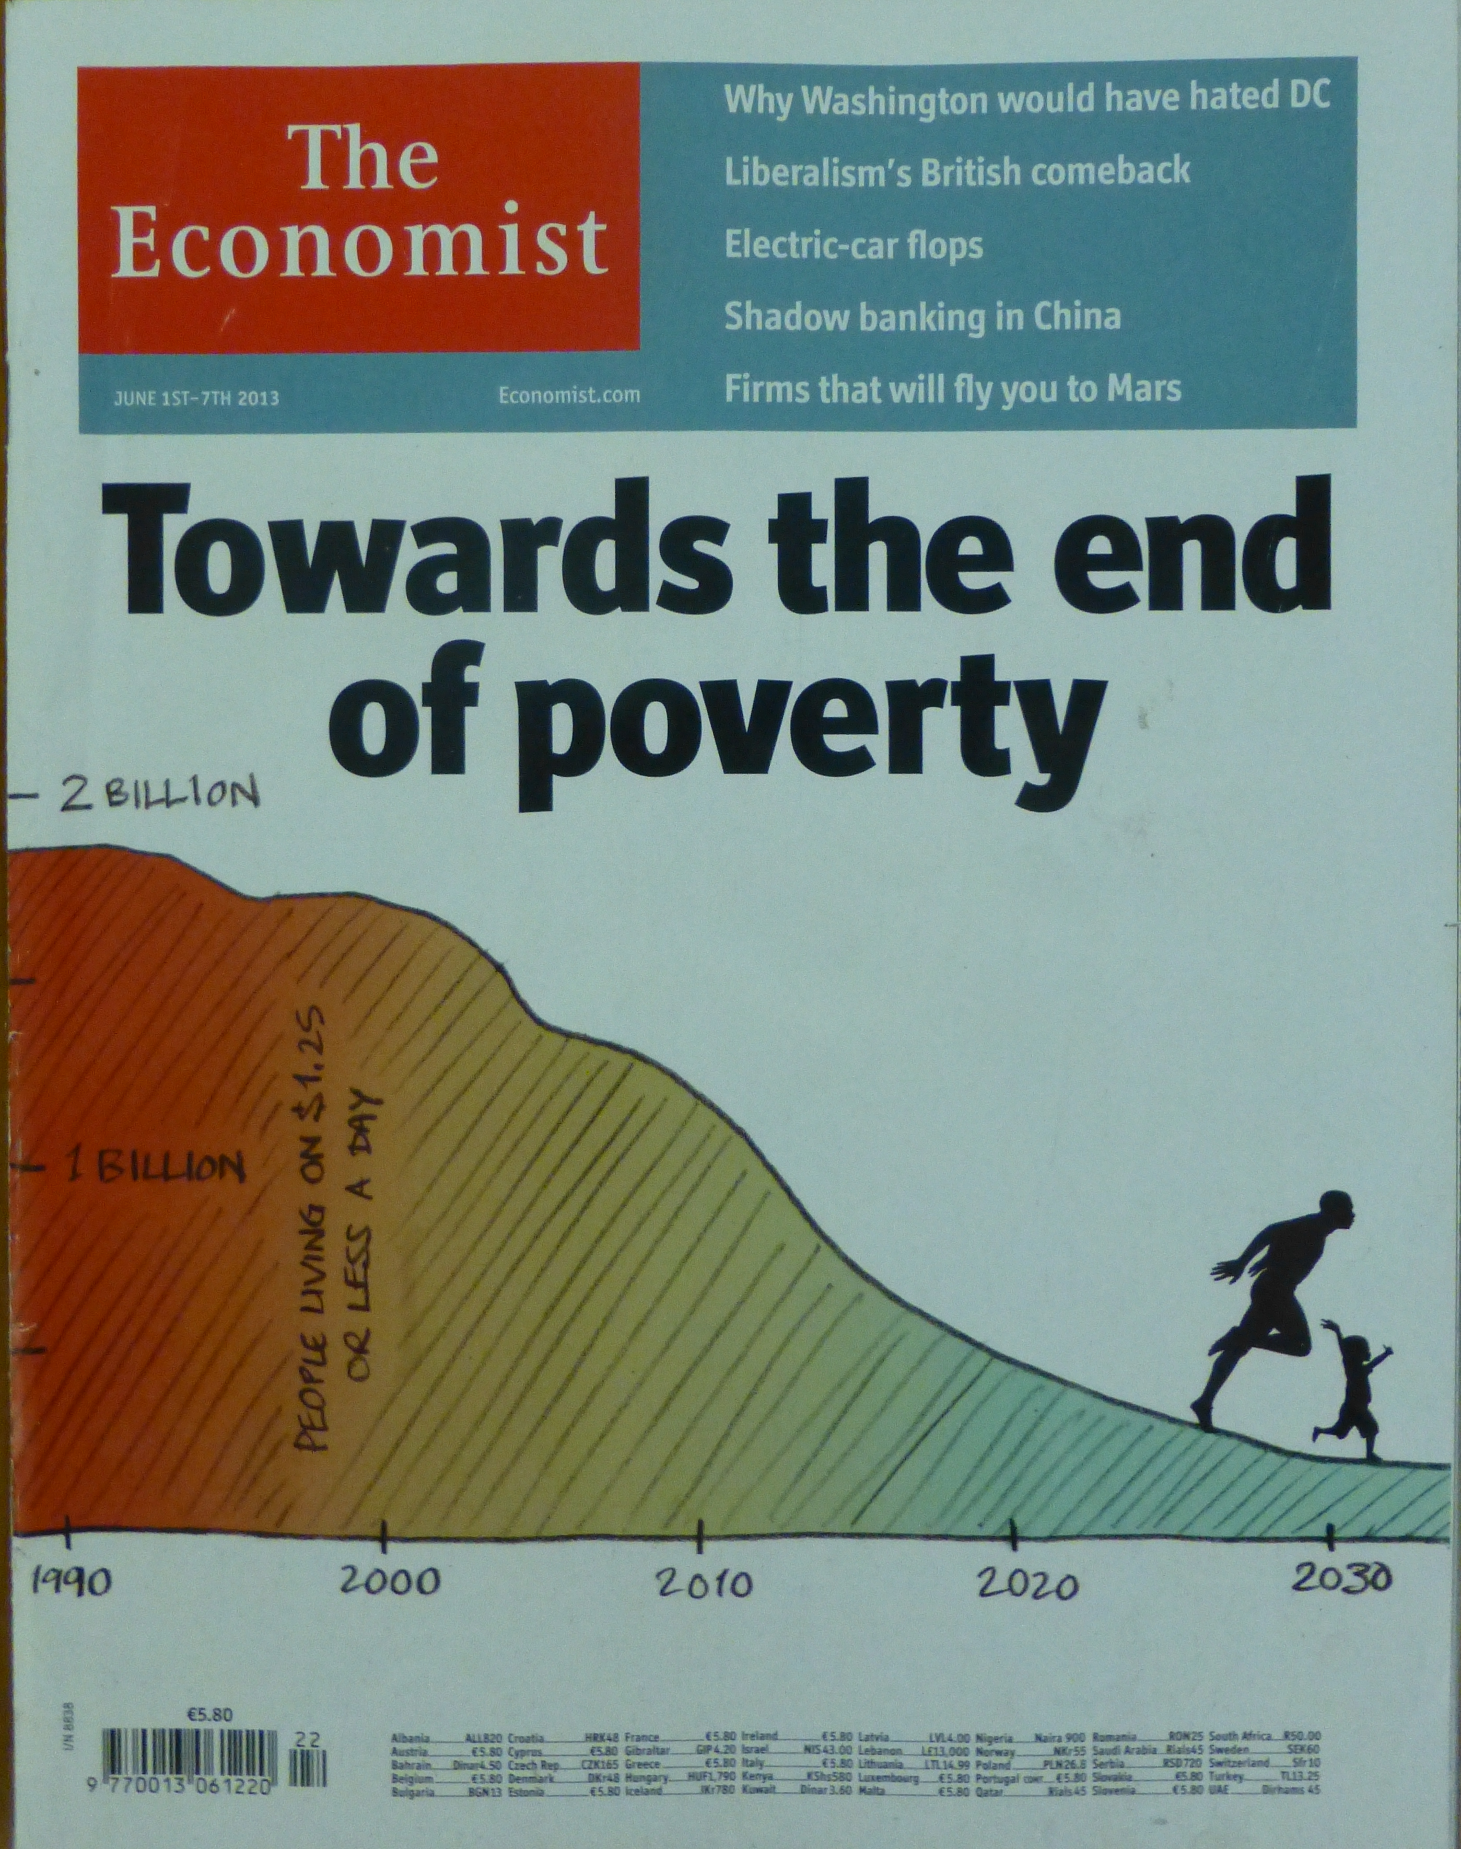
Re-imagining agricultural innovation needs in a changing world – requires new capacities beyond technological solutions
Productivity ‘yield gap’ – more than a
constraint of technology… of inputs vs returns and risk aversion
Consumers shaping demand & production - nutrition: health nexus
Rethinking agriculture from an
engendered perspective…
Who benefits from innovations? Who
can be disadvantaged?
Poverty-hunger nexus: Future challenges will be in reaching the poorest sector, usually rural
Impacts of disrupted systems:
22 countries in protracted crises

Slide 4
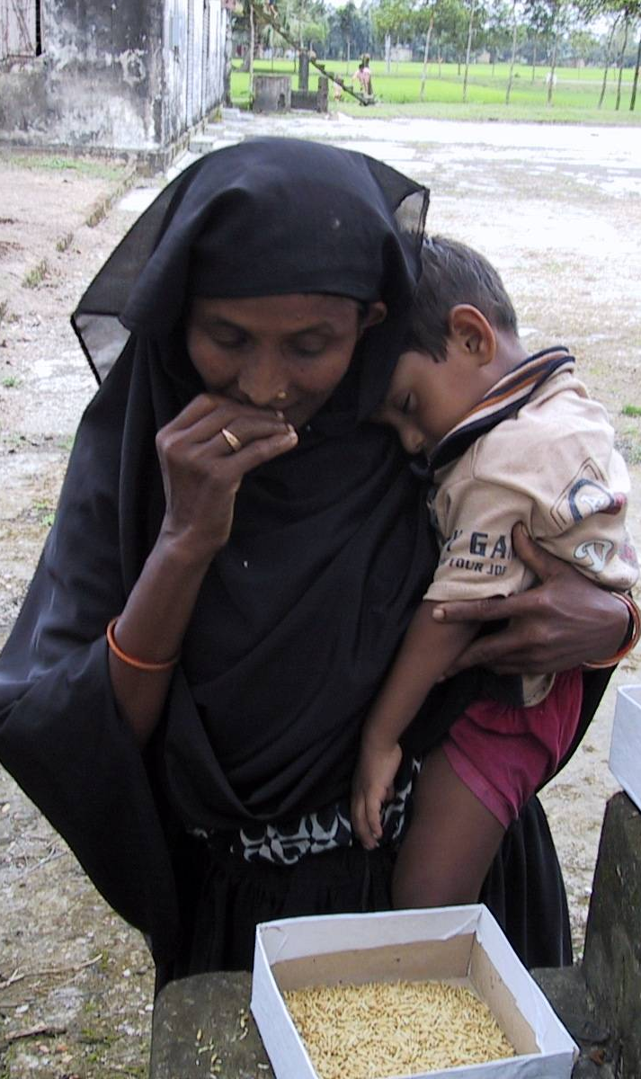
Partnership in innovation: all knowledge has value
Scientific knowledge is reductionist, trusted & validated by its method
Local knowledge is holistic, risk-aware, trusted & validated by experience
Need to link & reconcile these knowledge & trust bases
Sustainable development
must value & capitalize on both
P. Van Mele

Slide 5
GCARD Roadmap: Knowledge & innovation are essential, but are not themselves sufficient for development
Innovation pathways
Desired development outcome
Institutions & capacities supporting agricultural
development &
innovation
Enabling environment
& inputs
Notes:
This means in effect that to reach desired development outcomes it is no longer good enough to think of a technology pipeline with ‘someone else’s job’ to turn innovations into field impacts and an outcome of take up by those with best advantages that can further disadvantage the poorest. We must consider how the complex actions and interactions that enable innovations to be generated, accessed and used can be brought together with the enabling environments and inputs required (credit, crop inputs etc) and with innovation policies that promote agricultural development for smallholders.

Slide 6

Our Unique Global Forum:
Catalyzing & Enabling Change and Action
Transforming agricultural research, extension, education and enterprise for development:
IFAD & FAO
CGIAR & AIRCA – the international agricultural research centres
Farmers organizations: 285 linked, >200 M farmers
Regional Fora : AARINENA, APAARI, CACAARI, EFARD, FARA, FORAGRO
Private sector: SAI - 55 major food companies; PanAAC SMEs - 35 countries, Input sector networks
CSOs: Prolinnova NGOs in 17 countries, CSO-GARD >70 members
Advanced research : G20 MACS & BRICS: 70% of world investment
Advisory Services – GFRAS, networks around the world
Higher Education – GCHERA : >600 universities, >1 million students
Youth - YPARD - 6,600 youth members

Slide 7


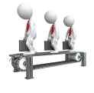

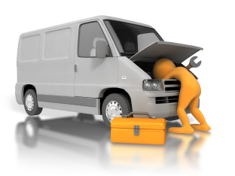
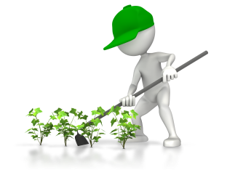
Building the Human Capacity Pyramid
Policy makers, scientists, researchers – client linkage
Entrepreneurs, traders, processors, wholesalers
Advisory workers/change agents
Rural technicians and artisans
Small-holder producers
Notes:
Determining what it will take to produce capacity builders who are fit for purpose in 21st century agricultural industry
Identifying the building blocks of successful approaches and best practices in capacity strengthening from technical and vocational to tertiary education
Enumerating the resources that are required to; first assemble the pyramid so that Africa will have a truly functional capacity strengthening system that will be able to drive agricultural development effectively and sustainably and second to start the process of reckoning what it would take to build the pyramid to the size that Africa needs to be assured of having sufficient human and institutional capacity to achieve the African Vision for Agriculture, i.e., the 6% per annum growth in agricultural production that is far higher than the continent has ever achieved and yet is the minimum for meeting the needs of the expanding populations while making real inroads into relieving extreme poverty and hunger.

Slide 8
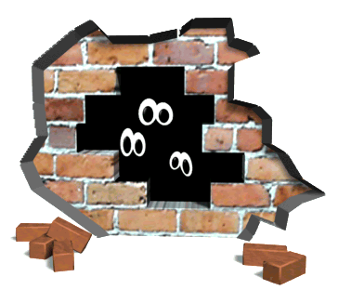
The Global Forum:
Breaking down the sectoral walls
Farmer-centred thinking
Stakeholders learning
& innovating together,
managing benefits & risks
Catalyzing Global Partnerships
Measures of success beyond
productivity alone
Mobilizing agricultural innovation
& enterprise, engaging all sectors
Institutional reorientation & changed attitudes/values
Convergence of Research, Extension, Education and Enterprise, Policies & Resources
joedale.typepad
Notes:
A fundamental need is to break down the institutional divides, the walls that prevent effective collaboration and partnership towards shared goals. Doing so will require:
Development-centred thinking with the needs of poor farmers and consumers at the centre of the process
Innovative knowledge access & transformation systems
Stakeholders learning & innovating together, managing benefits & risks
Institutional reorientation & changed attitudes/values
Convergence of R&D, education and business policies and resources

Slide 9
The Global Conference on Agricultural Research for Development – a process for change
GFAR – Catalyzing partnerships & programmes for action among all those generating, accessing, adapting & using agricultural knowledge & technologies
CGIAR Evolving Strategy and New Programmes of International agricultural research system require partnership, consultation & accountability
GCARD – Unique multi-stakeholder process of dialogue, with milestone conferences, for transforming and strengthening agricultural innovation systems around the world
Notes:
The Global Conference on Agricultural Research for Development , a process organized jointly by the Global Forum on Agricultural Research and the CGIAR, sets out to combine the processes of GFAR in catalyzing programmes and partnerships for action and the reform of the CGIAR towards an outcome-focused basis that requires partnership, consultation and shared accountability for outcomes. The GCARD establishes an outcome focused process and milestone conferences tor transforming and strengthening agricultural research for development around the world.

Slide 10
The GCARD Roadmap – GFAR & CGIAR
endorsed by all GFAR Stakeholders 2011, reaffirmed in 2013 survey
Improving foresight and collective focus on future needs and key priorities as determined and shaped by science & society
True and effective partnership between research and those it serves
Increased investments to meet the huge challenges ahead and ensure required development returns from AR4D
Greater capacities to generate, share and make use of agricultural knowledge for development change among all actors
Effective linkages that embed research in the wider development context and actions enabling change
Better demonstration and awareness of development impact and returns from agricultural innovation

Slide 11
The Global Foresight Hub: Linking science and society
Trends are products of our behaviours – and can be changed
Not just projecting what the world may become but deciding what kind of world we would like to see in future
And what innovations we need to get to desired scenarios
Grassroots Foresight: Smallholders envisioning their own futures
Societies decide for themselves, on their own terms – e.g. Mediterranean dialogues

Slide 12
Catalyzing Global Partnerships for Change
CGIAR and GCARD: bringing the voice of partners to shape international research
UN Agencies: connecting innovation to international policies
Regional & National Fora: fostering multi-stakeholder dialogue & action
Global Alliance for Climate Smart Agriculture: enabling civil society involvement
EAT Forum: New metrics to reshape production values sand access to nutrition
Prolinnova: Promoting Local Innovation
Kigali Movement: innovation in protracted crises

Slide 13
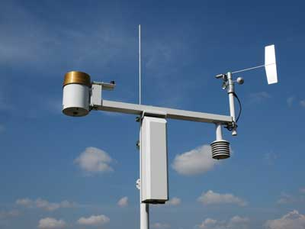
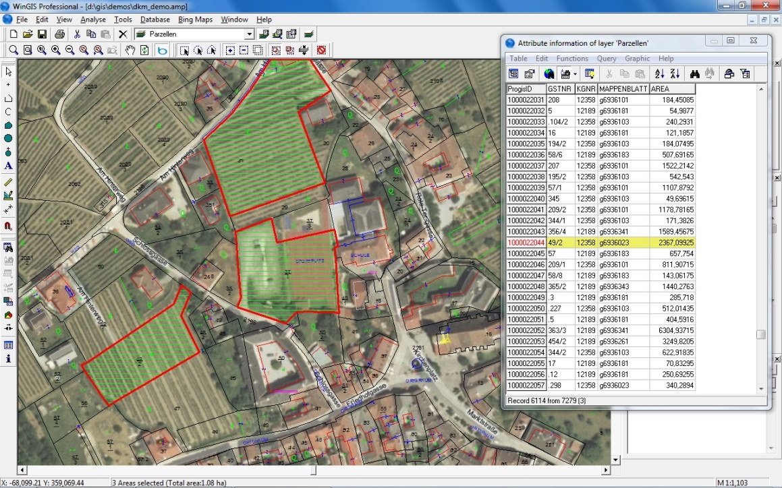
Agricultural Knowledge for All
GODAN & CIARD: opening access to agricultural Knowledge
New Technologies applied individually and together
Bringing new opportunities in agricultural services, agro-industries and agribusiness, risk management, investment
DG Connect: helping to shape the European agenda in agri-food chains

Slide 14
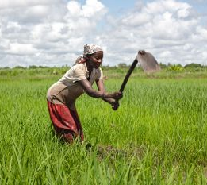
Economic Empowerment of Rural Women & Youth
Almost 50% of farmers are women, yet receive 10% of income and 5% of technical assistance in agriculture
Women farmers, given equal access to inputs, are as productive as men
Gender in Agriculture Partnership, >220 institutions working together, innovation into enterprise
YPARD
Worldwide, average farmer age is ca 60
Young farmers need access to credit,
land, inputs, knowledge
ICTs revolutionize opportunities
Training curricula need urgent
reform with entrepreneurial skills

Slide 15
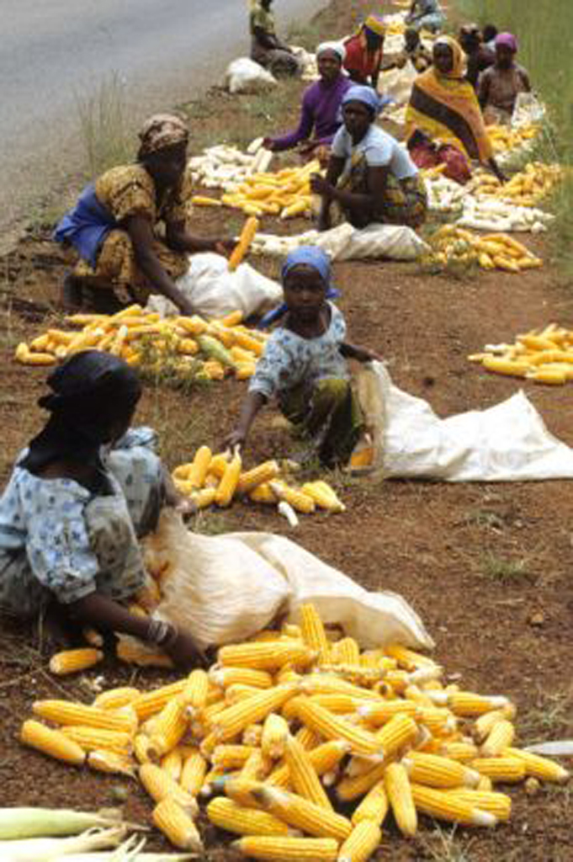
For resource-poor family farms, turning innovation into enterprise requires policy change & investment:
Private sector: services are paid for by the client, rather than being paid for from public funds.
Balanced by social and environmental considerations: agriculture & entrepreneurship are products of cultures and societies.
Research into enterprise: Global market share, top 5 seed companies: 1995: 9.4% 2011: 45.9%
Small farmers and traders under-represented and vulnerable: lack of productivity and market gain, high cost of inputs and transport
Need more participation of youth and women
Need enabling business environment, Business Development Services, financing
Need innovation platforms, effective cooperatives/producer companies and enabling environment

Slide 16
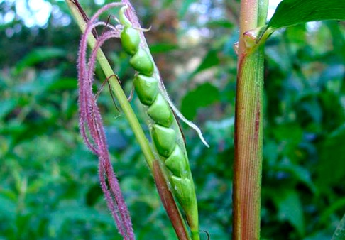
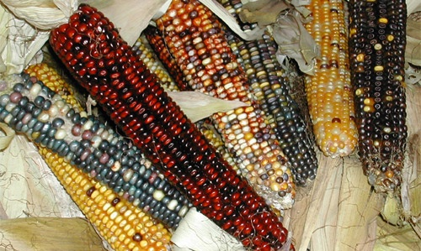
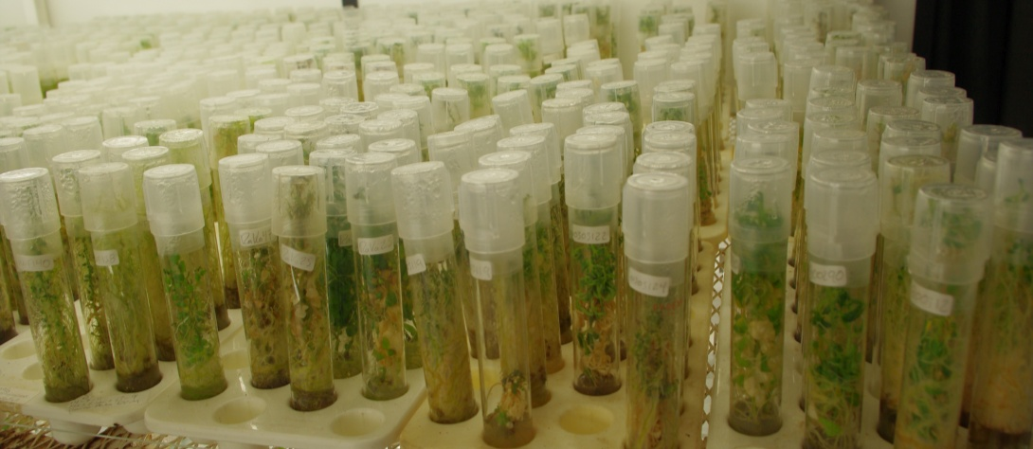
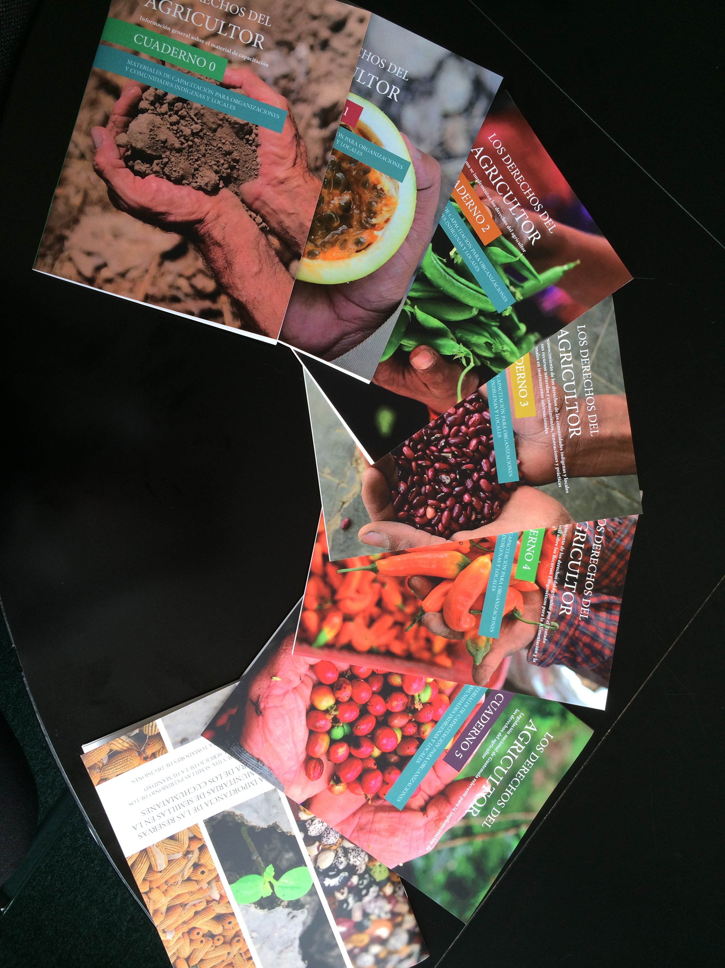
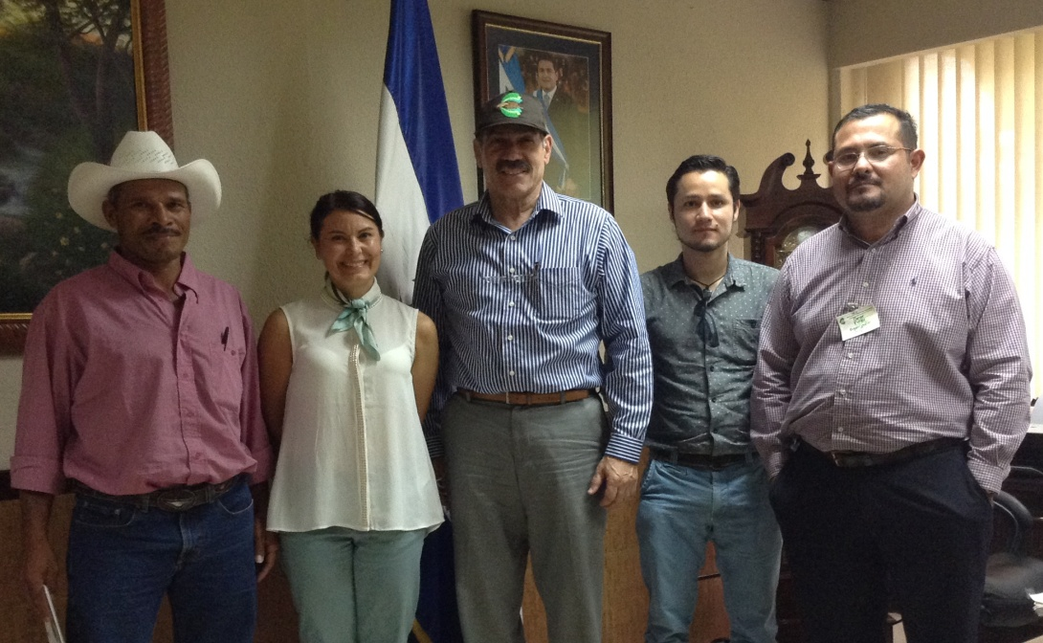
Reconciling
Farmers’ rights and Breeders rights

Slide 17
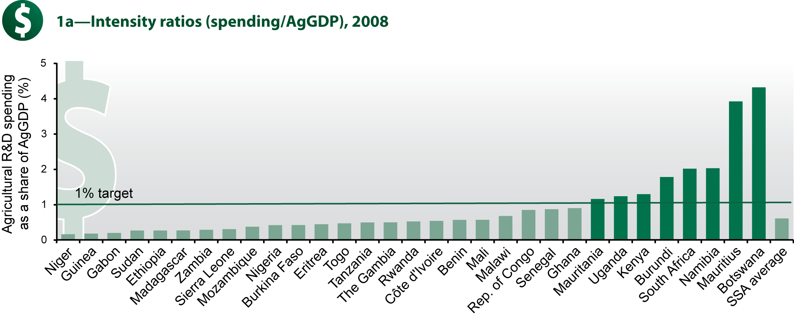
The Investment & Capacity Challenge
G20 is >75% of all public AR4D investments
Africa under-invests in agricultural R&D, constrained budgets & aid project dependent. NEPAD target: at least 1% of GDP to R&D
22% global increase ($5.6 billion) in last decade, but $3.2 billion was China, India & USA
Private sector is 21% of total $40 billion, 54% on food, 46% agriculture

Slide 18
An Integrated Investment and Innovation Facility for Innovation & Growth
National delivery via Innovation Platforms of PP&C partners & programmes, with
client accountablity
IFAD multi-donor Investment Fund,
grants & loans, national multi-stakeholder priorities with oversight via GFAR SC
Coordinated Capacity Development support based on coherent TAP framework for CD in AIS and mobilizing specific external skills

Slide 19

Thank You
https://www.youtube.com/watch?v=No4dMfArOHw&feature=youtu.be
www.egfar.org

