Slide 1

EC Workshop
Horizon 2020 (2014 – 2020)
7 November 2014
Hans-Jörg Lutzeyer
DG Research and Innovation
F-3 Agri-Food Chain

Slide 2

  How does Agricultural Research
  fit into H2020?
Horizon 2020: 3 Priorities
1. Health, demographic change and wellbeing
2. Food security, sustainable agriculture and forestry, marine and maritime and inland water research and the bioeconomy 3.851 billion euros 2014-2020
3. Secure, clean and efficient energy
4. Smart, green and integrated transport
5. Climate action, resource efficiency and raw materials
6. Inclusive, innovative and reflective societies
7. Secure societies
1. Excellent
science
2. Industrial
leadership
3. Societal
challenges

Slide 3
Legal texts for the EU Research Program (Framework Programme 7 up to 2013, Horizon 2020 (2014 to 2020)
Horizon2020
Specific Programmme
Work Programme (updated bi-annually, current version 22/07/2014)
Calls for Proposals (next deadline 03/02 2015)

Slide 4
Strategic Programming: Development of Focus Areas
SPECIFIC PROGRAMME
2014 - 2020
Strategic Programming
WORK PROGRAMME
2014-2015: 3 Calls
2.1 Sustainable Agriculture and Forestry
2.2 Sustainable and Competitive agri-food sector for a safe and healthy diet
2.3 Unlocking the potential of aquatic living resources
2.4 Sustainable and competitive bio-based industries
2.5 Cross-cutting marine and maritime research
Focus Area
Sustainable Food Security (SFS)
Focus Area
Blue Growth
(BG)
Innovative, Sustainable and Inclusive Bioeconomy (ISIB)
FA Waste, FA Water, FA Personalising Health
Notes:
Strategic Programming

Slide 5
2.1 Sustainable agriculture and forestry
  Increasing production efficiency and coping with climate change, while ensuring sustainability and resilience
  …integrated and diverse production systems,including precision technologies and ecological intensification approaches to benefit both conventional and organic agriculture…;
  Providing ecosystem services and public goods
  Wider societal public goods and important ecological services (biodiversity, pollination, water regulation, landscape, GHG mitigation)…management solutions; decision-support tools…
  Empowerment of rural areas, support to policies and rural innovation
  Socio-economic research along with development of new concepts and institutional innovations; social and economic cohesion; diversification of economic activities; relation urban/rural areas; regional/local/inter-regional/European; tools/indicators/models/forward looking activities; support to policy making (monitoring/assessment of strategies, policies, legislation)…

Slide 6
Sustainable Agriculture and Forestry
Emphasis on an integrated chain approach from primary production to transformations and consumers
Emphasis on multifunctional character of agriculture and forestry
Foster innovation and innovative capacity of the agri-food sector/chain and rural areas

Slide 7
International cooperation in Horizon 2020
Key messages:
Horizon 2020 is open to participation from across the world!
Ambition to increase participation of international partners!
How:
Automatic funding:
  Member States (including overseas departments and overseas territories)
  Associated Countries
  exhaustive list of countries in annex to work programme, including all Mediterranean countries (but: no longer BRIC + Mexico in this list!)
Participants from other countries only funded in exceptional cases:

Slide 8

International collaboration
- Food security requires a global approach
- Problems targeted in call topics may not be specific to Europe and require that the best expertise – globally - is gathered to provide solutions
- Agricultural research is highlighted in existing commitments for international research collaboration
- General encouragement to international collaboration in several topics (e.g. SFS 5,7B,14A,15,20)
- Targeted international collaboration is proposed with partners in Africa (SFS 6,18), China (SFS 1A,1B,3B,4,13) and others in Asia, Australia and North America (SFS 10B,16,18)

Slide 9
The SFS Call in the context of Horizon2020
General features
- (Most) topics are framed in a very general way have a large scope. They offer significant opportunities for proposing innovative ideas
- Integration of more basic and applied research with a clear remit to "translate" outputs into practice (farming sector, business, policy)
- Objectives of topics require participation of several disciplines and sectors
- Horizontal issues such as innovation, sustainability, climate, gender are intrinsic to projects and need to be given due consideration
Specific features
- Several topics ask for synergies with European Innovation Partnership: E.g. specific request for so called "multi-actor approach"

Slide 10
SFS - Sustainable food production systems
Topic | 2014 | 2015
SFS-1 Sustainable terrestrial livestock production | X | X
SFS-2 Sustainable crop production | X | X
SFS-3 Practical solutions for native and alien pests affecting plants | X
SFS-4 Soil quality and function | X
SFS-5 Strategies for crop productivity, stability and quality |  | X
SFS-6 Sustainable intensification of agro-food systems in Africa | X
SFS-7 Genetic resources and agricultural diversity | X | X
SFS-8 Resource-efficient eco-innovative food production, processing | X | X
SFS-9 Towards a gradual elimination of discards in Europ. fisheries | X
SFS-10 Disease related challenges and threats faced by European farmed aquatic animals | X | X
SFS-11 Eco-system based approach for European aquaculture | X | X

Slide 11
  H2020 SC2
  WP 2014–2015
SFS-18 Small farms but global markets: the role of small and family farms in food and nutrition security
Impacts
provide a better understanding of the role of small and family farms and small food businesses in meeting the sustainable FNS challenge (across its various dimensions) encompassing the implications on small and medium size businesses along the supply chain and within the context of demographic developments
help better tailoring international cooperation and agricultural research for development to the agro-food sector
contribute to policy making for the identification of new development models for the agro-food sector.

Slide 12
  H2020 SC2
  WP 2014–2015
ISIB-3-2015: Unlocking the growth potential of rural areas through enhanced governance and social innovation
Impact
- Clarify the different dimensions of social innovation and its dynamics in agriculture, forestry and rural development
- Identify pathways to unfold the territorial capital of rural regions and thus shape sustainable development trajectories in different types of rural areas
- Support more sustainable agri-food and forestry systems and rural development, thus contributing in the medium term to smart, inclusive and sustainable growth in rural areas

Slide 13
  H2020 SC2
  WP 2014–2015
ISIB-3-2015: Unlocking the growth potential of rural areas through enhanced governance and social innovation
Impact
- Improve territorial governance and pave the way for an integrated approach to rural development (i.e. ensuring effective mechanisms to coordinate different policies and establish appropriate linkages with other areas).
- Deliver analyses of different innovative governance mechanisms with respect to social innovation in different contexts
- Allow policy makers and the local communities to improve the formulation and delivery of relevant policies as well as to shape such programmes that explicitly foster the creation of sustainable social innovations.

Slide 14

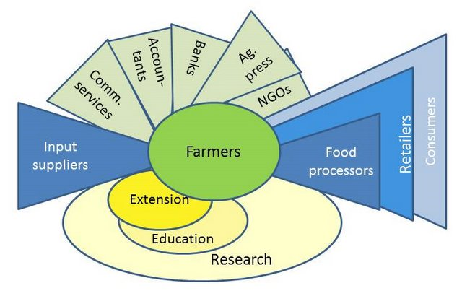
Agricultural Knowledge and Innovation Systems

Slide 15
Agricultural Research in Horizon 2020
Topics have a larger scope and offer significant opportunities for proposing innovative ideas
Integration of more basic and applied research with a clear remit to "translate" outputs into practice (farming sector, business, policy)
Objectives of topics require participation of several disciplines and sectors
Horizontal issues such as sustainability, climate, gender are intrinsic to projects and need to be given due consideration

Slide 16
Multi-actor projects in
Horizon 2020 Work Programme 2014-2015
  Total budget for all multi-actor projects and thematic networks in the first Horizon 2020 Workprogramme: 148 mio euro
  All multi-actor projects have the following sentence in the description of the topic:
    "Proposals should fall under the concept of multi-actor approach"
  and refer to footnote 1 on p.4 of the Work programme that describes the multi-actor approach as follows

Slide 17
Multi-actor projects in
Horizon 2020 Work Programme 2014-2015
  "multi-actor" is more than a strong dissemination requirement or what a broad stakeholders' board can deliver
  "all along the project" *: a clear role for the different actors in the work plan, from the participation in the planning of work and experiments, their execution up until the dissemination of results and the possible demonstration phase.
  Project proposals should illustrate sufficient quantity and quality of knowledge exchange activities
  This should generate innovative solutions that are more likely to be applied thanks to the cross-fertilisation* of ideas between actors, the co-creation and the generation of co-ownership for eventual results.
  (*legal base in Specific Programme)

Slide 18
Multi-actor projects in
Horizon 2020 Work Programme 2014-2015
  A multi-actor project needs to take into account:
    how the project proposal's objectives and planning are targeted to needs / problems and opportunities of end-users
    the composition of the project consortium must get sufficient involvement of key actors with complementary types of knowledge (scientific and practical) to reach the project objectives and make its results broadly implemented.
  (see evaluation criteria on ambitions, expected impact, etc)

Slide 19
Which multi-actor projects in 2015?
  2 stage-call – deadline for proposals 03/02/2015)
SFS-1C | Sustainable terrestrial livestock production: Assessing sustainability of livestock production
SFS-2B: | Sustainable crop production: Assessing soil-improving cropping systems
SFS-5 | Strategies for crop productivity, stability and quality
SFS-13 | Biological contamination of crops and the food chain
SFS-20 | Sustainable food chains through public policies: the cases of the EU quality policy and of public sector food procurement
ISIB-4B | Improved data and management models for sustainable forestry

Slide 20
Strategic Programming
Foresight (I) > Insight (II) > Strategy (III) > Action (IV)
II Sense-making
IV Imple-mentation
framework programme
I Strategic intelligence
monitoring
building the vision
in depth studies
analysing the drivers
exploring different visions
decision making process
III Selecting priorities
evaluating
foresighting
analysing the system
analysing the context
selections
creating different
scenarios
analysing the trends
Features of I and II:
involves input from wide range,
gets input from MS strategy processes
uses new informal processes,
exposes increasingly to global signals
seeks constantly new ways to increase openness
Features of III and IV:
involves decision makers
uses existing formal processes
seeks constantly new ways to increase openness
SCAR Foresight ……….
Existing
Existing

Slide 21
Strategic programming: timing
2014 | By the summer break | External consultation, including: - Advisory Groups; - other stakeholders and wider R&I community; - Strategic configuration of the PC (on process, criteria)
 | After the summer break | Discussion with PC configurations on the basis of drafted documents
 | December | Proposed 2nd Strategic Programme
2015 | First half of the year | Preparation of the 2016/17 Work Programme content, prepared on the basis of the endorsed Strategic Programme
 | In the course of Summer 2015 or later | Adoption of the Work Programme; Publication of the calls for 2016

Slide 22
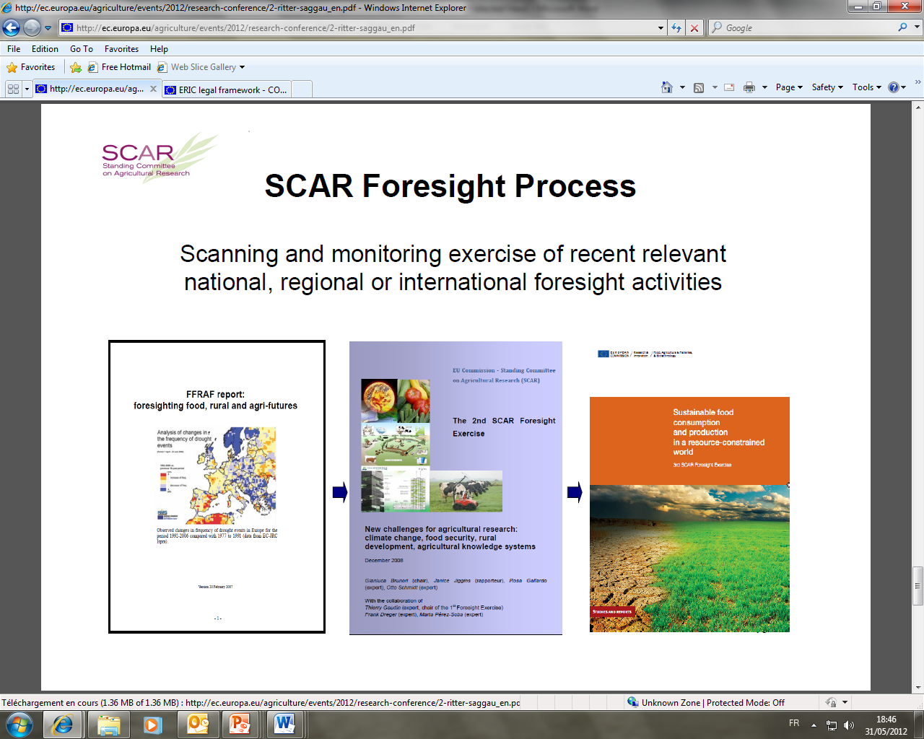
1. FORESIGHT PROCESS

Slide 23
SCAR Collaborative/Strategic
Working Groups
2. COMMON RESEARCH AGENDAS
Update 11 June 2014

Slide 24
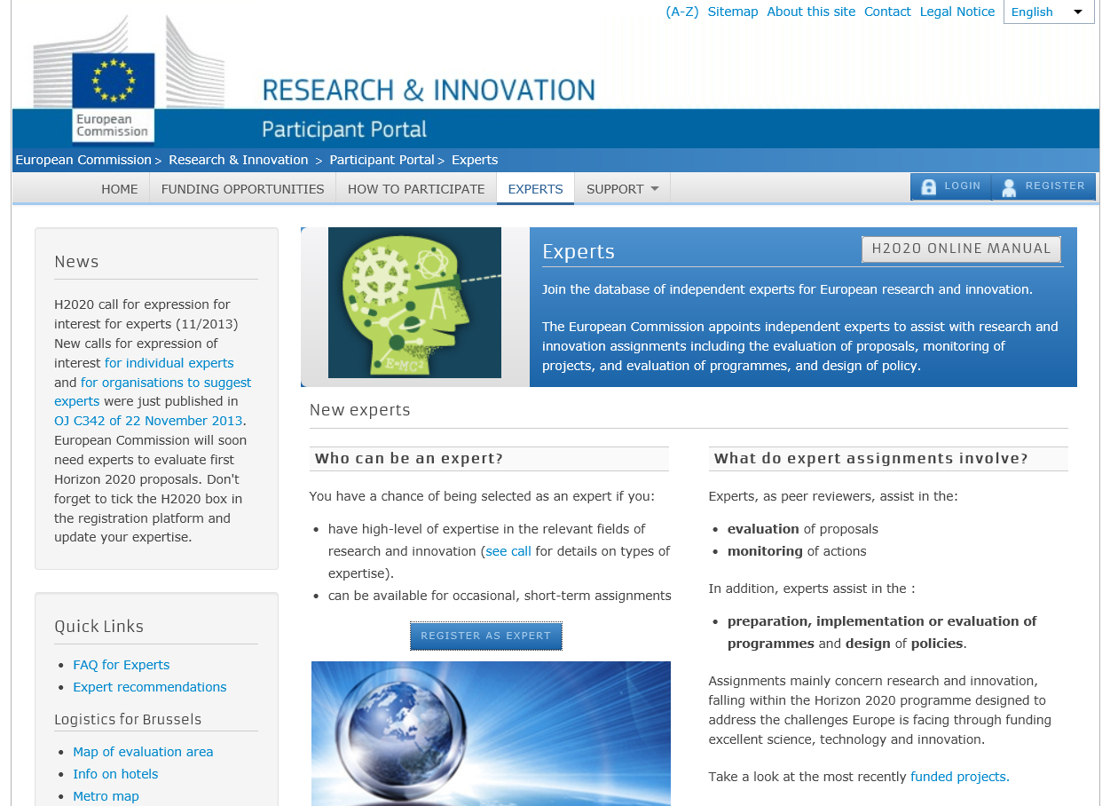
Horizon 2020: EXPERTS

Slide 25
AFRICA in FP7 (Sept. 2013)
Leading participants

Slide 26
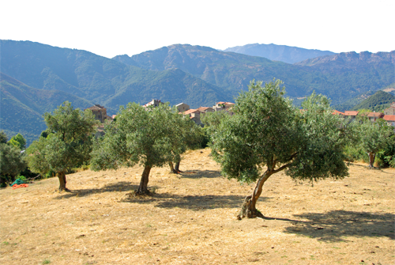
Thank you for your attention

