Slide 1
Shaping the Strategic Path for Putting Research Into Use : The SSA CP Story
‘Yemi Akinbamijo (PhD)
Executive Director FARA

Slide 2
State of Africa Agriculture [a decade ago..]
Agricultural productivity was low.. reflecting the failure to find, adopt and use of more productive farming technologies and poor market linkages.
Inadequate infrastructure and poor land tenure arrangements
Some Data
<5% suitable agricultural land in production
Only 4% land in production irrigated (30% in S Asia)
Low fertiliser use/high depletion of soil nutrients
Agricultural productivity was 25% of global average
Only 1% of commercial lending in Africa goes to agriculture

Slide 3
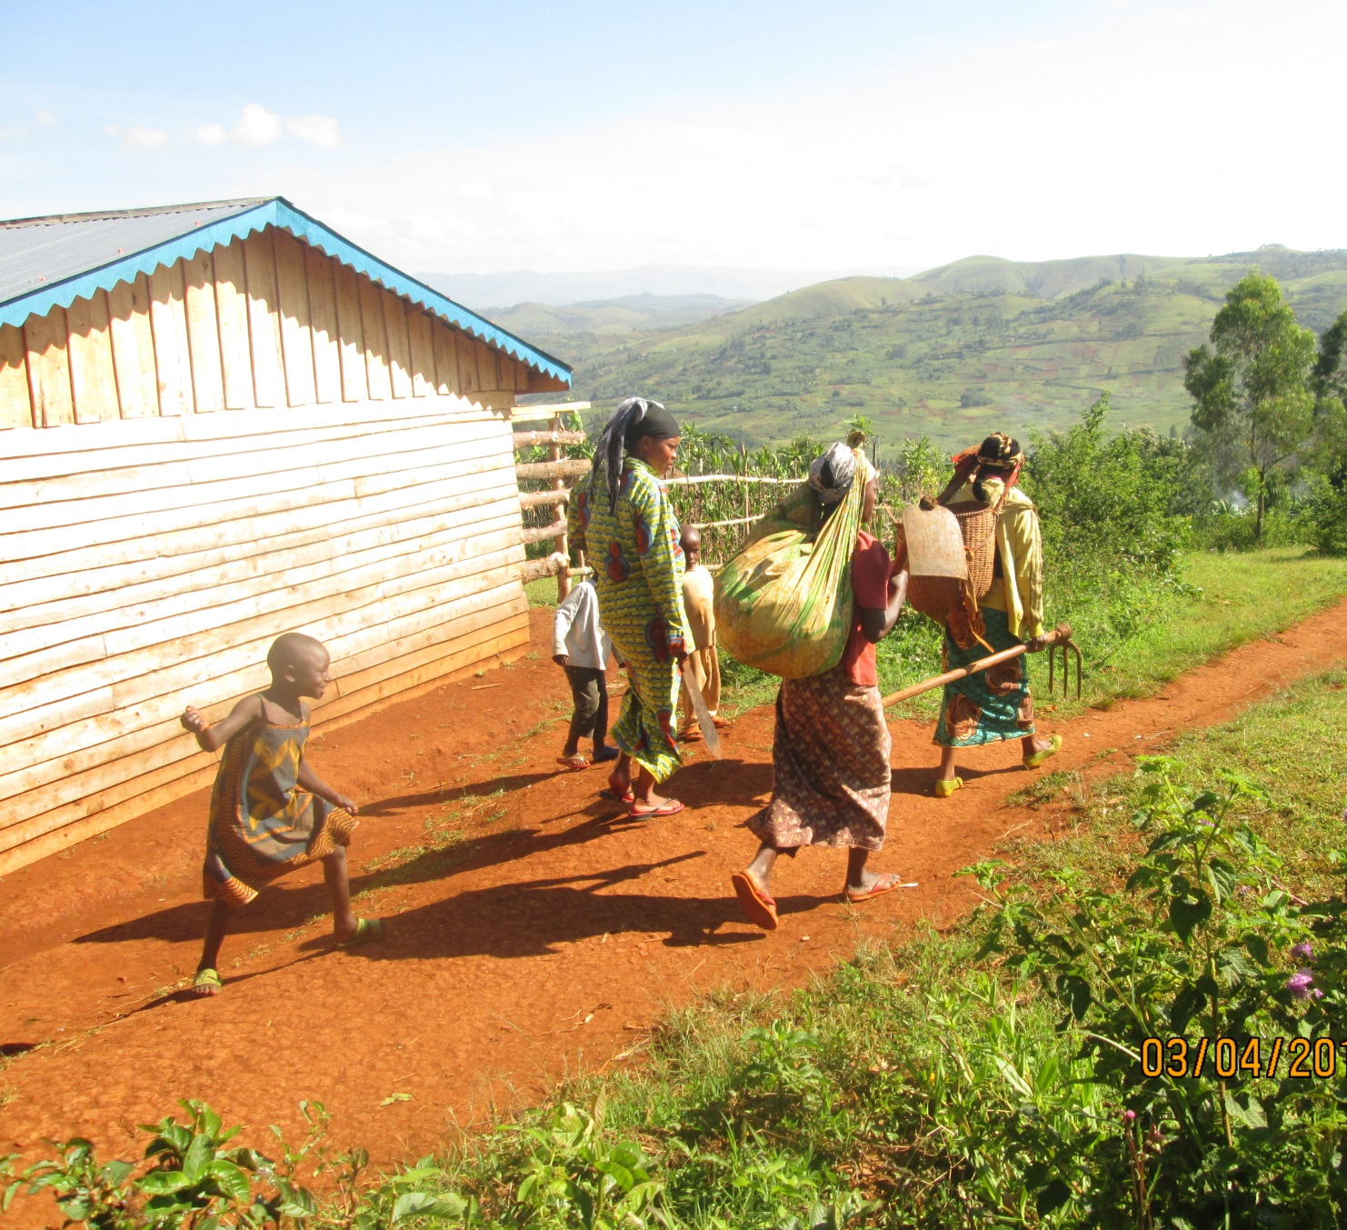
State of Africa agriculture [a decade ago..]
Weak private sector
Underinvestment in research; leading to ineffective R&D models; weak and unaccountable institutions
In appropriate policies
External influences [ globalization etc.]

Slide 4
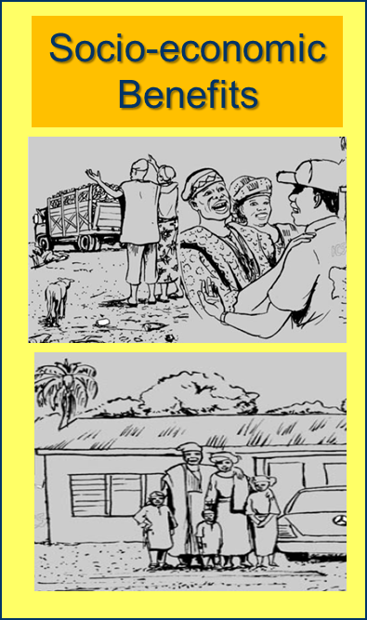
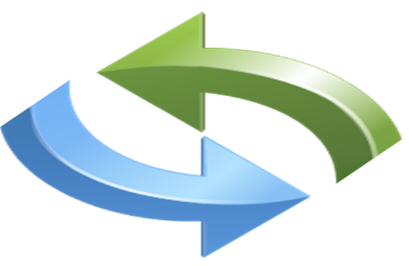
The Root Problem…
How to convert research outcomes into socio-economic benefits / real impact / development outcomes
Research
Market
Productivity
NRM
Policy

Slide 5

Technological and Institutional Barriers
Common institutional barriers
Land tenure
Access to credit
Access to information
Availability of seeds
Access to inputs
Availability of fertilizer
Market access
Trade policies
Product regulations
infrastructure etc.
Often untamed Institutional issues will prevent socio-economic benefits from the best-bet technologies

Slide 6
About IAR4D
IAR4D concept entails a multi-sectorial,
multistakeholder
orientation to agricultural problem diagnosis, and
draws on integrated approaches using ‘hard’
and ‘soft’ sciences to provide solutions,
while maximizing the available
resources
IAR4D was designed to overcome the shortcomings of the traditional R&D systems.
.
IAR4D is premised on the innovation
systems approach and requires systemic
interaction among all stakeholders
around specific commodity or
production system.

Slide 7
Peculiarities of the IAR4D Approach
IAR4D is based on the innovation systems approach.
IAR4D simultaneously addresses research and development as a fused continuum.
IAR4D proposes to carry out research in a demand driven mode.
Research activities in IAR4D mode are all-encompassing.
IAR4D engages the policy makers at different levels.
The IAR4D IPs operates in a business mode for measurable socio-economic benefits and smooth P-P-P.
IAR4D uses the Innovation Platform as its operational frame.

Slide 8
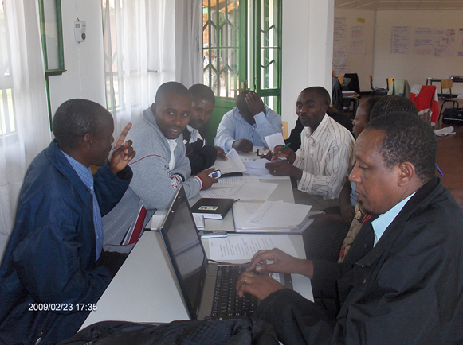
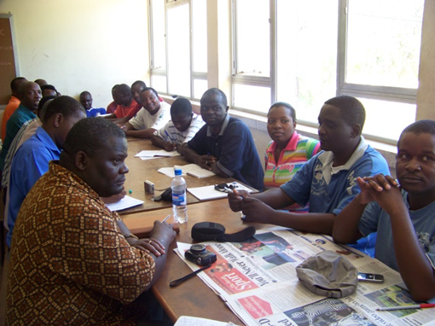
…the Innovation Platform
An Innovation Platform is a physical or virtual forum established to facilitate interactions, and learning among stakeholders selected from a commodity chain analysis.
Their interaction leads to participatory diagnosis of problems; joint exploration of opportunities and investigation of solutions leading to the generation of agricultural innovation along the targeted commodity chain

Slide 9
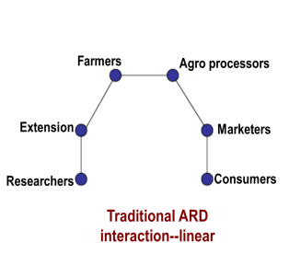
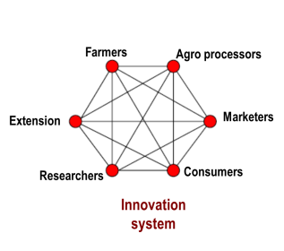
Linear vs Innovation system approaches
Notes:
Reform of the systems to make them more integrated (research, extension, education) and response to demand across the value-chain
Along with this was the advocacy for research to be given a priority in agriculture and food security investment plans

Slide 10
IAR4D offers Iterative Learning

Slide 11
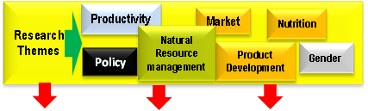
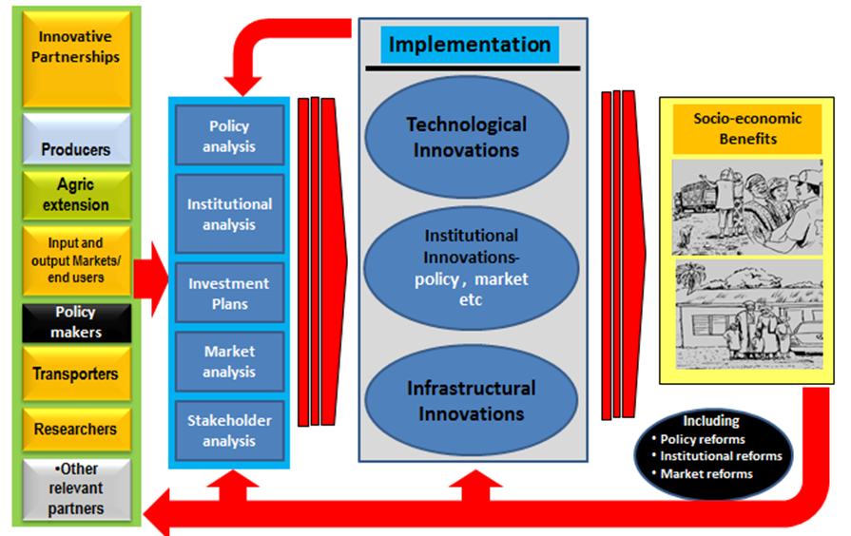
How the IP Turns Knowledge, Information and Skills Into Socio- economic Benefits

Slide 12
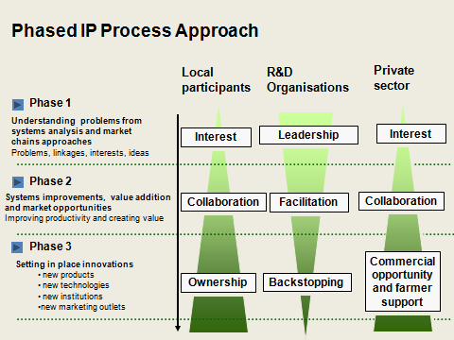
Developing the Capacity to Innovate

Slide 13
The Goal of SSA CP
SSA CP was established to facilitate high impact from agricultural research for development (AR4D) , leading to improved rural livelihoods, increased food security and sustainable natural resource management throughout Africa.
Method:
The SSA-CP bridged up the research-to-development gap by introducing, testing, refining and scaling up. “Integrated Agricultural Research for Development” (IAR4D) based on the innovation systems approach

Slide 14
Research Questions for the Proof of IAR4D Concept
Principal Research Questions
Does the IAR4D concept work?
Does the IAR4D framework deliver more benefits to end users than conventional approaches?
How sustainable and useable is the IAR4D approach outside the test environment ?

Slide 15
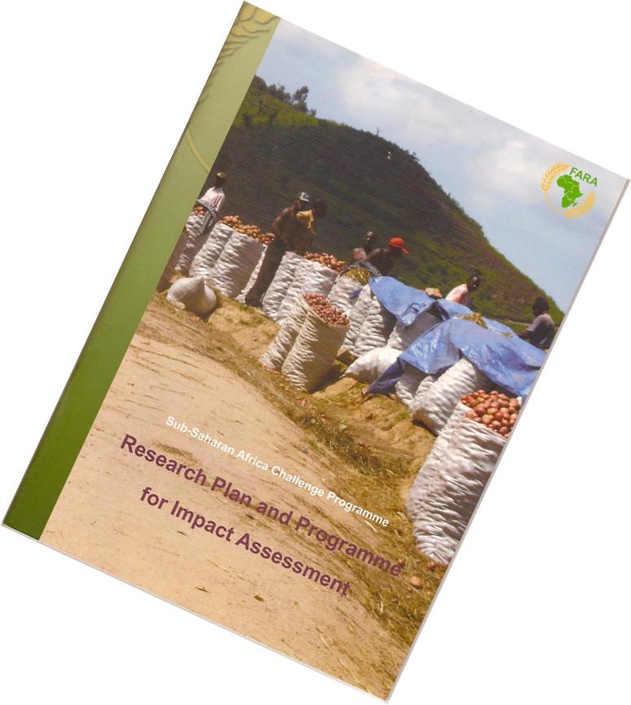
SSA CP Research Methodology
Established
3 pilot learning sites
36 Innovation platforms
3 treatments (IP, Conventional and Clean)
Worked in 5,400 households.
Worked with 80 institutions.
Collected baseline data & Endline data

Slide 16
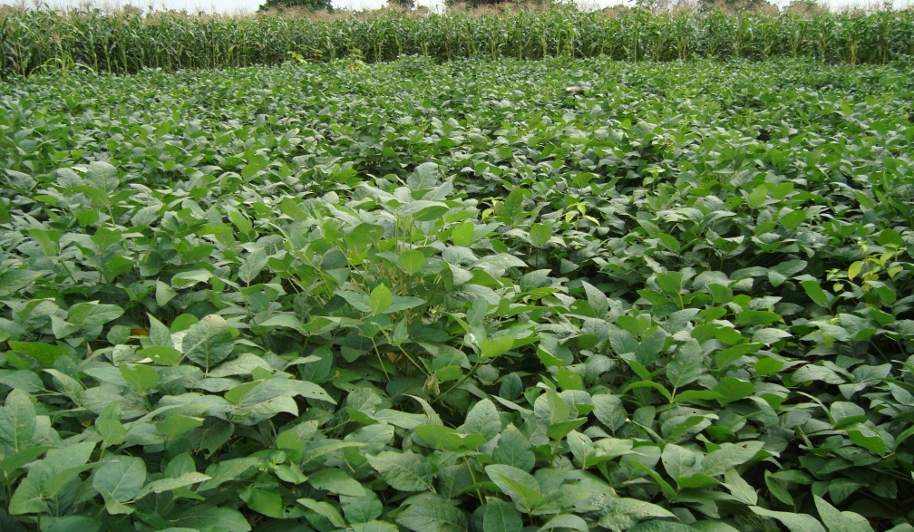
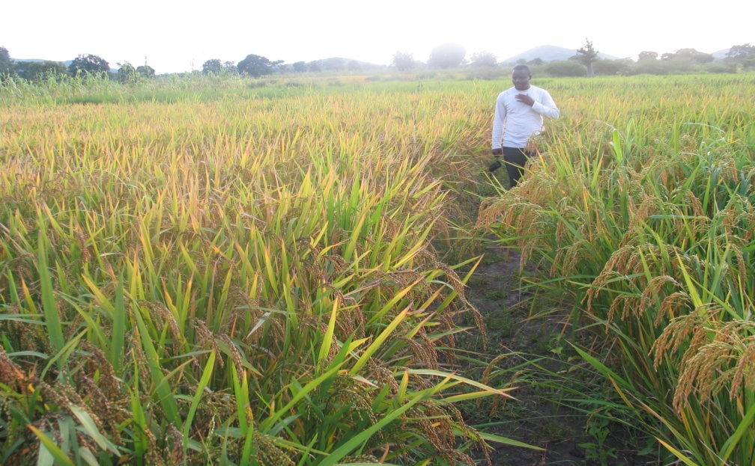
Success Story: Productivity
Two of the improved maize varieties outperformed the locals by 13-62% on farmers’ plot in both States
Two of the improved sorghum varieties out-performed the locals by 18-46%
NERICA4 and NERICA3 rice varieties outperformed the local checks by 71 and 86%, respectively.
Improved soybean varieties out-performed the late varieties by 100-681%
Two improved cowpea varieties outperformed the locals by 27 to 107%
Notes:
Soybean yields increased from 0.9 t/ha to 2.0 t/ha in northern Nigeria – a 120% increase for 150,000 farmers – an additional income of USD 500 per ha per season for each farmer!

Slide 17
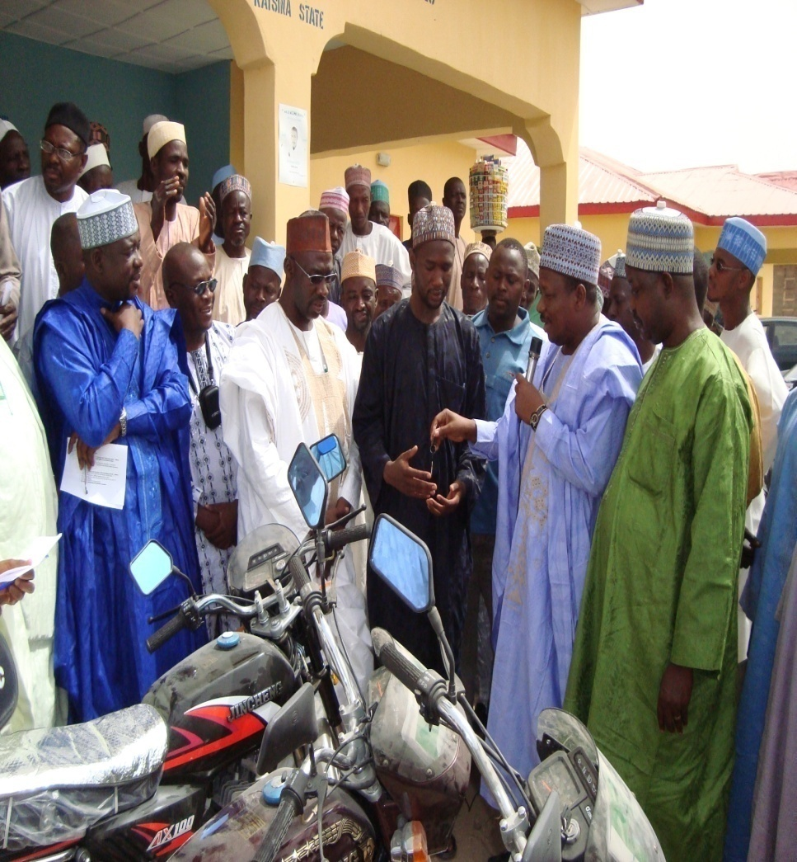
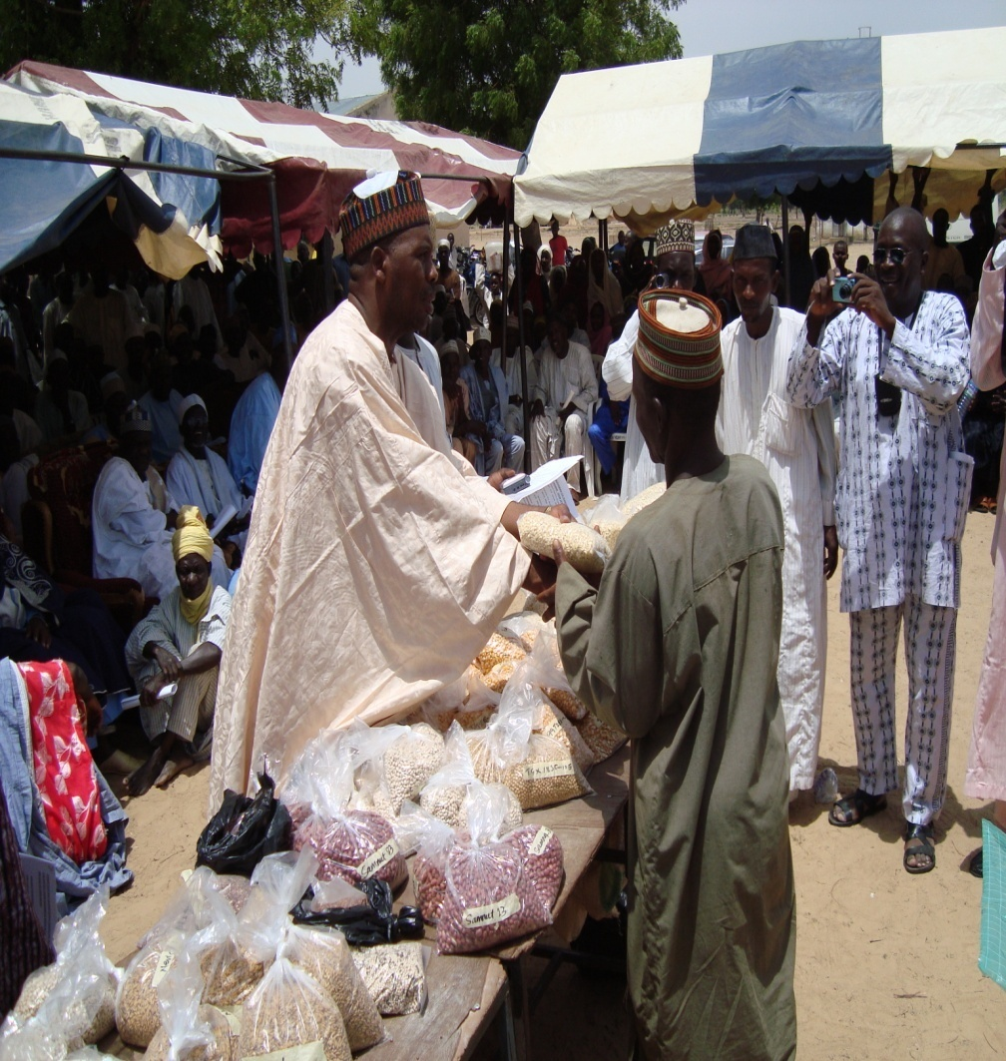
Success Story: Engagement of policy makers

Slide 18
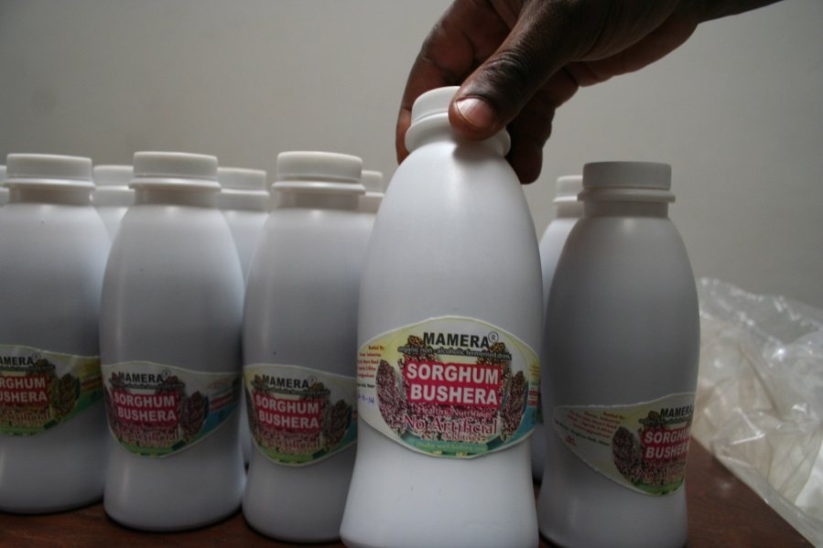

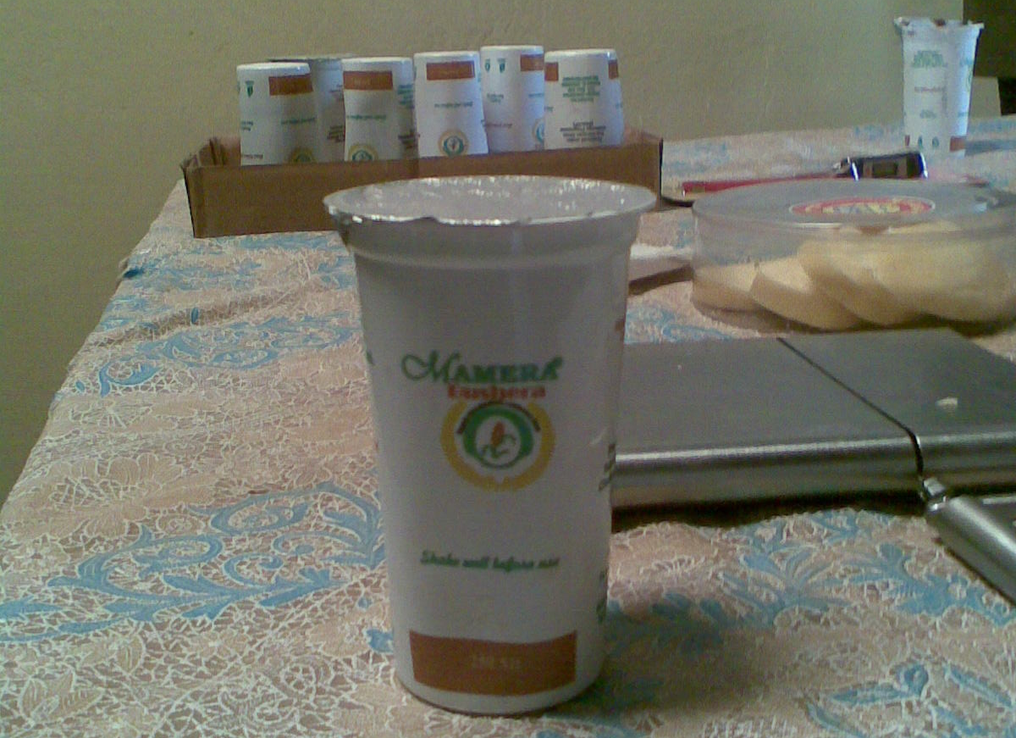
Success story…. Uganda
Mamera
Product of indigenous knowledge strengthened with modern science and contributions from the University of Makerere
willing entrepreneurs
Producers looking for market
Input dealers looking for market
Cooperation of Policy makers and extension
Stanbic Bank
Win-Win Partnerships
Mamera now in the supermarket
Notes:
Mamera drink was developed from sorghum at Makerere University. Through Mamera drink, 5000 farmers increased their income due to sorghum production by an average of 80% in Uganda.

Slide 19
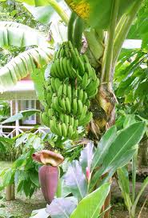
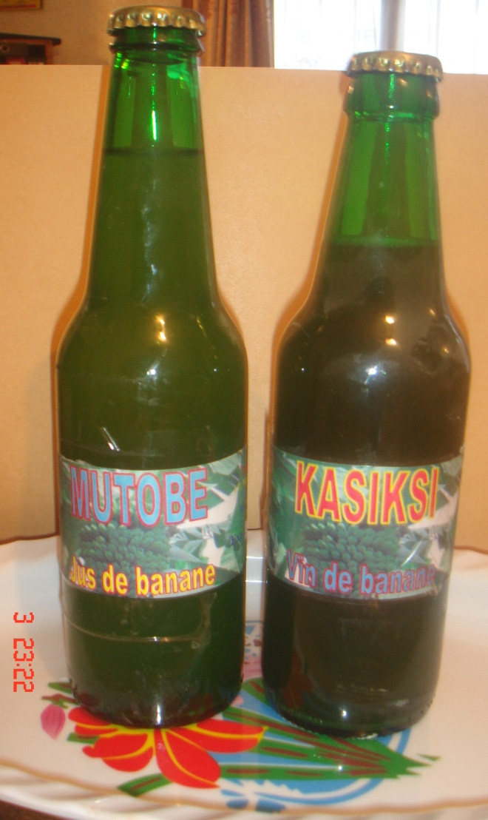
Success Story…. DRC
Kasiksi & Mutobe
Product of indigenous knowledge strengthened with modern science and contributions from the University of Goma, DRC
willing entrepreneurs
Producers looking for market
Input dealers looking for market
Cooperation of Policy makers and extension
Mecrego Microf-innance
Win-Win Partnerships
Notes:
Kasiksi drink was developed from banana at the University of Goma in DRC. Kasiksi increased the income of 2500 banana farmers by an average of 200% as a result of banana drink production in DRC.

Slide 20

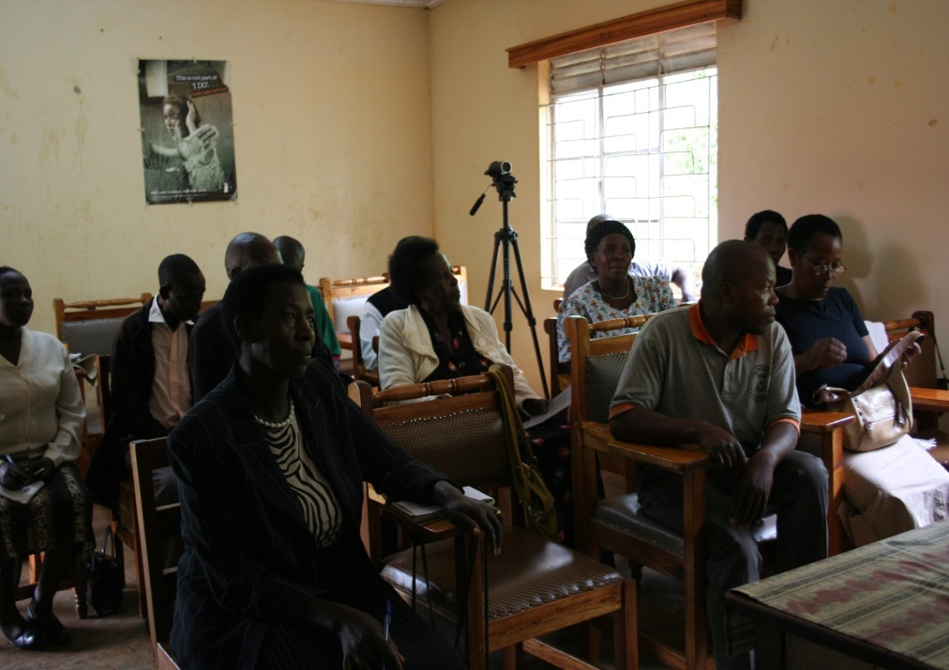
Success story: Innovation Platform
Kabale, Uganda
Innovation platform pix
Zimbabwe
Innovation platform is a fundamental institutional innovation

Slide 21
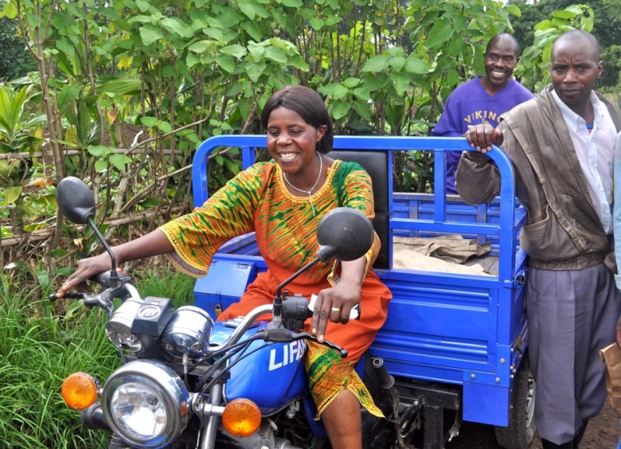
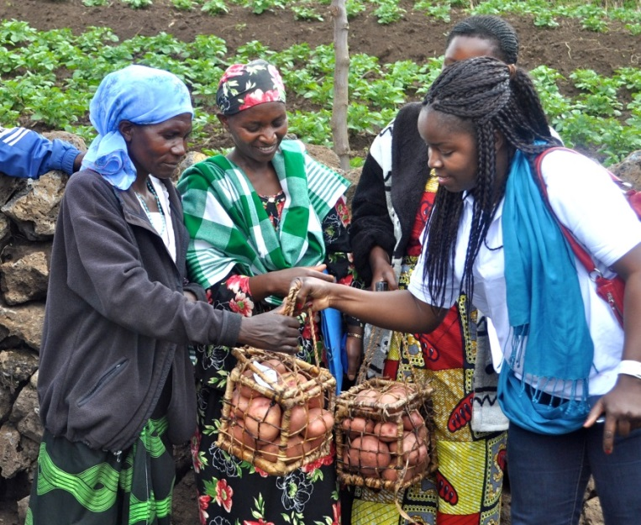
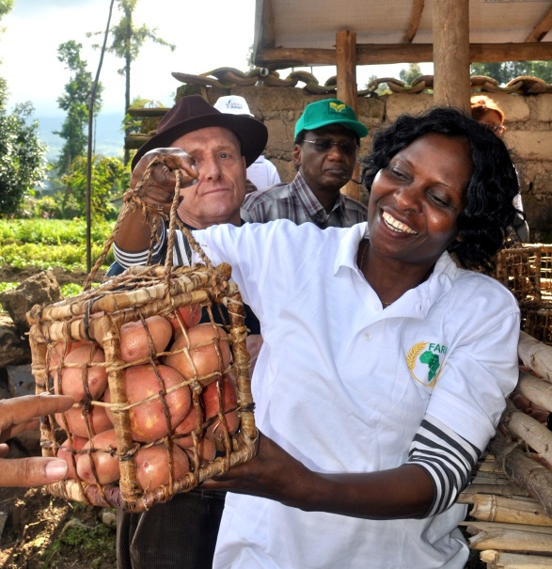
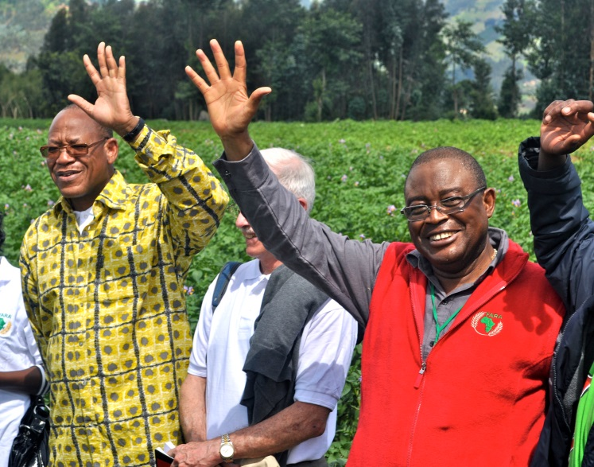
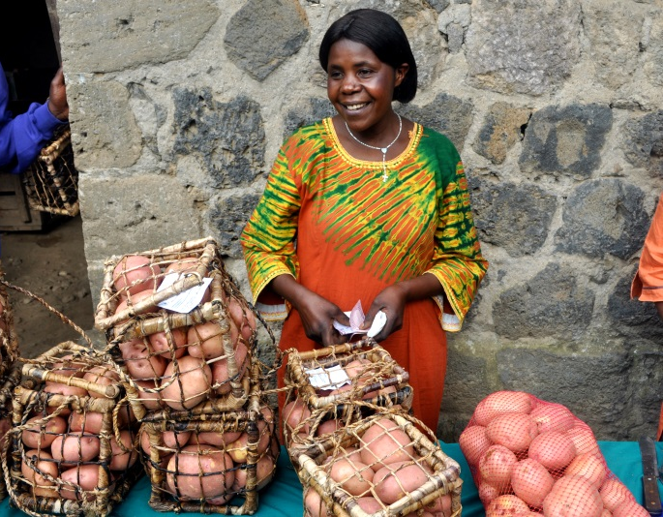
Success story: Market Innovation
Washing and packaging Irish Potato

Slide 22
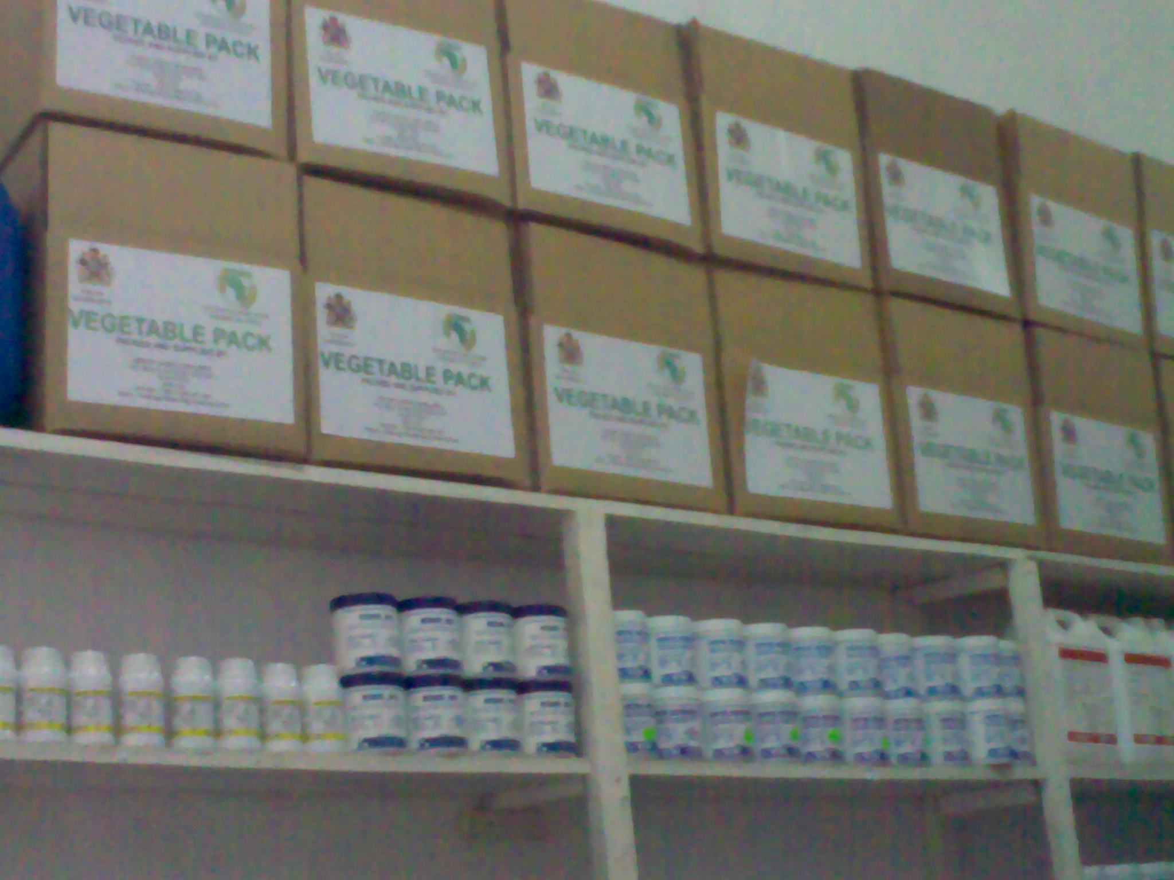
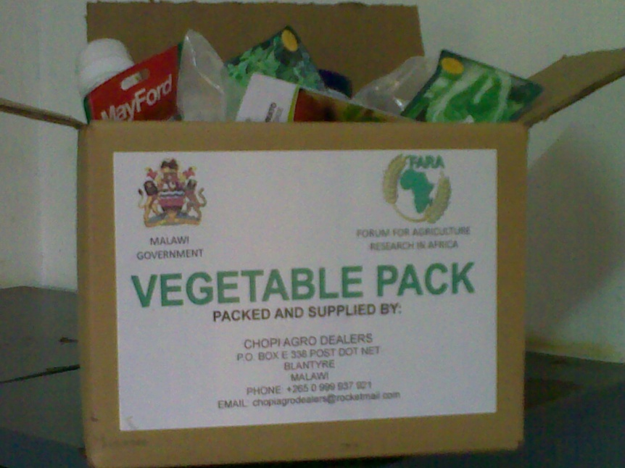
Success Story: Vegetable Box in Malawi
Increasing farmers access to inputs
Notes:
Participation of input dealers on the platforms in Zimbabwe led to mobilization of additional business of USD 3.2 million, giving USD 640,000 additional profits to input dealers.

Slide 23
Outcome and Impact (Numerical analysis)
Farmers increased productivity of soybeans from an average of 900 kg/ha to an average of 2 tons/ha in northern Nigeria. -120% increase for a total of 150,000 farmers. -an additional income of USD 500/ha/ season for each farmer.
Engagement of banks on the IPs in southern Niger mobilized an additional USD 6 million for agricultural production and yielded a profit of USD 960,000 to the financing agencies

Slide 24
Outcome and Impact
Through Mamera drink, 5000 farmers increased their income by an average of 80% in Uganda
Kasiksi drink developed at the University of Goma in DRC increased the income of 2500 banana farmers by an average of 200% in DRC
Introduction of new packaging of potatoes doubled the income of 2000 farmers from USD 0.2/kg to USD 0.4/kg per farmer, with each farmer making an additional average profit of USD 1,600 per season from potato production.

Slide 25

The phases of SSA CP
Scaling-out
SSA CP has completed the proof of IAR4D Concept
Inception Phase
2005-06
Development
of a research methodology
Setting up IPs
2007
Experimental Action
Monitored through
PM&E
2008 - 2012
Proof of Concept
&
Documentation
Dissemination
2013 to 2014
Baseline Study
2008
We going there
We are here

Slide 26
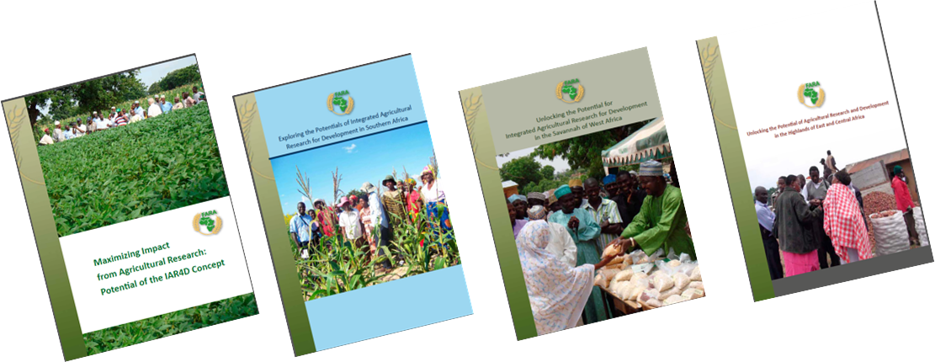
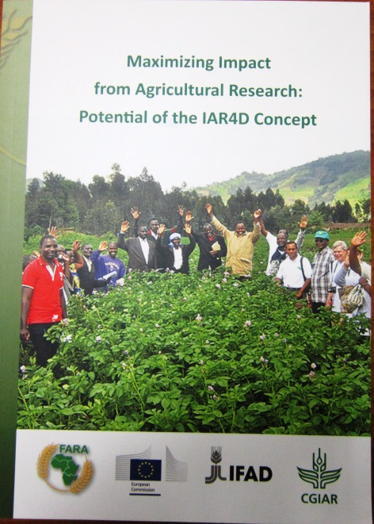
The Proof IAR4D Concept
IAR4D Proof of Concept Documents

Slide 27
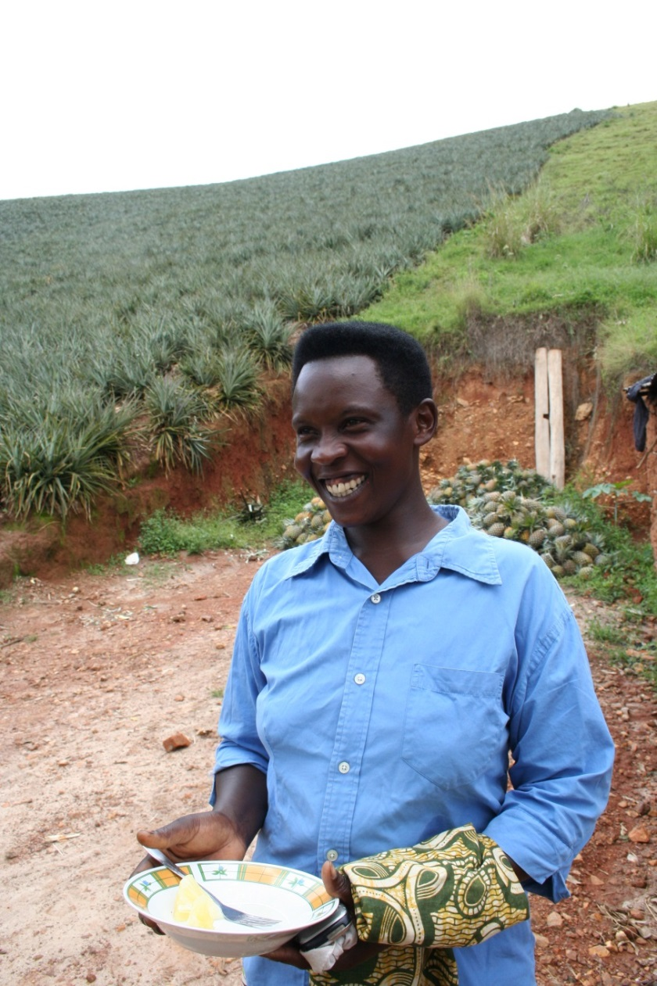
Excerpts from Proof of Concept Analysis
Does IAR4D Works
Average income of individuals participating is $1,362.72 an average of $3.73 / day
Compared to the baseline income of $588.44 which translate to $1.61
Percentage effect = $ 231%

Slide 28
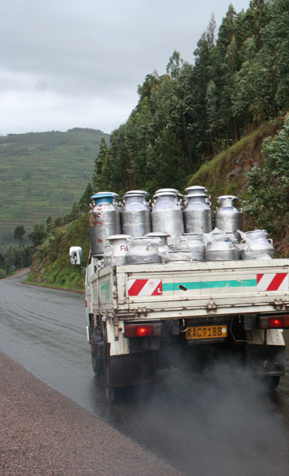
Excerpt from Proof of Concept Analysis
Does IAR4D deliver more than the conventional approaches.
Income of women increase by 326%
Food security improved by 324%
Wealth distribution 5%
Household income increased by 232%
Income inequalities decreased by 6% (Gini Coefficient)
Productive assets value increased

Slide 29
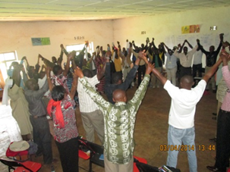
Excerpt from Proof of Concept Analysis
How sustainable and useable is the IAR4D approach outside the test environment ?
Spread / beneficiary estimation (Economic surplus Model) indicated a reach in the excess of 10 million ARD stakeholders across the continent.

Slide 30
Proposed Future of IAR4D Concept
FARA wishes to scale out the IAR4D concept and the Innovation Platforms to facilitate sustainable broad based impact from agricultural research and development.
FARA wishes to package the scaling out of IAR4D concept this into a new program, tagged SSA CP^{+.}

Slide 31
Proposed Future of IAR4D Concept [2]
The Objectives of SSA CP⁺ is to facilitate substantially greater impact from agricultural research for development (AR4D) leading to improved agricultural livelihoods, wealth generation, food security and sustainable natural resource management throughout Africa
SSA CP⁺ aims to fully integrate the IAR4D concept and the IP into the existing structure for conducting agricultural research and development activities

Slide 32
IAR4D is Spreading in Africa
Governments are adopting the structure (Sierra Leone, Liberia, Mozambique, Uganda, Nigeria, Gambia…).
Research institutes – Kenya Agricultural and Livestock Research Organisation - KALRO
International NGOs – EU CORD operating in 12 African countries.
Donor financed projects - USAID MARKETS, RIU, Ireland financed project in Mozambique….
Consortium programs (Mega programs) of the CGIAR.
Private sector – Olam , GADCO, SinaGerald…

Slide 33
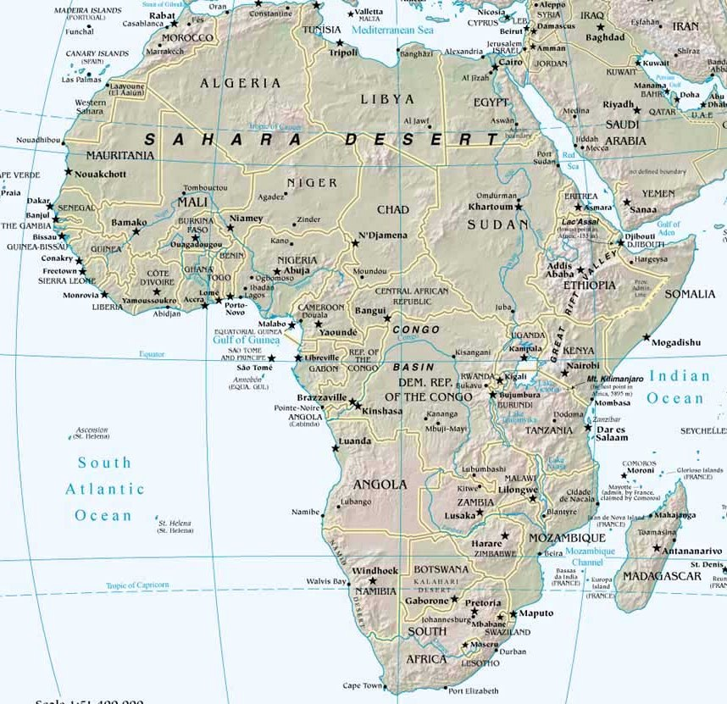
IAR4D is spreading
In various
Countries
Niger
Nigeria
Uganda
Rwanda
DR C
Malawi
Zimb
Mozambique

Slide 34
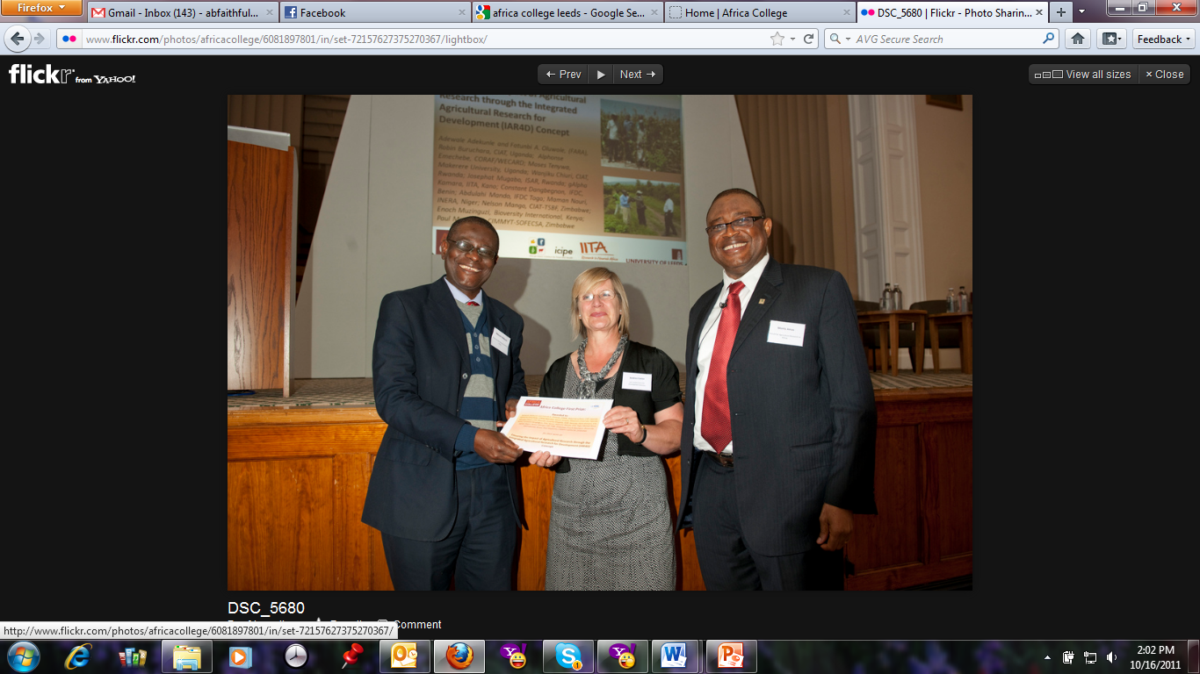
SSA CP Award (2011)
Africa College 1st price for best practice on translating research results into impact on food security and human health in sub-Saharan Africa
http://www.africacollege.leeds.ac.uk/conf2011/prize.php

Slide 35
Conclusions
FARA developed the IAR4D and has successfully completed the proof of concept.
SSA CP has registered considerable amount of innovations within the proof of concept phase
The IAR4D and the IP concept has secured substantial acceptance by the ARD stakeholders in Africa.
The scaling-up and Scaling-out of the concept is required to maximize benefits from the efforts and investment into the concept
FARA has develop SSA CP⁺ to move the process forward

Slide 36

Please join us in
Celebrating FARA
26-28 November 2014
Johannesburg, South Africa

Slide 37
Thank you for the attention
To get bi-monthly news on
African agriculture research for development visit
www.fara-africa.org

