Slide 1
Environment and climate change in development cooperation
Integrating environment and climate change in programming – Module 4

Slide 2
Structure
EU operations cycle
Aid delivery methods
Integrating in the strategic analysis
Integrating in the indicative programmes
Initiatives and approaches

Slide 3
Activity 1 – The operations cycle
Closure
Programming
Evaluation
Identification
Policy dialogue
Implementation
Formulation
Notes:
Expansion
Examples:
Groupwork / discussion
Separate for Project and Budget Support
Note the need to integrate with the country cycle and the cycle of other donors
Use the white card – put up the first one
Ask small groups to put up the white cards
more on questions than answers ....later de-construct the green cards... And then rebuild at project

Slide 4
Overview of aid delivery methods
Approaches
Financing modalities
Project approach
EC (donor) contractual and financial procedures
Sector approach
Pooled fund
Macro approach
Budget support
Notes:
Expansion
Examples:
Groupwork / discussion

Slide 5
Programming
Closure
Programming
Evaluation
Identification
Policy dialogue
Implementation
Formulation

Slide 6
Steps in multi-annual programming
Strategic analysis
  Analysis of the country situation
  Sound assessment of risks
  Review of national and donor priorities
  Identification of the response strategy and focal sectors
Multi-annual indicative programme
  Design of the intervention framework
  Budget
Multi-annual programming is subject to a mid-term review
Notes:
Expansion
Examples:
Groupwork / discussion

Slide 7
Strategic analysis (CSP or equivalent)
Possible entry points
Issues to be addressed
Co-operation objectives
Analysis of the country situation
Partner country’s policy agenda
EC and other donors’ co-operation (past and on-going)
Response strategy
Annexes
Sustainable development objectives
Key environmental issues (incl. climate change), risks, links with social and economic situation
Environmental/climate policy, multilateral environmental agreements
Actions taken to integrate the environment/climate change, results obtained, donor coordination
Proposed approach to integrate the environment/climate change
Country Environmental Profile

Slide 8


Strategic analysis
Political economy – a new insight and tool
Focus of traditional analysis
Focus of political economy analysis
More on Political Economy analysis
Notes:
On the surface life seems simple and straightforward
Underneath it can be more complicated – particulary around lunch time

Slide 9
Political economy
Traditional technical and financial focus has underestimated of the influence of the political economy
influence
Persistent problems
dysfunctional institutions
resistance to reforms and change
collective action fails despite participatory approaches
capacity building with little impact
reluctance to mainstream ENV and CC
Sector effectiveness – in some circumstances are highly counter-productive (e.g. WfP in Jordan)
Political, economic and social factors are parts of the explanation
Notes:
Some (not all) of the explanations can be found through looking at political and economic and social factors – drivers of change - power relations – incentives – interests – social norms and institutions
Examples from sector performance report.........ASK THE PLENARY FOR EXAMPLES
State of lake victoria
tariffs and political influence (good or bad)
fragmentation of districts – challenges
North-East ...peace
O&M failings
contested

Slide 10
Political economy analysis
Reveals how power and resources are distributed and contested
Provides insights into interests, incentives, rules and institutions
Supports effective and politically feasible development strategies
Ensures more realistic expectations of what can be achieved
Helps outline the risks involved
Identifies the main opportunities and barriers for policy reform
Indicates how donors can support positive change
GSDRC 2010
Notes:
Can go onto a fuller PE slide show if needed
BETTER AT DIAGNOSIS THAN CURE

Slide 11
Political economy : different analyses
Strategic corruption & governance analysis (SCAGA)
Power analysis
Poverty, social impact analysis (PSIA)
Drivers of change
Problem driven governance & political economy (PGPE)
Notes:
Much more in common than apart

Slide 12
Insights on mainstreaming
Causes of poor economic/social and environmental performance are often the same and often related to governance
Development cooperation agencies can do more on mainstreaming by strengthening indigenous institutional frameworks rather than imposing external frameworks.
Mainstreaming can only work if it comes from within – a demand pull - rather than being ’imposed’
Political economy
Understanding the context
Policy dialogue
Awareness raising
Strengthening Institutions
More

Slide 13
Activity 2 Looking at stakeholder analysis (light touch)
Sugar industry case study - bearing in mind the different stakeholders and their power and interests plot where they are in terms of their interest to mainstream environment and their power and ability to carry this out. (an example of such a plot from water demand management in the agricultural sector in Jordan is given)
Groups of 5 get together with each one making a plot using a standard axis and then placing cards .
5’ for additional reading; 20’ for group discussion and cards; 15’ plenary review: allow 45 mins

Slide 14
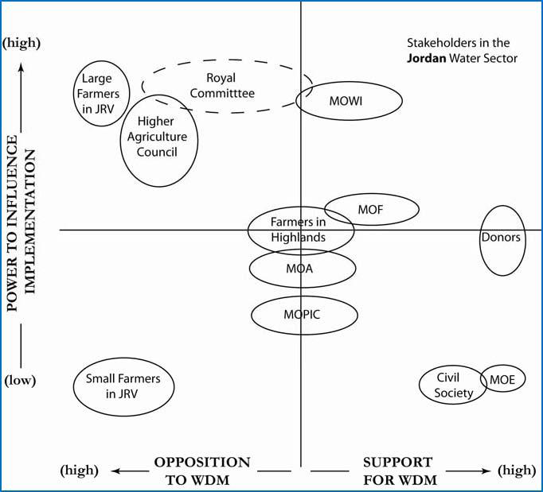
Example of application of PEA

Slide 15
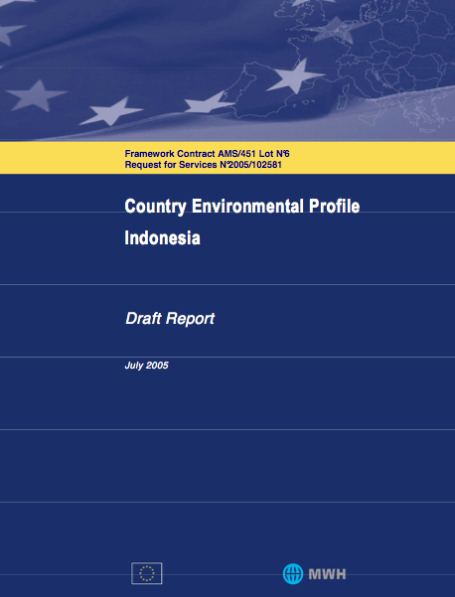
Environmental profiles: structure
Summary
State of the environment -> inputs for the “analysis of the environmental situation” in MIP
Environmental policies, legal and institutional framework
Implications of climate change
EU and other donors’ co-operation from an environmental perspective
Conclusions and recommendations -> to be considered in the design of the response strategy
Notes:
ASK HOW MANY PEOPLE HAVE FINISHED PROGRAMMING. THEN WE WILL ASK HOW MANY PEOPLE HAVE GOT A CEP? FROM THERE WE CAN HAVE A DISCUSSION ABOUT WHETHER TO GO FOR THE OPTIONAL SLIDES OR NOT.

Slide 16
Possible outcomes of integration in the CSP: Indonesia
  Education
      Promoting environmental education
  Trade and investment
      Eco-labelling and certification
      Environmental standards
      Sustainable energy and energy efficiency
  Law enforcement and justice
      Fight against illegal logging
      Proposed indicator: number of law enforcement personnel trained

Slide 17
Possible outcome, integration in the MIP
Theme to be raised in the policy dialogue
‘Environment and natural resource management’ chosen as a focal sector
Objectives and approaches of other sectors reflecting consideration for ENV / CC (incl. commitment to SEA/EIAs)
Actions related to ENV and CC in non-focal sectors
Budgets for the actions
Environmental concern reflected in objectives and indicators
Alignment and harmonisation
Notes:
Expansion
Examples:
Groupwork / discussion
Theme to be raised in the policy dialogue
‘Environmental and natural resource management’ chosen as a focal sector and/or
Objectives, approaches and strategies of other sectors reflecting adequate consideration for environmental /climate change issues (incl. commitment to undertake SEA/EIAs)
Actions related to environmental and climate change in the framework of non-focal sectors
Indicative budgets for the actions identified
Concern for environmental sustainability reflected in intervention objectives and associated indicators
Alignment and harmonisation

Slide 18
Programming mid-term review
May reveal some weaknesses or missing issues
An opportunity to address on-going issues and consider new issues for example:
  The impact of increasing water scarcity for irrigation development or hydropower schemes
  The impact of new roads on charcoal production
“sector scripts” on climate change provide a check list of issues on climate change adaptation and mitigation in a variety of sectors
Notes:
Expansion
Critical assessment of environmental integration in programming documents may reveal some weaknesses or missing issues
e.g. failure to consider the implications of increasing water scarcity
The mid-term review of programming documents provides and opportunity to address these weaknesses
It also provides an opportunity to consider new issues e.g. climate change
a series of “sector scripts” on climate change were prepared to support thinking on climate change adaptation and mitigation in a variety of sectors – these can be used to help identify issues
Examples:
Groupwork / discussion

Slide 19
Recap module 4 main messages
Operations cycle provides pragmatic entry points for integration
Political economy is a powerful approach for understanding possible barriers to integration and where the best opportunities lie
At the programming stage, integration is possible in the strategic analysis, when designing the multi-annual indicative programme and at the mid-term review
There are a wide variety of tools, initiatives and approaches including political economy analysis and country environmental profiles (CEP) or equivalent
Notes:
Recap of structure:
Operations cycle
Tools and approaches
Environmental integration in the programme cycle
Environmental integration at programming stage
Programming documents – CEP – NIP/MIP – SDA
Aid delivery methods - blending
Optional – details on CEP and SDA

Slide 20
Resources
Programming
Project Cycle Management – EU
http://ec.europa.eu/europeaid/multimedia/publications/documents/tools/europeaid_adm_pcm_guidelines_2004_en.pdf
Guidelines on environmental mainstreaming – EU
http://ec.europa.eu/europeaid/infopoint/publications/europeaid/documents/172a_en.pdf
Sector support and project guideline – EU
http://ec.europa.eu/europeaid/how/delivering-aid/sector-approach/documents/guidelines_support_to_sector_prog_11_sept07_final_en.pdf
Strategy Papers
EU Country Strategy Papers 2007-2013 – EU
http://eeas.europa.eu/sp/index_en.htm
Notes:
56. We affirm that there are different approaches, visions, models and tools available to each country, in accordance with its national circumstances and priorities, to achieve sustainable development in its three dimensions which is our overarching goal. In this regard, we consider green economy in the context of sustainable development and poverty eradication as one of the important tools available for achieving sustainable development and that it could provide options for policy making but should not be a rigid set of rules. We emphasize that it should contribute to eradicating poverty as well as sustained economic growth, enhancing social inclusion, improving human welfare and creating opportunities for employment and decent work for all, while maintaining the healthy functioning of the Earth’s ecosystems.

Slide 21
Resources (continued)
Political Economy Analysis
Country Environmental Profiles
CEP example from Kenya – EU
http://ec.europa.eu/development/icenter/repository/Kenya_CEP_2006.pdf
Experience with use of CEP – EU
http://ec.europa.eu/development/icenter/repository/env_helpdesk_CEPs_en.pdf
Indicators
Sustainable Development Indicators – EU
http://epp.eurostat.ec.europa.eu/portal/page/portal/sdi/indicators
Notes:
56. We affirm that there are different approaches, visions, models and tools available to each country, in accordance with its national circumstances and priorities, to achieve sustainable development in its three dimensions which is our overarching goal. In this regard, we consider green economy in the context of sustainable development and poverty eradication as one of the important tools available for achieving sustainable development and that it could provide options for policy making but should not be a rigid set of rules. We emphasize that it should contribute to eradicating poverty as well as sustained economic growth, enhancing social inclusion, improving human welfare and creating opportunities for employment and decent work for all, while maintaining the healthy functioning of the Earth’s ecosystems.

Slide 22
Optional slides

Slide 23
Initiatives & approaches policy, planning
Strategic Env. Assessment | Analytical and participatory approach to assess policies, plans and programmes and evaluate the inter linkages
Environmental Impact Assessment | An ex ante assessment of the environmental impacts of a specific project to reduce negative /optimise positive effects
Green Innovation Policies | Policies to trigger green innovation Green industrial, energy and other policies - research, subsidies, feed-in tariffs.
Framing Policies: communication and nudging | Social marketing, changing norms, soft power, persuasion and appeal
Analysis of Labour Markets and Income | Identifies opportunities and challenges in labour market and best response – green jobs
Decision Making under uncertainty | Cost-Benefit Analysis, Robust Decision Making, Climate Informed Decision Analysis.
Notes:
Expansion
This a group of tools and approaches that can be used in different ways, in different parts of the programme cycle and in different sectors
Examples:
Groupwork / discussion
Adapted from A Toolkit of Policy Options to Support Inclusive Green Growth 2012

Slide 24
Initiatives & approaches - implementation
Adapted from A Toolkit of Policy Options to Support Inclusive Green Growth 2012
Fiscal Reform and Charges | (1) taxes for NRM exploitation; (2) reforms of product subsidies and taxes; (3) cost recovery measures; (4) pollution charges
Public Env. Expenditure Review | Examines resources allocation, highlights policy mis-matches, identifies new revenue sources and savings
Sustainable Public Procurement | Achieving value for money not only to the organization but also to society, economy, environment
Social Protection Instruments | Provision of essential services and transfers for individuals in need of protection – the inner half of the “doughnut”
Payment for Env. Services | Voluntary, conditional agreement over a well defined environmental service/land use”.
Certification Sustainable Prod. | Differentiating between green products – putting information power in hands of consumers
Green Accounting | Extends national accounts to include the value of the damage and depletion of the natural assets – genuine net savings
Notes:
Expansion
Examples:
Groupwork / discussion
Adapted from A Toolkit of Policy Options to Support Inclusive Green Growth 2012

Slide 25
initiatives
 |  | INCENTIVISE |  |  | DESIGN | FINANCE | MONITOR
Sector | Tool | pricing pollution and natural resource use | complement pricing policies | foster inclusiveness | manage uncertainty | Financing and investment | Monitoring
Governance | Environmental Fiscal Reform and Charges | √ |  | √
PFM | Public Environmental Expenditure Review | √ | √ |  | √
Public sector reform | Sustainable Public Procurement |  | √ | √ |  | √
All | Strategic Environmental Assessment |  | √ | √
Social net | Social Protection Instruments |  | √ | √ |  | √
Natural resource sectors | Payment for Environmental Services | √ |  | √ |  | √
Private sector | Certification for Sustainable Production |  |  | √ |  | √ | √
Notes:
Add a column to the left where relevant sectors would be highlighted so that colleagues can relate.
For ex.
Economic governance <> Environmental fiscal reform and charges
Public financial management <> PEER
Public sector reform <> Sustainable public procurement
All <> SEA
Not sure about social protection instruments for our purpose here (if not clear delete this row)
NR based sector (water, forestry, mining) <> PES
Private sector development <> CSP
Not sure about the communication and nudging here, may be put at the bottom together with SEA, decision-making under uncertainty, EAI, as cross-cutting tools
Private sector development <> Green innovation...
Private sector development <> Analysis of Labour Markers and Income Effects
Agriculture <> SLM
Water <> IWRM
Economic governance <> Green accounting
Not sure if the categorisation of the tools is useful here (incentivise, etc...)

Slide 26
 |  | INCENTIVISE |  |  | DESIGN | FINANCE | MONITOR
Sector |  | pricing pollution and natural resource use | complement pricing policies | foster inclusiveness | to manage uncertainty | Financing and investment | Monitoring
All | Tools to frame environmental policies: communication and nudging |  | √ | √
Private sector | Green Innovation and industrial policies |  | √ |  |  | √
All | Decision Making under uncertainty |  |  |  | √
Project level | Project level Impact assessment |  |  | √ | √
Public sector | Analysis of Labour Markets and Income Effects |  | √ | √
NRM sectors | Sustainable land management– Framework & Guidelines on Land Policy | √ | √ | √
Water sector | Integrated Water Resources Management | √ | √ | √
Public sector reform | Green Accounting |  |  |  |  |  | √

Slide 27
CEP/SDA, NIP & policy dialogue
CEP/SDA
NIP
Results of environmental integration
Environ-mental situation
Social, economic & political situation
Environmental integration tools & methods used at all further stages of the cycle of operations
Policy dialogue
Notes:
Expansion
Slide is an optional one depending on the needs
Examples:
Groupwork / discussion

Slide 28
Country Environmental Profile
Identifies and assesses the environmental issues to be considered during the preparation of the National Indicative Programme (or mid-term review)
identifies the main environmental challenges incl. climate-related aspects
highlights the main links between the environment climate, the economy and poverty reduction
gives recommendations
contains information to facilitate dialogue.
This is not an over technical document: it must be accessible to non-environmentalists
Notes:
Expansion
Examples:
Groupwork / discussion:

Slide 29
CEP: conclusions and recommendations
How best to address environmental issues, their relative priority and challenges of implementation
Identify opportunities, direct interventions and safeguards for other activities
Any recommendations for additional studies (SEA)?

Slide 30
Sources and resources for drafting a CEP
Sources of information:
partner government institutions
other organisations (e.g. local or international NGOs, research institutes)
international organisations (e.g. World Bank, UNEP, World Resource Institute, FAO)
Take stock of available information and identify missing information
Use internal resources (desk, Delegation) if available, add external resources according to needs (usually framework contract)
Perspectives: towards a single CEP shared by government and development partners?

Slide 31
CEP practical issues
Duration
  Approx. 4 months between start of contract and final report
Cost
  Varies according to size and complexity of country and availability of information
Length
  40 pages + annexes
Expertise required
  Generally 2 experts, of which one “generalist of the environment”; familiarity with EC programming; country experience

Slide 32
Regional Environmental Profile
Commissioned for a region to inform the Regional Strategy Paper / Regional Indicative Programme
Same format as the CEP, but focused on:
  The identification and assessment of regional environmental opportunities and challenges
  Issues that are better addressed through a regional (supranational) approach
    e.g. shared resources (management of cross-border watersheds, some fisheries…), trade-related issues, etc.
The REP is not a substitute for country profiles – rather, it complements them

Slide 33
A menu of mainstreaming actions
Policy dialogue – consultations
Awareness raising at all levels
Increasing institutional capacity
Applying specific Tools
Policy and sector Reviews
Fund studies for data/ information
Institutional incentives to mainstream
CEP / SDA
Strategic Environmental Assessment
Environmental Impact Assessment
Climate Risk Assessment
Others
National – Sector Indicators
Fund activists and civil society
Fund capacity development
Budgets
Fund activities to demonstrate benefits
Provide TA to strengthen capacity
Notes:
But first
understand the context
Understand the incentive environment and the political economy

