Slide 1
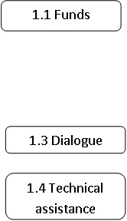
Overview of the impact of BS
BS inputs | Strength of linkage | Induced outputs | Strength of linkage | Impacts
Prudent Macroeconomic Management
Economic Growth
Increased Public Investments
Quantitative factors:
Improved PFM
Qualitative factors:
Improved Budget Alloc. to Education and related service delivery
Empowerment&social inclusion of poor people and disadvantaged groups
Improved public policy formulation

