Slide 1
Air Quality Governance in ENPI East Countries
Air Quality Governance within
Capacity4dev.eu
Iliyana Arnaudova
PROJECT FINAL CONFERENCE AND 5TH STEERING COMMITTEE
Brussels, 27 November 2014

Slide 2
Content
Capacity4dev.eu – Connecting the Development Community
How to find the project page?
How to use the page?
How to find information?

Slide 3
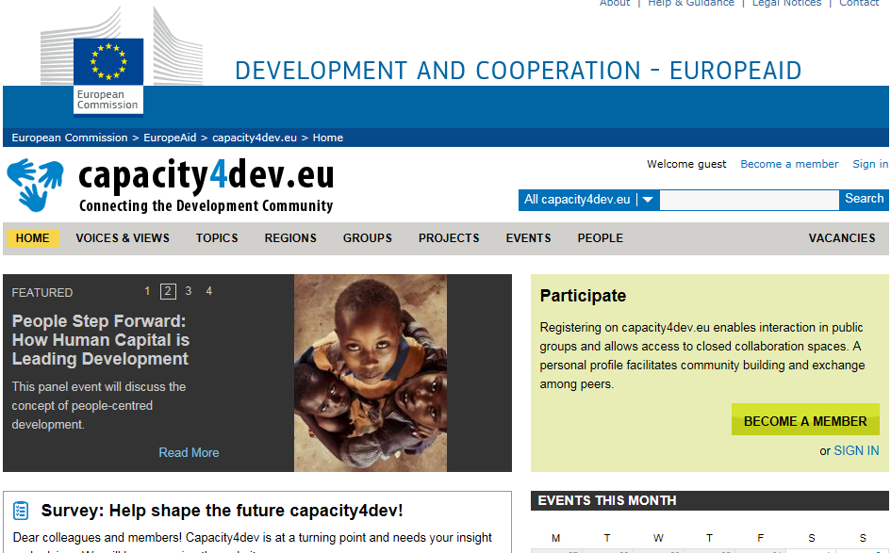
How to become a member of capacity4dev.eu
Username
Password
Email address
First name
Last name

Slide 4
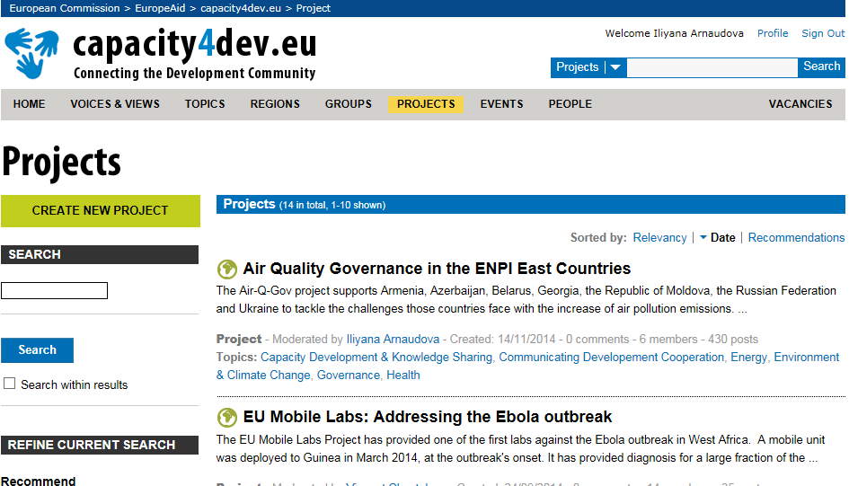
Finding Air Quality Governance in the ENPI East Countries
Click on the tab “Projects”
Use the search engine
Use filters (by topic, region or country)

Slide 5
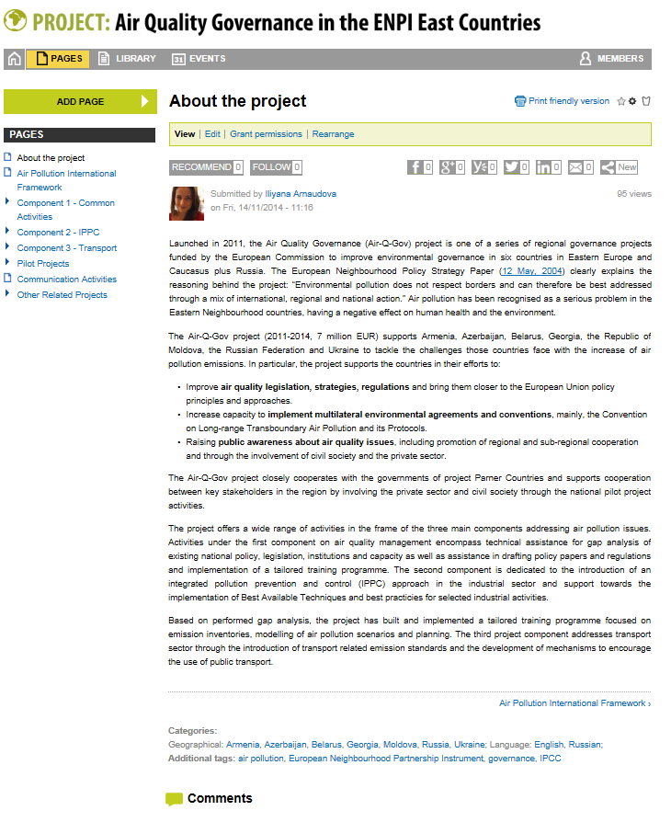
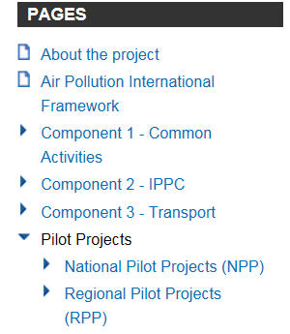
How to use the page?

Slide 6
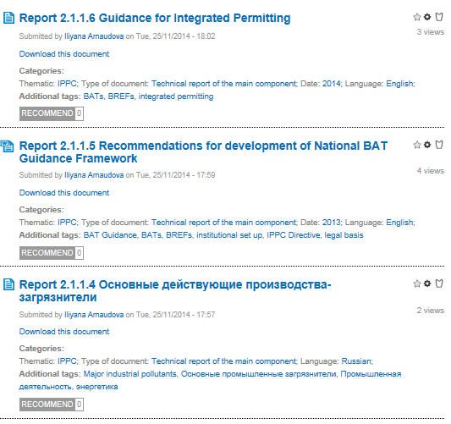
How to find information in the Library?
Categories over:
Thematic nature
Geographical coverage
Type of Document
Date
Language
Additional tags to support your search:
e.g. green urban areas, IPPC Directive, план деятельности по транспорту, регистр выбросов

Slide 7
Thank you for your attention

