Slide 1
INTRODUCTION TO CARBON MARKETS
Carbon pricing mechanisms and associated markets

Slide 2


In this presentation
1
2
3
4
WHAT IS CARBON PRICING
MAIN PRICING INSTRUMENTS AND THEIR RESULTING MARKETS
THE VOLUNTARY
CARBON MARKET
IMPLICATIONS FOR EU DELEGATIONS
Objectives of carbon pricing
Carbon taxation
Proposed focus for EU delegations
Emission trading systems
The voluntary carbon market (VCM)
Result-based payment
mechanisms
Crediting mechanisms

Slide 3

1
WHAT IS CARBON PRICING.

Slide 4
WHAT IS CARBON PRICING.
Putting a price on emissions.
It captures the external costs of greenhouse gas emissions—the costs of climate change that the public pays — and ties them to their emitters through a price.
Carbon pricing, within an integrated policy mix, is a powerful tool to guide economies toward low-emission paths.
Notes:
the polluter pays principle

Slide 5
OBJECTIVES OF CARBON PRICING.
To achieve mitigation targets in a cost-effective manner, by spreading the effort.
To provide strong incentives to raise private investments.
To allow emitters to decide between lowering their emissions or continue emitting and paying for their emissions.
To stimulate technological change and acceleration of low-carbon innovation.
To generate revenues for governments to finance further climate action.

Slide 6





CARBON PRICING INSTRUMENTS AND MARKETS.
Instruments applied through Article 6 of the Paris Agreement
Carbon pricing instrument or mechanism
Resulting market
Carbon taxation | None
Emission trading systems | Domestic compliance market
Result-based climate finance | None, but has an effect on other markets
Carbon crediting mechanisms | Domestic compliance market Voluntary carbon market
Instruments applied through Article 6 of the Paris Agreement
Carbon pricing instrument or mechanism
Resulting market
Notes:
Scope of the regulation and market: subnational, national, regional, international
Complex and variable vocabulary

Slide 7
CARBON PRICING INSTRUMENTS AND MARKETS.
68
carbon pricing instruments
including taxes and emissions trading systems (ETSs), are operating.
23%
Covering approximately
of total global greenhouse gas (GHG) emissions.
Notes:
Only 4 % of global emissions are priced high to be aligned with the 1.5 degrees goal of the PA

Slide 8
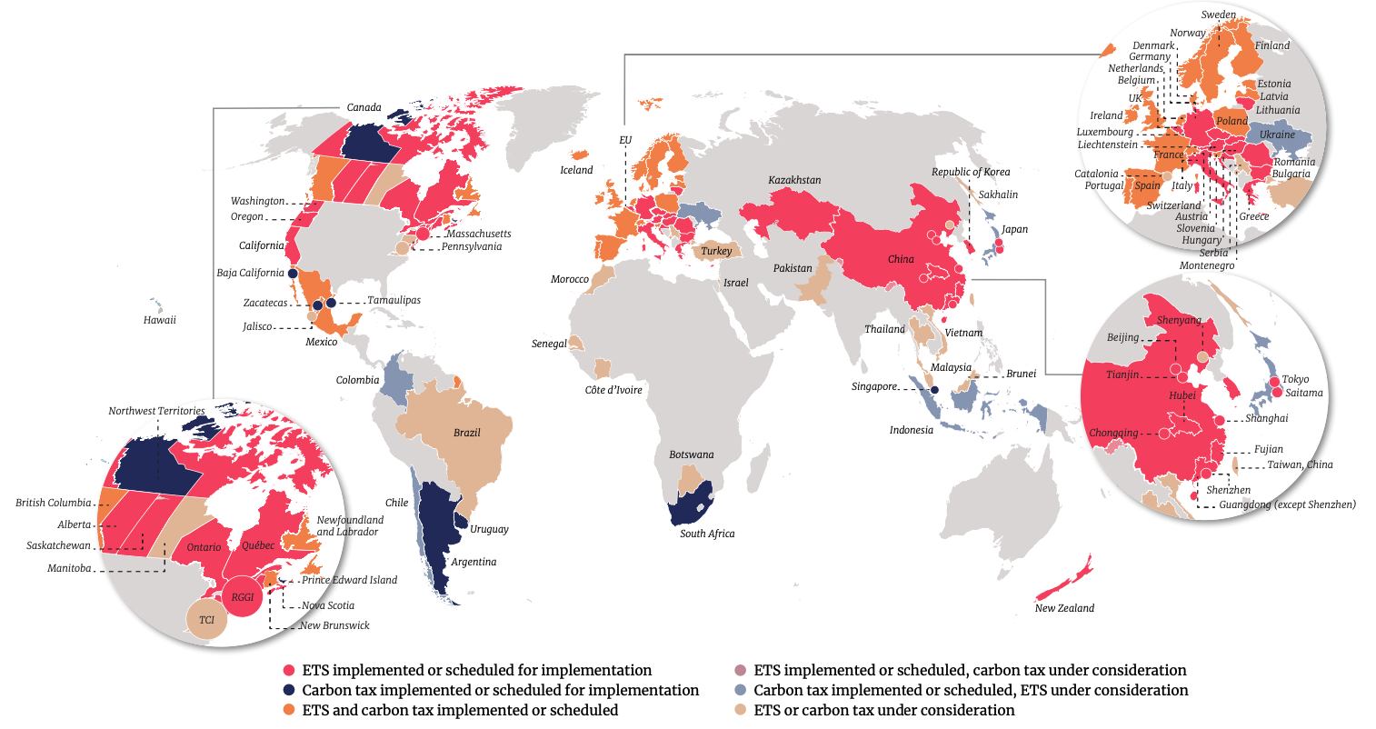
Notes:
Te majority of carbon prices remain far below the $40-80/tCO2e range recommended for 2020 to meet the ‘well below 2°C’ temperature goal of the Paris Agreement. At this point, carbon prices in the recommended range cover less than 5% of global emissions.

Slide 9

2
MAIN PRICING INSTRUMENTS AND THEIR RESULTING MARKETS.

Slide 10
CARBON TAXATION.
Directly sets a price on carbon by defining an explicit tax rate on greenhouse gas emissions.
Notes:
It is different from an Emission Trading System (ETS) in that the emission reduction outcome of a carbon tax is not pre-defined but the carbon price is.

Slide 11
CARBON TAXATION.
POLITICAL RISKS and risks of switching to informal sources of energy (wood, charcoal).
36 JURISDICTIONS
covering a total of 5.7% of global emissions (2022).
EASIER
to implement than other carbon pricing instruments, especially in developing countries.
USED
to discourage the consumption of fossil fuels and shift to lower-carbon fuels.
BEWARE
of fossil fuel subsidies.
EXAMPLES: Uruguay, Colombia, Senegal (under development).
Notes:
Important to note: areas, sectors and installations that are taxed, cannot be regulated through another carbon market mechanism (additionnality).
Fossil fuel subsidies erode the effect provided carbon taxation, by counteracting the price signal

Slide 12
EMISSION TRADING SYSTEM (ETS).
A compliance system where emitters trade emission allowances between them to meet their emission targets.
To comply with their targets, emitters can either reduce emissions internally or buy emission allowances from other emitters.

Slide 13
EMISSION TRADING SYSTEM (ETS).
PRICE SETTING
through a centralised trading system, based on auctions
REGULATED ENTITIES mostly large emitters: producers of steel, cement, paper, and fertilisers, power stations, oil refineries.
RESULTING MARKET
closed domestic compliance market.
CAP AND TRADE
Most applied system.
Notes:
Traded units: emission allowances, -permits or –units (not credits!!)
EU ETS: over 10,000 installations, covers 40% of EU emissions
In some jurisdictions combined with a compliance carbon crediting system
Linked with the Swiss system.

Slide 14
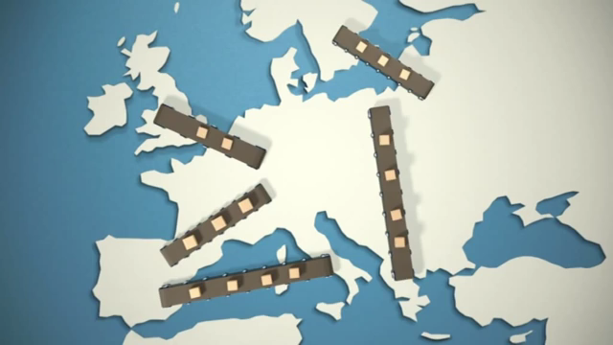
Notes:
EU Commission explainer on EU ETS: from 1min .12 seconds (from “in a nutshell”)

Slide 15

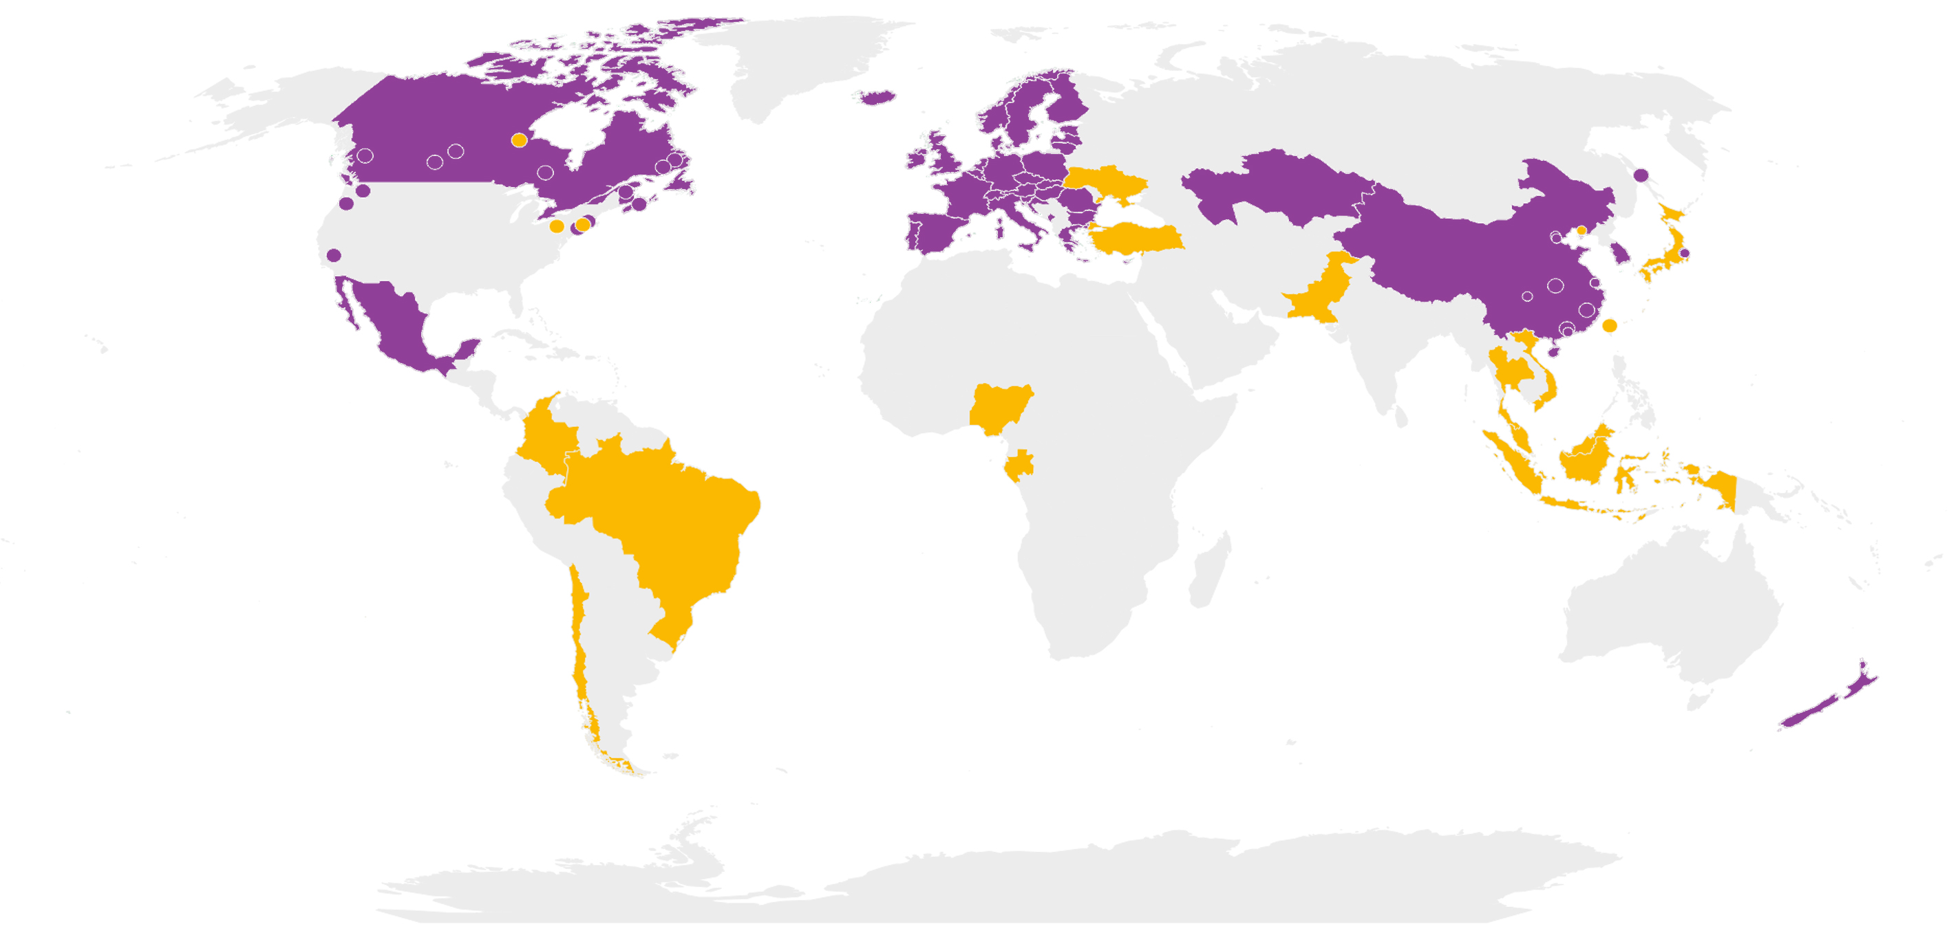
EMISSION TRADING SYSTEM (ETS).
Distribution
Implemented
Planned
Source: World Bank, 2022
Notes:
34 ETS in place (2022), one regional (EU ETS), 11 national systems and 22 subnational systems, covering 17.6% of global emissions
Examples in developing countries: Indonesia, Mexico, Vietnam

Slide 16

RESULT-BASED PAYMENT MECHANISMS.
Funding approach where payments are made after outputs related to climate change, such as emission reductions, are delivered and verified.

Slide 17
RESULT-BASED PAYMENT MECHANISMS.
EXAMPLES
Green Climate Fund, World bank’s Carbon Fund, Central African Forest Initiative.
HELPS BUILD CAPACITY
and prepares developing countries to participate in international carbon markets.
CONTRIBUTION TO FUNDS
international and national sources, non-profit and private contributors, but are mostly public funds.
Notes:
Many programs combine GHG reductions with poverty reduction, and other health and community benefits.
To accelerate climate action investments where there are no clear business cases yet, or that carry a higher risk.
Works best on NBS (restoration, reducing deforestation, etc.); Sustainable infrastructure; Fiscal and financial solutions (e.g., fade-out fuel subsidies)
Contribution to funds may come from international and national sources, non-profit and private contributors, but are mostly public funds.

Slide 18
CREDITING MECHANISMS.
Market mechanism that valorises greenhouse gas emission reductions from project-based mitigation activities.
Credits or offsets are 1 ton of CO₂ equivalent of compensatory value obtained through:
Activities leading to removal of carbon from the atmosphere (removals or carbon sequestration).
Activities leading to emission reductions
compared to a baseline scenario.

Slide 19
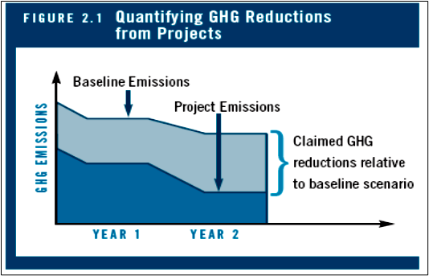
CREDITING MECHANISMS.
QUANTIFYING GREENHOUSE GAS EMISSIONS FROM PROJECTS
Notes:
Difference between credits and allowances. Difference in accounting

Slide 20






CREDITING MECHANISMS.
To have full compensatory value (= integrity), credits and the associated mitigation activity must be:
  REAL
  ADDITIONAL
  UNIQUE
  PERMANENT
  TRANSPARENT
  FREE OF LEAKAGE
Notes:
Real and measured (robustly quantified and verified by a third party)
Additional (additional efforts compared to business-as-usual)
Unique (absence of double counting), registry!
Permanent (the sequestered carbon or emission reduction must remain out of the atmosphere over time)
Transparent (full disclosure of all information and verification/validation reports)
Leakage-free (no additional emissions are provoked outside the project scope)

Slide 21
CREDITING MECHANISMS.
Credits are to comply with either:
An international agreement
A domestic regulation (compliance market)
Voluntary corporate objectives (voluntary market)
Notes:
Currently, there is a need to improve methodologies, set up more stringent criteria and integrity principles.

Slide 22
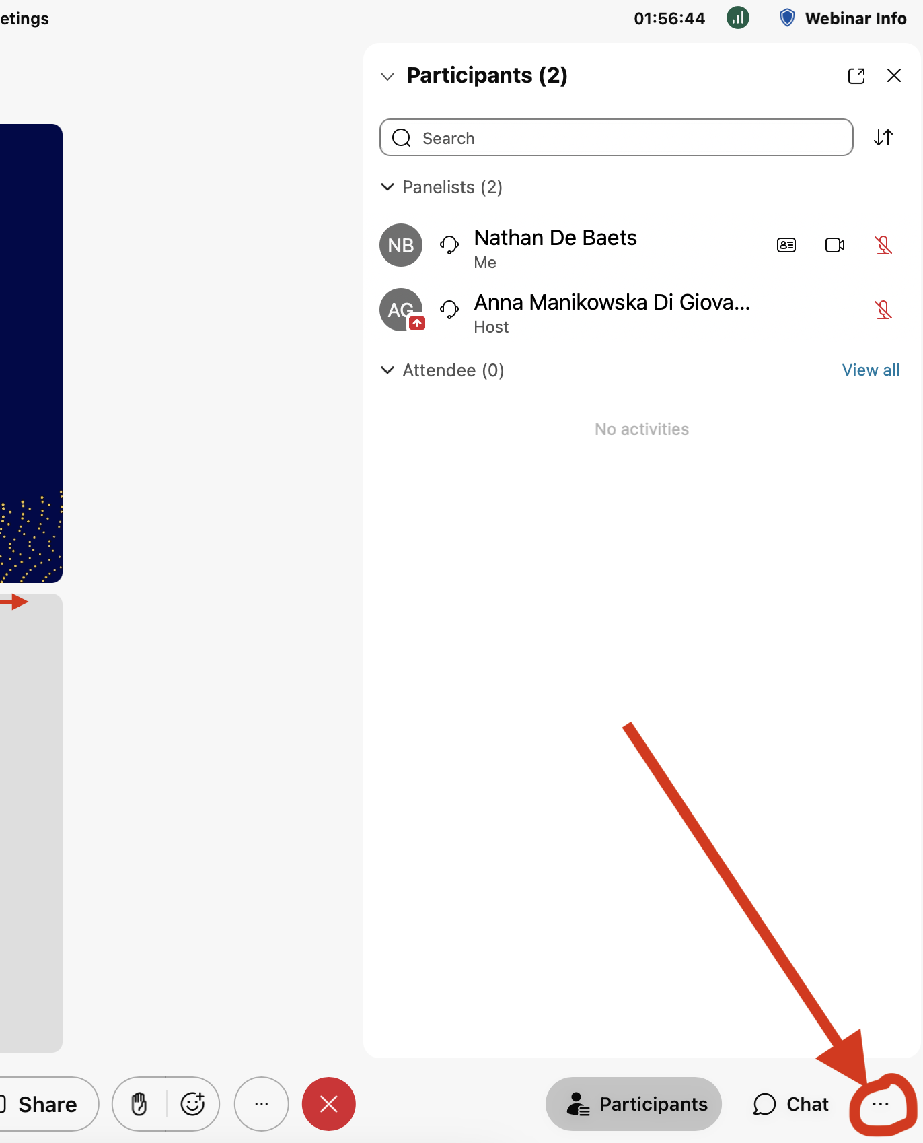
Poll
Which carbon pricing instruments imply exchanges of carbon units on a market?
Carbon crediting
Result-based finance
Emission trading systems
Carbon taxation
None
All of them
TEST YOUR KNOWLEDGE.

Slide 23
3
THE VOLUNTARY CARBON MARKET.

Slide 24


COMPLIANCE VERSUS VOLUNTARY MARKET.
 | Compliance markets | Voluntary market
Regulation | By government law or regulation | Non-regulated
Type of participation | Mandatory participation | Voluntary participation
Most common market instrument | Emission trading system (cap & trade) | Carbon crediting
Main type of transaction | Centralised market mechanism (auctions) | Between buyer and seller (over-the-counter) or through public exchange markets
Methodologies and procedures | Determined by regulation | Proposed by independent certification bodies (e.g. Verra, Gold Standard)
Sources: Partnership for market readiness (PMR) (2021); World Bank (2022)

Slide 25








THE VOLUNTARY CARBON MARKET (VCM).
2020
2021
VOLUME (MtCO2e)
PRICE
(USD)
VALUE
(USD)
VOLUME (MtCO2e)
PRICE
(USD)
VALUE
(USD)
 | FORESTRY AND LAND USE | 57.8M | $5.40 | $315.4M | 227.7M | $5.80 | $1,327.5M
 | RENEWABLE ENERGY | 93.8M | $1.08 | $101.5M | 211.4M | $2.26 | $479.1M
 | CHEMICAL PROCESSES / INDUSTRIAL MANUFACTURING | 1.8M | $2.15 | $3.9M | 17.3M | $3.12 | $53.9M
 | WASTE DISPOSAL | 8.5M | $2.69 | $22.8M | 11.4M | $3.62 | $41.2M
 | ENERGY EFFICIENCY / FUEL SWITCHING | 30.9M | $0.98 | $30.4M | 10.9M | $1.99 | $21.9M
 | HOUSEHOLD / COMMUNITY DEVICES | 8.3M | $4.34 | $36.2M | 8.0M | $5.36 | $43.3M
 | TRANSPORTATION | 1.1M | $0.64 | $0.7M | 5.4M | $1.16 | $6.3M
 | AGRICULTURE | 0.5 | $10.38 | $4.7M | 1.0M | $8.81 | $8.87M
Source: Forest Trends, 2022

Slide 26
THE VOLUNTARY CARBON MARKET (VCM).
Issuances of carbon credits by Project Type (2010-2022)
Nature-based Avoidance
Nature-based Removals
Renewables
Community
Technical Removals
Waste
Other
Source: South Pole (2022)
NBS Avoidance
RE
Community
NBS Removals
Technical Removals
Waste
Other

Slide 27



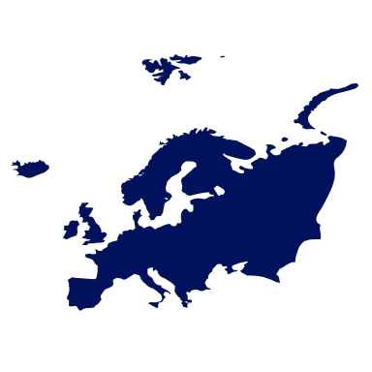
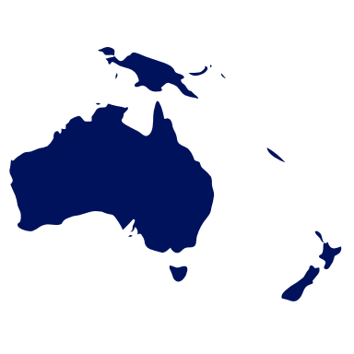
THE VOLUNTARY CARBON MARKET (VCM).
 |  | Share in world transactions (%) | Average Price (USD)
 | Asia | 51% | 2,0
 | Latin America & Caribbean | 20% | 3,2
 | North America | 13% | 3,8
 | Africa | 13% | 4,4
 | Europe | 2% | 3,4
 | Oceania | 1% | 12,2
Total / average | Total / average | 100% | 4,8
Ecosystem Marketplace’s Global Carbon Markets Data Intelligence and Analytics Dashboard (2023)
Notes:
The VCM started in the 1990s. It grew slowly in volume, types of credits, and participants for two decades, and then took off in 2017, more than doubling in size in the last 5 years (See Annex 1 – Size by value of traded carbon credits). The corporate commitments made in the context of the Paris Agreement were the main drivers of this growth. This increased demand is also one of the main reasons why African partner countries show a growing interest in the VCM.

Slide 28
SUPPLY-SIDE RISKS ASSOCIATED TO VOLUNTARY MARKET ACTIVITIES (1/2).
SOCIAL RISKS
Absence of just carbon benefit-sharing mechanisms.
FINANCIAL RISKS
Low prices, high carbon transaction costs, small benefits for carbon owners.
TECHNICAL RISKS
Complex carbon measurement, reporting, and verification.
Notes:
Financial risks: at current VCM prices, carbon transaction costs may absorb the largest part of carbon revenues, leading to small marginal benefits for carbon owners (business and forest owners, communities, smallholders).
Technical risks: the capacities and infrastructure to comply with complex carbon MRV and ESG might not be present in the host country.
Social risks: low benefits and absence of just and inclusive carbon benefit-sharing mechanisms among smallholders and community members. Carbon project activities may also carry a risk of eroding existing land rights of indigenous people, and smallholder communities/families.
Environmental risks: Mitigation activities such as afforestation with monospecific plantations reduce biodiversity, deplete other natural resources (water, soil).
Non-alignment of the carbon project activities and MRV with national and international climate change policies (NDC, Paris Agreement).

Slide 29
SUPPLY-SIDE RISKS ASSOCIATED TO VOLUNTARY MARKET ACTIVITIES (2/2).
ENVIRONMENTAL RISKS
Some mitigation activities may deplete natural resources (water, soil).
NON-ALIGNMENT
with national and international climate change policies (NDC, Paris Agreement).
GENDER RISKS
Carbon project design doesn’t allow women and girls to benefit, carbon ownership is mainly attributed to men.
Notes:
The VCM started in the 1990s. It grew slowly in volume, types of credits, and participants for two decades, and then took off in 2017, more than doubling in size in the last 5 years (See Annex 1 – Size by value of traded carbon credits). The corporate commitments made in the context of the Paris Agreement were the main drivers of this growth. This increased demand is also one of the main reasons why African partner countries show a growing interest in the VCM.

Slide 30
DEMAND-SIDE RISKS ASSOCIATED TO VOLUNTARY MARKET ACTIVITIES.
Poor quality and integrity of carbon credits.
The VCM does not require the buyer to reduce its own emissions. This may lead to reduced ambition from emitters, as all emissions may be compensated by acquiring carbon credits produced elsewhere.
With the increasing interest in voluntary markets, it is important for partner countries to assess risks and regulate voluntary market activities.
Notes:
Financial risks: at current VCM prices, carbon transaction costs may absorb the largest part of carbon revenues, leading to small marginal benefits for carbon owners (business and forest owners, communities, smallholders).
Technical risks: the capacities and infrastructure to comply with complex carbon MRV and ESG might not be present in the host country.
Social risks: low benefits and absence of just and inclusive carbon benefit-sharing mechanisms among smallholders and community members. Carbon project activities may also carry a risk of eroding existing land rights of indigenous people, and smallholder communities/families.
Environmental risks: Mitigation activities such as afforestation with monospecific plantations reduce biodiversity, deplete other natural resources (water, soil).
Non-alignment of the carbon project activities and MRV with national and international climate change policies (NDC, Paris Agreement).

Slide 31
Poll
To have full compensatory value (integrity), carbon projects and credits must be:
Transparent
Additional
Temporary
Free of leakage
Secret
Compliant with the EU ETS
Real
TEST YOUR KNOWLEDGE.

Slide 32
4
IMPLICATIONS FOR EU DELEGATIONS.

Slide 33
IMPLICATIONS FOR EU DELEGATIONS.
Increased market demand = increasing interest by developing countries in the voluntary carbon market, Article 6 opportunities.
Partner countries want to improve understanding, and access carbon markets to seize opportunities.

Slide 34
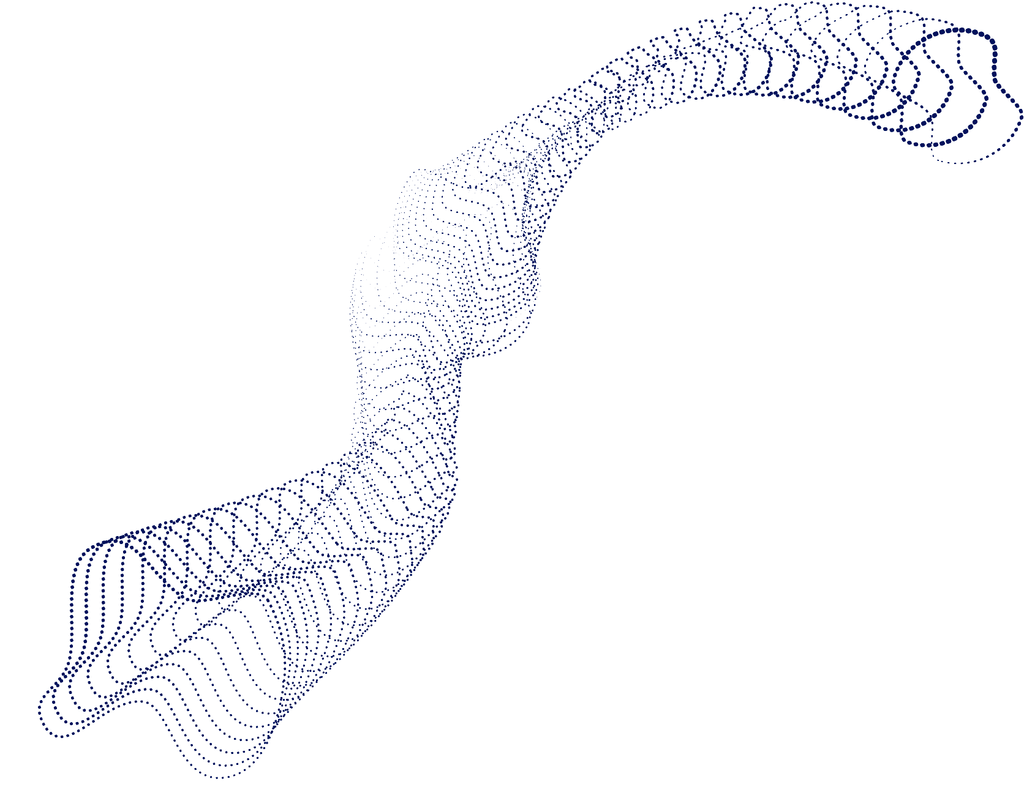
PROPOSED FOCUS FOR EU DELEGATIONS.
ALIGNMENT
with international commitments and targets (NDCs).
ASSESSING CURRENT STATE OF AFFAIRS
on carbon market activities in their respective countries.
PROMOTE NATIONAL REGULATION
on carbon market activities (benefit-sharing, integrity, ownership and reporting).

Slide 35

QUESTIONS

Slide 36
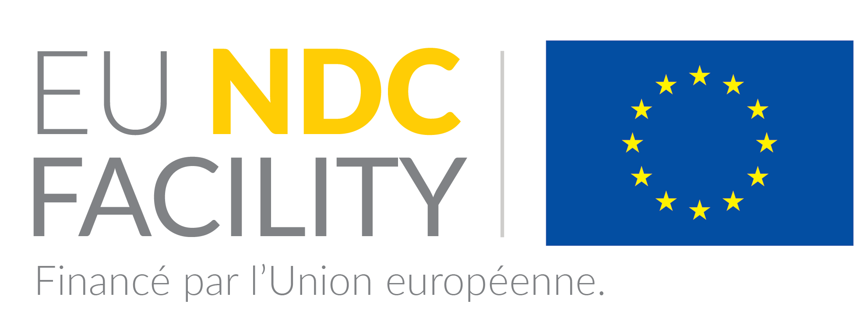
THANK YOU.
ndcfacility@dai.com

Slide 37
BIBLIOGRAPHY.
General carbon pricing
The World Bank. 2022. State and Trends of Carbon Pricing 2022, World Bank, Washington, DC. Doi: 10.1596/978-1-4648-1895-0. License: Creative Commons Attribution CC BY 3.0 IGO. Available at: https://openknowledge.worldbank.org/collections/d9ab9a14-0168-54e9-9ff2-b84a1c83fb43
World Bank. 2023. State and Trends of Carbon Pricing 2023. Washington, DC: World Bank. doi: 10.1596/978-1-4648-2006-9. License: Creative Commons Attribution CC BY 3.0 IGO. Available at: https://www.worldbank.org/en/news/press-release/2023/05/23/record-high-revenues-from-global-carbon-pricing-near-100-billion
The World bank, 2021. Carbon Prices now Apply to Over a Fifth of Global Greenhouse Gases. Press release May 2021. Available at: https://www.worldbank.org/en/news/press-release/2021/05/25/carbon-prices-now-apply-to-over-a-fifth-of-global-greenhouse-gases
Carbon taxation
The World Bank 2023. The Carbon Pricing Dashboard. Consulted on 5th of June 2023. Available at: https://carbonpricingdashboard.worldbank.org/
Parry I., 2019. What is carbon taxation? Finance and development. International Monetary Fund (IMF) Available at: https://www.imf.org/en/Publications/fandd/issues/2019/06/what-is-carbon-taxation-basics
Emission trading systems
European Commission. EU Emissions Trading System. Consulted in May 2023. Available at:
https://climate.ec.europa.eu/eu-action/eu-emissions-trading-system-eu-ets_en
The World Bank 2023. The Carbon Pricing Dashboard. Consulted on 2nd of June 2023. Available at: https://carbonpricingdashboard.worldbank.org/
Result-based climate finance systems
https://www.worldbank.org/en/news/feature/2022/08/17/what-you-need-to-know-about-results-based-climate-finance
De Nys E, 2022. What You Need to Know About Results-Based Climate Finance. World Bank Feature Story. Available at: https://www.worldbank.org/en/news/feature/2022/08/17/what-you-need-to-know-about-results-based-climate-finance
The World Bank 2023. The Carbon Pricing Dashboard. Consulted on 30th of May 2023. Available at: https://carbonpricingdashboard.worldbank.org/
Crediting mechanisms
The World Bank 2023. The Carbon Pricing Dashboard. Consulted on 2nd of June 2023. Available at: https://carbonpricingdashboard.worldbank.org/
Markets and current market trends
Forest Trend’s Ecosystem Marketplace, 2022. The Art of Integrity: State of the Voluntary Markets, Q 3 Insights Briefing. Washington DC: Forest Trends Association. Available at: https://www.ecosystemmarketplace.com/publications/state-of-the-voluntary-carbon-markets-2022/
Pearson, T.R.H., Brown, S., Sohngen, B. et al. Transaction costs for carbon sequestration projects in the tropical forest sector. Mitigation and Adaptation Strategies for Global Change 19, 1209–1222 (2014). https://doi.org/10.1007/s11027-013-9469-8 .
https://www.imf.org/en/Publications/fandd/issues/2019/06/what-is-carbon-taxation-basics
Guizar-Coutiño, A., Jones, J. P. G., Balmford, A., Carmenta, R., & Coomes, D. A. (2022). A global evaluation of the effectiveness of voluntary REDD+ projects at reducing deforestation and degradation in the moist tropics. Conservation Biology, 36, e13970. https://doi.org/10.1111/cobi.13970.
Schmalensee R. and Stavins R., 2019. Learning from Thirty Years of Cap and Trade. Resources Magazine, Issue 201. Available at: https://www.resources.org/archives/learning-thirty-years-cap-trade/
Alers M. and Jones B., 2021. A Guide to Carbon pricing and fossil fuel subsidy reform. A summary for policy makers. UNDP. Available at: https://www.undp.org/publications/guide-carbon-pricing-and-fossil-fuel-subsidy-reform
Howard, A., 2021. Country perspectives: opportunities and challenges for international voluntary carbon markets in the context of the Paris Agreement. Partnership for Market Readiness (PMR). Available at: https://openknowledge.worldbank.org/entities/publication/d49582fa-132a-524c-8a28-f9a82eed284d
World Bank, 2023. Pricing carbon website. Consulted on the 5t of June 2023. Available at: https://www.worldbank.org/en/programs/pricing-carbon
Lima REDD+ Information Hub. Available at: https://redd.unfccc.int/info-hub.html?sortCountry=desc
Pryor J., Santikarn S., Gadde H., Oppermann K., and Besley D. A Guide to developing domestic carbon crediting mechanisms. Partnership for market readiness (PMR) and World bank. Available at: https://openknowledge.worldbank.org/server/api/core/bitstreams/9a57817b-998f-584b-b60d-a12d1c4648cf/content
South Pole, 2022. The voluntary Carbon market 2022-2023. Available at: https://storage.pardot.com/881182/1680172478zgFzdrQY/South_Pole___VCM_Report_2022_2023.pdf

Slide 38
STYLIZED REPRESENTATION OF TYPES OF CARBON CREDITING MECHANISMS AND MARKET SEGMENTS.
  International crediting mechanisms
  Regional, national, and subnational crediting mechanisms
  SOURCES OF SUPPLY
  Independent crediting mechanisms
  e.g. CM, Art 6.4
  e.g. California Compliance Offset Program
  e.g. VCS, Gold Standard
  INTERNATIONAL COMPLIANCE MARKETS
  DOMESTIC COMPLIANCE MARKETS
  RESULTS-BASED FINANCE
  VOLUNTARY CARBON MARKET
  Credit purchases aimed at helping countries meet their NDCs and airlines comply with CORSIA
  Credit purchases aimed at complying with obligations under carbon taxes, ETS
  Credit purchases aimed at meeting voluntary targets or commitments
  Credit purchases as public policy tool for incentivizing mitigation
  MARKET SEGMENTS

Slide 39



CARBON PRICING INSTRUMENTS: A SIMPLIFIED OVERVIEW*
Category | Non-market |  | Market
Type | Carbon taxation | Result-based climate finance (payments) | Emission trading system (ETS) | Carbon crediting mechanisms
Type of regulation | Government regulation | Fund or programme regulation | Government regulation | Government regulation | None (Voluntary)
Resulting market | / | / | Domestic compliance market | Domestic compliance market | International Voluntary carbon credit market
Main suppliers | / | Eligible projects or programs | Regulated emitters (companies, power stations) | Project or program proponents in non-regulated sectors | Project or program proponents
Main buyers | / | Funders: countries, multilaterals, private sector | Regulated emitters (companies, sectors) | Regulated emitters | Companies / corporates
Examples at international level | / | Carbon Fund, GCF, CIF, CAFI, NORDEC, LEAF | EU ETS (only EU) | / | International Voluntary carbon credit market (VCM)
Examples at national level | Uruguay, Senegal (under development) | Brazil (Amazon Fund) | Indonesia, Mexico, Vietnam | Colombia, South Africa, Canada | /

