Slide 1
Part II.1.
Promoting local development through a territorial approach
Opportunities and limits of the Thematic Program CSO-LA
Session 2.1. Framing the topic
Jorge Rodriguez Bilbao
“Civil Society & Local Authorities"
European Commission-DG DEVCO B2
Workshop on Decentralization reforms, Local Governance, Local and Territorial development
13 to 17 April 2005

Slide 2
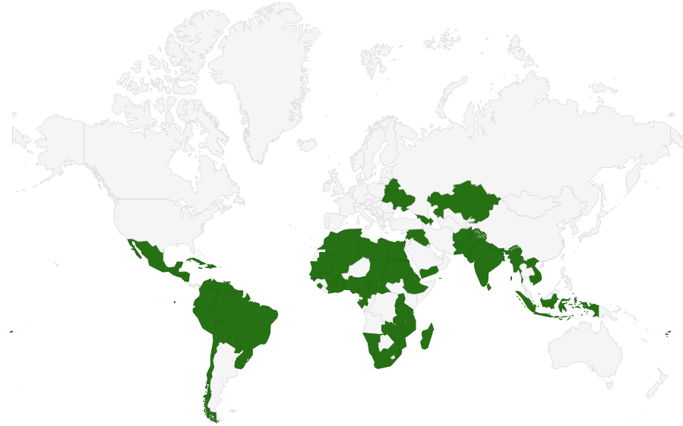
CSO-LA 2014-2017
One of its objectives “testing pilot actions promoting LD through a territorial approach (TALD)
LA-CSO led projects!!
MAAP (2015-2017):
  LA-led actions : 144.040 M€
  CSO-led: 423.075 M€
  Support measures: 2,5-5%
Notes:
The Multi-annual Indicative Programme
Annual Action Programme (AAP)

Slide 3
Testing pilot actions promoting LD
through a territorial approach (TALD)
We don’t want just to finance actions led by CSO-LA We want to test pilot actions promoting LD!!!
Questions you need to answer:
What are the features on any actions led by LA and/or CSO to be labelled as “LD”
How can we “promote” (and not just “finance”) those actions?
Notes:
The Multi-annual Indicative Programme
Annual Action Programme (AAP)

Slide 4
Improved Local Development Management System
Comprehensive scope of local development
Improved systems of local development planning
Enhanced & diversified instruments of local development financing
Improved institutions & capacity for local development implementation
National Level Policies
Sub-National level institutions & capacity
Decentralization policy enhancing autonomy and accountability of LAs
National urban agenda supportive of LAs
National rural development policy supportive of LAs
Effective institutions of inter-governamental cooperation
Local leadership and administrative capacity development
Active citizenship and public private partnerships

Slide 5
THANKS

