Slide 1
Session 1.5
A Territorial Approach to Local Development
The missing decentralization-development link ?
Leonardo G. Romeo
Local Development International LLC
New York University
Workshop on Decentralization Reforms, Local Governance, Local and Territorial Development
Brussels - 13 to 17 April 2005

Slide 2
On Terminology : “Territorial” Development
The adjective “territorial” typically refers to either, or both:
Development which is spatially integrated i.e. reflects a spatial vision of a territory’s future
    [this stresses the importance of integrating physical/environmental and social/economic considerations and overcoming the fragmentation of sector-based policy making and implementation.]
Development of specific places at multiple scales (local, urban, metropolitan, regional, national, or supra-national)
    [This points at the multiplicity of scales) at which local development can be promoted (“local” as a relative concept) and to the interdependence of such scales)
We recover both meanings (spatially integrated and multi-scalar) and combine them with the defining characteristics of “local” development (endogenous and incremental) to come to a richer definition of Local/Territorial Development (see next slide)

Slide 3
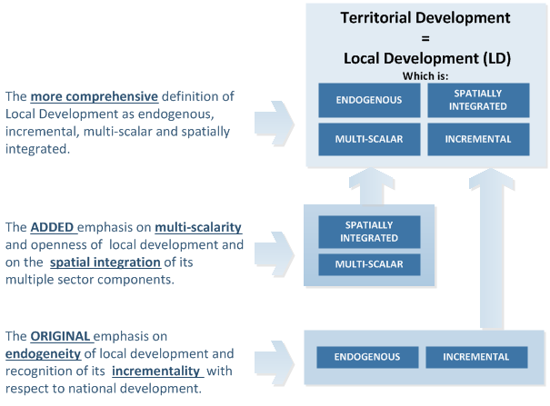
On Terminology : “Territorial” as “Local” Development

Slide 4
On Terminology : A “Territorial Approach to Local Development”
We define the “Territorial Approach to Local Development” (TALD) as a multi-dimensional national policy that:
Understands Territorial Development as endogenous, incremental multi-scalar and spatially integrated, Local Development
Values Territorial Development as a critical component of the National Development model
Recognizes the primary responsibility of autonomous and accountable local authorities for promoting territorial development, and empowers them to plan, finance and manage it.

Slide 5
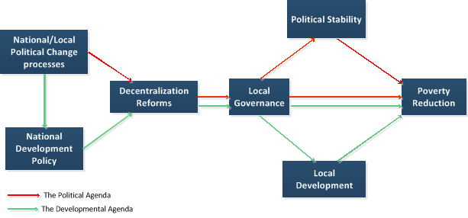
Decentralization: Driven by Politics, Shaped by Policy
DRIVE
SHAPE
KEY QUESTION
Is the National Development Policy supportive of Local/Territorial Development ?

Slide 6
Why a TALD ? : Growing inequalities and ineffective responses
Globalization associated with
  Adoption of outward oriented development models
  growing imbalances, (across economic and social indicators), between urban and rural areas and within urban areas.
  Increase of inequality threatening political stability and economic growth.
Traditional policies have aimed at correcting territorial disparities, through
  a variety of regional development programs (mostly focused on infrastructure spending in less developed areas)
  Spending for upgrading housing and sanitation conditions in fast growing slum areas.
Mixed results. Problems with these policies are both conceptual and practical.
  strictly top-down, sectoral logic, instead of integrated packages and lack of strategic spatial focus in public investments planning
  Resources required beyond the possibilities of public spending under fiscal discipline constraints

Slide 7
Leading to questions and a search for new approaches…
Radical questioning of whether “balanced” development itself should be pursued (see the World Bank’s 2009 WDR)….
An emerging consensus, that a new set of more realistic, selective and effective policies is needed, including:
Rebalancing the economic model that generates the inequalities with greater support to internal demand and domestic market
Embracing, rather than fighting accelerated urbanization
Strategically focus public investments to help selected localities emerge as competitive nodes of the global economy
Packaging public investments to support LD strategies
Injecting realism in services delivery systems by supporting an expanded role for community-based and private sector co-provision/production.

Slide 8
…which call for an empowerment of local authorities
Clearly, both expanding the territorial footprint of economic growth and preserving or enhancing basic social services, will require
  Greater efficiency (local-responsiveness and value-for-money) in the use of limited central State resources, as well as
  Mobilization of additional resources from local communities and private sector.
None of this will be possible without developmental local authorities empowered with a meaningful degree of autonomy and embedded in effective networks of accountability relations.

Slide 9
    Assessing the context: Where does your country stand ?

Slide 10
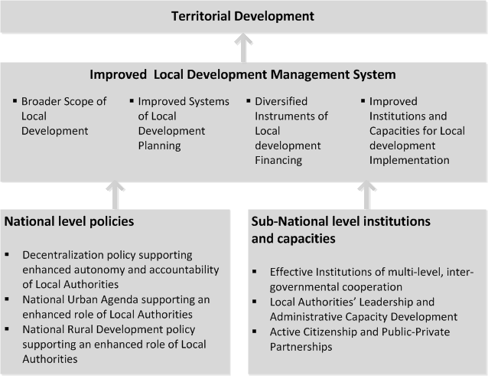
The TALD building blocks : Multiple entry points for aid

Slide 11
TALD-supporting Program Framework : where to focus ?

