Slide 1
Seminar on
DECENTRALIZATION REFORMS, LOCAL GOVERNANCE LOCAL AND TERRITORIAL DEVELOPMENT
Key messages day 1

Slide 2


The ‘fil rouge’ of the seminar
Part 1:
Part 2:
RED THREAD:
How to support the local-territorial development and the developmental role of LAs in partner countries
Setting the scene:
shift in thinking about decentralization Reforms: from traditional concerns with functional and fiscal reassignments to a focus on local and territorial development.
Panoramic overview of the different ‘entry points’ to support DR-LG and LD through either geographic or thematic instruments.
Specific focus on how to operationalize a ‘territorial approach to local development’ through the TP CSO&LA
Part 5
Part 3:
Part 4:
How EC manages the relationship with Associations of LAs
Supporting DR-LG and LD through the geographic instrument
Windows of opportunities and strategic use of aid modalities
Exploring the scope for LA involvement in the delivery of sector outputs

Slide 3
MESSAGE 1
WELCOME TO THE WORLD OF
COMPLEXITY

Slide 4
LAs: A new actor in the local arena that is not like the others!!
Central Government
Ministries
Health
Environment
Education
Donors
Big NGOs
Power transfers
Accountability
PRIVATIZATION
DEMOCRATIC DECENTRALIZATION
Non market
Privatisation
DECONCENTRATION
Hybrids?
Individual or
Corporation
Administrative
Local
Authority
NGO
PVO
CBO
ELECTED LOCAL
GOVERNMENTS
Customary
Authority
GOVERNMENT
Private
Decentralization
Public
Public-Private Spectrum
Local Population

Slide 5
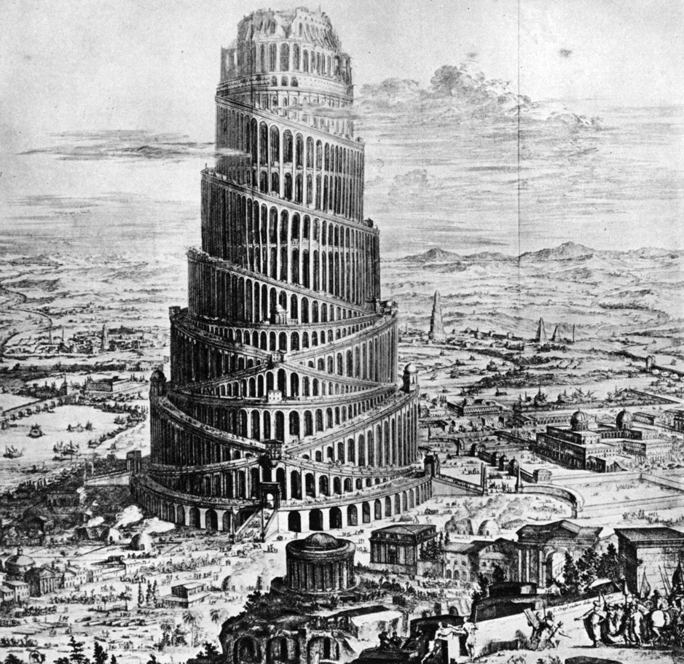
No shortage of (semantic) confusion

Slide 6


Slide 7

Yet even in hostile environments there are opportunities to support local dynamics

Slide 8

There are 100 ways to prepare a lasagna

Slide 9
MESSAGE 2
SHIFTING VIEWS ON
DECENTRALISATION AND LOCAL DEVELOPMENT

Slide 10
KEY DIMENSIONS OF EMERGING NEW THINKING
Less “technocratic” view : central role politics
Empowerment of people through the empowerment of their local government
LAs have a dual mandate –including a “general mandate” as political representative of citizens
Allocative efficiency AND mobilising additional resources (“instrumental” view on decentralisation)
Territorial perspective (endogenous, incremental
+ multiscalar and spatially planned

Slide 11

NO EMPOWERMENT OF LOCAL AUTHORITIES WIITHOUT
AUTONOMY AND ACCOUNTABILITY

Slide 12

OVERCOMING RESISTANCE FROM VESTED (SECTOR) INTERESTS

Slide 13
MESSAGE 3
IMPLICATIONS OF THIS SHIFT
FOR EU ROLES AND APPROACHES

Slide 14
SOME KEY IMPLICATIONS
Need for systematic “political economy analysis” (interests, incentives, demand side, progressive scope for reform)
Respect “endogenous nature” of reforms
(=citizens at centre, seize windows of opportunities, accept unavoidable “ups and downs”)
Accepting “empowerment” takes time
Political “weight” and leverage EU? Joint Action?
Creative use of policy dialogue, instruments and forms of support
Managing risks and expectations

Slide 15
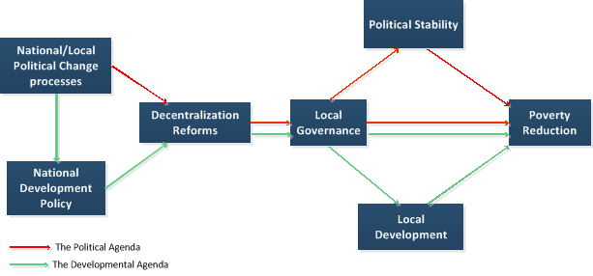
Decentralization : Two Agendas

Slide 16
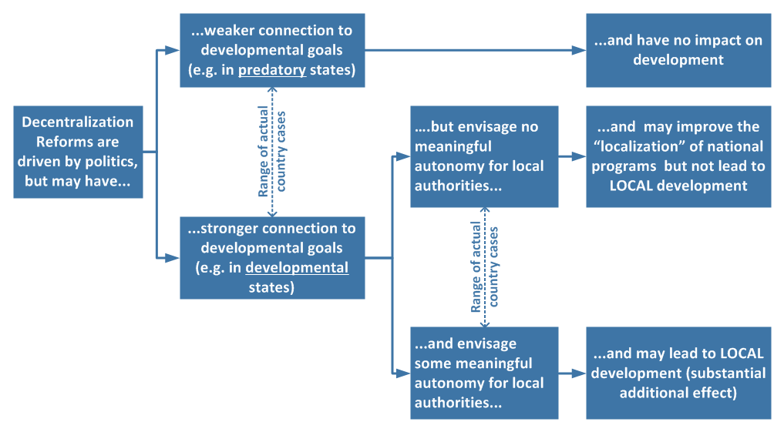
Decentralization and Local/Territorial Development
Many decentralization reforms don’t promote Local/Territorial Development because they were neither initiated nor designed to do that

Slide 17
MESSAGE 4
WHAT RESULTS?

Slide 18
RESULTS IN DR/LG/LD: A TRICKY ISSUE
Outcomes in local development and local democracy require constructive interaction LA-CS
Outcomes in development/governance require effective intergovernmental systems
Concerns about limited impact CD/ID
Empowerment of people and LAs is difficult to translate into indicators
Need for realistic action fiches and regular stock-taking (are things moving in right direction?)

