Slide 1
Part II.1.
Supporting local development through territorial approach using the Thematic Program CSO-LA
Session 3.1. Framing the topic
Jorge Rodriguez Bilbao
“Civil Society & Local Authorities"
European Commission-DG DEVCO B2
Workshop on Decentralization reforms, Local Governance, Local and Territorial development
13 to 17 April 2005

Slide 2

Improved Local Development Management System
Comprehensive scope of local development
Improved systems of local development planning
Improved institutions & capacity for local development implementation
Enhanced & diversified instruments of local development financing
National Level Policies
Sub-National level institutions & capacity
Decentralisation policy enhancing autonomy and accountability of LA
National urban agenda supportive of LA
National rural development policy supportive of LA
Effective institutions of inter-governmental cooperation
Local leadership & administrative capacity development
Active Citizenship & Public-Private Partnership

Slide 3
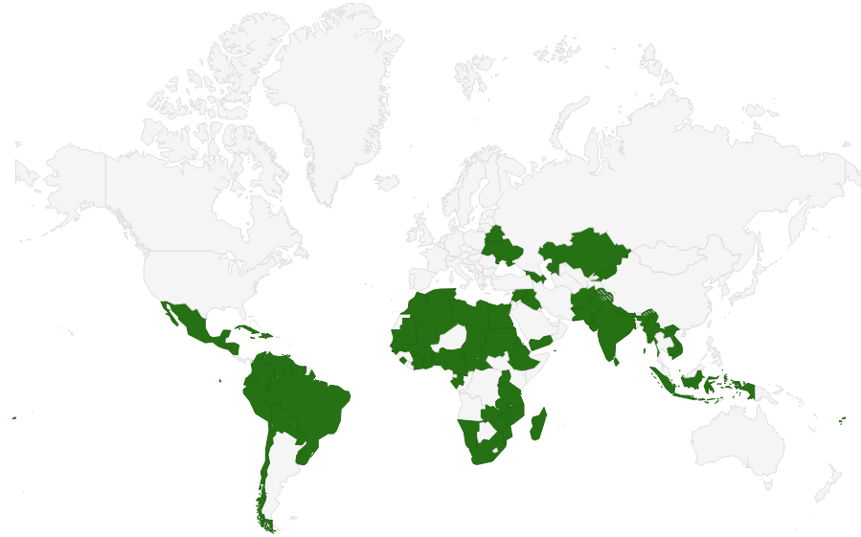
CSO-LA 2014-2017

Slide 4

Improved Local Development Management System
Comprehensive scope of local development
Improved systems of local development planning
Improved institutions & capacity for local development implementation
Enhanced & diversified instruments of local development financing
National Level Policies
Sub-National level institutions & capacity
Decentralisation policy enhancing autonomy and accountability of LA
National urban agenda supportive of LA
National rural development policy supportive of LA
Effective institutions of inter-governmental cooperation
Local leadership & administrative capacity development
Active citizenship & Public-Private Partnership

