Slide 1
Session 4.5.
Politically smart, locally led development programs
Jorge Rodriguez Bilbao
“Civil Society & Local Authorities"
European Commission-DG DEVCO B2
Workshop on Decentralization reforms, Local Governance, Local and Territorial development
13 to 17 April 2005

Slide 2

In which context direct support could be justified?
In partner countries where there is little or no political drive for a development-oriented decentralization that enhances the autonomy of local authorities,
Context characterised by a policy and systems vacuum and unclarity of institutional mandates
Context with decentralization reforms going« nowhere » (inconsistent design, fragmented implementation etc…
Notes:
2

Slide 3
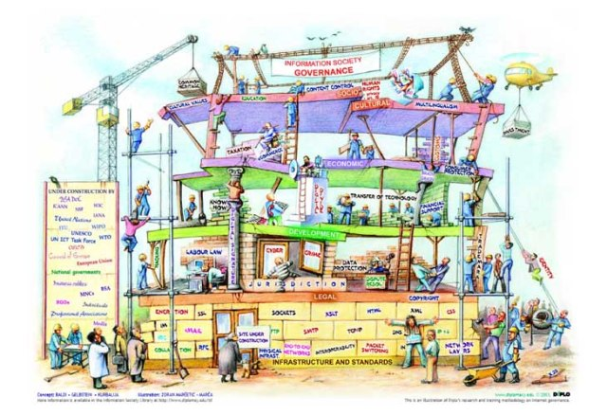
What do we want to
achieve?
Programs conceived from the onset (or that become) «policy and systems experimentation» at the scale of a representative geographic-administrative area
The purpose of experimentation can be
  Demonstrate that the local public sector can also be constructed or consolidated ‘from below’
  Demystify the usual allegations regarding weak local capacity;
  Create stronger local constituencies advocating for change;
  Inform the national debate and bargaining process on the future of the decentralization reform.
  pilot experiments can also play a key role in providing “an alternative model for policy dialogue
Notes:
3

Slide 4
Improved Local Development Management System
Comprehensive scope of local development
Improved systems of local development planning
Enhanced & diversified instruments of local development financing
Improved institutions & capacity for local development implementation
National Level Policies
Sub-National level institutions & capacity
Decentralization policy enhancing autonomy and accountability of LAs
National urban agenda supportive of LAs
National rural development policy supportive of LAs
Effective institutions of inter-governamental cooperation
Local leadership and administrative capacity development
Active citizenship and public private partnerships

Slide 5
Guiding principles
Explicit linkage to the development of national decentralization policies
Use, although it can be difficult in weak system and institutional environment, country systems to the extent feasible and to increasingly do so as systems and capacities are built and enhanced;
Interactions between program and policy making process in both directions;
Key operational device: constantly asses, learn, reflect, revise, and adapt to the issues and challenges that emerge
Notes:
5

Slide 6
The "financial facility": A crucial element of the experimentation
Classic doctrine: ‘resources follow functions’!!
Proposed approach: capacities will be the result of the action and not a precondition for receiving funds
The road to change is to directly inject resources into the budget of local authorities in order to allow them to learn by doing and gradually develop their capacity

Slide 7

The three benefit to be derived from directly funding local authorities.
  Funding as a means to build capacities:
  LG are in the driving seat
  They will face a steep learning curve in order to translate the financial support into service delivery
  Direct support to LAs allow to to test and (over time) institutionalize:
  Procedures for planning, budgeting and implementation of local public sector expenditures;
  The structures and procedures through which the state supports and supervises local authorities.
  Suitable rules and processes for central-to-local financial transfers
  The outcomes of the local test may in particular inspire the development of a more solid fiscal decentralisation system
  Strengthening the accountability of local authorities. By making local authorities responsible for their own public policy choices, a different kind of local political process can start to emerge, involving citizens (as stakeholders) and articulated around more transparent and accountable delivery of services.

Slide 8
Basic components of Politically smart, locally led support programs
The establishment of a financial facility as a pilot of a mechanism for regular, sustained, and transparent intergovernmental fiscal transfers to finance local authorities’ development (non- recurrent) expenditures;
Implementation devise: Try, learn, adjust
Establishment of Development of participatory procedures for local-level planning, programming, budgeting and implementation of local development investment and local public service delivery
Introduction of sustainable mechanism for technical/administrative support to local authorities and effective supervision of their performance, coupled with a capacity building programme
Accompany different categories of actors up the learning curve through tailor-made and on-the-job training
Support to policy dialogue on decentralization reforms, through the establishment of a specific learning platform (e.g. policy-oriented monitoring and evaluation mechanism) and other policy development support measures (e.g. technical studies, national task forces, drafting of policy papers….).

Slide 9
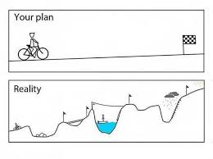
Formulation : Accepting that log-frames are not cast in stone!!!
  Less emphasis on the “perfect design” from the beginning and more on learning from implementation;
  Avoid too many details at formulation stage (it can create a Procrustean bed!);
Notes:
9

Slide 10

Implementation: Walker, there is no path, the path is made when walking
  Forget about elaborating a “detailed road map”!
  Live with failures is an integral part of implementation process
  Design needs to be permanently updated/fine-tuned from lessons during implementation!
    It is a question of dealing with problems as they arise, feeling your way, muddling through….
    Each step of reform is built from lessons learnt from the previous one
Notes:
10

Slide 11

Not shorcuts, not models
The human factor is crucial!!
Attitudinal change can be achieved if given time
It takes vision and willingness to experiment. It takes courage to learn from mistakes and courage to implement necessary and/or controversial changes as implementation moves ahead
Trade-off between exploration and experimentation on one hand and consolidation and predictability on the other.
The transition from an experimental mode to an institutional is a complex issue
What did work once does not necessarily work today
.
We need "artist" with special talents...rather than "technicians"
Notes:
11

Slide 12
Thank you!!

