Slide 1

PART VI
Strategic Partnerships between the EU and Associations of LAs operating at international and regional levels
Elena ASCIUTTI
European Commission, EuropeAid
Unit B2 “Civil Society and Local Authorities”
Brussels, 17/04/2015
Development and Cooperation

Slide 2
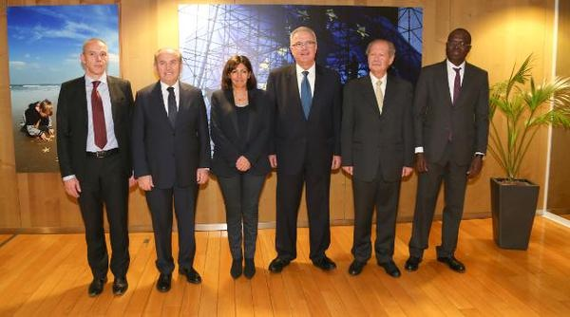

Slide 3


INDEX
I. From Policy to Action
II. Framing the Strategic Partnership
III. The state of art in testing FPAs
VI. What next: EU Delegations?

Slide 4
I. From Policy to Action
Development and Cooperation

Slide 5
Commission Communication “Empowering Local Authorities in partner countries for enhanced governance and more effective development outcomes”, 15 May 2013
One Overall Objective
Unlocking the development potential of Local Authorities, as policy and decision-makers, in favour of transparent and accountable policy-making and service delivery at the local level [...] via increased democratic participation, justice, human rights, active citizenship, participation of women and youth in the public sphere, and multi-level accountability
Two Pillars
  (i) Good governance at local level; (ii) Territorial Approach to Development
Four Priorities
Enhanced political, administrative and fiscal autonomy of Local Authorities through decentralisation reforms;
Strengthen LAs' institutional and operational capacity;
Smart solutions in front of rapid urbanisation;
Support ALAs at national, regional, international levels

Slide 6
Commission Communication “Empowering Local Authorities in partner countries for enhanced governance and more effective development outcomes”, 15 May 2013
Priority on Associations of Local Authorities
“Associations of Local Authorities can be instrumental in achieving good governance and development outcomes at local level. [...]
The EU should seek to involve ALAs in the programming of national and local priorities as well as in the implementation of related EU-funded programmes, particularly those related to decentralisation. Furthermore, the EU should facilitate the establishment of partnerships between Associations of Local Authorities in partner countries and the EU".

Slide 7
Endorsement through Conclusions of the Council of EU Member States “Local Authorities in development”, 22 July 2013
“The Council welcomes the Commission's Communication on 'Empowering local authorities in partner countries for enhanced governance and more effective development outcomes, which proposes a more strategic engagement with accountable, representative local authorities and associations of local authorities in partner countries […]
Local authorities and their associations are important actors for change in reducing poverty and in promoting human rights and democracy, good governance and sustainable development at local levels in partner countries. [...]
Local authorities and their associations can implement their institutional and operational responsibilities with a special focus on building accountability at the local level” [...]

Slide 8
¿¡Associations of Local Authorities (ALAs)?!
  Umbrella organisations based on membership and representativeness at different levels (sub-national, national, continental and international);
  Generally organised as an autonomous legal entity in accordance with the legislation in force in the country of registration;
  Composed of a representative body elected by its LA members (LA politicians) and a permanent secretariat (technicians)
  Functions: (i) advocacy of members' interests in front of central governments and other national stakeholders as well as in international fora; (ii) lobby for decentralisation processes; (iii) coordination among members; (iv) experience and knowledge sharing with the view to enhance Local Authorities’ capacities; (v) provision of services to members; (vi) quality supervision of LAs’ performance in matters of local policy-making processes and service delivery; (vii) contributing to the formulation of governance/development/urban planning at the local level

Slide 9
MIP of the EU Thematic Programme
“Civil Society Organisations and Local Authorities”
2014 - 2020
Priority 2 - Focus on the capacity of European and partner countries CSOs networks/platforms and Associations of LAs, to effectively contribute to policy dialogues on development related issues at regional, including EU, and global levels:
(i) Strengthening their representativeness and capacities to effectively link local realities to regional and global debates
(ii) Supporting their networking initiatives, which will allow them, to join forces and act as strategic partners for key policy makers"

Slide 10
Annual Action Plan 2014
of the TP “Civil Society Organisations and Local Authorities”
Overall objective - To contribute to the empowerment of ALAs at regional (including the EU) and global levels, to enable them to play their role in favor of enhanced governance and more effective development outcomes at the local level.
Specific objective - To strengthen the structure and capacities of regional and international ALAs, in order to reach a legitimate and effective coordination role, to provide their members with adequate as well as to concretely represent the needs of local communities in institutional dialogues.
Modality - Programme Approach, establishment of strategic partnerships between the EU and certain ALAs, on the basis of the mutual interest and shared general objectives, in pursuing and EU policy as defined by COM on LAs and related Council Conclusions.

Slide 11
II. Framing the Strategic Partnerships
Development and Cooperation

Slide 12
Legal Basis (i)
Article 121 (EU FR) and Article 178 (RAP)
Strategic Partnerships may be established and regulated through Framework Partnership Agreement (FPA) - as a long-term cooperation mechanism with strategic partners (not for profit “non-state actors”) - and are structured in two levels:
POLITICAL: FPA will define the respective roles and responsibilities of the Commission and its Partner in implementing the partnership.
OPERATIONAL: Specific Grant Agreement, whether one-off (action grant) or as a part of an approved annual work programme (operating grant), will define the operational terms of the strategic partnership, instrumental to achieve the common political priorities and objectives between the Partners.

Slide 13
Legal Basis (ii)
Article 121 (EU FR) and Article 178 (RAP)
[continued]
The duration of the partnership may not exceed four years, save in exceptional cases, justified in particular by the subject of the framework partnership. [...]
Principles of transparency or equal treatment of applicants.
Framework partnerships shall be treated as grants with regard to programming, ex ante publication and award.
Specific grants based on framework partnership agreements shall be awarded in accordance with the procedures laid down in those agreements, and in compliance with [Financial Regulation]” - direct award (monopoly/adm and technical competences/crisis situation) and calls for proposals; co-funding.

Slide 14
Documents of the Strategic Partnership (i)
Framework Partnership Agreement (FPA) - Political Part
Preamble: Creation of a strategic/long-term cooperation between the EU and strategic partners on the basis of the EU policy
Strategic Plan: common political priorities and objectives of the strategic partnership, on the basis of the Partner’s Multi-Annual Strategy
Annexes:
  General Conditions;
  Model specific grant agreement;
  Narrative report of political processes and operations (in case of grant);
  Financial report
No reference to funding as the FPA does not constitute an obligation for the EU to provide the Partner with funds

Slide 15
Documents of the Strategic Partnership (ii)
Specific Grant Agreement (SGA) - Operational Part
This document will define the operational terms of the strategic partnership, instrumental to achieve the common political priorities and objectives between the EU and ALA
Action grant or Operating Grant
Duration of SGA : Action grant up to 48 months; Operating Grant max 12 months (related to the annual work plan of the Partner)
SGA includes the following documents:
  Description of the action: objectives (linked to the FPA), activities, target groups/beneficiaries, location, results, indicators, sustainability, human resources, work plan;
  Logical Framework;
  Budget

Slide 16
STRUCTURE of FPA
Preamble
Strategic Plan
EU Policy
Mutual interests EU/ALAs
Specific Grant Agreement
Partner’s Multi-Annual Strategy
General Objective
Specific Objectives
Activities
Funding
Results
11

Slide 17
III. State of art in testing FPAs
Development and Cooperation

Slide 18
January 2015: DEVCO Commissioner Mimica
signing strategic partnerships with 5 ALAs

Slide 19
ALAs | FPA Vision for 2015-2020 | Type of grant | EU financial support for 2015-2017
UCLG | ALA’s structures Members capacity and know-how, especially in EU partner countries, to execute their legal and institutional mandate for transparent and accountable service delivery at the local level, through decentralised cooperation Participation in international decision-making processes | Direct Award: three Operating Grants (Financial years 2015/2016/2017) | EUR 4.350.00
AIMF | Contribuer à renforcer et structurer les Associations sous-régionales d’Autorités locales qui vont relayer les positions de leurs membres au niveau national et régional | Direct Award: an action grant covering 2015/2016/2017 | EUR 2.030.000
CLGF | To strengthen the structure and capacities of regional and global Associations of LAs; To contribute to the empowerment of CLGF’s members; To implementing the Sustainable Development Goals | Direct Award: an action grant covering 2015/2016/2017 | EUR 1.420.000
CEMR-PLATFORMA | To cooperate towards consolidating LAs n partner countries as accountable, autonomous and responsive sphere of government, instrumental to state building and rule of law + DEAR in Europe | Direct Award: an action grant covering 2015/2016/2017 | EUR 5.650.000
UCLG-A | Support to decentralization processes on the African continent; Enhancement of accountable and representative African local authorities through appropriate authority, responsibilities, capabilities and resources, facilitating citizen participation in local affairs | Direct Award: three Operating Grants (Financial years 2015/2016/2017) | EUR 6.900.000

Slide 20
4 MAIN EU POLICY PRIORITIES FOR EMPOWERING LAs/ALAs in EU PARTNER COUNTRIES
Important FOCUS AREAS
as per LA COM (2013) 280
Org/Inst/Ind/capacity development of LAs
Advocacy at international level (i.e. Post-2015 Agenda, UN-HABITAT III)
Support to decentralisation processes
Sustainable urbanisation
Support to ALAs
Decentralised Cooperation
UCLG
X
X
X
X
X
AIMF
X
X
X
X
X
CLGF
X
X
X
ALAs' proposals
CEMR/PLATFORMA
X
X
X
X
UCLG-Africa
X
X
X
X
X
X

Slide 21
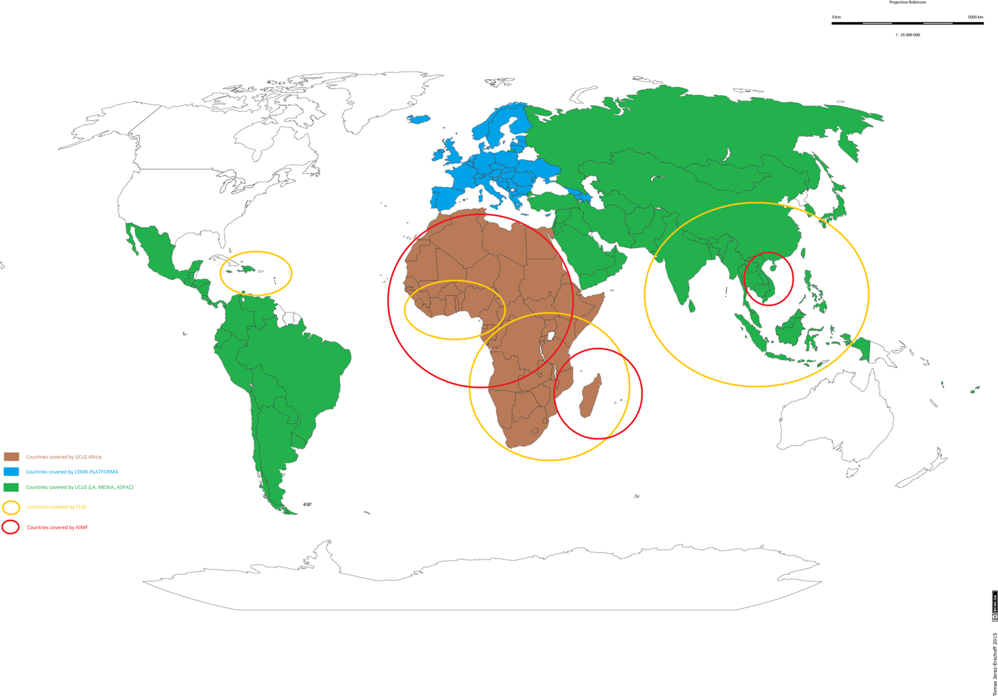

Slide 22
Monitoring and Evaluation Mechanism (MEM)
Taken in charge by the EC
Via independent evaluation experts team working with Reference Group (EC + ALAs)
Monitoring and Evaluation in the same mechanism
Focusing on political processes (FPA) and on operational results (SGA)
Evaluation before the end of the first grant (possibly at the third year of implementation) will determine the stipulation of the second grant of a duration of 3 years (period 2018-2020)

Slide 23
Added Value of FPA
Long-term vision and purposes based on mutual interests and objectives
Grounded on a single and comprehensive policy vision that could be implemented by several EU-funded actions through different cooperation instruments
Strengthening of existing and representative ALAs
Leadership and ownership by the beneficiary actors
Enhancement of their capacities to engage in policy dialogue and operations
More structured policy dialogue and cooperation with the EU
Potential for simplified procedures of reporting

Slide 24
VI. What next: EU Delegations?
Development and Cooperation

Slide 25
¿Questions?
Any added value of FPAs for policy dialogue and operations at country level?
Possibility to use FPA in supporting National ALAs?
Usual suspects vs long-term partners?
Could FPA enhance complementarity between reform processes started with central authorities though a more strategic and long-term involvement of LAs via their Associations?
NB: MAAP “CSO-LA” 2015-2017 foresees the possibility to use FPA at country level

Slide 26
MANY THANKS!
Development and Cooperation

