Slide 1



Advanced CSIRT Management Training
&
The World Wide CSIRT System
Notes:
Courtesy note: this slideset was developed by Don Stikvoort, with additions by Klaid Mägi.
Trainer: adopt the course type and the title to what suits your needs. You may also need to hide some slides depending on your audience, and the time you have available.
Trainer: fill in trainer names and location and date

Slide 2

Who am I : Trainer_name
Insert photo of trainer
Concise_bio_of_trainer
…
…
“If you think you’re too small to make a difference,
try sleeping in a closed room with a mosquito”.
Notes:
Trainer: tailor this slide. If you have co-trainers, make more of these slides. Keep it short and interesting, the goal is not to overwhelm your students, but to make the curious and engaged. You can replace the quote at the bottom of course – the one left here is an old African saying, often used by the Dalai Lama.

Slide 3
Rules of engagement
Share SHARE SHARE PLEASE
Default is TLP:AMBER : only share with colleagues on a need-to-know basis
Feel free to also share TLP:RED : for our eyes and ears only

Slide 4
TLP – Traffic Light Protocol
TLP:RED For the eyes and ears of individual recipients only
TLP:AMBER Recipients can only spread this on a need-to-know basis within their organization and its clients
TLP:AMBER+STRICT Within organisation ONLY
TLP:GREEN Recipients can spread this within their community
TLP:CLEAR Recipients can spread this to the world
Full standard: see https://www.first.org/tlp/

Slide 5
Schedule, modelled after SIM3
Day 1
Day 2
Day 3
Organisation
Human factor – the crucial one
Technology / tools
Policies & processes

Slide 6
Foundations
The higher the building, the deeper the foundation

Slide 7
Exercise – role of CSIRTs
Hint: read CSIRT below as CSIRT / CERT / PSIRT / NCSC / CDC / SOC ….
Let’s get into groups of 4-6 and discuss in 25 minutes :
  What’s the role of the CSIRT community in your country ?
  What’s the role of the national CSIRT in that community ?
  How do the members of this community make sure that important threat intel and incident info are shared in the community
  How do you as community reach out to CSIRTs in other countries, worldwide ?

Slide 8
The crucial role of CSIRTs
Think back of discussion just now …
The one very crucial bit is about information sharing and how that works in real life and how it’s the anima aeterna, the breath of life of the CSIRT community in every country and worldwide
So what is your conclusion ? What do you need to do inside your country ? Who to engage ? Who to convince ?
And what should your mandate be ? Can you turn that into a mission statement ?
Notes:
Metaphors:
Cisco and Juniper when Juniper joined FIRST
Banks in NL
EE 2007
Klaid has example about when he and colleagues of other telco companies in EE decided to share some important cyber sec info and almost got fired

Slide 9
Exercise – Babylonic name confusion
CSIRT
CERT
PSIRT
NCSC
CDC
SOC
ISAC
Tell me how these terms are different – or not ?

Slide 10
Solution of the Babylon confusion (i)
CERT : Computer Emergency Response Team
  Origin 1988, later trademarked: CERT Coordination Center (CERT/CC)
  They used to have a “permission to use the name CERT” system (that many teams use as PR), but are abandoning this – the most recent I got from the team was this quote: “Contact CERT/CC Security Operations (security-operations@cert.org) for CERT partnership details.”
CSIRT : Computer Security Incident Response Team
  Origin 1998 : https://resources.sei.cmu.edu/library/asset-view.cfm?assetid=6305
  Free to use !
CERT = IHT = SIRT = CIRT = IHC = CSIRT

Slide 11
Solution of the Babylon confusion (ii)
SOC : focuses more on internal security log/data handling and the reaction to that
CDC: often combines CSIRT and SOC (but not always …)
nCSIRT : national CSIRT
NCSC: nCSIRT with added spice – no fundamental difference, but usually an NCSC ties directly into national crisis management (= escalation, not normal operation)
PSIRT : Product Security Incident Response Team
  Where vendors work on the vulnerabilities in their software/firmware
  Fundamental in the CSIRT community right from day 1
ISAC : a CSIRT without incident response ;) Focuses on information sharing.

Slide 12
Solution of the Babylon confusion (iii)
What’s in a name –
YOU
MUST have a
CSIRT capability !
( and if you can add SOC spice, that’s a good thing ! )

Slide 13
Trust
Oxford dictionary :
UK (US): Firm belief in the reliability, truth, or ability (or strength) of someone or something
Webster :
1a : Assured reliance on the character, ability, strength, or truth of someone or something
1b : One in which confidence is placed
Duden:
Vertrauen = Festes Überzeugtsein von der Verlässlichkeit, Zuverlässigkeit einer Person, Sache
Larousse:
Confiance = Sentiment de quelqu'un qui se fie entièrement à quelqu'un d'autre, à quelque chose
Rae.es:
Confianza = Esperanza firme que se tiene de alguien o algo
Sapere.it:
Fiducia = Sentimento di sicurezza che deriva dal confidare in qualcuno o in qualcosa

Slide 14
Relax for a moment … history class ahead !
196X: ARPANET
1988: Morris Worm led to creation of CERT et al.
1984: creation of global DNS
2001: TF-CSIRT started & Budapest Convention signed
2003: World Summit on the Information Society
1998: CSIRT Handbook & EuroCERT … …
1989: FIRST founded
1993: Start of collaboration of teams in Europe
1996: Dotcom boom & Aleph1: “Smashing the Stack for Fun and Profit”
2000: The Millennium bug & gov teams start joining community
2000: Burst of Dot-Com Bubble
2012: WCIT-12 in Dubai (governance)
2015: GFCE
2007: Cyber attack on Estonia
2005: IGF
2017: 1st IoT botnets
>2021: AI plays along
2010: Stuxnet
2011: Diginotar
Timeline courtesy FIRST

Slide 15
” The CSIRT System “
Worldwide
mesh of teams
at all levels
that works …
… fascinatingly well
Notes:
UNTIL HERE TOOK FROM 0930-1230 – CONTINUED HERE AT 1330

Slide 16
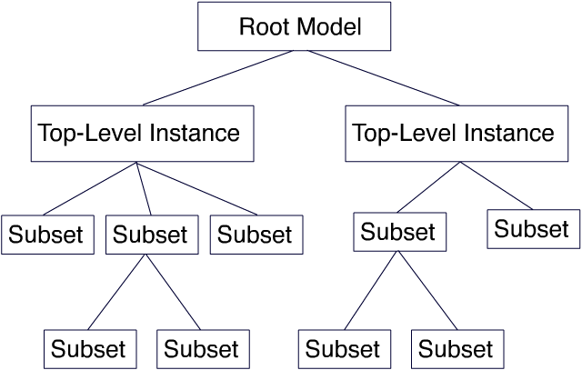
CSIRT System philosophy ? Hierarchy ? Mesh ?

Slide 17
CSIRT System philosophy is is a mix of non-hierarchical trust relationships and some mostly national structure

Slide 18
Anecdote Trust
Photo by Luke Helgeson on Unsplash

Slide 19

Anecdote Trusted Organisation
Automatically
TRUST

Slide 20
Anecdote challenges within “boundaries”
Boundaries can be of constituency, or of country, …
Stuff will happen
  Very best solution – solve stuff within boundaries
  2nd best solution – solve stuff within boundaries
Basis of solution = trust
Basis of trust = personal relationships
Escalations need to be possible but trust comes first

Slide 21
Anecdote no-person-name e-mail in CSIRT community
… …
… … … ➔ valid content
… …
Kind Regards
CERT XXX ➔ valid team … but no person name
And granted, there is a risk in pgp keyservers, linkedIn etcetera – something to
pay attention to but not at the expense of trust building

Slide 22
Exercise – build trust
In groups discuss in 20 minutes :
  How to build trust in your own CSIRT’s constituency
  How to build trust inside your country’s CSIRT community
  How to build trust towards CSIRTs in other countries, in the region and worldwide

Slide 23

Trust between teams is based on faces and names not on official paperwork
[ Your trainers ]

Slide 24
We must explain “trust” better
Trust comes by foot but leaves on horseback.
We experts know this but often take it for granted.
We – and you – need to explain this more !
Photo by Joshua Hoehne on Unsplash

Slide 25
How to build TRUST (i)
Reach out to your constituency – make sure there are faces with names
  Takes at least a year
Reach out inside your country – make sure there are faces with names
  nCSIRT can play a connecting and inspiring role: cooperate, facilitate
  Pushing or pressing people is bad for trust
  Legislation should inspire and support
Reach out regionally and worldwide – make sure there are faces with names
  AfricaCERT
  TrustBroker Africa
  GFCE
  FIRST
  Etcetera

Slide 26
How to build TRUST (ii)
Meet colleagues
Eat, drink with people
  Beer drinking model of trust
  Papaya juice or madeira are fine too
Engage on projects with colleagues
  Volunteering helps a lot
  Managers – this helps your team too, allow your team members to reach out, it pays back with interest
Go to meetings/conferences and reach out
Photo by Shane Rounce on Unsplash
Notes:
The “beer drinking model of trust” is an old insider joke in the CSIRT community. It’s however serious enough – the trust building between people is significantly helped by eating and drinking together, this is just who we humans are. Sitting in a meeting room with 50 people and listening to a speaker does comparatively not so much in building trust – unless the speaker or trainer engages the attendants and gets them to do things together, like exercises etc.

Slide 27
Yes, the corona situation was … annoying
Two learnings at least
  We can do much more online than we thought we could
  Some things just don’t work online, we are humans, we need human contact
Maintaining trust online is ok, building new trust is _ very difficult _
We need to meet up in person _ often enough _
Building and maintaining trust remains as vital as it always
was in our community and is based on faces and names

Slide 28
CSIRT – where to start ?
Once you have a clue about incident response and “CSIRT”, and want to push forward, then :
Adopt SIM3 – this CSIRT maturity model gives you 95% of the things you need to pay attention when starting, evaluating and maturing your CSIRT
  Write a Charter document for your team covering at least the Organisational parameters
  Write a Human Policy document for your team covering the Human parameters
  Fill out rfc2350
  Design and test an incident management process
Adopt the FIRST CSIRT Services Framework – this helps you to pick the right services for your CSIRT to offer
Support TLP – the Traffic Light Protocol
Take it from there

Slide 29
SIM3
SIM3 = Security Incident Management Maturity Model
For (self) assessment, membership criteria & certification purposes
45 parameters in 4 categories
O – Organisation : 11
H – Human Aspects : 7
T – Tools : 10
P – Processes : 17
All parameters measure on an integer scale from 0 to 4
SIM3 is a neutral model that does
not tell you how mature you should be
Organisation
Human
Tools
Processes

Slide 30
SIM3 scores
Each parameter can score :
0 = not available / undefined / unaware
1 = implicit : “between the ears only”
2 = written down but not formalised
3 = like 2 but approved by CSIRT head : “rubberstamped” (or published)
4 = like 3 but actively assessed or audited on authority of governance levels above the CSIRT management on a regular basis (with a feedback loop in place)

Slide 31
SIM3 how-to-use for all types of CSIRTs
SIM3 standard and further reading : https://opencsirt.org/csirt-maturity/sim3-and-references/
Jump right into the online SIM3 tool : https://sim3-check.opencsirt.org/
See where you are as a CSIRT maturity wise, and where the gaps are
Based on that and on your ambitions (assigned by higher governance) make an action plan to improve maturity. If you are an n/g CSIRT: use the GCMF levels Basic, Intermediate and Advanced as part of a more-year planning!
Regularly go back to step 2 : improve maturity step-by-step

Slide 32
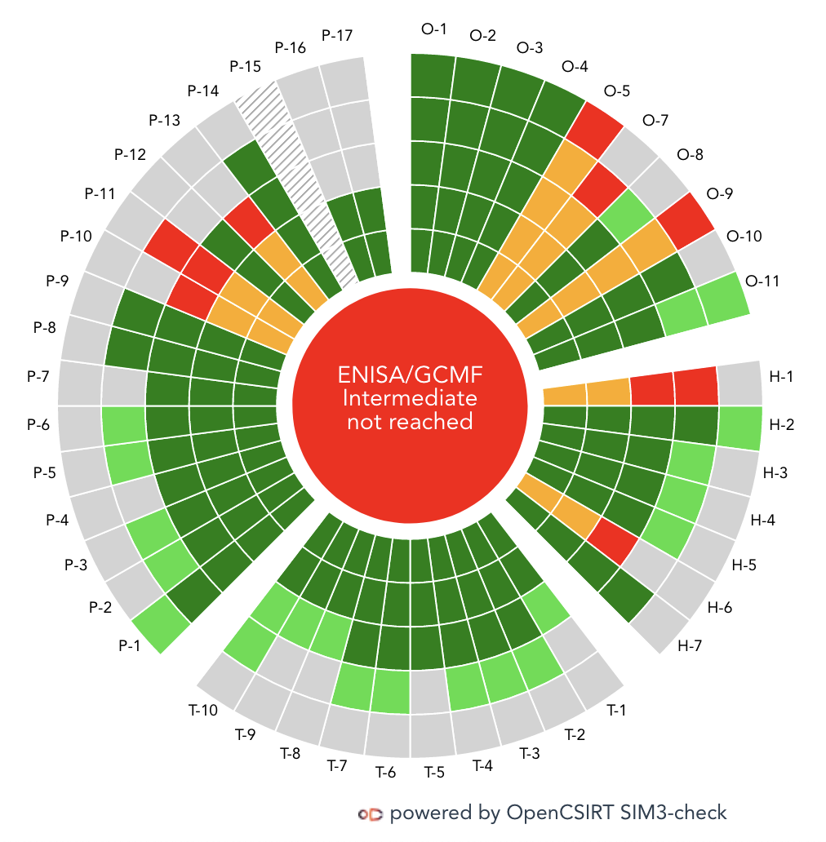
SIM3 online tool
https://sim3-check.opencsirt.org/

Slide 33
Organisation
Where to begin ? How to engage the management ? How to organise your team ?

Slide 34
Mandate : SIM3 O-1
Remember, we discussed your “role” ?
Mandate must come from highest governance, at the end of the day
Could be in law for an nCSIRT
Must be specific enough or it ain’t no use
– test: can you directly translate it into a clear Mission Statement ?

Slide 35
Constituency : SIM3 O-2
= who you target your IM services at, your target group
can be your own organisation
or a group of organisations
or a whole network, or the country
or for a commercial team: paying customers)
Constituency management
Presentation of Constituency models and (Estonian) practice
To understand your current model that you have at the moment
Problems you are facing, changes needed (if any)
Steps forward to reach desired level

Slide 36
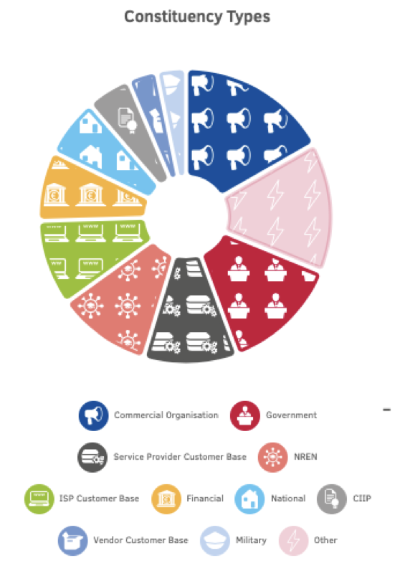
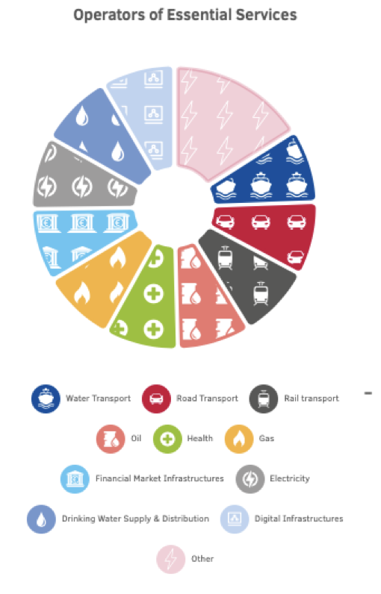
Constituency types
Source: https://www.itu.int/en/ITU-D/Cybersecurity/Documents/Session%202%20-1115-1230-v09-10-2016.pdf

Slide 37
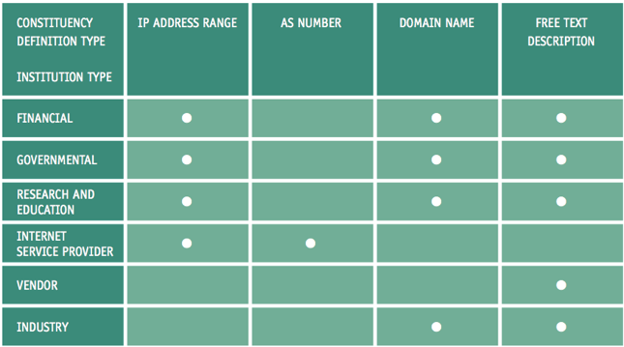
Constituency definition

Slide 38
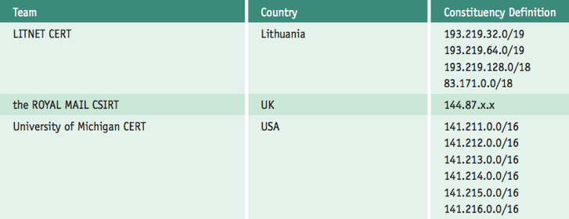
Constituency definition by IP address

Slide 39
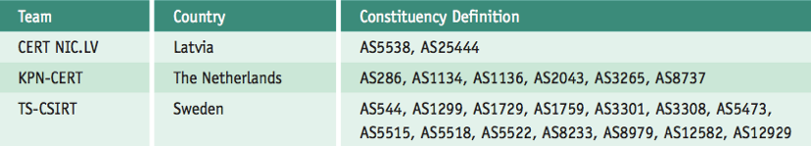
Constituency definition by AS number(s)

Slide 40
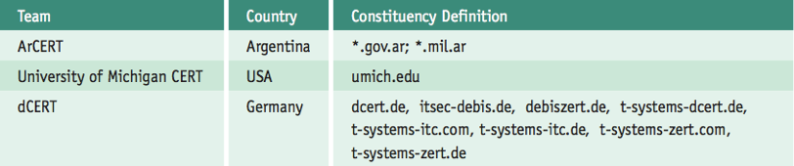
Constituency definition by domain name(s)

Slide 41
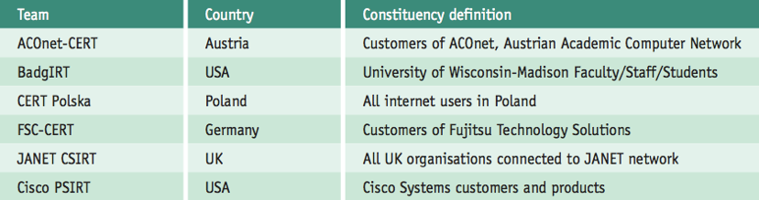
Constituency definition by free text

Slide 42
Authority : SIM3 O-3
= what your team is allowed to do to fulfil its mandate for your constituency
Your “power”
Must come from the highest governance levels
Three main levels of authority towards your constituency:
Full authority: the CSIRT can make decisions, without higher management approval, to directly respond to incidents in the constituency and take appropriate recovery actions.
Shared authority: the CSIRT participates in the decision process regarding incident response, in the constituency but can only influence, not decide by itself.
No authority: The CSIRT cannot decide or take actions on its own for the constituency. The CSIRT can only act as an advisor to the constituents, providing suggestions, mitigation strategies, or recommendations.

Slide 43
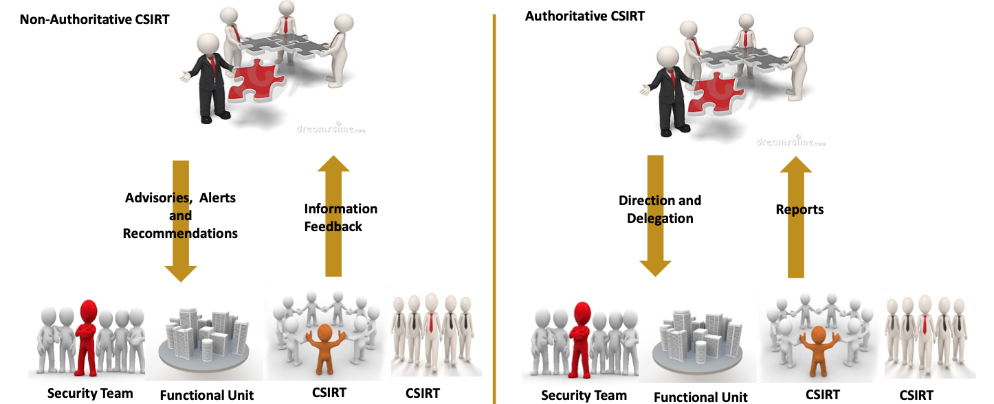
Authority diagram
Source: https://www.itu.int/en/ITU-D/Cybersecurity/Documents/Session%202%20-1115-1230-v09-10-2016.pdf

Slide 44
Responsibility : SIM3 O-4
= what your team is expected to do to fulfil its mandate for your constituency
You always have more responsibility than what you have authority for: gap should no be too big
Responsibility is what you are expected to do to :
  Prepare for incidents and threats
  Prevent incidents and disarm threats
  Detect incidents and observe threats
  Respond to incidents and mitigate threats
  Lessons learnt : feeds back to all previous steps
A more specific, structured description of your responsibility is found in the Service description (O-5)

Slide 45
Group Exercise: Mandate, Constituency, Authority and Responsibility
How is your current constituency described ?
Where do your mandate, authority and responsibility come from ? Where are they written down – and are they approved ?
Take 20-25 min to prepare
Present per team/agency

Slide 46
Services : SIM3 O-5 & Service levels : SIM3 O-7
= the specific services that your team delivers to your constituency
Based on your mandate and responsibility
SIM3 O-5 only asks to describe these, and to use rfc-2350 to make that public
But you need a much more detailed service description for yourself and your constituency: you use the FIRST CSIRT Services Framework (v2.1) as a basis for that :
  https://www.first.org/standards/frameworks/csirts/csirt_services_framework_v2.1
  SIM3 and the services framework are “orthogonal”: SIM3 describes the whole range of 45 maturity parameters for a CSIRT – the services framework is an in depth survey of O-5 (and O-7)
  There is a separate FIRST PSIRT Services Framework for PSIRTs (product security teams)
You must wonder for each service you offer, what service levels it needs – your constituency must know those
  Your service window (= opening times) and human reaction time to incidents are classics
  Service levels should depend on the type of incident and the (potential) impact (SIM3 O-8)

Slide 47
FIRST CSIRT Services Framework – overview
5 Service areas:
Security Event Management
Incident Management
Vulnerability Management
Situational Awareness
Knowledge Transfer
Every service area has several services defined
Every service has several functions defined
Use this framework as a restaurant menu – pick the service-area:service:function menu items that you must do according to your team’s mandate, and that you are capable of doing with the people and resources you have available at the time

Slide 48
Service area : Security Event Management
Services (and functions) :
Monitoring and detection
  Log and sensor management
  Detection use case management
  Contextual data management
Event analysis
  Correlation
  Qualification
The SOC service area ! Not all CSIRTs do this … but it’s essential for internal CSIRTs (whether they do it themselves, or done by a separate SOC, or by the IT department)

Slide 49
Service area : Incident Management
Services (functions left out) :
Information security incident report acceptance … includes triage
Information security incidents analysis
Artefact and forensic evidence analysis … this is definitely advanced and challenging
Mitigation and recovery … this is essential for internal CSIRTs, not so much for coordinating teams
Information security incident coordination … includes sharing inside and outside constituency
Crisis management support … essential once crisis management (e.g. national) is in place

Slide 50
Service area : Vulnerability Management
Services (functions left out) :
Vulnerability discovery / research
Vulnerability report intake … strongly recommended to have some way of dealing with this !
Vulnerability analysis
Vulnerability coordination
Vulnerability disclosure
Vulnerability response
This is a more advanced topic that requires enough people and expertise to offer it as services. Few teams go deep here. Yet we do strongly recommend to do vulnerability report intake as in slide responsible disclosure (explained 3 slides later!)
Notes:
KLAID SLIDES

Slide 51
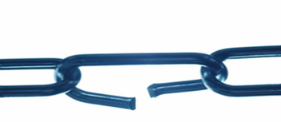
Clarification Vulnerability Management
What is a vulnerability, outside the realm of IT/cyber ?
It’s a weak spot in defenses, that could be breached.
If e.g. a burglar can bypass the security guard at the front door and get into the building via the back door, then that possibility is definitely a vulnerability.
If he actually does that – it is a burglary, a crime.
And by the way: if intruders have physical access to your server(s) - they are not yours anymore!

Slide 52
Example Vulnerability Management : discovery & report intake
Strongly recommended: apply Responsible Disclosure :
= Allow and encourage constituents or “volunteers” to report vulnerabilities or other problems
Rewards: honour (nice words!), t-shirts “I helped the government”, hall-of-fame, … it works !
Commercial companies implement bug bounty programs, but: expensive, wrong incentive ?
Of course if you do responsible disclosure, you then also need some way of dealing with those vulnerabilities, even if only to report them to IT vendors / PSIRTs or specialised, bigger CSIRTs - and await their feedback.

Slide 53
Example Vulnerability Management : vulnerability disclosure
Disclosure is when a vendor/PSIRT does not deliver on their promises to fix it – and you publish the vulnerability to warn everyone.
Teams who do VM sometimes issue a deadline for the vendor/PSIRT to fix the problem, or else they will disclose
Important to have a realistic deadline ! Not every problem is simple to solve.
Advantage: stimulates and motivates vendors/PSIRTs to create and publish fixes.
Disadvantage: increases risk of exploitation and damage.

Slide 54
Example Vulnerability Management : vulnerability response
= what do about these vulnerabilities, especially installing remedies, patches, workarounds
Create an organization-specific remediation database !
Database should contain instructions on removing vulnerabilities by installing patches, performing workarounds, etc.
Keep a copy of each patch
  Just in case of no Internet, or the vendor’s site being compromised
Test the remedies :
  Check authenticity of vendor
  Checksums – MD5, SHA1, SHA256
  Scan patches before installation for viruses
  Check configuration changes on non-production systems
  Ensure patch installation sequence is correct

Slide 55
Service area : Situational Awareness
Services (functions partially left out) :
Data acquisition … including open source threat intel, information gathering & technology watch
  Policy aggregation, distillation, and guidance
  Asset mappings of assets to functions, roles, actions, and key risks
  Collection
  Data processing and preparation
Analysis and synthesis
Communication ➔ information sharing ➔ next slide
Without eyes and ears a CSIRT is of no use !

Slide 56
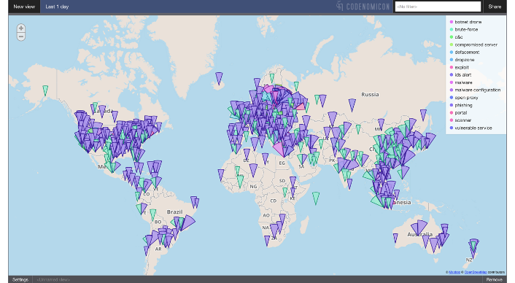
Example Situational Awareness : information sharing (i)

Slide 57
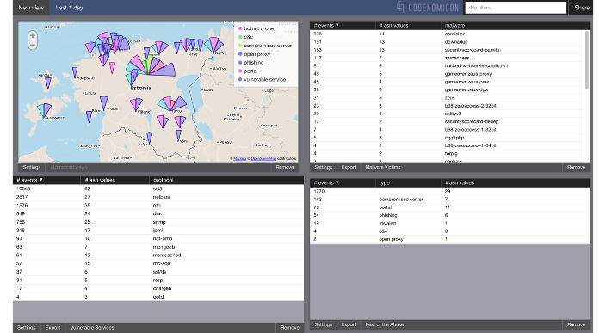
Example Situational Awareness : information sharing (ii)

Slide 58
Service area : Knowledge Transfer
Services (functions left out) :
Awareness building … an absolute must for all CSIRTs. Examples:
  Press releases - regular and ad-hoc (event initiated)
  Campaigns – will depend on target group
  Trainings – for IT professionals, sure, but maybe also for ??
  Seminars – target based
Training and education … maybe not essential, but highly recommended as part of constituency outreach !
Exercises … would you trust a fire brigade that never exercises ? ➔ next slide
Technical and policy advisory
Spreading the word is part of the “must do” of all CSIRTs !
Photo by Seema Miah on Unsplash

Slide 59
Example Knowledge Transfer : Exercises
Functions:
  Requirements analysis
  Format and environment development
  Scenario development
  Exercises execution
  Exercise outcome review
Cyber security exercises and fire drills are of the greatest importance for any CSIRT and their constituency and beyond
Photo by Mauro Sbicego on Unsplash

Slide 60
Services can also differ for different constituency types
Example:
Constituency type 1 (Gov, Ministries) – services offered IH, F, T, C
(IH, F:forensics, T:trainings, C:conference)
Constituency type 2 (CIIP) – services offered ABD
Constituency type 3 (SME) – services offered DZX
etcetera

Slide 61
Incident classification : SIM3 O-8
= the taxonomy of incidents that you use
At least have a technical incident type – e.g. ENISA classification
Best also have down-to-earth levels of impact:
  Simplest: default and high
  Or maybe: low, standard and high
  Perhaps also allow for crisis

Slide 62
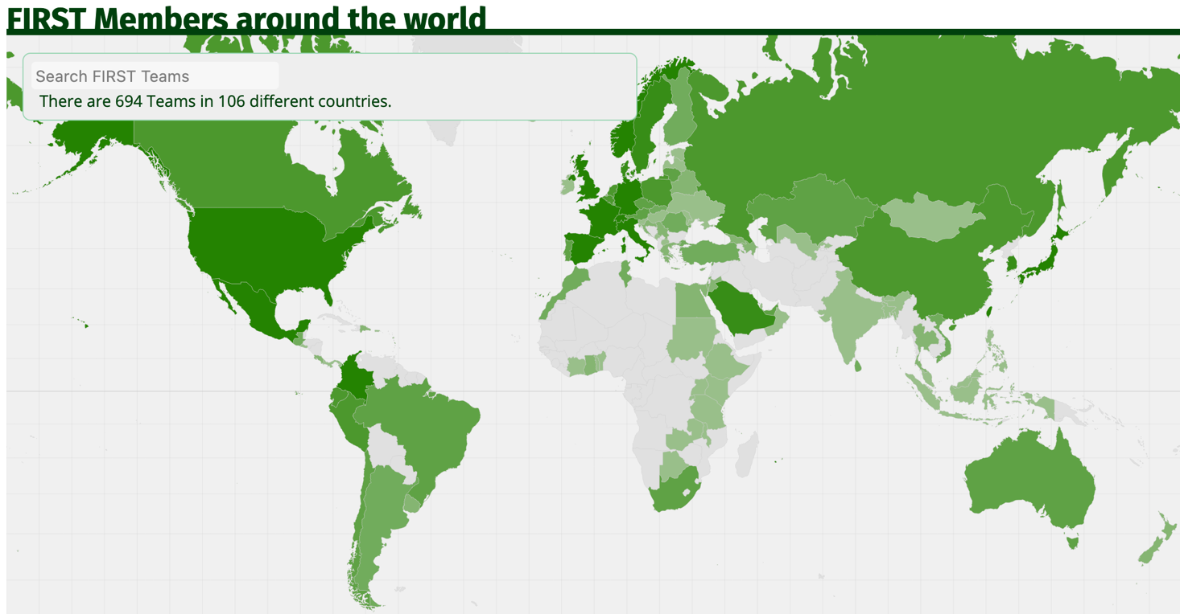
Participation in CSIRT Systems : SIM3 O-9
Collaboration and cooperation inside your country and beyond with other IM teams.
Example:

Slide 63
Cooperation – exercise
Let’s get into groups of 4-6 and discuss in 30-40 minutes :
  What is critical infrastructure in your country ? What are the key players there in regard cyber security ? Do they have CSIRTs or similar already ?
  Did you include the CII (critical information infrastructure) in this ? You should !
  What about less critical sectors like SMEs ? (small and medium size companies)
  Do you know the key CSIRT(-like) players, not just from government, but also ISPs, critical infrastructures, etc. ?
  How to cooperate in the region ? Worldwide ?
  What about IT vendors ? Do they play a role for you ?
  Could you actually make a drawing of a possible cooperation model for your country, naming the (organisation) names ?
  How to build trust in your country … and towards teams abroad ?

Slide 64
Cooperation = win/win
Organisational cooperation
National cooperation
Cooperation with law enforcement
Cooperation with c-level, politics, cyber diplomats etc.
Sectorial cooperation – focus on CI sectors first (but do not forget SMEs and citizens)
Regional cooperation – focus on the various continents and their cooperation bodies
Cooperation with IT vendors & PSIRTs
Global cooperation (FIRST, GFCE, ITU, UN, etc.)

Slide 65
Organisational Framework : SIM3 O-10
= Team Charter
Write up of at least O-1 to O-11
Add some human aspects OR refer to “Human Policy”
P-1 to P-3: the “escalation” parameters
P-8: the audit process
P-13: the constituency outreach process
P-14 & P-15: the reporting parameters

Slide 66
Public Media Policy (O-6) & Security Policy (O-11)
Fundamental policies, therefore in SIM3 under “O” not under “P”
Public media policy: identifies the various public media that are used, and how to deal with each of those.
Security policy:
Your team always has special needs: you need your own policy
Includes business continuity (BCM) !

Slide 67
How to make it all work together ?
Discussion : how does a CSIRT function in real life ?
Decide on a proper example together, like a company internal team, or an nCSIRT, or … do realise then that yes, different types of teams have some differences – but in truth, there are more similarities between the various teams than differences. That is also the reason why SIM3 can work on all sorts of CSIRTs, and the same goes for the FIRST CSIRT Services Framework.

Slide 68
Continue to Advanced CSIRT Management presentation

