Slide 1
Advanced CSIRT Management 2 Human factor – the crucial one
The heart and soul of the CSIRT house
Notes:
KLAID SLIDES

Slide 2
Human factor – the crucial one
CSIRT work is many faceted and challenging.
Required are :
Communication skills
Technical skills and experience
Trustworthiness & reliability
Trust building skills ➔ build human networks
Common sense
Creativity, thinking outside the box
At times: stamina
Photo by roya ann miller on Unsplash
Notes:
Trainer: shortly explain all 6, and the order: of course you could change the order slightly, it’s not meant to be cut in stone. Creativity and trust building are probably the factors that make the CSIRT craft so fascinating and are certainly important reason that people keep coming back to the CSIRT community.
Repeat that “trust” is based on interpersonal relationships – NOT on organisational bonds, or on website certificates, etc

Slide 3
Exercise (20 minutes)
Split into groups of 4-6 :
One member make some notes for wrap-up
Choose ONE (1) of the CSIRTs (or SOC, sec.team) in your group and discuss (= exercise purpose)
Staffing & training :
What challenges do you face in meeting your requirements for staffing ?
Do you have relevant role descriptions and did you write down the skills needed for those roles ?
Can you arrange trainings for your staff, i.e do you have the budget ?
Escalations :
Can you effectively escalate (also outside business hours) to a) the highest governance levels, b) the press handlers, c) your corporate/organisational lawyer(s) ?
Plenary wrap-up (discuss only highlights of group discussions)
Notes:
Trainer: the plenary wrap-up is not meant to get all the answers from each group – this takes too long and is boring. If there is time, ask each group to highlight ONE (at most 2) interesting aspect of their discussion. Every now and then you will have to – nicely and politely – stop students who still want to tell everything they have discussed in their tracks and get them to focus on the highlights. If there is not enough time select the questions that they need to cover, e.g. leave out the 4th one.
{ authors to-do : make a slide about the escalations which ties into SIM3 P1 – P3 – unless covered by new operational module }

Slide 4
Code of Conduct: SIM3 H-1
The human factor is the prime factor in the success of any CSIRT – Without a good, trustworthy team … nothing goes
Trust is one of the key factors in successful CSIRT cooperation
Your CSIRT takes at least a year to build trust and can lose it overnight
Trust is built on personal relationships, not on organizational ones
Avoid hiring ex(?)-crackers
Use a Code-of-Conduct and discuss it with your team each year : e.g. https://www.trusted-introducer.org/TI-CCoP.pdf or https://ethicsfirst.org/
TLP - Traffic Light Protocol : active knowledge and use required : https://www.first.org/tlp/
[ Quis custodiet ipsos custodes? - Who watches the watchers? – applies to CSIRTs too ]
Notes:
Trainer : “who polices the police” (we are talking about CSIRTs here, NOT the real police! Hence the quotes) was inserted because of a recent situation (in Europe) where an investigation by a CSIRT of a case involving sexual harassment was stopped – as it turned out possibly due to a conflict of interests. Who do you turn to in such a case? Undefined. This is unmapped territory. Worthwhile discussing with students if there is enough time.

Slide 5
Staff Resilience: SIM3 H-2
Need enough team members to cover for holidays/illness
SIM3 says minimum 3 (can also be part-timers)
Burnt-out team members are not effective
Always have a plan B … and then some more resilience !
And what about agility/flexibility ?
(And talking about elephants in the SIM3 room – what about team performance ?)
CSIRT work can be challenging – what to compensate
Offer appropriate rewards
Keep work varied
Budget for trainings
Let staff attend events
Swapping team members between befriended teams ?
Notes:
Trainer : SIM3 calls this indeed “personal resilience” but that’s simply a language error – should be ”personnel” or “staff” resilience. This will be corrected in the next SIM3 version (says the OCF who governs and maintains SIM3). Also trainer, DISCUSS the plan B with the students! Don’t spell it for them, let them think about it out loud in the group. If there is enough time, can do as short 7 min exercise in groups, then wrap-up plenary.

Slide 6
Skillset Description: SIM3 H-3
What skillsets are needed?
General: common sense, communication, diplomatic, quick learner, stress resistant, team player, integrity, owns up to mistakes, problem solving, time management, …
Technical: to match what the CSIRT offers
Skillset description for each role (job profile)
(Senior) incident handler, team manager, …
Bigger teams can have more roles like triage officer, researcher, forensics expert, etc.
Use this new resource : https://www.first.org/standards/frameworks/csirts/csirt_roles_competences
Need other resources ?
Specialist skills (e.g. forensics), legal, crisis management, …
Arrange before an emergency hits
Notes:
Trainer : skills depend on your site infrastructure and you may be able to recruit from existing support staff. Plan for training and staff turnover.
Checking the history of recruits can be difficult and varies from country to country – often you have to just try them and see. Have defined procedures for joiners and leavers to regulate system access, if possible have them formally agree to workplace network monitoring.
It makes sense to re-use any existing teams if possible, indeed CSIRT teams will benefit from close working with network and IT teams.

Slide 7
Typical Skillset for (Senior) Incident Handler (non detailed example)
Incident Handler:
Investigate problem, analyse logs
Evaluate impact to other systems
Develop recovery plan
Communicate findings and remediation plan to incident handler and other experts involved
Perform needed actions on system to restore service operation
Document findings, recovery steps and if-applicable recommendations for improvement
Etcetera
Senior Incident Handler:
The same as above at a more senior level, including helicopter view
Can communicate effectively with management and higher governance

Slide 8
Typical Skillset for Team Manager (non detailed example)
Excellent oral and written communication skills
Good teambuilder & leadership qualities
Assist with and ultimately be responsible for the process design
Review opportunities for process enhancements and for improving the efficiency thereof
Ensure that all staff know their role in the IM process and understand how it works overall
Ensure the Incident Management procedure and process is followed and used correctly
Provide higher governance with strategic decision making information related to incidents
Ensure that the Incident Management process operates effectively and efficiently
Make sure that IM works effective, within the set service levels or better
Responsible for reporting both to higher governance, as well as to the constituency
Escalate an incident when necessary

Slide 9
Staff Development: SIM3 H-4
Personal development ➔ team development
Personal development plan
Skills development: include soft skills
Budget & timeline
Feedback : commonly done by manager but consider having an experienced team member do feedback instead (less pressure, more coaching style)
Photo by Martine Jacobsen on Unsplash
Staff Development = SIM3 parameter H-4
Technical training = SIM3 parameter H-5
Soft skills training = SIM3 parameter H-6

Slide 10
H-4
H-5
H-6
Staff Development
Technical Training
Cyber4Dev
Soft Skills Training
Communication & presentation skills
Teamplay, time management, etc.
Speaking to press
Working with police
FIRST
AfricaCERT
AU and others
Internal Tools
Team Building
Local Processes

Slide 11
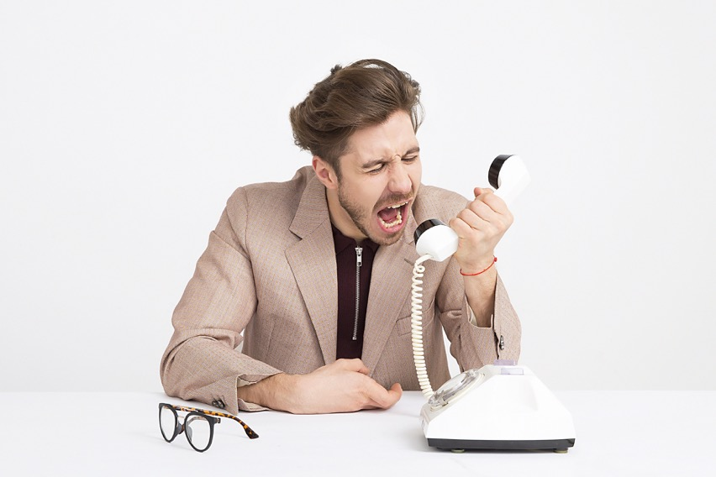
Human communication
THE MEANING OF COMMUNICATION IS
THE RESPONSE YOU GET (= the result)
Photo by Icons8 team on Unsplash
Notes:
Trainer : this “writing on the wall” is actually one of the presuppositions of NLP – NLP is a useful set of tools that can help people communicate better. There are more approaches that work. It’s not about NLP or any approach here – but this presupposition stands out in all approaches.

Slide 12
Common sense is vital in incident management
90% of your time can easily be wasted on 10% of the question. Prioritise, discuss with colleagues, focus on the desired outcome and damage control – incident handling is not scientific research.
“Habe Mut, dich deines eigenen Verstandes zu bedienen.” – have the courage to use your own mind ! (Immanuel Kant, 1724-1804)
Read some blog(s) and articles, e.g. Bruce Schneier, Brian Krebs et al.
Take nothing for granted, not even Immanuel Kant or your trainers here – nor your colleague who has done this work for 15 years

Slide 13
External Networking : SIM3 H-7
Work with your nCSIRT & other key players in the country
Build a “CSIRTs Network” in your country
Build trust with key/interesting teams outside your country ? ➔ MoUs ? Or not ?
AfriNIC
AfricaCERT
TrustBroker Africa
Work with the likes of EAC / SADC / ECOWAS
African Union
FIRST
TF-CSIRT
OiC-CERT
Notes:
Trainer: shortly explain all 6, and the order: of course you could change the order slightly, it’s not meant to be cut in stone. To most of these aspects the training will come back.
Creativity and trsut building are probably the factors that make the CSIRT craft so fascinating and are certainly important reason that people keep coming back to the CSIRT community.
Explain that “trust” is based on interpersonal relationships – NOT on organisational bonds, or on x509 certificates, etc

Slide 14
Technology / tools
The wiring, electricity and appliances in the CSIRT house

Slide 15
Tools example
•Spamtrap & sinkhole – ACCEPT ANY
•CERT public sandbox (based on cuckoo/*)
•Drop area – paste everything (black hole)
•#newsfeed for target groups
•Wikipedia
•Forum
•Manuals
•Incident management
•IRC (some chat “notSkype”) Mattermost
•Public IDS/IPS service - Suricata
•Gov/public VirusTotal
•Sensors – Suricata/Moloch
•RRT – Rapid Reaction Team
•Pen testing
Photo by Hunter Haley on Unsplash

Slide 16
Tools, from management perspective
Essential tooling
e-mail and security (pgp)
secure messengers and platforms (e.g. signal, mattermost)
incident tracking (e.g. RT, OTRS)
port/vulnerability scanners (e.g. nmap, nessus)
dashboards (e.g. “hardenize”)
MISP: Indicators of Compromise (IoCs)
Taranis: information source management
IntelMQ
Notes:
KLAID SLIDES

Slide 17
Essential Tooling
Your own internal wiki system (e.g. confluence) is highly recommended
Webpage(s)

Slide 18
IT Assets and Configurations : SIM3 T-1
Aka “System inventory” or “CMDB” :
Determine which hardware equipment, operating systems and software applications are used within the organization
Group and prioritize resources: group by:
Same functions or mission objectives
Similar security needs
Same general operating environment
High-security areas - group by network location
Update on a regular basis

Slide 19
Asset management / system inventory ctd
Inventory needs to have data like:
System name
Property name
Owner of resource (main user)
System administrator
Physical location
Connected network port
Hardware configuration
CPU
Memory
Disk space
Ethernet address (network cards)
WiFi capability
I/O capability (USB, Firewire)
Firmware version
IP addres (if static)
Software configuration
OS and version number
Software packages and version numbers
Network services
Relevant TCP/UDP port numbers
Etc
Etcetera

Slide 20
Information Sources List : SIM3 T-2
Many info sources !
Vendor info
Websites
RSS etc. feeds
E-mail distribution lists
Membership lists (FIRST, AfricaCERT etc.)
Public media
Etcetera etcetera
Taranis : written specifically for information source management
Dutch NCSC-NL developed this – managed more than a 1,000 sources in here
MISP : indicators of compromise (IoCs)
IntelMQ
TheHive
NOTE: must have a process to maintain this (P-12)

Slide 21
Consolidated Messaging System(s) : SIM3 T-3
Good old E-mail: you absolutely need it
Choice of client/server software: there is more than MS, also open source
Stand alone system (under roof of host), or provided service ?
Security !? Pgp ? (Use of pgp in global environment is a MUST)
Backups …
System management, access, remote access, etc.
Integration into incident tracking system (T-4)
”Modern” messaging
Why we need it and why it needs to be secure
Choice of client/platforms (e.g. Signal, Threema, Mattermost)
Management, access, etc.
Backups ??
Whatsapp and Telegram are not suited for professional CSIRT use (but fine to agree where to meet for lunch)

Slide 22
Incident Tracking System : SIM3 T-4
Must have to track incidents, integrate e-mail (and other info) and manage workflow
RT(IR)
keeps you organized
every incident has an ID, status, progress and an owner
e-mail automation (mail-in, autoreplies)
helps to measure what you do, and report about it
build knowledge base
proved by years (20+ yo)
OTRS is similar
TheHive can do most of this as well and has other advantages
RT(IR) and OTRS are free to use – you can get support contracts on RT if you like; TheHive was for free but this is changing

Slide 23
Resilient Voice calls / Messaging / Internet access : SIM3 T-5/6/7
Can you rely on your phone/cellphone setup ?
Can you rely on your e-mail & messaging setup ?
Can you rely on your Internet access ?
Are you sure ?
Really ?
What if there’s a big ISP outage or the power goes down ?
What if you are under attack ?
Do you have alternative means, like cellphones – do you use more than one provider ?
Resilience in e-mail setup ?
Backup Internet line, e.g. 4G or 5G ?

Slide 24
Incident Prevention / Detection / Resolution Toolsets : SIM3 T-8/9/10
Scanners (e.g. Nmap and Nessus – open source)
Port scanner tool
Vulnerability scanner tool
Online tools ?
AV tools & VirusTotal
Hardenize
https://www.hardenize.com/dashboards/ (look e.g. at EE dashboard)
MISP: Indicators of Compromise (IoCs) – open source
Taranis: information source management – open source
IntelMQ – open source
Your e-mail, messaging, incident tracking system are all part of this toolset too
You name some more

Slide 25
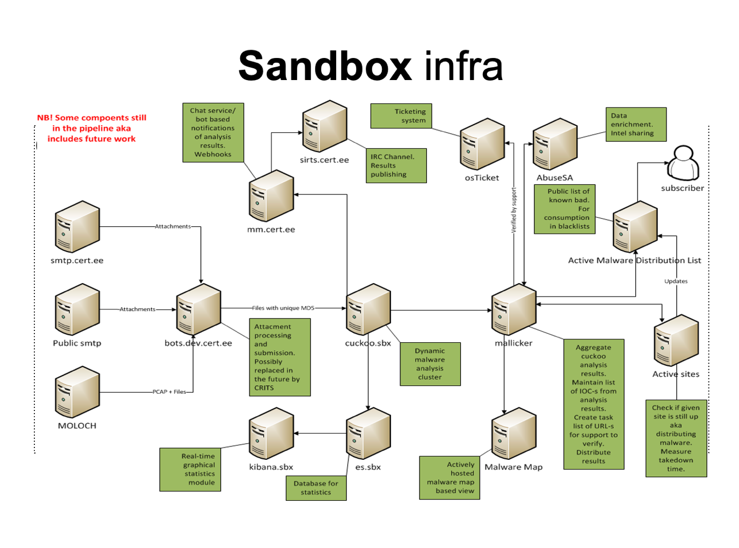
Estonian example

Slide 26
Discussion
What are the challenges while using tools?
Challenges to choose tools?
Where are biggest problems?
People?
Skills?
Money/resources? ➔ the best tools are open source, and supported by community
Information?
Mandate?
15 min discussion

Slide 27
Policies & processes
The rules and regulations of the CSIRT house

Slide 28
Escalation to Governance / Press function / Legal function : SIM3 P-1/2/3
Escalation to highest governance levels (including highest political levels)
Escalation to press function & talking with the press
Escalation in regard legal matters
Always need to know : WHO ? HOW ? WHEN ?
Escalation chain needs to be short or it will fail
Does your escalation also work at 3 am, or on Sunday morning? It must. Also when some actor is on holiday.
To reach high political or corporate level make sure there is someone inbetween who can speak the “high level language”
Turn the press into your allies – not your enemies

Slide 29
Incident Prevention / Detection / Resolution / Specific Processes : SIM3 P-4/5/6/7
All the tools in T-8/9/10 need to be covered in the corresponding processes P-4/5/6 : when/how to use these tools, process steps, manual, etc. – ideally on an internal wiki or similar
These processes also need to clearly outline all the steps needed for preventing, detecting and resolving incidents.
Process descriptions should include essential communication patterns and escalations. Adding diagrams is recommended! E.g. use (E)BNF (Backus-Naur-Form) tools.

Slide 30
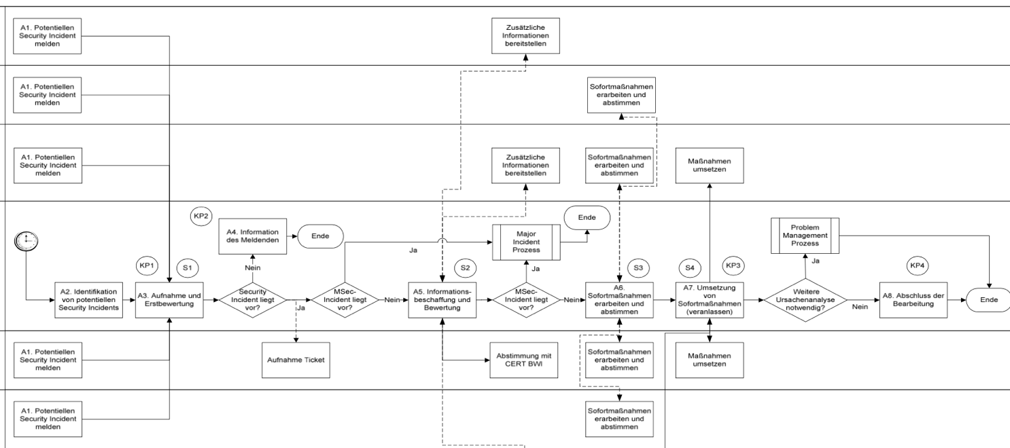
Use a graphical process tool for SIM3 P-4/5/6/7, together with plain text
CERT xxx
Note: this is (E)BNF notation. There are free software tools for this.

Slide 31
Incident Prevention : SIM3 P-4
Coordinating teams like national or sectorial ones often think they don’t do incident prevention
Usually this is not true: many teams do e.g. portscans or other vulnerability scans and then warn their constituents – that is incident prevention
Or they send out threat advice – again incident prevention

Slide 32
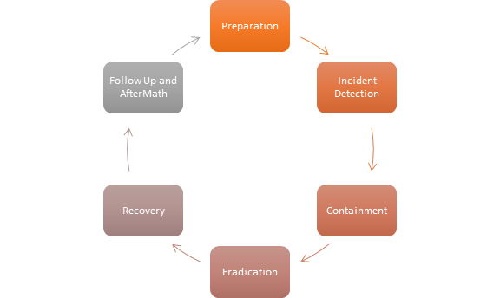
IM workflow in general for ncident detection and resolution

Slide 33
Exercise for SIM3 P-5/6
Closing incident
Data analysis
Eradication & Recovery
Improvement proposals
Incident archiving
Final classification
Incident report
Triage
Preparation
Action performed
Resolution Research
Registration
Post analysis
Final information
Incident resolving
Action proposed
Post analysis
Notes:
Groups need to discuss these randomised elements of the P-5/6 and put them into the right order. On a flipover piece of paper (big) or using post-its. Takes at least half an hour usually more. Then each groups presents it at the end.
NOTE: the terms are from the ENISA process treated below, but do not tell that to the students, let them run with it first.

Slide 34
Incident management process (i) – detection : SIM3 P-5
Report
Input from SOC
Oral information
Media (social, mass)
Sensors
Monitoring
Honeypot
Something happens
Notes:
These 4 slides are about a common sense process, not standardised by ENISA, NIST or anyone else.
The process is continued on the next slide !

Slide 35
Incident management process (ii) – resolution : SIM3 P-6
Report
Input from SOC
Oral information
Media (social, mass)
Sensors
Monitoring
Honeypot
YES
Something happens
Triage
Decision
NO
ITS
Notes:
ITS = Incident Tracking System (SIM3 T-4)
After the YES on the right hand side of this slide, the process is continued on the next slide !

Slide 36
Incident management process (iii) – resolution ctd
Actions continue until done
YES
Classifi-cation
Next actions
Public announcement
Escalation
Information gathering
Communication with partners
Forensics
Recommendations
Analysis
Scope
Grouping
Ask for additional resources
Reporting (LE, intelligence etc)
ITS
Notes:
ITS = Incident Tracking System (SIM3 T-4)
After the actions (could be very many) are done, follow the long arrow: the process is continued on the next slide !

Slide 37
Incident management process (iv) – resolution ctd
Conclusions
Follow-up actions
Communication with partners
Post-analysis (“post mortem”)
Recommendations
Announcements
Reporting
Learning
Statistics
…
After actions

Slide 38
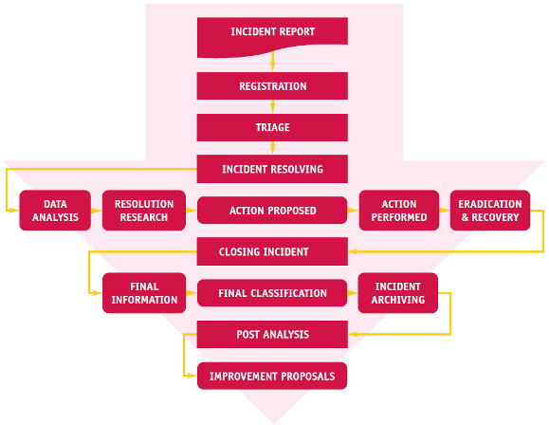
ENISA IM process (short: IMP)
Preparation !!!!
https://www.enisa.europa.eu/publications/good-practice-guide-for-incident-management
The next 20 slides we do a deep dive into the ENISA IM process as for both team managers as well as incident responders this is core business !
Notes:
Preparation step was added as it is sadly missing in the ENISA guide !
Note: the NIST incident handling process is a good alternative to the ENISA process. Common sense says that such processes cannot be too different, as they are modelled on reality and experience.

Slide 39
IMP -- Preparation
Do all it takes to be prepared !
Contact lists (e-mail, phone etc.)
What if a contact is on holiday
What if it is urgent and it’s a strange time of day
Escalation schemes
Tools working ?
Processes ready ?
Etc. etc.
Keep updating your preparedness !

Slide 40
IMP -- Incident report (i)
Incident notification via:
E-mail
Phone (even sometimes still fax …)
Social media ?
Website form
Automated reporting
Lists
Honeypots
Sensors
Could come from your SOC or SOC-function
Newspaper, radio, TV, …

Slide 41
IMP -- Incident report (ii)
Actively look for incidents:
Subscribe to services (e.g.Zone-H)
Monitor your network
Monitor blacklist
Exchange data with others about incidents in your constituencies
Closed source info

Slide 42
IMP -- Registration
Good practices:
Use an Incident Tracking System, one tool to manage your incidents!
Numeration (e.g.CERTname#inc.no)
Filtering repeatable messages, e.g. from automatic systems like SpamCop
Automate where feasible

Slide 43
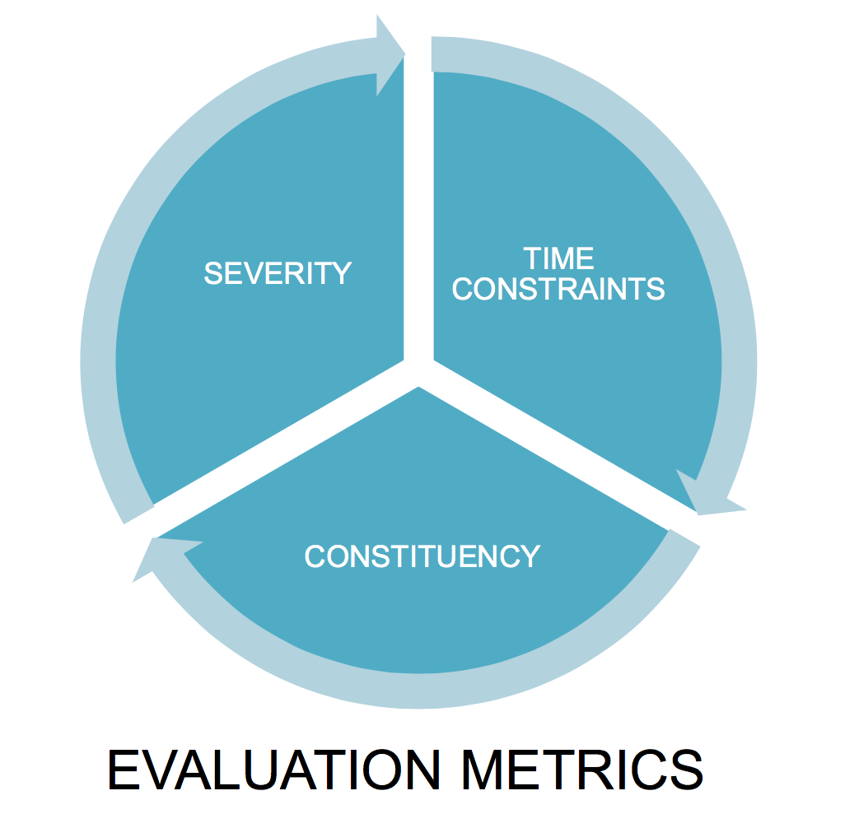
IMP – Triage (i) : overall idea

Slide 44
IMP – Triage (ii) : questions to ask
Some questions you might/should ask:
Is it really a IT security incident?
Is it related to one of your constituents?
Does it fit with in the CSIRT mandate?
Is the source of good quality?
What is the impact? Priority?
Is there possible collateral damage?
How fast could it spread to other constituents?
How many people do you need to handle this?
Which incident handler(s) should take this up?

Slide 45
IMP – Triage (iii) : in a nutshell
In a nutshell:
Decide if this is an incident you have to deal with ...
and who will deal with it ...
and with what priority

Slide 46
IMP – Triage (iv) : classification
Classification:
Initially by the reporter of the incident
Should be checked by you, and changed if necessary
May change during the IM process
Take a pragmatic approach:
There can be ambiguities (e.g. phishing can include a variety of attacks), so …
Choose the more relevant label …
and don’t waste too much time on that, you are the fire brigade, not an accountant!

Slide 47
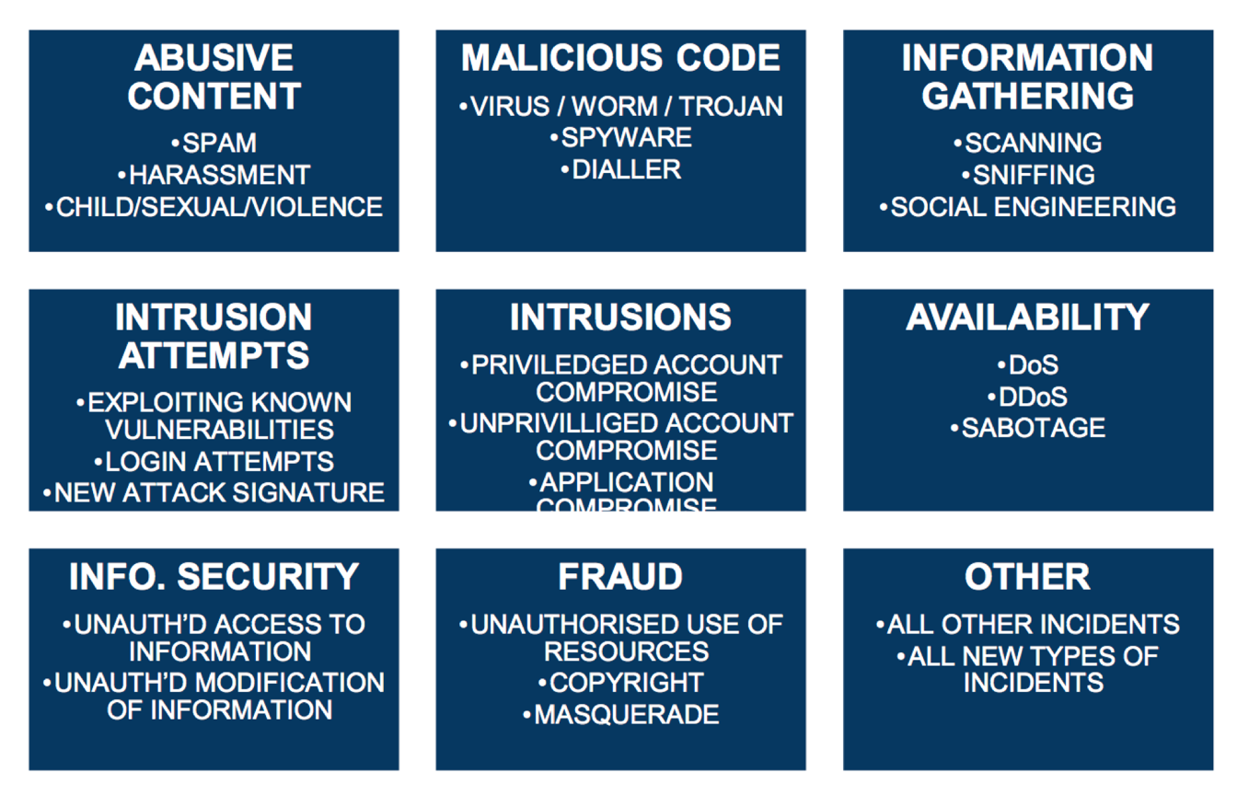
IMP – Triage (v) : example classification (ENISA/MISP)
Notes:
This example classification is purely based on technical incident types – it’s promoted by ENISA, and used in MISP and other tools, and by many teams. It’s pretty good (not perfect at all, but useful) if you stick to the main incident types. The subtypes are more examples, if you start to classify all those, you end up with something too complicated, hard to manage and less useful.

Slide 48
IMP – Triage (vi) : classification continued
Classifying incidents gives you the ability to:
Recognize trends
Provide statistics/graphs to management and to press office
Compare your statistics with others
See part of the threat landscape (not all)
Challenges:
As said, there will be ambiguities
Don’t waste time on over-classifying (too critical or too many types/subtypes) : KISS
There is more than just technical classification, what about:
Impact ?
Priority ?
See next 2 slides!

Slide 49
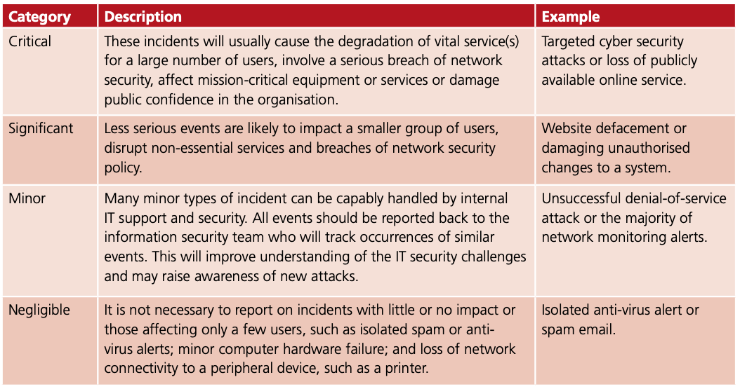
IMP – Triage (vii) : classification can include an impact rating
EXAMPLE

Slide 50
IMP – Triage (viii) : classification can include a priority rating
Example of priority rating:
Red – Very high – Ddos, phishing etc
Orange – High – Trojan, unauthorised modification
Yellow – Normal – Spam, copyright issue
Could also be different for different parts of your constituency, e.g.:
Govt organisation
SLA customer
Others

Slide 51
IMP – Triage (ix) : finally, someone’s gotta deal with it now ☺
Who will be dealing with it?
”Generic” incident responder
Or senior incident responder
Or a specialist
Virus specialist
Spam specialist
Ddos specialist
Forensics specialist
Phishing specialist
Etc., the manager needs to set up a pool of responders and specialists that are fit for purpose (and dependent on how big a pool you have)

Slide 52
Reminder ENISA IM process
Preparation !!!!
Notes:
Preparation step was added as it is sadly missing in the ENISA guide !

Slide 53
IMP -- Incident resolving (i) : introduction
These can and will loop !!!
Note: this phase starts and ends with thinking/talking about observations, ideas and possible actions
To do brainstorming sessions for complicated or sophisticated cases is a very good idea

Slide 54
IMP -- Incident resolving (ii) : how to get people to share with you
How to convince others to share data with you?
These arguments WORK:
Improvement of security level
Helping others, helping yourself
Required for legal reasons
These arguments do NOT WORK:
“It is your responsibility!”

Slide 55
IMP -- Incident resolving (iii) : the 80/20 rule
When looking for additional information remember the 80/20 rule:
20%
of the data can give you
80%
of the knowledge required to find a solution
Or in general:
20% of the facts can give you 80% of the answers
You have no time to find 80% of all the facts, let alone 100% !

Slide 56
IMP -- Incident resolving (iv) : proposing actions
You can propose different actions for different parties involved
Remember to adjust your language to your target audience
One option is to propose to remedy at the source, e.g.:
Turn off a service
Check the system for malware
Patch a system
Audit a system
Collect more information

Slide 57
IMP -- Incident resolving (v) : are your proposed actions performed ?
Your influence on your action takers is limited
Monitor what they really did after you asked for action(s):
Is the attack target reachable (or not) as it’s supposed to be reachable (or not)?
Is it still vulnerable?
Is the traffic filtered properly?
Did they take actions you did not ask for – and if yes, what consequences does that have for your own plan?
Stay in touch with them
By e-mail, phone or chattools (best using a confidential one like Signal or Threema)
Increase pressure if needed …

Slide 58
Reminder ENISA IM process
Preparation !!!!
Notes:
Preparation step was added as it is sadly missing in the ENISA guide !

Slide 59
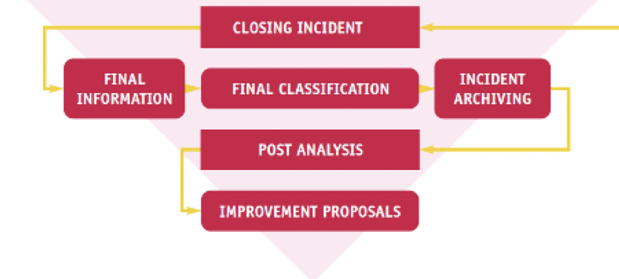
IMP – Closing Incident
This is mostly common sense
Final information & classification is consolidated in the ITS: again, KISS
Post analysis (“post mortem”) doesn’t have to be done right away, but do not wait too long
Use team meetings for your post mortems – or special meetings for crucial cases
Turn your lessons learnt into improvement proposals and track those

Slide 60
Specific Incident Processes : SIM3 P-7
Every team must have a generic incident detection/resolution process (P-5/6)
Almost every team also has additional to that some specific processes for specific types of incidents
Examples: DDoS, ransomware, copyright violations, …
What those specific processes are depends on what the priorities of the team are for their constituency
The specific processes can be inside the generic P-5/6 process, or can be separate
Playbooks for P-7 processes are increasingly becoming popular

Slide 61
Audit & feedback process : SIM3 P-8
Photo by John Schnobrich on Unsplash
Notes:
Discuss this with the group:
Get above the table that a good audit process is ”ordered” by higher governance, and that it’s only good if there is also useful feedback and discussion with the team afterwards … and actions defined, taken and tracked
Explain that this is in SIM3 what is informally called the “level 4 process” which helps to define those parameters that should be(come) level 4 – these must be specifally actioned in the audit&feedback process (unless they are SPECIFICALLY mentioned in cyber law)
Make clear that this process can vary from one A4, to a (usually) more complicated ISO 27k setup with sets of controls etc – and anything inbetween those two

Slide 62
Emergency Reachability Process : SIM3 P-9
If the team is not reachable 24/7, some kind of emergency reachability needs to be in place for at least the core constituency, as well as for peer CSIRTs
Make this info (phone number and/or e-mail address) available to those who need to know
Make a procedure (simple script) to decide if an incoming report will be dealt with as emergency, or moved to the next working day
Make sure to support any legal obligations
Test e.g. annually if the emergency reachability works
Photo by camilo jimenez on Unsplash

Slide 63
Best Practice Internet Presence : SIM3 P-10
SIM3 has the following minimum requirement:
This process must at least ensure that:
the mail addresses cert@... and security@... must be tracked by the team (install aliases)
some form of web presence for the CSIRT must exist, at least internally
Preferably also a public webpage, including rfc-2350
a policy must be present on if and how to deal with social media

Slide 64
Secure Information Handling Process : SIM3 P-11
Is the confidential info that you often receive kept safe enough?
Safe sysadmin practices
Secure storage & back-ups (also offsite)
Lifecycle of hardware and storage
Is pgp/gpg supported (still a must for internationally operating teams)
Support of TLP is a must
…
Photo by Vitolda Klein on Unsplash

Slide 65
Information Sources Process : SIM3 P-12
The process corresponding with the list of such sources (T-2)
This process needs to enable the argumented addition of sources, but also the deletion
Needs to have some measure of “reliability” of the sources
Needs to define what actions to take for what sources

Slide 66
Outreach Process & Constituency Reporting Process : SIM3 P-13 & P-15
The outreach process defines how to reach out to the constituency NOT in the case of incidents:
Workshops
Newsletters
Webpages
Webinars
Annual conference?
The constituency reporting process defines what to report to the constituency and when:
Annual trend report?
Statistics yes, or no?
[ Higher governance can decide not to report to the constituency ]

Slide 67
Governance Reporting Process : SIM3 P-14
What, how and when to report to higher governance
There can be reporting to more than one layer of higher governance
KISS
Make sure that written reporting can be postponed in case of emergencies, and replaced by oral reporting
Photo by Myriam Jessier on Unsplash

Slide 68
Meeting process : SIM3 P-16
Your team should meet regularly and discuss incidents & whatever seems useful
Typically once per week for 1 hour – make sure that home workers join online
Or more often but short meetings (20 min.)
Interactive and give everyone a chance to speak and share
Not just incidents, also e.g. for a team member to explain what they learnt in a recent training
Essential to track the lessons learnt and make them actionable, and then follow up
Photo by Redd F on Unsplash

Slide 69
Peer Collaboration Process : SIM3 P-17
Peers are other teams or entities with who you have some kind of trust relationship because of:
Legal or institutional rules
Membership (e.g. of FIRST)
MoU or similar
Your team members must know how to treat info incoming from such peers, as this will be different than info coming from unknown or lesser known source – that’s what the process is for
Working with Law Enforcement is a special case and must be very well described (same for working with intelligence services if that applies to you)

Slide 70
www.cyber4dev.eu

