Slide 1






International Cyber Security Engagement
&
Relationship with Public stakeholders

Slide 2
Bedside story
17 Apr Finance ministry hacked by ransomware, authorities several days in denial
19 Apr “If the minister cannot explain to his taxpayers what is going on, we will: we have penetrated his critical infrastructure, gained access to over 800 servers, downloaded over 900 GB of databases …”
US$ 10 million ransom
21 Apr New attacks take place. The country’s President states:
“I reiterate that the state WILL NOT PAY ANYTHING to these cybercriminals.”
National CSIRT (under construction) gets very busy
<2 May Attacks continue, on many govt institutions and later also companies
8 May Newly elected President immediately declares national emergency
31 May 2nd major attack, now on health care
<15 Jun Chaos took at least 2 months to clear

Slide 3
Bedside story ctd
“Two major ransomware attacks have crippled many of the country’s essential services, plunging the government into chaos as it scrambles to respond. Officials say that international trade ground to a halt as the ransomware took hold and more than 30,000 medical appointments have been rescheduled, while tax payments have also been disrupted. Millions have been lost due to the attacks, and staff at affected organizations have turned to pen and paper to get things done. “
“Several terabytes of data and more than 800 servers at the finance ministry have been impacted.”
“Local reports say import and export businesses faced shipping container shortages and estimated losses range from $38 million per day up to $125 million over 48 hours.”
Healthcare: “759 of the 1,500 servers and 10,400 computers have been impacted.” [Wired]
“We are determined to overthrow the government by means of a cyber attack.” [Attackers]
>>> SO, WHAT IS YOUR REACTION TO EVENTS LIKE THIS ? <<<

Slide 4
Organise your ”Incident Management” Landscape & Build CSIRT/SOCs
Notes:
Japan is a good example of a country with a well functioning national cyber security ecosystem: every country NEEDS something like that – this concept comes back in at least two more slides below.

Slide 5


Executive SEMINAR / workshop:
International Cyber Security Engagement
&
Relationship with Public stakeholders
Trainer_names
Training_location_and_date
TLP:GREEN
Notes:
Courtesy note: this slideset was developed by Don Stikvoort, with additions by Klaid Mägi.
Trainer: adopt the course type and the title to what suits your needs – an executive seminar has a different target audience than a workshop. You may also need to hide some slides depending on your audience, and the time you have available.
Trainer: fill in trainer names and location and date

Slide 6
Who am I : Trainer_name
Insert photo of trainer
Concise_bio_of_trainer
…
…
“If you think you’re too small to make a difference,
try sleeping in a closed room with a mosquito”.
Notes:
Trainer: tailor this slide. If you have co-trainers, make more of these slides. Keep it short and interesting, the goal is not to overwhelm your students, but to make the curious and engaged. You can replace the quote at the bottom of course – the one left here is an old African saying, often used by the Dalai Lama.

Slide 7
TLP – Traffic Light Protocol
TLP:RED For the eyes and ears of individual recipients only
TLP:AMBER Recipients can only spread this on a need-to-know basis within their organization and its clients
TLP:AMBER+STRICT Within organisation ONLY
TLP:GREEN Recipients can spread this within their community
TLP:CLEAR Recipients can spread this to the world
Full standard: see https://www.first.org/tlp/

Slide 8
Brief History of the Internet & Cyber Security
196X: ARPANET
1988: Morris Worm led to creation of CERT et al.
1984: creation of global DNS
2001: TF-CSIRT started & Budapest Convention signed
2003: World Summit on the Information Society
1998: CSIRT Handbook & EuroCERT … …
1989: FIRST founded
1993: Start of collaboration of teams in Europe
1996: Dotcom boom & Aleph1: “Smashing the Stack for Fun and Profit”
2000: The Millennium bug & gov teams start joining community
2000: Burst of Dot-Com Bubble
2012: WCIT-12 in Dubai (governance)
2015: GFCE
2007: Cyber attack on Estonia
2005: IGF
2017: 1st IoT botnets
>2021: AI plays along
2010: Stuxnet
2011: Diginotar
Timeline courtesy FIRST

Slide 9
EU keywords for digital society
OPEN
FREE
SECURE
RESILIENT

Slide 10
Global Network – United Nations
UN Agencies
ITU
UNIDIR : conflict research
UN member negotiations
United Nations Group of Governmental Experts (UN GGE) on Developments in the Field of Information and Telecommunications in the Context of International Security
Open Ended Working Group (OEWG)
For some outcomes see e.g. https://www.eda.admin.ch/eda/en/fdfa/fdfa/aktuell/newsuebersicht/2021/04/uno-cyber-normen.html

Slide 11
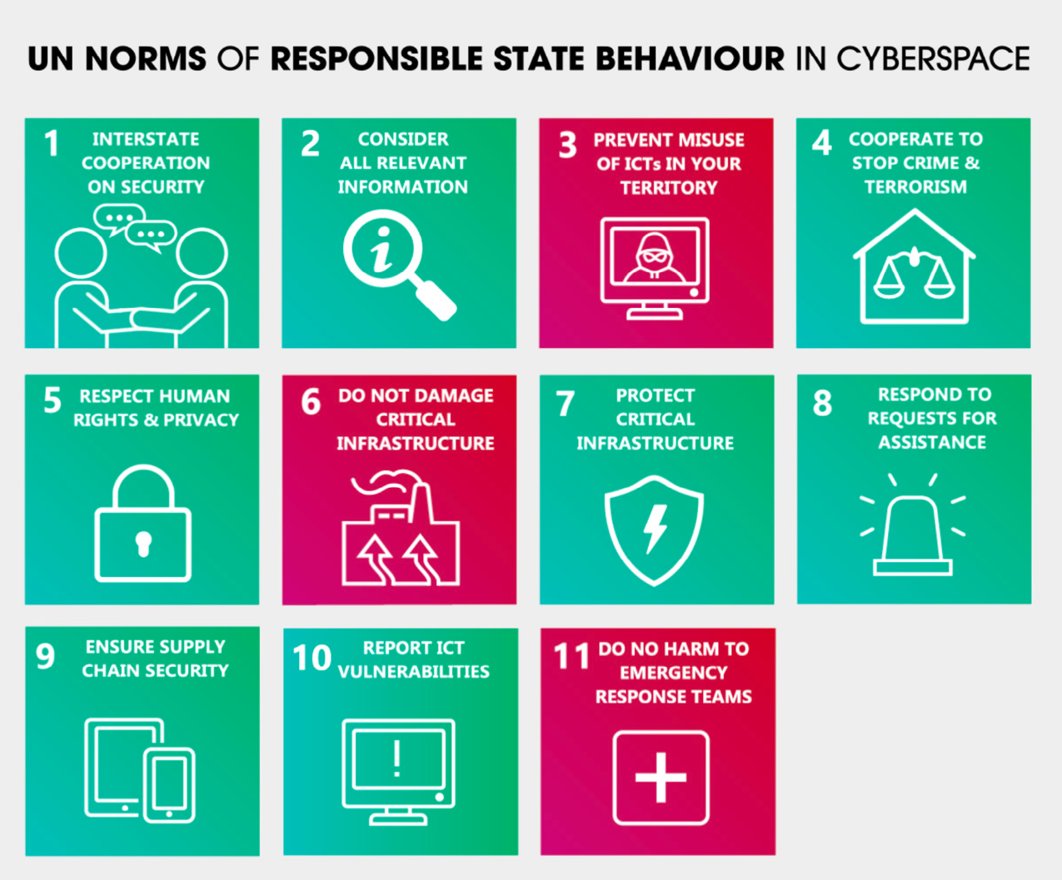

Slide 12
Global Network – Cyber Diplomacy
Read e.g. https://www.cyber-insights.org/cyber-diplomacy-an-emerging-strategy-of-foreign-policy/
Cyber diplomats are here to stay
Inside the Foreign Ministry you need a “international cyber policy coordinator” or “cyber ambassador” to lead this effort
e.g. Maartje Peters in The Netherlands: https://thegfce.org/maartje-peters-head-of-the-dutch-taskforce-on-international-cyber-policy-becomes-the-new-co-chair-of-the-global-forum-on-cyber-expertise/
Make sure to ”talk with the techies” in order to stay grounded – be part of the national network
Good contacts with national CSIRT needed

Slide 13
The importance of policy – content synergy
Nice buzzwords, what do they mean ?
The world of politics, government and governance of big companies is one world
The world of content, application challenges, threats, techies (including brilliant ones) is a different world
These two worlds usually don’t meet – and when they do, the outcome is usually : CONFUSION AND MUTUAL ANNOYANCE
In order to make (digital) society more secure and protect us ALL, these worlds MUST meet and understand each other !
Journalists can help … how ?

Slide 14
Global Network – some examples: GFCE, Commonwealth, EU
GFCE : Global Forum on Cyber Expertise – membership based
Meeting place for CSIRTs, cyber diplomats, bigcos, research, and all regions of the world
https://thegfce.org/
Commonwealth’ CHOGM (Heads of Government Meeting) has “cyber” strongly on the agenda
“Commonwealth Cyber Declaration”: commitment to expand cyber security capacity building
https://thecommonwealth.org/our-work/commonwealth-cyber-declaration-programme
EU : targets an open, free, secure & resilient cyberspace
Manifold cyber security related programs all over the world – cyber diplomacy is key (EU delegations)
Cyber4Dev: part of of the Foreign Policy Instrument (FPI) of the European External Action Service (EEAS)
https://cyber4dev.eu/

Slide 15
The crucial role of CSIRTs – backbone of the cyber security ecosystem
CSIRTs share information about security incidents and threats – local, nationwide, worldwide
In order to prevent “fires” – and extinguish them – local, nationwide, worldwide
Information sharing
and how that works in real life is the
anima aeterna, the
breath of life
of the CSIRT community
in every country
and worldwide
Notes:
Metaphors:
Cisco and Juniper when Juniper joined FIRST
Banks in NL
EE 2007
Klaid has example about when he and colleagues of other telco companies in EE decided to share some important cyber sec info and almost got fired

Slide 16
So you thought this was easy ? … … Babylonic name confusion ☺
CSIRT
CERT
PSIRT
NCSC
CDC
SOC
ISAC

Slide 17
Solution of the Babylon confusion (i)
CERT : Computer Emergency Response Team
  Origin 1988, later trademarked: CERT Coordination Center (CERT/CC)
  They used to have a “permission to use the name CERT” system (that many teams use as PR), but are abandoning this – the most recent we got from the team was this quote: “Contact CERT/CC Security Operations (security-operations@cert.org) for CERT partnership details.”
CSIRT : Computer Security Incident Response Team
  Origin 1998 : https://resources.sei.cmu.edu/library/asset-view.cfm?assetid=6305
  Free to use !
CERT = IHT = SIRT = CIRT = IHC = CSIRT

Slide 18
Solution of the Babylon confusion (ii)
SOC : focuses more on internal security log/data handling and the reaction to that
CDC: often combines CSIRT and SOC
nCSIRT : national CSIRT
NCSC: nCSIRT with added spice – no fundamental difference, but usually an NCSC ties directly into national crisis management (= escalation, not normal operation)
PSIRT : Product Security Incident Response Team
  Where vendors work on the vulnerabilities in their software/firmware
  Fundamental in the CSIRT community right from day 1
ISAC : a CSIRT without incident response; focuses on information sharing.

Slide 19
Solution of the Babylon confusion (iii)
What’s in a name –
YOU
MUST have a
CSIRT (like) capability !

Slide 20
Pivotal role of CSIRTs and the National CSIRT
International cooperations
International cooperations
International cooperations
Civil Society CSIRT ?
Gov CSIRT
Mil CSIRT
National CSIRT
Sectorial CSIRTs
Sectorial CSIRTs
Sectorial CSIRTs
Sectorial CSIRTs
SME CSIRT ?
Big company CSIRTs
Big company CSIRTs
Big company CSIRTs
Big company CSIRTs
Notes:
A first take on the national cyber security ecosystem that every country NEEDS.
Question marks with Civil Society and SME CSIRTs because solutions for these “sectors” are really needed, but hard to implement. They can however not be forgotten, because civil society is ”all of us” and SMEs are companies that may not be in the CI but without SMEs the country stops functioning very soon.

Slide 21
Global Network - FIRST
Forum of Incident Response and Security Teams https://www.first.org/

Slide 22
National Network
To make your national CSIRT rock in your country,
you need Champions:
Policy Champion
CSIRT Champion
…
Multi-stakeholder approach, first and last
Build a national cyber incident management network, or CSIRTs network – based on
cooperation, collaboration & inspiration and well-understood authority
2021 guide, published by the GFCE :
https://cybilportal.org/publications/getting-started-with-a-national-csirt-guide/
Notes:
Trainer: the photo is meant to be of a true “champion”, but in the sports field as those are the best known ones. The champion here is Haile Gebrselassie, famous marathon runner from Ethipia: see https://en.wikipedia.org/wiki/Haile_Gebrselassie . Replace as you feel is appropriate for where you are and the age of your audience.

Slide 23
National Network
Law Enforce-ment
MilCERT
Energy
Secret
service
GovCERT
Civil
society
Finance
nCSIRT
R&E
sectoral
Transport
Health
sectoral
Water
Major Hospitals
Telecom
SME
sectoral
Notes:
Another take on the national cyber security ecosystem that every country NEEDS.

Slide 24
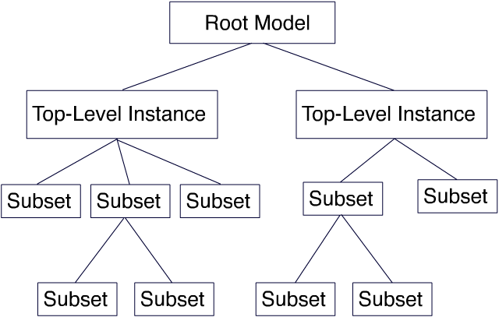
CSIRT System philosophy ? Hierarchy ? Mesh ?
Notes:
Is it a hierarchy? A mesh? Answer in next slide.

Slide 25
CSIRT System philosophy is is a mix of non-hierarchical trust relationships and some mostly national structure

Slide 26

Trust between teams is based on faces and names not on official paperwork
[ Your trainers ]

Slide 27
We must explain “trust” better
Trust comes by foot but leaves on horseback.
We experts know this but often take it for granted.
We – and you – need to explain this more !
Photo by Joshua Hoehne on Unsplash

Slide 28
How to build TRUST (i)
Reach out to your constituency – make sure there are faces with names
  Takes at least a year
Reach out inside your country – make sure there are faces with names
  nCSIRT can play a connecting and inspiring role: cooperate, facilitate
  Pushing or pressing people is bad for trust
  Legislation should inspire and support
Reach out regionally and worldwide – make sure there are faces with names
  AfricaCERT
  TrustBroker Africa
  GFCE
  FIRST
  Etcetera
Notes:
Trainer: this slide has in the 2nd half an African focus. Change if needed, depending on your audience.

Slide 29
How to build TRUST (ii)
Meet colleagues
Eat, drink with people
  Beer drinking model of trust
  Papaya juice or madeira are fine too
Engage on projects with colleagues
  Volunteering helps a lot
  Managers – this helps your team too, allow your team members to reach out, it pays back with interest
Go to meetings/conferences and reach out
Photo by Shane Rounce on Unsplash
Notes:
The “beer drinking model of trust” is an old insider joke in the CSIRT community. It’s however serious enough – the trust building between people is significantly helped by eating and drinking together, this is just who we humans are. Sitting in a meeting room with 50 people and listening to a speaker does comparatively not so much in building trust – unless the speaker or trainer engages the attendants and gets them to do things together, like exercises etc.

Slide 30
Yes, the corona situation was … annoying
Two learnings at least
  We can do much more online than we thought we could
  Some things just don’t work online, we are humans, we need human contact
Maintaining trust online is ok, building new trust is _ very difficult _
We need to meet up in person _ often enough _
Building and maintaining trust remains as vital as it always
was in our community and is based on faces and names

Slide 31
Cyber Security Hygiene & Awareness
See separate presentation about
Cyber Security Hygiene & Awareness
Notes:
Trainer: there is a presentation associated with this one, about Cyber Hygiene/Awareness. If there is time, go into that training here, and after that come back here to go on with the remaining slides here.

Slide 32
CSIRT – where to start ?
Once you have a clue about incident response and “CSIRT”, and want to push forward, then :
Adopt SIM3 – this CSIRT maturity model gives you 95% of the things you need to pay attention when starting, evaluating and maturing your CSIRT
  Write a Charter document for your team covering at least the Organisational parameters
  Write a Human Policy document for your team covering the Human parameters
  Fill out rfc2350
  Design and test an incident management process
Adopt the FIRST CSIRT Services Framework – this helps you to pick the right services for your CSIRT to offer
Support TLP – the Traffic Light Protocol
Take it from there

Slide 33
SIM3
SIM3 = Security Incident Management Maturity Model
For (self) assessment, membership criteria & certification purposes
45 parameters in 4 categories
O – Organisation : 11
H – Human Aspects : 7
T – Tools : 10
P – Processes : 17
All parameters measure on an integer scale from 0 to 4
SIM3 is a neutral model that does
not tell you how mature you should be
Organisation
Human
Tools
Processes

Slide 34
SIM3 scores
Each parameter can score :
0 = not available / undefined / unaware
1 = implicit : “between the ears only”
2 = written down but not formalised
3 = like 2 but approved by CSIRT head : “rubberstamped” (or published)
4 = like 3 but actively assessed or audited on authority of governance levels above the CSIRT management on a regular basis (with a feedback loop in place)

Slide 35
SIM3 how-to-use for all types of CSIRTs
SIM3 standard and further reading : https://opencsirt.org/csirt-maturity/sim3-and-references/
Jump right into the online SIM3 tool : https://sim3-check.opencsirt.org/
See where you are as a CSIRT maturity wise, and where the gaps are
Based on that and on your ambitions (assigned by higher governance) make an action plan to improve maturity. If you are an n/g CSIRT: use the GCMF levels Basic, Intermediate and Advanced as part of a more-year planning!
Regularly go back to step 2 : improve maturity step-by-step

Slide 36
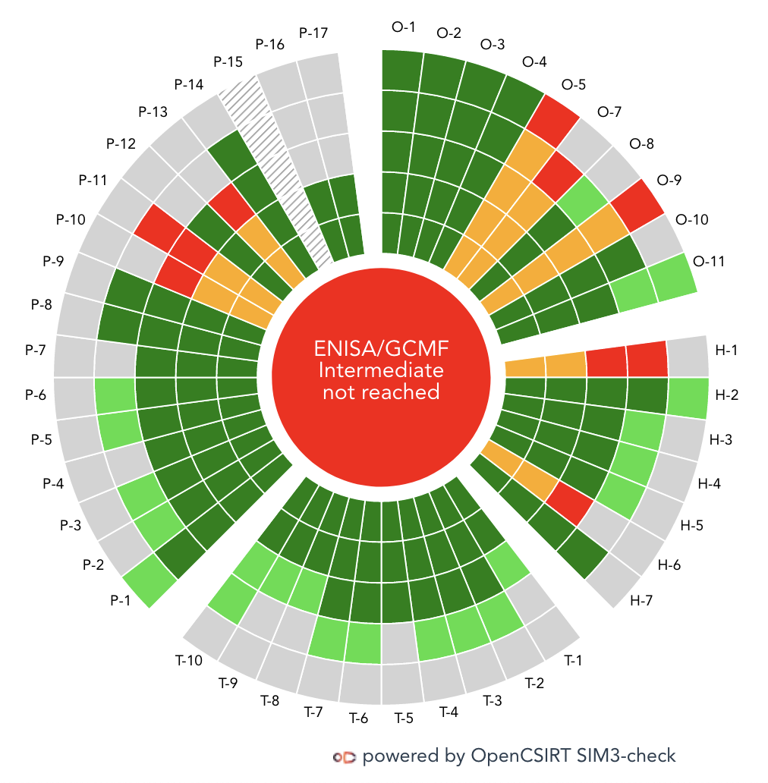
SIM3 online tool
https://sim3-check.opencsirt.org/
⍺

Slide 37
FIRST CSIRT Services Framework
FIRST CSIRT Services Framework (v2.1)
  https://www.first.org/standards/frameworks/csirts/csirt_services_framework_v2.1
  There is a separate FIRST PSIRT Services Framework for PSIRTs (product security teams)
These frameworks enumerate in depth the kind of “services” that a CSIRT (or PSIRT) can deliver to their constituencies (their clients)
This is an amplification of the SIM3 parameters O-5 and O-7
SIM3 and the service frameworks are “orthogonal”: SIM3 describes the whole range of 45 maturity parameters for a CSIRT – the service frameworks are an in depth survey of 2 of those parameters

Slide 38
FIRST CSIRT Services Framework – overview
5 Service areas: Services: Functions:
Security Event Management Every service area Every service
Incident Management has several has several
Vulnerability Management services functions
Situational Awareness defined defined
Knowledge Transfer
Smallest “unit” can always be written as: service-area:service:function
Use this framework as a restaurant menu – pick the service-area:service:function menu items that you must do according to your team’s mandate, and that you are capable of doing with the people and resources you have available at the time

Slide 39
Service area : Incident Management
Services (functions left out) :
Information security incident report acceptance … includes triage
Information security incidents analysis
Artefact and forensic evidence analysis … this is definitely advanced and challenging
Mitigation and recovery … this is essential for internal CSIRTs, not so much for coordinating teams
Information security incident coordination … includes sharing inside and outside constituency
Crisis management support … essential once crisis management (e.g. national) is in place
IM is the core service of every CSIRT/CERT/NCSC/CDC/…

Slide 40
Service area : Knowledge Transfer
Services (functions left out) :
Awareness building … an absolute must for all CSIRTs
Training and education … maybe not essential, but highly recommended as part of constituency outreach !
Exercises … would you trust a fire brigade that never exercises ?
CSIRT exercises can go much beyond technical, even involving executive and ministerial levels.
Technical and policy advisory
Spreading the word is part of the “must do” of all CSIRTs !

Slide 41
TLP – Traffic Light Protocol
TLP:RED For the eyes and ears of individual recipients only
TLP:AMBER Recipients can only spread this on a need-to-know basis within their organization and its clients
TLP:AMBER+STRICT Within organisation ONLY
TLP:GREEN Recipients can spread this within their community
TLP:CLEAR Recipients can spread this to the world
Full standard: see https://www.first.org/tlp/

Slide 42
Human factor – the crucial one
CSIRT work is many faceted and challenging.
Required are :
Communication skills
Technical skills and experience
Trustworthiness & reliability
Trust building skills ➔ build human networks
Common sense
Creativity, thinking outside the box
At times: stamina
Notes:
Trainer: shortly explain all 6, and the order: of course you could change the order slightly, it’s not meant to be cut in stone. Creativity and trust building are probably the factors that make the CSIRT craft so fascinating and are certainly important reason that people keep coming back to the CSIRT community.
Repeat that “trust” is based on interpersonal relationships – NOT on organisational bonds, or on website certificates, etc

Slide 43
Role of public stakeholders: online and printed Media
The three Is:
Information ➔ Inform the readers – includes warning function
Interpretation ➔ Provide frames and supporting information, quality checks, etc.
Interest ➔ Raise interest and awareness
Additional ideas (from your trainers here):
Bad news makes the headlines quickest, but needs to be balanced with good, constructive news
Informing the public can cause panic and the media have a human responsibility here to weigh that risk with the need-to-inform: ultimately the choices made in that balance is the responsibility of the media, a critical responsibility
Fact checking is a must, but at the same time nothing is harder in 2023 – and also there needs to be room for new ideas, even if they may seem “out there” at first. Again a difficult balance !

Slide 44
The Media & your national cyber security ecosystem
The media will contact who they choose to contact, and that is as it should be
In the years ahead CSIRTs will develop in various sectors and companies, and they will be obvious contact points for the media
The national CSIRT in any country is at the core of this ecosystem
The Media are welcome to contact the nCSIRT !
The nCSIRT will inform the media pro-actively in situations where it matters
Important to create trust relationship, which ultimately benefits the whole of the country
Balance: freedom of press is crucial … but also it is sometimes reasonable to delay publication
➔ It is crucial that nCSIRT and other cyber sec stakeholders build good trust relationships with representatives of the Media. Trust yields respect and respect allows both to do their jobs better. You don’t always have to agree – working together is more important than that.

Slide 45
Get to know the nCSIRT cyber security team !
Insert names and faces including the senior technical people, the leadership and the press officer(s)
Be transparent, build trust.
Notes:
Trainer: fill out and unhide this slide if applicable.

Slide 46

www.cyber4dev.eu

