Slide 1
Introduction to Green Economy
A DEVCO Training Course Prepared in Partnership with UNITAR, UNEP and ILO

Slide 2
Module 1: What is the Green Economy and Why is Green Economy Action Needed?
Module 1:

Slide 3
Objectives of Module 1:
Introduce examples, definitions, concepts, and perspectives
Explain the rationale for a transformation towards a green economy
Highlight key principles, elements and opportunities of a green transformation
Consider developing country perspectives
Summarize approaches for measuring progress

Slide 4
What is the Green Economy?

Slide 5
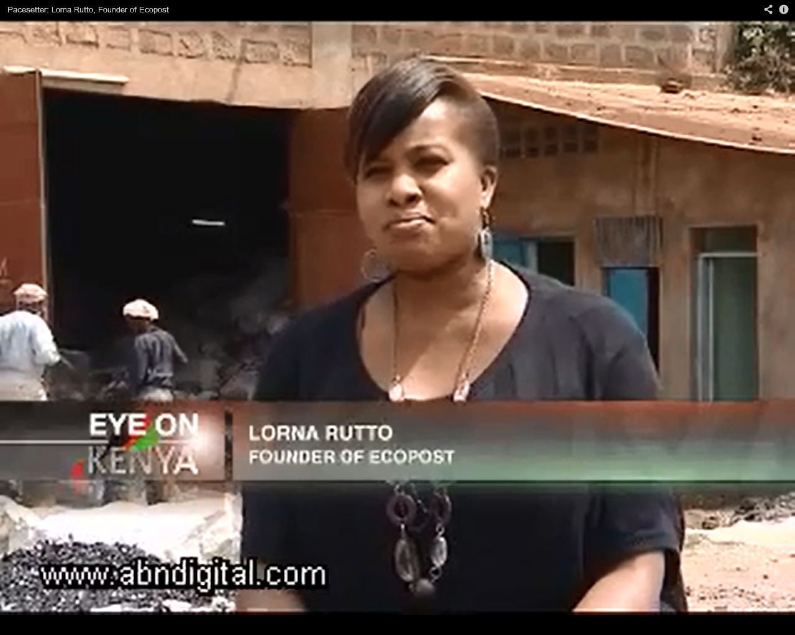
Green Economy Entrepreneurship on the Ground in Kenya
https://www.youtube.com/watch?v=0wFbo8pGNw8

Slide 6
Green Economy Principles
(Based on UN DESA 2012)
Type | Principles
Economic | Recognizes natural capital and values Integrated in economic development and growth models Internalizes externalities Promotes resource and energy efficiency Creates decent work and green jobs
Environmental | Protects biodiversity and ecosystems Invests in and sustains natural capital Recognizes and respects planetary boundaries and ecological limits Advances international environmental sustainability goals (e.g. MDG 7)
Social | Delivers poverty reduction, well‐being, livelihoods, social protection and access to essential services Is socially inclusive, democratic, participatory, accountable, transparent, and stable Is equitable, fair and just – between and within countries and between generations

Slide 7
EC Perspective
“An economy that can secure growth and development, while at the same time improving human well-being, providing decent jobs, reducing inequalities, tackling poverty and preserving the natural capital upon which we all depend.”
Commission Communication “Rio+20: towards the green economy and better governance’’ COM (2011) 363 adopted on 20 June 2011

Slide 8
Green Economy Contribution to Sustainable Development
Economic
Development
Inclusive
Growth
Green
Economy
Social
Development
Environmental
Sustainability
An inclusive green economy that can reduce poverty and inequality and sustain inclusive growth
UNDP 2013

Slide 9
Green Economy Opportunities
New economic opportunities and markets
Leap frog to cleaner technologies
Potential for net job creation poverty reduction

Slide 10
The Business Case for a Green Economy
New markets and investment opportunities
Technological innovation
Enhanced skills of workforces
Efficiency gains and profits

Slide 11
The Triple Bottom Line……
Taking the sustainable development to the enterprise level
Accounting for
People
Planet
Profit

Slide 12
Why Do We Need a Green Economy? Rationale for Action

Slide 13
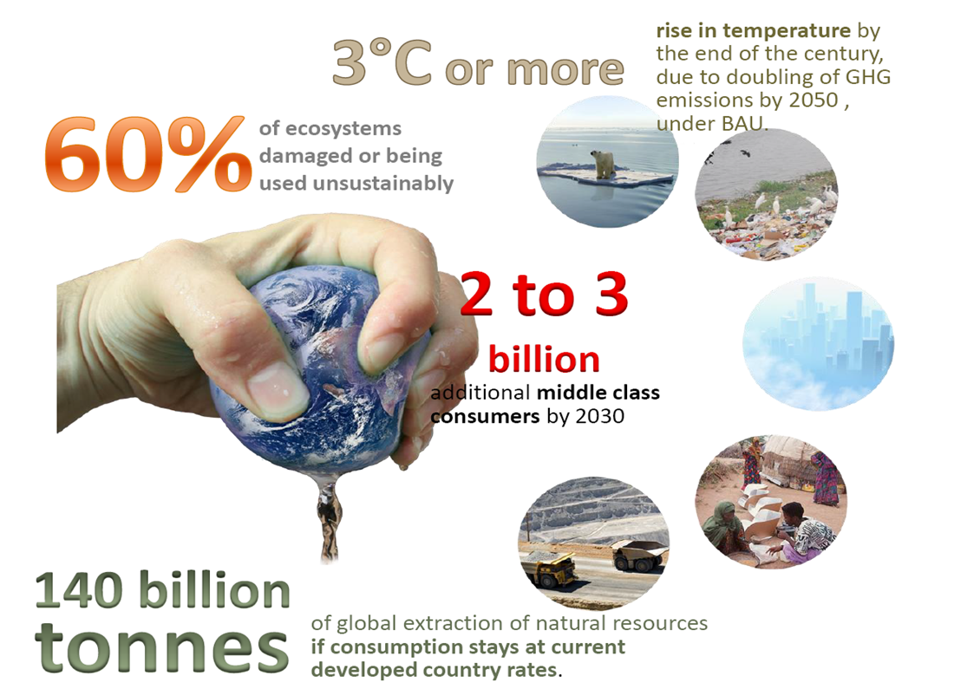
The Consequences of Current Economic Development Patterns

Slide 14
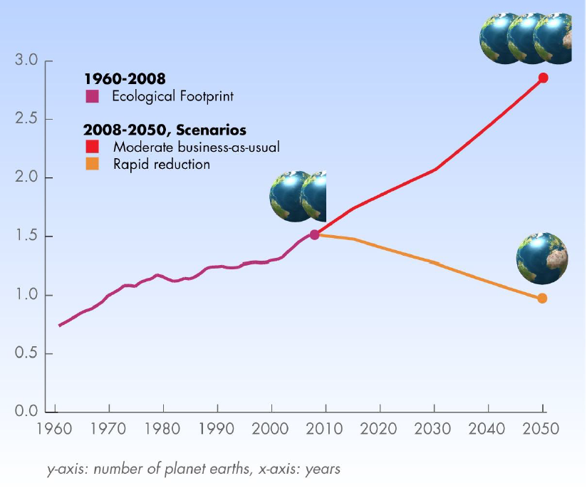
WHY care?
Today we use the equivalent of 1.5 Earth.
By 2030 we will need 2.0 based on moderate BAU scenario.
Global Footprint Network 2012
Notes:
ENVIRONMENTAL RATIONALE : pretty obvious… we should be protecting the earth(‘s capacity) – thus our interventions should not contribute (too much – at all) to environmental degradation… + we have international commitments etc.
The environmental (ecological) footprint calculates human pressure on the planet. It measures how much land and water area a human population (region, activity, humanity) requires to produce the resource it consumes and to absorb its carbon dioxide emissions, using prevailing technology and compares this measurement to how much land and sea area is available.
Since the 1970s, humanity has been in ecological overshoot with annual demand on resources exceeding what Earth can regenerate each year. Today humanity uses the equivalent of 1.5 planets to provide the resources we use and absorb our waste. This means it now takes the Earth one year and six months to regenerate what we use in a year. i.e. we eat/deplete the stock.
This translates into the concept of sustainable consumption and production: using resources and energy more efficiently and reducing GHG emissions and other environmental impact. It is about producting and using products and services in a way that is least harmful to the environment (and why not neutral or even positive impacts – this is what we shall see in future slides).
i.e. idea of this environmental rationale – current way of producing and consuming is not sustainable in the long run
-----
Added info.
Biologically productive land and sea includes area that 1) supports human demand for food, fiber, timber, energy and space for infrastructure and 2) absorbs the carbon dioxide emissions from the human economy. Biologically productive areas include cropland, forest and fishing grounds, and do not include deserts, glaciers and the open ocean.
Current Ecological Footprint Standards (www.footprintstandards.org) use global hectares as a measurement unit – which makes data and results globally comparable.

Slide 15
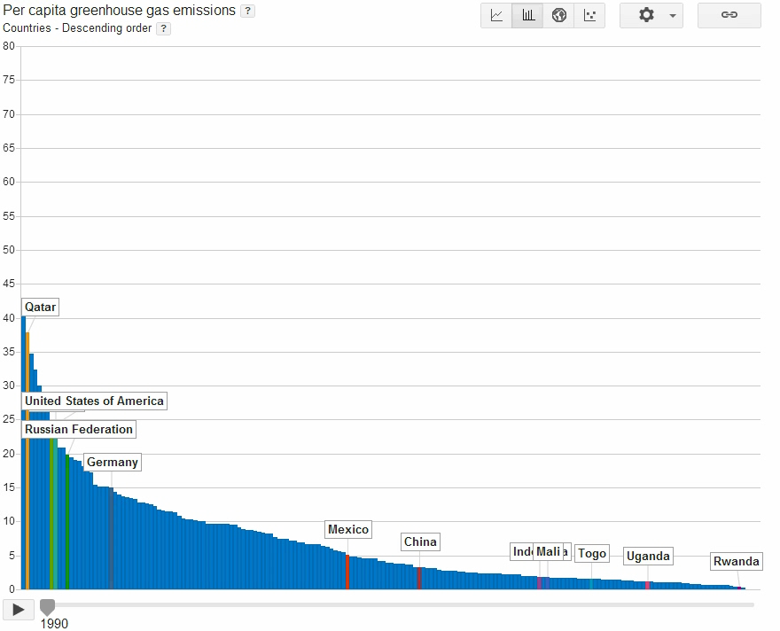
Evolution of GHG Emissions Globally
WRI & Google Public Data 2013

Slide 16
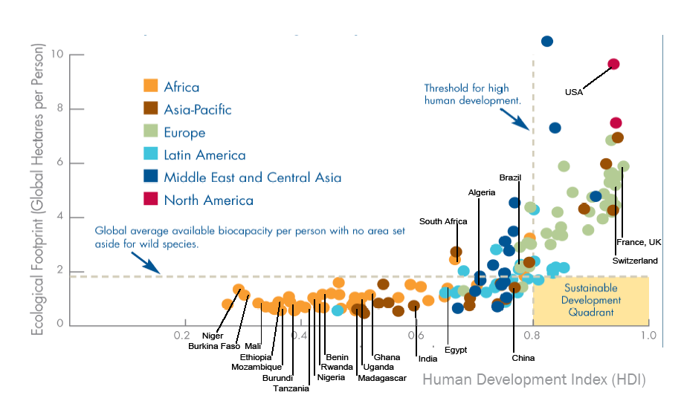
How Promoting Human Development While Recognizing Ecological Limits
Global Footprint Network and WWF 2006

Slide 17
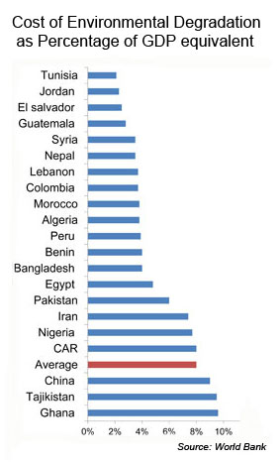
Grow First and Clean Up After:
Not an Option….

Slide 18
Global Policy Milestones and Consensus Decisions
Rio+20 Outcome Document: The Future We Want
(UN General Assembly A/RES/66/288, 2012, para 56)
UNEP Green Economy Initiative and Governing Council Decision “Green Economy in the Context of Sustainable Development and Poverty” (UNEP GC 27/8, 2013)
102nd Session of the International Labour Conference, 5-20 June 2013 “Sustainable Development, Decent Work and Green Jobs”

Slide 19
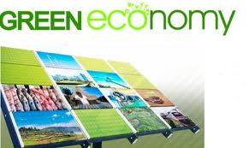
A Vision for a Green Economy…
“A green economy is one that…
results in improved human well-being
and social equity,
while significantly reducing environmental risks and ecological scarcity.”
UNEP 2011

Slide 20
Key Elements of a Green Economy Transition
Value of natural capital
Appropriate economic regulations and incentives
Appropriate environmental regulations and law enforcement
Sustainable production and consumption patterns
Fair distribution of income and social standards
Investment in training and environmental education

Slide 21
Green Economy Concepts

Slide 22
What are....
……Public Goods (and Services)?
Non-excludable and non-rivalrous goods (and services)
Individuals cannot be effectively excluded from use
Use by one individual does not reduce availability to others
Examples: fresh air, national defense, street lighting
Excessive use results in negative externalities ("free-rider problem”, “tragedy of the commons”)
Need for regulatory interventions

Slide 23
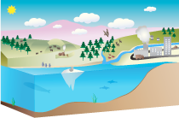
What is…
…Natural Capital?
Natural capital is:
  Land
  Air
  Water
  Living organisms (e.g. fish)
  Etc.
Provides habitat and basis for all living beings, including mankind
Can be considered like an asset in a bank account that generates interest
Should not be depleted
June 1 2013: Ecological Deficit Day
Source: TEEB Study

Slide 24
Five Types of Capitals as Enablers of Sustainable Development
EMG 2011

Slide 25

What is....
…an Environmental Externality?
Economic Externality:
  Effect of an activity on an uninvolved party
Environmental Externality:
  Uncompensated/ignored environmental
  effects deriving from production and consumption
Full cost of activity not reflected by market mechanisms/market prices
Creates markets distortions and misallocation of capital
Source:
http://www.greenbiz.com

Slide 26
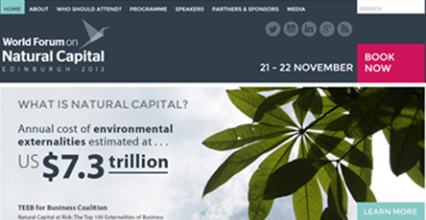
Global Costs of Environmental Externalities
Market prices need to reflect environmental and social externalities/costs……!

Slide 27
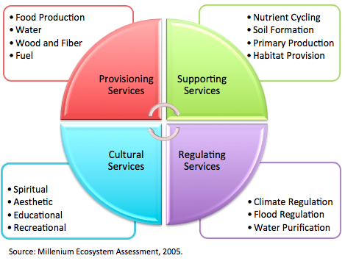
What are...
…Ecosystem Services?

Slide 28
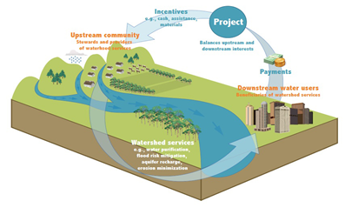
Payment for Ecosystem Services:
Watershed Management

Slide 29
What is…
….Resource Efficiency?
The concept of creating goods and services, while using fewer resources and creating less waste and pollution!
Measures to achieve resource efficiency
  A reduction in the material intensity of goods or services
  A reduction in the energy intensity of goods or services
  Reduced dispersion of toxic materials
  Improved recyclability
  Maximum use of renewable resources
  Greater durability of products
  Increased service intensity of goods and services

Slide 30
What is ...
…. a Circular Economy?
Reduces the consumption of resources and the generation of wastes
Reuses and recycles wastes throughout the production, distribution and consumption processes.
Resonates with the “3R” concept signalling a waste mitigation hierarchy
  Reduce
  Re-use
  Re-cycle
Reduce
Re-cycle
Re-use

Slide 31
Green Industry
“Economies striving for a more sustainable pathway of growth, by undertaking green public investments and implementing public policy initiatives that encourage environmentally responsible private investments.”
UNIDO 2012

Slide 32
Decent Work and Green Jobs
Green but not decent. Examples:
Electronics recycling without adequate occupational safety
Low wage installers of solar panels
Exploited biofuels plantation day laborers
Green and decent. Examples:
Unionized wind and solar power jobs
Green architects
Well-paid public transit employees
Environment
Neither green, nor decent. Examples:
Coal mining without adequate safety
Women working in the cut flower industry in Africa and Latin America
Hog slaughterhouse workers
Decent but not green. Examples:
Unionized car-manifacturing workers
Chemical engineers
Airplane pilots
Decent Work
UNEP, ILO et al. 2008

Slide 33
Developing Country Perspectives

Slide 34
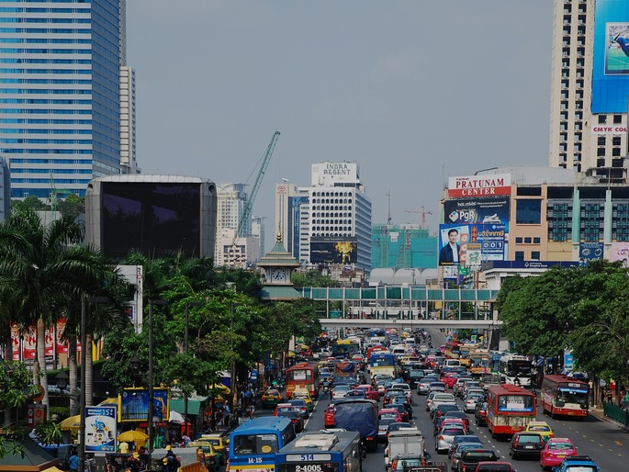
Many Challenges in Developing and Developed Countries are Similar…

Slide 35
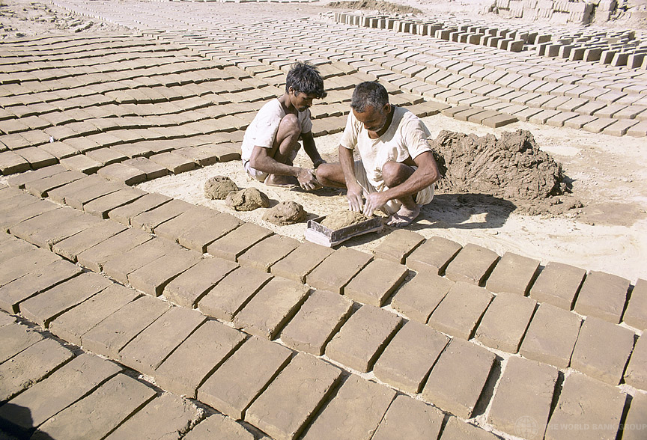
Many Challenges in Developing Countries are Different….

Slide 36
“Green Economy” Concerns by Developing Countries
“Commodification” of Nature
Market Mechanism vs. Rights-based Approach
Green Protectionism and Conditionalities
“One Size Fits All” Approach

Slide 37
Opportunities for Making the Green Economy Work for the Poor (Based on PEP 2013)
Low carbon, organic sustainable agriculture
Improved off-grid green energy sources
Fiscal mechanisms to foster pro-poor environmental change
Poverty reduction through greening the tourism sector

Slide 38
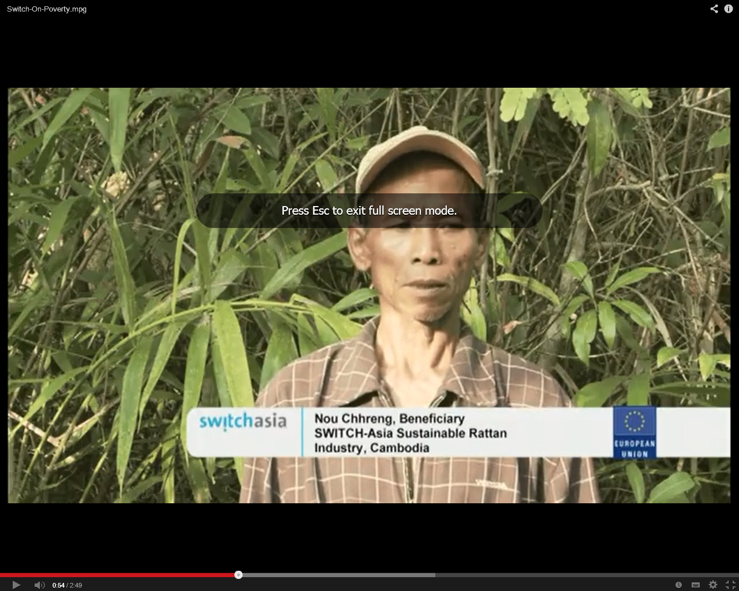
Green Economy and Poverty Eradication:
Sustainable Rattan in Cambodia
http://www.youtube.com/watch?v=1icOCnJq394&feature=player_embedded

Slide 39
Green Economy Projections and Trends

Slide 40
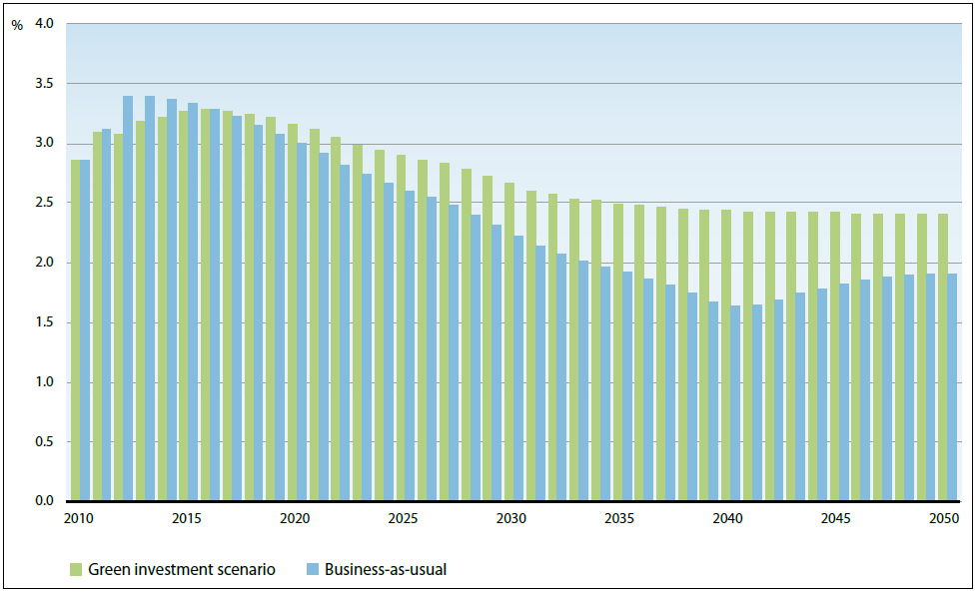
Global Growth Trends 2010–2050 and the “Green Investment Scenario”
UNEP 2011

Slide 41
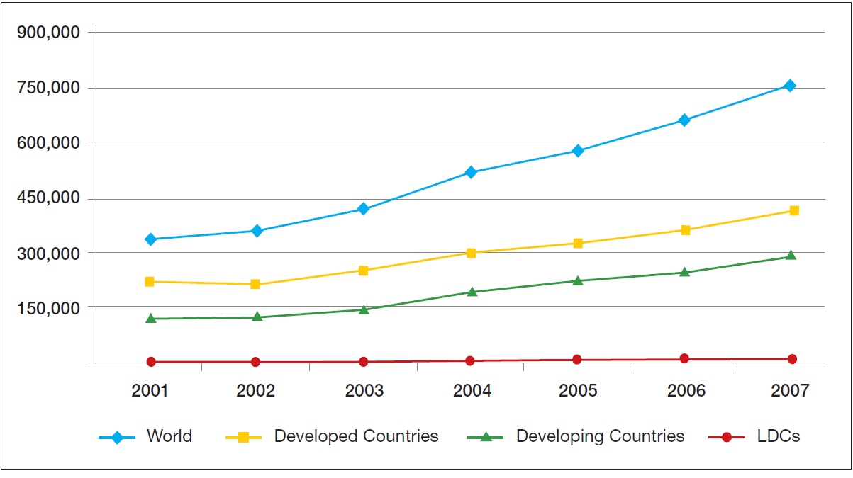
Growth of Environmental Goods Export, 2001-2007
UNEP, 2013

Slide 42
Measuring Progress towards a Green Economy

Slide 43
Rio+20 Outcome Document on Broader Measures of Progress
“We recognize the need for broader measures of progress to complement gross domestic product in order to better inform policy decisions…”
Rio+20 Outcome Document, Para 38

Slide 44
From GDP to Total Wealth Accounting
Economic performance of countries generally being measured through GDP (Gross Domestic Product)
  GDP = market value of all officially recognized final goods and services produced within a country in a given period of time
  GDP does not account for natural capital and social/human capital
Initiatives to move to beyond GDP
  United Nations System on Environmental and Economic Accounting (SEEA)
  Wealth Accounting and the Valuation of Ecosystem Services WAVES partnership
  EU Beyond GDP initiative

Slide 45
UK Environmental Accounts
Satellite accounts to the main UK National Accounts
Statistics on the environmental impact of UK economic activity
Accounts include….
  natural asset accounts (e.g. oil and gas reserves, forestry, land)
  physical flow accounts (e.g. greenhouse gas emissions, air pollutants, energy consumption, consumption of raw materials)
  monetary accounts (e.g. environmental taxes, environmental protection expenditure)
Produced to high professional standards and approved by the UK Statistics Authority
Facilitate environmental-economic analyses

Slide 46
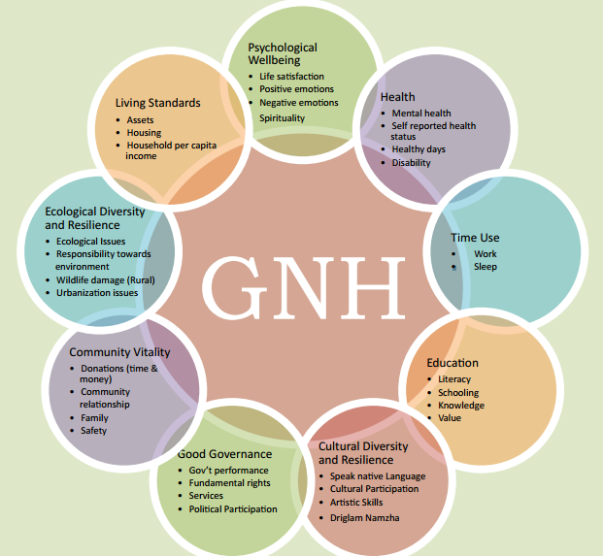
Gross National Happiness Index in Bhutan

Slide 47
Indicators at Different Stages of Green Economy Policy
Initial stages
Indicators for environmental issues and targets
Intermediary stages
Indicators for policy interventions
Final stages
Indicators for policy impacts on well-being and equity
UNEP 2012

Slide 48
Key Messages of Module 1
Economic activities need to be environmentally sustainable to ensure human well-being. This is no longer an option, but a necessity.
Investments in measures that advance environmental sustainability can trigger economic growth and job creation.
The green economy provides an opportunity to reform economic and financial systems to achieve environmental and social objectives.

Slide 49
Discussion Points
Are the presented key principles and features of the green economy clear and evident?
How does the green economy relate to concepts like environmental management, environmental mainstreaming, and sustainable development?
What does the green economy concept mean for the current approach to growth and development?
How do the challenges and opportunities presented by the green economy differ:
  Between developing and developed countries?
  Between developing countries or within a particular country?

