Slide 1
Introduction to Green Economy
A DEVCO Training Course Prepared in Partnership with UNITAR, UNEP and ILO
27 September 2013, Brussels
Notes:
1

Slide 2
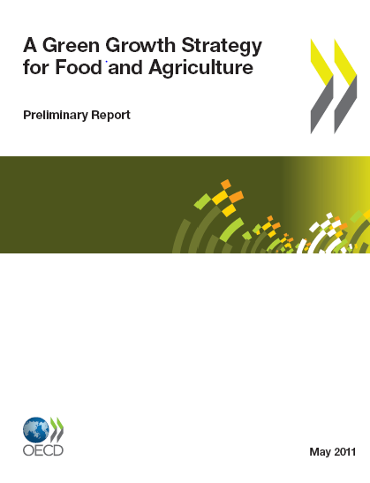
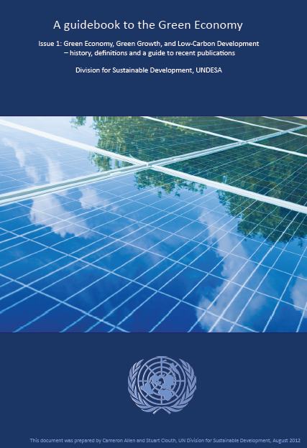


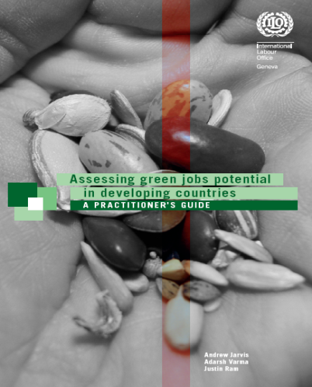
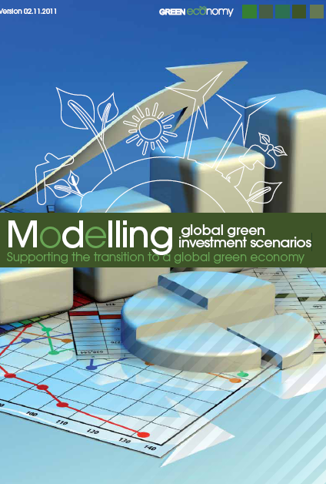

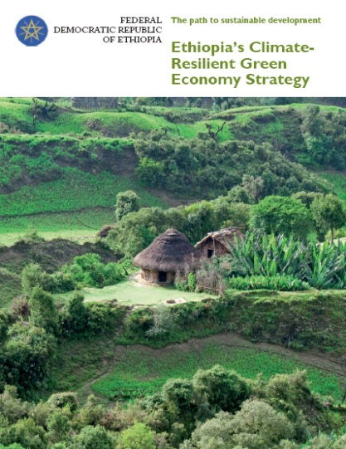
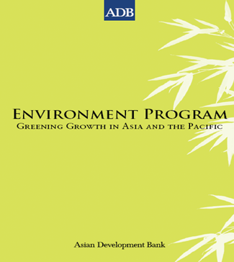
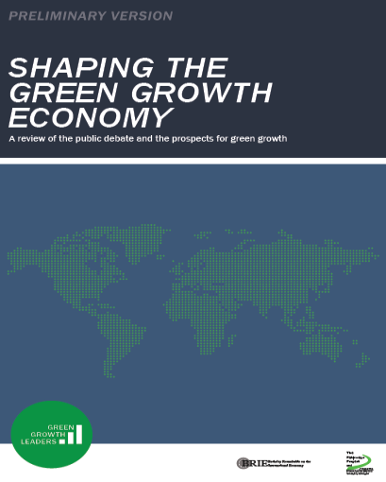

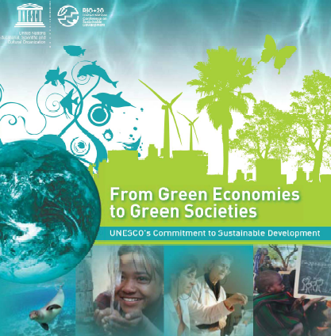

Slide 3
Diverse Perspectives on a Green Economy……
UN DESA 2012

Slide 4


Slide 5
Possible Questions of a Development Practitioner …….
  What is the difference between green economy and sustainable development?
  How does the green economy affect work in areas such as climate change, environmental mainstreaming, etc.?
  How does it affect development cooperation in key economic sectors, e.g. agriculture and energy?
  Are “traditional” environmental projects green economy projects?
  Is it just a hype that will go away…..? What’s really new?

Slide 6
Course Objectives
  Introduce green economy examples, definitions and related concepts
  Provide an overview of green economy policy options and instruments
  Explain linkages between different levels of action
  Introduce key aspects of inclusive green economy planning and implementation
  Present international policy frameworks, initiatives and funding sources

Slide 7
Course Structure
  Session 1: What is the Green Economy and Why is Action Needed?
  Session 2: Policy Options and Interlinkages between Macro, Meso, and Micro-Level Action
  Session 3: Green Economy Planning and Implementation
  Session 4: Strengthening Development Cooperation for Green Economy
  Conclusion and Evaluation Session

