Slide 1
New phase of DeSIRA Innovations at scale for agroecology (DeSIRA+) & Regional Multi-actor Research Network in Agroecology in sub-Sahara Africa (RMRN-Agroecology)
2024, June

Slide 2
Food systems transition in Africa through agroecology
Context: Food systems are at risks facing polycrisis. Food systems transitions are urgently needed to change the way food is produced, processed, traded and consumed. Agroecological approaches are well suited to address several challenges in Africa : food security and nutrition, job creation, decent livelihoods, climate change, biodiversity loss, or soil degradation. However, invesments in R&I and an enabling policy environment are required to unleash the potential of agroecology at scale.
Investments are necessary to:
better understand and make use of the ecological processes at play
develop innovations (technologies, capacities, institutional arrangements) compatible with agro-ecology
stimulate and support innovations at scale
mobilise actors from the private sector and civil society organisations (CSO),
strengthen capacities of national research + farmers’ + CSO and private sector to improve enabling policies

Slide 3
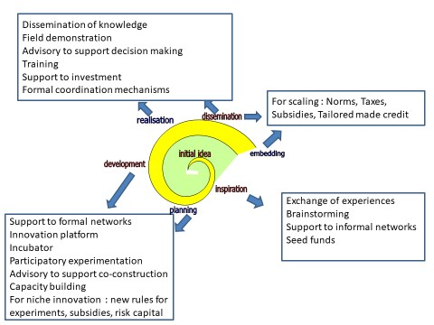
Support to agroecological innovations at scale
Key ingredients for innovation:
Production of knowledge for action mixing local and scientific knowledge,
Development of new technologies and practices making use of ecological processes,
Strengthening of relevant capacities to innovate with solutions adapted to local contexts
Organisational arrangements with shared governance
Enabling policies for agroecology

Slide 4
New phase of DeSIRA: Two distinct but complementary components
Support to agroecological transitions towards productive, sustainable and resilient food systems through increased investments in research and innovation in Sub-Saharan Africa
Component 1: Support to agro-ecological innovations in Sub-Saharan Africa (DeSIRA+)
Component 2: Regional Multi-actor Research Network in Agroecology in Sub-Saharan Africa (RMRN-Agroecology)

Slide 5
Working on shared topics
Transversal and shared topics in line with agroecology :
In-situ agrobiodiversity (crops, animals), including NUSs & production and dissemination of farmers’ seeds
Bio-solutions (organic fertilisers, mycorrhiza/bacteria) and integrated pest & disease management
Soil health and sustainable soil fertility management
Adapted mechanisation for small-scale farmers
Legumes, plant-based and/or alternative proteins
Value chains based on agroecological principles
Access to markets for products from agroecological agriculture

Slide 6
DeSIRA+ vision
Objective: Support to agroecological, ecosystem- and nature-based transitions towards sustainable and resilient agriculture and food systems through increased investments in research and innovation
Specific objectives:
Increased co-creation and adoption of agroecological innovations (products, technologies, models and/or services) by small-scale farmers and SMEs of the agri-food sector
Increased capacity of farmers’ organisations, civil society and private sector actors (SMEs) to scale innovation
Improved enabling policy environment for agroecology at national, regional and continental levels
Strategy:
Intervention through EU MS and international organisations
Implementation notably through consortia of actors led by non-research actors (private sector, FOs, CSO) with support of research and selected via competitive processes (depending on implementing entities)
Fostering strong relationships with policies at national, regional and continental levels
Transversal support: DeSIRA LIFT + and FAO (TAPE tool, Agricultural Innovation Systems)
Budget : €100 millions + EU MS/International organisations’ contributions

Slide 7
RMRNs vision
Objective: Contribute to a sustainable agri-food system transition based on agroecological principles in Sub-Saharan Africa through the establishment and operationalisation of a regional multi-actor research networks (RMRN) for agroecology
Specific objectives:
Strengthen the scientific and technological capacities of RMRN members on agroecology (approaches)
Increase the RMRN’s contribution to scientific knowledge generation and innovation for agroecology through transformative quality research
Enhance the RMRN support on agroecology to practitioners, scientists and policy-makers with a gender-sensitive approach
Strategy:
Identify and strengthen consortia of African universities/research organisations to address specific agroecological related topics (soil health, integrated pest management, etc.) through several dimensions (innovation, education, policy)
Strengthen Sub-Regional Research Organisations, when relevant/feasible, to support the consortia

Slide 8
Thank you
© European Union 2020
Unless otherwise noted the reuse of this presentation is authorised under the CC BY 4.0 license. For any use or reproduction of elements that are not owned by the EU, permission may need to be sought directly from the respective right holders.
Slide xx: element concerned, source: e.g. Fotolia.com; Slide xx: element concerned, source: e.g. iStock.com
Notes:
Update/add/delete parts of the copy right notice where appropriate.
More information: https://myintracomm.ec.europa.eu/corp/intellectual-property/Documents/2019_Reuse-guidelines%28CC-BY%29.pdf

