Slide 1

Seminar on
Fragility, Security and Development
in the context of EU external action

Slide 2
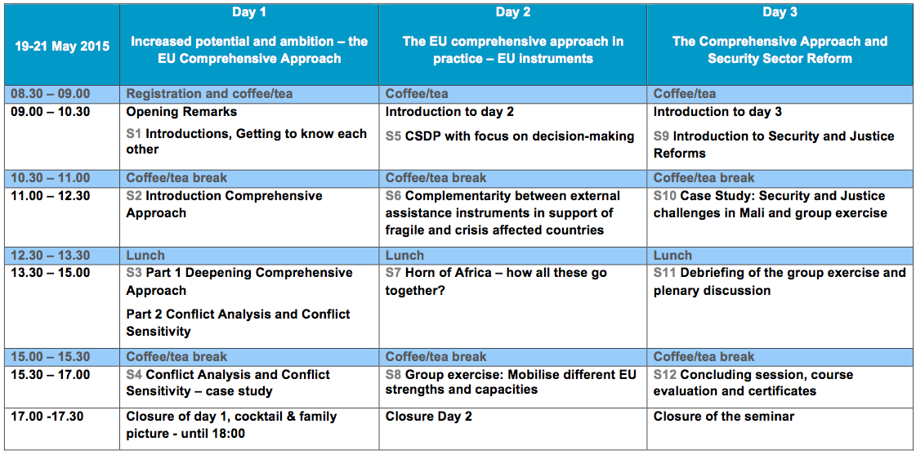

Slide 3
Session 1
How is the institution you are representing contributing to conflict mitigation, stabilisation, reconstruction and rehabilitation?
3 minutes, then switch

Slide 4
Session 1
Please explain to your neighbor the key features of the Comprehensive Approach as you see them from your perspective.
3 minutes, then switch

Slide 5
Session 1
On what topics of the seminar
would you like to be surprised?
Discuss with your neighbor.
5 minutes

Slide 6
Session 1
Group of 4 - Please explore who is working on
a) diplomatic/foreign policy aspects
b) security aspects
c) development aspects
d) humanitarian aspects.
5 minutes

Slide 7
Session 1
Group of 4
Identify if the linkages between diplomatic/foreign policy, security and development objectives existing in your group.
6 minutes

Slide 8
Session 2
3 stations with a theme + a host
25 minutes per theme/station
Room 1: Comprehensive Approach Action Plan
Room 2: The role of development actors in the Comprehensive Approach
Room 3: The role of security actors in the Comprehensive Approach

Slide 9
Session 6
Abbreviation Quiz

Slide 10
Session 6
PFCA
PCNA
ICI

Slide 11
Session 6
PFCA | Political Framework for Crisis Approach
PCNA | Post-Conflict Needs Assessments
ICI | Industrialised Countries Instrument

Slide 12
Session 6
TRM
ERCC
EOM

Slide 13
Session 6
TRM | Transitional Results Matrix
ERCC | Emergency Response Coordination Centre
EOM | Election Observation Mission

Slide 14
Session 6
ENTRi
DRR
EUAVSEC

Slide 15
Session 6
ENTRi | Europe's New Training Initiative for Civilian Crisis Management
DRR | Disaster Risk Reduction
EUAVSEC | European Union Aviation Security Mission

Slide 16
Session 6
PCD
FoRB
EPHS

Slide 17
Session 6
PCD | Policy Coherence for Development
FoRB | Freedom of Religion or Belief
EPHS | Essential Package of Hospital Services

Slide 18
Session 6
Humanitarian Assistance
What are five recent or current disasters which have triggered EU humanitarian aid?
Do EU humanitarian aid and civil protection take the same approach in natural disasters and in conflict situations?
What are particular challenges in long term humanitarian crises and protracted displacements?

Slide 19
Session 6
Crisis Response
Why a separate instrument for crisis response?
In terms of concrete activities, how do you think an IcSP crisis response action looks different from a humanitarian or development action?

Slide 20
Session 6
Development Cooperation
What can development cooperation do in fragile and conflict-affected countries?
What do we aspire to achieve?

Slide 21
Session 8
Exercise: Scenarios
Each group will work on one challenge:
  set out the internal (EU) process you need to formulate a comprehensive response to the challenge.
  detail the other allies you will need to draw into the EU process. How will you do this as the EU?
  based on your experience detail the obstacles you are likely to encounter and how you plan to address them.

