Slide 1

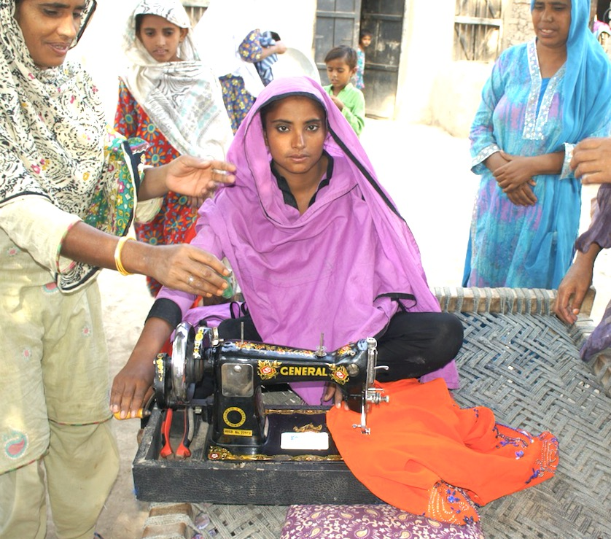

Slide 2




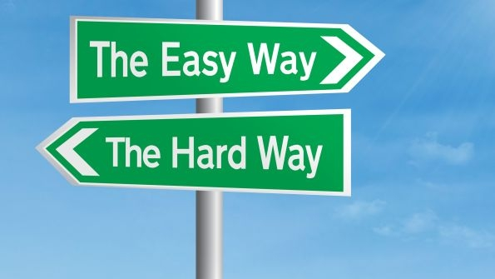
Research Network Support Facility
RNSF
Research
Network
Support
Facility
X
Notes:
The title of our project will quickly become clear to you during our presentation

Slide 3
Overall Goals
1) Strengthening the quality and coherence of EU Actions on:
Empowerment for better livelihoods
Skills development, vocational, and education training
Improving social inclusion of vulnerable groups
2) Development of a useful body of information to inform decision makers at all levels
Notes:
Of people dependent on the informal economy
From implementing partners, local stakeholders, national and international bodies

Slide 4
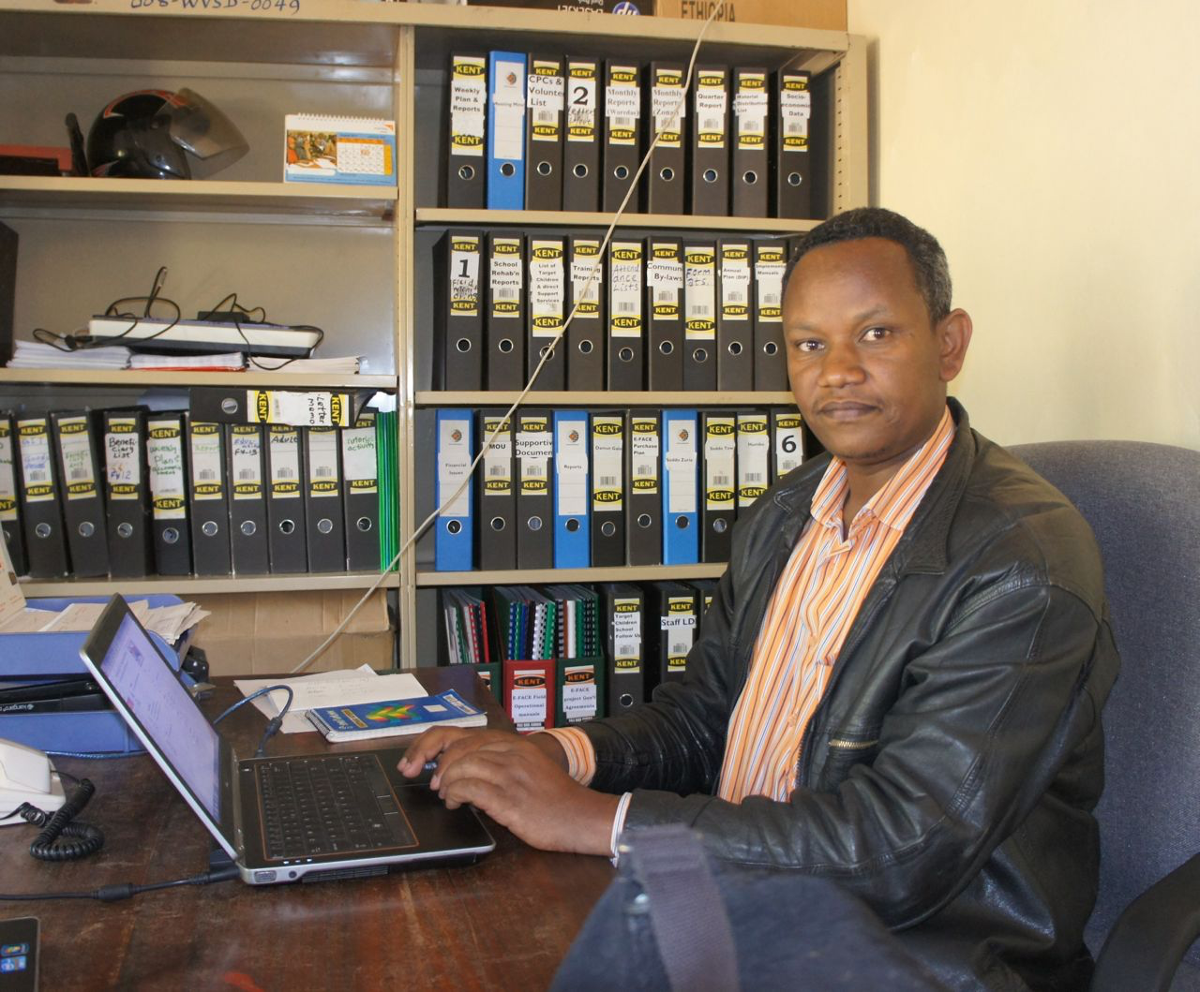
Project has 2 Interlinked Main Components
Informal Economy
Support Facility
Research
Notes:
Photo staff World Vision Ethiopia

Slide 5
Informal Economy Support Facility
Overall Goals of IESF are to:
Improve impact of projects and strengthen implementing partners
Network together across 17 projects in 13 countries to achieve real results
Provide direct support from the overarching RNSF project to each of the 17 projects individually
Learn from the experiences of networking throughout the 3-4 years to replicate the IESF
Improve effectiveness and impact of future projects

Slide 6


What IESF is
What IESF is not
IESF is designed to support you in line with your implementation needs
We hope to learn as much from you as you from us and from each other
We will track how useful our joint inputs are to improve projects and IESF functioning
Guidance provided on the IESF are suggestions, implementation of guidance is not mandatory
IESF does not replace the work of delegations in the countries.
Notes:
It is a work in progress and

Slide 7
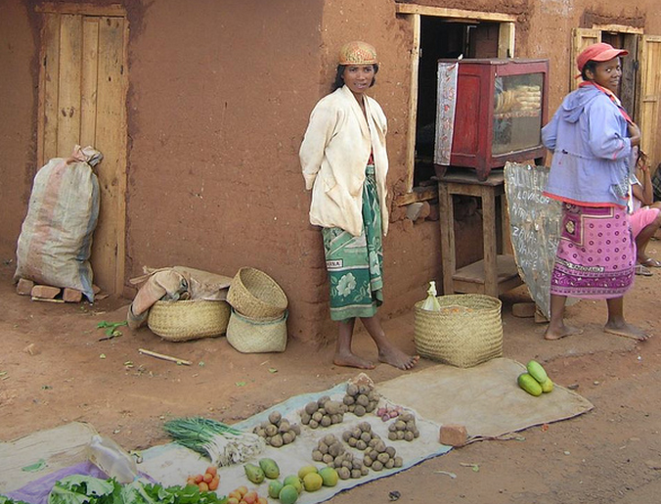
Research component
What does the RNSF and EC hope to learn:
Innovative approaches
Good practices
Lessons learned
How implementation challenges were overcome to inform future planning in different contexts
Notes:
Innovative e approaches, good practices, lessons learned raining from legal and policy development to practical actions at community level.

Slide 8
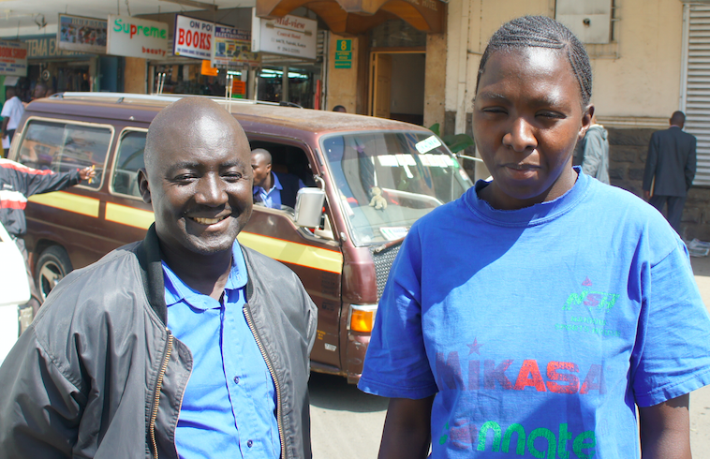
Sources of information:
Documentation- literature from a wide array of sources
The 17 projects as they are being implemented
Past projects
Conferences, workshops, meetings with experts
Notes:
Your role is vital here. While you are being supported we also hope to learn from you about what works, what does not work and why?

Slide 9
Summary Goals of the Seminar
Project implementing partners, RNSF staff, and key relevant DEVCO staff will be well acquainted on a professional and personal level
Implementing partners will be able to effectively use the IESF (Platform) for the benefit of their projects and collaborate with others to improve theirs.
Functioning of the IESF will be improved due to input from participants
Implementing partners will have acquired strengthened capacities on relevant technical subjects
Notes:
In line with the preceding

Slide 10
5. RNSF staff will have acquired a better understanding of the support needs of the implementing partners
6. RNSF staff will have gained improved conceptual insights on research options on implementing partners’ project implementation experiences
7. The ultimate potential of projects will have improved due to increased focus on ownership and sustainability

Slide 11
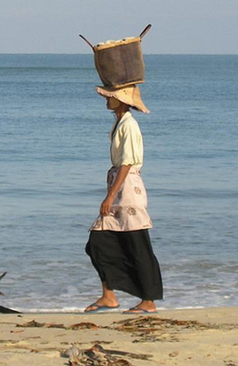
Content of the seminar is based on:
Your responses to questions on the type of support that you think would be useful.
RNSF team need to ensure that the IESF is clear and easy to use.
Notes:
Madagascar

Slide 12
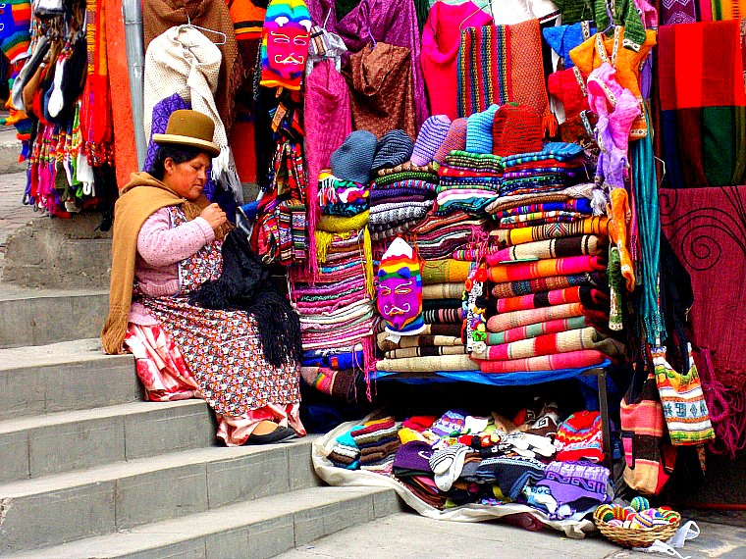
Content:
IESF
Social inclusion in the Informal Economy
Enabling environment development: strengthening legal and policy frameworks, institutions, coordination, capacity strengthening.
Social Behaviour Change Communications (SBCC) and Advocacy
Using visibility tools for your projects
Notes:
Strengthening legal and policy frameworks, institutions, coordination, capacity strengthening.
SBCC methodologies followed by exercise on how to apply in own projects

Slide 13
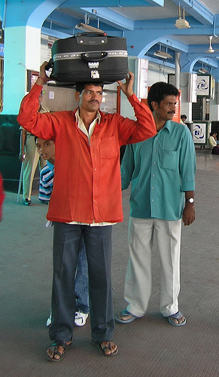
Improving logical frameworks- overview
Vocational and skills training and the IE
Achieving decent work in the IE and related formalising aspects
Organising IE entrepreneurs and workers
Social Protection within the Informal Economy

Slide 14
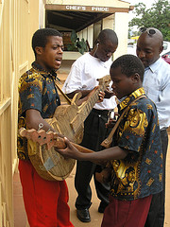
Thank you
Merci
Asante sana
Gracias
धन्यवाद
Grazie
Dank je wel
شك را
di ou mèsi
Jere jef

