Slide 1
Research Network Support Facility Seminar
Social Behaviour Change Communications (SBCC) and Advocacy
Myriam N Horngren
Advocacy and Communications Consultant
Notes:
Present your self

Slide 2
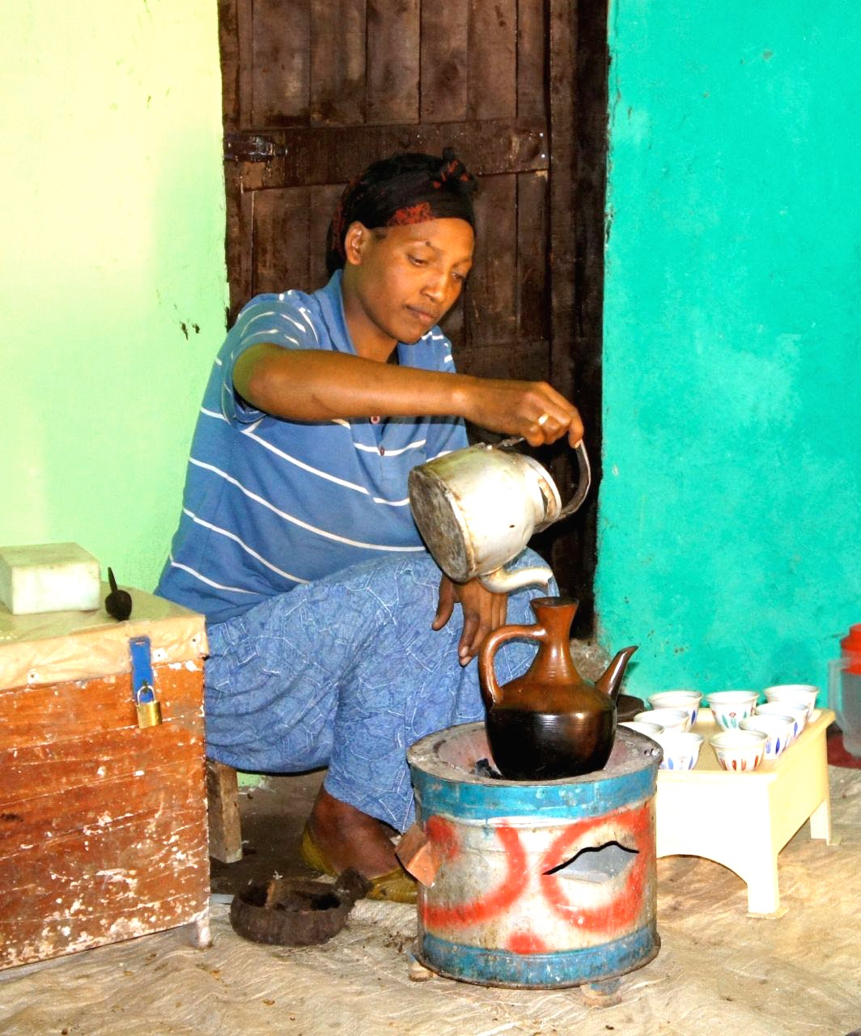
presentation
1) Theory Time: change communication
Key points on Behaviour Change Communication
Key points on Social Change Communication
Context
2) Practial Time: Engaging Change
Roadmap and Tips for Change Communication
Approaches and Channels
3) Exercise Time: Change Communication for Your Project
Notes:
We have little time to cover an area that is very wide. So I will use this session to give a bit of background about change communication and then share some of my experience to what I think are cornerstones, absolute pillars to take into account into any effort of supporting, accompanying change through communication. These might appear obvious, but in my experience they are often not worked through sufficiently and lead to at best very inefficient communication efforts and at worst, very counterproductive efforts. And ideally I would want to work with you on how this experience can benefit your own process of elaborating change communication in your projects. Therefore keep in mind your projects when I talk you through this presentation and do use them in the question and sharing times. My background is not in the IE sector and therefore I think it makes more sense that you lead on that part and that this presentation becomes a moment of exchange.

Slide 3
Key point about behaviour change communication
About specific change, usually related to health: stopping smoking, washing hands, using latrines, using moquitoe net, and sexual health more specifically around issues such as HIV/AIDS and family planning
Underlying of beliefs and attitudes: gender and sexual roles for issues around HIV/AIDS and family planning, belief (use of latrines), cultural representation (smoking perceived as « cool »)
More diffusionist communication model
Ebola: https://www.youtube.com/watch?v=AyDYXFZHEFQ&list=PLLnYeCQ-QQDlO5f_QQmtxW1zqDnf7MJml&index=8
Notes:
Behaviour change is about getting people to do things differently at an individual level, to stop doing things that are harmful or to start doing things that are positive. Often it is based around giving information (diffusionist model and we will get to that later) on the assumption that once people have the information they will act to their best interest. Unfortunately this is not as simple: spend some time on the latrine example to show that behaviour change, although trying to do something simple, picks up on beliefs and attitudes that are not easily convertible into the desired mind-set. Show example of Ebola until 2.37

Slide 4
Key point about social change communication
Larger social issues having to do with empowerment
Changing attitudes towards social/cultural/political norms (Gender relations, perceptions on the rights of the child, race relations)
Creates debate, dialogue, confrontation, engages various constituencies and opinions/view points (participatory model)
Leads to behavior change: doing certain things is unacceptable/ legal change (sexual violence: rape)
It takes time…
Example : Rei do Gado/The Cattle King (Tufte 1998) and landless farmers (https://www.youtube.com/watch?v=0sQ0mi1JV6g)
Notes:
Change beyond the individual to affect the group.
In 1996 the Brazilian telenovela Rei do Gado (The Cattle King) brought a very polemical issue to the screen, that of agrarian reform and the social movement of
the landless peasants in Brazil (the SEM TERRA movement). The issue was raised in the midst of serious land conflicts in Brazil, so here the issue is not anymore about changing behavior but is a question of addressing the environment, in this case, access and ownership of the land.
Nineteen landless peasants were killed in a conflict with landowners shortly before the telenovela went on air. The narrative –telling the story of a rich landowner who falls in love with a poor land- less woman who was part of a group that occupies part of the rich landowner’s estate– becomes a direct comment to the contemporary conflict in Brazil.
The fictitious senator fighting for an agrarian reform in Congress became a ‘true’ spokesman of the landless in Brazil, and achieved –acting as senator– twice to meet in real life with Brazil’s President Cardoso. This fictitious ‘senator’ had obviously gained clout and negotiation power. When he was killed in the telenovela, supposedly by the landowner’s contract killers, two real senators participated, acting themselves, in the fictitious burial of the fictitious senator. Rei do Gado thus visibilized a growing social struggle, making the problem an issue of public knowledge, debate and concern and this what communication for social change is about, creating debate, questioning the status quo be it political, social or cultural. In this example the landless movement has political claim (land distribution) and campaigned for many years. The Soap helped push and promote the issue but not much would have happened if the Soap had existed outside a social movement to make political claims.
The bit we will see is the death of the SenadorCaxias who has been fighting for land justice and whilst I don’t speak Portuguese we can get words like: access to land a question of justice, pushing for these laws to change the right to access land, I have put my life on the line for this, this is my life, etc… so we are very much in a an explanation about how to change the environment for the better: legal and political change and this means struggle. Show video until 4.07

Slide 5
SECTION 3: Social Change and Behaviour Change Paradigms (C4D Ltd Basic Introduction to C4D)
Dominant paradigm: knowledge transfer
(addressing a lack of knowledge and information)
Critical paradigm: participation
(addressing a lack of participation and empowerment)
Mixed
Notes:
Influenced by media theory and development theory the main thinking about change communication paradigms (or systems of thinking) has been that our communication intentions are generally located within either a dominant / diffusionist paradigm or a critical / participatory paradigm.
We can see a strong shift towards more participatory approaches [UNICEF example]
We also see some competition within the sector about which is more appropriate or ‘right’ – the old style ‘knowledge transfer’ paradigm or the newer more participatory ‘knowledge creation’ paradigm.
There has been a shift towards more participatory activity, but the diffusionist paradigm is still also in information delivery in disasters, in health promotion (as per the Ebola example) or with regards to accessing market prices basically when people need information as the primary need.
However then advocacy, voice and accountability and personal expression (helped hugely by new media) are pushing the participatory paradigm into a more dominant position.
The idea that change has to come via social change not just individual change is also influencing this paradigm shift.
This dichotomy is not useful – as both intentions have merit, and it is the context that should determine what is the most appropriate route. Also increasingly the reality of change communication in practice is a blending of paradigms – with meeting the needs of people being the main driver not the conceptual standpoint.

Slide 6
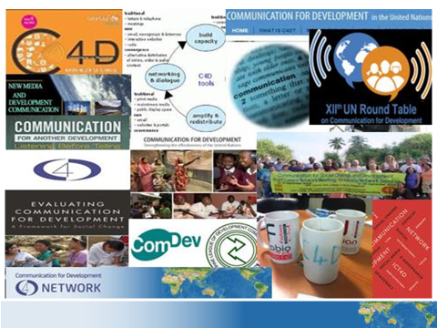
Question/sharing time
Notes:
First anything you’d like me to clarify on the slides we have just seen?
2d: is there anything you’ve seen so far that rings with some of the issues you’re having to deal with in your project?

Slide 7
Engaging Change: roadmap
Your issue/your message
Your context
Your Audience
Your story
Notes:
These are the cornerstones of what I think makes effective change communication. And ideally I’d like you to pay particular attention to this section of seven slides and see what resonates with your project so that we can share at the next sharing time. These slides will also be key for the exercise I will propose to you.

Slide 8
Step 1: Identify your issue/message
« I want to go from a situation where women have no say to how the money they earn is spent at home to a situation where women are able to negotiate with their partner the spending of their earnings» (3 lines, max)
Take your time, confront, try and try again…
How will you know that your message has been understood?
Test, test, test…
Notes:
The idea of change is that it helps you both identify the problem and the solution: the problem for instance is that women can earn money but once at home they are not in a position to decide how the money is spent because the husband is the one who decides. The solution is to engage with the issue of power dynamics at home. This exercise of writing « I want to go from a situation where » is a very simple yet difficult exercise to do but extremelly useful: this exercise will then help support all your public communication and help you fully integrate in your minds and your hearts what is the most important to the success of your project: its clear purpose. So make sure you define first the change you want to see happen because from this will come all your communications effort and greater chance of successful social mobilisation. Very often I see a lot of visually and attractive communication products but in fact I don’t know what they want from me. And also decide in advance what will be the measure of success for you and then test, again and again, and learn: if you meet your measure of success then great and if you don’t then you will know and therefore you will be in a position to learn what worked/didn’t work. Success is built on failure. Ideally though, try to fail before going public…

Slide 9
Roadmap: Step 3: Identify and understand your audience(s)
Who needs to know?
Why are they important to the change?
Who are they?
How do they feel about the change you want them to be involved in?
Can you put yourself in their shoes? What do you see?
Notes:
You can first relay on your gut, your first reaction to these questions, answer them on a paper. Ask your colleagues, your friends, your partners to do the same. Confront your opinions. For many of you, you have been working on the issues for a while and you know a lot already about your audiences. So use it, but if possible, you should really check with colleagues and people in your sphere but also, you should check with your audience. I want to show you an example.

Slide 10
One Man Can Campaign
Document review
Group discussions
Street surveys
New finding: that men and boys were concerned about domestic violence but did not know how to act against it…
Relevant awareness raising activities and material in line with findings
Result: positive
http://www.endvawnow.org/en/articles/1188-formative-research-on-target-audiences.html?next=1189
Notes:
The campaign supports men and boys to take action, individually and collectively, to end domestic and sexual violence and to promote healthy, equitable relationships that men and women can enjoy. The One Man Can Campaign relied on a range of research methods to determine its content and design. To decide on the content of the action sheets, Sonke reviewed existing materials that had been developed elsewhere. Focus group discussions with survivors of violence, faith-based leaders, teachers, sports coaches, youth and adult men were held. Sonke also carried out a number of street surveys, stopping men in shopping malls, restaurants, barber shops and bus stations to find out how they understood the problem of men's violence against women and what they would be willing to do about it. This formative research indicated that men and boys were concerned about domestic and sexual violence but that they often did not know how to act against it. To come up with the look of the campaign, Sonke worked with a youth advisory team and tested different logos on the streets of Cape Town and Johannesburg with 120 men and women.
Phone survey data indicate that particularly the workshops have had a positive effect on behaviour in the weeks following Sonke workshops: 25% of the participants reported having accessed voluntary counseling and testing services; 50% reported witnessing acts of gender-based violence in their home or community and of this group, 50% reported these to the police, about a third (37%) reported them to community structures and 4% to local NGOs. 61% of participants reported increased condom use. More than 4 out of 5 participants at Sonke workshops also reported having subsequently talked with friends or family members on the campaign issue.

Slide 11
CONTEXT
National and global influences
Community, peers, culture
Family, household
Individual – beliefs, habits, education, compulsions
An Ecological Approach
(C4D Ltd: Basic Introduction to C4D)
Notes:
Ecological model:
Once you have done all this work wit your message and your audience, do remember the following though, and this is crucial: Your project is part of the everyday life and the world is a complex place and for communication especially it is very hard to attribute impact to just one intervention and therefore to YOUR intervention specifically – people experience many different forms of communication coming from very many parts of their lives. This is what is known as understanding the ‘ecology’ of people’s lives and hence the ecological model.
Points to make: Think of all the different influences on a person - This understanding of complexity in people’s lives has led to many C4D thinkers adopting an ‘ecological’ approach
The Ecological Model slide

Slide 12
Roadmap Step 2: Identify your context
Ecological communication context
Groups that will be on your side (and why)
Groups that will be against you (measure risks)
The discourse
The communication landscape
Your communication strengths/weaknesses?
Then decide where you can have impact and where you can’t THIS TIME ROUND…
Notes:
Therefore once you have defined your Ecological context as per the previous slide
Clarify the groups different from your audience that will be on your side (and why) and those who can help you and how
Calrify the groups that will be against you: will they try something? Measure risk and decide how far you can/can’t go this time round
The discourse: what is said about your issue in the public sphere? (the preconceptions, the misconceptions, the truths (even those you dont agree with), the lies, the fears, the opportunities, the players,etc.)
What is the communication landscape? what kind of media? What kind of mediums (radio, face to face, personnal, etc.) ? What networks?
Define your chances of success

Slide 13
Roadmap: what is the story?
Creating Recognition
Creating Emotion
Creating Connection
Fostering Engagement
https://www.youtube.com/watch?v=On25Za9sbw4
Test, test, test
Notes:
The purpose of change communication is to mobilise people to operate change for themselves and for them to push others to make changes as well. So you need to create an interest, a connection with the issue to foster their engagement and you need to be remebered to compete witin this ecological approach.
The concept of story telling is very useful in meeting these objectives. Story telling is universal and we all are the targets of it everyday, from the advertising we see, to the movies we watch, to the soap operas we listen to, to the songs and the music we play, we even tell our own story of our life to ourselves and to others.
Story telling: do you have a story that exemplifies the change you want to see: that is able to describe the problem and show the solution (Think of the Brasilian soap we saw earlier on). Story telling is universal, it can come from personnal testimony, it can be a creation of your own, it can use people, an individual, a group, it can use animals, etc. but basically it is there to reinforce the engagement of your target audience to your cause. It needs to address what is inside us and links us to the rest of humanity. It will basically help hang your entire campaign, tell the story of your project, be the thread of your campaign.
You can create your own or with artists that can help you build that story that will move your audience that by now you know so well. There is a lot of information about corporations and story telling but in the video I will show you, it can be fully applied to NGOs. There is a lot more on the internet about story telling advice and tip as well technology that can help you build your story line to be able to transfer your commitment to others. A good link is a Ted-X talk on: https://www.youtube.com/watch?v=YbV3b-l1sZs I can’t show it here because it’s 15 minutes but it is worth checking out (there are subtitles).

Slide 14
Questions/sharing time
Notes:
Questions so far, and we have seen what I consider is the most important. WE will now move briefly to more technical part of communication issues, but these come only AFTER the part of elaboration of the issues, context and knowing your audience and ideally build your story(ies)

Slide 15
Roadmap: Step 4: APPROACHES
(C4D Ltd; Basic Introduction to C4D)
Community media approaches
Edutainment approaches
Participation & Empowerment
Social media & ICT4D
Participatory communication
Social mobilisation
Test test test…
Notes:
These varied methodologies are often presented as approaches
Emphasising the choice of communication channel: community media approaches Emphasising the use of a particular type of format: edutainment such as soap opera
Emphasising a particular type of engagement: peer to peer education for example ...... These options (and many more) are neutral as far as being useful/not useful, relevant/not relevant (although there is huge debate about effective options ) ...... BUT the deciding factor is that they have to be appropriate to the context - it is the context that needs to lead the choice of what approach to take and what methodologies to use ......
And the context needs to be clearly understood (research) so that choices are based on evidence. If you still don’t know, then talk to people around you who can advise you or give you’re their view points but make sure to ask them of examples of similar choices they made in the past, why and what were the results.

Slide 16
Roadmap: Step 5: CHANNELS (C4D Ltd: Basic Introduction to C4D)
Print channels – newspapers, posters, comics
Digital channels – online video & audio, websites, blogs, social networking
Broadcast channels – TV and radio
Interpersonal channels – person to person communication, speeches, theatre and drama
Emerging and converging tech channels – Satellite, GPS mapping, codes etc
Audio/visual channels - video, podcasts, photography
Telephonic channels– mobile, smartphones, SMS
Test, test, test…
Notes:
There is a wide diversity of old and new communication technologies and media platforms that can be used in implementing change communication. These include:
Broadcast routes: television and radio
Audio visual routes: video, podcasts, photography and more
Print routes: newspapers, IEC materials, posters, graphic publications and more
Telephonic routes: mobile telephones – 3G and further, SMS, landline
Digital routes: online platforms - email-based, web-based, social networking platforms, online databases, audio-visual online and more
Satellite routes: satellite television and other content
Innovations: personal handheld devices PDA and other innovations around delivery of technology, wind-up radios, one child – one computer and many others
Convergent routes: the combination of one or more of these options, such as SMS and community radio for listener input in a regular talk show
Emerging routes: the innovations are constantly emerging, particularly in the area of the multi-platform mobile+ routes, such as the scanning of two dimensional barcodes (quick response or QR). Again, it will depend on your context and the needs of your audience.

Slide 17
about your project: exercise
Choose from the RoadMap slides 8-13
Discuss your project based on one (or more) of the slides with your partner
Make notes (ideas, comments, questions)
Share back in plenary
Plenary discussion (feedback from the room)
Notes:
Please distribute handout with notes. This is where I am done and you start the work (read slide)

