Slide 1
Informal Economy and Social Inclusion
Research Network Support Facility Seminar
1st- 3rd June 2015
Jacques Charmes Brussels

Slide 2
What is the informal economy?
Definitions
Size
Contribution
Characteristics

Slide 3

The informal economy has inspired many zoological metaphors
For Hans Singer, the informal sector is like a giraffe: difficult to define, but easy to recognise
No, it is rather a unicorn, according to Bruno Lautier: many definitions, but nobody has ever seen one
An elephant for Meade and Morrisson: too big to be ignored and left to itself
A chameleon changing its colours whenever the institutions or rules are not convenient for it

Slide 4

The informal economy is not the ‘underground’ or ‘shadow’ economy
Informal workers do not operate in the moonlight, but in the open sun
In Kenya, the informal operators are called ‘Jua Kali’, which means ‘under the burning sun’
Informal sector activities « are not necessarily performed with the deliberate intention of evading the payment of taxes or social security contributions, or infringing labour or other legislations or administrative provisions »

Slide 5
The substantive definition of the informal sector (1993)
  Consists of units engaged in the production of goods or services with the primary objectives of generating employment and incomes to the persons concerned
  These units typically operate at a low level of organisation
  With little or no division between labour and capital and on a small scale
  Labour relations – where they exist – are based mostly on casual employment, kinship or personal and social relations rather than contractual arrangements with formal guarantees

Slide 6
The operational definition of the informal sector
Group of production units which form part of the household sector as household enterprises or unincorporated enterprises owned by households
  Units not constituted as separate legal entities independently of the households and without a complete set of accounts
  Informal own-account enterprises which may employ contributing family workers and employees on an occasional basis
  Enterprises of informal employers which employ one or more employees on a continuous basis
    With a size under a specified level of employment
    Or/and non registration of the enterprise or its employees

Slide 7
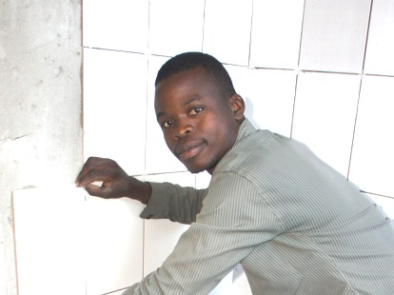
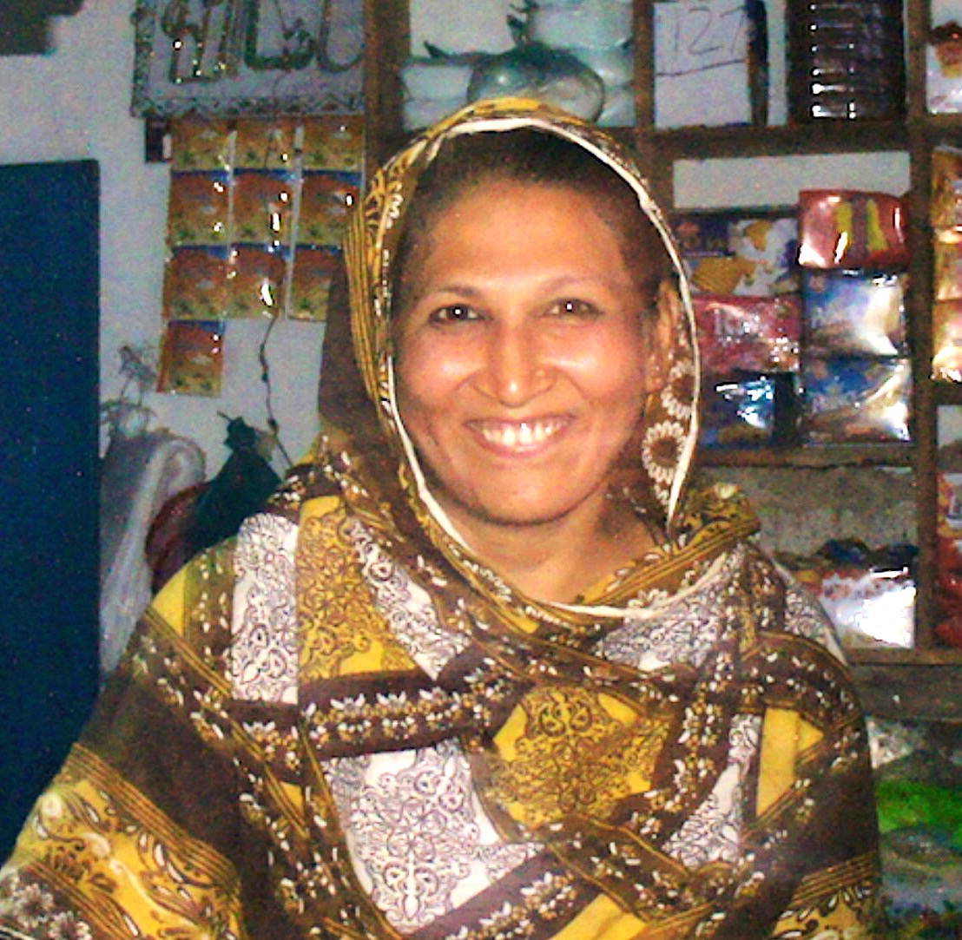
The definition of informal employment (2003)
Workers and especially employees “whose employment relationship is, in law or in practice, not subject to national labour legislation, income taxation, social protection or entitlement to certain employment benefits (advance notice of dismissal, severance pay, paid annual or sick leave…) because of non declaration of the jobs or the employees, casual or short duration jobs, jobs with hours or wages below a specified threshold, (…), place of work outside premises of employer’s enterprise (outworkers), jobs for which labour regulations are not applied, not enforced, or not complied with for any other reason”
Informal employment is therefore usually defined by the absence of social protection or non-payment of social contribution (mainly health coverage)

Slide 8
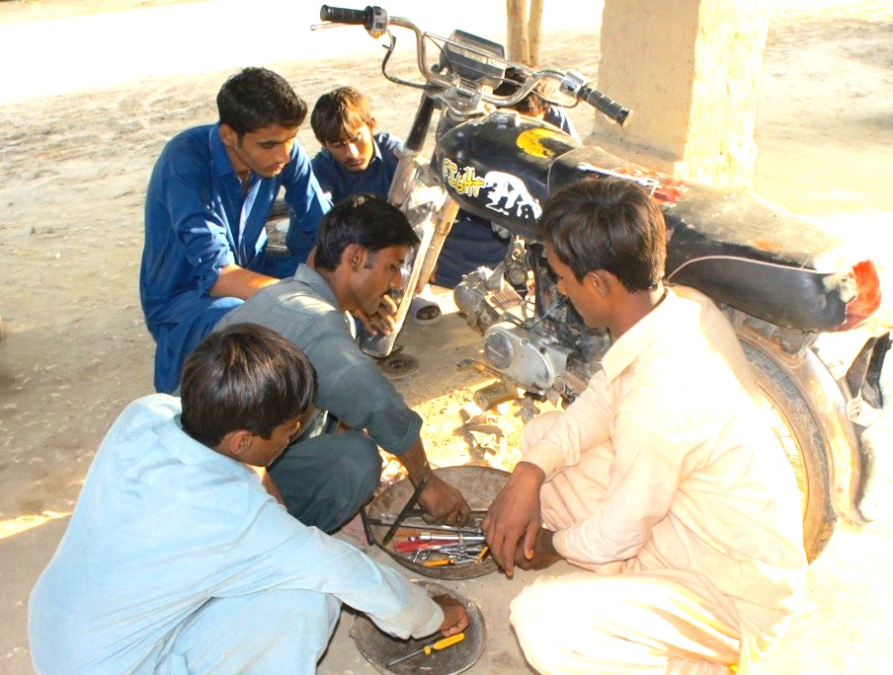
The components of the informal economy
The informal economy is comprised of
  The informal sector
  Informal employment outside the informal sector
    Informal employment in the formal sector (precarious jobs/non decent work)
    Informal domestic workers
    Producers of goods for own final use

Slide 9
Size of the informal economy (in % of non agricultural employment)
Regions | 1975-79 | 1980-84 | 1985-89 | 1990-94 | 1995-99 | 2000-04 | 2005-09 | 2010-14
Northern Africa | 39.6 |  | 34.1 |  | 47.5 | 47.3 | 53.0 | 50.5
Sub-Saharan Africa |  | 67.3 | 72.5 | 76.0 | 78.1 | 67.6 | 70.0 | 74.7
Latin America |  |  |  | 52.5 | 54.2 | 55.9 | 57.7
Southern and South-Estearn Asia |  |  | 52.9 | 65.2 | 69.9 |  | 69.7
Western Asia |  |  |  |  |  | 43.2
Transition Economies |  |  |  |  |  | 20.7 | 22/6
Source: Charmes Jacques (2012), ‘The informal economy worldwide: trends and characteristics’, Margin—The Journal of Applied Economic Research, 6:2 (2012): 103–132, updated for recent years

Slide 10
Employment in the informal economy in the projects’ countries
% | 2000-04 | 2005-09 | 2010-14
Egypt | 45.9 | 51.2 | 49.6
Morocco | 67.1 | 78.5 | 70.1
Burkina Faso | 78.4 | 90.5
Côte d’Ivoire |  | 69.7
Kenya | 71.6 (1999) | 76.8
Mali | 82.7
Niger | 88.8 |  | 88.5
Tanzania | 57.7 | 46.0
Zimbabwe | 51.6
Bolivia |  | 75.1
Colombia |  | 61.4
Haiti | 92.6
Peru | 67.9 | 71.3
India | 83.4 (1999) | 84.2

Slide 11
Contribution of the informal sector to GDP
 | Gross Value added (including agriculture) in % of total GDP | Gross Value added (excluding agriculture) in % of total GDP | Gross Value added (excluding agriculture) in % of non agricultural GDP
Middle East North Africa | 36.2 | 26.2 | 29.2
Sub-Saharan Africa | 63.6 | 31.3 | 50.2
Latin America | 29.2 | 24.0 | 29.3
India | 54.2 | 38.4 | 46.3
Transition economies | 19.5 | 10.7 | 13.9

Slide 12
Components of employment in the informal economy

Slide 13
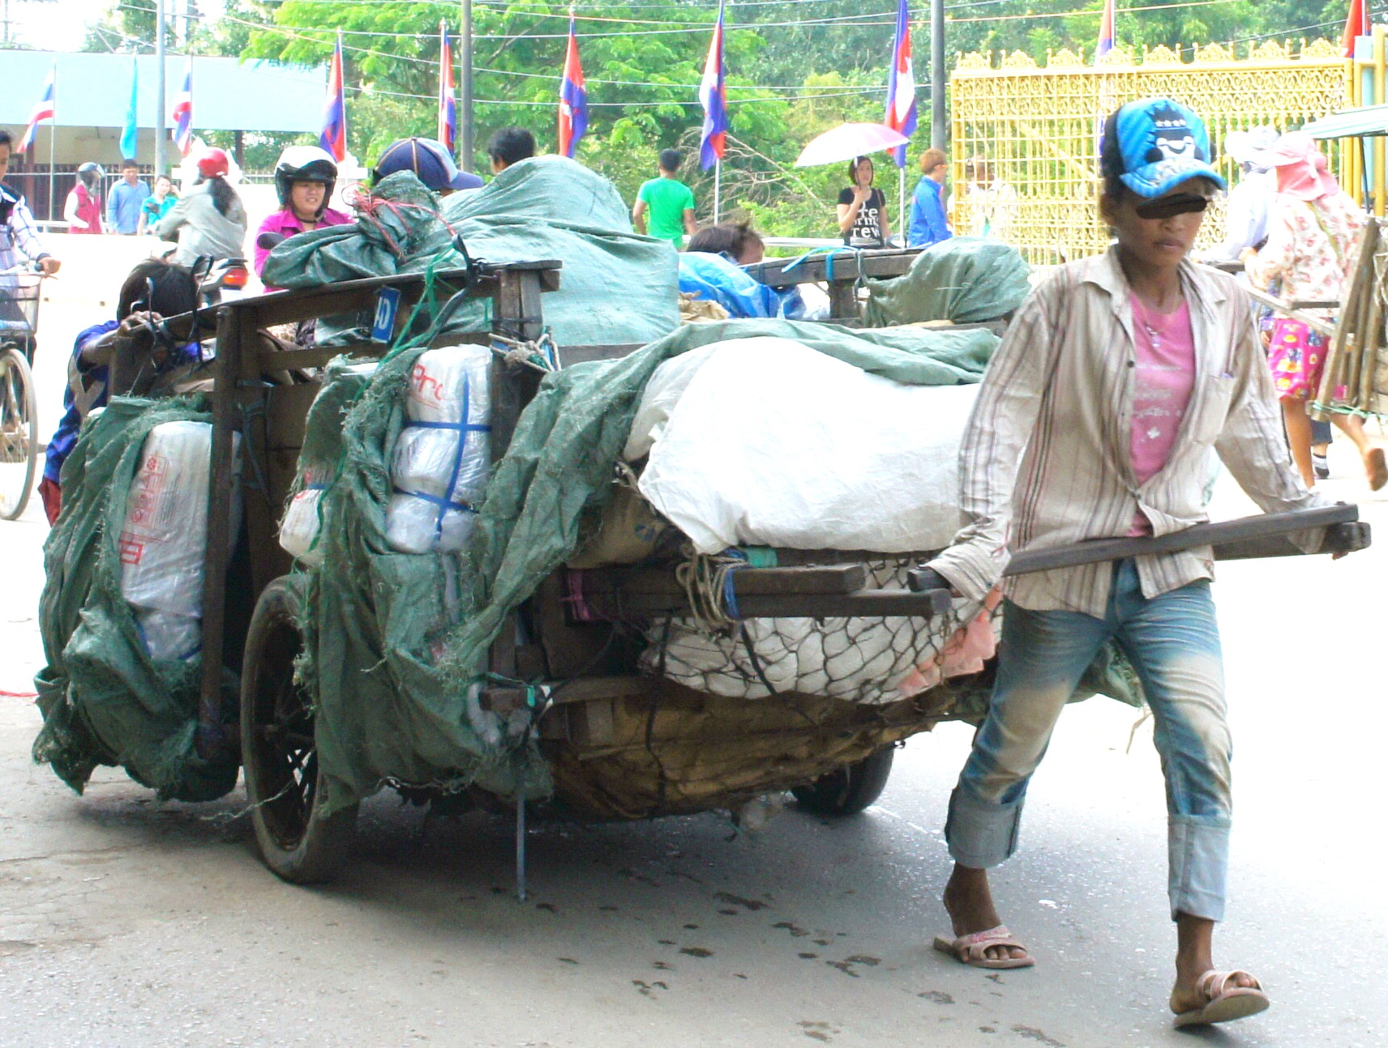
Child labour and Youth
The above-presented estimates
do not take into account children in employment
  Prevalence of child employment at world level: 14.5% in 2008, 11.8% in 2012
Child labour is entirely informal
  Prevalence at world level: 12.6% in 2008, 9.0% in 2012
  Most of them in Asia and in sub-Saharan Africa
High rate of informality in youth employment: ¾ of employed youth are operating in the informal economy in Northern Africa

Slide 14
Women in the informal economy
Women represent less that 50% of total employment in the informal economy, except in Latin America
But the prevalence of informal jobs in total female employment is low, except in Latin America, and shows that most women are employed in the formal economy

Slide 15
Multiple jobs in the informal economy
As regards main jobs, employment in the informal economy is mainly urban, masculine and tertiary in Burkina Faso
When taking secondary activities into account, employment in the informal economy becomes mainly rural, feminine and manufacturing

Slide 16
Informality and poverty

Slide 17
Share of informal sector in household incomes (Sub-Saharan Africa)
 | Agri-culture | Informal sector | Wages | Transfers | Other | Total
National | 43 | 24.6 | 16.7 | 13.3 | 4.5 | 100.0
Urban | 7.5 | 36.3 | 38 | 16 | 4.6 | 100.0
Rural | 58.6 | 19.5 | 7.6 | 12.4 | 4.3 | 100.0

Slide 18
Informal employment negatively related to GDP per capita

Slide 19
Informal employment positively related to population living below national poverty line

Slide 20
Social inclusion
Social inclusion is the process of improving the terms for individuals and groups to take part in society
Social inclusion aims to:
  empower poor and marginalized people to take advantage of global opportunities
  ensure that people have a voice in decisions which affect their lives
  ensure that they enjoy equal access to markets, services and political, social and physical spaces
Vulnerable people depending on the informal economy, though representing the majority in most developing countries, do not benefit from decent work conditions, social protection
Public policies addressing social inclusion of the poor and vulnerable still need to be properly designed

Slide 21
Public (and Donors’) policies addressing the informal economy
Public policies are ambivalent, hesitating between incentives and repression:
  They pretend to struggle against unfair competition resulting from the non-payment of taxes and social contributions at national level, as well as the illegal occupation of public spaces at municipal level
  They define active measures of employment creation, especially addressing the young unemployed graduates, or the unemployed in general

Slide 22
Micro-finance and Micro-credit
Microfinance has enjoyed great success
But its financialisation has induced adverse effects, far from its initial aim of solidarity
Microcredit for income-generating activities has been implemented by many governments, agencies and projects

Slide 23
Conclusions
If public policies are necessary for providing the national institutional and legal framework, they are not enough
Monitoring and mentoring are key aspects of the policies designed for the transition from the informal to the formal economy
And it is up to grassroots organisations to challenge the obstacles at local and field levels: it is your job!

Slide 24
Main statistical sources
Charmes Jacques (2012), ‘The informal economy worldwide: trends and characteristics’, Margin—The Journal of Applied Economic Research, 6:2 (2012): 103–132
Charmes Jacques (2015), Informal Economy and Social Inclusion, EU-NRSF-IESF,
ILO (2012), Statistical Update on Employment in the Informal Economy, ILO, Department of Statistics, Geneva, http://laborsta.ilo.org informal_economy_E.html
ILO (2014), Women and Men in the Informal Economy: A Statistical Picture, ILO,

Slide 25
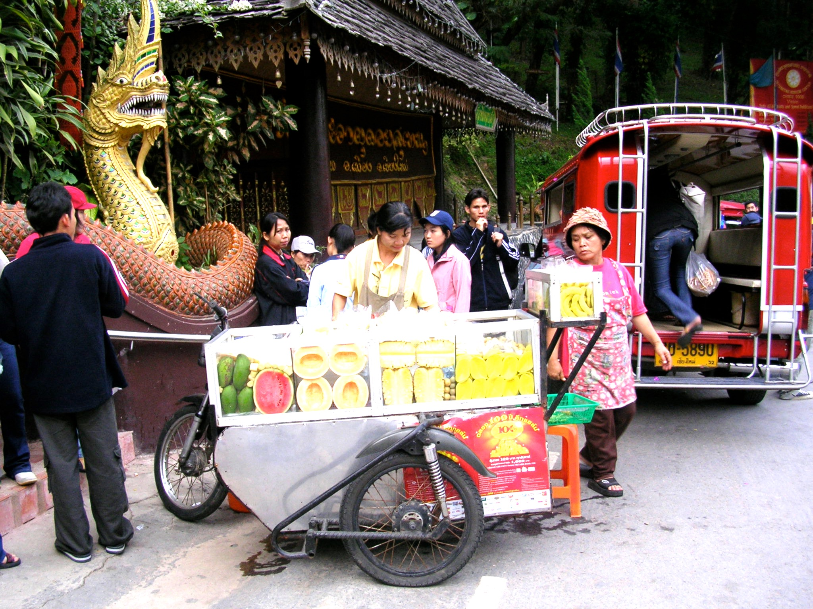
Thanks for your attention
A street vendor in Chiang Mai

