Slide 1
K4DWB
Knowledge for Development Without Borders
Contact: amouzou.bedi@gmail.com

Slide 2
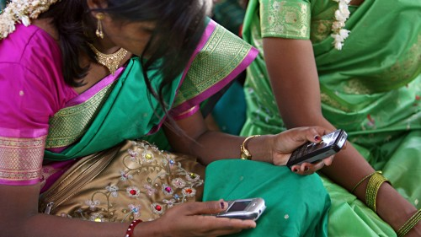
K4DWB
Knowledge for Development Without Borders
Contact: amouzou.bedi@gmail.com

Slide 3
Information and Knowledge
Knowledge has an important role to play in addressing development issues, but this requires access to information as well as the availability of relevant and useful knowledge.
Right information and Knowledge is central to sustainable development. Information and Knowledge are essential for survival and sustainability.

Slide 4
Can you believe that…?
…there is currently no platform or information system which collects and addresses problems around the world?
… in many cases there is no reliable information concerning what would be needed to solve the problem?
BUT: … ngos, development organizations, development research institutions, private sectors, banks and development funding agencies could be connected through a globally accessible database and use this information to identify the most useful development processes!

Slide 5
The relevancy of K4DWB
The mission of the K4DWB outlines a work progress war against the afflictions of poverty, famine, cybercrime, youth radicalization, violent extremism and war.
“We see more global warming. Unfortunately, we could not solve all the problems of the world at the same time. But it is potential and useful to have a simple, strong, and independent global platform so called development Service Support like K4DWB which covers the social, economic, cultural and environmental challenges of the people who are in needs for immediate or future actions so that they could not feel that they have been excluded or marginalized!”
We aim to connect a global audience to necessary resources while providing a central global support system to make development issues and best practices available to all, and to translate the available goals, data, information and knowledge into sustainable local best practices.

Slide 6
The relevancy of K4DWB
…..we want to increase
Knowledge about MDGs, SDGs and other development trends and policies worldwide.
Access to first-hand data, information and Knowledge on development issues through a support mechanism.
For example: local rain forest will disappear without action or there are suspicious and unofficial social or environmental activities that could affect the lives of a group of populations and the local environment, local volunteers will sound the alarm by raising a development aid support request via K4DWBs central database.

Slide 7
The activities of K4DWB
K4DWB is…
aiming to translate the MDGs and SDGs into concrete practices and define action steps.
mobilizing local communities, governments and NGOs to work towards the achievement of the MDGs.
collecting and processing information and knowledge from the ground on our integrated central platform and making it available to development organizations and responsible bodies.

Slide 8
How this works in practice?
Local volunteers are educated (Awareness is raised among communities about MDGs and SDGs)
Local volunteers go into their community to note any issue
Volunteers are able to point out and report problems and/or best practices, by raising a request for development aid via a central coordinated database using web or mobile for action or intervention

Slide 9
The advantages of this practice
Better Information
Universal accessibility via a central database
Relevant in helping governments, international agencies, the private sector and CSOs
Ability to track and monitor human development frustrations, challenges, needs, and progress
Through higher reliability as decisions, interventions and investments are evidence-based
Strengthened accountability

Slide 10
The advantages of this practice
Young people, students, community, and interested volunteers in this practice will receive new skills that will serve them well in marketing themselves;
They have the opportunity to analyze and understand their own local development challenges and frustrations so that they could engage themselves in development arena to fix these social, economic, environmental, cultural and politic challenges immediately or in the future.

Slide 11
The Role of this practice
The practice intensifies the communications in sharing good news stories of citizens acting in their communities and, most importantly, making social development goals simple and relevant every day, to everyone.
Therefore, every single person wherever is given the voice to express the needs of it community via a coordinated central database.

Slide 12
Why a collaboration would be beneficial
Quality Assurance. Better information and knowledge is universally accessible via a central database.
K4DWB benefits:
governments, international agencies, the private sector and CSOs.
the ability to track and monitor human development frustrations, challenges, needs, as well as their progress in real time via website or mobile App.
decisions, interventions and investments to be evidence-based.
strengthen accountability, reliability, transparency, effectiveness and sustainability.

Slide 13
Our Tool
We build the efficiency of our program around communities mobilization and a globally accessible database. The database has the purpose of helping ngos, development organizations, development research institutions, private sectors, banks and development funding agencies be able to use this information and Knowledge for helpful purposes such as to identify the most useful development processes and policies.
In addition, information and knowledge provide by local communities are used to raise awareness with responsible bodies so that development issues are addressed.

Slide 14
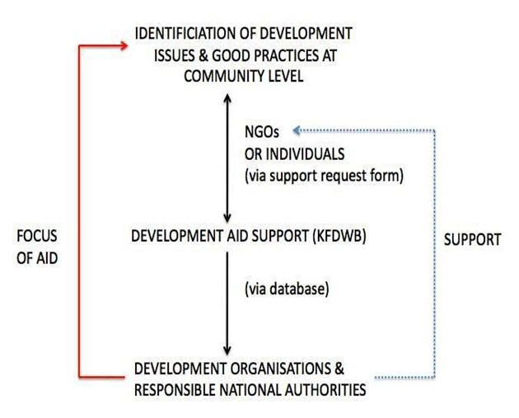
Our Operational System
Receive and process data.
An unbiased expert evaluates the situation locally.
We accept or reject the Aid Request based on reliability.
Contact interested stakeholders offering the development case study through our development aid support mechanism (database)
Local communities receive the requested aid.

Slide 15
Example of a logfile - What information do we store?
K4DWB Unit
Region
Development issue
Number of populations concerned
Education level of the concerned populations
Local capacity level of the concerned populations
Availability of the other basic needs for human existence
Additional information
Date and Signature
Log File Reference: | e.g. KFDWB 200774
KFDWB Unit: | e.g. KFDWB - West Africa 034
Knowledge Customizer Name: | e.g. Ms./Mr. Muster man
Region | e.g. Continent: Africa
 | e.g. Division: KFDWB - Centre Africa - West Africa
 | e.g. Regional KFDWB: West Africa ID2007
 | Country: e.g. Muster Country
 | Locality: e.g. Village xxx
Development issue identified | Description: e.g. Sounding alarming no hospital nearby. The villagers’ kids die of malaria or other diseases because there is either no hospital nearby, even they cannot afford the cost when there is a hospital.
 | Priority: high
Number of populations concerned: | e.g. 500.000
Education level of the concerned populations: | e.g. Middle (Most of the populations in the village do not go to school)
Local capacity level of the concerned populations: | e.g. Weak - There are no action, no guidance, no engagement and no mobilization of the populations to undertake the process of having access to a local hospital
Availability of the other basic needs for human existence: | e.g. The populations are living in survival modus (lack of health care, sanitation, clean water, employment, local cooperation, food, inter alia, guidance) etc.
Additional information: | e.g. Inspection, verification videos, reportages, assessments, evaluations, meetings, documentations etc.
Date and Signature:

Slide 16
What kind of support is needed?
Financial support
Volunteers, experts & partners around the world
IT Infrastructure - our platform
- Cloud system to store the relevant data
- A system which is capable of complex data classification
& user-friendly for all

Slide 17
Quick Links
development aid support ngo jobs
capacity for development
scoop.it facebook
twitter
K4DWB

Slide 18
K4DWB
“Imagine a world
in which every single person on the planet is given the chance to understand,
to know and play its role in sustainable development.”
Thank you

