Slide 1
ENI Cross Border Cooperation 2014-2020
Interreg, inter-regional cooperation and cross-border cooperation with neighbourhood countries 2014-2020: state of play
Lunchtime briefing, 7 May 2015,
European Committee of the Regions,
Nathalie Thiberge, DG NEAR, European Commission

Slide 2
First generation of integrated CBC between Member States and Partner countries: ENPI CBC 2007-2013
As from 2007: Fully integrated projects with one contract covering both sides of the borders
Single set of rules
Grants cover up to 90% of the eligible expenditure
Pooled ERDF/ENPI funding (+ national cofinancing in some cases)
Total EU contribution: 950 m EUR (ERDF + ENPI)
13 (out of 15 initially envisaged) Programmes on-going on the EU external borders with Joint Managing Authorities established in Member States

Slide 3
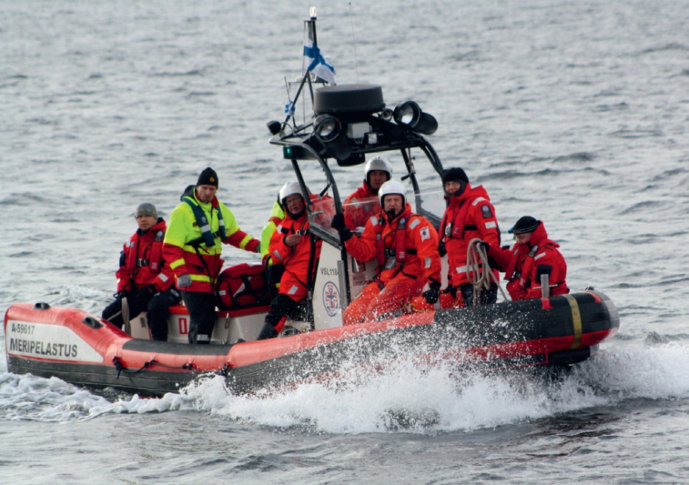
What types of Projects did we implement so far?
1."Standard projects" selected via Call for proposals: 933 ongoing or already finalised
First example: RescOp: development of rescue operations in the Gulf of Finland (ENPI CBC South East Finland Russia)

Slide 4
What types of Projects did we implement so far?
1."Standard projects" selected via Call for proposals: 933 ongoing or already finalised
Second example: Medgeneration: Mobilising Southern Neighbourhood diaspora established in EU Member States to finance start-ups in Lebanon, Jordan and Palestine. (ENPI CBC Mediterranean sea basin programme)
Third example: Not for Sale - Say stop to human trafficking: increasing awareness of children about human trafficking (ENPI CBC Romania, Ukraine, Republic of Moldova)

Slide 5
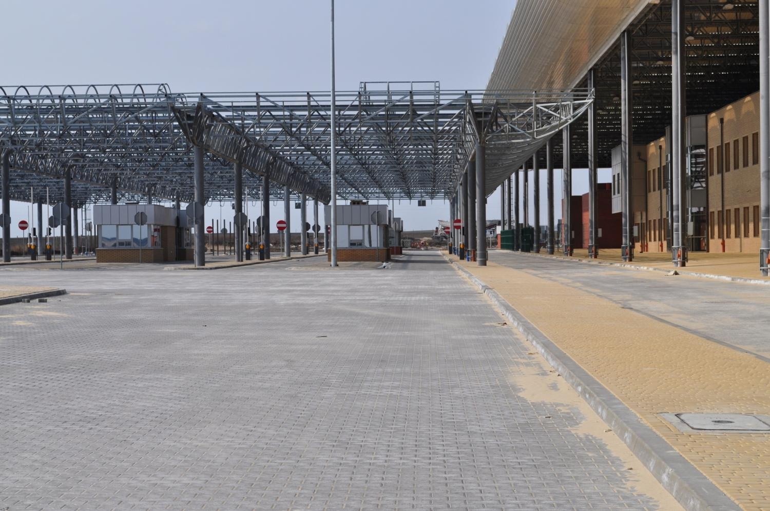
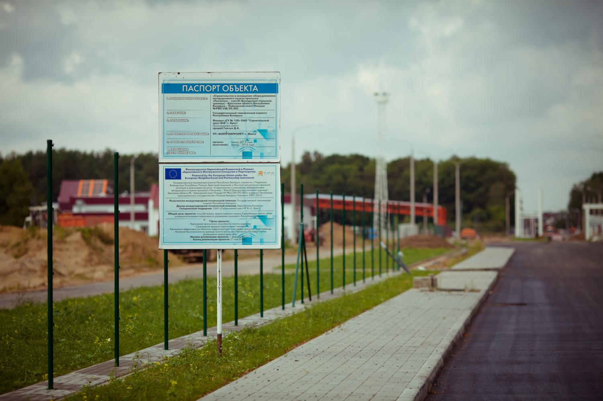
What types of Projects did we implement so far?
2. Large Scale Projects identified and selected directly by the participating countries – Direct award. 51 projects mainly on renovation of border crossing points, roads etc.
ENPI CBC Poland-Belarus -Ukraine - Construction of the Road Border Crossing in Dołhobyczów & Construction and instrumentation of the road border checkpoint “Peschatka

Slide 6
So far, CBC between MS and neighbouring countries in a nutshell:
High quality project implementation (confirmed by external monitoring)
Strong interest and commitment at all levels (programme & project) despite a difficult context (political crisis etc)
"CBC" impact to be reinforced (new programmes more targeted)
Capacity building needs at local level in Partner countries

Slide 7
What next? The ENI CBC 2014-2020
Continuity principle
Shared management
More financial responsibilities to both MS and PC
17 programmes (3 trilateral programmes split into bilateral ones and a new "basin programme" the Mid Atlantic Sea Basin)
4 out of 10 Thematic objectives to select per programme

Slide 8
2014-2020 ENI CBC programmes
(EU contribution 1,052 MEUR)
Land Border Programmes | Sea crossing Programmes
Kolarctic | Italy/Tunisia
Karelia
South East Finland/Russia
Estonia/Russia
Latvia/Russia
Lithuania/Russia
Poland/Russia
Latvia/Lithuania/Belarus | Sea Basin programmes
Poland/Belarus Ukraine | Baltic Sea Region
Hungary/Slovakia/Romania/Ukraine | Black Sea
Romania/Ukraine | Mediterranean Sea
Romania/Moldova | Mid-Atlantic

Slide 9
Challenges ahead
First time that Programmes have to develop their own procedures (DMCS, expenditure verification in PCs etc)
Higher responsibilities of Partner countries (e.g. recoveries) (capacity issue)
Financing Agreements negotiations (procurement, cofinancing, controls and checks)

Slide 10
Expected timeline
Submission of JOP: 30 June 2015 ( to secure 2015 ERDF allocation)
Objective: Decision adopted by the EC by the end of 2015 ( if not: both 2015 ENI and ERDF allocations lost)
Financing agreements to be signed at the latest at the end of the year following the programme adoption (2016)
First calls for proposals 2016/2017
First projects: 2017

Slide 11
How are the CBC programmes MS/PC prepared? What is the Legal framework?
ENPI / ENI regulation: sets the principles of CBC between MS and PC
CBC Strategy paper/programming document : lists the objectives, programmes' areas and budgets
Implementing rules: gives the framework for implementation
JOP: developed by participating countries: Specific objectives, project selection, programme management etc
Financing agreement to be concluded between the EC and each of the PC involved

Slide 12
What is the CBC between
Member States and Partner countries for ?
Avoid creation of new dividing lines
Contribute to integrated and sustainable regional development between neighbouring border regions and harmonious territorial cooperation over the borders

Slide 13
Want to know more?
http://ec.europa.eu/enlargement/neighbourhood/cross-border-cooperation/index_en.htm
http://enpi.interact-eu.net/enpi/358
http://capacity4dev.ec.europa.eu/home (Cross-Border Cooperation 'neighbourhood' group)

