Slide 1
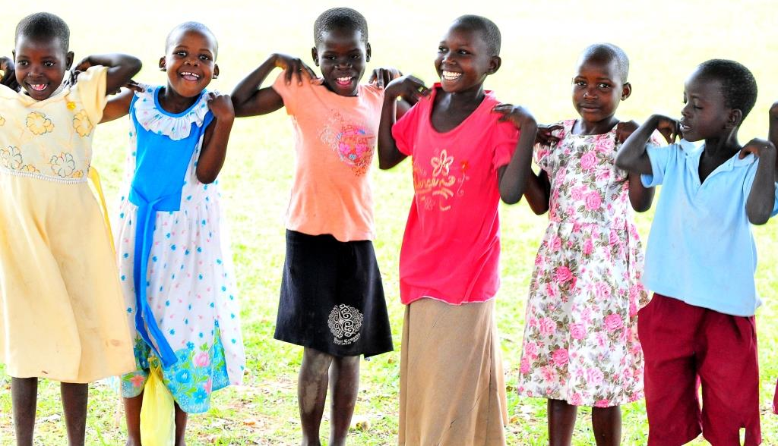

the Plan: to enhance livelihoods and social inclusion of marginalised young people dependent on the informal economy
Notes:
1

Slide 2
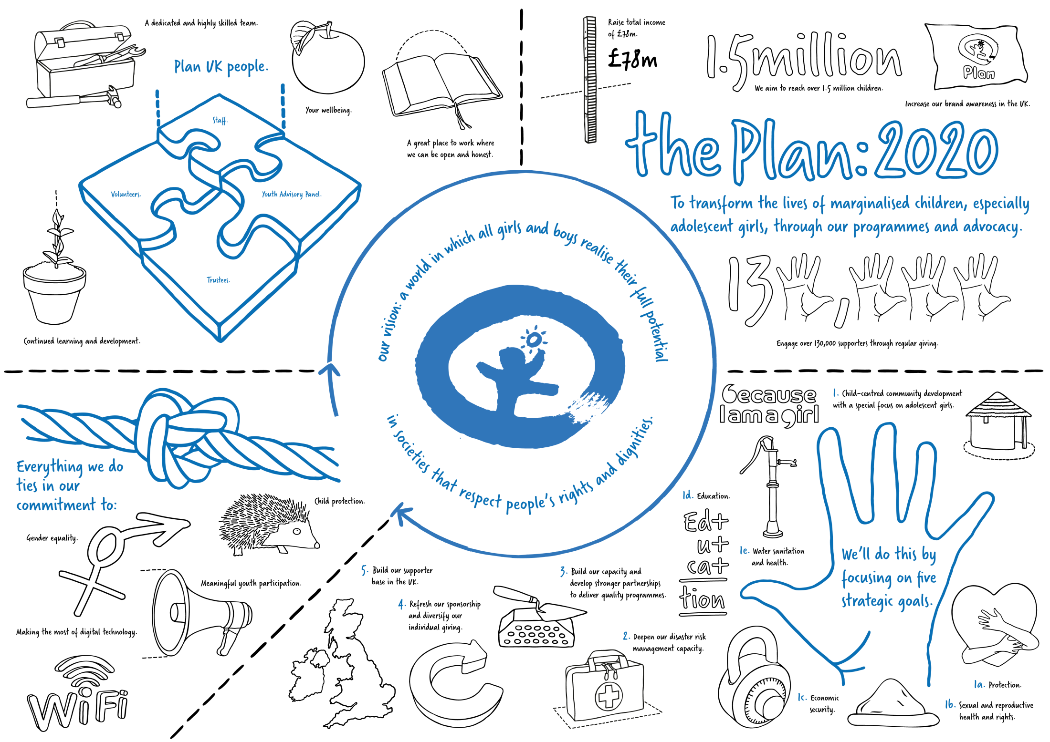

Slide 3
Each year, 1 million new young people arrive on the Tanzanian job market
Whilst Tanzania’s economy is growing quickly, marginalised youth groups are not benefitting
They experience the highest unemployment rates. In Dar es Salaam youth unemployment is over 30%, partly due to rural-urban migration.
They struggle to access market-relevant skills training, services and information for employment linking;
and are not represented in regional and national initiatives on youth livelihoods.
The opportunities that do exist are low paid, or even dangerous, especially where they fall outside the formal regulatory frameworks and protection
These problems are more acute for particularly marginalised groups, such as young women (who have to face gender norms) and people with disabilities (only 11% of people with disabilities are employed according to the 2008 Disability Survey)
the Plan:
to work with the world’s poorest children so they can move themselves from a life of poverty to a future with opportunity

Slide 4
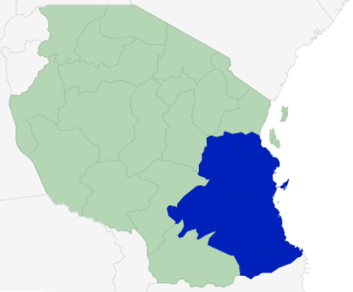
The intervention logic
Overall Objective: To contribute to the reduction of poverty and exclusion amongst vulnerable groups who are dependent on the informal sector in Tanzania
Specific Objective 1: To improve and increase opportunities for wage and self-employment among marginalised young men and women dependent on the informal sector in Dar es Salaam, Pwani, Morogoro, Lindi and Mtwara regions
Result 1
9,100 marginalised young men and women have improved market-relevant skills and knowledge
Result 2
Marginalised young women and men access financial services and employment opportunities
Specific Objective 2: To improve economic empowerment among marginalised young men and women through meaningful participation and stronger linkages between youth groups, government and the private sector.
Result 3
Increased knowledge among young men, women, and employers of government policies and services, and of labour market information
Result 4
Marginalised young women and men are empowered to represent their interests in the labour market and government decision making processes.
the Plan:
to work with the world’s poorest children so they can move themselves from a life of poverty to a future with opportunity

Slide 5
The intervention logic: the Youth Economic Empowerment Pathway
Empowerment, work and life skills
Career information and informed choice
Training for employment
Job placement
Follow-up
Placement for job-ready youth
Business training
(start-up)
Business development, market linkages
Support for success
Access to finance
Integrated intervention leading to both wage- and self-employment opportunities through a combination of skills training, access to finance and follow-up support incorporating CCCD principles.
the Plan:
to work with the world’s poorest children so they can move themselves from a life of poverty to a future with opportunity

Slide 6
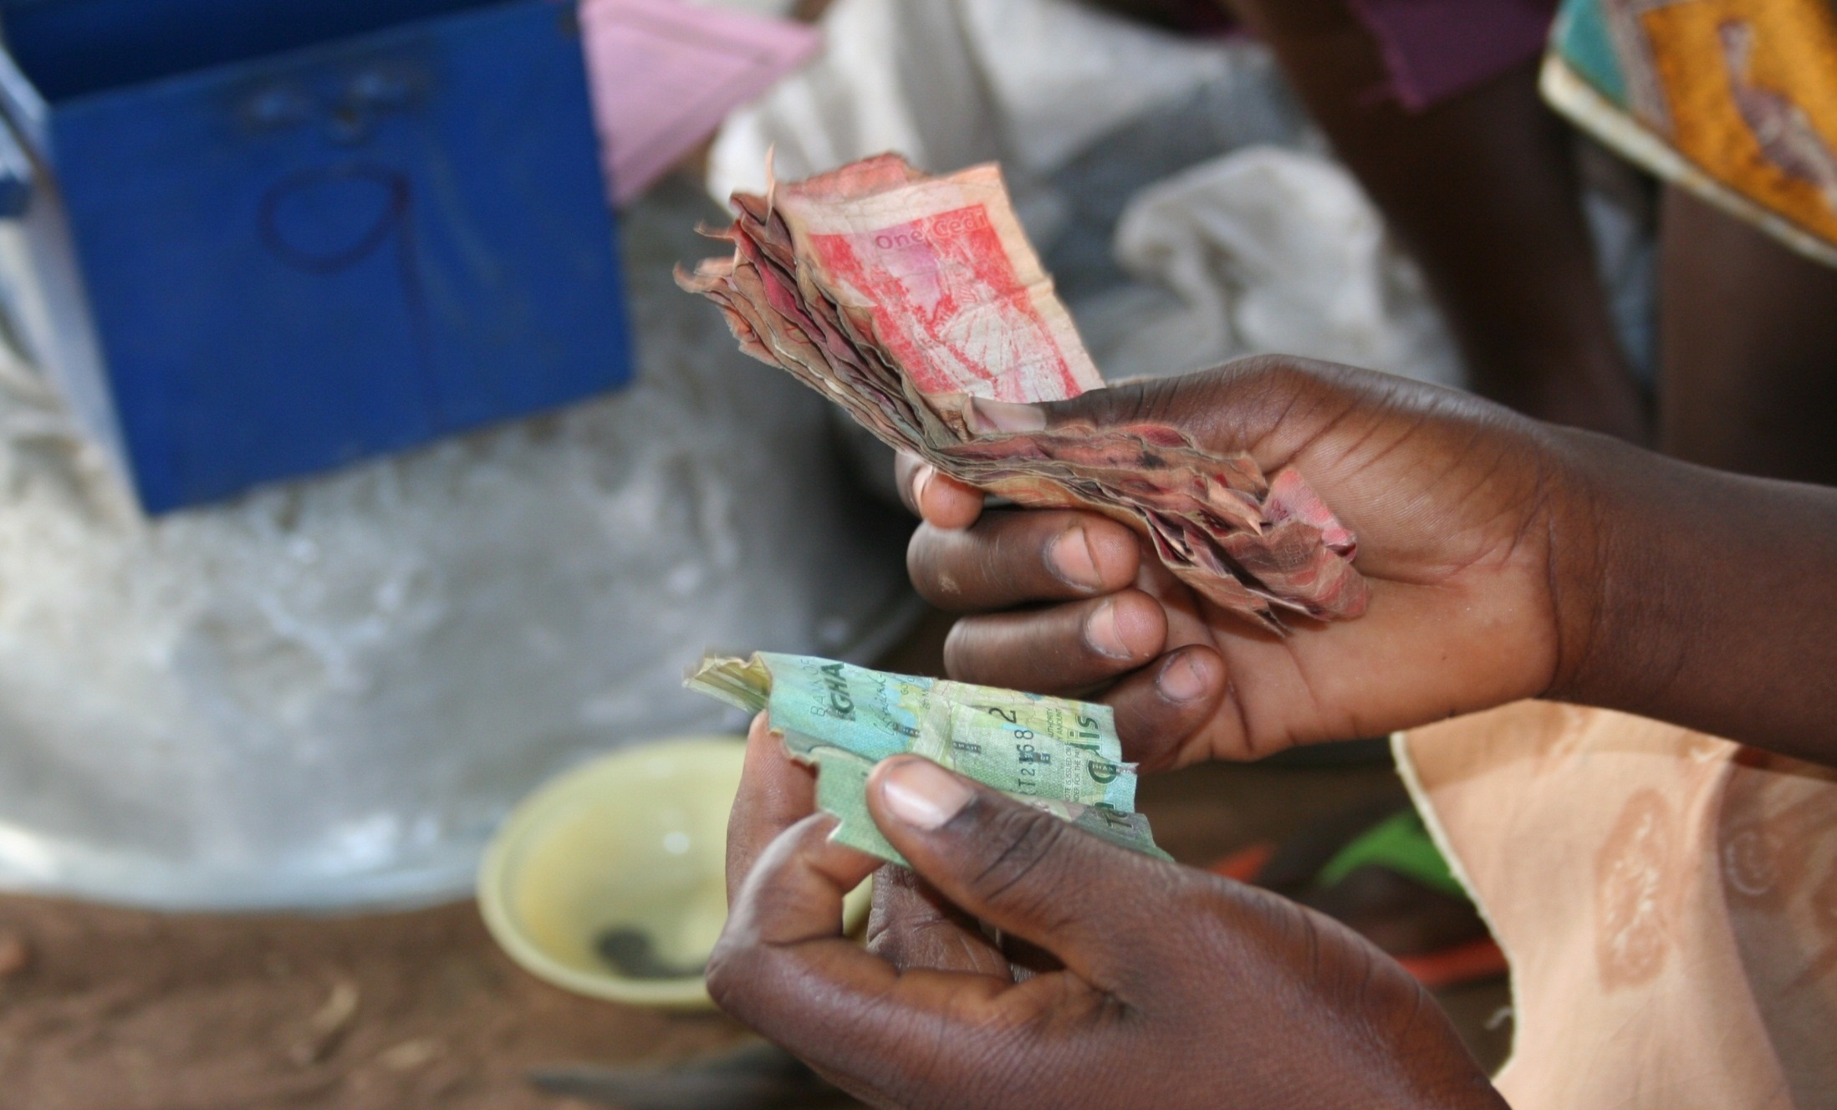

The intervention logic:
Village Savings and Loans Association
Subheading 22pt Arial bold subheading 22pt Arial bold
Self-selected group forms VSLA and organises to have regular meetings
Liquidation: accumulated savings and interest earnings are shared out at an agreed point.
First level body text or bullet point 20pt Arial regular
Second level body text or bullet point 24pt Verveine
Second level body text or bullet point 24pt Verveine
Savings collected as shares and invested into loan fund.
Loan repayments and interest is invested back into loan fund
Members also contribute to ‘social fund’ (a form of micro-insurance)
Undisbursed Savings kept in lockable cash box with 3 keys
Members can take loans from the loan fund at a rate defined by the group
the Plan:
to work with the world’s poorest children so they can move themselves from a life of poverty to a future with opportunity

Slide 7
Who will benefit from the project?
9,100 particularly marginalised Youth
53% female
10% people with disability
Low levels of formal education
Adults stakeholders
18,200 parents/guardians (54% female)
270 master craftpersons (30% female)
At least 150 private sector employers
Young mothers and single parents
Affected by HIV/AIDS
Coming from youth-headed HH and particularly poor families
At least 100 staff (30% female) from national, regional and district government authorities
90 VETA instructors (30% female)
Estimated indirect beneficiaries: 675,482 (361,477 female) young people, 50% of the population aged 15-35 in the 9 target districts through outreach activities and increased youth representation in government decision making

Slide 8
The project consortium
VSO
VETA
UHIKI
Plan
CODERT
CCBRT
Ministry of Information, Youth, Culture and Sport
Ministry of Labour and Employment

Slide 9
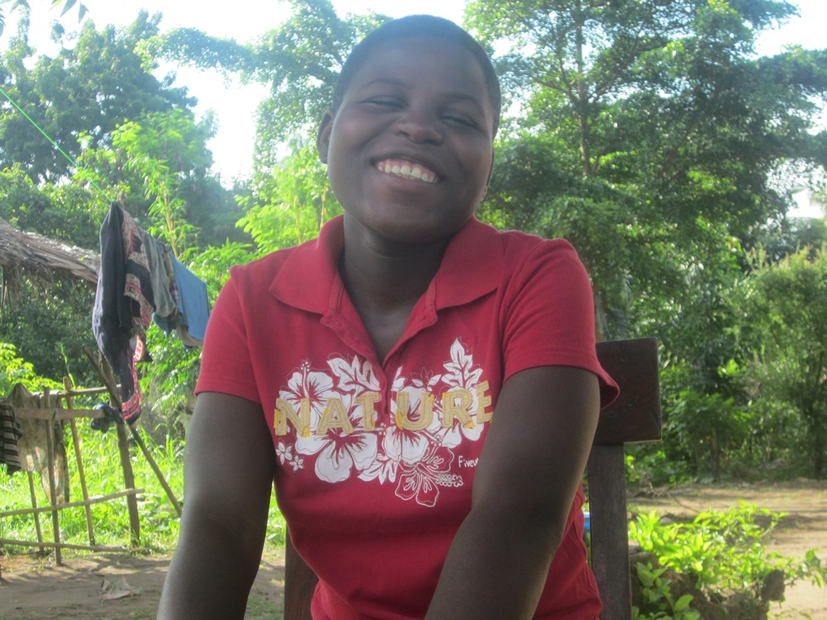
Thank you for your attention
Questions?
Notes:
9

