Slide 1
Seminario
Enfoque Territorial del Desarrollo Local
La facilitación de procesos
Qué significa y como jugar este papel?
Presentación por J. Bossuyt (ECDPM)

Slide 2
FACILITAR… FACILITAR … FACILITAR …

Slide 3
Porqué se necesitan ‘facilitadores’?
Visión del desarrollo como PROCESOS de cambio profundo en el tiempo
El fin de la ilusión que UN ACTOR puede hacer todo (lógica multi-actorial)
Partenariados entre varios actores con INTERESES differentes
Necesidad de facilitadores para llegar a compromisos
Accompanamiento de procesos

Slide 4
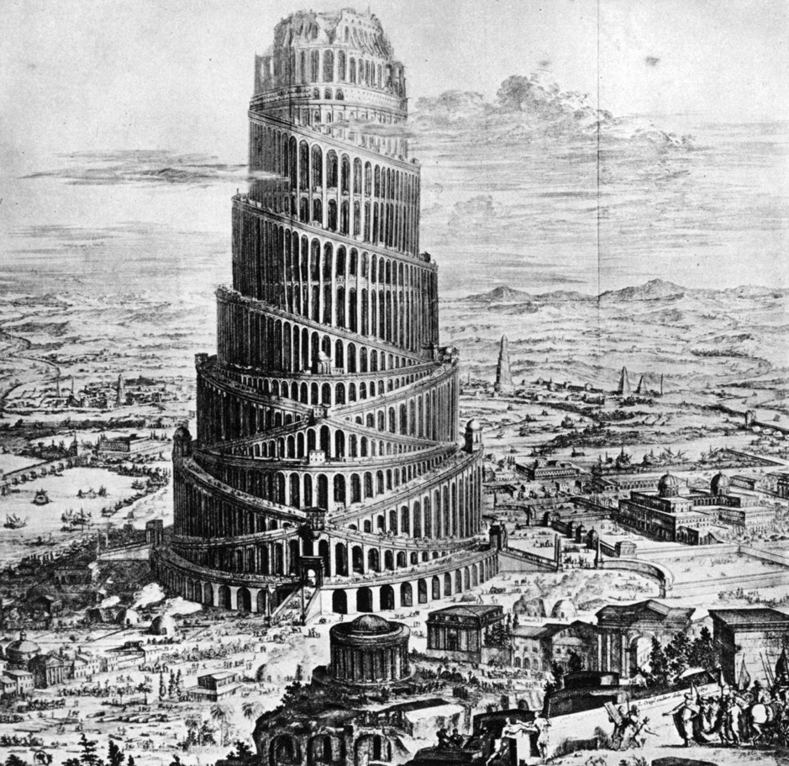
Crear algún orden en el caos …

Slide 5
Implicaciones para la UE
Cuestionamiento del papel tradicional de los donantes/EU (financiamiento)
Demandas internas (‘policy dialogue’, hoja de ruta sociedad civil)
Expectativas externas hacia la EU para actuar como facilitador
Mejorar el impacto

Slide 6
PRIORIDAD A LOS PROCESOS AL NIVEL PAIS
Procesos de plíticas públicas al nivel del pais
Donante
Gobiermo central
Ientre donantes
Como jugar un papel de facilitador?
Notes:
STRUCTURE AND CONNECT POLICY DIALOGUES TO ENSURE SPILLOVER EFFECT IN DOMESTIC POLICY MAKING
COM is an actor in the PD between domestic and external actors. But, in order to reach results it takes into consideration the wider dimension of Policy Dialogue within a country and seeks to connect all policy dialogues. Gives primacy to domestic policy dialogue
CALIBRATING PD OBJECTIVES TO SECTOR CONTEXT & PEA
Exerting influence versus supporting an open ended consensus building process around complex issues
Raise awareness on importance of reforms by bringing in technical inputs
Facilitation by helping structure national dialogue process (eg. Support participation of key domestic actors or convey their views; communicate)
In domestic process:
Broker: bring information =>understanding the context and assessing the content of PD
Capacity Development: support to stakeholders for their effective/owned participation
Table setting becomes a key roles for donors and agencies (including NGOs) to make the process credible and purpose-led: support to stakeholders for their effective participation
In Donor-Country dialogue:
Structuring of the process while leaving the leadership to the national parties around the table
Donor-Donor dialogue:
Division of Labour becomes critical for mobilising resources and coalition building

Slide 7
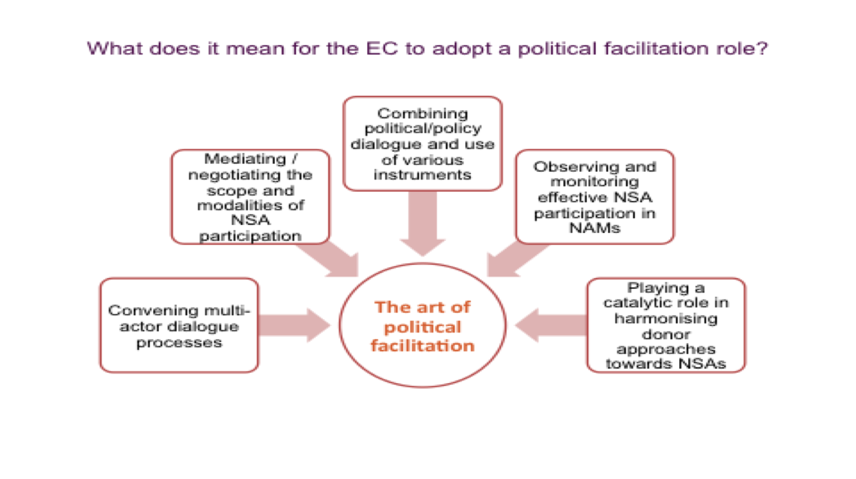
EC New Roles

Slide 8
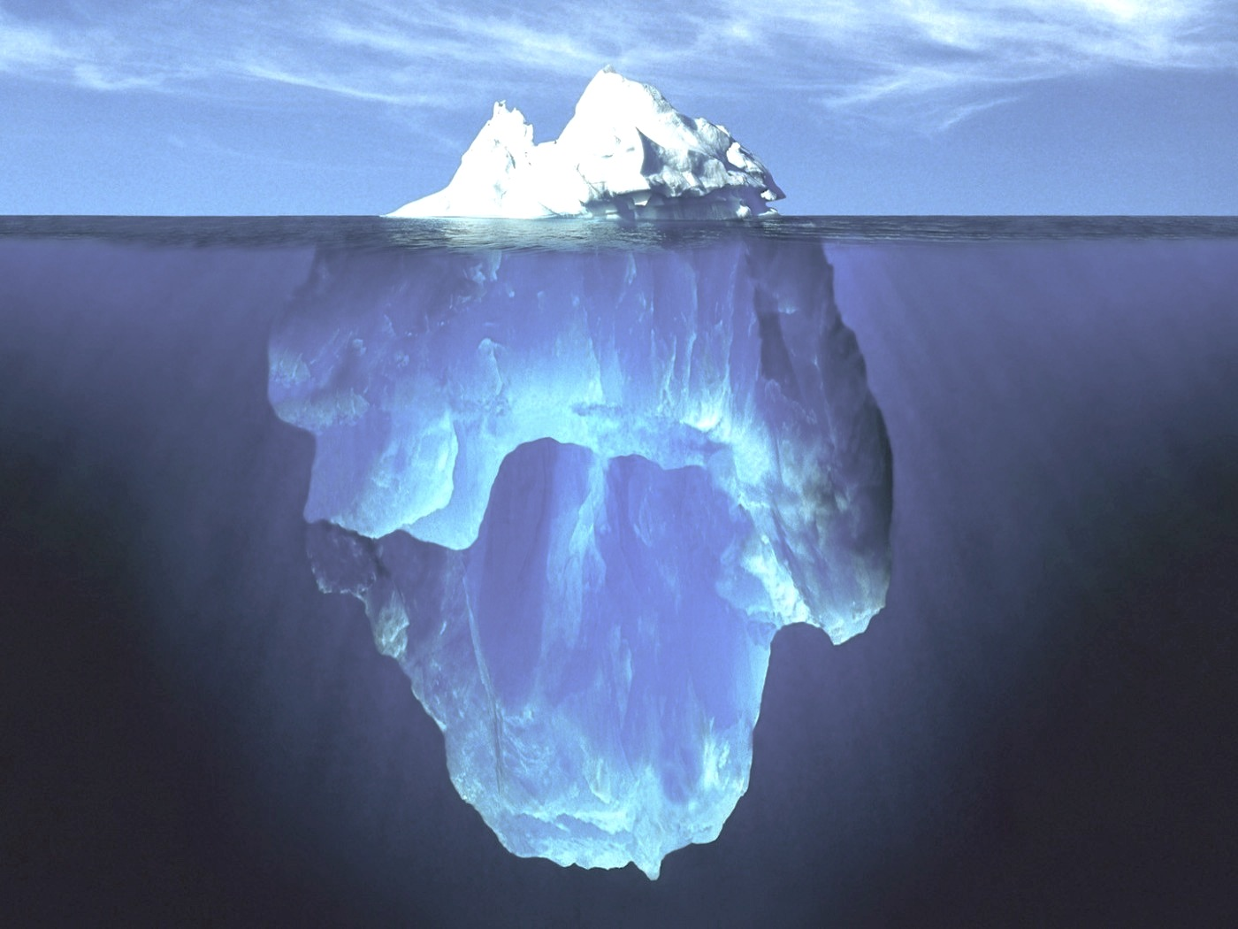
The visible word: national strategies, action plans, formal institutional structures, etc.
Political processes: contestation and negotiation of power, wealth and goods
Why do reforms fail to take root?
Need for a systemic approach with a specific focus on:
Economic and financial processes, and their link with politics
Formal and informal institutions
Relations, incentives and interests of actors « under the surface »

Slide 9
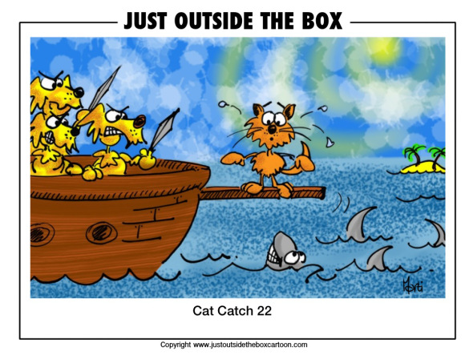
Facilitación: un arte y ejercicio de equilibrio

Slide 10
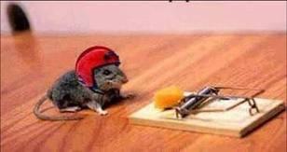
Tomar riesgos calculados

