Slide 1
Organising entrepreneurs and workers in the informal economy
Research Network Support Facility Seminar
1st- 3rd June 2015
Brussels

Slide 2
WIEGO AND SEWA EXPERIENCES
Women in Informal Employment: Globalizing and Organizing (WIEGO)
“A global research-policy-action network that seeks to improve the status of the working poor, especially women in the informal economy”
Created in 1997

Slide 3

Builds and strengthens networks of informal workers’ organizations
Undertakes policy analysis, statistical research and data analysis on the IE
Provides policy advice and convenes policy dialogues
Has enumerated more than 800 organizations with more than 3 millions members in its data base
Documents and disseminates good practices in support of the informal workforce; www.wiego.org

Slide 4

Was founded in the 1970s in Ahmedabad,
Was recognised as a trade-union in 1983.
Is major microfinance institution and is a founding member of WIEGO
2 millions members
Was part of the negotiations for the adoption of the Convention on Home Work (C177) by the International Labour Conference in 1997.

Slide 5
The working poor in the informal economy, especially women, need to organize to overcome structural disadvantages at the local, regional, and transnational levels.
Organizing provides:
The power of solidarity
A way to be seen and heard by decision makers from local to international policy level
Information sharing and (regional/international) influence

Slide 6
Formation of global networks greatly enhances advocacy
Since 2000, several transnational networks have been formed or consolidated:
  StreetNet International (2002)
  HomeNet South Asia (2000)
  Latin American Waste Pickers Network (Red Lacre) (2005)

Slide 7
  International Domestic Workers’ Network (IDWN) (2009)
  Global Network of Waste Pickers (2009)
  HomeNet East Europe (2013)
  The International Domestic Workers Federation (2013)
Notes:
was officially launched in 2013: initially an informal network, the Federation grew in numbers and solidarity through the successful campaign for an International Domestic Workers Convention (C189) which was adopted at the 2011 International Labour Conference (ILC)

Slide 8
Priorities, challenges and bargaining counterparts

Slide 9
Analysis Tool for Organising
Sector/Group | Priority Issues | Organizing Challenges | Bargaining Counterparts
Street, market vendors and hawkers | Right and space to vend Facilities: storage, shelter, toilets, water Protection against police harassment Safety and security Competition: protection against bad effects Access to credit | Not regarded as workers by selves and others Controlled by politicians, “mafia” Fear of harassment by authorities, police Competition amongst selves & formal sector Time spent on organizing means loss of income No forums for bargaining | Municipality: local economic development, health and safety, zoning National and municipal police Suppliers and buyers
Home-based workers | Equal income, benefits as factory workers Identifying employer End to exploitation by intermediaries Access to regular work Access to markets, to credit | Isolated in homes, invisible Time-double burden of work and home care Fear of losing work Restrictions imposed by religion, culture Children working Unprotected by labour law or disguised status | Contractors Tripartite boards Suppliers & buyers
Notes:
The participants already know this, you may just upload this page as an overview on the IESF as it does give an interesting overview, perhaps together with the other 2 slides I suggest deleting.

Slide 10
Organizing benefits (1)
Economic Benefits:
  Negotiating better wages and conditions
  Receiving better prices
  Pooling limited resources and increasing access to financial resources

Slide 11
Organizing benefits (2)
  Social Protection Benefits:
  Access existing social protection systems
  Build mutuality structures and achieve improved support systems
  Organizations can improve working conditions, including occupational safety and health (OSH)
Notes:
running schools, child care centers, and health centers, mobilizing assistance during disasters of hardships
including occupational health and safety (OHS) approaches for informal workers

Slide 12
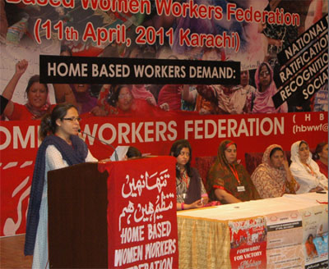
Organizing benefits (3)
  Intangible but Important Benefits:
    Organizing can lead to
    improved self-esteem
    social empowerment among informal workers

Slide 13

Successful achievements: domestic workers
In 2006, domestic worker organizations began to organize internationally with support of international trade unions and NGOs, including WIEGO
  Demands: to be recognized as workers with rights and related benefits
In 2008, after the International Labour Organization (ILO) decided to place Decent Work for Domestic Workers on the agenda of the International Labour Conferences in 2010 and 2011 a campaign for an ILO Convention was launched

Slide 14
Results
Campaign had immediate benefits and led to the adoption with overwhelming vote of two international labour standards:
  Domestic Workers Convention, 2011
  Domestic Workers Recommendation, 2011
Conventions: domestic workers are unconditionally defined as workers with the same protections under national labor laws and social protection schemes as other workers
National level ratification is a long term process, legislative changes are taking place as a result of the adoption of the Convention

Slide 15
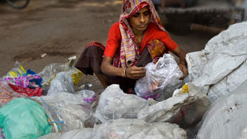
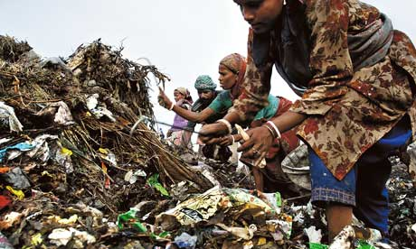
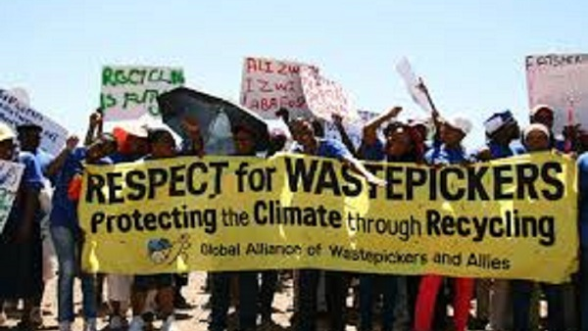
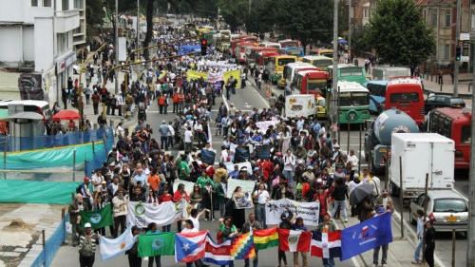
The struggle of wastepickers

Slide 16
The continuous struggle of waste pickers in Colombia (1)
For decades, recicladores (waste pickers) in Bogotá earned a living by recycling metal, cardboard, paper, plastic, and glass and selling the recycled material through intermediaries
An estimated 12,000 recicladores work in Bogotá
Recent privatization of public waste collection threatened livelihoods.
Previous municipal administrations in Bogotá granted exclusive contracts to private companies for the collection, transport, and disposal of waste and recyclables
In response, the Asociación de Recicladores de Bogotá (ARB), an umbrella association of cooperatives representing over 2,500 waste pickers in Bogotá, began a legal campaign to allow the recicladores to continue to collect and recycle waste.
Notes:
Shorten text

Slide 17
Results
The recicladores achieved a landmark victory in 2003 when the Constitutional Court ruled that the municipal government‘s tendering process for sanitation services had violated the basic rights of the waste-picking community.
In December 2011, scheme halted to award US$1.7 billion worth of contracts over ten years to private companies for the collection and removal of waste in Bogotá. The court mandated that the cooperatives of waste pickers had a right to compete for the city tenders and gave the ARB until March 31, 2012 to present the municipality with a concrete proposal for solid waste management inclusive of the waste picking community.
Notes:
I suggest you just explain this as opposed to having all this detail on the slide.

Slide 18
The continuous struggle of waste pickers in Colombia (2)
The current Mayor of Bogotá de-privatized waste collection, setting up a public authority to manage solid waste management and allowing ARB and other organizations of recicladores to bid for contracts.
With the help of WIEGO and others, the ARB prepared a proposal, elements of which were adopted in the official proposal made by the district agency in charge of the city‘s public service
In March 2013, waste pickers began to be paid by the city for their waste collection services.
In June 2014, the national government mandated that the Bogotá model be replicated in cities and towns across the country.
Vested interests in the private sector who want to regain control over the waste collection and recycling sector have mounted a political campaign to remove the current Mayor of Bogotá who rescinded some of the private contracts to set up a public waste management authority and brokered the contract with the recicladores. They argue that the public management of waste collection and the involvement of the recicladores undermine 'free competition" and are, therefore, illegal.
Notes:
I suggest you just explain this as opposed to having all this detail on the slide.
The most recent ruling, in December 2011, halted a scheme to award US$1.7 billion worth of contracts over ten years to private companies for the collection and removal of waste in Bogotá. The court mandated that the cooperatives of waste pickers had a right to compete for the city tenders and gave the ARB until March 31, 2012 to present the municipality with a concrete proposal for solid waste management inclusive of the waste picking community
The current Mayor of Bogotá honored this mandate by de-privatizing waste collection, setting up a public authority to manage solid waste management and allowing ARB and other organizations of recicladores to bid for contracts. With the help of WIEGO and other allies, the ARB prepared a proposal, elements of which were adopted into the official proposal made by the district agency in charge of the city‘s public service
In March 2013, waste pickers began to be paid by the city for their waste collection services. And, in June 2014, the national government mandated that the Bogotá model be replicated in cities and towns across the country.
Vested interests in the private sector who want to regain control over the waste collection and recycling sector have mounted a political campaign to remove the current Mayor of Bogotá who rescinded some of the private contracts to set up a public waste management authority and brokered the contract with the recicladores. They argue that the public management of waste collection and the involvement of the recicladores undermine 'free competition" and are, therefore, illegal.

Slide 19
Organizing informal workers is different than organizing formal workers (1)
The “employment relationship” between a recognized employer and employee has historically represented the central legal concept around which labour law and collective bargaining agreements have sought to recognize and protect the rights of workers
Usually excluded the self-employed but also wage workers or employees who are hired by firms in ways that disguise the employment relationship or make it unclear and ambiguous
Many key stakeholders– policy makers, trade unions, other workers do not perceive or recognize informal workers as workers
Notes:
: which is the case with most informal wage workers

Slide 20
Some informal workers do not perceive themselves as workers, especially women and, in particular, those who produce goods and services in their own homes (home-based workers) or in the homes of others (domestic workers)
Informal workers belong to various statuses in employment making it difficult to organize around a single identity.
Individual workers may be engaged in multiple activities and/or employment statuses within a single day, month, or year

Slide 21
Most informal workers:
do not work in a standard workplace
deal with multiple points of control or multiple dominant players
face control points and dominant players that are often sector- specific: they have to negotiate on several fronts with private businesses and with local authorities
Notes:
but work primarily in public spaces (streets, markets, pastures, forests, waterways), in private homes (as home-based producers or domestic workers), or on private farms

Slide 22
New and innovative approaches to organizing and collective bargaining are needed:
At the local level, organizing takes different forms depending in part on the local political and legal environment
  trade unions
  cooperatives
  associations of various kinds
  savings-and-credit groups
  self-help groups

Slide 23
And no one model fits all
  In many countries, there are unregistered associations that function like cooperatives or trade unions but find it difficult to register as such. But to some extent, organizational form follows organizational function

Slide 24
Models
  Domestic workers who need solidarity in order to bargain with their employers often form or join trade unions
  Self-employed home-based workers often form associations to leverage skills training, product design, and marketing services
  Industrial outworkers who work from their home need to form unions for collective bargaining with employers and their intermediaries
  Street vendors need to bargain collectively with local authorities often form unions or market-specific associations
  Waste pickers who provide recycling services to cities or cleaning services to firms often form cooperatives

Slide 25
Lessons learned
At the heart of each of these successful campaigns, except for the domestic workers campaign, was a legal case.
Key to the success of the legal cases was access by the informal workers and their organizations to free pro-bono, high-quality, and responsive legal assistance
Technical knowledge and political support from civil society—most importantly, from the informal workers themselves –were critical to the success of the legal case

Slide 26
The motto of StreetNet International :
"Nothing for us, without us”
Reflects the key enabling condition to ensure more and better work opportunities for the working poor in the informal economy:
Participation of organizations of informal workers to help develop appropriate policies, laws and regulations that recognize, validate and integrate their work and livelihoods.

Slide 27
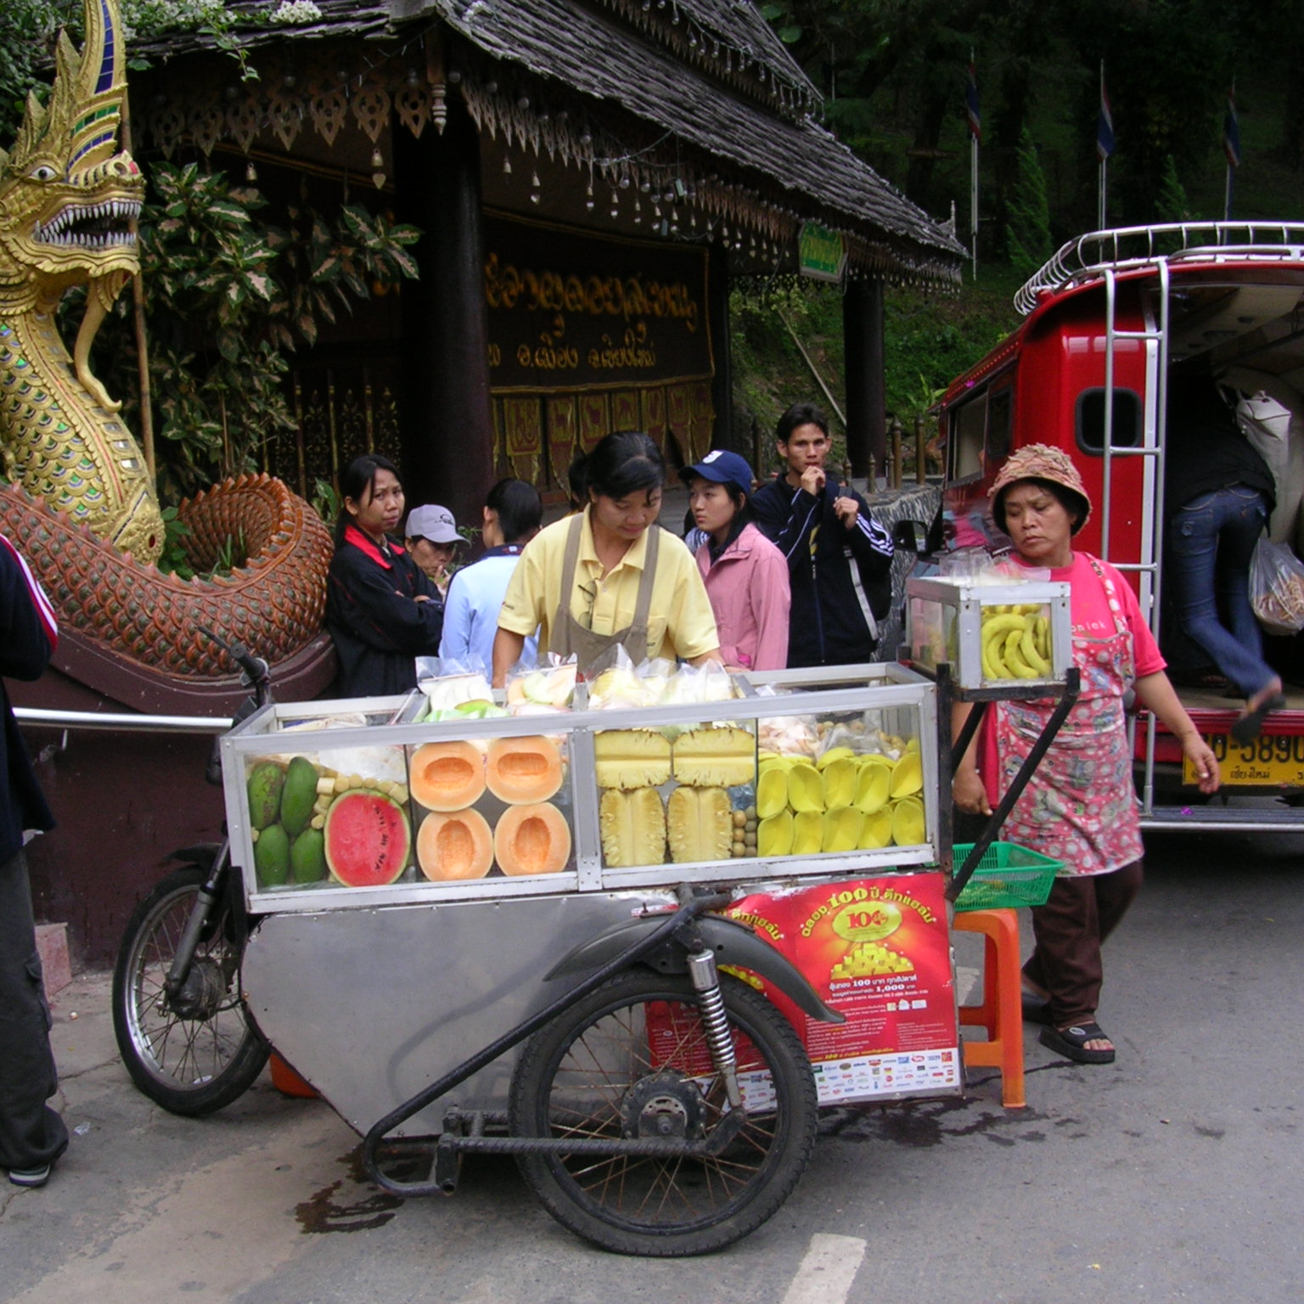
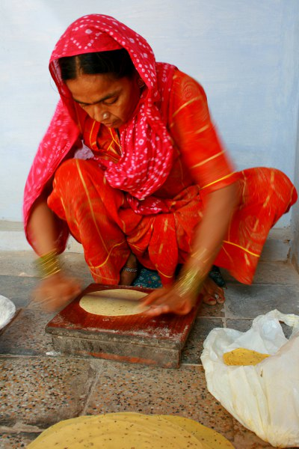

Thanks for your attention
A home-based worker in India

