Slide 1
Sustainable Energy Options for the Water Industry
Winston Moore (PhD)
Department of Economics
University of the West Indies, Cave Hill Campus
Notes:
Good morning everyone, it is my pleasure this morning to try to pull together these two topics and illustrate the benefits that are available for the Caribbean.
Water and energy are intertwined. Producing energy uses water and providing freshwater uses energy. Both of these processes face growing limits and problems. In most power plants, water cools the steam that spins the electricity generating turbines. This therefore implies that where every there is a shortage of one of these resources the other would be impacted.

Slide 2
Overview
The link between energy and water
Motivation for adopting sustainable energy options in the Caribbean
Policy options for reform
Recommendations

Slide 3
Link between energy and water…

Slide 4
The link between energy and water
Innovations
Watershed planning & management
Equitable allocation between consumptive and non-consumptive uses
Cost recovery pricing
Multi-stakeholder participation in governance
Notes:
Watershed planning and management comprise and approach to protecting water quality and quantity that focuses on the whole watershed. Due to the variety of land based sources of pollution (development, transportation, agriculture).
Water used consumptively diminishes the sources and is not available for other uses; whereas nonconsumptive water use does not diminish the source or impair future water use. Key nonconsumptive water uses include hydroelectric projects, fish hatcheries. Implies that water should be returned in the same quantity and quality.
Prices are one of the most efficient information mechanisms we have and have a significant impact on the decisions we make. When prices do not reflect the full costs and benefits of production and consumption, issues related to resource scarcity and environmental impacts aren’t made known to the consumer. This includes the abstraction, use or pollution of water. I will show you a slide that quite clearly shows the implications of not getting this price mix correct.
In addition to the other innovations mentioned above, there has also been a shift to integrated governance in water resource management. Developed in the 70s and adopted in the 90s, has quickly become the dominant approach to managing water rights. It considers the management of shared water resources in a holistic way and focuses on a participatory approach that involves users, planners and policymakers at all levels.

Slide 5
The link between energy and water (cont’d)
Rio +20
  “we consider [the] green economy in the context of sustainable development and poverty eradication as one of the important tools for achieving sustainable development …”
  Water and energy efficiency were identified as critical components of a green economy and sustainable development.

Slide 6

The link between energy and water (cont’d)
Identified options for greening the economy of Barbados
Key cross-cutting issues were:
  Water
  Waste
  Energy
Notes:
one of the most water scare countries in the world
tourism destination
housing and tourism development
electricity is largely generated using fossil fuel
how to management the waste of about 300,000 locals and more than half a million tourists

Slide 7
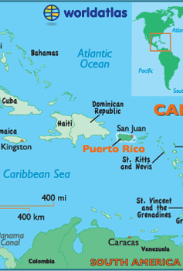
Advancing Caribbean States’ Sustainable Development Agenda through Green Economy (ACSSD-GE)
Endorsed by the 37th Special Meeting of COTED
US$1.55 million
Support for technical assistance, capacity building, investment reforms, etc.

Slide 8
The link between energy and water (cont’d)
Water for energy
  VINLEC
  DOMLEC
  Micro-hydro generators in Cuba
Notes:
St. Vincent Electricity Services (VINLEC) has invested in three hydroelectricity plants (South Rivers plant is 870kW; Richmond 550kW; Cumberland new development.)
Dominica Electricity Services (DOMLEC) hydro accounts for 48% of generation capacity
Micro-hydro generators provide energy to some rural villages in Cuba

Slide 9
Motivation for adopting sustainable energy options in the Caribbean…

Slide 10
Comparative Fossil Fuel Consumption
Notes:
Most recent year of data

Slide 11
Trends in Electricity Production
Caribbean
OECD
Notes:
the focus is not on the comparative difference in terms of magnitude but in terms of trajectory

Slide 12
Efficiency of Energy Use
Notes:
shows the impact of pricing on consumption decisions where Trinidad's consumption of fossil fuel is so heavily subsidized that efficiency in energy use is very low.

Slide 13
Jamaica -
National Water Commission’s Operating Expenses
Notes:
http://www.nwcjamaica.com/PDFs/FinancialStatements/Audited%20Financial%20Statements%20-%20Mar%202013.pdf

Slide 14
St. Lucia’s Water and Sewage Company Inc.

Slide 15
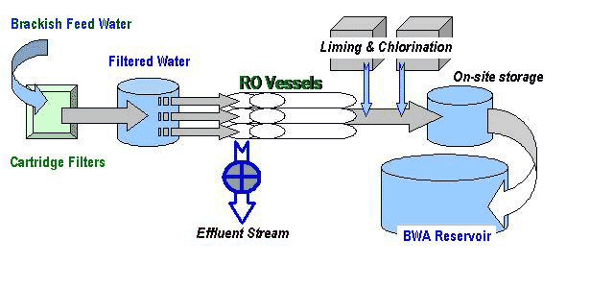
Barbados Water Authority
Brackish Water Reverse Osmosis Desalination plant
energy consumption (1kWh/m³)
Solar array installed to defray electricity costs
Notes:
Unfortunately, as climate change is altering the hydrology of our planet, water will no longer be avail- able in the places, at the times and of the quality that it historically has been. One of the most dangerous effects of climate change is a risky rise in water variability.
30,000 m3/day brackish water reverse osmosis desalination plant
build-own-operate contract
in 1994-95 island experience a 1 in 150 year drought resulting in the loss of water to the whole of Bridgetown, including the Queen Elizabeth Hospital.
since 2000

Slide 16
Motivation for adopting sustainable energy options in the Caribbean
Notes:
Simulation of the likely losses from a shock to energy prices

Slide 17
Links to the green economy…

Slide 18
Water industry energy use
‘Dynamic’ and ‘Smart’ link between energy demand and supply for the water industry
Renewable energy can be used to:
  backup an unpredictable supply
  reduce the cost of energy
Notes:
A number of technologies offer opportunities to address the water-related impacts of energy use. 1. Energy efficiency. By making appliances, buildings and vehicles more efficient less electricity is required and therefore less water is needed for the generation of electricity.
2. Use of renewable energies to reduce the demand for energy (both from the perspective of the utility and household) and hence water

Slide 19
Cost of Various Renewable Energy Technologies

Slide 20
Break-even oil price

Slide 21
Capital costs

Slide 22
Reducing Energy Costs in Water and Waste-Water Facilities: The Case of Barbados
Variable frequency drives
PV systems
Natural gas generators at pumping stations
Notes:
Expected to be installed in all facilities by October 2015
A Variable Frequency Drive (VFD) is a type of motor controller that drives an electric motor by varying the frequency and voltage supplied to the electric motor. Other names for a VFD are variable speed drive, adjustable speed drive, adjustable frequency drive, AC drive, microdrive, and inverter.
Frequency (or hertz) is directly related to the motor’s speed (RPMs). In other words, the faster the frequency, the faster the RPMs go. If an application does not require an electric motor to run at full speed, the VFD can be used to ramp down the frequency and voltage to meet the requirements of the electric motor’s load. As the application’s motor speed requirements change, the VFD can simply turn up or down the motor speed to meet the speed requirement.
Optimizing motor control systems by installing or upgrading to VFDs can reduce energy consumption in your facility by as much as 70%. Additionally, the utilization of VFDs improves product quality, and reduces production costs. Combining energy efficiency tax incentives, and utility rebates, returns on investment for VFD installations can be as little as 6 months.
These will be used in water generation and waste water stations
PV systems will also be used at the golden ridge pumping station

Slide 23
Recommendations…

Slide 24
Recommendations
Consistent with a green growth strategy
Funding options available
Social benefits of many technologies should also be taken into account
Notes:
Unfortunately, as climate change is altering the hydrology of our planet, water will no longer be avail- able in the places, at the times and of the quality that it historically has been. One of the most dangerous effects of climate change is a risky rise in water variability.

