Slide 1
EU BLENDING FRAMEWORK
Water Workshop
18-22 May 2015
Bridgestown

Slide 2
1. BLENDING IN THEORY:
What is blending?
    History, today and future
2. BLENDING IN PRACTICE:
How do we prepare and implement blending projects?
    Operational aspects

Slide 3
There are 3 major global fund flows
ODA is a modest share of total <20%
Notes:
ODA: Official Development Assistance
FDI: Foreign Direct Investment
Remitance: Tft from private persons.

Slide 4
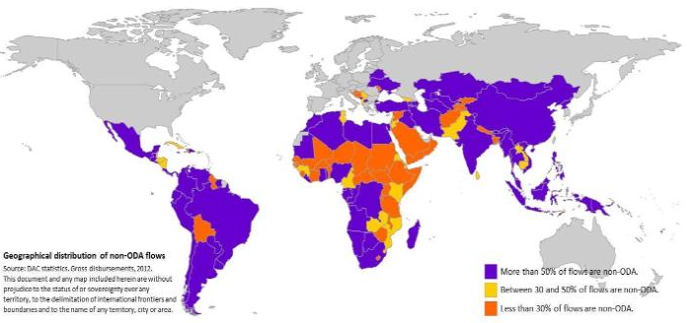
(Though ODA more important for some)
ORANGE COUNTRIES ODA>70% OF INFLOWS

Slide 5
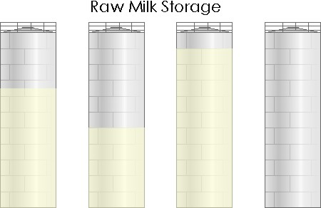
The flows used to operate in ‘silos’
‘SEPARATE WORLDS’
Objectives
Operations
Procedures
Beneficiaries
Etc.
REMITTANCES
FDI
ODA
loans
ODA grants
PRIVATE
Remittances
Individuals (mostly)
PRIVATE
Foreign Direct Investment FDI
Businesses & fund managers & investors
OFFICIAL
Loans & investments, concessional
THE IFIs and FIs
OFFICIAL
Grants, debt relief
‘Donors’

Slide 6
Blending is one such new development
But these silos began to open & overlap
Remittance funds
Investor funds
REMITTANCES
FDI
ODA
loans
ODA grants
PPP BOT etc
Blending
Co-financing
PRIVATE
Foreign Direct Investment FDI
Businesses & fund managers & investors
PRIVATE
Remittances
Individuals (mostly)
OFFICIAL
Loans & investments
THE IFIs and FIs
OFFICIAL
Grants, debt relief, concessional
‘Donors’

Slide 7
EU: Blending also reflects specific goals
FINANCIAL: mobilize public and private resources for enhanced development impact and do more with less (financial constraints)
NON-FINANCIAL: improve project sustainability quality, innovation, targeting and speed
POLICY: support reforms in line with EU policies
AID EFFECTIVENESS: improve cooperation between European and non-European aid actors (donors and financial institutions)
VISIBILITY: provide more visibility for EU development funding

Slide 8

Blending is defined as …..
THE STRATEGIC USE OF A LIMITED
AMOUNT OF GRANTS TO MOBILISE
FINANCING FROM PARTNER FIs
AND ENHANCE THE DEVELOPMENT
IMPACT OF INVESTMENT PROJECTS
LEVERAGE
Partner FI funds
Grant

Slide 9
Blending activities represent a limited share of EU programmes
Funding Instrument | Countries covered | Total funding available 2007-2013
European Neighbourhood and Partnership Instrument | 17 | € 11.2 billion
European Development Fund | 79 | € 22.68 billion
Development Co-operation Instrument | 47 | € 10.06 billion
Thematic instruments | all | € 5.6 billion
 | TOTAL | €49.5 billion
Total blending approvals 2007-2013: €1.6 billion (3% of total EU programmes), so far financed out of regional programmes

Slide 10
So far, blending takes one of 5 forms
BLENDING GRANT TYPE | …WHICH CAN ELIMINATE A KEY PROBLEM
Direct Investment Grant | Reduce cost to end users or taxpayers by reducing total investment cost
Interest Rate Subsidy Grant | Reduce cost to end users or taxpayers by reducing interest / financing cost
Technical Assistance Grant | To boost management, project design, feasibility/preparation, quality & speed
Risk Capital | To address (perceived) risk by filling the higher risk financing gap (with the objective of mobilising commercial financing)
Guarantee | To address (perceived) risk by partly guaranteeing certain types of investments (with the objective of mobilising commercial financing)

Slide 11
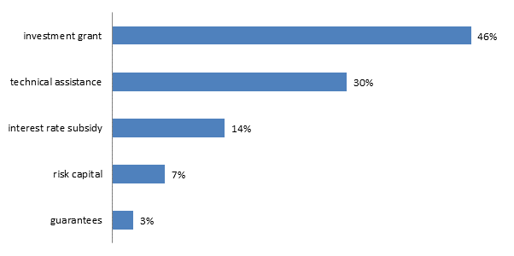
Though 2 of these are still small
GLOBAL BLENDING INSTRUMENTS
Notes:
Interest rate subsidy not possible with EDF money, follow the cotonou rules, except when managed by EIB for the ITF.

Slide 12
Blending has a broad legal basis
  DCI – ENI – EDF
  New Financial Regulation defines financial instruments
  Common Implementing rules (CIR) and the 11th EDF Financial Regulation specify that financial instruments can be grouped in ‘Facilities’

Slide 13
Any project will meet the following conditions:
Project is 100% in line with agreed policy objectives
Environmental & social standards are met
Preservation of macro-economic stability
Market distortions are avoided
Additionality of grant element (ensuring viability, delivering for the poor, improved quality)
Blending is a
EU aid modality
It must adhere to the same principles as other aid modalities

Slide 14
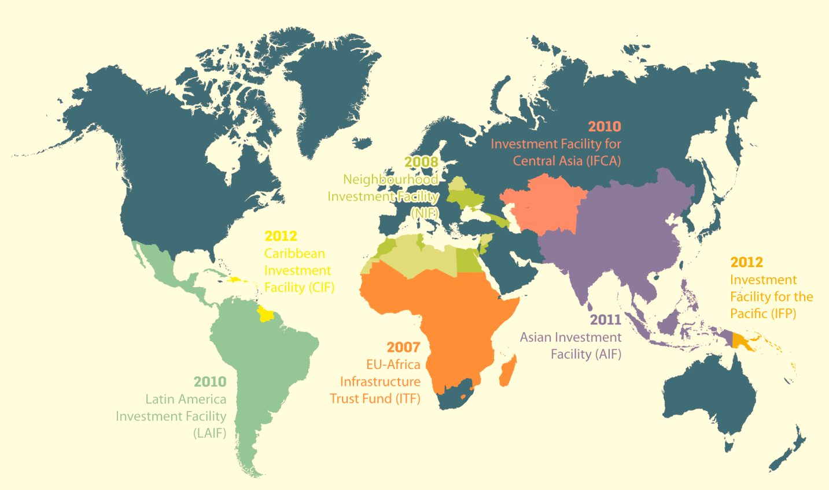
Blending framework: 7 facilities

Slide 15
With different ages, focus & volumes
FACILITY | ITF | NIF | LAIF | IFCA | AIF | CIF | IFP | TOT
Year established | 2007 | 2008 | 2010 | 2010 | 2011 | 2012 | 2012
Region | Sub-Saharan Africa | ENPI countries | Latin America | Central Asia | Asia | Caribbean | Pacific
Cumulative envelopes (€m) | 799* | 867** | 197 | 85 | 60 | 70 | 10 | 2088
* Including € 161 m from Member States
**Including € 78 m from Member States
Data up to 31/12/2013

Slide 16
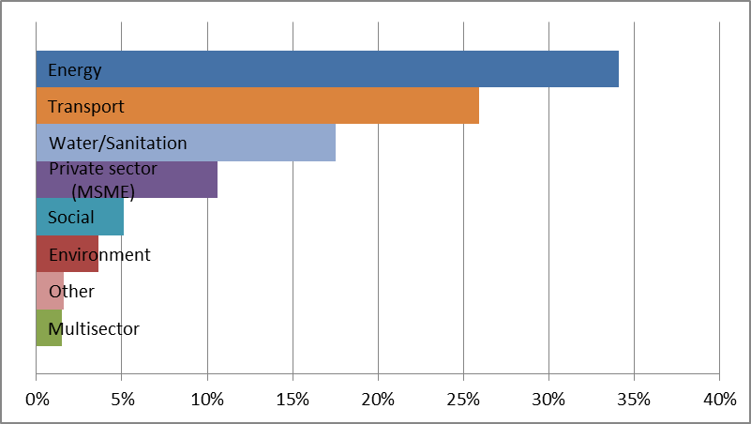
The bulk has gone to energy & transport
GLOBAL SECTOR COMPOSITION BLENDING
NOTE
Typically ‘suitable’ sectors for project finance and blending;
i.e. basically ‘bankable’ but with special needs

Slide 17
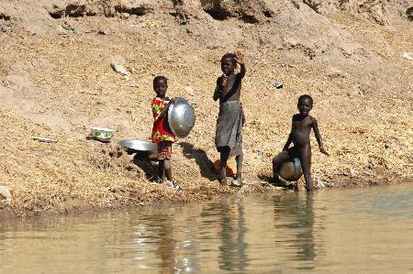
Interest rate subsidy
Lake Victoria WATSAN Initiative (ITF)
Regional initiative aiming at reversing the environmental deterioration of Lake Victoria and improve living conditions in the lake basin.

Slide 18
Three projects are supported by the ITF in the context of the LV WATSAN initiative in Uganda, Kenya and Tanzania.
In Uganda, the project aims at increased coverage, reliability and access of water supply & sanitation for the population of metropolitan Kampala.
IRS needed to meet objectives set by the Ugandan debt strategy and concessionality requirements in the context of IMF programme (see also previous slides: Uganda classified as ‘medium risk’ by IMF).
Total project volume: €212 m
Grant contribution: €14 m IRS / €8 m TA
Involved EFIs: KfW, AFD, EIB
Lake Victoria WATSAN Initiative (ITF)

Slide 19
The impact of the instrument
Interest rate subsidy (& TA)
Increase concessionality
Technical Assistance
Water distribution model in peripheral urban areas
Sanitation and waste management
Water loss management
Debt servicing without grant
€
IMF limits
More concessionality with grant
time

Slide 20
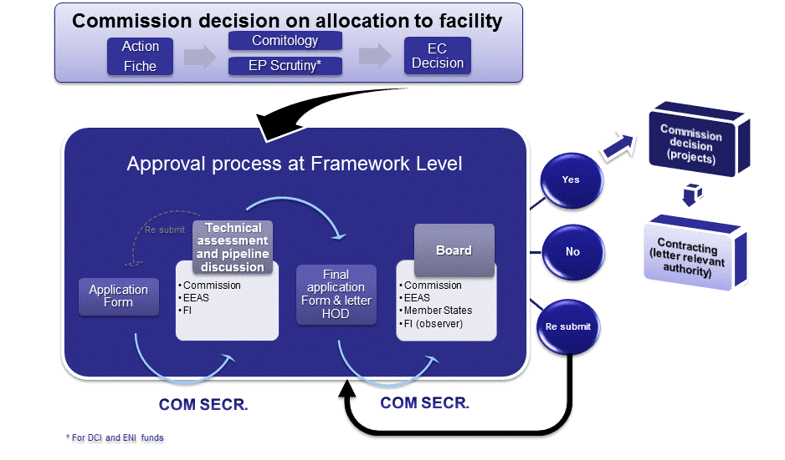
With different documents & inputs

Slide 21
The Facilities’ project cycle has 7 steps
The Blending Facilities project cycle
Identification | Preparation | Peer review & screening (Technical meeting) | Board Opinion (Board meeting) & Com Decision | Contracting | Monitoring | Evaluation
Generating the pipeline’– ideally so there is a chance to select from multiple projects | Ensuring that the project meets criteria and info is complete | Testing the project to see if it meets all the standards | Recommend whether to approve the grant – and on which conditions, followed by formal COM decision | Getting going and implementing in compliance with regulations | Obtaining the right information to ‘steer’ and manage | Checking to see if the objectives were met and feeding findings into future designs

Slide 22
Roles: ‘who does what and how’
The EU Blending project cycle
 | Identification | Preparation | Peer review & screening | Board Opinion & Decision | Contracting | Monitoring | Evaluation
EU Delegation/Geo Reg | √ | √ | √ |  |  | √ | √
DEVCO HQ | √ | √ | Lead (Geo Director) | Lead (Geo Director) | Lead (Geo Director) | √ | √
Partner FI | Lead | Lead | √ |  | √ | Lead | √
Beneficiary | √ | √ |  |  | √
Member States |  |  |  | √
Other |  |  | Line DGs DEVCO C, Geo, EEAS | COM decision

Slide 23
Unit C3 DEVCO acts as a blending ‘hub’
1 Secretariat of the Facilities: (pipeline, management of the assessment process, communication, data management)
2 Contracting of blended projects
3 Management of other blending mechanisms: (GEEREF – EDFI Guarantee). Screening EIB projects and ACP IF.
4 Thematic & strategic follow-up: (QSG, new developments, EU Platform..)
DIRECTOR GENERAL
DEVCO C
Sustainable Growth & Development
C3
Financial Instruments

Slide 24
There is a new application form
Blending application form
Latest version August 2014
38 requirements in 3 main fields: Identity, Recommendation, Description
Annex 1: Key requirements (eligibility)
Annex 2: Public description of project
Annex 3: Contractual information
Annex 4: Breakdown of costs

Slide 25
Its annex 1 lists the ‘must-haves’
Key requirements check-list
12 main requirements: yes-no
Benefits eligible countries
Consistent with EU principles
ODA eligible
No duplication with other operations
Complementary to other ops
Fulfils Facility objectives
7. Explains use of grant
8. Technically & financially sound
9. Helps leverage loans
10. Avoids distortions or replacing private financing
11. Impacts poverty alleviation
12. Justifies grant size

Slide 26
There is a parallel FI decision process
2F BOARD OPINION
Beneficiary/Lead FI
Proposes to
EU Blending Framework
Assessment & Decision making process
FIs Operation Approval Process
-Due diligence
-Board Approval
-Loan signature
EU Blending Framework Decision making Process
- Technical Assessment
-Board opinion
-EC decision
Financing
BLENDED FINANCING
EU Contribution
Other financing

Slide 27
Responsibility is concentrated
BOARD OPINION
Unit/Entity | Task | Output
Delegation | Formally endorse project | Letter of support from Head of Delegation
C3 | Guide lead FI to prepare final application for Board submission; prepare Board meeting | Annotated agenda for Board meeting chair; Minutes of the Board meeting
Partner FI | Prepare and submit final application to the Board | Final application form
Member States (Board) | Review and recommend for approval, rejection or resubmission | Comments during Board meeting

Slide 28
Responsibility is shared
CONTRACTING
Unit/Entity | Task | Output
Delegation | Participates in the negotiation of the contract Negotiates the Financing Agreements on behalf of HQ | Finalised contract=> deconcentrated
C3 | Negotiates and prepares the contract | Finalised contract
Partner FI | Negotiates the contract | Finalised contract (incl. signature)
Geographical+ FCUs of geographical directortes | Participate in the negotiation of all the contracts | Finalised contract (incl. signature)

Slide 29
Responsibility is with the FI
MONITORING
Unit/Entity | Task | Output
Delegation / Geo Reg. | Receive and approve periodic reports from lead FI, ensure appropriate monitoring and progress. Initiates proposals for ROM projects | Corrective actions Inclusion of results in Blending Facility annual reports)
DEVCO geographicals | Participates in the selection of projects to be proposed for the ROM | ROM reports
Lead FI | Primary responsibility for monitoring and reporting according to contractual obligations | Regular monitoring and progress reports

Slide 30




Thank you

