Slide 1
Developing an ESCO Industry in Jamaica
Presentation by Alex Dropinski – EU Delegation in Jamaica

Slide 2
What is an ESCO?
An energy service company or energy savings company (acronym: ESCO or ESCo) is a commercial or non-profit business providing a broad range of energy solutions including designs and implementation of energy savings projects, retrofitting, energy conservation, energy infrastructure outsourcing, power generation and energy supply, and risk management

Slide 3
Industry and Market Overview

Slide 4
  Drivers for Sustainable Energy in the Caribbean:
  High and volatile energy prices are a real roadblock to the Caribbean’s economic development.
  With energy consumers generally dissatisfied with the existing energy situation, there is an increasing demand for viable EE and RE projects.
  The Jamaican economy is characterised by high-energy intensity and low efficiency and is almost completely dependent on imported oil.

Slide 5
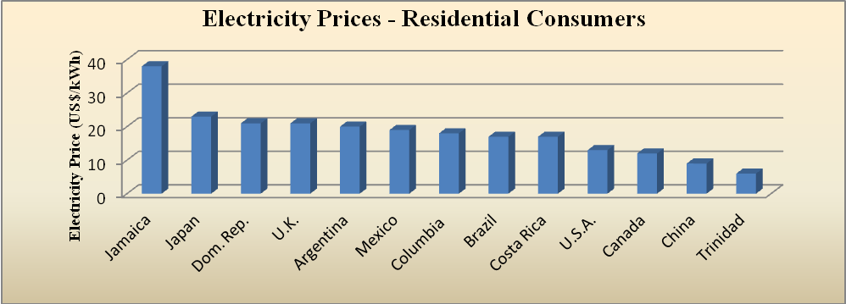
SECTORAL ANALYSIS
Regional & Extra-regional Energy prices for Residential Customers in 2013
Source: US DOE 2014

Slide 6
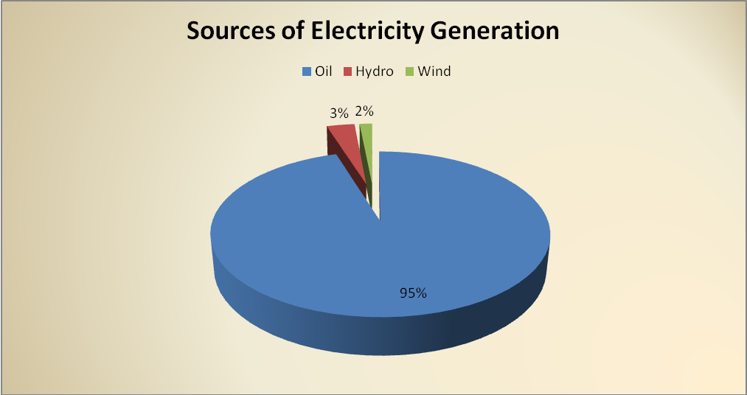
SECTORAL ANALYSIS
Source: MSTEM 2014

Slide 7
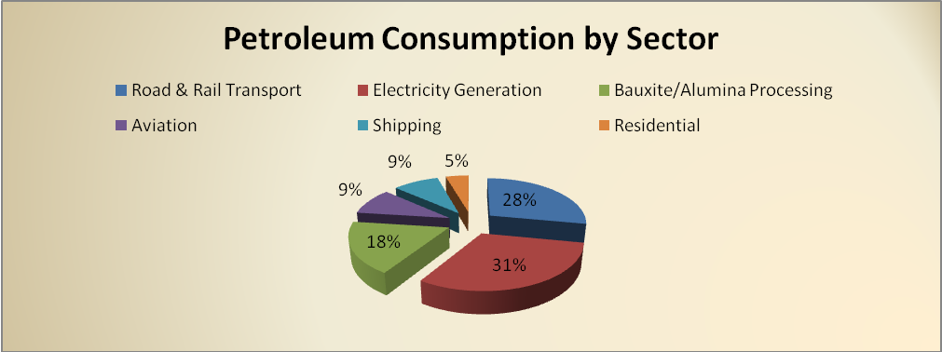
Industry and Market Overview

Slide 8
SECTORAL ANALYSIS
Power Generation
JPS generates 68 % 0f the 925.2 MW of installed electricity capacity in Jamaica, supported by 4 IPPs
2. Jamaica Energy Partners
3. Jamaica Private Power Company
4. Wigton Windfarm Limited
5. Jamalco
The OUR regulate power generation, transmission and distribution efficiency at the commercial level, and as such monitors heat rate efficiencies of power generating facilities with internal combustion and steam generating engines, as well as transmission and distribution losses associated with the national grid.

Slide 9
JPS’ ownership:
Marubeni Corporation (Korean): 40%
Korea East-West Power Company Ltd: 40%
Government of Jamaica: 19.9%
Other shareholders (private): 0.1%

Slide 10
SECTORAL ANALYSIS
Power Generation
Transmission and distribution losses
- 21 % 2013 - 26 %
National target - 17.5 %
In the USA and Japan total transmission and distribution losses average about 7 and 9 % per annum, respectively.
The JPSCo is allowed to recover the 17.5 % losses through the fuel cost
Technical losses are reported to be 9.6 %, which suggests that approximately 16 % of overall production (4,135 GWh) or 660 GWh of the electricity produced is stolen. To put in context, this is 35 % more electricity than that which is used in the entire public sector (to include NWC, street lighting, all Ministries, JDF, JCF, etc), at an annual cost of ~ EUR 150 million.

Slide 11
Current market barriers and bottlenecks
Information and data for calculating EE/RE potential is still insufficient although it is slowing being developed
There is still uncertainty about the quality of EE/RE devices available in the market, although knowledge is improving as there is a growing interest for EE/RE technology
Higher market prices of EE/RE technology and/or products compared to standard equivalent technology.
Customer reluctance to pay higher prices for more efficient devices.
High variability of electricity charges to consumers.

Slide 12
Current market barriers and bottlenecks (cont’d)
Limited availability and capacity of human resources for EE/RE program development and implementation.
Lack of technical capacity in energy management.
Lack of solid economic impact evaluation methodology for energy costs on economic and social development.
Insufficient inclusion of EE/WE savings when calculating the profitability of general projects
Lack of a suitable institutional framework for launching EE/RE/WE initiatives (current framework not favorable)
Lack of national authorities and other EE/RE/WE government bodies to invest in developing, implementing and monitoring EE/RE/WE programs.
Lack of financial incentives for EE/RE/WE projects.

Slide 13
Current market barriers and bottlenecks (cont’d)
Lack of information campaigns and training sessions on EE/RE/WE intended for consumers.
Lack of information campaigns and training sessions on EE/RE/WE intended for energy service companies.
Lack of implemented pilot projects to demonstrate the many benefits of EE/RE/WE.
Low level of awareness/information among consumers

Slide 14
Key Factors Influencing the Development of ESCOs
# | Critical Factors | Pre-requisites
1 | Technical Capabilities | Ability to identify, develop, implement and sustain a cost effective energy efficiency programme with participation from key and influential stakeholders.
2 | Credit Worthiness | The ability to raise or arrange project based financing from local commercial banks in a structured and efficient manner. Financing is one of the major limitations for SMEs as initial investment cost are normally high.
3 | Regulatory Aspect | An enabling legal framework that would recognize clearly the status and specificities of an energy performance contract, supported by a justice system that can efficiently enforce contractual agreements.
4 | Standards Specifications | The presence of a neutral third-party institution that certifies ESCO products and/or services as an important commercial imperative.
5 | Consumer Awareness | An appropriate institutional framework with supporting programmes to facilitate a good understanding of the energy performance contracting concept.
6 | Strategic Market Focus | Definition and presentation of a market. The public sector is normally given up to the market.

Slide 15
Key Factors Influencing the Development of ESCOs
The following represent three (3) additional challenges that could derail an ESCO development initiative if not strategically and effectively addressed.
7 | False Reliance | Dependence on in-house personnel with limited technical competencies.
8 | Inadequate Institutional Support | No anchoring support from Government.
9 | Structural and political Barriers | Unnecessary/inappropriate Government intervention. (This includes inflexible and overbearing non-value added procurement requirements)

Slide 16
Institutional & Regulatory Framework:
There is no specific legislation or regulatory environment applicable to the facilitation of ESCO operations, nor is there an Energy Act or any general legislation dealing with energy efficiency in Jamaica. There are however existing common law or statutory provisions which would be applicable to ESCOs.

Slide 17
# | Legal | Domain of intervention
1 | Law of Contracts | Preparation of Model ESCO Performance Contracts.
2 | Building Act | To include EE/RE measures to the Building Act.
3 | Dispute Resolution | To set up mechanism to expeditiously handle contract disputes.
 | Regulatory | Domain of intervention
4 | Public Sector Procurement | To enable performance contracting and facilitate ESCO activities for the benefit of government institutions
5 | Standards Specifications | To establish service and systems standards for ESCO sector.
6 | Energy Efficiency Building Code (EEBC) | To roll-out revised Energy Efficiency Building Code.

Slide 18
2009 – 2030 National Energy Policy
Jamaica’s Energy Vision
“A modern, efficient, diversified & environmentally sustainable energy sector providing affordable & accessible energy supplies with long-term energy security & supported by informed public behaviour on energy issues & an appropriate policy, regulatory & institutional framework”
The development of an ESCO industry in Jamaica in very large measure lends support to the achievement of this vision.

Slide 19
However, there is the All Island Electricity License of 2001 and reinstated in 2007 which effectively grants to the power company JPS, until year 2027, an exclusive distribution monopoly of electricity.
This means that power producers and ESCOs cannot sell electricity directly to potential consumers using their own generation assets, which effectively limits significantly the ESCO industry growth.

Slide 20
The GOJ and the European Commission have signed a Financing Agreement to implement a project titled:
“Developing an Energy Services Company (ESCO) Industry in Jamaica”
The project is financed through a EUR 431,854 grant from the 10th EDF Energy Facility II

Slide 21
Specific objectives:
to develop a sustainable ESCO industry in Jamaica by raising the level of awareness and understanding of the business of energy efficiency (EE) and renewable energy (RE);
introducing new business models to enable increased levels of investment in and implementation of EE and RE projects;
increasing dialogue, trust and confidence in the industry among its stakeholder groups.

Slide 22
The project intends to develop a sustainable platform on which an ESCO industry can flourish. This includes:
1. Increasing public awareness of the opportunities that exist in the industry and the benefits to be gained by each stakeholder group
2. Introducing to Jamaican businesses ESCO models that have been implemented successfully in other parts of the world
3. Introducing creative financing products that can support ESCO projects
4. Increasing the levels of confidence in ESCO business models

Slide 23
5. Building capacity to utilise, manage, measure and monitor ESCO contract performance
6. Improving the institutional support for the ESCO industry
7. Stimulating dialogue related to issues of trust and integrity between contracting parties
8. Strengthening the regulatory protocols and frameworks that will protect ESCOs and their customers
9. Improving the arbitration processes for performance based contracts used by ESCOs
10. Implementing policies that will support public sector ESCO contracting so that results can be sustained in the long term

Slide 24
ESCO Project achievements up to now
Very limited due to:
  Lack of political will and support for the project (current government is the same that granted and renewed the All Island Electricity License to JPS)
  Lack of capacity and interest of the implementing agency (Jamaica Productivity Center)
  Lack of success and delays in the procurement of consultants
  Project goals are too ambitious but resources are insufficient

Slide 25
In the meantime…
Private sector does not wait for the government’s help.
Given the quick return on investment, the business sector is actively pursuing energy cost reducing strategy by undertaking energy audits, increasing EE measures, improving thermal efficiency, installing solar panels, windmills, etc. for their own use.
As a result, the RE industry is booming, however it’s scope for further growth and additional benefits from Economy of Scale is limited by politics.

